Slide 1
Business Plan Update
Park and Recreation
Golf Operations Division

Slide 2

Park and Recreation
Golf Operations Business Plan Review Process
Annual Updates
  Municipal Golf Committee
  Park and Recreation Board
Every 3 years
  Environment Committee

Slide 3
Park and Recreation
Customer Satisfaction Survey
Course | 2010 Calendar Year | FY 2015 | FY 2017 | FY 2017 vs CY 2010
Balboa Park | 95% | 97% | 98% | 3%
Mission Bay | 88% | 96% | 91% | 3%
Torrey Pines North | 95% | 98% | 96% | 1%
Torrey Pines South | 95% | 98% | 98% | 5%

Slide 4
Park and Recreation

Slide 5
Park and Recreation
Golf Operations Division Revenue and Expenses FY 14 - FY18
 | FY14 Actual | FY15 Actual | FY16 Actual | FY17 Actual | FY18 Budget
Revenue | $19,949,901 | $20,347,684 | $18,267,631 | $18,402,418 | $20,470,347
Expense | $15,455,418 | $16,020,960 | $15,643,184 | $17,007,701 | $18,229,823
Net Revenue | $4,494,483 | $4,326,724 | $2,624,447 | $1,394,717 | $2,240,524

Slide 6
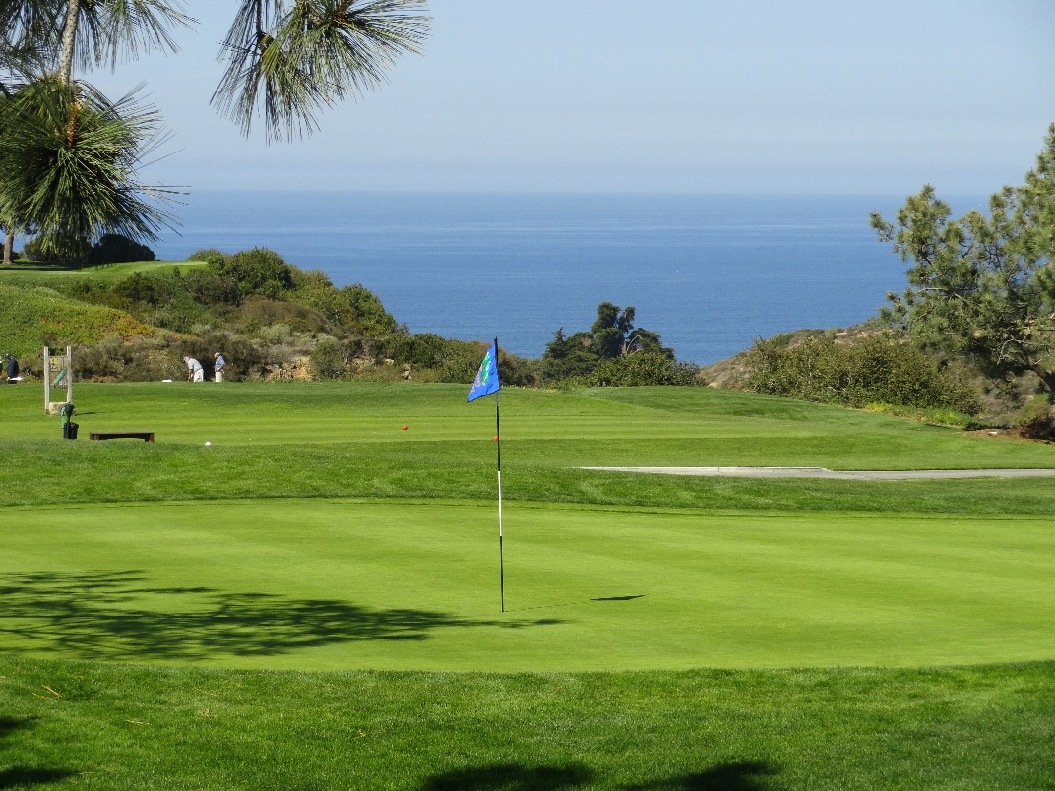
Park and Recreation
Capital Improvements Program (CIP)
Torrey Pines Golf Course
  North Course Renovation
    completed November 2016
  South Course Improvements
improvements to irrigation system,
turf, tee-boxes, bunkers, and cart paths

Slide 7
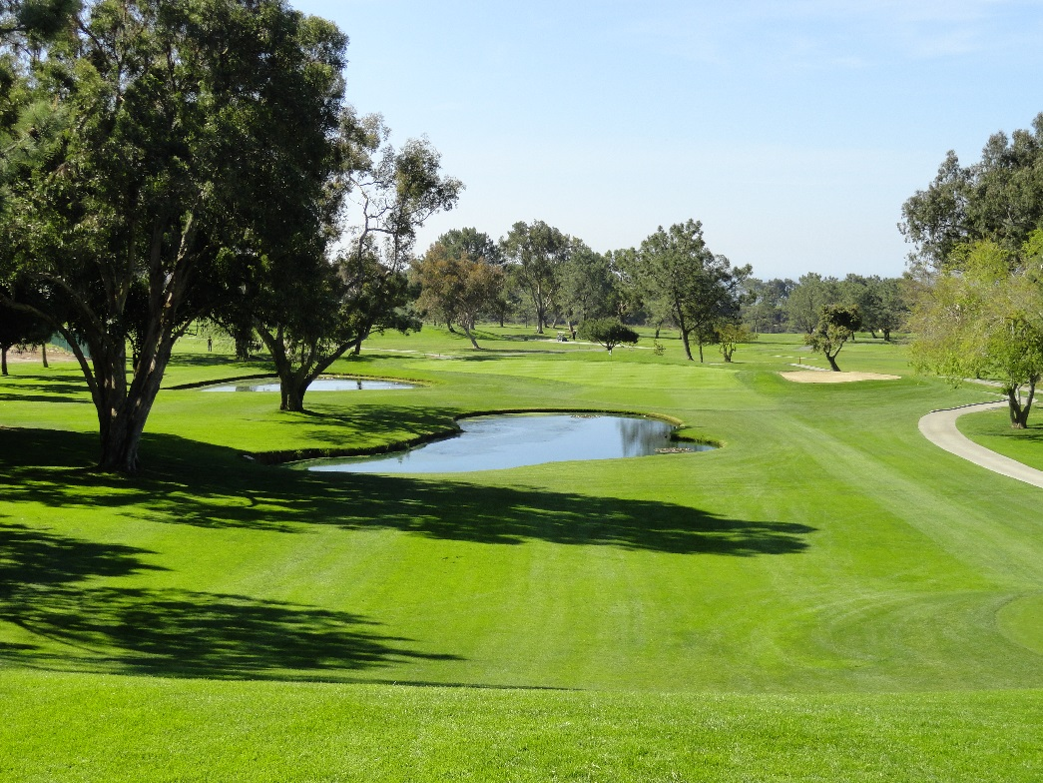
Park and Recreation
Capital Improvements Program (CIP)
Mission Bay Golf Course
  Renovation & Reconstruction Improvements - new state of the art irrigation system
  Club House Demolition & Portable Building – replace the 60 year old club house
  Construction bids expected to be issued in 2018 for both projects

Slide 8
Park and Recreation
Fees
Increase greens fees for Torrey Pines North Course
    5% increase for non-residential fees only
    $5 - $7 increase per round
Proposed increases, effective January 1, 2018, are in accordance with the Golf Division Business Plan

Slide 9
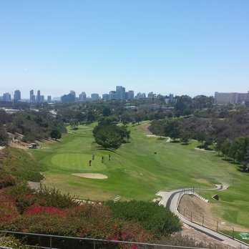
Park and Recreation
Accomplishments
North Course Improvements have produced a world class course that is rapidly receiving positive public recognition.
Implemented a 12 year lease contract for golf maintenance equipment
PLAY Golf Program re-invented with a three (3) tiered approach to teach youth to play golf with competency.

Slide 10
Park and Recreation
Accomplishments
Balboa Park Golf Course Pro Shop - completed first year of operation generating $716,900 in revenue.
FootGolf rounds increased by 23% to 5,034 rounds of play and generated $74,500 in new revenue.
Mission Bay Golf Course - lighting maintenance and repairs were completed in time for fall activities.

Slide 11
Park and Recreation
Future Outlook
Continue the implementation of ongoing capital improvement projects at golf course facilities.
Issue a new long term contract for food and beverage operation at the Balboa Park Golf Course.
Continue preparations for the 2021 US Open Golf Championship

Slide 12
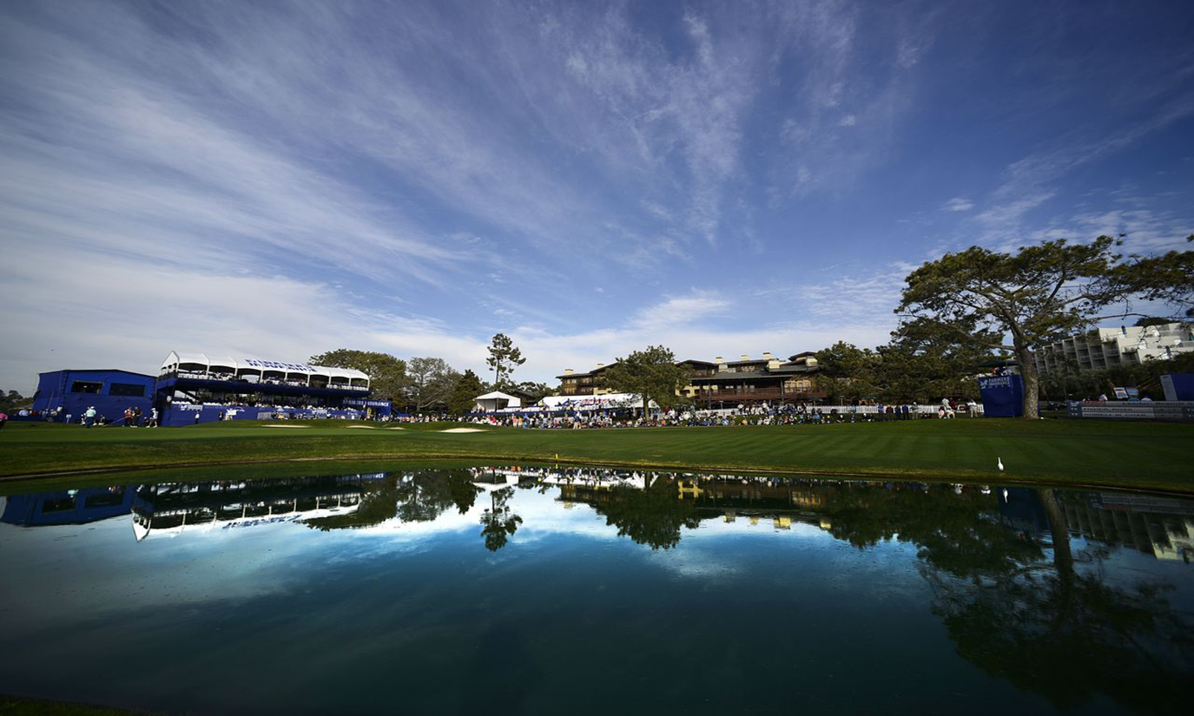
Park and Recreation
Questions

