Slide 1

Presented to the
Regional Park Improvement Fund Oversight Committee
October 19, 2017
Regional Park Improvement Funds
Projects Allocation & Expenditure
Semi-Annual Update

Slide 2
BACKGROUND
RPIF is derived from Mission Bay Park lease revenue per City Charter Sec 55.2
Charter was revised under Measure J passing on November 2016 to include:
  First $3.5M or 35%, whichever is greater above the threshold amount of $20 million from the Mission Bay Leasehold revenues goes into the RPIF beginning in Fiscal Year 2018.
  RPIF can only be used for capital improvements/deferred capital
This presentation only covers on-going CIP’s funded by the RPIF

Slide 3
PROJECTS COMPLETED TO DATE
Ocean Beach Comfort Station Replacement
Museum of Man Roof Reconstruction
Diamond Street Stairs Reconstruction
Palisades Park Comfort Station
Pescadero Street Stairs Reconstruction
California Tower Electric Room Relocation
Los Peñasquitos Ranger Station
Balboa Park Hall of Nations Foundation Reconstruction
Jas Arnold Trail For All People
Coastal Beach Access Project
Chicano Park Comfort Station Replacement

Slide 4
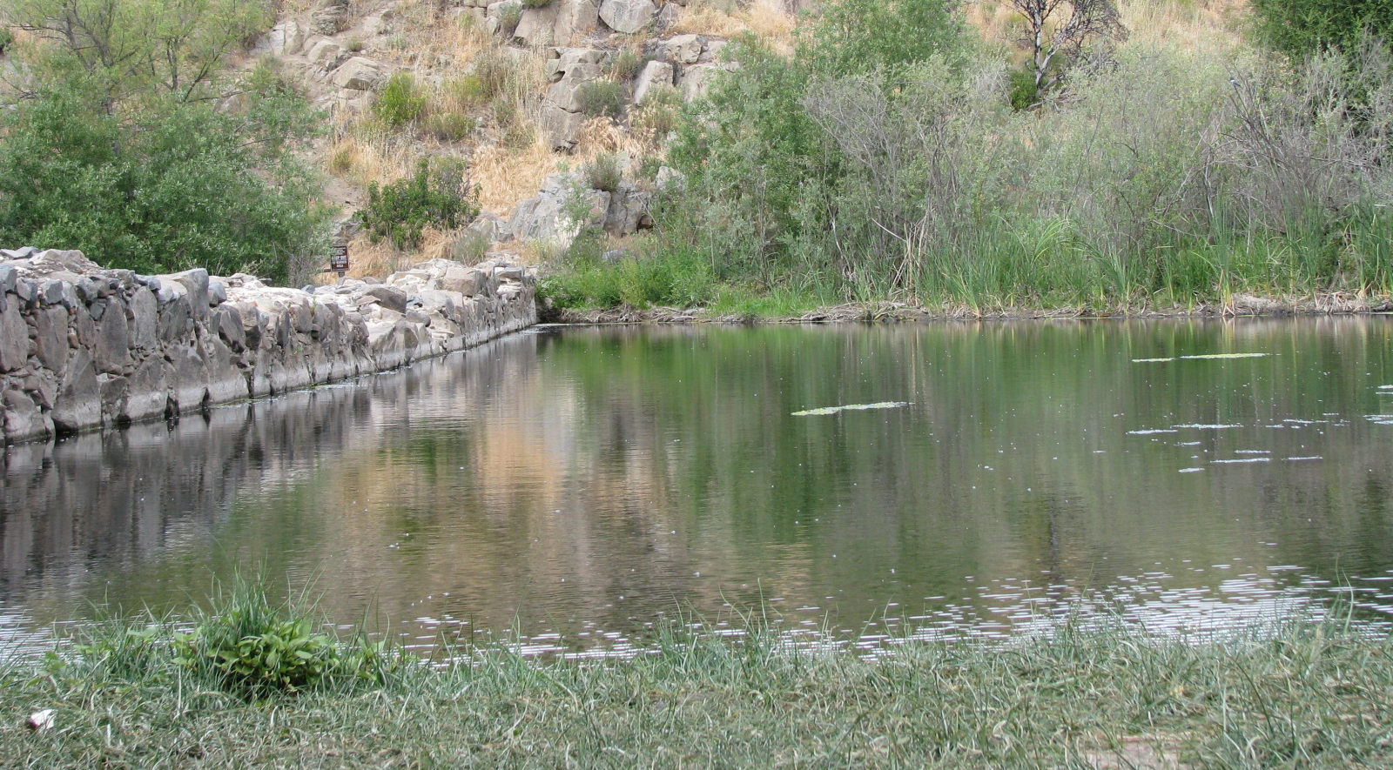
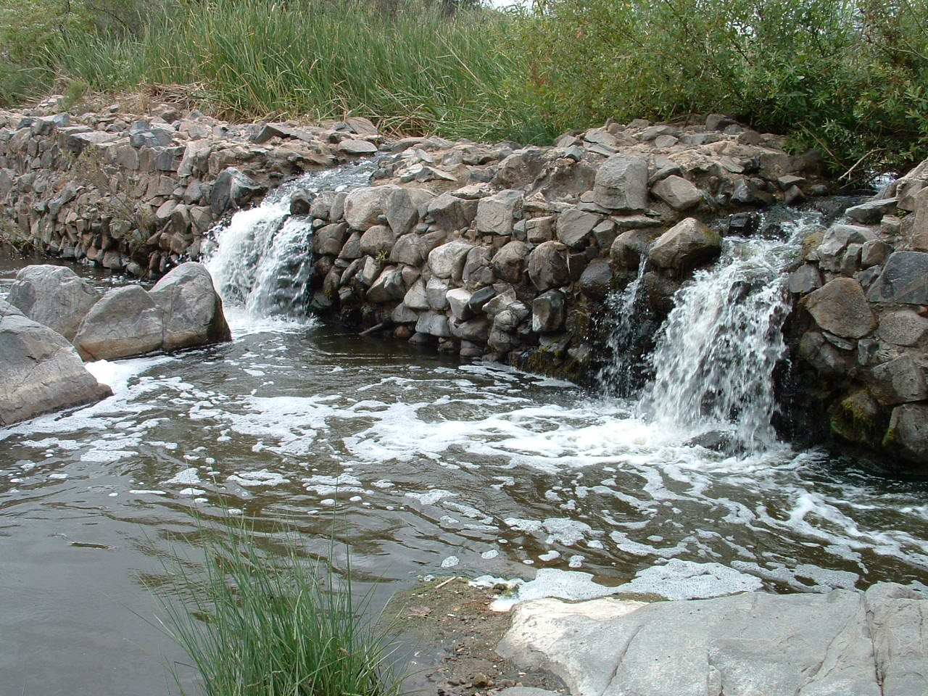
OLD MISSION DAM PRESERVATION
S-00611
Managed by P&R Department
Scope
  Completion of the 5 year Mitigation, Monitoring & Reporting Program previously required by the 2008 dredging of the historic dam
Financial
  Total Cost $ 0.918M
  RPIF Allocation = $0.315M (FY10)
Status
  Extended 5 yr mitigation monitoring due to contractor default
  Acquiring approvals for permitting long-term dredging
  Mitigation to Complete in FY18
Notes:
Delay of completion due to default by Maintenance Contractor and need to hiring a new contractor
Steve Haupt

Slide 5
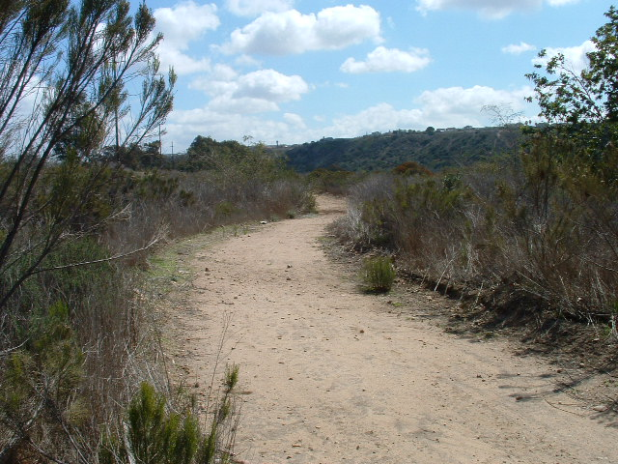
MISSION TRAILS REGIONAL PARK
MULTI TRAIL SYSTEM
S-10066
Managed by P&R Department
Scope
  Construction of approx. 5,000 LF of new trail & the rehab of approx. 3,500 LF of existing trail
Financial
  Total Cost $0.20M
  RPIF Allocation: $0.20M (FY11)
Status
  Thru Park Master Plan (MP) & Environmental Assessment
  Work will be completed after completion of the Natural Resources MP & MP Update (both ready for public review in FY18)
Notes:
Cost change from 250k to 215k based on the report description
Steve Haupt update 1-25-16

Slide 6
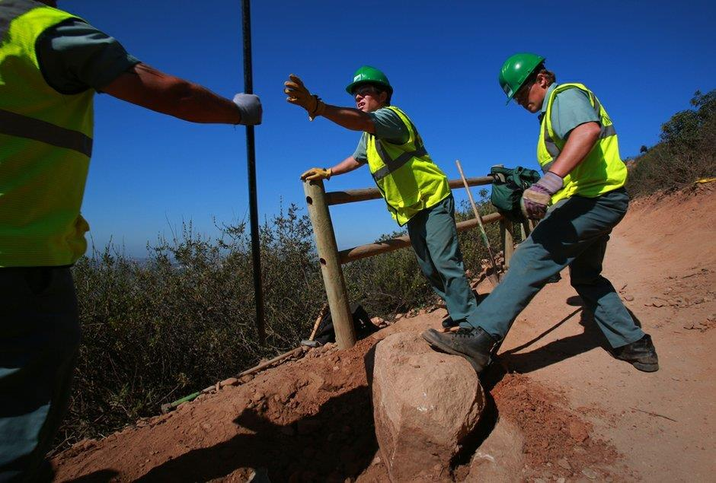
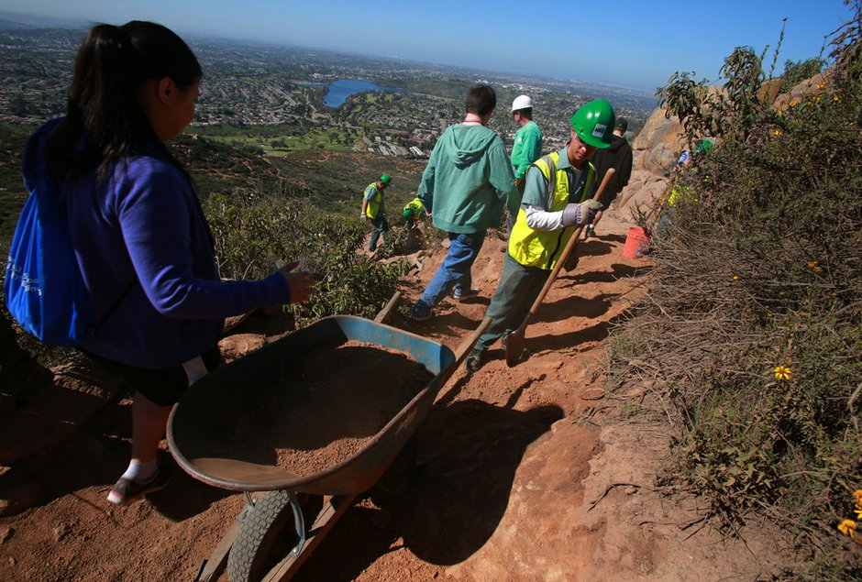
COWLES MOUNTAIN TRAIL – MISSION TRAILS
S-10065
Managed by P&R Department
Scope
  Restoration of approximate 2,000 FT of existing trail
Financial
  Total Cost: $0.40M
  RPIF Allocation: $0.40M (FY11)
Status
  In Construction
  Construction to complete in FY18
Notes:
Slight delay from late 2016 to early 2017 due to higher priority issue
Steve Haupt

Slide 7
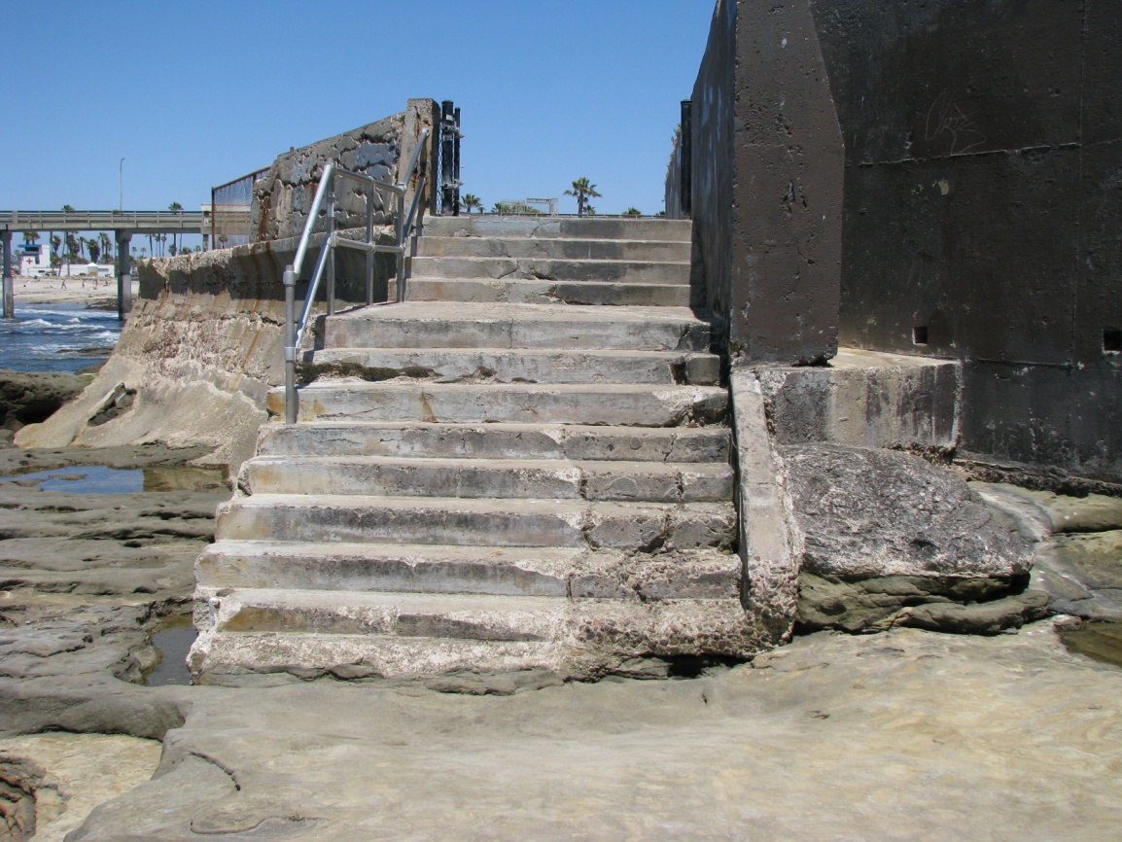
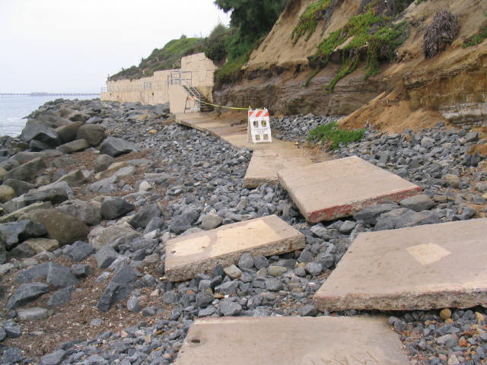
COASTAL BEACH ACCESS PROJECTS
B-14073
Scope
  Repair and re-construction of 3 coastal access stairs:
    Old Salt Pool in OB
    Capri by the Sea in PB
    Orchard Ave in OB
Financial
  Total Cost: $0.450M
  RPIF Allocation: $0.435M (FY12)
  Due to 100-202 Coast Blvd. Emergency project, $377,895 in funding was reallocated from project per Oversight Committee Action on July 21, 2016
Status
  Construction to start in FY18 and complete in FY 18.
Notes:
Project temporarily suspended. Funding reallocated to an emergency beach access project Coast Boulevard. Report submitted Andy Field in the July 21st RPIF report.
Work is expected to resume upon funding of the project which is anticipated to take place in FY 18 budget.
Elizabeth Schroth -Nichols

Slide 8
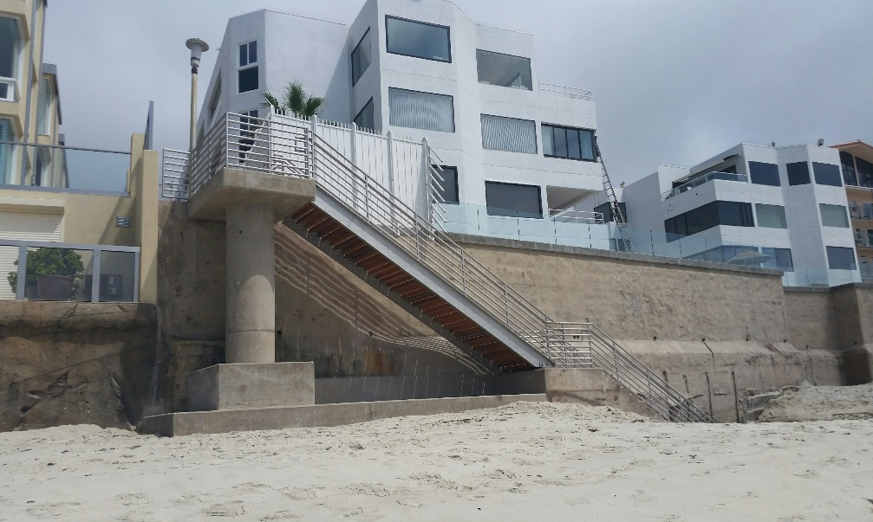
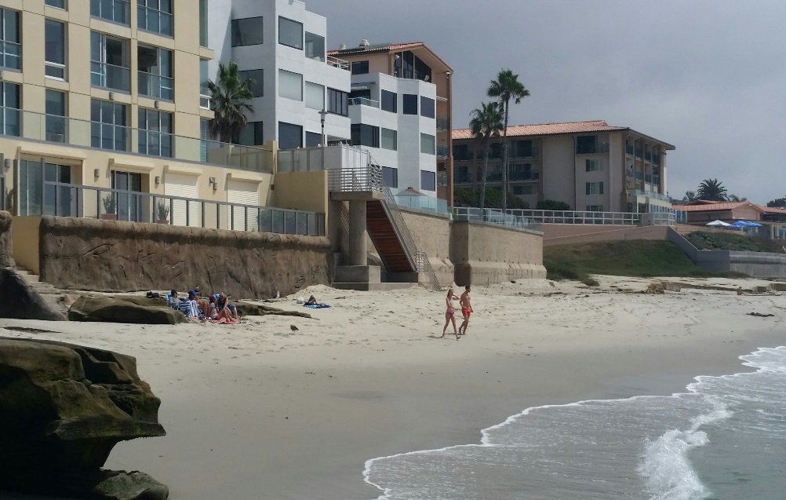
COASTAL BEACH ACCESS PROJECTS
B-17029
Scope
  Emergency repairs at the coastal access stairs at 100-202 Coast Boulevard
Financial
  Total Cost: $.72M
  RPIF Allocation: $0.378M (FY17)
  Due to 100-202 Coast Blvd. Emergency project, $377,895 in funding was reallocated from project B-14073 Old Salt Pool, Orchard Ave & Capri by the Sea per Oversight Committee Action on July 21, 2016
Status
  Construction started in FY17 and completed in FY 18.
Notes:
Project temporarily suspended. Funding reallocated to an emergency beach access project Coast Boulevard. Report submitted Andy Field in the July 21st RPIF report.
Work is expected to resume upon funding of the project which is anticipated to take place in FY 18 budget.
Jong
Shakelford

Slide 9
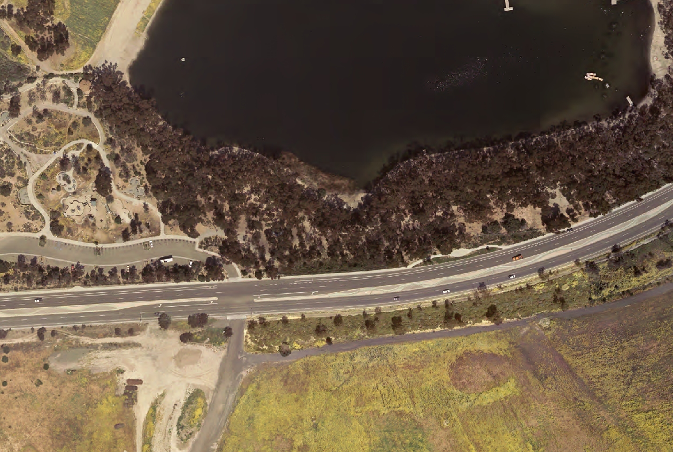
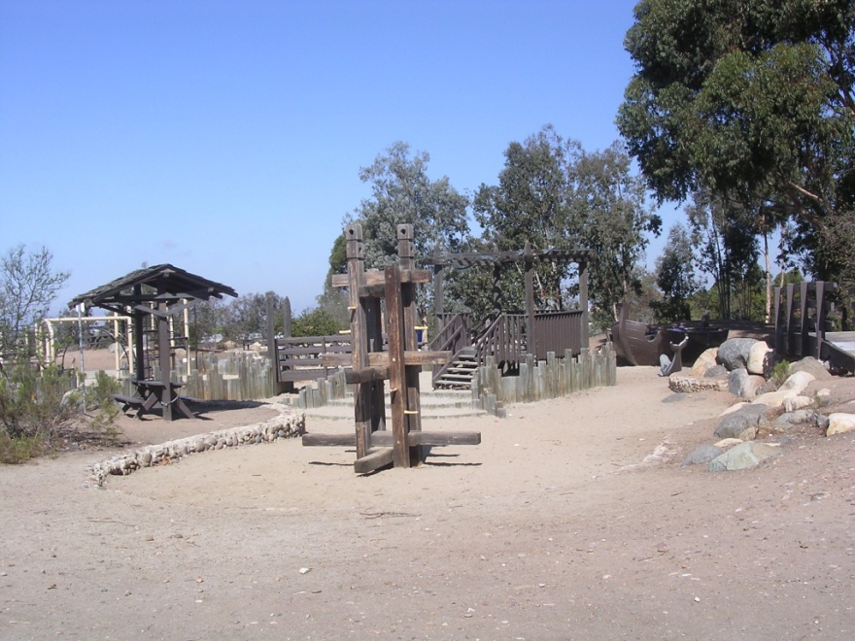
CHOLLAS LAKE PLAYGROUND RENOVATIONS
PHASE I
S-14002
Scope
  Replacement of existing playgrounds at Chollas Lake Park
Financial
  Total Cost: $1.939M
  RPIF Allocation: $0.974M (FY12)
  $0.300M (FY18)
Status:
  Construction to start in FY 18 & complete in FY18
Notes:
updated
Barry Kelleher

Slide 10
CALIFORNIA TOWER SEISMIC RETROFIT
L-12003.2
Scope
  The seismic retrofit of the California Tower to upgrade the structural protection & improve the public safety of the iconic SD landmark
Financial
  Total Cost: $4.061M
  RPIF Allocation: $1.50M (FY13)
  RPFI Allocation: $0.65M (FY18)
Status
  Design phase completed in FY17
  Construction to start in FY19
  Construction to complete in FY19
Notes:
Added FEMA Grant Application
Construction delay due to request by Museum of Man Lessee
Michelle Garcia-Quilico

Slide 11
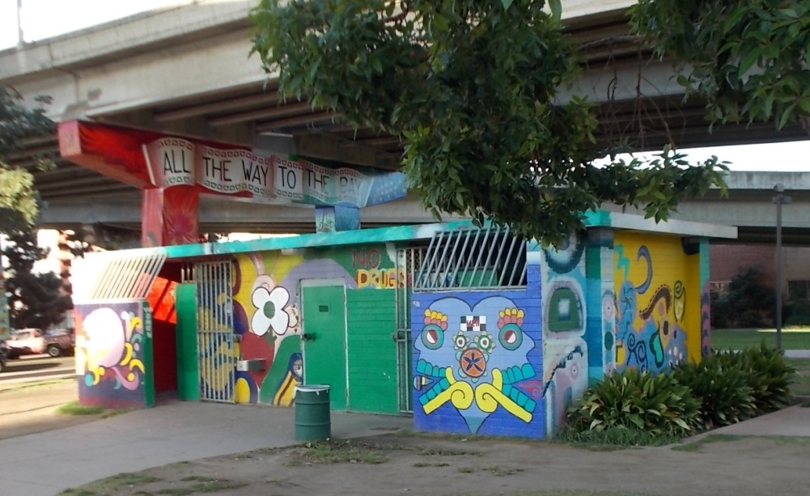
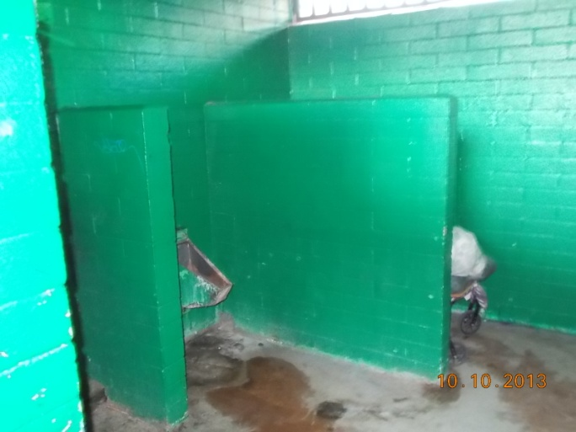
CHICANO PARK COMFORT STATION
S-13003
Scope
    Improve/Expand existing aged, undersized and ADA non-compliant comfort station
Financial
  Total Cost: $1.16M
  RPIF Allocation: $0.2M(FY13)
Status:
  Construction is completed
  Park will be opened to public in October FY18.
Notes:
Barry Kelleher/ Samir Mahmalgi

Slide 12
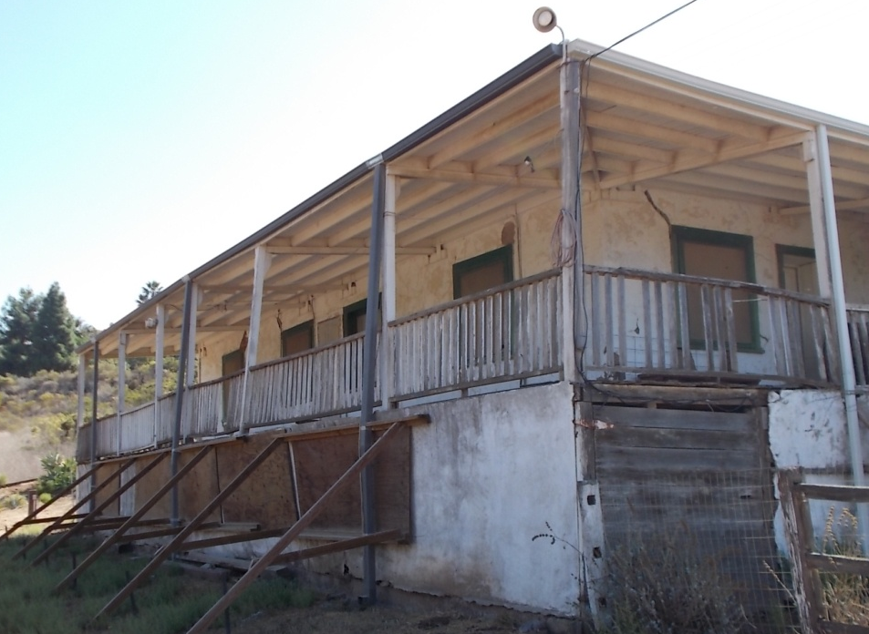
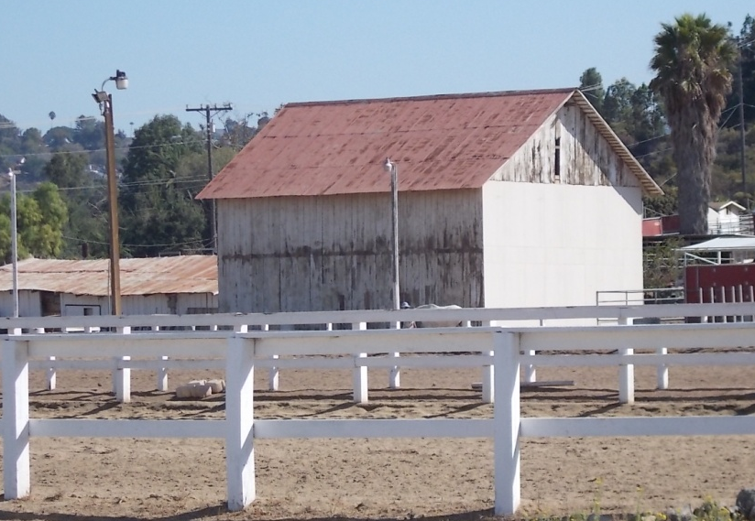
MOHNIKE ADOBE & HAY BARN RESTORATION
S-13008
Scope
  Per Municipal Code, protect historic Mohnike Adobe Cultural Landscape on national register of historic places
  Phase 1 of the adobe home rehabilitation was completed in 2005
Financial
  Total Cost: $2.45M
  RPIF Allocation: $1M (FY13 & FY15)
  RPIF Funds of $852,402 were reallocated to fund other projects
  RPFI Funds of $1M was added back on the project (FY 2017)
Status
  Feasibility Study Completed
  Design & Environmental permitting phase to start in FY 18.
  Construction is scheduled to start in FY 19.
Notes:
Project status changed to design
Update by Michael Ramirez / Shannon Getz

Slide 13
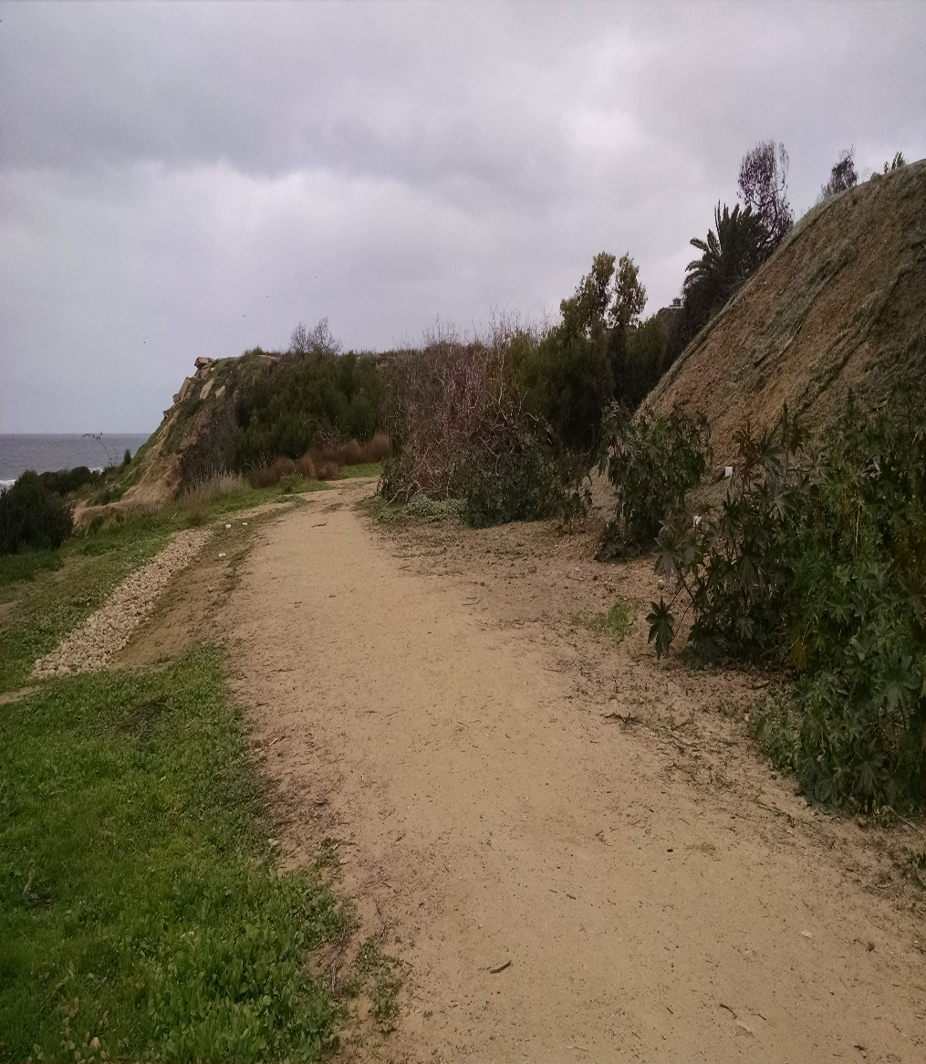
SUNSET CLIFFS NATURAL PARK
HILLSIDE IMPROVEMENTS
PHASE I (S-10091 / L-16001)
Scope
  Construction of new trails within the entire park including revegetation plan and removal of demolished housing.
Financial
  Total Cost: $1.0M (Phase IA)
  Total Cost: $3.2M (Phase 1B)
  RPIF Allocation:
    $1.1M (FY14)
    $1.0M (FY18)
Status
  Phase 1A (L-16001.1) Construction complete FY 16
  MMRP PH1A (L-16001.1) completes 2021
  Phase 1B (L-16001.2) Design completed in FY18; Project in Bid/Award Phase. Construction to start in FY 18 and complete in FY19
  MMRP PH1B (L-16001.2) completes 2023
Notes:
Elizabeth Schroth-Nichols / Freiha

Slide 14
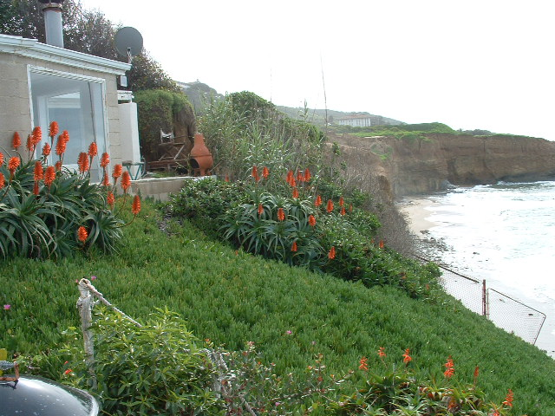
SUNSET CLIFFS NATURAL PARK
REMOVAL OF LOMALAND DR. AND LADERA ST. STRUCTURES
PHASE 2 (L-14005.1)
Scope
  The removal of Lomaland Dr. and Ladera St. structures; regrading and re-vegetating the sites; construction of overlooks and trails.
Financial
  Total Cost: $835K
  RPIF Allocation $456K
Status:
  In Design
  Environmental permits to complete FY 19
  Construction to start FY 19
  Construction to Complete FY 20
Notes:
Elizabeth Schroth-Nichols / Freiha

Slide 15
SUNSET CLIFFS NATURAL PARK
HILLSIDE DRAINAGE IMPROVEMENTS
PHASE 3 (L-14005.2)
Scope
  Design drainage solutions to arrest severe soil & coastal bluff erosion
Financial
  Total Cost: $4M (Phase I)
  RPIF Allocation ($4M total):
    $1M (FY13)
    $1M (FY15)
Status:
  In Design
  Construction to start FY 20
  Construction to Complete FY 21
Notes:
Elizabeth Schroth-Nichols / Freiha

Slide 16
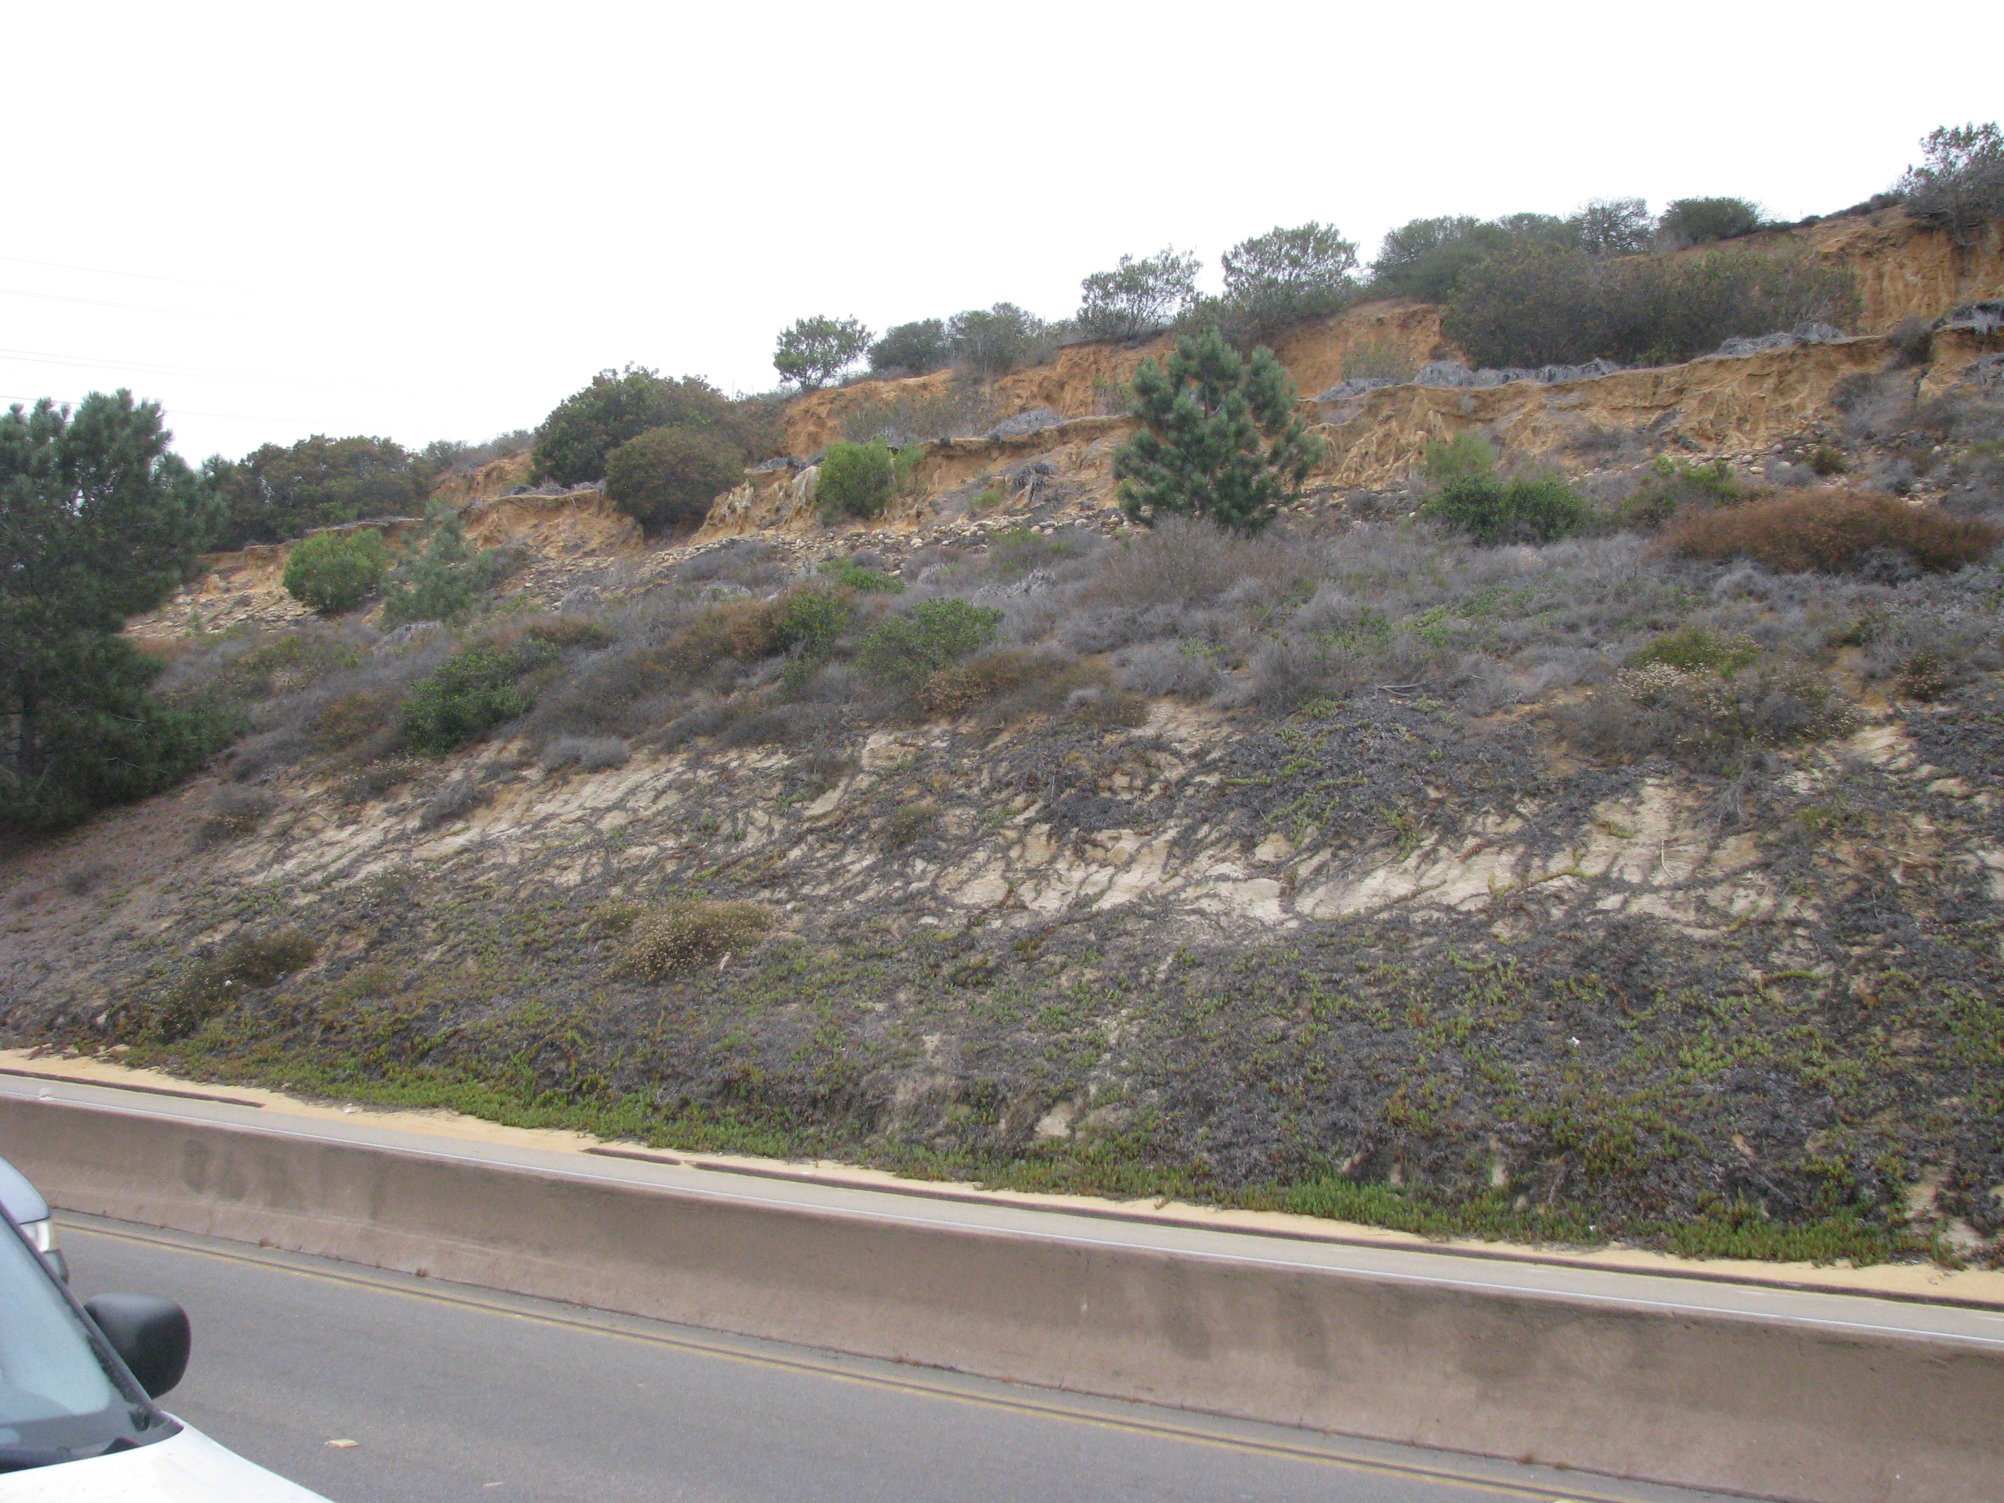
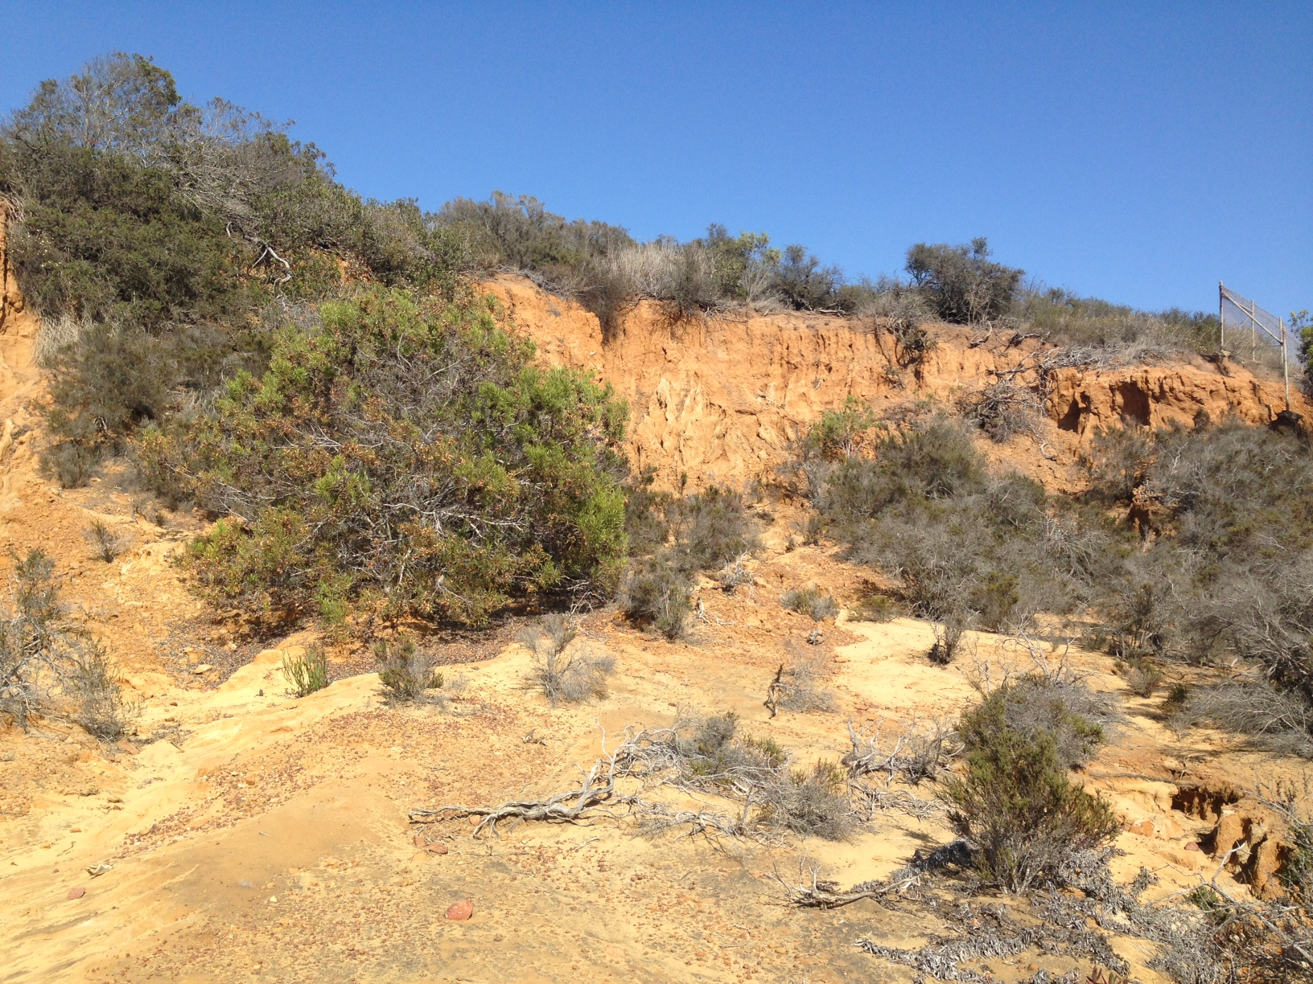
LJ PARKWAY/ MT SOLEDAD EROSION CONTROL
B-10089
Scope
  Reconstruct the failing brow ditches and stabilize the slope on the east side of La Jolla Parkway.
Financial
  Total Cost: $1.62M
  RPIF Allocations: $500K (FY15)
Status
  Feasibility Study Phase
  Design to start & complete in FY18
  Construction to start in FY19
Notes:
Rawsan Salha / Freiha

Slide 17
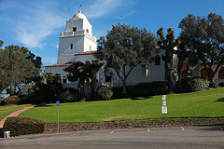
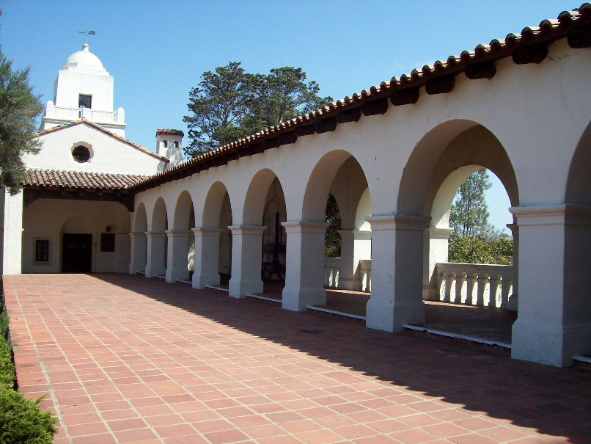
JUNIPERO SERRA MUSEUM ADA IMPROVEMENTS
S-15034
Scope
  Assess & improve Junipero Serra Museum ADA deficiencies
Financial
  Total Cost: $2.0M
  RPIF Allocations:
    $0.5M (FY15)
    $0.5M (FY16)
    $0.5M (FY18)
Status:
  Feasibility Study Phase- Completed
  Design to start in FY 18
  Construction to start in FY 19 & complete in FY 20
Notes:
Rawsan Salha / Freiha

Slide 18
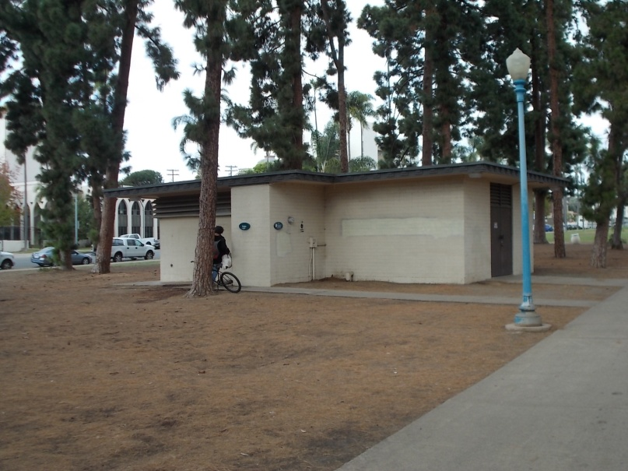
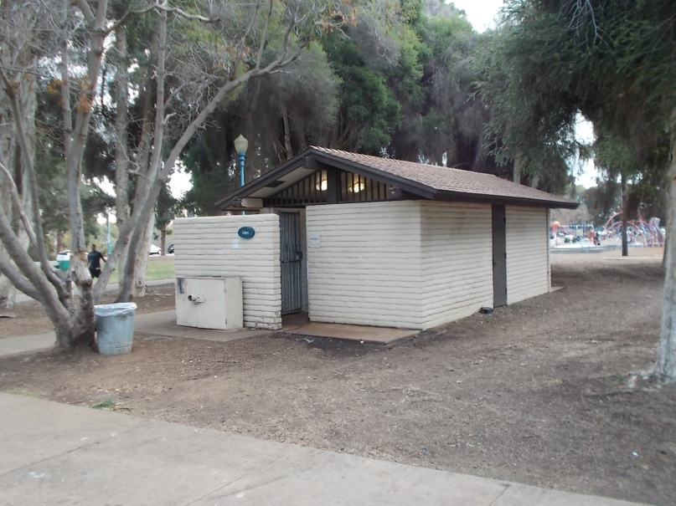
BALBOA PARK WEST MESA COMFORT STATION REPLACEMENT
S-15036
Scope
  Replace two existing comfort stations with new facilities on the West Mesa of Balboa Park.
Financial
  Total Cost: $1.692M
  RPIF Allocation: $1.0M (FY15)
  RPIF Allocation: $300K (FY16)
  RPIF Allocation: $200K (FY17)
Status
  Design completed in FY18
  Construction to start FY18
  Construction to complete FY19
Notes:
Michele Garcia-Quilico / Freiha

Slide 19
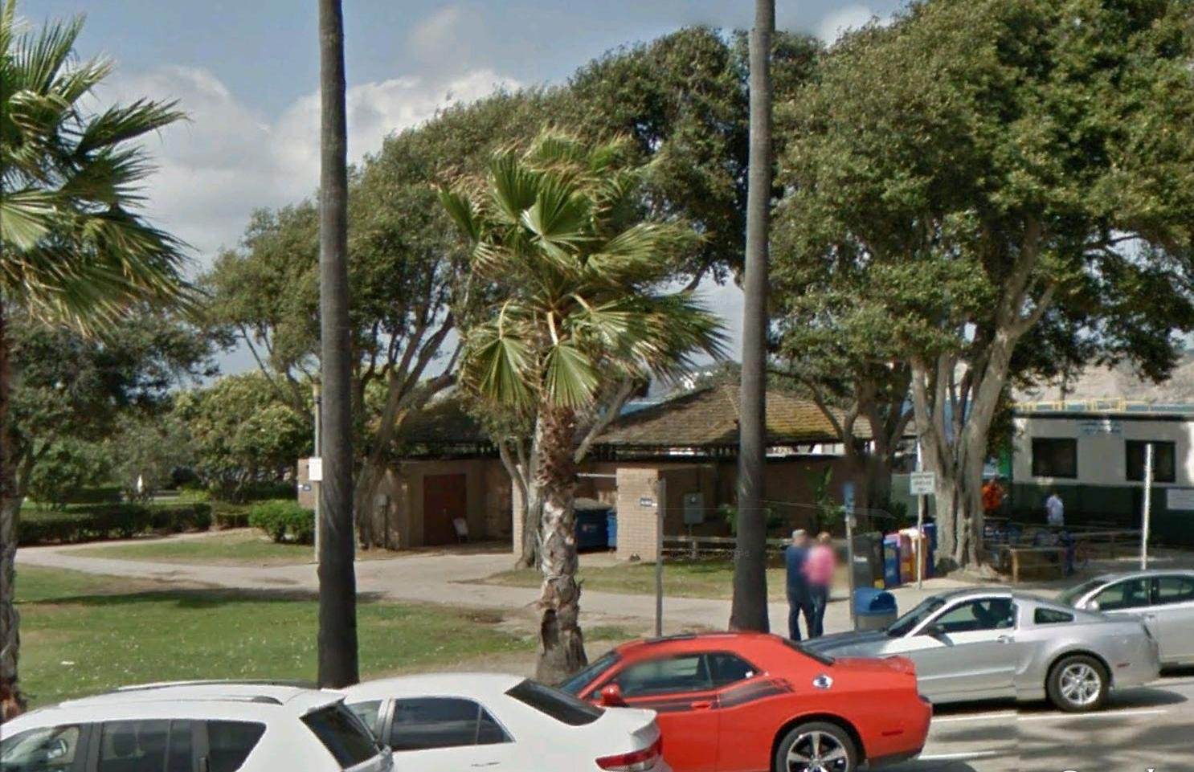
EB SCRIPPS PARK COMFORT STATION REPLACEMENT
S-15035
Scope
  The replacement of the existing comfort station
Financial
  Total Cost: $2.93M
  RPIF Allocation:
    $0.250M (FY14)
    $0.700M (FY17)
Status:
  In Design
  Construction to start FY19
  Construction to complete FY21
Notes:
Elizabeth Schroth-Nichols / Freiha

Slide 20
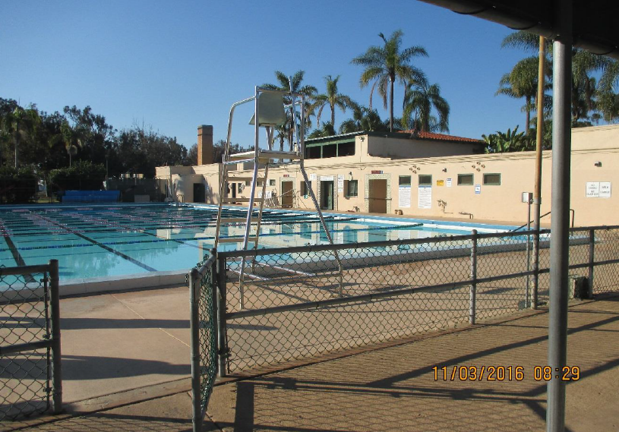
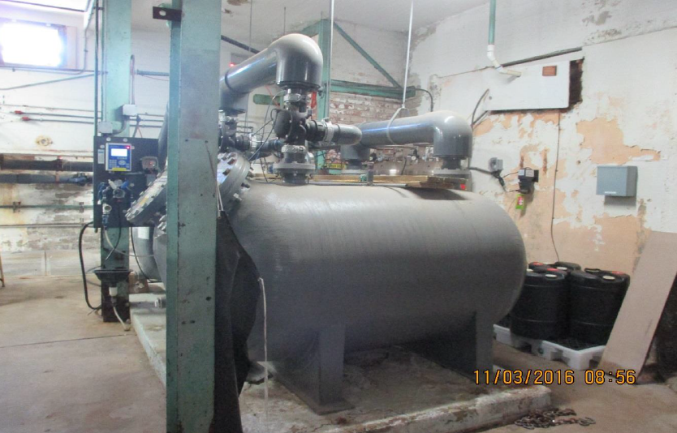
BALBOA PARK BUD KEARNS AQUATIC COMPLEX
S-17000
Scope
  The pool mechanical systems , ADA path of travel and interior tenant improvement.
Financial
  Total Cost: $1.544M
  RPIF Allocation:
    $0.500M (FY17)
Status:
  Design phase starts in FY 18
  Construction to start FY20 and complete in FY20
Notes:
Michele Garcia-Quilico / Freiha

Slide 21
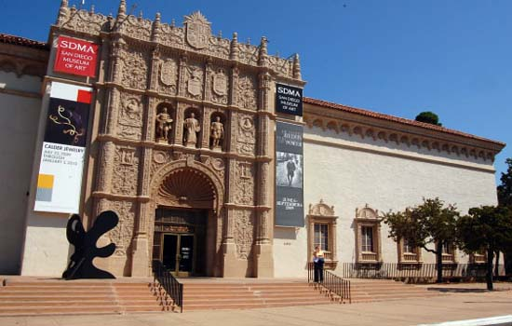
MUSEUM OF ART ELEVATOR MODERNIZATION
B-10042
Scope
  The project consists of modernization upgrades to one passenger elevator and two freight elevators.
Financial
  Total Cost: $1.167M
  RPIF Allocation:
    $0.120M (FY17)
Status:
  Construction started in FY17 and scheduled to complete in October , FY 18.
Notes:
Michel Maria/ Jason Grani

Slide 22
CHOLLAS LAKE IMPROVEMENTS
L-18001
Scope
  TBD
Financial
  Total Cost: TBD
  RPIF Allocation:
    $0.200M (FY18)
Status:
  The project remains in planning with asset owner Park & Rec.

Slide 23
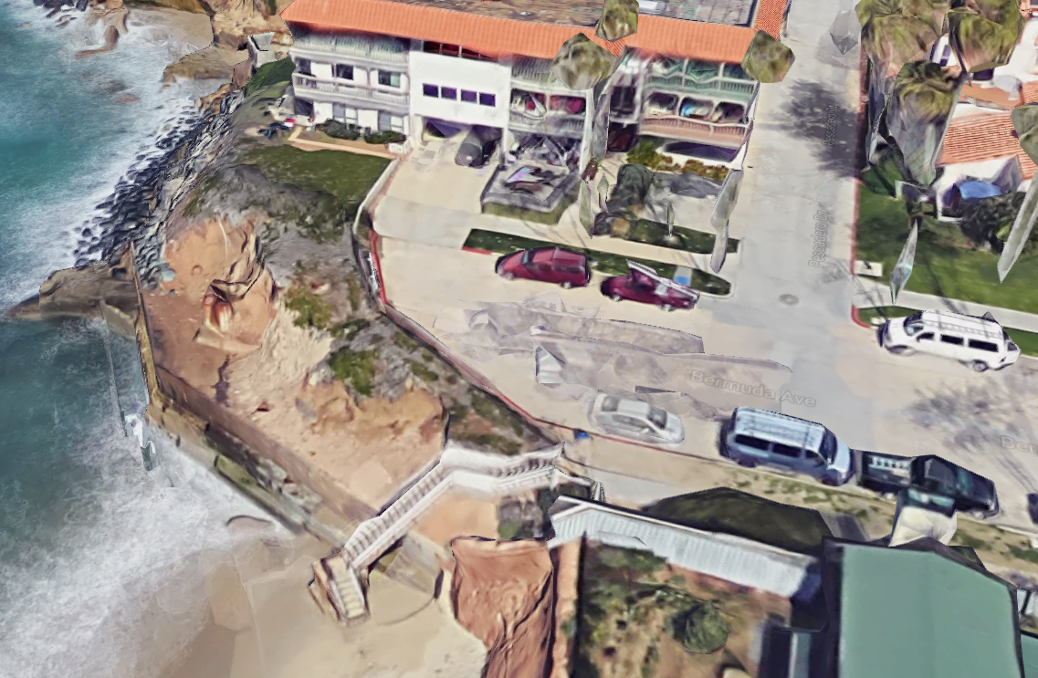
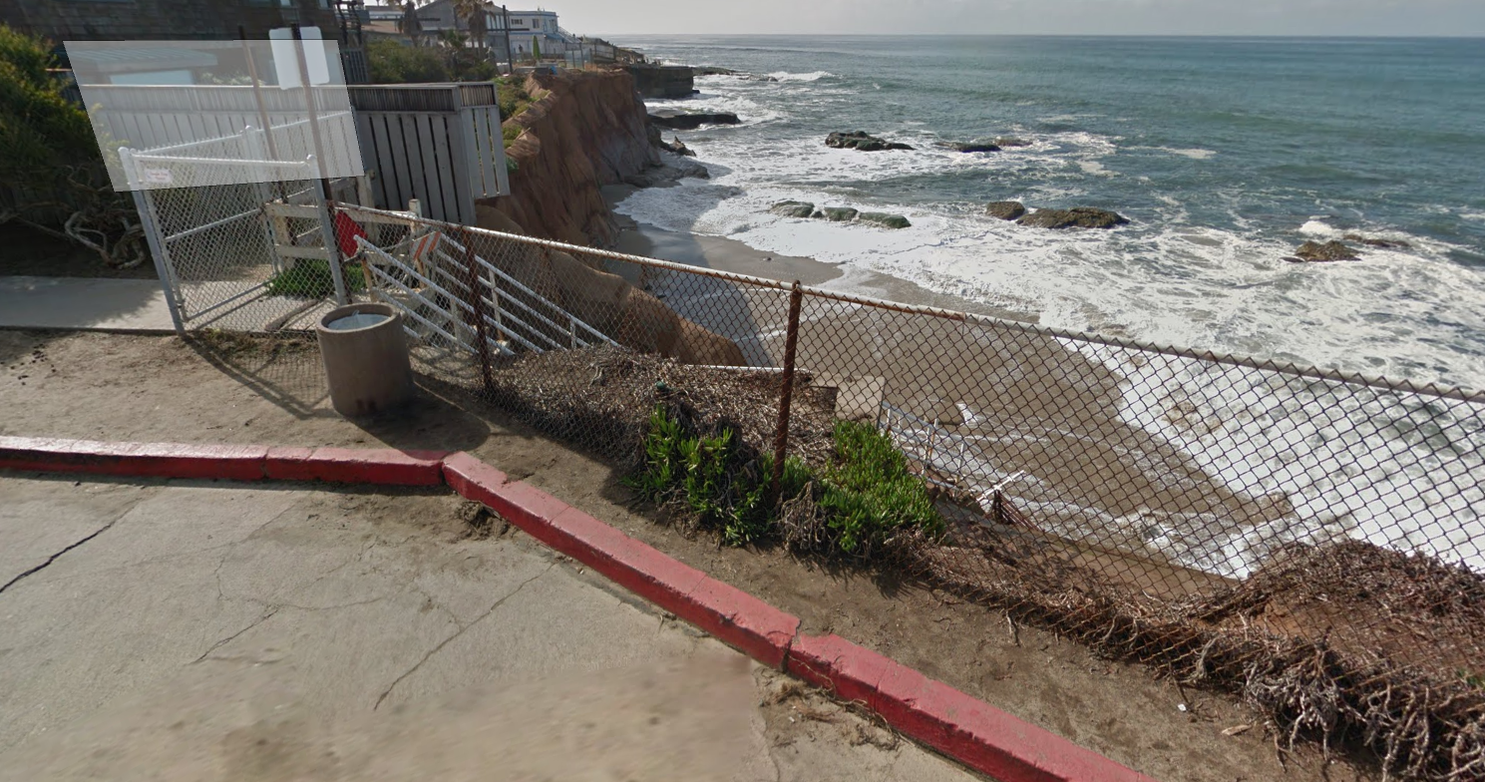
BERMUDA AVE COASTAL ACCESS & SEAWALL REPAIRS
B-17110
Scope
  Replacement of stairs and seawalls.
Financial
  Total Cost: $1.68M
  RPIF Allocation:
    $0.384M (FY17)
Status:
  Project is in Preliminary Design Phase.
Notes:
Julian Espinoza - PI

Slide 24
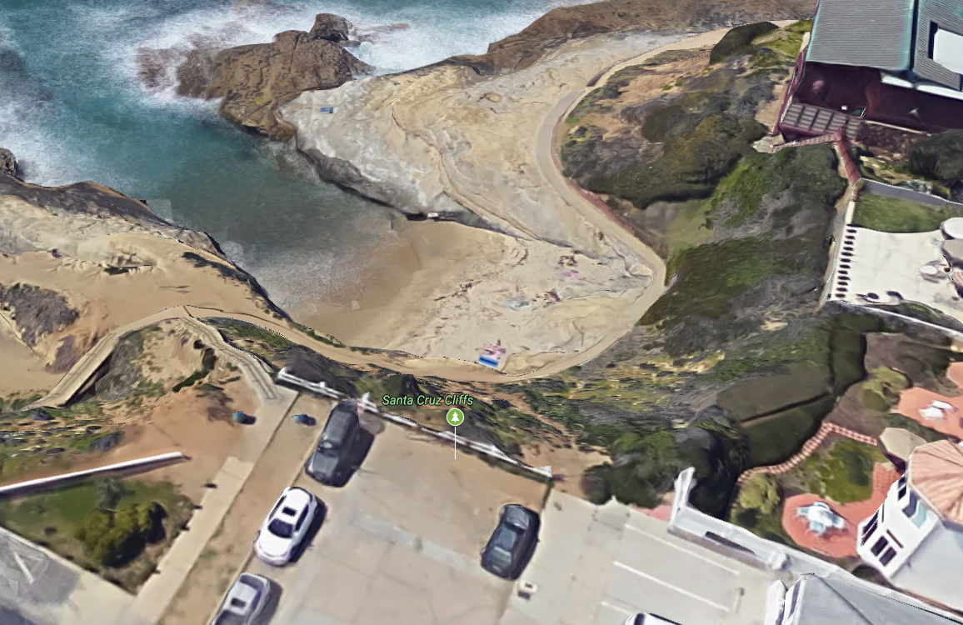
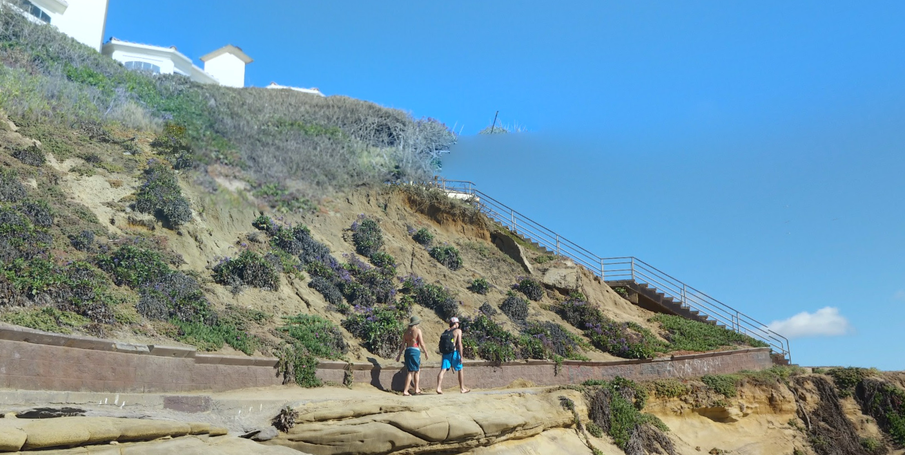
SANTA CRUZ AVE ACCESS STAIRS AND WALKWAY
B-18027
Scope
  Repair or replacement of stairs, walkways, and stabilization of the fill slope.
Financial
  Total Cost: TBD
  RPIF Allocation:
    $0.425M (FY18)
Status:
  Project is in Preliminary Design Phase.
Notes:
Julian Espinoza - PI

Slide 25
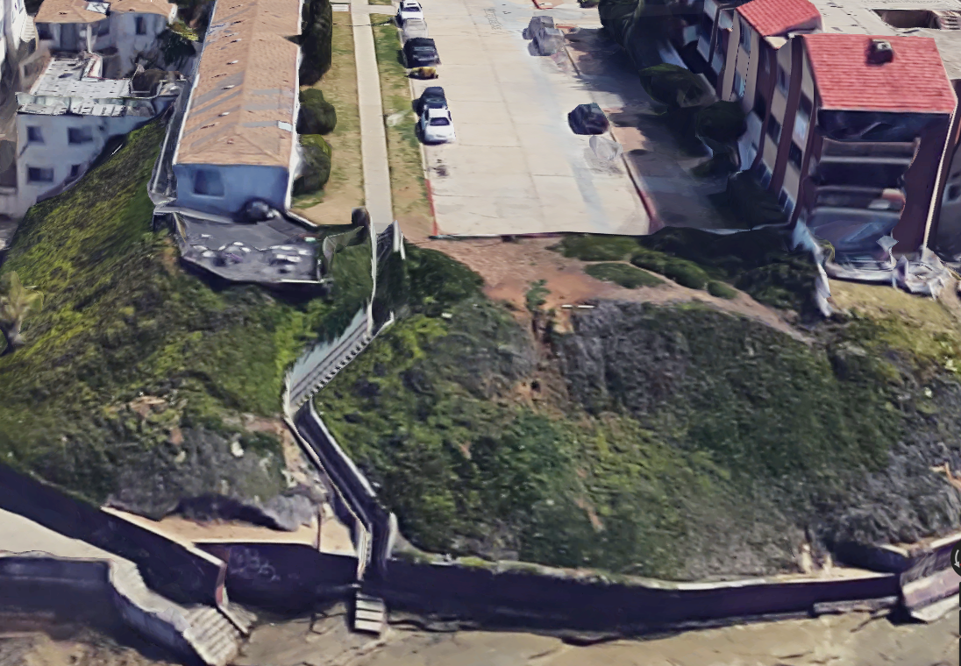
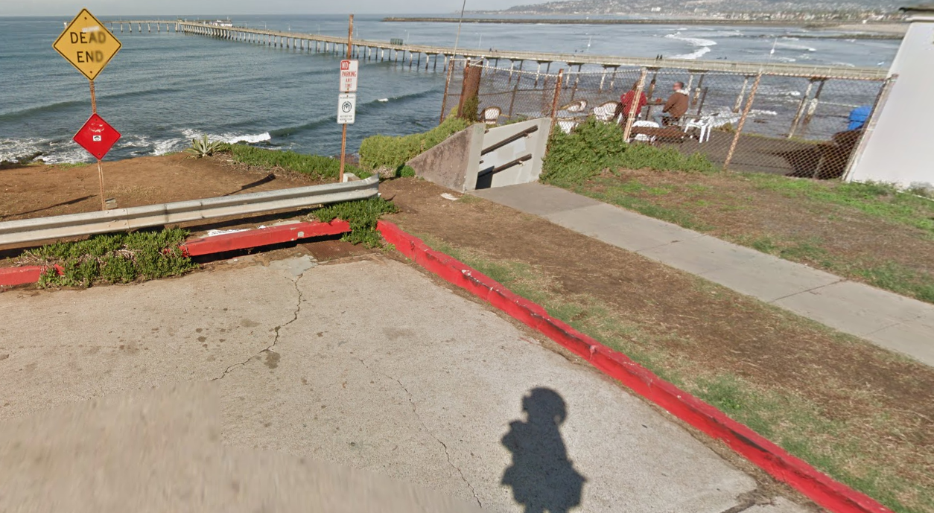
NARRAGANSETT AVE ACCESS
B-18026
Scope
  TBD
Financial
  Total Cost: TBD
  RPIF Allocation:
    $0.375M (FY18)
Status:
  CIP project to be cancelled.
Notes:
Julian Espinoza – PI
Project was cancelled per Andy Fields email on February 26th 2017 to Julian Espinoza w/PI

Slide 26
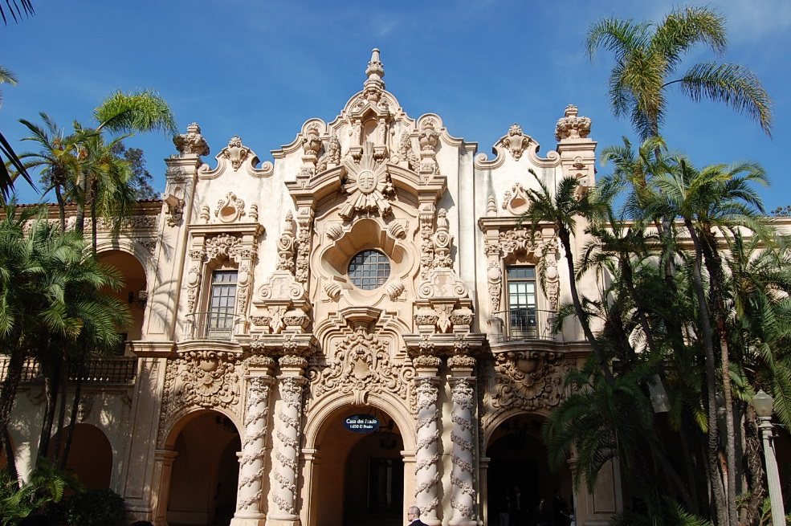
CASA DE BALBOA FIRE ALARM
B-17181
Scope
  Replace the Fire Alarm System
Financial
  Total Cost: $0.805M
  RPIF Allocation:
    $0.805M (FY17)
Status:
  Project is in Preliminary Design Phase.
Notes:
Julian Espinoza - PI

Slide 27

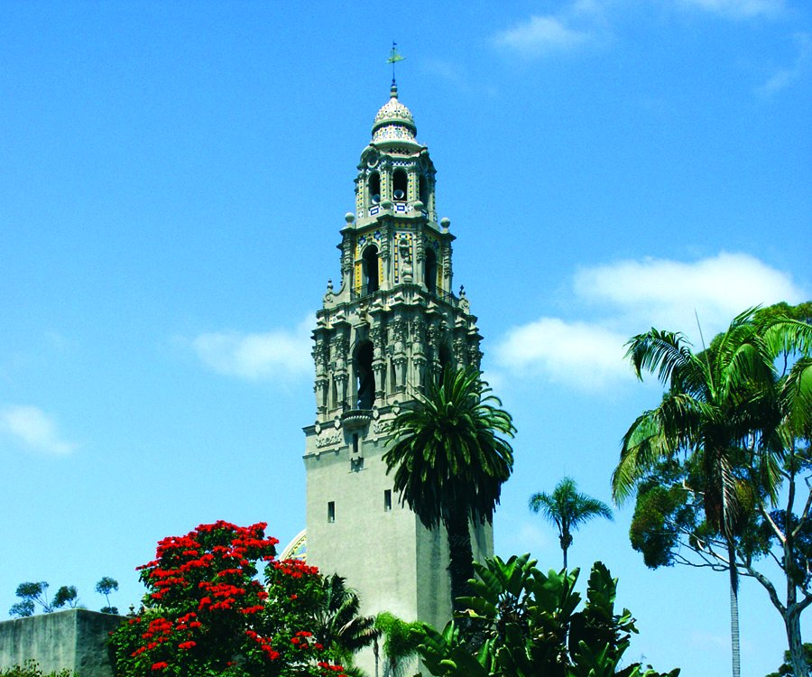

Public Works
Regional Park Improvement Fund
Allocation and Expenditure
Bi Annual Projects Update
Q & A

