Slide 1
Holmes Elementary Joint Use Facility General Development Plan
Planning Department
Park and Recreation Board
June 21, 2018
Action Item #101

Slide 2
Planning Department
Introduction
Play All Day Parks Program
New initiative put forth by Mayor Kevin Faulconer and Superintendent Cindy Marten in 2016
Over 45 new joint use facilities in the next 5-10 years.

Slide 3
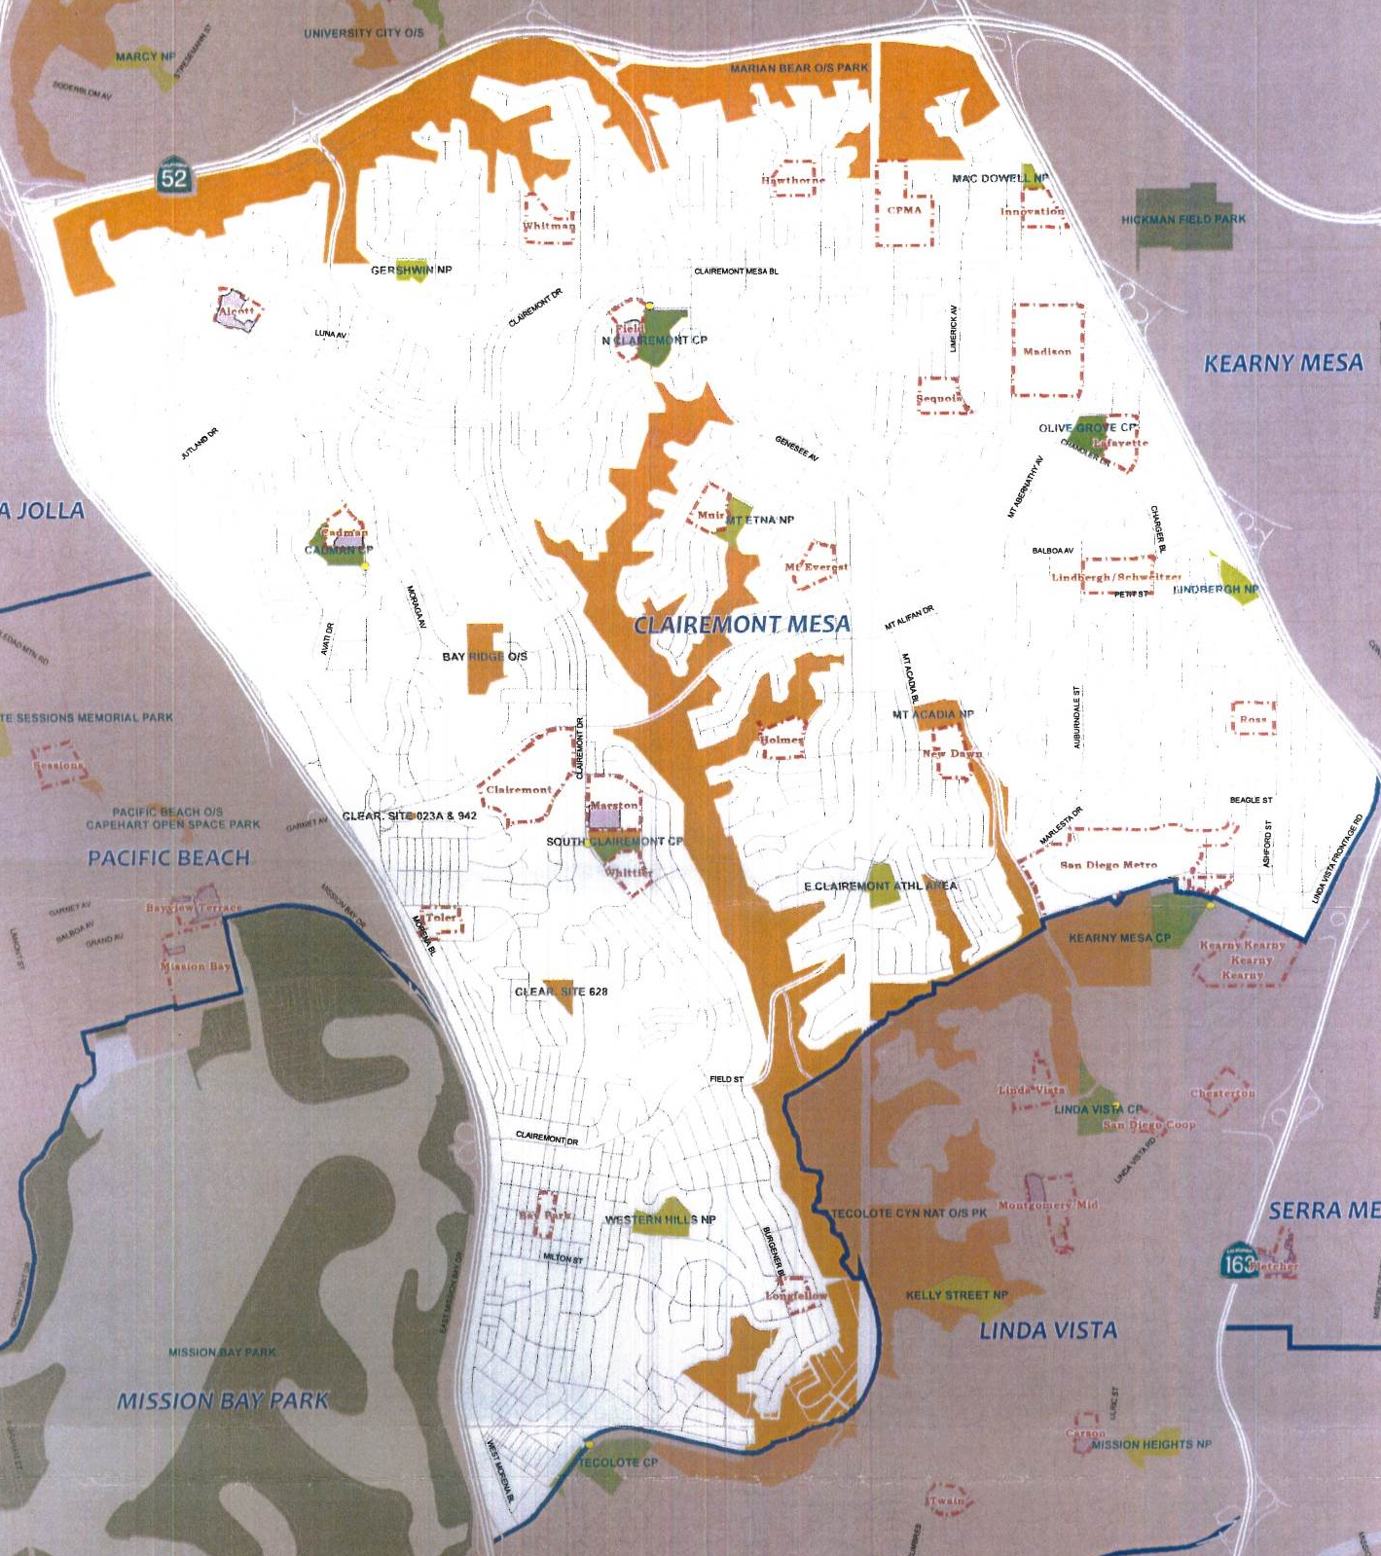
Planning Department
Background
Holmes Elem School
This project provides for the design and construction of a new joint use facility at Holmes Elementary School.
Located at 4902 Mt Ararat Drive within the Clairemont Community, Council District 6.
Will provide approx. 2.96 acres of population based park land.

Slide 4
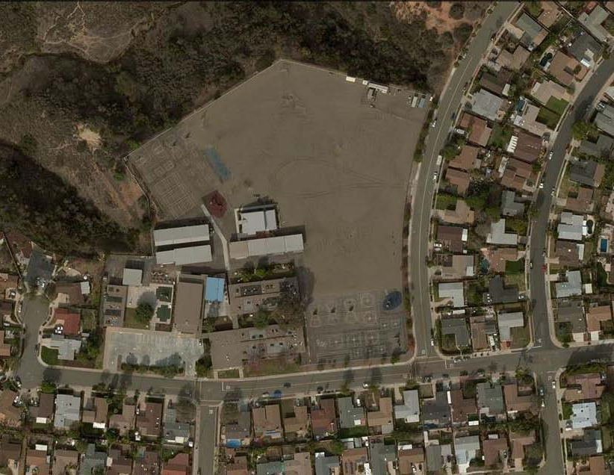
Planning Department
Project Scope
Design and construction of a multi-purpose natural turf field, walking track, drinking fountain, fencing and trees.
Funding for Design and Construction:
San Diego Unified School District Proposition S & Z Capital Improvement Bond Program
Joint Use Boundary
Mt Brundage Ave
Marvin Elementary School
Mt Ararat Dr
Site Location, Aerial Map

Slide 5
Planning Department
Discussion
Community Concerns
Addition of Amenities
Shade trees and backstops
Future PTA project
Future Comfort Station
Closing the Joint Use Field in the mornings before school
Before school programs in place to alleviate drop off congestion

Slide 6
Planning Department
Public Input Process
Recreation Council Recommendation
On June 21, 2017, the North Clairemont Recreation Council voted (4-0-1) to recommend approval the General Development Plan for Holmes Elementary School Joint Use Facility.
The North Clairemont Recreation Council voted (3-0-2) to recommend inclusion of a future comfort station to the General Development Plan for Holmes Elementary School Joint Use Facility.

Slide 7
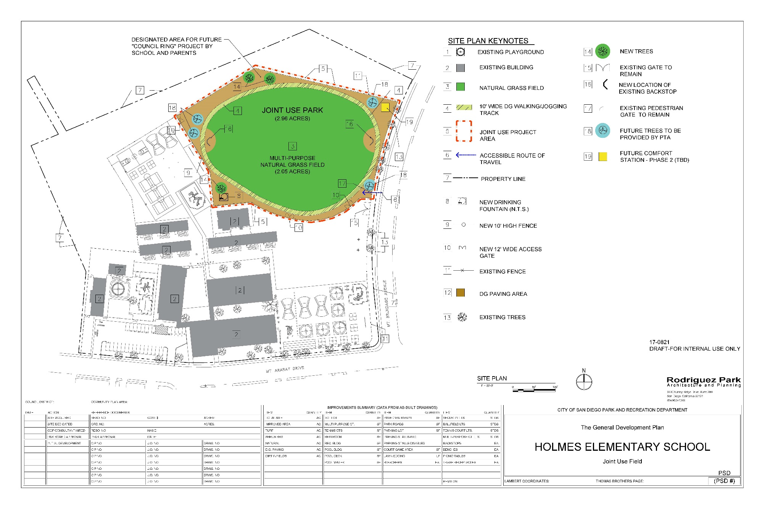
Planning Department
General Development Plan

Slide 8
Planning Department
Recommendation
Recommend approval of the proposed General Development Plan (GDP) for the Holmes Elementary School Joint Use Facility

