Slide 1
Longfellow K8 School Joint Use Facility General Development Plan
Planning Department
Park and Recreation Board
June 21, 2018
Action Item #102

Slide 2
Planning Department
Introduction
Play All Day Parks Program
New initiative put forth by Mayor Kevin Faulconer and Superintendent Cindy Marten in 2016
Over 45 new joint use facilities in the next 5-10 years.

Slide 3
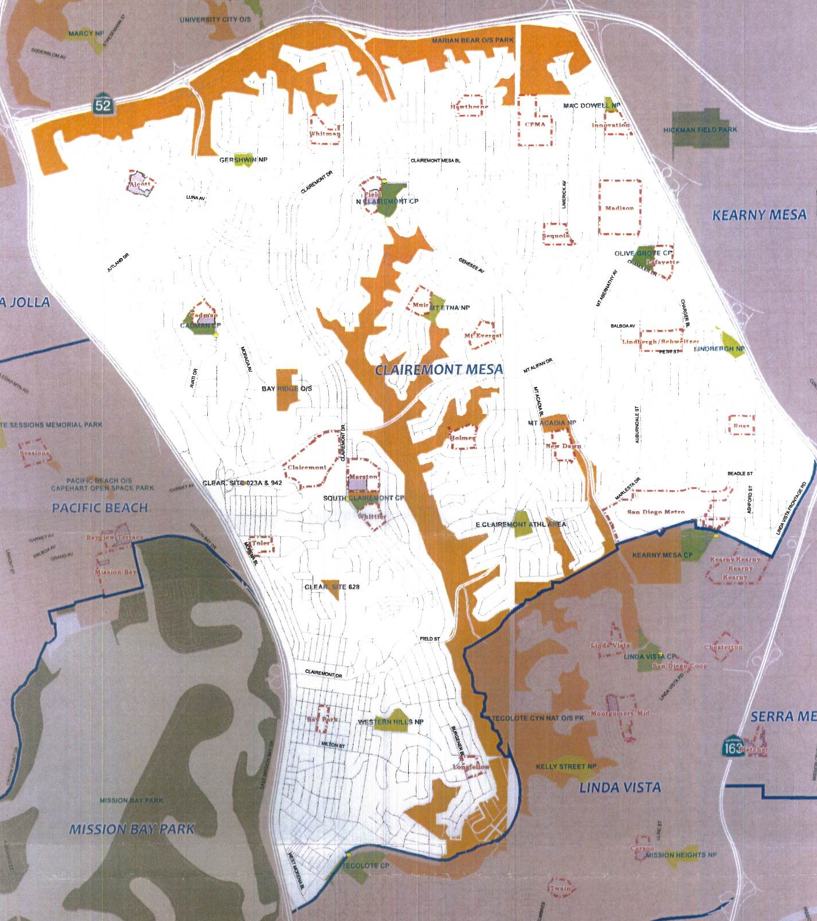
Planning Department
Background
Longfellow K8 School
This project provides for the design and construction of a new joint use facility at Longfellow K8 School.
Located at 5055 July Street within the Clairemont Community, Council District 2.
Will provide approx. 1.42 acres of population based park land.

Slide 4
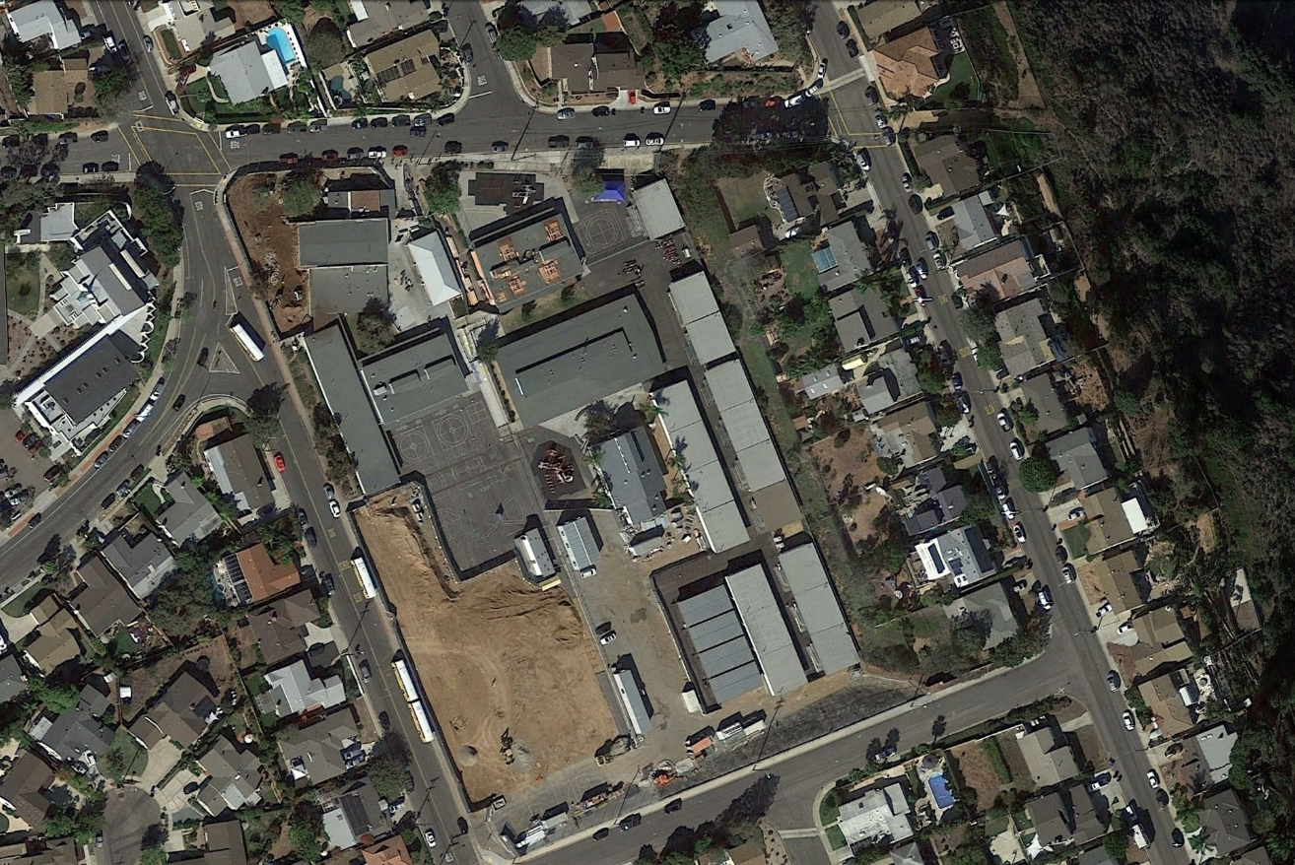
Planning Department
Project Scope
Design and construction of a multi-purpose natural turf field, walking track, drinking fountain, fencing and trees.
Funding for Design and Construction:
San Diego Unified School District Proposition S & Z Capital Improvement Bond Program
July Street
Cowley Way
Burgener Boulevard
Joint Use Boundary
Marvin Elementary School
August Street
Site Location, Aerial Map

Slide 5
Planning Department
Discussion
Community Concerns
Addition of Amenities
Shade trees
Future additional seating (bleachers)
Permitting the field for organized sports
Park will be designated as a passive park
Recreation Council Recommendation
On February 22, 2018 the Tecolote Recreation Council voted (4-0-0) to recommend approval of the General Development Plan for Longfellow K8 School Joint Use Facility.

Slide 6
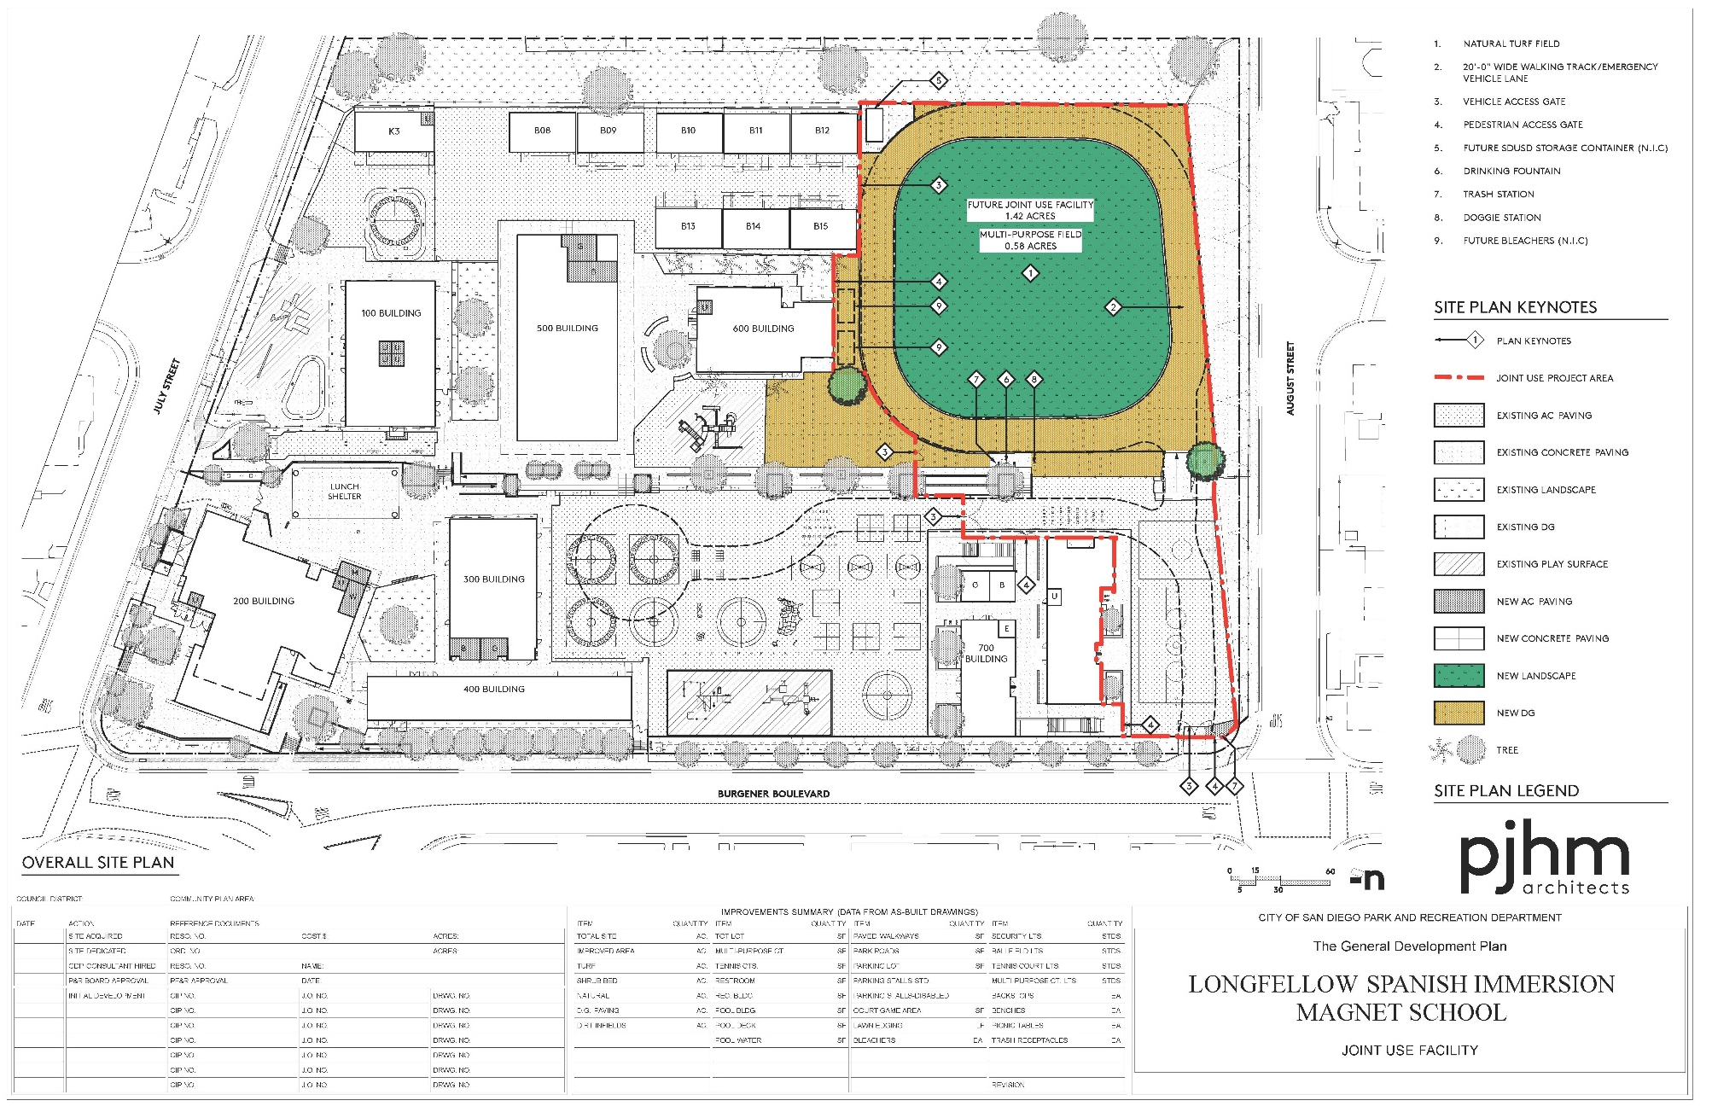
Planning Department
General Development Plan

Slide 7
Planning Department
Recommendation
Recommend approval of the proposed General Development Plan (GDP) for the Longfellow K8 School Joint Use Facility

