Slide 1
How practices based on ACEs science and ACEs Connection Network…
….can help build healthy communities
Notes:
ACEs Connection Network is two parts:

Slide 2
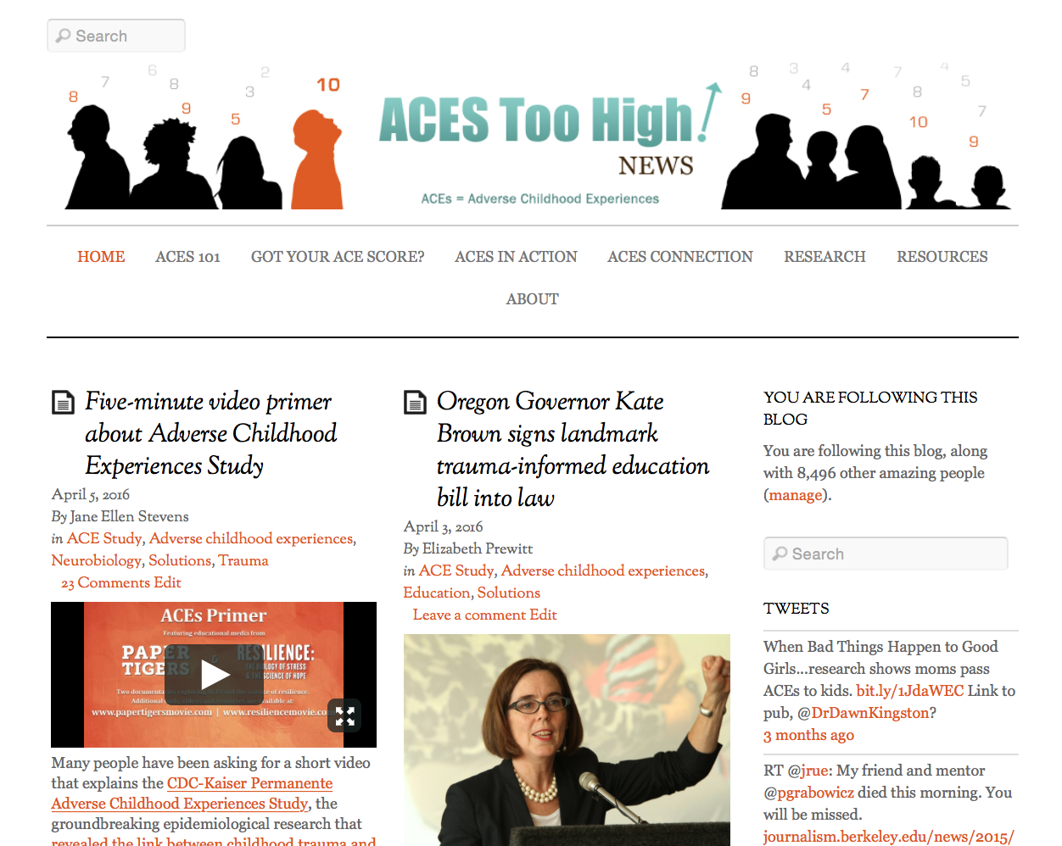
Notes:
ACEsTooHigh.com, a news site for the general public. It covers ACEs science and how people, organizations, systems and communities are implementing that science.

Slide 3
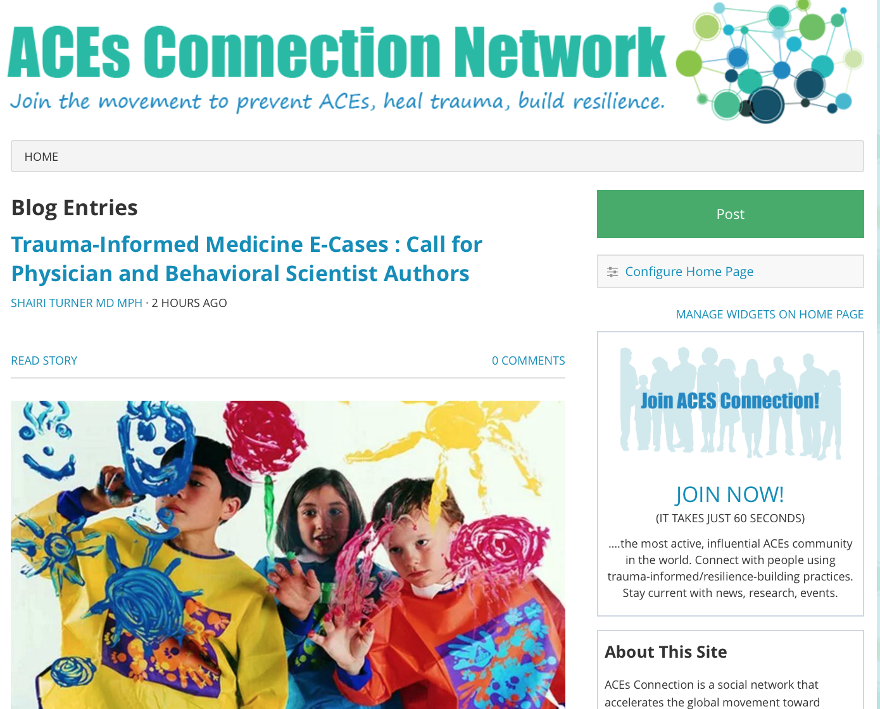
ACEsConnection.com
Notes:
The second part of ACEs Connection Network is ACEsConnection.com. It’s a social network for people who are developing trauma-informed and resilience-building practices to share information. Think Facebook with a few more bells and whistles. The network receives generous support from the Robert Wood Johnson Foundation and the California Endowment.
We tell stories, encourage others to tell their stories, we do our best to shorten the time it takes useful information to find its way from one person who has it to another person who needs it, and we’re using this distributed networking technology to eradicate the isolation caused by geography and siloed sectors.
Today, more than 9,100 people are part of ACEsConnection. They come from healthcare, education, criminal justice, law enforcement, civic, business and faith-based communities. They are parent leaders, social workers, pediatricians, teachers, judges, politicians and community advocates. We send information to them about the latest developments in ACEs and how people and communities are implementing the research. And there’s a lot happening.

Slide 4
Notes:
ACEs science. Some people call this new understanding the “unified science” of human development. Others call it the “theory of everything” about human development. We just call it ACEs science.
Today, I’ll explain the five parts of ACEs science.
…and some of the ways in which it’s being implemented;
…the remarkable systems-changing lessons learned so far;
….and how all this together offers us the opportunity to create self-healing communities.

Slide 5
Early Death
Complex Trauma/ ACE
Race/Social Conditions/ Local Context
Burden of dis/ease, distress, criminalization, stigmatizaton
Coping
Allostatic Load, Disrupted Neurological Development
Generational Embodiment/Historical Trauma
Notes:
There’s the ACE Study, which you’ve heard about.
Five results:
One -- childhood trauma is extraordinarily common. Nearly two-thirds of the participants had at least one ACE.
Two -- There’s an unmistakable link between adverse experiences in childhood and adult onset of chronic disease, mental illness, violence and being a victim of violence.
Three – The more types of childhood adversity, the more dire the consequences.
Four – If someone is experiencing one type of trauma, there’s an 87% chance that there’s another. And a 50% chance that there are two more. In other words, people experience complex trauma. So going after just violence or just sexual abuse and expecting to stop childhood trauma is completely unrealistic.
Five -- Trauma does not equal only violence. It’s “ordinary” experiences – experiencing divorce, living with an alcoholic or someone who’s depressed – that cause just as much damage as physical or sexual abuse.

Slide 6
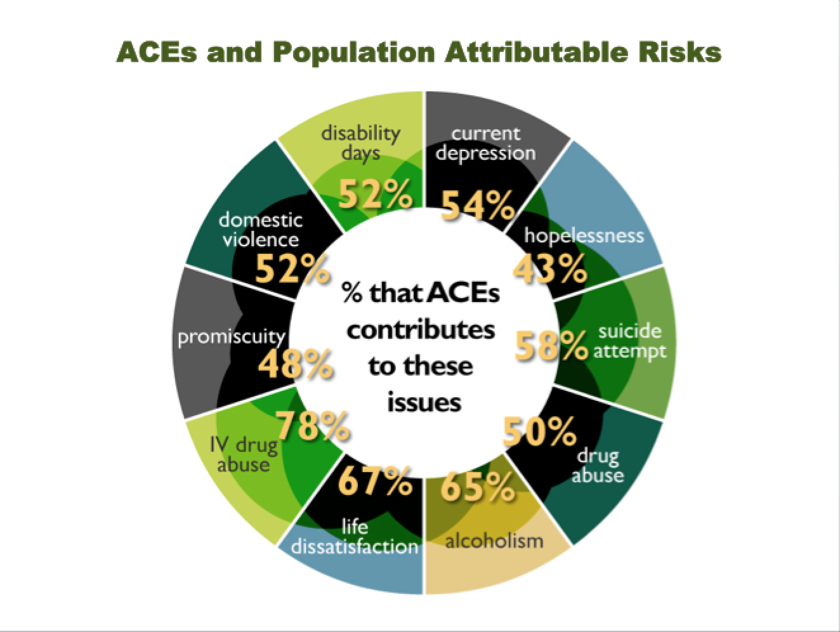
Notes:
And one last major finding: ACEs contribute to most of our major chronic health, mental health, economic health and social health issues.

Slide 7
Early Death
Complex Trauma/ ACE
Race/Social Conditions/ Local Context
Burden of dis/ease, distress, criminalization, stigmatizaton
Coping
Allostatic Load, Disrupted Neurological Development
Generational Embodiment/Historical Trauma
Notes:
Let’s go back to the ACEs pyramid for a moment.
You’ll notice here that a couple of other layers have been added – generational or historical trauma, and social conditions/local context, which translates to systems trauma. And, of course, there are other types of trauma.

Slide 8
Notes:
You know that the ACE Study measured ten types of childhood trauma. We’re most familiar with the five usual suspects -- abuse and neglect.
Depending on the population they’re serving, other ACE surveys are adding more ACEs: bullying, racism, witnessing violence outside the home, witnessing a sibling being abused.
There is also more recognition about systems trauma: involvement with the foster care system. Attending a school that enforces a zero-tolerance policy. Involvement with law enforcement. Involvement with juvenile justice. Even involvement in the medical system. It doesn’t mean there are mean and traumatizing people in these systems. On the contrary, these systems are filled with good-hearted people, but the systems’ services are organized to take a traditional blame, shame and punishment approach to changing people’s behavior, instead of an understanding, nurturing and healing approach. Or, the system has organized its services on what’s most convenient for the practitioners and not for the patients, students, clients, prisoners.
We’re revamping our resource center to include surveys that are addressing these other types of trauma.

Slide 9
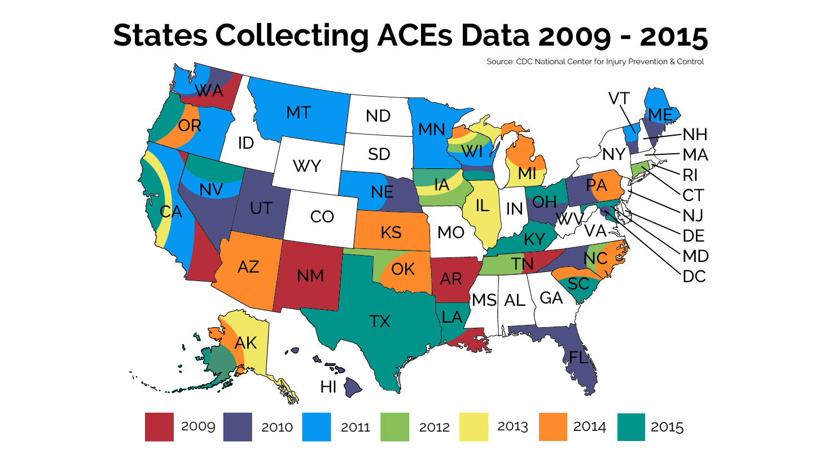
Notes:
Thirty-two states and the District of Columbia have done their own ACE surveys, and are finding similar results.

Slide 10
Notes:
So, why do ACEs cause so much damage? This is the second part of ACEs science – what happens to your brain when you have ACEs.
This work was originated by Dr. Bruce McEwen at Rockefeller University, and amplified by Dr. Jack Shonkoff at the Harvard Center on the Developing Child.
We all need positive stress to thrive. But life has its ups and downs, and comes with tolerable stress. The kind that’s temporary, and where you’re often helped to recover. But too many children and adults experience toxic stress – extreme, frequent or extended activation of the body’s stress response without the buffering presence of a supportive adult.
This long-term toxic stress – the kind that comes from living with a physically and verbally abusive alcoholic parent, for example – damages the function and structure of a kid’s brain. Toxic stress floods the brain with stress hormones. When a kid’s in fight, flight or freeze mode, their thinking brain is offline and doesn’t develop as it should.
Kids experiencing trauma act out. They can’t focus. They can’t sit still. Or they withdraw. Fight, flight or freeze – that’s a normal and expected response to trauma. So they can’t learn. Their schools respond by suspending or expelling them, which further traumatizes them.
When they get older, they cope by drinking, overeating, doing drugs, smoking, as well as over-achieving or engaging in thrill sports. To them, these are solutions. They’re not problems. Nicotine reduces anxiety. Food soothes. Some drugs, such as meth, are anti-depressants. So telling someone how bad smoking is for them isn’t likely to make much of an impression if it relieves anxiety.
And to the brain – it pretty much doesn’t matter what the trauma is, it will damage some part of the brain. And to the brain, anything that’s accessible and works can become a coping mechanism. So, chasing individual addictions is a losing game. If you don’t go to the root, people might stop smoking, but start eating. They will replace methamphetamines with opiods.

Slide 11
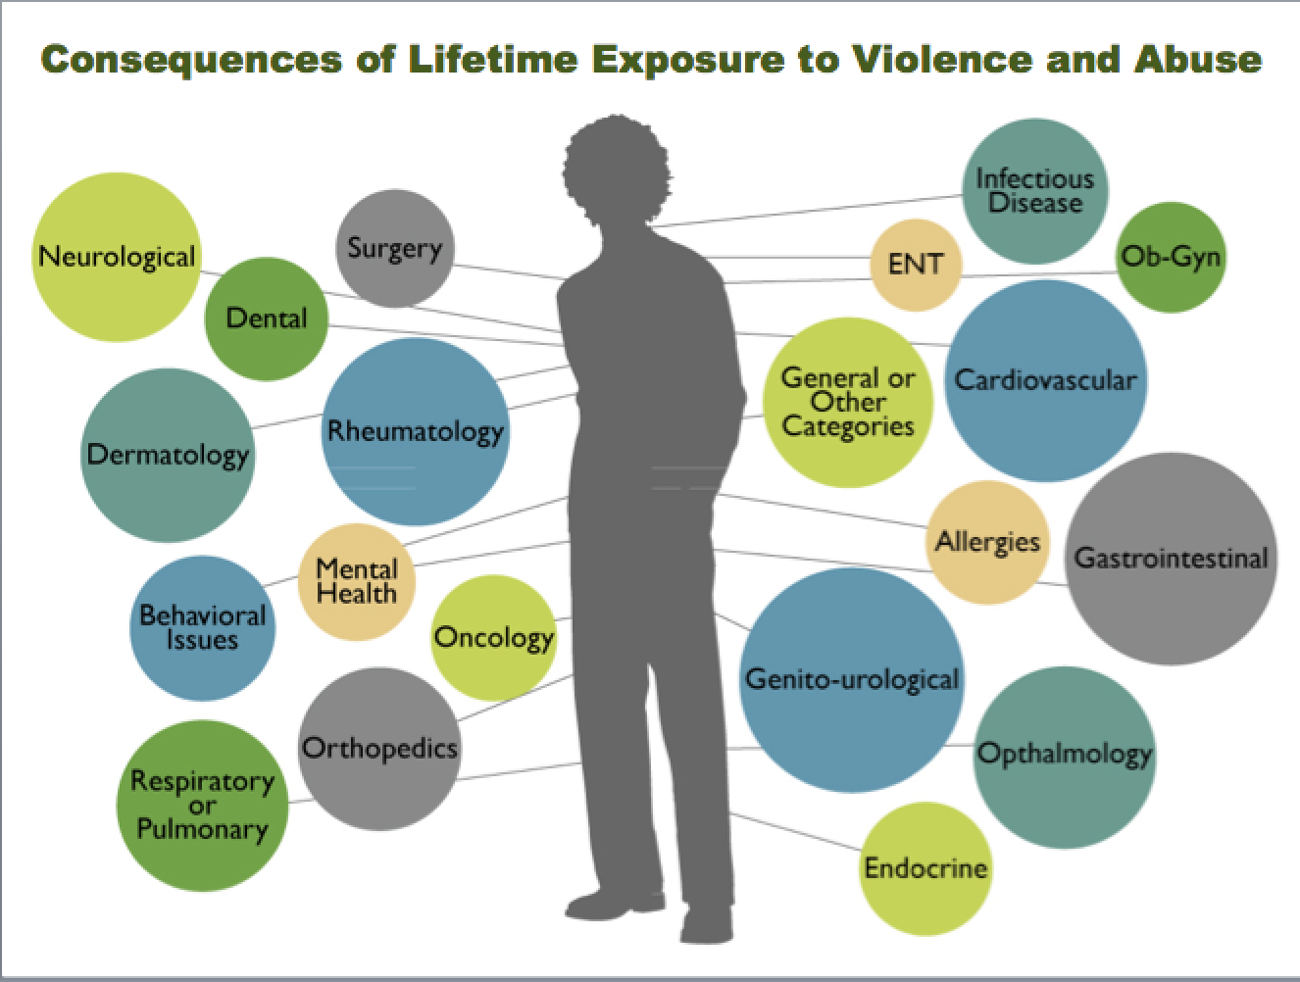
Notes:
Staying in red alert status puts a lot of wear and tear on the body. Bruce McEwen says: “It gets under the skin.” So even if people haven’t smoked or become obese, their risk of heart disease and diabetes increases, as do autoimmune diseases. This is the third part of the “theory of everything” – what happens to our bodies when we live with toxic stress for years.

Slide 12
Notes:
Toxic stress can turn genes on and off. And these changes can be transferred from parent to child. The area of research that looks into how our interaction with the people around us can change our genes is called epigenetics. That’s the fourth part of ACEs science.
This fourth part of ACEs science plays out in historical or generational trauma.

Slide 13
Notes:
Resilience research. Our brains are plastic. Our bodies want to heal.
We know a lot about how to increase individual resilience. To reduce stress hormones in our bodies and brains, we can meditate, exercise, get enough sleep and eat well, have safe relationships, live in a safe place, ask for help when we need it and, if necessary, get help from a counselor or therapist. Simple advice. But it works.
We can build resilient families -- We know that educating parents about their own ACEs helps them understand their lives and motivates them to learn to become healthy parents to prevent passing their ACEs on to their kids.
But you can’t have resilient families without healthy organizations, systems and communities. The frontier of resilience research lies in creating communities and systems that prevent childhood adversity and stop traumatizing already traumatized people.

Slide 14
Notes:
On ACEsTooHigh.com, we tell stories about how people, organizations, systems and communities are implementing this ACEs science.

Slide 15
Notes:
When principal Jim Sporleder learned about the ACE Study and the effects of toxic stress on kids’ brains, he said he’d been doing everything wrong when it came to disciplining kids. In one year, he changed the school so that when a kid threw a chair or yelled at a teacher, the staff didn’t suspend or expel the kid, which just further traumatizes the kid. They understood that the kid was behaving like that because he or she was experiencing trauma. So, instead of yelling at a kid: “What’s wrong with you? Why the hell did you do such a stupid thing?, they asked: “What happened to you? How can we help you?”

Slide 16
Notes:
After one year, suspensions dropped 85%, expulsions dropped 40%. After three years, suspensions dropped 90%, and they stopped expelling kids.
The kids’ grades, test scores and graduation rates went up. The kids, whose average ACE score is 5.5, say the school is their family.

Slide 17
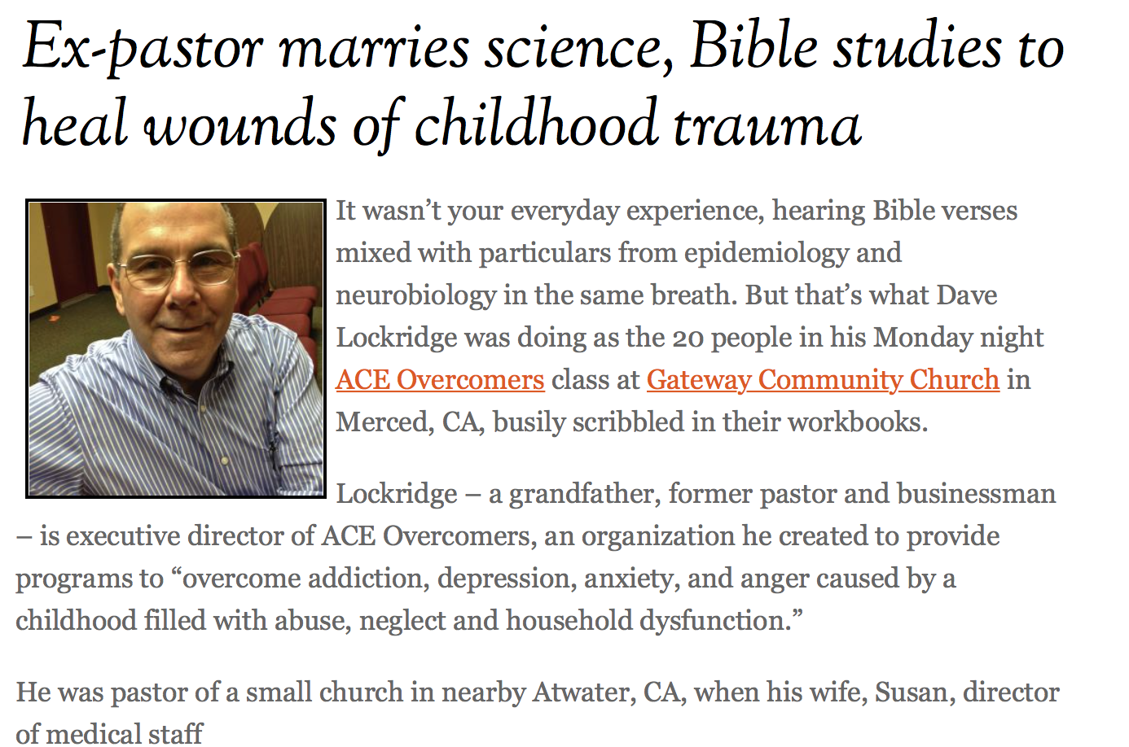
Notes:
Dr. Vincent Felitti, co-founder of the ACE Study, says that there aren’t enough therapists in the world to help all the people who are suffering from ACEs. That’s why he thinks everyone in the caring professions can learn about ACEs to help those they work with. And here’s an example of what can happen in the faith-based community.
Dave Lockridge was an evangelical Christian pastor who had a small church in a very poor town in California. After he learned about the ACE Study, he said he realized in his efforts to help his most troubled parishioners, he’d been doing everything wrong. Lockridge closed his church, got a psychology degree, and designed a course with a workbook that combines ACEs, the effects of toxic stress and Bible studies.
He took his course to people living in rescue missions –the last stop before the grave, a place of hopelessness.

Slide 18
They weren’t born bad.
They weren’t responsible for the things that happened to them when they were children.
They coped appropriately, given that they were offered no other ways – it kept them alive.
They can change.
Notes:
He helped them realize four important, life-changing things:
They weren’t born bad.
They weren’t responsible for the things that happened to them when they were children.
They coped appropriately, given that they were offered no other ways to cope; it kept them alive and sane.
They can change.
Dave’s course is now being used by rescue missions in several states.

Slide 19
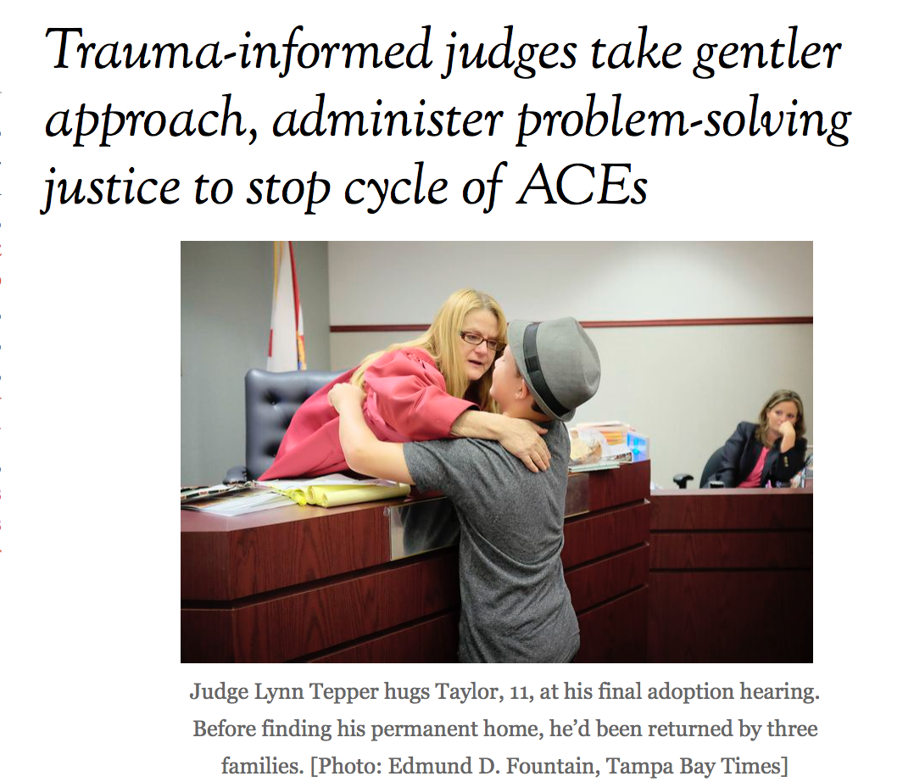
Notes:
There are trauma-informed judges, trauma-informed courts, including Safe Babies Courts that have completely changed how they work with families. Instead of always separating babies who come to the attention of child welfare from their parents, they only remove babies that are in immediate danger, and instead, immediately provide wrap-around services for parents, siblings and extended family, and ongoing support until the family gets back on its feet. Safe Babies Courts offer counseling, medical care, employment services, housing services, transportation, etc. The results are profound -- in Safe Babies Courts that help children and their parents, 99% of the kids suffer no further abuse.

Slide 20
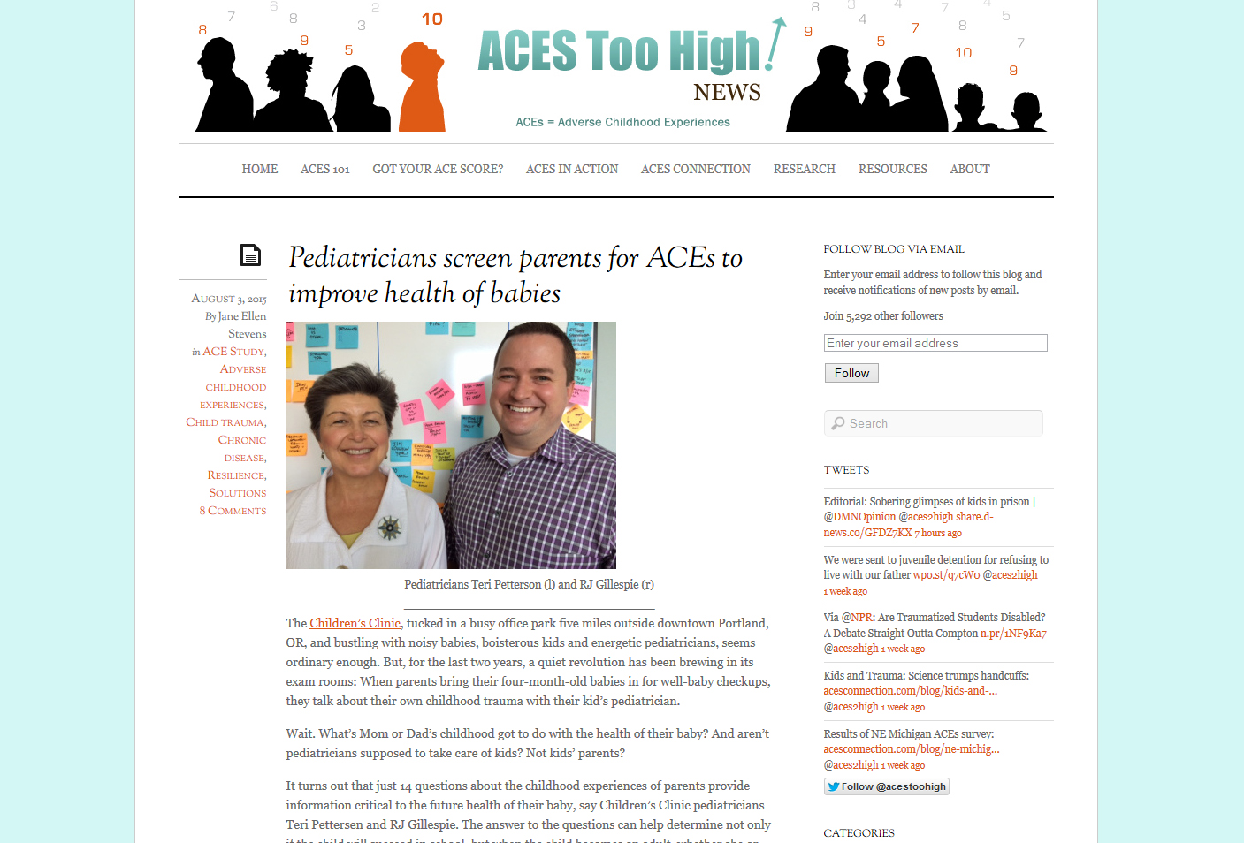
Notes:
Pediatricians in Portland, Oregon, are asking about the ACEs history – and the resilience history – of parents who bring their four-month-old babies in for a well-baby checkup. When parents learn they have a high ACE score, they usually say, “This explains my life.” Or “Why didn’t someone tell me this earlier?” And they want to know what they can do to prevent their children from having a high ACE score.

Slide 21
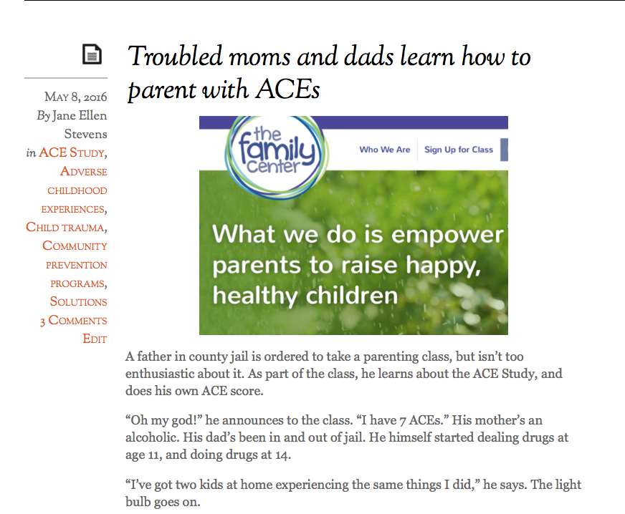
Notes:
The Family Center in Nashville, Tennessee, has educated more than 1,000 parents about ACEs in the parenting classes they provide to parents, most of whom are ordered by a judge to take classes.

Slide 22
Results of ACEs Data Collection at The Family Center
71%
51%
Have 4 or more ACEs
Have 6 or more ACEs
Results in 5 – 10 years earlier death
Compare to 13% from original ACE study
Results in 20 years earlier death
Notes:
As you can see, most have extremely high ACE scores. In addition, another 5% have 10 ACEs.

Slide 23
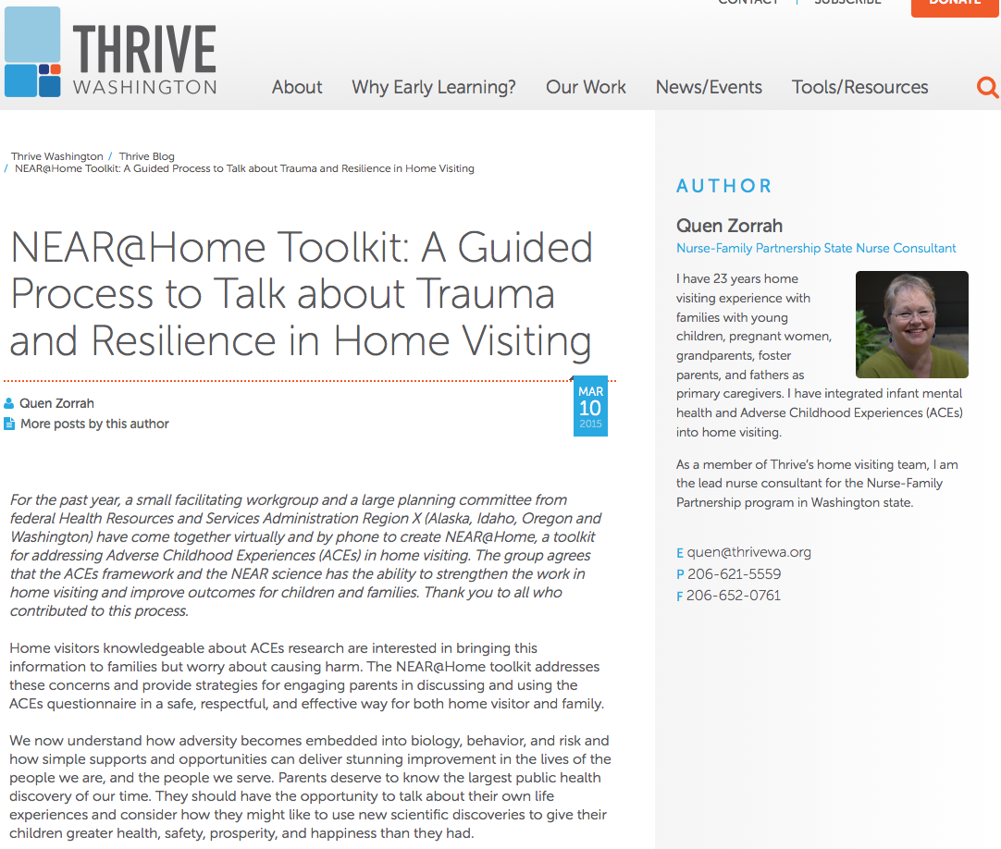
Notes:
The NEAR@Home toolkit was developed in Washington State for home visitors – people who work with new parents eligible for the program because they’re poor. They say that learning about ACEs is a SOCIAL JUSTICE issue. ”PARENTS HAVE THE RIGHT TO KNOW THE MOST POWERFUL DETERMINANT OF THEIR CHILDREN’S FUTURE HEALTH, SAFETY AND PRODUCTIVITY. “
This is not a deficit-based approach, because it does not ask “What’s wrong with you?” It asks, “What happened to you?” And helps reframe people’s history so that they know that they were not born bad, that they are not responsible for the things that happened to them in their childhoods, and that they can have hope to change their lives and their children’s lives.

Slide 24
Educating people about ACEs science….
It engages the people you serve by helping them understand their own lives and behavior.
It empowers people.
It changes their understanding of others’ behavior.
It opens a channel for them to tell you what they need.
Notes:
There are four major lessons learned from the people who’ve been implementing practices based on ACEs science, and educating their clients, patients, students, prisoners about ACEs science.
It engages the people you serve by helping them understand their own lives
It empowers people
It changes their understanding of others’ behavior
It opens a channel for them to tell you what they need
There are trauma-informed programs that don’t include ACEs science. They may make significant progress, but they’re unlikely to be as successful as they hope to be if they don’t educate organization staff members and the people they serve.

Slide 25
All organizations must implement trauma-informed, resilience-building practices for themselves…
…especially the organizations that are caring for people or directing other people-caring organizations.
Notes:
In other words, you’ve got to walk the talk.
You have to look at your own organization through a trauma-informed lens. Because that will lead the organization to looking at the people they serve as their partners in developing solutions, with the understanding that ACEs touch all of us. We all swim in the same ACEs soup; we all breathe the same ACEs air.
Dr. Sandra Bloom looks at this in depth in her trilogy of books: Creating Sanctuary, Destroying Sanctuary and Restoring Sanctuary. She developed the Sanctuary Model, a three-year program that organizations implement to themselves become trauma-informed. Hundreds of organizations in the U.S. are in the process of becoming certified; about 70 have finished.
The state of Wisconsin recently launched a one-year project for seven state agencies to themselves become trauma-informed.

Slide 26
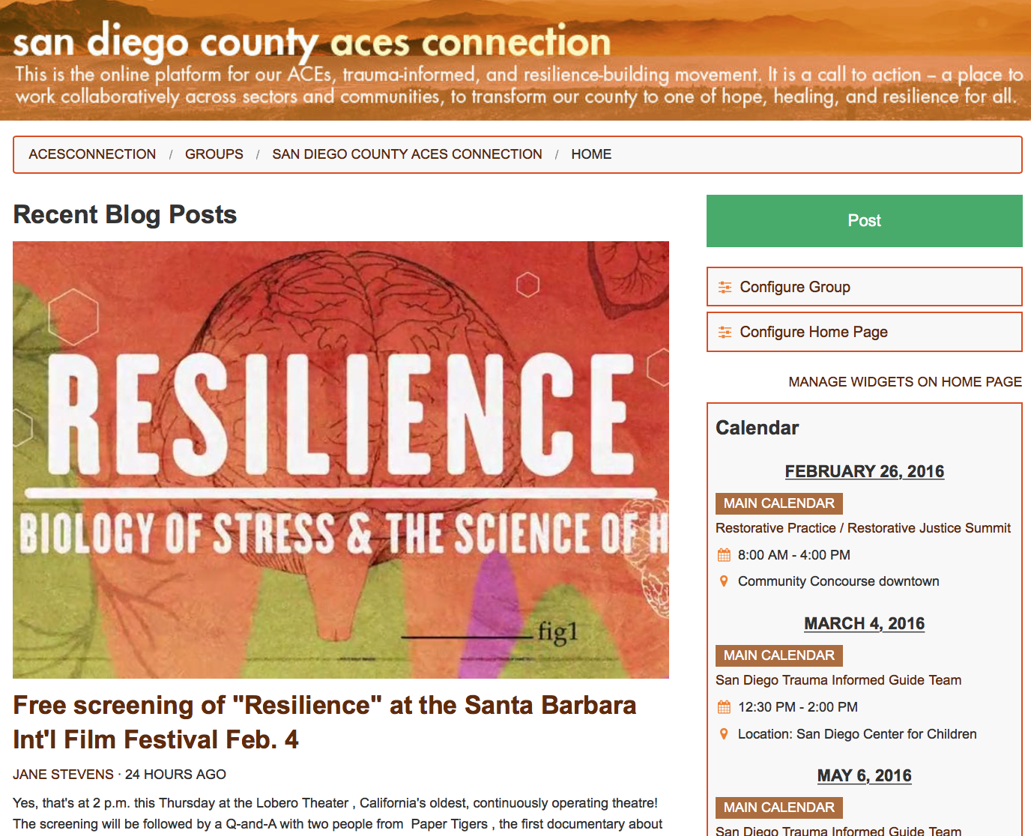
Notes:
This ACEs science touches everybody, every organization, every system, every community.
On ACEs Connection Network, we aim to provide the tools to help neighborhoods, cities, and counties to become self-healing communities.
We tell stories, encourage others to tell their stories, we do our best to shorten the time it takes useful information to find its way from one person who has it to another person who needs it, and we’re using this distributed networking technology to eradicate the isolation caused by geography and siloed sectors.
Today, more than 9,100 people are part of ACEsConnection. They come from healthcare, education, criminal justice, law enforcement, civic, business and faith-based communities. They are parent leaders, social workers, pediatricians, teachers, judges, politicians and community advocates. We send information to them about the latest developments in ACEs and how people and communities are implementing the research. And there’s a lot happening.

Slide 27
Notes:
At the heart of ACEsConnection.com are the groups – and this is how we’re helping people build a self-healing nation.
The groups are mini-versions of ACEsConnection.com. They exist to support the face-to-face activities that take place in a neighborhood, city, county, or region that is working to become a self-healing community – a trauma-informed, resilience-building community.
Each group has its own blog section to which all members of that group can post. Its own calendar, video and chat sections. And a place to archive documents, handouts, mission statement, etc. Everything’s contained in that group. For example, the Sacramento County ACEs Initiative used its group on ACEs Connection to coordinate its first county-wide summit, and it uses it to post agendas, meetings, and progress it’s making to becoming a trauma-informed county.
We have about 80 groups on ACEsConnection now. Most are geographic-based groups. Some are interest-based groups,

Slide 28
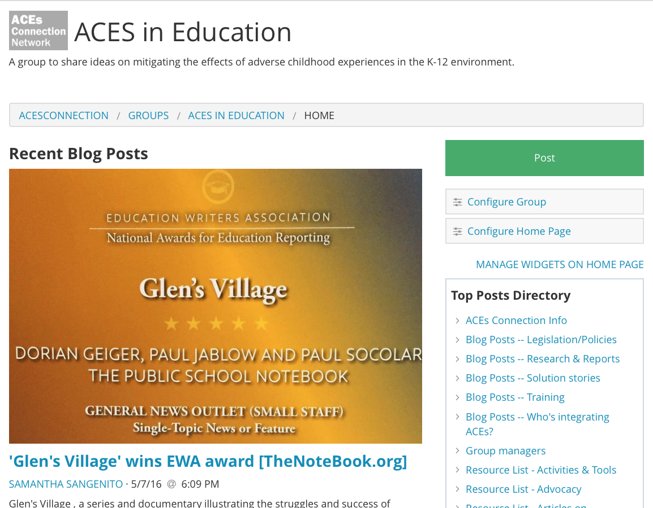
Notes:
such as ACEs in Education…

Slide 29
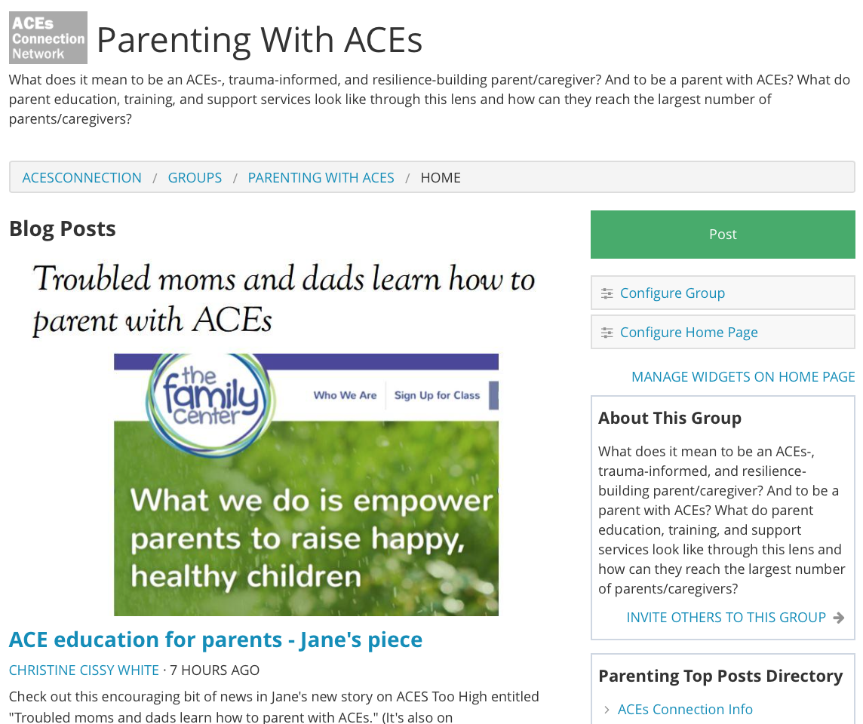
Notes:
…and Parenting with ACEs.

Slide 30
Notes:
ACEsConnection.com works like this – anybody on the network can reach out to anybody else. Any group on the network can reach out to any other group. It shortens the time it takes for good information to get from one person or group to another who needs it.

Slide 31
The goal…..
The entire community…
…integrates trauma-informed/resilience-building practices…
…based on ACEs science.
Notes:
But what is it you do to make your community self-healing?
This is our goal – the entire community integrates trauma-informed/resilience-building practices based on ACEs science.

Slide 32
The process…
Educate….
Engage…..
Activate…….
Celebrate!
Notes:
And its just this simple: Educate, Engage, Activate, Celebrate. Everything you do fits into one of those categories.
So, what do we mean?
Educate – Using the assets mapping tool, identify all of the sectors and the subsectors in your community.

Slide 33
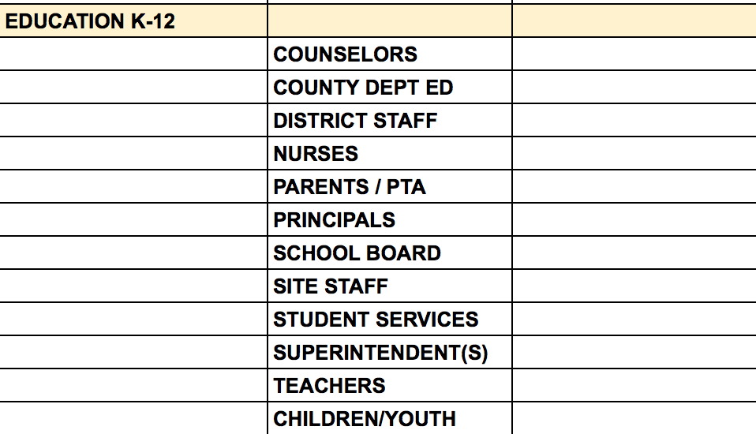
Notes:
For example, the Yolo County ACEs Connection group, identified 12 subsectors in the education sector.

Slide 34
The process…
Educate….
Engage…..
Activate…….
Celebrate!
Notes:
Do the same with health care. Social services. Public health. You don’t have to complete the assets mapping tool before starting to do presentations. It’s just a tool, a guide, a place to collect data.
Equip the people in your group who like to do presentations with 10-, 30-, 45-minute versions of ACEs science and how it’s being used, especially by people in the same profession as those you’re presenting to – we’ll have those in our resource center next month. Insert some compelling local data. Start doing presentations about ACEs science to anyone and everyone. Brainstorm in your group, as we did in Sonoma – who do you know in public health? Who do you know in the public defenders office? Or do you know someone who knows someone in the public defenders office? Email them. Call them up. Ask them: Do you know about ACEs? If yes, come join our community group. If no, this is something that you might want to know about. Can I set up a time to chat with you about it? Most organizations have brownbag lunches or some kind of continuing education or outside presentations that you can volunteer for.
Engage – Do the presentation. In almost every presentation, one or more light bulbs go off for people. And they want to learn more. Who else is doing this in my profession? Who else is doing this in my community? They want to participate. Bring them into the group.
Activate – More than likely, you’ll have to do the same presentation two or more times to the same group. There’s a reason for that. The first time people learn about ACEs, they look at it from the point of view of their personal lives. Often you can actually see people reframing their entire lives. That can take up all the space in the brain for a while, before someone says oh, if this explains my life, what would this do for my patients, clients, students, prisoners? And perhaps it requires another time or two before someone wonders, How would this knowledge change my organization?
This transition takes patience on our parts. Some people are ready; some aren’t. We walk the trauma-informed talk. We nudge gently and return another day if it’s overwhelming. But at some time, someone in an organization will say: We get it. What do we do now? How can we become trauma-informed? And then you bring in a person from the same profession or type of organization who’s integrated trauma-informed and resilience-building practices to take them across the threshold into taking the necessary steps to become a self-healing organization. You provide them with training resources, and connect them with similar organizations that are in various stages of implementing trauma-informed and resilience-building practices.
Cele- datatellyourstory -brate – Through all this, you’ll be gathering data. You can use the assets mapping tool to record how many presentations you’ve done and to whom, and where they are on the trauma-informed trajectory. Right now, the assets mapping tool isn’t very friendly, but we’re working on that to make it more useful. Eventually, it will show you where and how you’re making progress, and areas where you might want to put more resources. Over the next couple of years, we’re also going to providing you with data that you can use for this entire process.
The other part of celebrating is telling the story. That’s the blogging part. There’s nothing too small. Have you started each of your meetings with two minutes of mindfulness? Post a short blog about it! Did one of your group do a presentation to the Rotary Club? Do a blog post with a photo and a couple of sentences. Did a school principal tell you that your presentation convinced her to educate all teachers and staff about ACEs science? Do a blog post about it. Did learning about ACEs change someone’s life? Blog about it. Or better yet, ask them to. All those things inspire somebody to follow your lead, either by starting meetings with mindfulness, or by posting about what they’re doing.
There are other parts to your group that you can use, too – you can do chats about timely topics (did Prince’s ACEs lead to his early death?), and surveys. We’ll be doing more of those on ACEsConnection so that you can see how they work, and we’ll be glad to work with you to set some up in your communities.
This process – educate, engage, activate, celebrate – that’s all you have to do right now, and for the next two or three years, to get your community on the road to becoming trauma-informed. And, as you start figuring it out, you can start asking the state, your professional organizations, your educational institutions and your local politicians for the support you need to be successful, including policy change, recognition, endorsement, or funding.

Slide 35
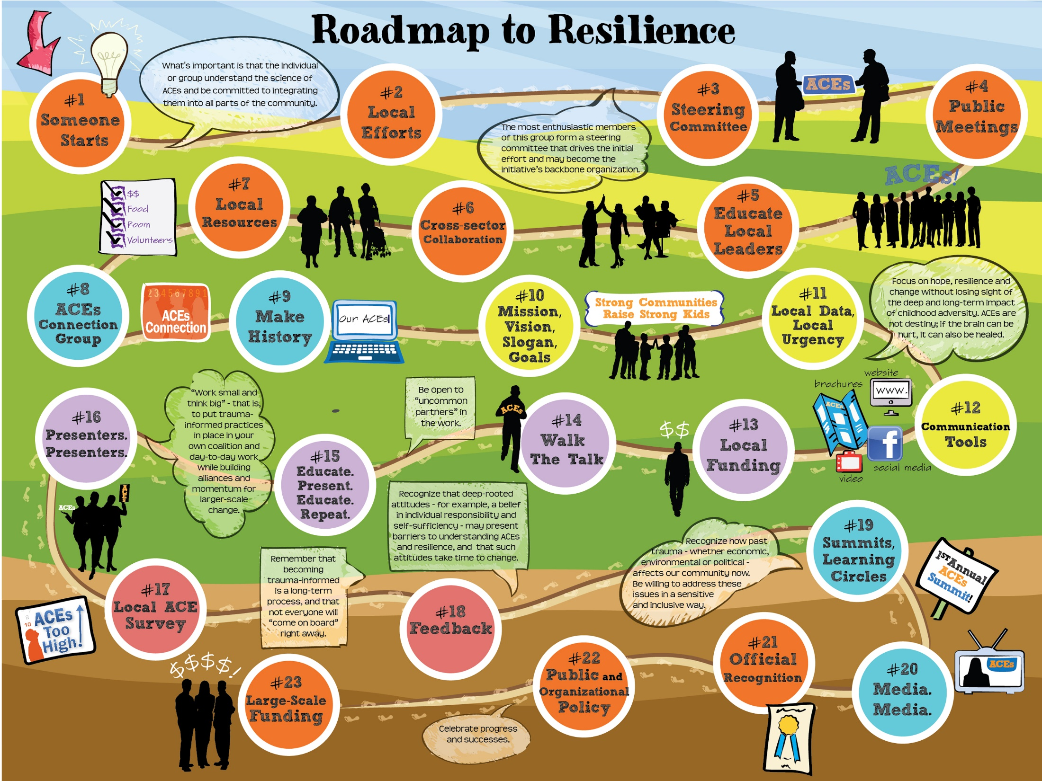
Notes:
Most of the details you need are in the Roadmap to Resilience toolkit. This is version 1.0. We’ll be doing 2.0 soon -- organizing this around the educate – engage – active – celebrate categories to make it more manageable.
But you can be pretty sure that anything you need for your group is here. Handouts, mission statements, tag lines, elevator speeches, assets mapping tool, logic model, examples of how other groups’ organizational structure, even sample agendas. You can take these, and tweak them to fit your own circumstances. If the changes are significant enough, we ask that you post your version, because it might be useful to another community. And if you come up with something that isn’t on here and are willing to share it, we want to know so that we can post it here.

Slide 36
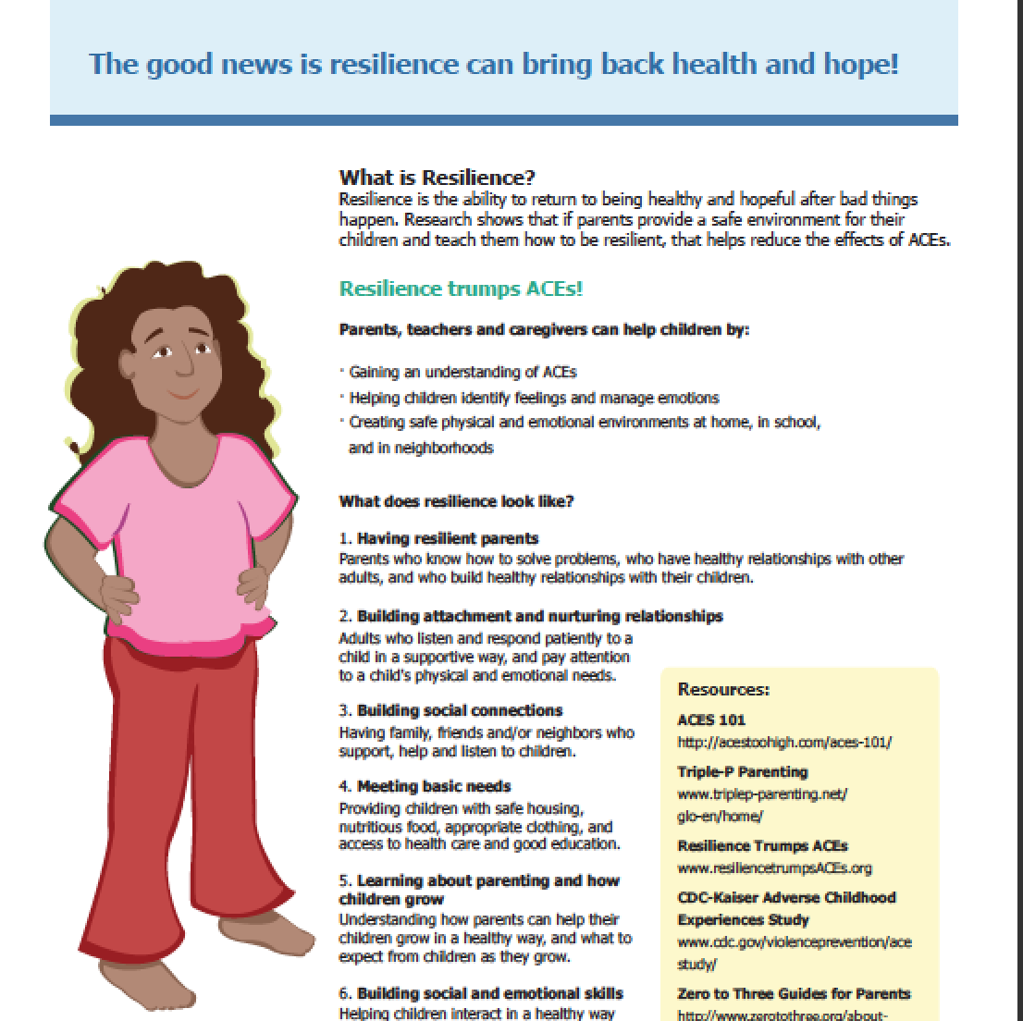
Notes:
For example, parent handouts about ACEs developed by public health nurses in Spokane, WA, that we posted to the network were downloaded by thousands of people within a matter of a few weeks and are being used in hundreds of communities across the U.S.

Slide 37
Resources
ACEs 101 – FAQs about adverse childhood experiences research with links to reports, stories and videos.
Got Your ACE Score? – Do your ACE score and your resilience score, and find out more about the consequences of each.
ACEsTooHigh.com – A news site for the general public. It covers research about ACEs and how people, organizations, agencies and communities are implementing trauma-informed, resilience-building practices based on ACEs research.
ACEsConnection.com – A social network for people who are implementing – or thinking about implementing – trauma-informed and resilience-building practices based on ACEs research.
The CDC-Kaiser Permanente ACE Study – The official ACE Study site, provided by the CDC.
The Center on the Developing Child at Harvard University – Here, take a deep dive into a site rich with reports, tools and videos about the neurobiology of toxic stress and resilience.
SAMHSA’s Concept of Trauma and Guidance for a Trauma-Informed Approach -- Introduces a concept of trauma and offers a framework for how an organization, system, or service sector can become trauma-informed. Includes a definition of trauma (the three "E's"), a definition of a trauma-informed approach (the four "R's"), 6 key principles, and 10 implementation domains.
Notes:
ACEs 101 – FAQs about adverse childhood experiences research with links to reports, stories and videos.
Got Your ACE Score? – Do your ACE score and your resilience score, and find out more about the consequences of each.
ACEsTooHigh.com – A news site for the general public. It covers research about ACEs and how people, organizations, agencies and communities are implementing trauma-informed, resilience-building practices based on ACEs research.
ACEsConnection.com – A social network for people who are implementing – or thinking about implementing – trauma-informed and resilience-building practices based on ACEs research.
The CDC-Kaiser Permanente ACE Study – The official ACE Study site, provided by the CDC.
The Center on the Developing Child at Harvard University – Here, take a deep dive into a site rich with reports, tools and videos about the neurobiology of toxic stress and resilience.
SAMHSA’s Concept of Trauma and Guidance for a Trauma-Informed Approach -- Introduces a concept of trauma and offers a framework for how an organization, system, or service sector can become trauma-informed. Includes a definition of trauma (the three "E's"), a definition of a trauma-informed approach (the four "R's"), 6 key principles, and 10 implementation domains.

