Slide 1
SAN DIEGO REGIONAL RESTORATIVE JUSTICE and RESTORATIVE PRACTICE SUMMIT The Circle Process
Dr. Jack B. Hamlin, Associate Professor Dr. Daniel Stacey
Department of Professional Studies CEO, Circles 4 Change
School of Professional Studies
National University
jhamlin@nu.edu

Slide 2
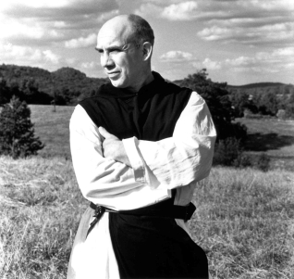
MY LORD GOD, I have no idea where I am going. I do not see the road ahead of me. I cannot know for certain where it will end. Nor do I really know myself, and the fact that I think that I am following your will does not mean that I am actually doing so. But I believe that the desire to please you does in fact please you. And I hope I have that desire in all that I am doing. I hope that I will never do anything apart from that desire. And I know that if I do this you will lead me by the right road though I may know nothing about it. Therefore will I trust you always though I may seem to be lost and in the shadow of death. I will not fear, for you are ever with me, and you will never leave me to face my perils alone.
Thomas Merton

Slide 3
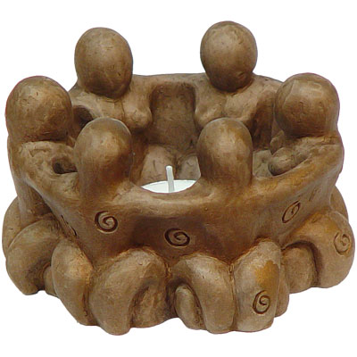
We shall not cease from exploration and the end of all our exploring will be to arrive where we started and know the place for the first time. - T.S. Eliot, Four Quartets
Notes:
Special and powerful tool – set the information you will learn in context of the work you do, tool can be used any where!
Restorative Lens!

Slide 4
Peacemaking Circle Premises
Build on the premise, humans want to be connected
Operate from the premise, everyone shares core values
Assume the premise, Connection and Acting from core values are difficult during conflict
Presume the premise, a Safe Place allows a re-discovery of core values and the positive desire to be re-connected

Slide 5
Universal Core Values
Circle Values
Love
Respect
Honesty
Humility
Sharing
Courage
Inclusivity
Empathy
Trust
Forgiveness

Slide 6
Circle Framework & Elements
Framework
Elements
Opening- Set intentions
Center piece
Talking Piece
Guidelines
Guiding Questions
Closing
Sitting in Circle
Circle keeping
Connectedness
Storytelling
Holding Paradox
Collective wisdom
Transparency
Reading the field
Notes:
Premise: humans want to be connected, Connection is more difficult during conflict, Safe Place allows a re-discovery of core values and the positive desire to be re-connected
The Talking Piece, Equality: everyone has a voice- different ways of sharing
Circle keeping- circle takes care of self

Slide 7
Facilitators Checklist
Have everyone introduce themselves.
Read the rules once more, and ask for questions.
Have everyone (including you) sign the rules.
Explain when the talking piece is passed to the participant, he or she has three options:
Speak about the issues presented in the question;
Sit quietly and hold the talking piece to reflect upon what has been said; or
Simply pass the piece to the next participant.
Explain each participant may share as much or as little as he or she desires, but in deference to the other participants, please keep sharing to three minutes.
Take a moment for everyone to quietly focus on the task at hand.
Pose the first question…and give your input, as an example.
After the talking piece has gone around one time, ask if anyone would like to comment on what has been said. If so, pass the talking piece to that participant.
Take a moment to very briefly summarize points made, then pose second question following the same procedure.
At conclusion of all the questions, another moment of silent reflection.

Slide 8
Ground Rules
The Circle Facilitator oversees the Circle
Listen with respect;
Each person gets a chance to talk, not talk or reflect;
The Talking Piece will be passed around the circle and everyone will get a turn;
Only the person holding the piece can speak;
You do not have to say anything when it is your turn. If for some reason you do not feel comfortable or able to speak, simply pass the talking piece to the next person.
One person talks at a time. Don’t cut people off;
Speak for yourself and not as the representative of any group;
It’s OK to disagree, but no name-calling or attacking.

Slide 9
THE FOUR INTENTIONS
Within the circle there are four intentions that hold the space together, which when observed, create safety and allow truth and trust to build in this very simple and powerful practice.
Speak from the heart
Listen from the heart
Speak spontaneously
Speak leanly
~~~
Confidentiality
Speak what will serve yourself, the circle, the highest good

Slide 10
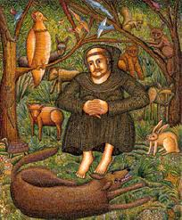
Lord, make me an instrument of your peace,
Where there is hatred, let me sow love;
Where there is injury, pardon;
Where there is doubt, faith;
Where there is despair, hope;
Where there is darkness, light;
Where there is sadness, joy.
O Divine Master, grant that I may not so much seek to be consoled, as to console;
to be understood, as to understand;
to be loved, as to love.
For it is in giving that we receive.
It is in pardoning that we are pardoned, and it is in dying that we are born to Eternal Life.
Amen.
St Francis of Assisi

