Slide 1
Influencing Systems Change
February 26, 2016
Dr. Dennis Doyle, Executive Director, CoTA Project; State Performance Plan Technical Assistance Facilitator
Dr. Geoff Twitchell, Director of Treatment and Clinical Services,
County of San Diego Probation Department
Vanessa Peters, Children and Youth in Transition Department –
Program Manager, San Diego Unified School District
Dr. Joe Fulcher, Assistant Superintendent of Equity, Culture, and Support Services, Sweetwater Union High School District
Notes:
+ Dennis name/center influencing systems change

Slide 2
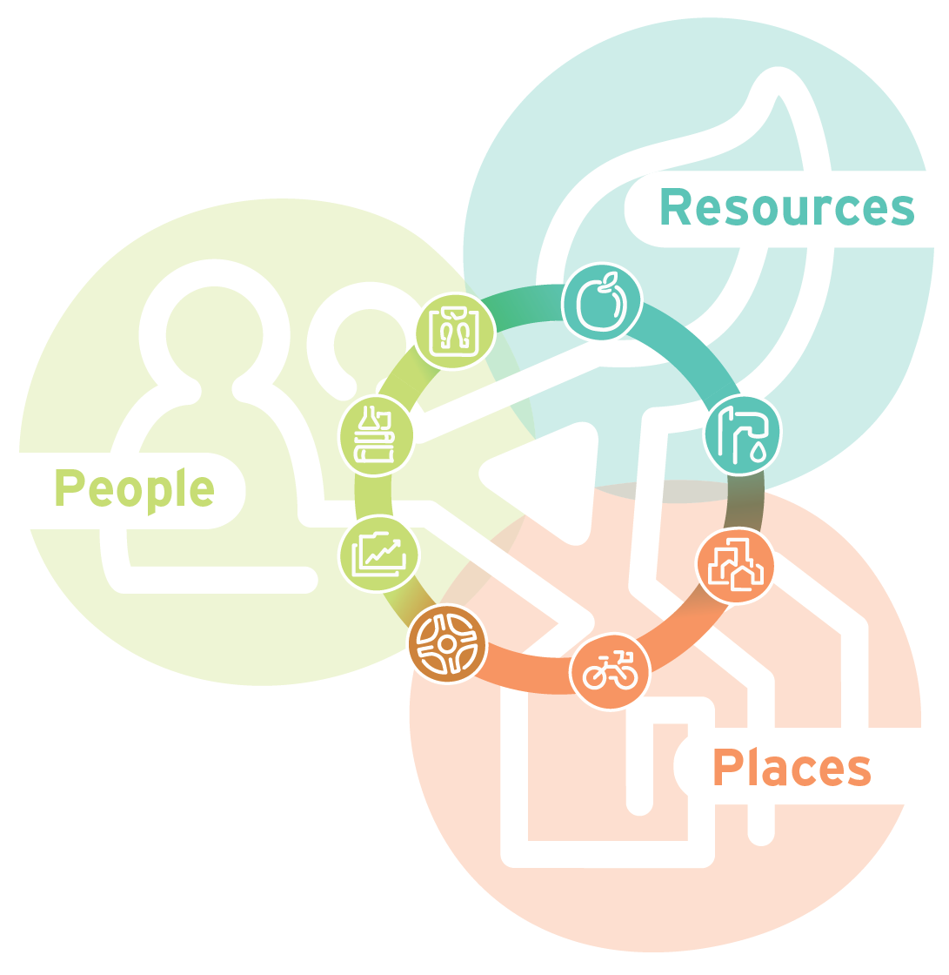
What is a system?
A system is a set of interrelated elements that make a unified whole. Individual things-like plants, people, schools, watersheds, or economies-are themselves systems and at the same time cannot be fully understood apart from the larger systems in which they exist.
Notes:
http://heartland2050.org/wp-content/uploads/2012/12/infographic_system_themes-v2.png

Slide 3



Systemic Change

Slide 4
Leadership Team Composition
Stakeholder: Governance, Senior Management Visibility, Supervision, Line, Support, Labor, Clients
Change Agents/Influencers
Purposefully selected small groups
Representation
Regional, racial/ethnic, gender

Slide 5
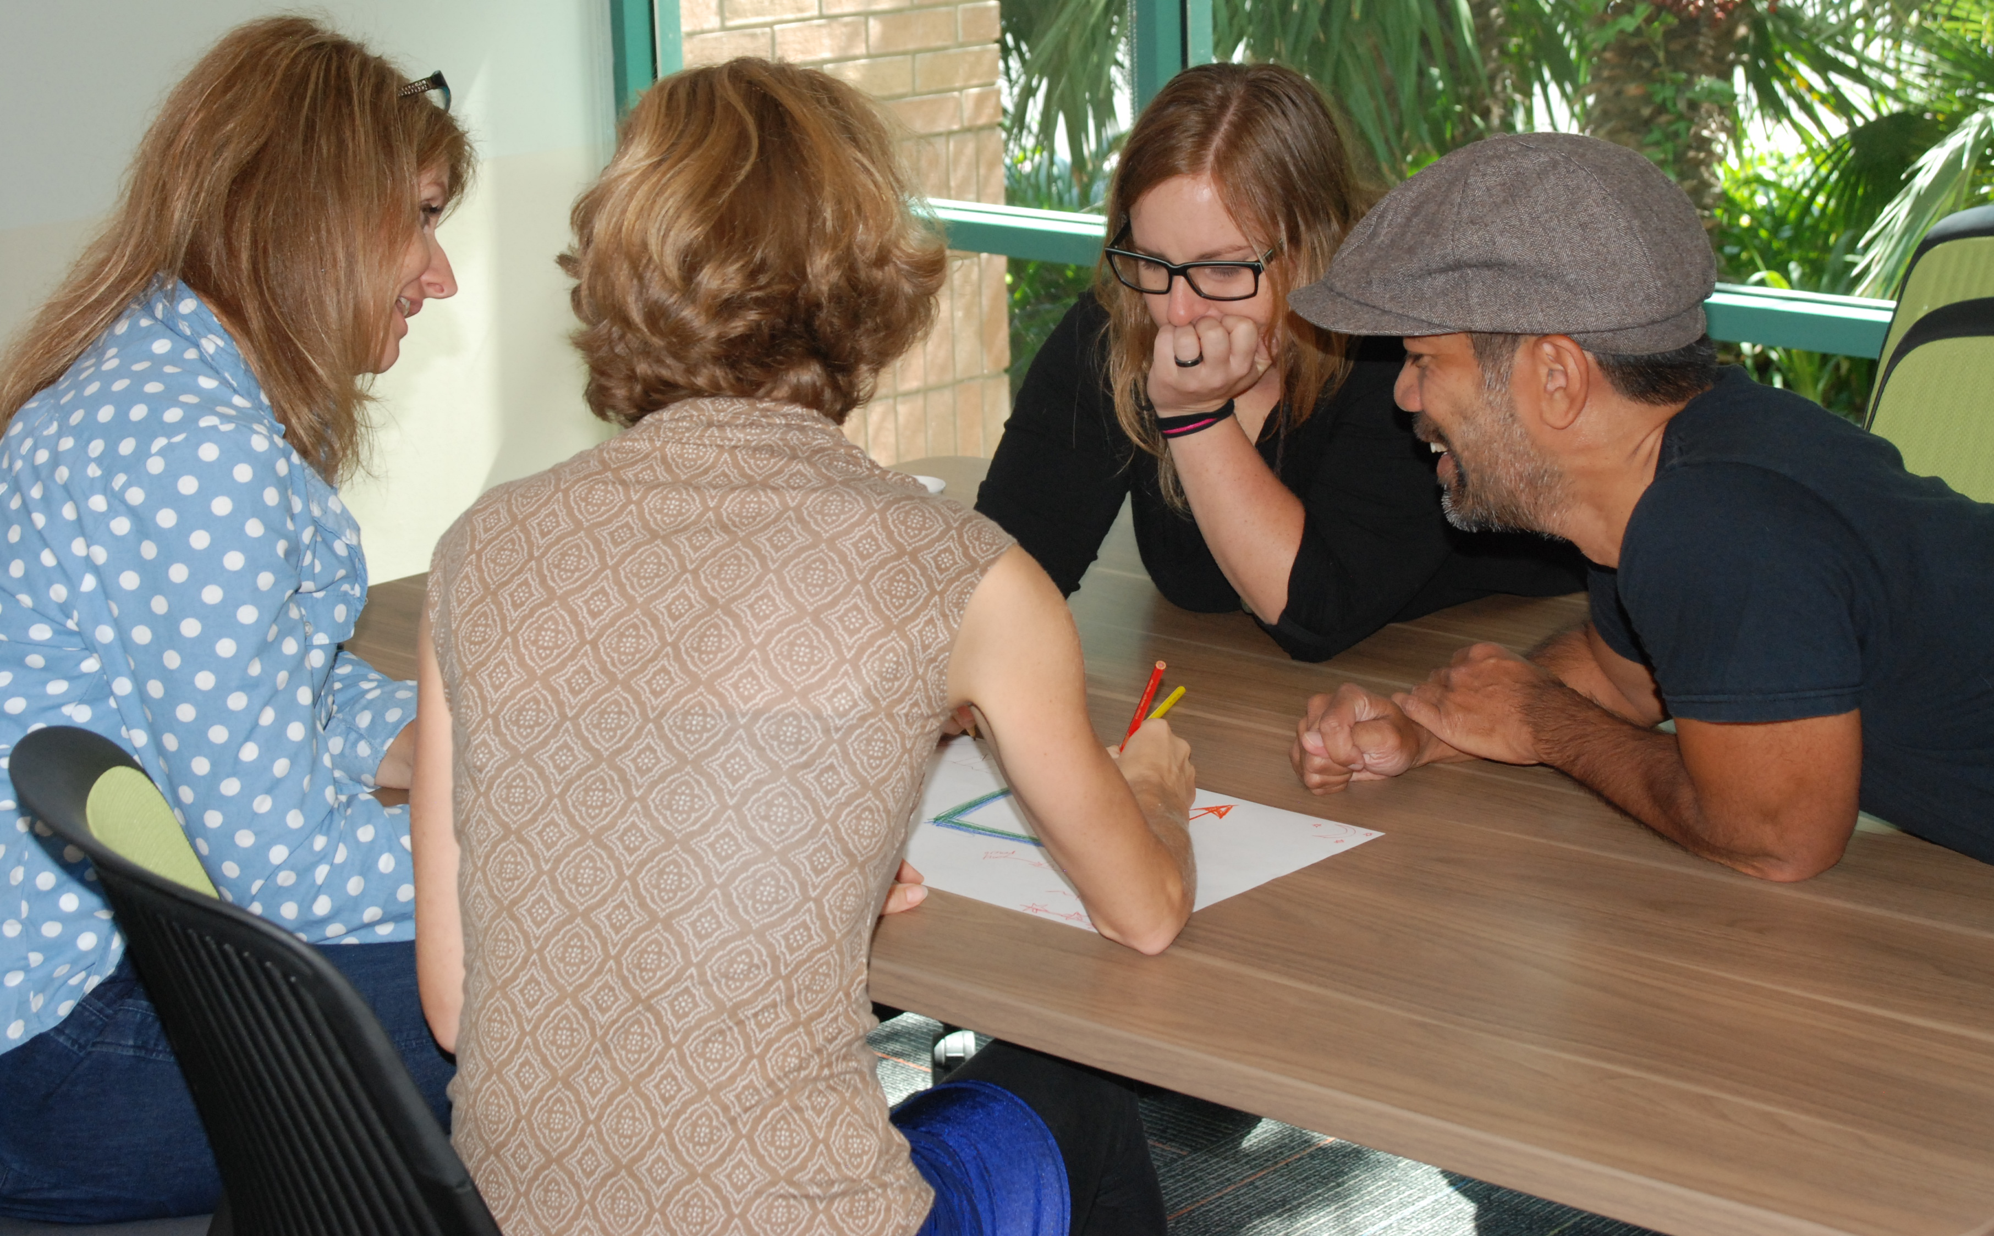
Awareness
How can data define the problem?
Root cause analysis? Surveys?
Articles? Digital videos? Site visits?

Slide 6
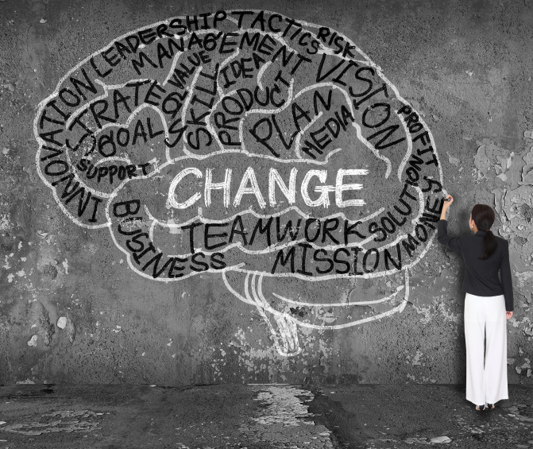
Awareness
Need for change?
Disequilibrium?
Disruption?

Slide 7
Table Top Questions - A
Where is your organization in the awareness stage?

Slide 8
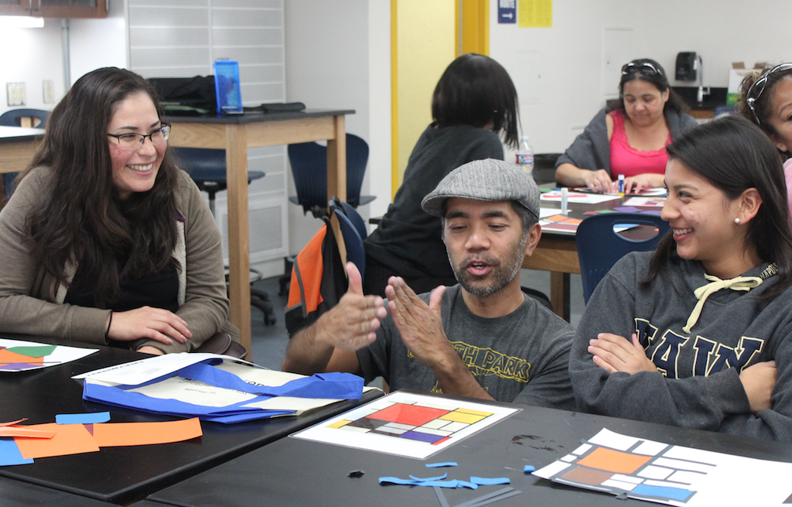
Buy-In
Small group inquiry? Processing? Sharing? Gallery walks?
Dialogue? Engagement? Agency? Personal investment?
Brainstorming? Vision? Backward design? Staging?
Notes:
http://www.wespire.com/employee-engagement-triggers-an-instrument-for-change/

Slide 9
Table Top Questions - B
What have you used or will you use for buy-in?

Slide 10
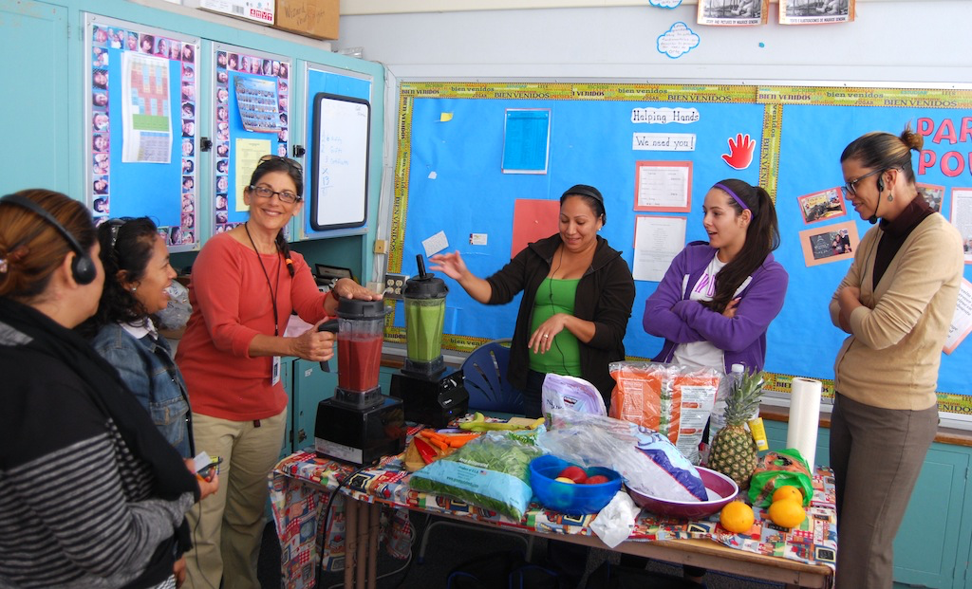
Commitment
Trainer of trainers? Capacity building?
Gradual release of responsibility?
Implementation? Reflection? Formative?

Slide 11

Commitment
Over time – not over night?
Coaching? Vulnerability? Presentation?
Shift of organizational culture? Data?

Slide 12
Table Top Questions - C
What mechanisms will sustain these practices?

Slide 13
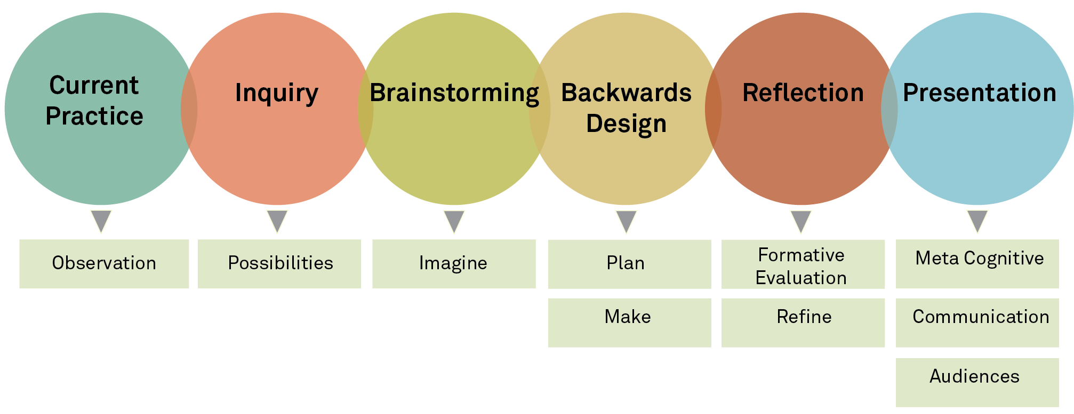
CoTA’s Mechanisms of Change

Slide 14
Table Top Questions – Next Steps
What are the next steps you will take to implement restorative justice and restorative practices in your organization?

Slide 15
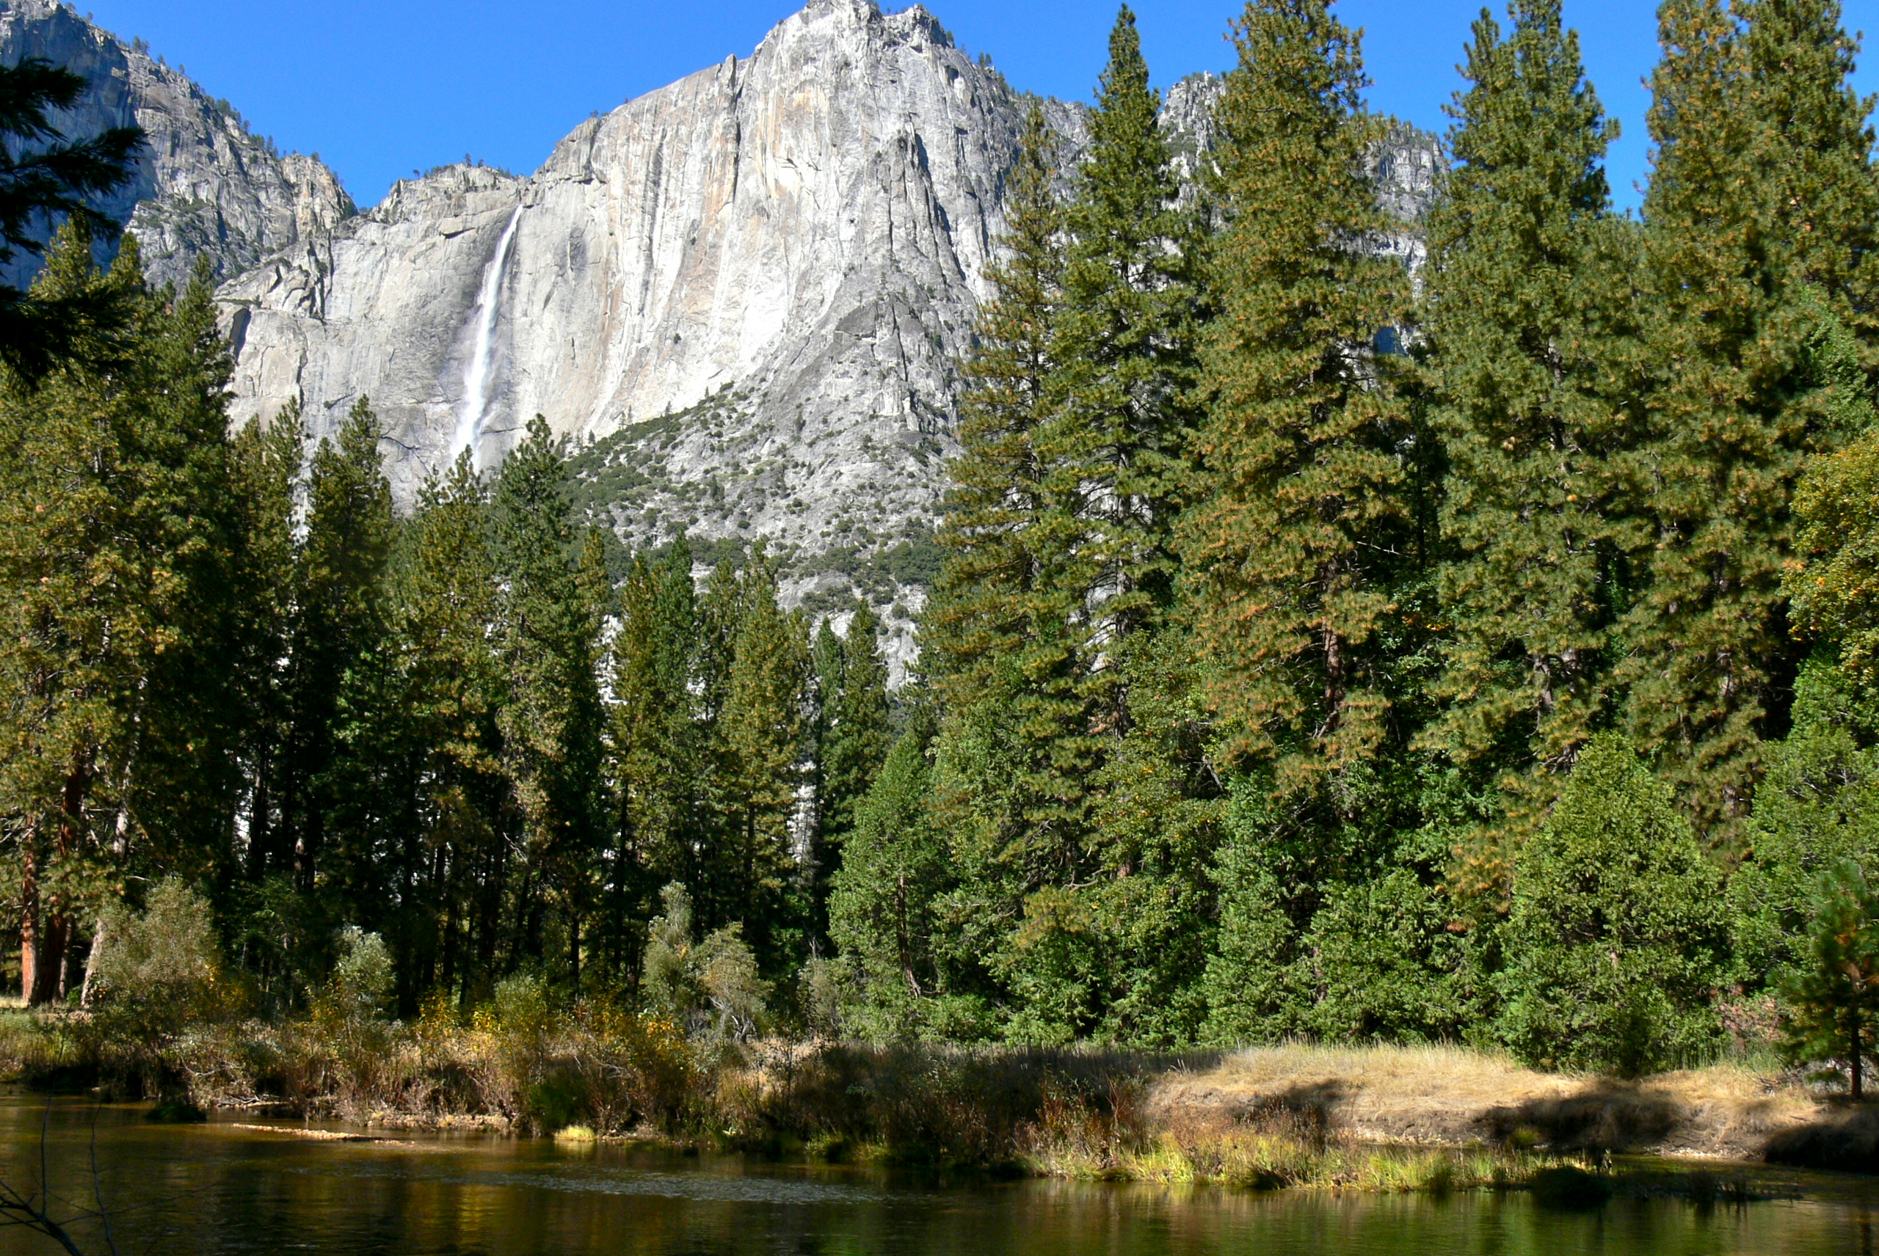
“When we try to pick out anything by itself, we find it hitched to everything else in the universe.”
- John Muir
Notes:
http://heartland2050.org/wp-content/uploads/2012/12/infographic_system_themes-v2.png
Bg for this slide!

Slide 16

Connect With Us!
cotaprogram

