Slide 1
RJ 101 An Introduction to Restorative Justice
Restorative Justice and Restorative Practices Summit
February 26, 2016
San Diego, CA
Mary Acosta and Deacon Jim Walsh

Slide 2
What is Restorative Justice anyway?
Restorative justice is…
An effective philosophy and a practical way to achieve justice
A transformational approach to attain full resolution of harms
An encouraging framework for the future of criminal justice
Not soft on crime

Slide 3
Two Different Views…
Retributive Justice
Restorative Justice
Crime is a violation of the law and the state.
Violations create guilt.
Justice requires the state to determine blame (guilt) and impose punishment.
Central focus: offenders get what they deserve.
Crime is a violation of people and relationships.
Violations create obligations.
Justice involves victims, offenders, and community members with the responsibility to put things right.
Central focus: victim needs are met and offender is accountable for repairing harms.
Notes:
High Crime Rates
Racial Disparity
High Cost of Incarceration
School to Prison Pipeline
Little participation of Victims

Slide 4
Definition of Restorative Justice
“Restorative Justice is a process to involve, to the extent
possible, those who have a stake in a specific offense and
to collectively identify and address harms, needs,
and obligations, in order to heal and
put things as right as possible”
- Howard Zehr
Notes:
Who are these “stakeholders”?

Slide 5
Four Key Aspects of the RJ Process
Encounter: creating opportunities for victims, offenders (wrongdoers), their families, and community members who want to meet to discuss the crime (harms, incident) and its impact on them.
Amends: expecting the wrongdoers to take steps to repair the harms they have caused.
Reintegration: seeking to restore victims and offenders to wholeness, to become contributing members of their communities.
Inclusion: providing opportunities for parties with a stake in a specific crime, harm or incident to participate in it’s resolution. (adapted from RJ Online)
Restorative Practices International, rpiassn.org

Slide 7
Restorative Justice Practices History
Origin: Indigenous, community based cultures
Rituals and cultural context are different but foundation of restoration is similar:
Native American traditions, Canada (First Nations), New Zealand (Maori family group conferencing), Uganda (Mato Oput), Rwanda (Gacaca courts), and so many others
1970s in the U.S.
Early victim/offender mediation programs in Mennonite communities (Indiana, USA)
First restorative programs in schools
Notes:
Justine
Small communities, can’t throw people away, must learn from mistakes and have support of community
Simplex vs. multiplex relationships (we live in a simplex society- you are on your own and don’t need to rely on anyone else BUT we still have multiplex relationships- in our work families and communities)
Draw 2 circles on the board- simplex has one line between them and multiplex has many lines between them.

Slide 8
Goals of Restorative Justice
Restorative Justice programs aim to :
Put key decisions into the hands of those most affected by the harms
Make justice healing and transformative for all stakeholders
Reduce the likelihood of future offenses
Achieving these goals requires that:
Victims are involved in the process and are satisfied as a result
Offenders understand how their actions have affected lives and take responsibility for those actions
Outcomes help to repair the harms done and address the reasons for the offense
Susan Sharpe, Restorative Justice: A Vision for Healing and Change

Slide 9
Spiritual Roots of Restorative Justice
Shared values among major religions and spiritual traditions
Restoration
Reconciliation
Healing
Forgiveness
Mercy
Substantive, transformative justice
Hope

Slide 10
Some Models of Restorative Justice Practices
Victim–offender mediation/dialogue/reconciliation
Community Conferencing
Circles
Restorative conferences, classroom conferencing, community-building circles (in schools)
Restorative Practices International, rpiassn.org

Slide 11
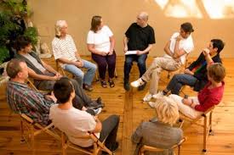
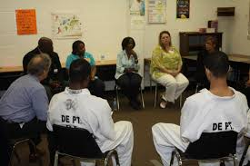
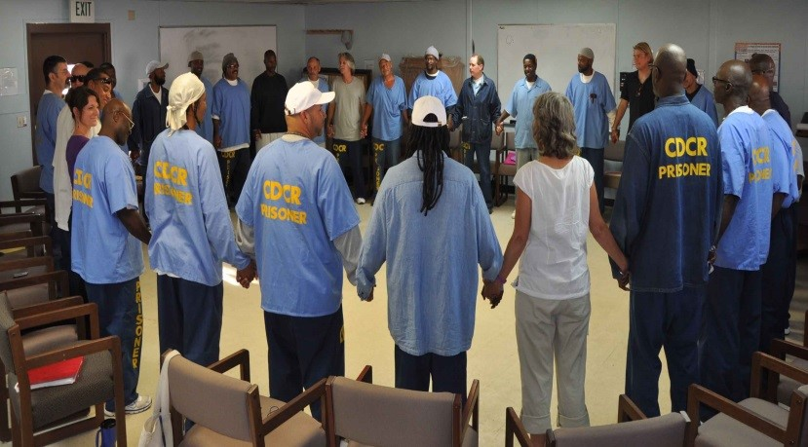

Slide 12
Benefits of participation in an RJ process
Mutual understanding of the causation and ripple effect of harms
Full, real resolution of harms
Increased victim satisfaction with the justice system
Reduced victim’s post-traumatic stress symptoms
Reduced repeat crime
Increased rate of completion of restitution/restoration agreements
Increased community safety and cohesiveness
Cost-benefit to society, especially when used as a diversion

Slide 13
Restorative Practices
Restorative practices is an emerging new field of practice and study that has its roots in restorative justice.
The fundamental premise is that people are happier, more cooperative and productive, and more likely to make positive changes when those in positions of authority do things with them, rather than to them or for them.
The focus of Restorative Practices is
To develop community, build relationships and connections
Manage conflict and tensions by repairing harm and rebuilding relationships
Adapted from International Institute for Restorative Practices, iirp.edu
Notes:
RP ties together theory, research and practice in fields such as education, counseling, criminal justice, social work and organizational management
The criminal justice field uses the phrase "restorative justice"; social workers say "empowerment"; educators prefer "positive discipline" or "the responsive classroom"; while leadership consultants choose "horizontal management". ^{(Wikipedia)}

Slide 14
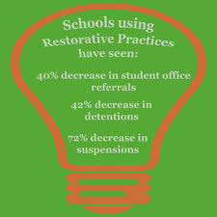
In schools, the use of restorative practices has been shown to reliably reduce misbehavior, bullying, violence and crime among students and improve the overall climate for learning.

Slide 15
Questions?
Notes:
Justine

