Slide 1
Otay Mesa Enhanced Infrastructure Financing District
Fiscal Year 2023 Otay Mesa EIFD Annual Report and Annual Review of the Infrastructure Financing Plan (IFP) February 22, 2024 Public Financing Authority Meeting
Item #3

Slide 2
Otay Mesa Enhanced Infrastructure Financing District
AB 116 Amendment to EIFD Legislation
Fiscal Year Annual Report
Adopt annual report on or before June 30th after holding a public hearing
Draft report shall be made available to the public 30 days before hearing
Written notice shall be mailed to every landowner and occupant in the District

Slide 3
Otay Mesa Enhanced Infrastructure Financing District
1. Description of the projects undertaken in the Fiscal Year
La Media Road Improvements (S-15018)
Estimated total project cost $60.6 million
$1.65 million in District revenues was budgeted in FY 2023
Project will widen La Media Road between SR-905 and Siempre Viva Road, and will improve drainage at the intersection of La Media Road and Airway Road

Slide 4
Otay Mesa Enhanced Infrastructure Financing District
1. Description of the projects undertaken in the Fiscal Year cont.
Hidden Trails Neighborhood Park (S-00995)
Estimated total project cost $10.96 million
$1.15 million in District revenues was budgeted in FY 2023
Project will provide a 4.0 acre Neighborhood Park with new restroom building, shade structures, exercise equipment, children's play area, half-court basketball, security lighting, site furnishings, and other park amenities

Slide 5
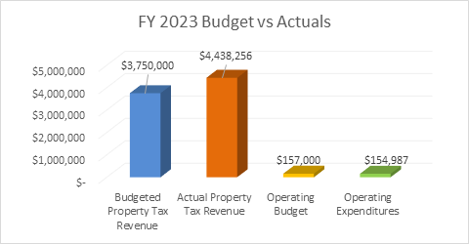
Otay Mesa Enhanced Infrastructure Financing District
2. Chart comparing actual revenues and expenditures

Slide 6
Otay Mesa Enhanced Infrastructure Financing District
3. Amount of Tax Increment (TI) revenues received
$4,438,256 of TI revenues were received
4. Assessment of the status of the projects in the District
La Media Road Improvements (S-15018)
In FY 2023 final design was completed and, project construction phase has begun and is currently in progress
In FY 2023, staff obtained all required resource agency permits, Caltrans encroachment permit, and completed the construction contract bid and award phases
Hidden Trails Neighborhood Park (S-00995)
Design began in FY 2022 and will be completed in FY24
Construction anticipate to begin in FY 2025
5. Amount of revenues expended to assist private businesses
No FY 2023 revenues were expended to assist private businesses

Slide 7
Otay Mesa Enhanced Infrastructure Financing District
Annual Review of District’s IFP
AB116 Requirements
Pursuant to Government Code section 53398.66(j)(1), the Authority must review the District’s IFP, at least annually, and make any amendments that are necessary and appropriate
Staff has no recommended amendments to the IFP for the Authority’s consideration

Slide 8
Otay Mesa Enhanced Infrastructure Financing District
Requested Action
Approve, via resolution, the District’s FY 2023 Annual Report and confirm the annual review of the District's IFP

