Slide 1


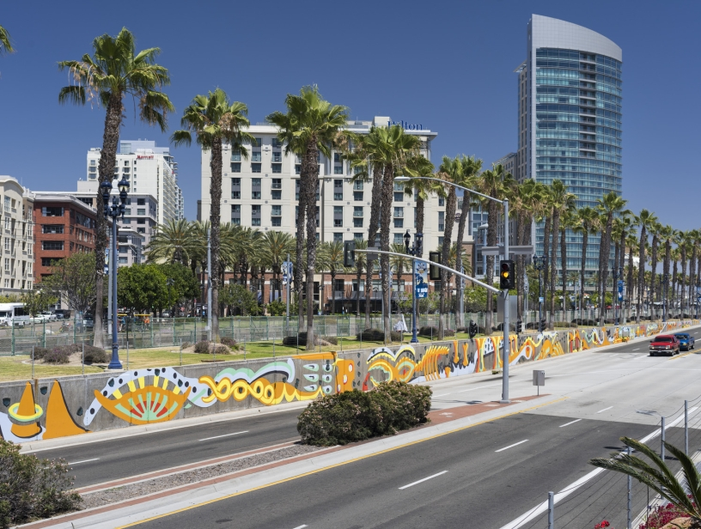

Fiscal Year 2025
Arts, Culture, and Community Festivals (ACCF)
City Council Allocations
Notes:
Hi everyone! Thank you so much for joining us as we provide an overview of the upcoming grant cycle for the ACCF City Council funding program, which we are excited to announce has been funded in the City’s Fiscal Year 2025 budget. My name is Malachi Bielecki and I’m a Grants Coordinator with Council Administration here at the City of San Diego. Our team manages the grant process on behalf of the City Council Offices for the CPPS and ACCF programs, and we’ll be your primary points of contact for any related questions.

Slide 2

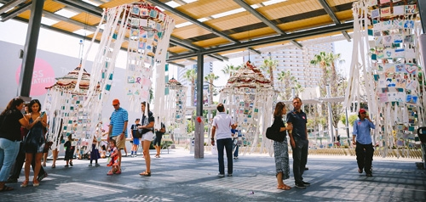
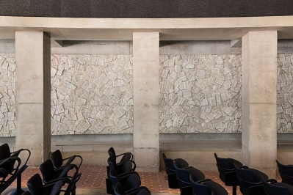
Arts, Culture and Community Festivals (ACCF)
City Council Allocations
Background
ACCF City Council allocations are awarded to nonprofit organizations and public agencies for the purpose of promoting local arts and culture.
Organizations may produce programs, projects or events that:
  Provide access to excellence in culture and the arts for residents of, and visitors to San Diego.
  Enrich the lives of the people of San Diego and build healthy, vital neighborhoods.
Notes:
Arts, Culture, and Community Festivals, or ACCF, funding is awarded to nonprofit organizations and public agencies for programs, projects, or events that promote local arts and culture. Organizations receive ACCF funding for programming that enhances the cultural and artistic experience of the City for both residents and visitors alike.

Slide 3
Arts, Culture and Community Festivals (ACCF)
City Council Allocations
Background
The allocations are administered jointly by Council Administration and Commission for Arts and Culture.
ACCF funding is awarded at the discretion of each Council Office.
All recipients of ACCF allocations:
  Submit an application.
  Enter into an agreement with the City.
Notes:
The program’s award allocations are administered jointly by Council Administration and the Commission for Arts and Culture. Funding is awarded strictly at the discretion of each Councilmember and their office. All recipients will have submitted an application for review and enter into an agreement with the City.

Slide 4
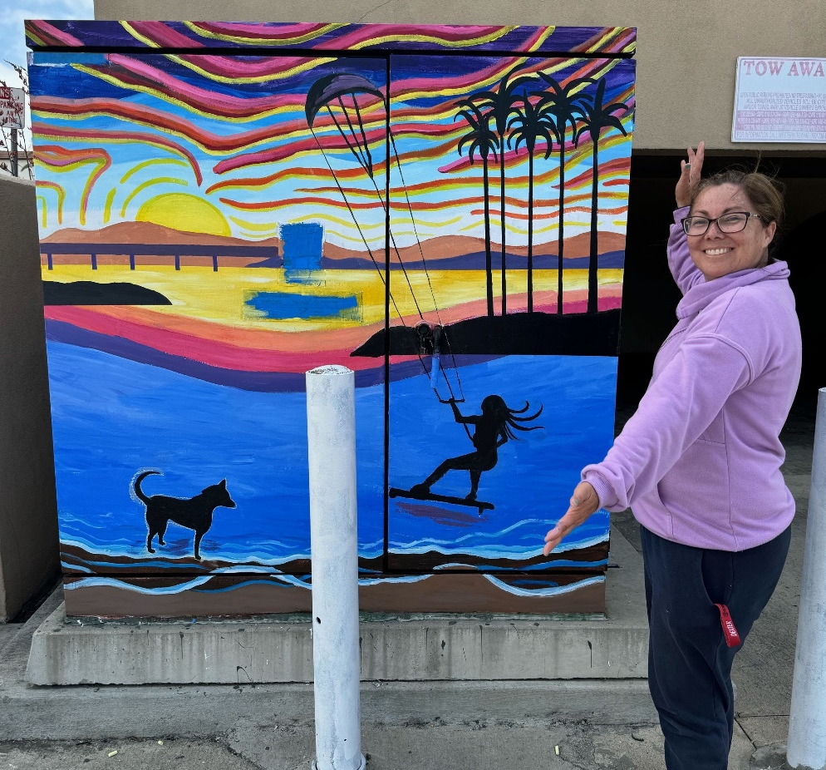
Arts, Culture and Community Festivals (ACCF) City Council Allocations
Background
Transient Occupancy Tax (TOT)
Reimbursement only
Council Policy 100-23
Notes:
The annual funding levels are subject to the amount of Transient Occupancy Tax (or TOT) allocated to each Councilmember. ACCF City Council Allocations are disbursed as reimbursements provided at the end of the fiscal year. It’s important to note that ACCF remains reimbursement-based only. Additionally, allocations are governed by Council Policy 100-23, which is available on our website.

Slide 5

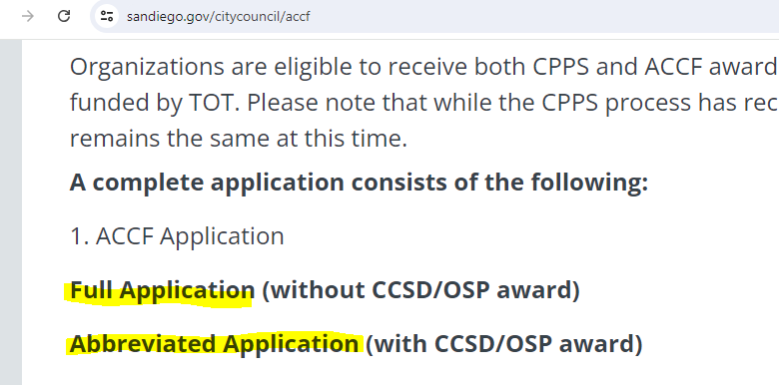
Application Process
ACCF Application
  If your organization is receiving a CCSD or OSP award:
    Apply using the Abbreviated ACCF application.
      If funds are awarded, your FY25 OSP or CCSD award will be amended.
Notes:
There are two ways organizations can apply. If an applicant is receiving a CCSD or OSP award this fiscal year, then they will have the option to submit an abbreviated application. If an applicant is selected by a Council Office, the organization’s OSP or CCSD agreement will be amended to add the additional funds. Please note that this means that grantees can only use this allocation for the original purposes identified in their agreement OSP or CCSD agreement. Awards of this type simply represent additional funding for that OSP or CCSD project beyond what was already awarded by the Commission for Arts and Culture. Again, if an organization would like to apply for additional funding toward their OSP or CCSD award, they can submit an abbreviated application. This screenshot is how the two applications look on our website. When the application opens, both the highlighted portions will be clickable links.

Slide 6
Application Process
ACCF Application
  If your organization is not receiving a CCSD or OSP award:
    Apply using the Full ACCF Application and provide supplemental documentation.
    Documentation Required:
      Proof of nonprofit status (IRS Determination Letter)
      Proof of “ACTIVE” status with the CA SOS
      Proof of “CURRENT” (or exempt) status with the CA AG
      Certification for a Drug Free Workplace
      EOC Workforce Report (pages 1-3)
      IRS Form 990, 990EZ, or 990N
      IRS Form W-9
Notes:
Alternatively, if your organization is not receiving an OSP or CCSD award for fiscal year 2025, a full application will be made available, and you will need to provide full documentation. For those organizations that applied for CPPS, this will be a very similar process as the required documents are the same for both programs. Lastly, if your organization did receive an OSP or CCSD award but would like to apply for funding for a different, unrelated project, then you are able to apply using the full application.

Slide 7

ACCF City Council Allocations
Fiscal Year 2025 Schedule
Application................................. Aug. 19 – Sept. 13, 2024
Award Announcement.......... Middle of November (tentative)
City Processing........................... Nov. 2024 - Mar. 2025
  Contracts are signed after full City Council approval
Reimbursement Process………………Apr. 2025 – Jul. 2025
*Dates are subject to change
*This schedule only applies to those completing a full application, it is not relevant to those with existing CCSD/OSP Agreements.
Notes:
The ACCF application will be open from August 19 to September 13, 2024, allowing applicants 25 days to submit their application. Following the application period, our office will vet applications for eligibility and provide a cure period, allowing applicants to correct any resolvable errors. The Council Offices will then select their grant awards and the City Attorney’s Office will vet them for legality. We expect to announce the awards in the middle of November, though this may be subject to change. As a reminder, ACCF is reimbursement only, and the reimbursement process will take place once the City Council approves the grant award and the funding agreement is signed by all parties, likely no sooner than April 2025. It’s important to note that this schedule only applies to those completing a full application, it is not relevant to those with existing OSP or CCSD agreements who submitted an abbreviated application. While the application timeline and award announcements are the same, the processing protocol differs. Once the award for an OSP or CCSD is approved by Council, the Commission for Arts and Culture takes over as administrator and those grantees will follow their schedule.

Slide 8
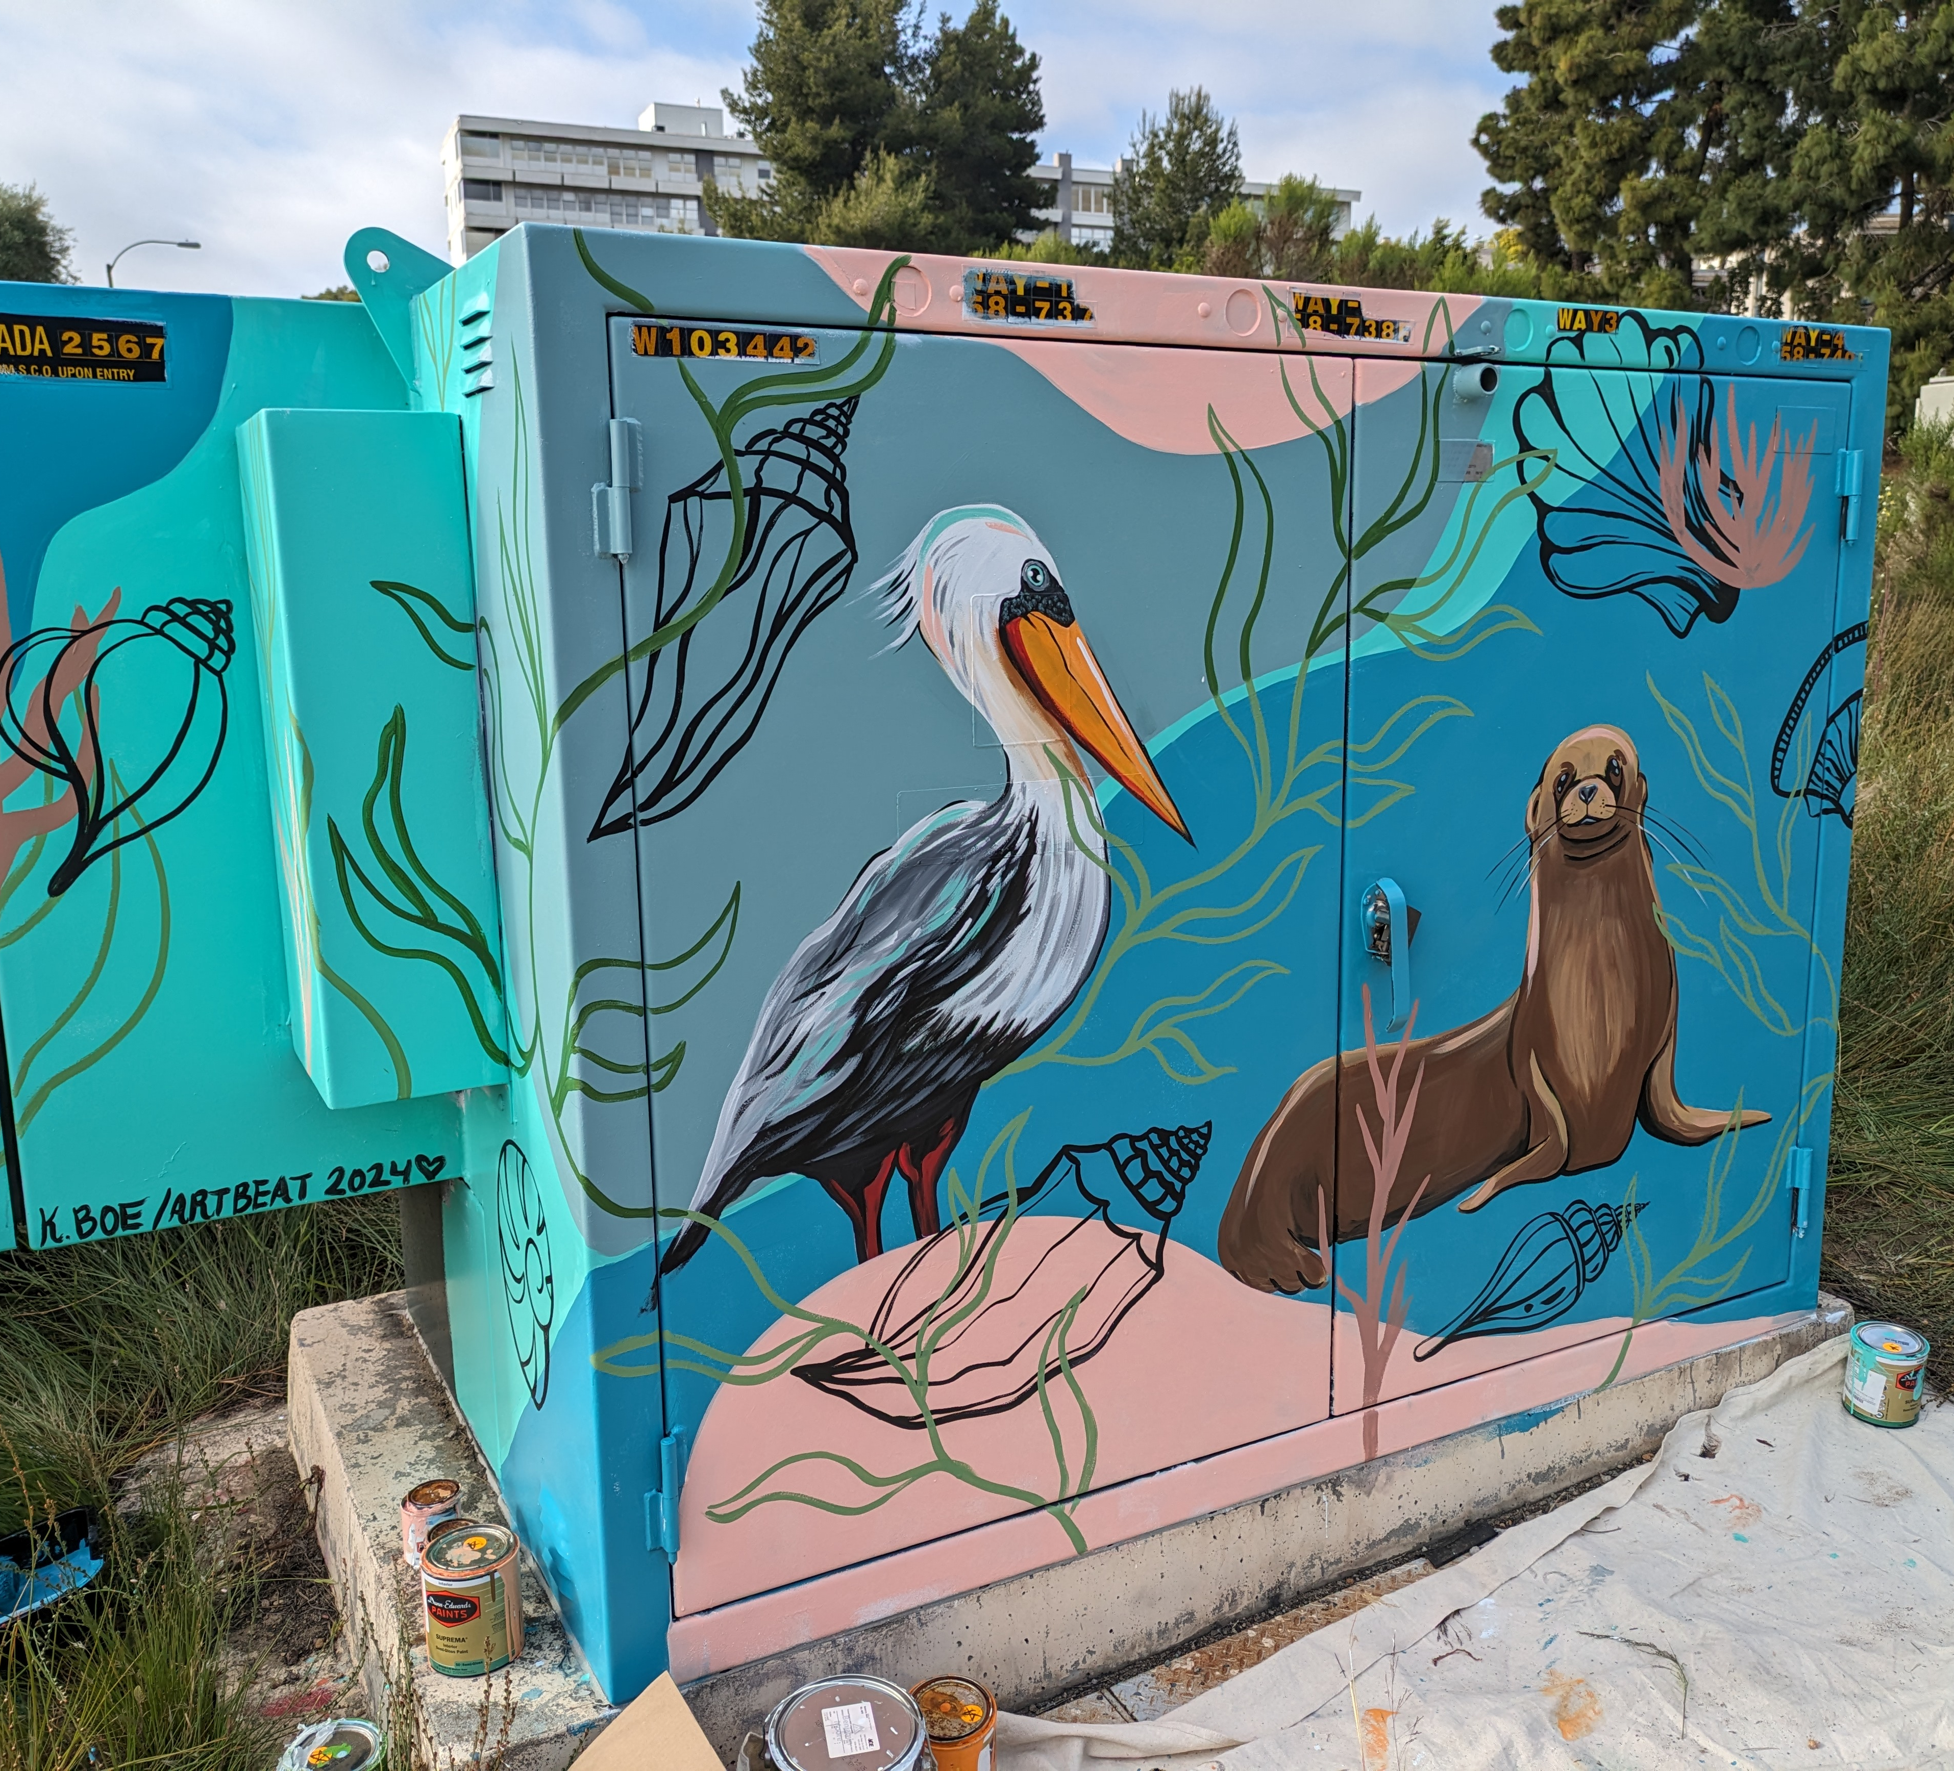
ACCF Projects/Programs/Events
Examples from FY24
Barnard PTA: Annual Lunar New Year Festival
San Diego Parks Foundation: I Love My Park Day
Black San Diego Empowering Our Community: Jazz in the Garden
San Diego International Sister Cities Association: World Design Capital Indigenous Forum
Notes:
Here are some examples of organizations that received ACCF City Council allocations.
Barnard PTA: Annual Lunar New Year Festival
San Diego Parks Foundation: I Love My Park Day
Black San Diego Empowering Our Community: Jazz in the Garden event
San Diego International Sister Cities Association: World Design Capital Indigenous Forum
These are just a few of dozens of projects put on by diverse organizations across the city. More examples are available on our website.

Slide 9

ACCF City Council Allocations
Budget Summary
FY25 ACCF Funds: $450,000
$50k per office
Notes:
The City’s recently approved Fiscal Year 2025 budget includes a $450,000 allocation for ACCF. This number is divided across the nine Council Offices, with each office allocated a $50,000 budget, which is the same as in the previous two fiscal years.

Slide 10


ACCF City Council Allocations
Reminders & Council Policy Review
ACCF funds cannot be used for food, beverages, travel, private purposes, political, religious, or fundraising activities.
$1,500 minimum funding allocation.
Matching funds is not required.
Notes:
Here are some important program reminders. Funds cannot be used for food, beverages, travel, private purposes, political, religious, or fundraising activities. The minimum funding allocation is $1,500 and matching funds are not required. Additionally, funds should be considered a one-time resource.

Slide 11
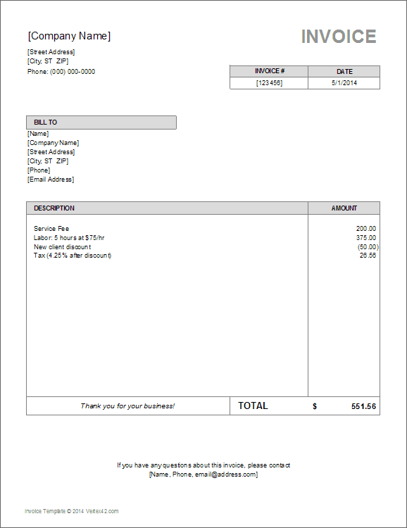
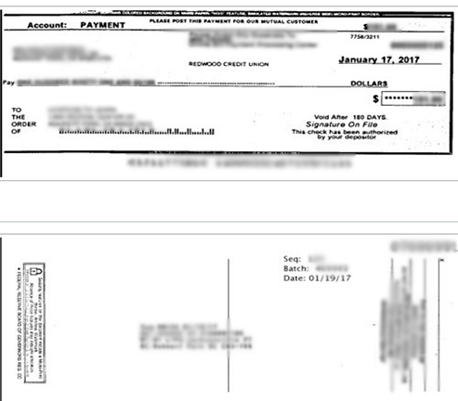
ACCF Payments
Reimbursement Process
To receive reimbursement:
  Request for Reimbursement Form, supplemental documentation, and Final Performance Report must be submitted by July 31, 2025.
  Supplemental documentation include both proof of purchase (receipts, invoices, pay stubs, time sheets, etc.) and proof of payment (cancelled checks, bank/credit card statements, etc.).
  Your assigned contract administrator will inform you when it is time to request reimbursement.
  Only eligible expenditures incurred within the Fiscal Year (July 1, 2024 – June 30, 2025), are eligible for reimbursement.
Notes:
After City processing has been completed, the reimbursement process will take place at the end of the fiscal year.
All expenses must have been incurred within the fiscal year, which begins on July 1, 2024, and ends on June 30, 2025, and documentation is due no later than July 31st, 2025. After reimbursement documentation has been reviewed and approved, the City will issue the payment. Mailed checks can take up to 30-60 days to process. The same reporting documentation as CPPS will be required. Each expense must have a corresponding proof of purchase and payment document corroborating the expense. Please be sure to retain these records. Proof of purchase documentation may include receipts, invoices, pay stubs, or time sheets, and proof of payment documentation may include bank statements, credit card statements, or cancelled checks.

Slide 12

FY25 CPPS and ACCF
Assistance
To Learn More
Council Offices→ https://www.sandiego.gov/citycouncil
CPPS Homepage → https://www.sandiego.gov/citycouncil/cpps
ACCF Homepage→ https://www.sandiego.gov/citycouncil/ACCF
Office Hours→ By Appointment (Phone)
Contact Us
Submit ACCF questions to ACCF@sandiego.gov
Submit CPPS questions to CPPS@sandiego.gov
  Council Administration Malachi Bielecki Abigail Edwards
  619-236-6441 Mbielecki@sandiego.gov EdwardsA@sandiego.gov
Notes:
This concludes our presentation. Here is our contact info and links to our websites. Please feel free to reach out to our office with any questions.

