Slide 1

Otay Mesa Enhanced Infrastructure Financing District
Fiscal Year 2024 Otay Mesa EIFD Annual Report and Annual Review of the Infrastructure Financing Plan (IFP)
March 6, 2025
Public Financing Authority Meeting
Item # 3

Slide 2

Otay Mesa Enhanced Infrastructure Financing District
AB 116 Amendment to EIFD Legislation
Fiscal Year Annual Report
    Adopt annual report on or before June 30th after holding a public hearing
    Draft report shall be made available to the public 30 days before hearing
    Written notice shall be mailed to every landowner and occupant in the District

Slide 3
Otay Mesa Enhanced Infrastructure Financing District
Fiscal Year 2024 Annual Report
Report Requirements
Description of the projects undertaken in the fiscal year
A chart comparing actual revenues and expenses
Amount of tax increment revenues received
Assessment of the status of the projects in the District
Amount of revenues expended to assist private businesses

Slide 4
Otay Mesa Enhanced Infrastructure Financing District
1. Description of the projects undertaken in the Fiscal Year
La Media Road Improvements (S-15018)
  Estimated total project cost $60.6 million
  $3.98 million in District revenues was budgeted in FY 2024
  Project will widen La Media Road between SR-905 and Siempre Viva Road, and will improve drainage at the intersection of La Media Road and Airway Road

Slide 5
Otay Mesa Enhanced Infrastructure Financing District
1. Description of the projects undertaken in the Fiscal Year Cont.
Dennery Ranch Neighborhood Park Project (RD22001)
  Estimated total project cost $22 million
  $2.1 million in District revenues was budgeted in FY 2024
  Project will provide a Neighborhood Park with playground areas, sports facilities, fitness equipment, picnic shelters, and new green landscaping
  A substantial conformance review was completed and an updated cost estimate and schedule will be prepared once the engineering design and construction documents are finalized

Slide 6
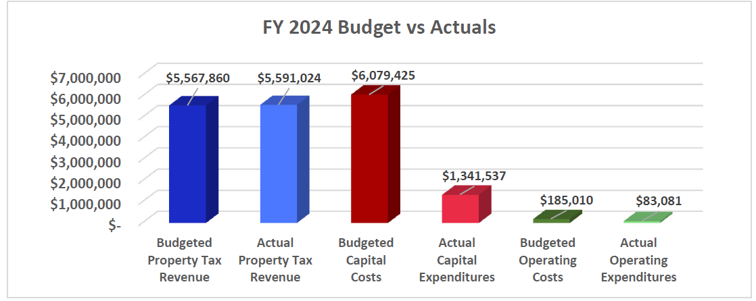
Otay Mesa Enhanced Infrastructure Financing District
2. Chart comparing actual revenues and expenditures

Slide 7
Otay Mesa Enhanced Infrastructure Financing District
3. Amount of Tax Increment (TI) revenues received
$5,591,024 of TI revenues were received
4. Assessment of the status of the projects in the District
La Media Road Improvements (S-15018)
  Staff obtained all required resource agency permits, Caltrans encroachment permit, and completed the construction contract bid and award phases in FY 2023
  In FY 2024, this project was and currently is in active construction
Hidden Trails Neighborhood Park (S-00995)
  Design began in FY 2022 and will be completed in FY 2025
  Modifications to the stormwater system deemed necessary resulted in additional engineering design and updated construction documents
  Construction anticipate to begin in FY 2026
5. Amount of revenues expended to assist private businesses
No FY 2024 revenues were expended to assist private businesses

Slide 8
Otay Mesa Enhanced Infrastructure Financing District
Annual Review of District’s IFP
AB116 Requirements
Pursuant to Government Code section 53398.66(j)(1), the Authority must review the District’s IFP, at least annually, and make any amendments that are necessary and appropriate
Staff has no recommended amendments to the IFP for the Authority’s consideration

Slide 9
Otay Mesa Enhanced Infrastructure Financing District
Requested Action
Approve, via resolution, the District’s FY 2024 Annual Report and confirm the annual review of the District's IFP

