Slide 1
Accessibility Advisory Board
Tactile Wayfinding—Improving Access for People with Vision Disabilities
May 14, 2025 - Meeting

Slide 2
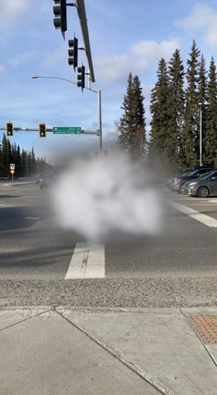
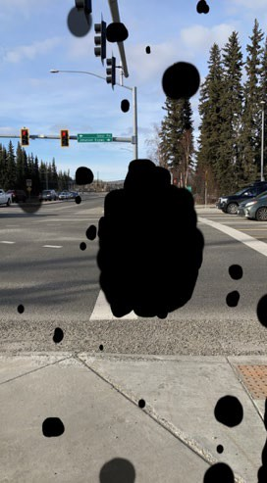
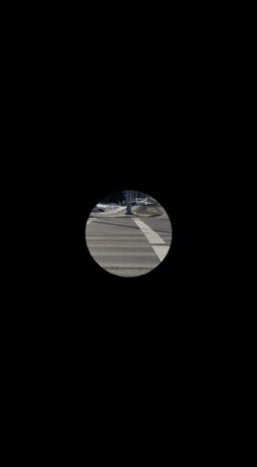
Who are we talking about?
The large majority have some vision
The large majority become vision disabled after the age of 60
The large majority have some degree of age-related hearing loss
Macular degeneration
Diabetic Retinopathy
Retinitis pigmentosa
Photo credits: ADB Staff

Slide 3
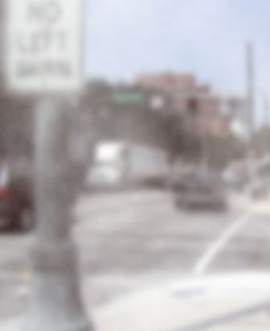
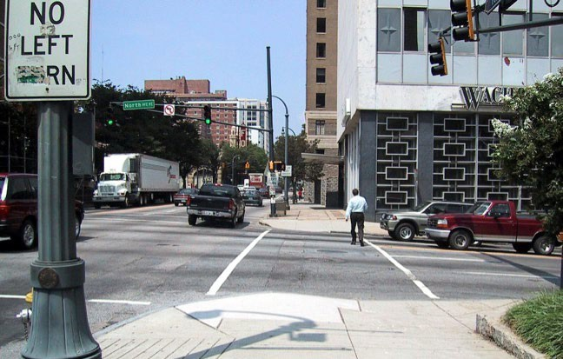
People with low vision may have:
Loss of visual acuity (sharpness of vision)
Loss of visual field
Difficulty seeing at night
Sensitive to glare
Reduced contrast sensitivity
Photo credit: ADB Staff

Slide 4
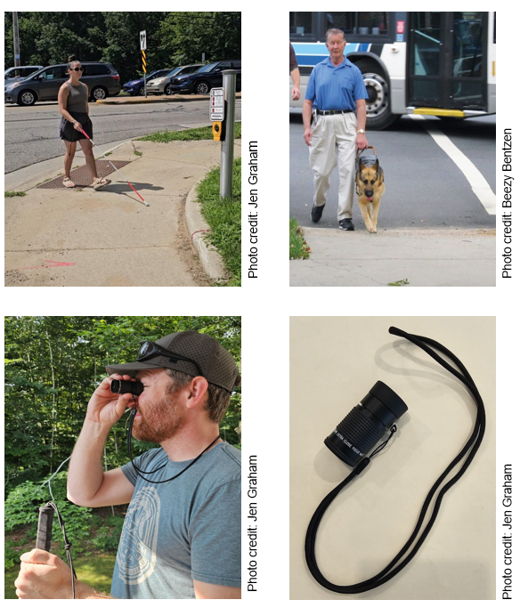
Tools for travel
Many People with Visual Disabilities (PVDs) use no obvious tool!
Long white cane—scans the environment approximately where the next foot will fall
Dog guide—handler gives directions; dog provides safety; only 5-10% of PVD
Low vision aids—monocular; primarily for spot checking, especially signs
Apps—helpful to some PVD; never a substitute for providing accessible information

Slide 5
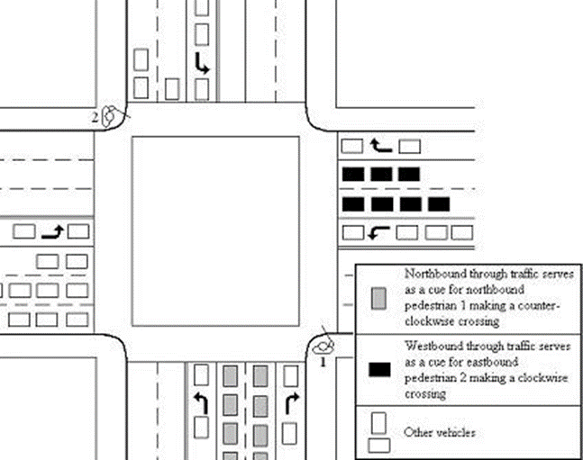
Techniques for travel
Listening—most important technique
Vehicle sounds to determine onset of walk interval at signalized crossing— surge of through traffic in near lane
Vehicle sounds to determine direction (align to cross)—primarily traffic parallel to crosswalk
Vehicle sounds to detect traffic gaps and yielding vehicles
Many PVDs have never been taught techniques for maximizing use of their low vision, or taught to use any special techniques
Photo credit: Janet Barlow-SOMA 2016 presentation

Slide 6
Wayfinding Challenges

Slide 7
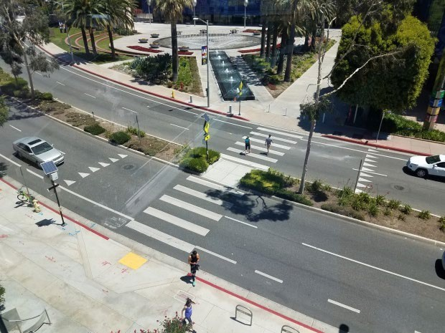
Finding non-corner crossings:
Mid-block crossings
Roundabouts
Photo credit: www.pedbikeimages.org / Toole Design Group

Slide 8
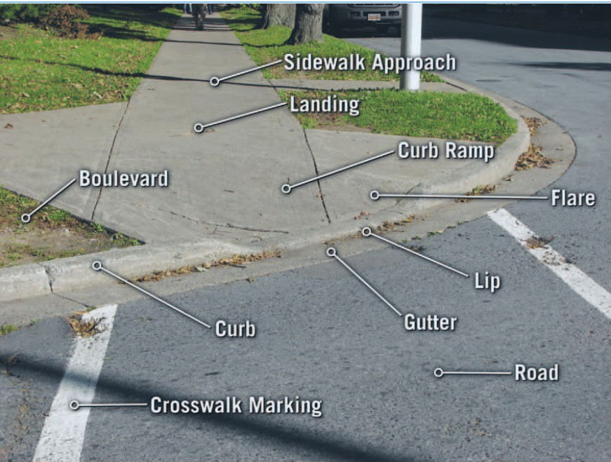
Recognizing the boundary of a street with curb ramp without detectable warning surface
Photo Credit: Sean Bennett, Fig. 1. Representative intersection of sidewalk and road, including a diagonal curb ramp Download Scientific Figure on ResearchGate (researchgate.net)

Slide 9
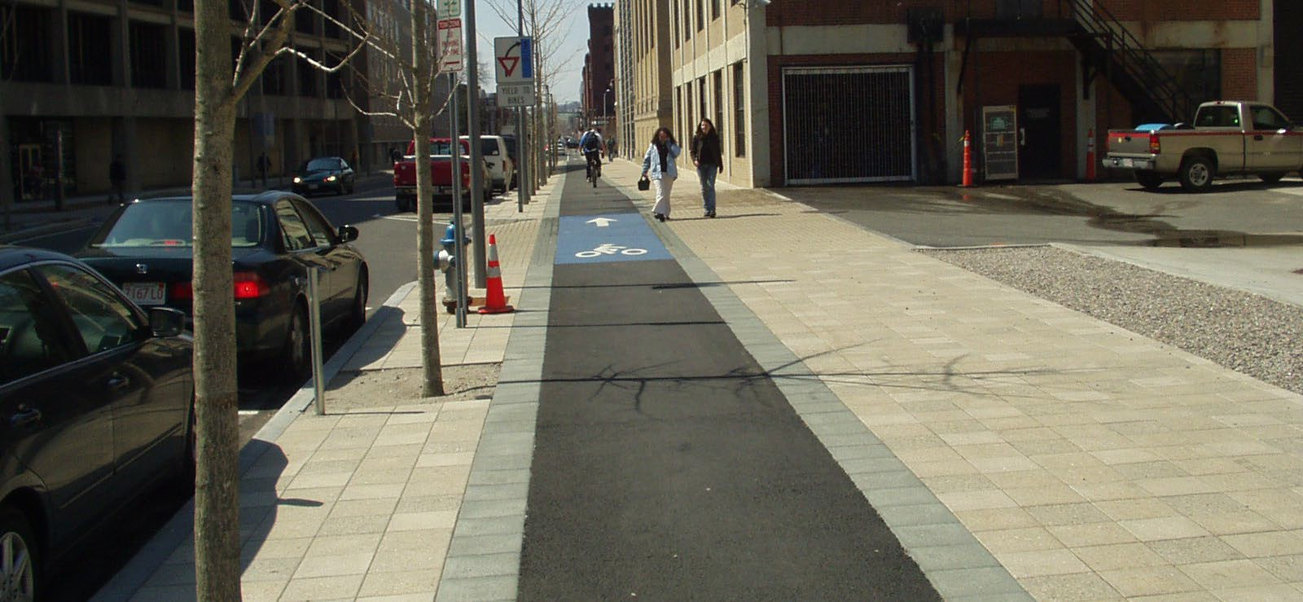
Avoiding separated bike lanes at sidewalk level
Photo credit: Toole Design

Slide 10
Finding Transit Facilities
Guidance to:
Fare-gates, ticket machines
Platforms
Elevators/escalators
Bus transfer areas
Locating bus stops,
Floating transit islands

Slide 11
Wayfinding Options

Slide 12
The Transportation Research Board published the final document that discusses the requirements for successful tactile wayfinding:
New research discusses how different tactile walking surface indicators (TWSIs) can be used in complex transportation and crossing settings.
Where other design cues may be inconsistent, confusing, misleading, or missing to provide wayfinding information to people who are blind or visually impaired.
The results of experiments on detectability, discriminability, and application of TWSIs along with
Guidelines for planning, designing, constructing, and maintaining TWSIs in different transportation and crossing settings.

Slide 13
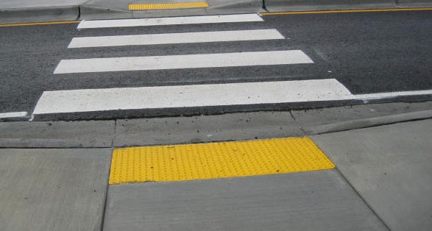
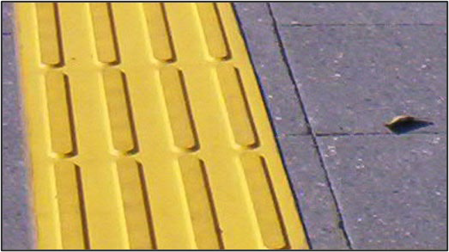
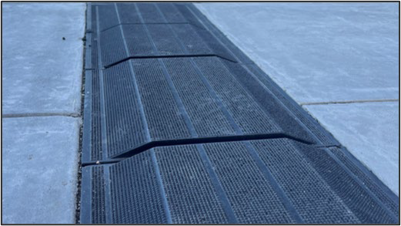
Tactile Walking Surface Indicator (TWSI)
Photo Credit: Beezy Bentzen
Generic term for 3 types of walking surfaces to aid wayfinding for pedestrians with vision disabilities:
Detectable warning surface (DWS)
aka: truncated domes, or domes
Tactile direction indicator (TDI)
aka: raised bars, guiding bars, or directional bars
Tactile warning delineator (TWD)
aka: trapezoidal delineator, or trapezoid
Photo Credit: John Robert McPherson, CC0,via Wikimedia Commons
Photo Credit: Linda Myers

Slide 14
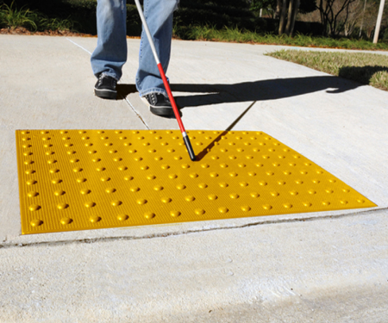
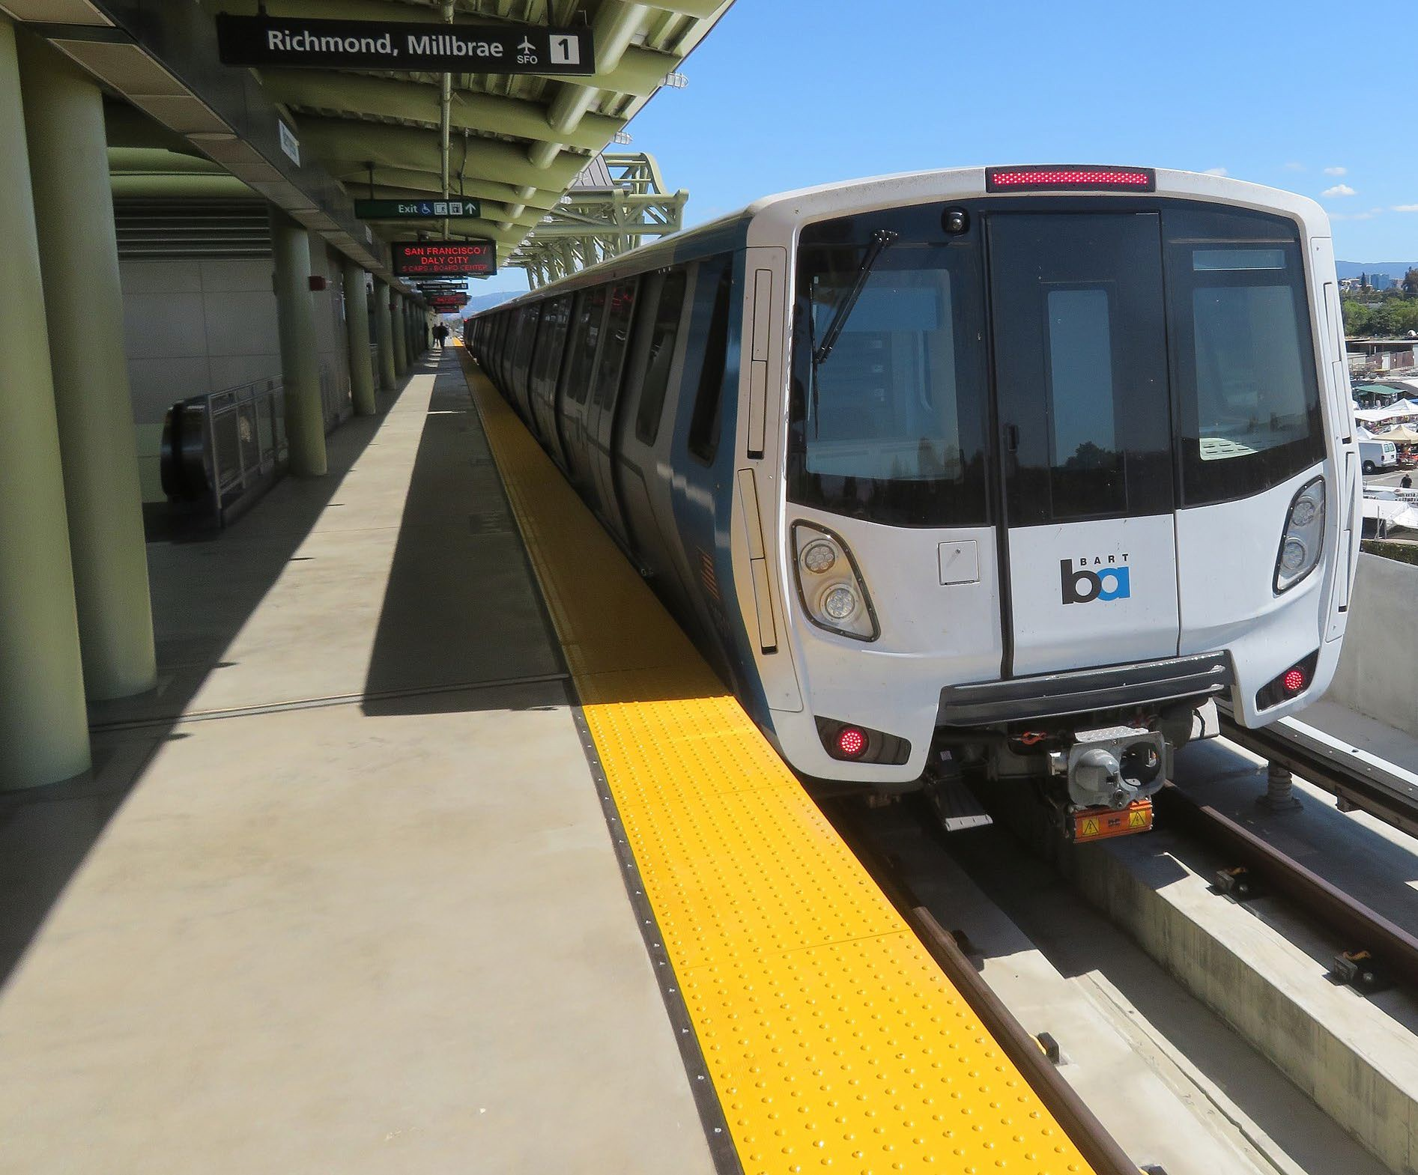
Detectable Warning Surface
What should pedestrians who are vision disabled think when they encounter truncated dome DWS?
I should stop and figure out whether I’m at a street or transit platform and prepare to either cross the street or board the vehicle.
If I’m at a street, I should explore for cues to help me align in the direction of the crosswalk.
The domes should NOT be used as a cue for aligning to cross.
Photo Credit: Pi.1415926535, CC BY-SA 3.0
https://commons.wikimedia.org/w/index.php?curid=91289870

Slide 15
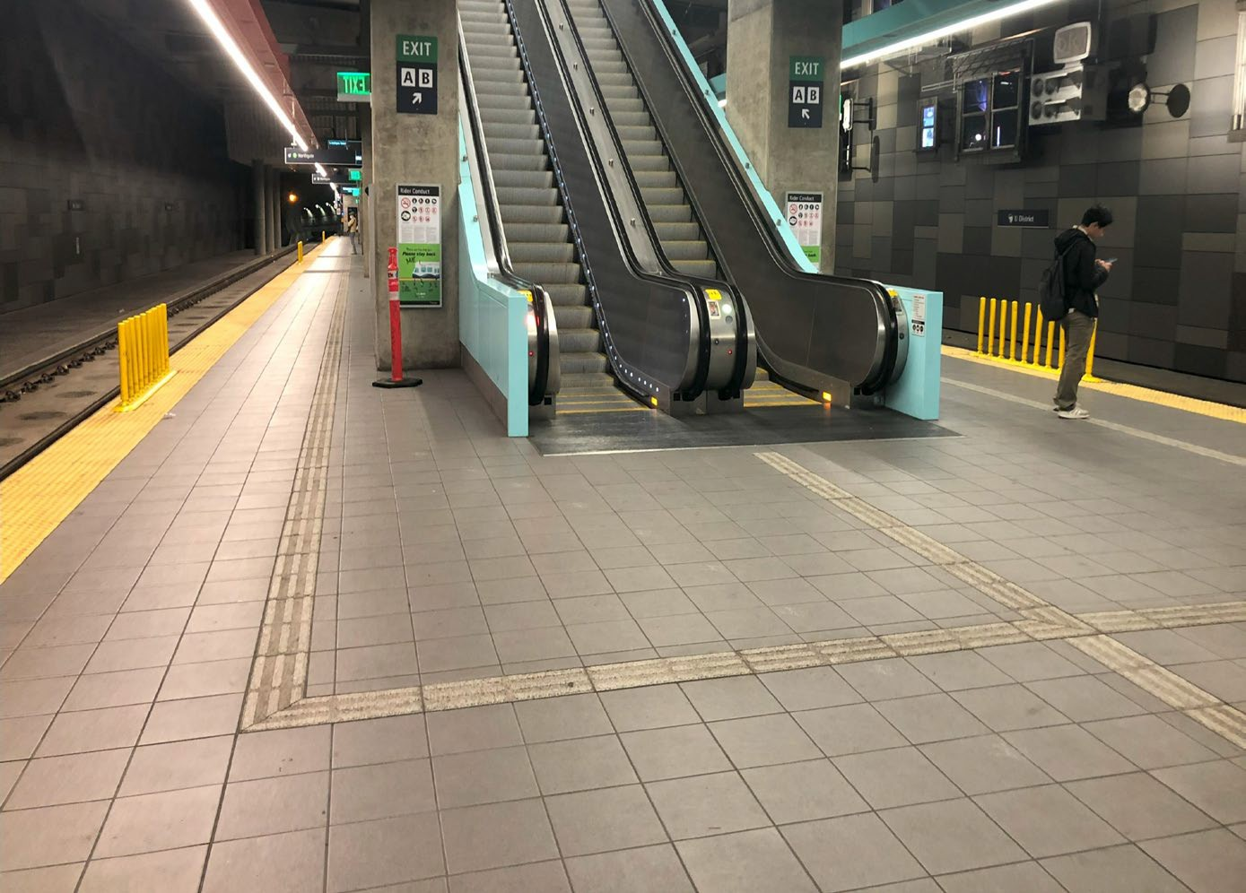
Tactile Direction Indicator (TDI) – Bars
What should pedestrians who are vision disabled think when they encounter TDI bars?
It depends on environmental context and width of the surface!
If 12 in. (4 bars): follow the bars parallel
If 24 in. follow the bars perpendicular
If the bars are running in parallel and extending some distance, then this is a surface I can follow.
I can follow it on either side if there is room.
I should not encounter obstacles if I am following along while walking beside it.
Photo Credit: ADB Staff

Slide 16
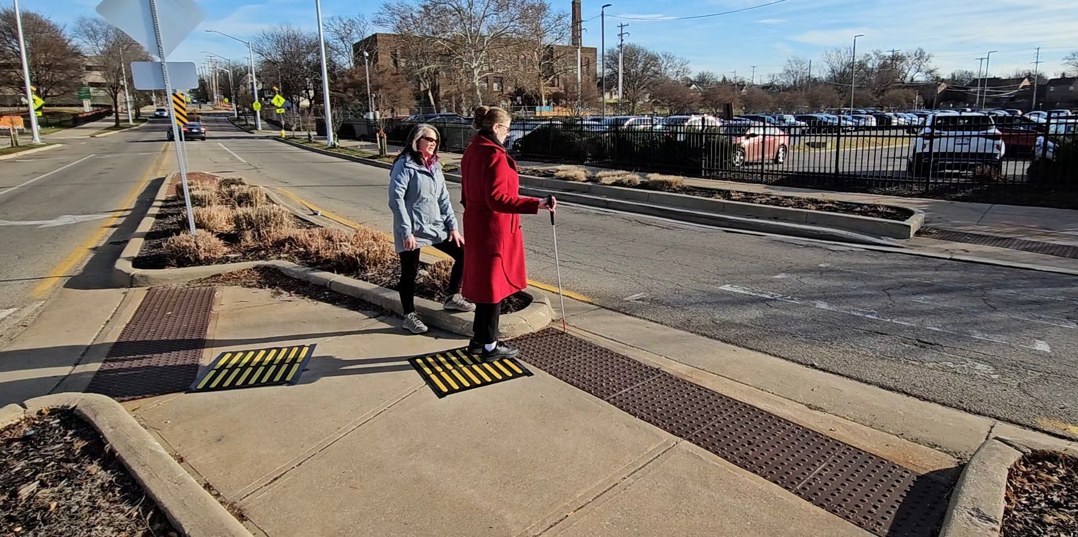
Tactile Direction Indicators – Alignment Bars
2 ft. x 2 ft. square of bars
Orient bars perpendicular to the direction of travel across crosswalk
If a “patch” of raised bars is located near a street crossing, and near the end of or just behind a DWS, I can use it to establish an accurate alignment with the crosswalk.
Photo Credit: ADB Staff
Photo Credit: Steve Graham

Slide 17
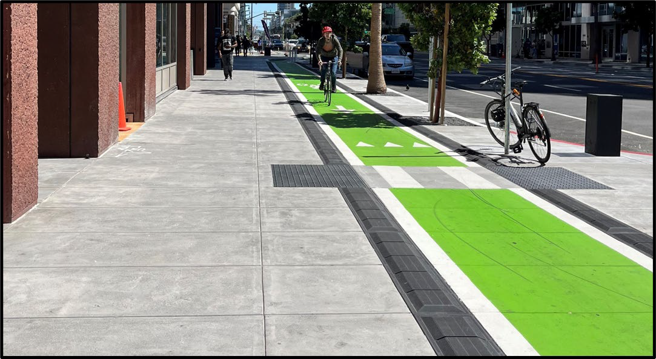
Tactile Warning Delineator (TWD)
What should pedestrians who are vision disabled think when they encounter a trapezoidal TWD?
I should not cross this surface because there is danger of a crash with a bicycle or other hazard on the other side.
Photo credits: Linda Myers

Slide 18
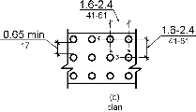
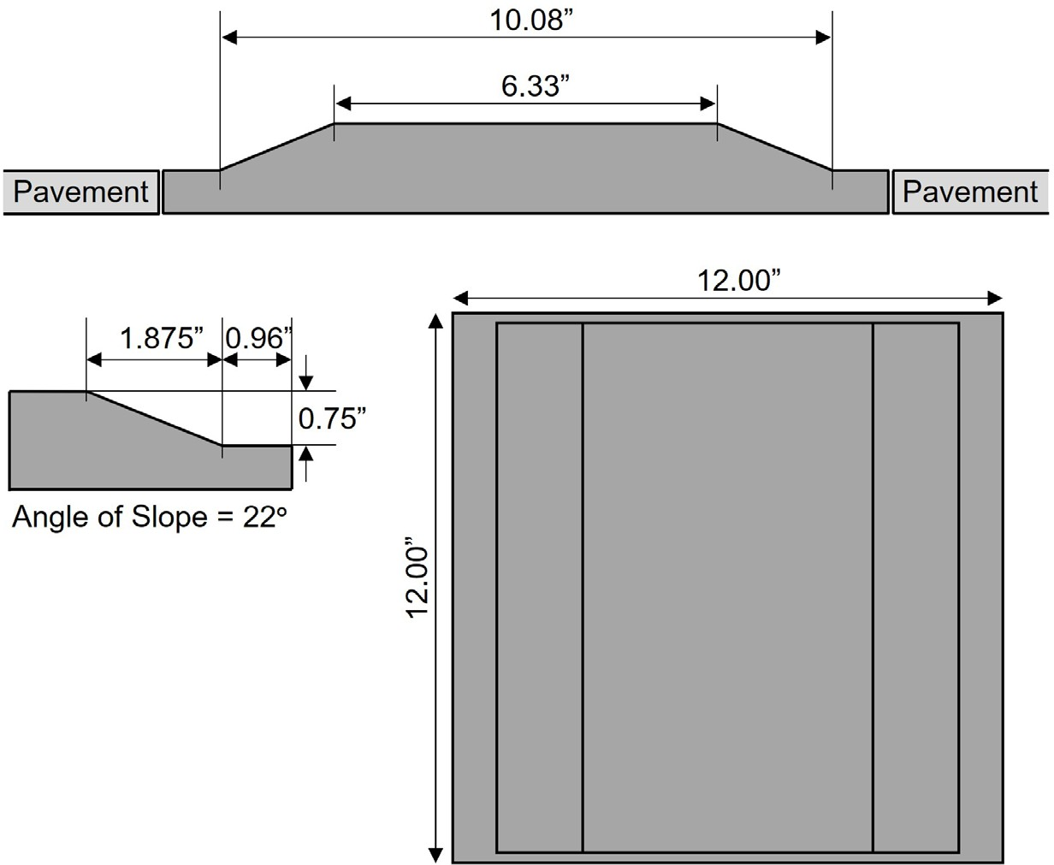
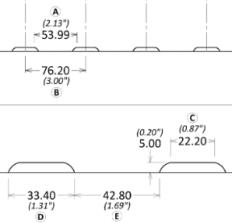
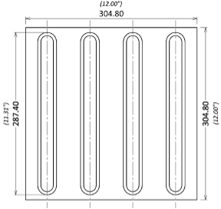
Specifications for TWSIs
Detectable Warning Surface (DWS)
Tactile Warning Delineator (TWD)
TCRP Research Report 248, Figure 5
Tactile Direction Indicator (TDI)
TCRP Research Report 248, Figure 9
TCRP Research Report 248, Figure 7

Slide 19
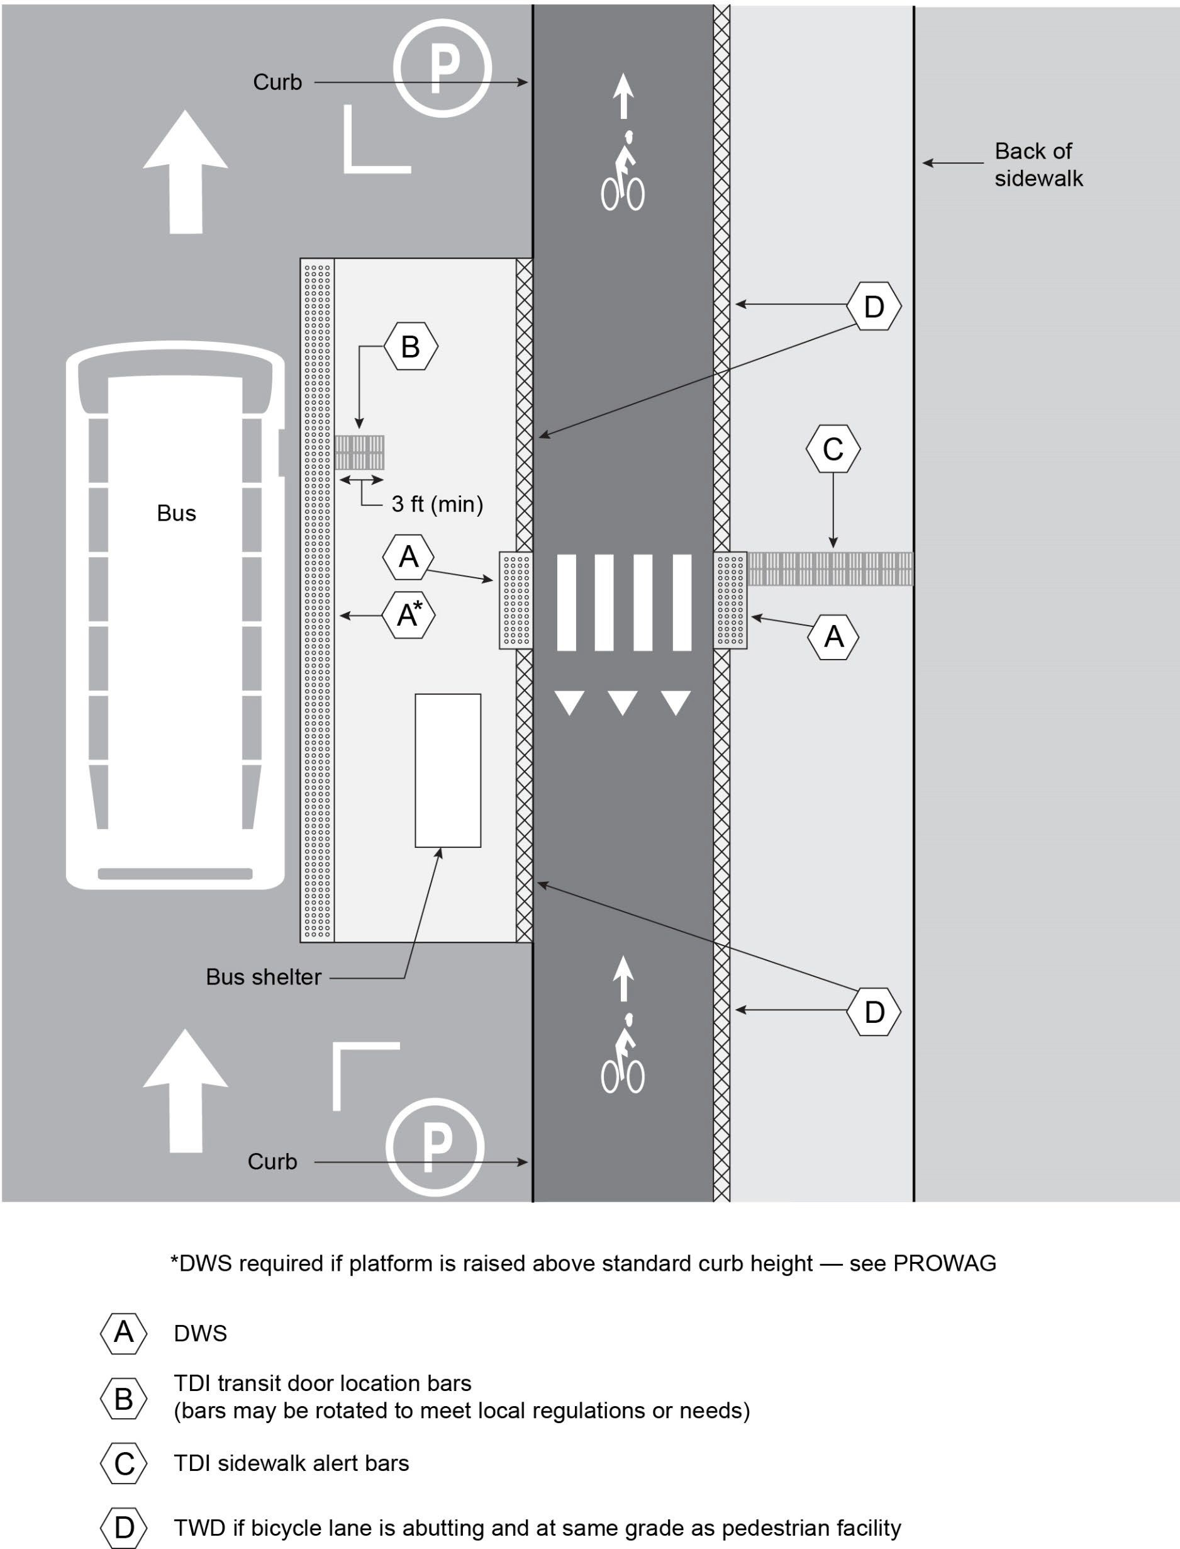
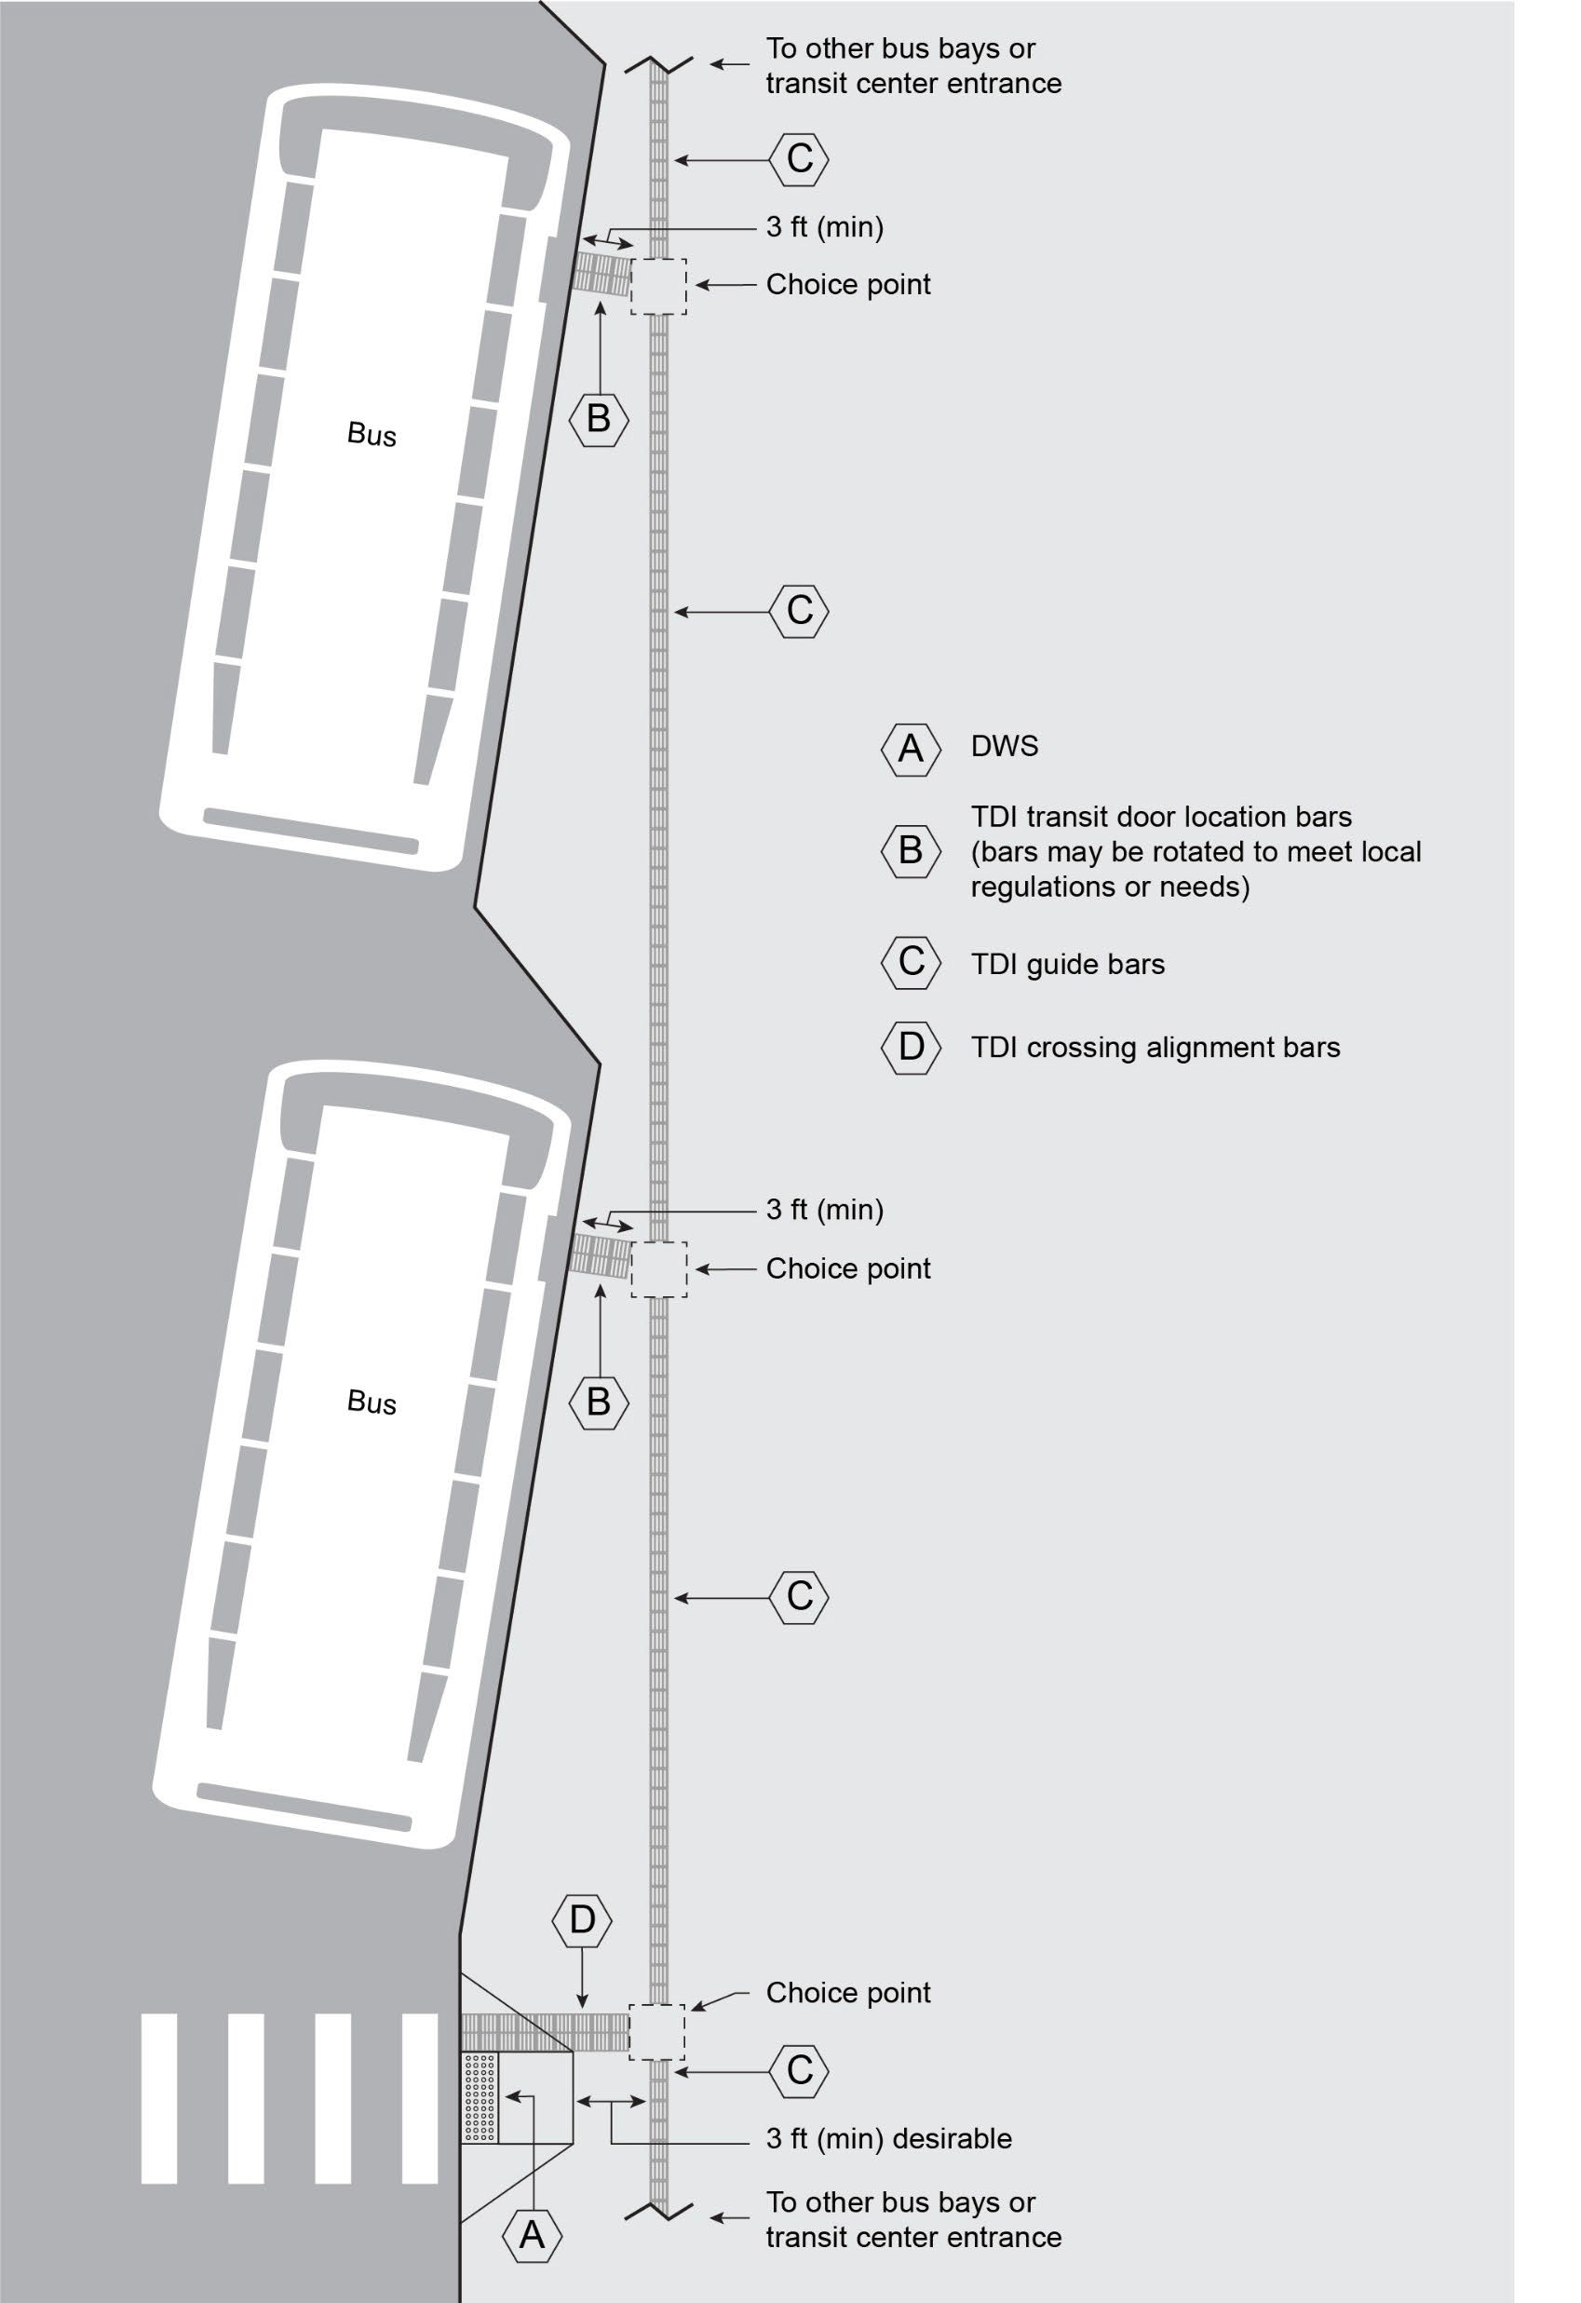
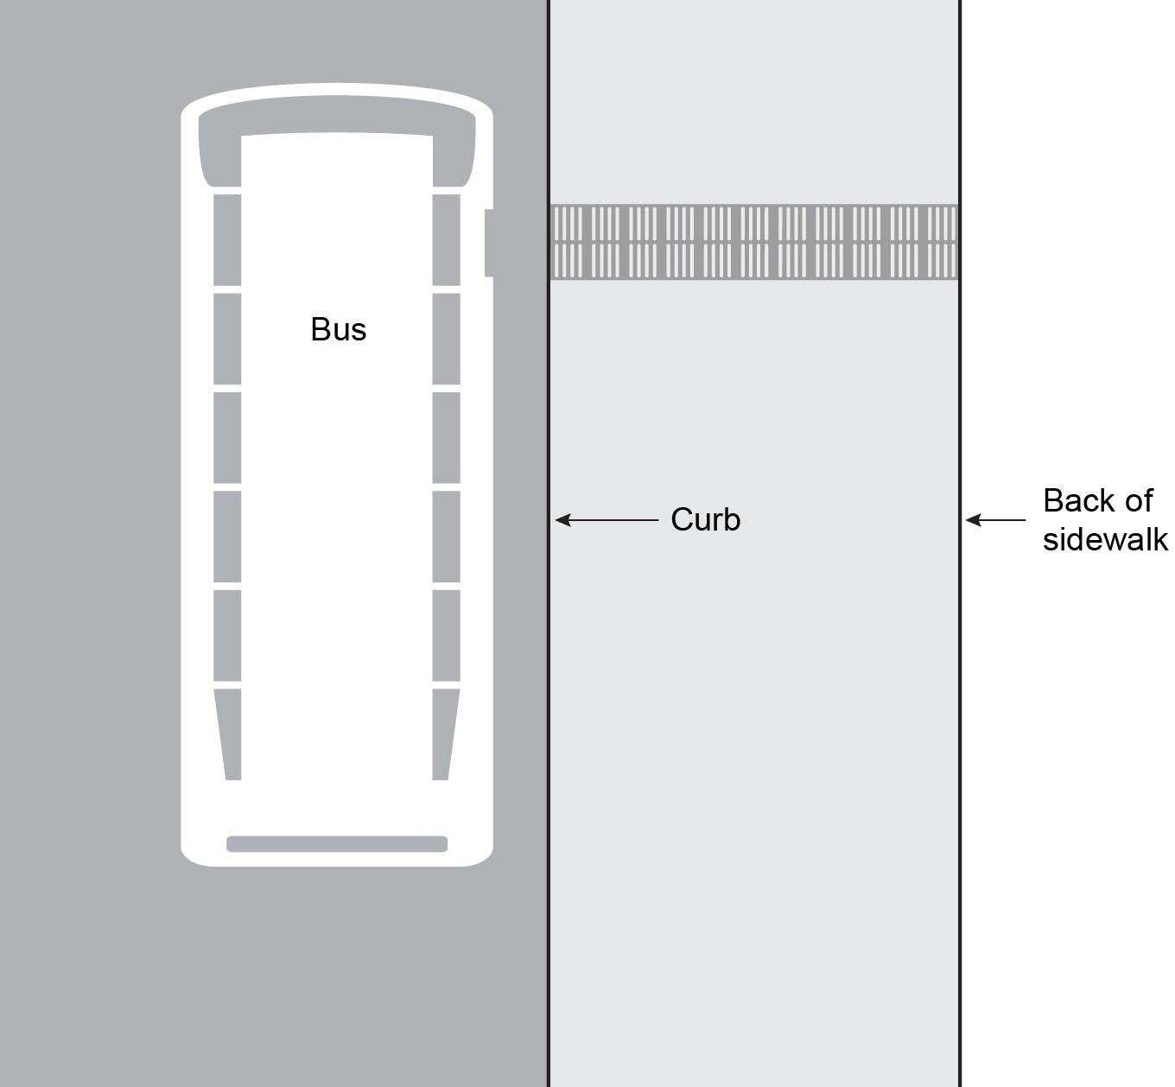
Bus Stops, Bus Boarding Islands, and Transit Centers
TCRP Research Report 248, Figure 25
TCRP Research Report 248, Figure 23
Detectable Warning Surface (DWS)
Tactile Direction Indicator (TDI)
Tactile Warning Delineator (TWD)
TCRP Research Report 248, Figure 24

Slide 20
Crossing Applications
TWSIs can help people who are blind or have low vision identify the following items:
Location where a street intersects the pedestrian path
Boundary between pedestrian path and the path of motor vehicles, bicyclists, or trains
Alignment of the street crossing
Changes in alignment for the pedestrian path
Transitions between shared-use paths and separated bicyclist and pedestrian paths
Use good design geometry should do most of the work;
TWSIs should be a supplement, not a primary measure

Slide 21
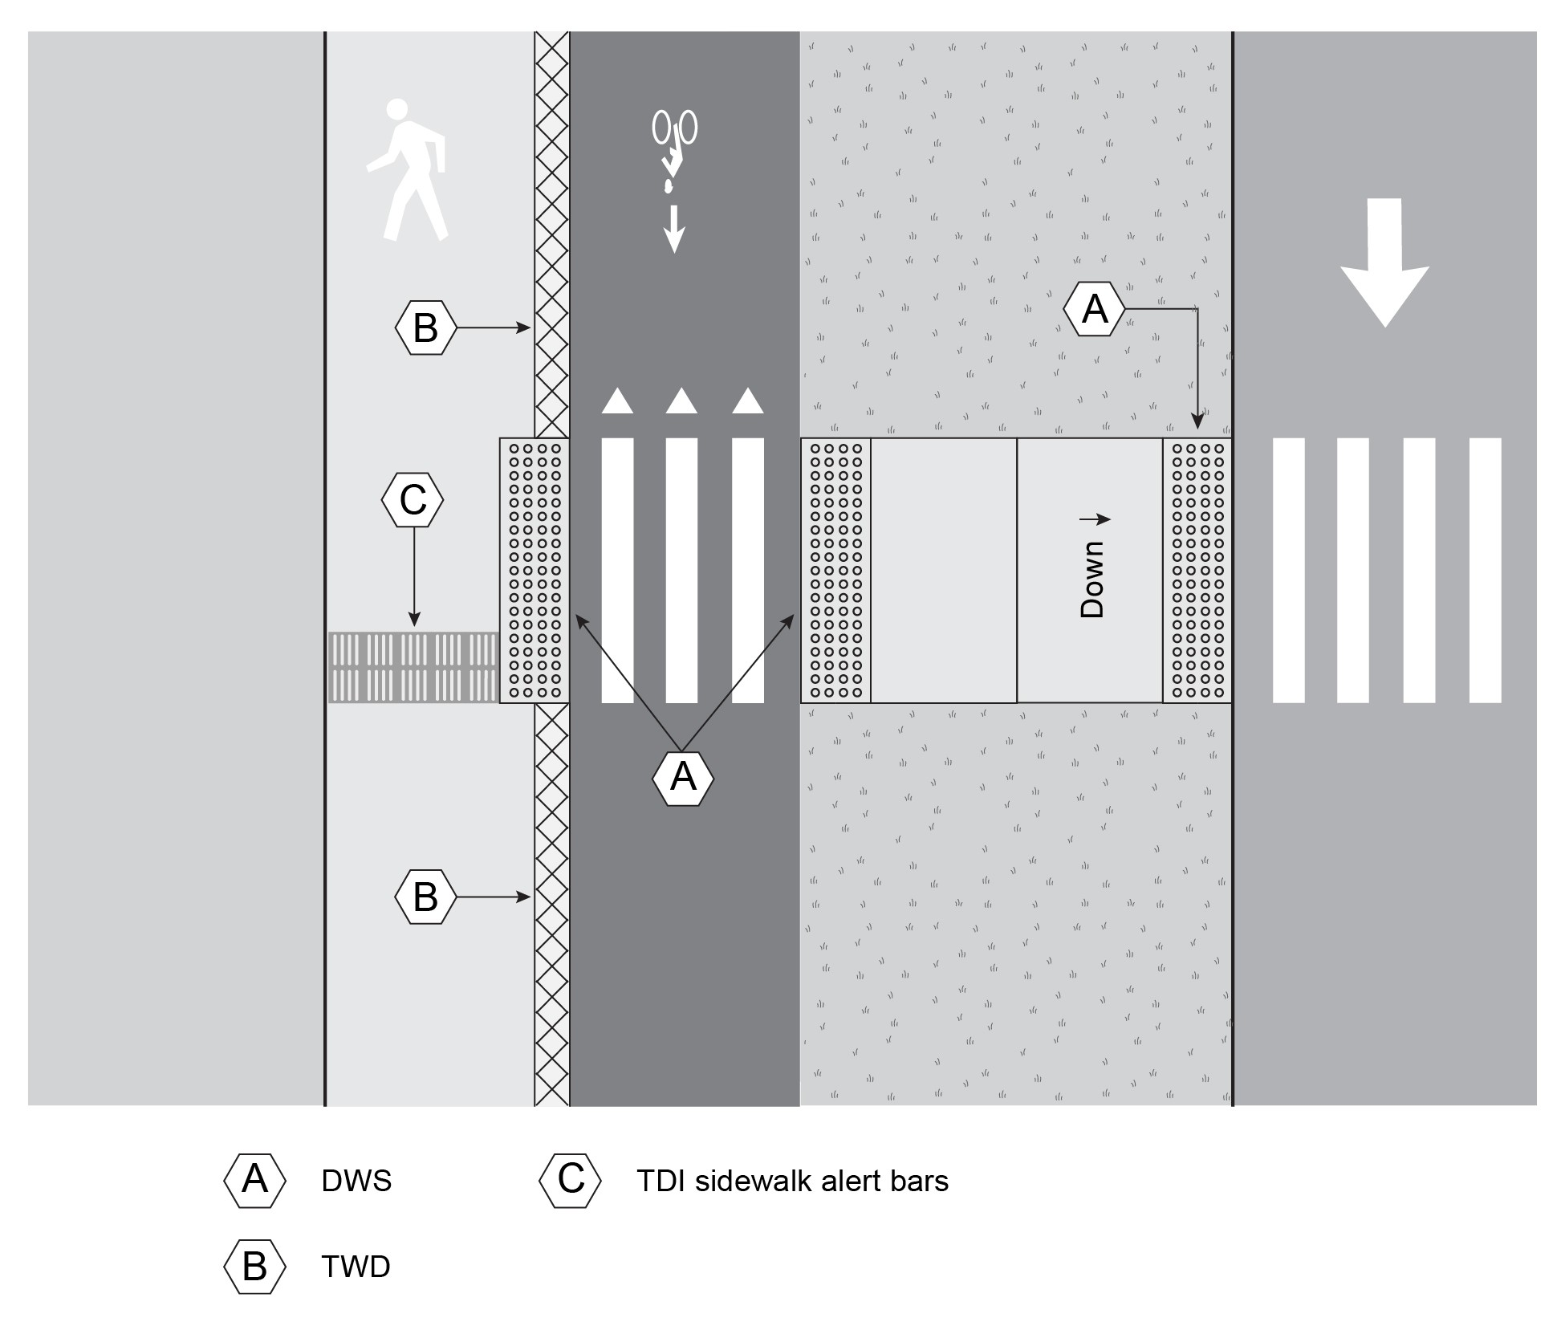
Crossing Median - Separated Bicycle Facility

Slide 22
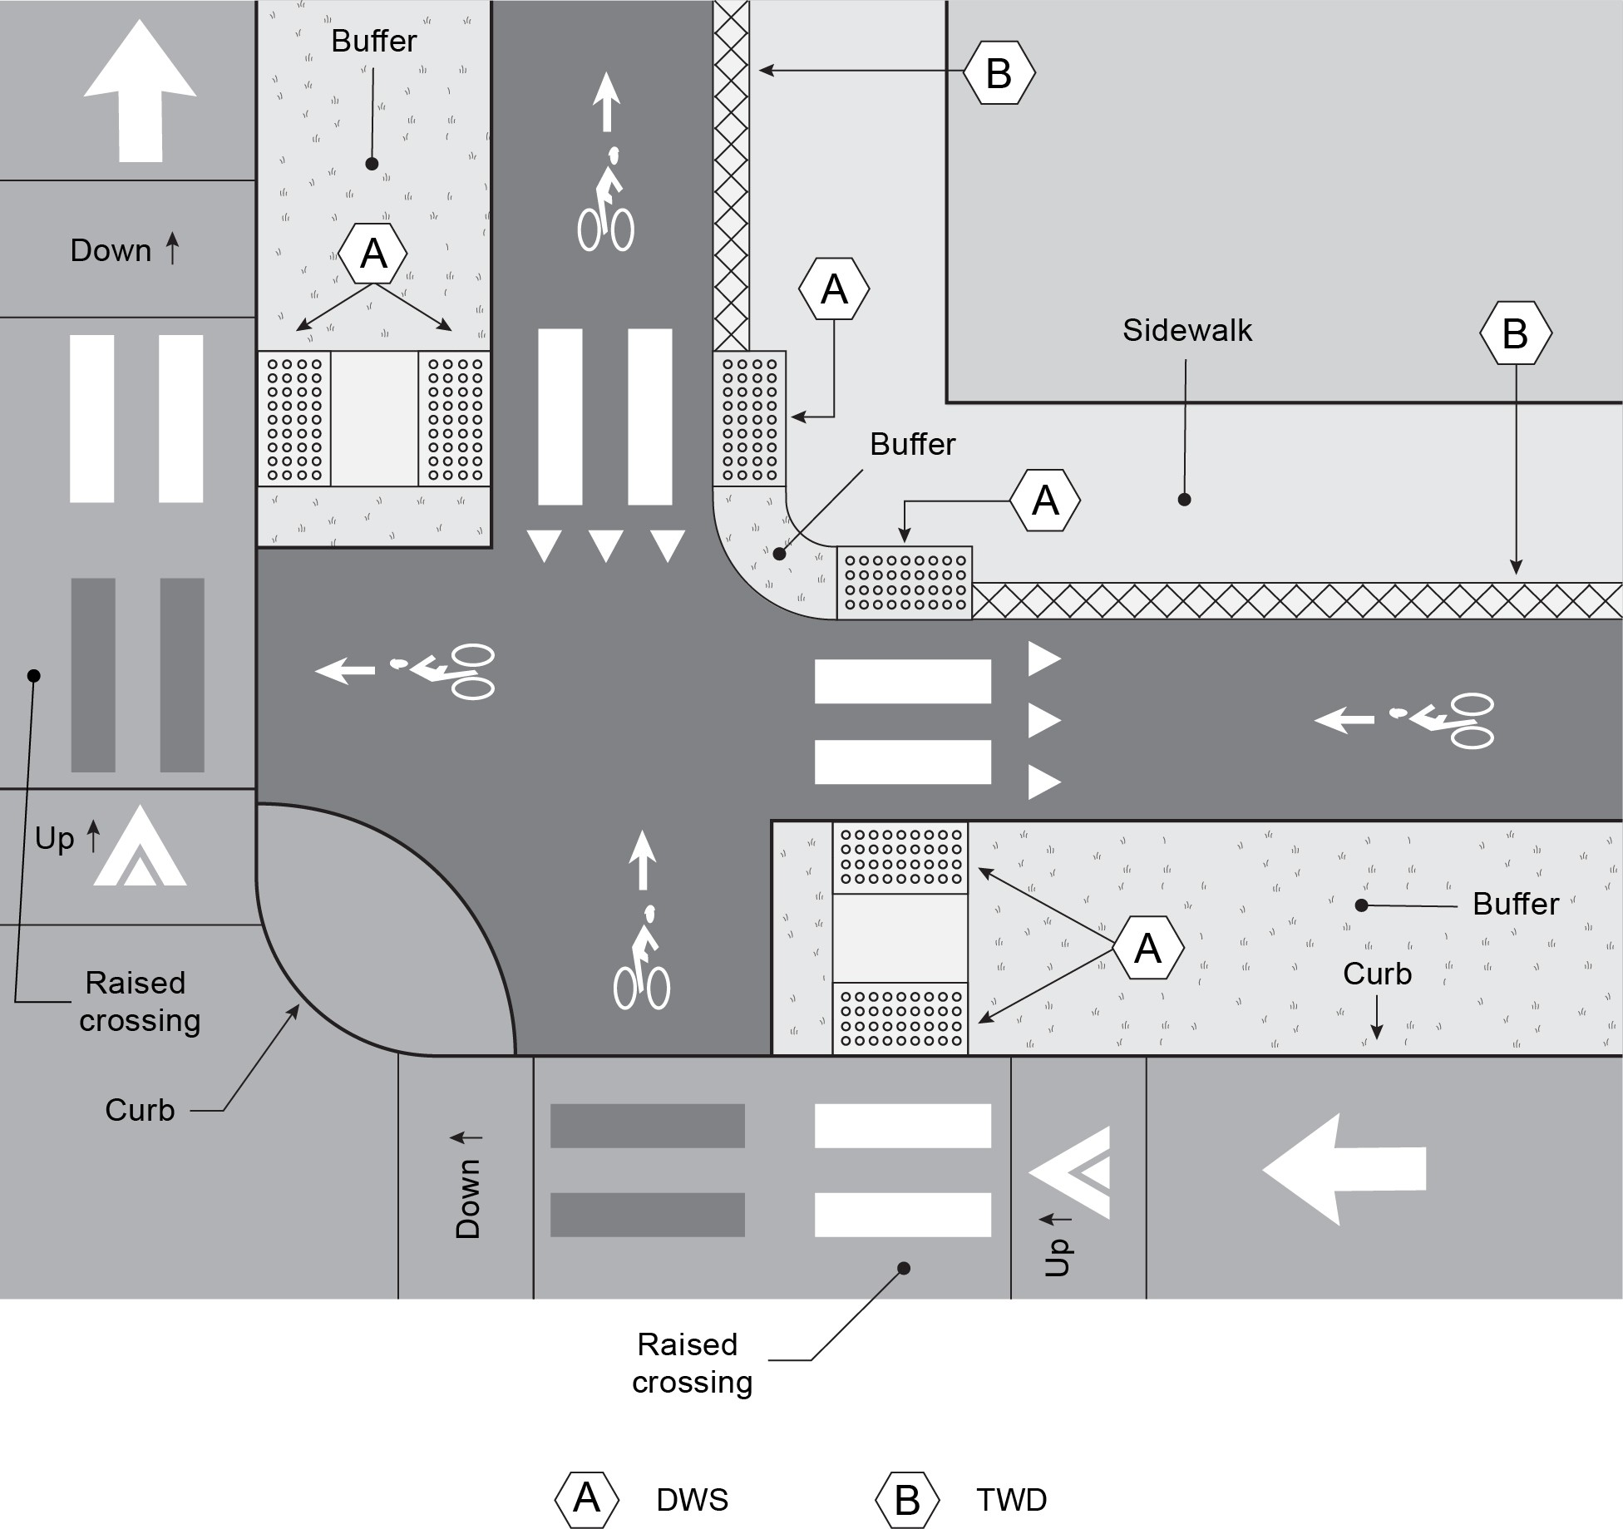
Separated Bike- Ped Facilities
TCRP Research Report 248, Figure 39

Slide 23
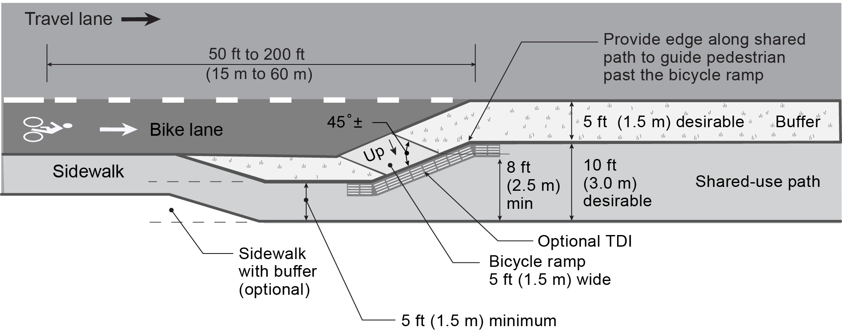
Bicycle Ramp Applications
Used to transition between on-street bicycle lane and shared-use path
TCRP Research Report 248, Figure 40

Slide 24
Implementation Challenges

Slide 25
Implementation
Selecting TWSI materials
Maximizing durability and detectability
Minimize future maintenance
Guidance for Orientation and Mobility (O&M) Professionals
Training potential users
Discussion of basic principles using terminology familiar to O&M professionals
“Domes”, “Raised Bars”, and “Trapezoid”
Discussion of locations where different kinds of TWSIs might be found
Cane technique for detecting TWSIs
Strategies for using TWSIs

Slide 26
Implementation Activities
Assessing effectiveness of tactile wayfinding system after installation
Maintenance
System design to minimize future maintenance
Routine maintenance activities
Maintaining wayfinding during utility and construction work
Developing Standards
Designating a team
Affording the team?

Slide 27
Tactile Warning Delineator (TWD)

Slide 28
Case studies
Brief case studies on four U.S. agencies
Bay Area Rapid Transit (BART), San Francisco Bay Area, California
Los Angeles Metro Rail, Los Angeles County, California
City of San Francisco, California
City of Seattle, Washington

Slide 29
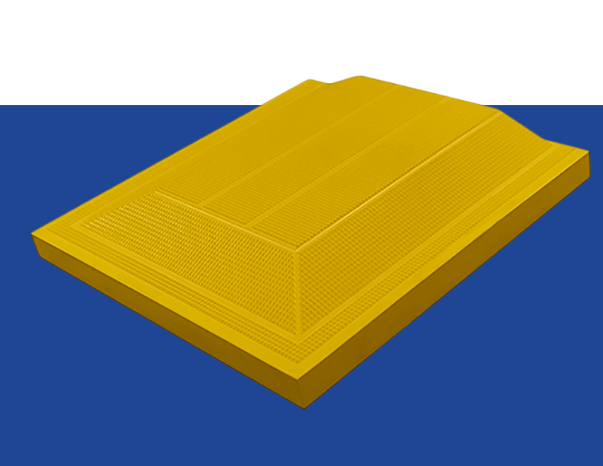
Tactile Warning Delineator (TWD)

Slide 30
Tactile Wayfinding
Questions
and
Comments

Slide 31
Parallel Curb Ramps 6’ wide

Slide 32
Access Board- Public Right of way accessibility guidelines (PROWAG)
PROWAG PR (2013) R304.3.1 Turning Space
A turning space 1.2 m (4.0 ft) minimum by 1.2 m (4.0 ft) minimum shall be provided at the bottom of the curb ramp and shall be permitted to overlap other turning spaces and clear spaces.
If the turning space is constrained on 2 or more sides, the turning space shall be 1.2 m (4.0 ft) minimum by 1.5 m (5.0 ft). The 1.5 m (5.0 ft) dimension shall be provided in the direction of the pedestrian street crossing.
PROWAG FR (2023) R304.3.4 Landings
Landings shall be provided at the bottom of parallel curb ramps. Landings shall be 48 inches (4.0 ft) wide minimum by 48 inches (4.0 ft) long minimum. The slope of the landing, measured parallel to the direction of travel on the curb ramp run, shall be permitted to be equal to or less than the slope of the roadway or the cross slope of the crosswalk as specified by R302.5..

Slide 33
Parallel curb ramps – California Building Code (CBC)
11B-406.3.2 Turning space. A turning space 48 inches minimum by 48 inches minimum shall be provided at the bottom of the curb ramp. The slope of the turning space in all directions shall be 1:48 maximum.

Slide 34
2019 Intermediate Code Changes
DSA STATEMENT OF REASONS:
This change reformats Section 11B-705.1.2.2 to present detectable warnings requirements separately for perpendicular and parallel curb ramps. Revised detectable warning requirements are also provided for parallel curb ramps with one entrance/exit point (i.e. transition from the turning space to the gutter, street or highway) and those with two entrance/exit points – as may be found in parking lots where a median has accessible parking on both sides of an island.
The amendment language requires the turning space to include a 36” minimum width passage without detectable warnings so pedestrians may travel through the turning space without passing over the detectable warnings. This provision responds to numerous comments from wheelchair users who experience pain when travelling over extended lengths of detectable warnings.

Slide 35
Parallel Curb ramps - CBC
11B-705.1.2.2.2.1 One entrance/exit point. Where the turning space has one entrance/exit point other than the sloped ramp segments, detectable warnings shall be 36 inches deep, as measured perpendicular to the curb, and the turning space shall provide minimum 36 inches wide portion without detectable warnings to allow pedestrian travel in the direction of the sidewalk without travelling over the detectable warnings.
Exceptions:
1. Where it is technically infeasible to provide a minimum 72 inches wide turning space, as measured perpendicular to the curb, the depth of detectable warnings may be reduced to 24 inches minimum.
2.Existing parallel curb ramps with detectable warnings in compliance with the code requirements in effect at the time of installation shall not be required to provide a minimum 36 inches wide portion of the turning space without detectable warnings.

Slide 36
Parallel Curb ramps - CBC
11B-705.1.2.2.2.2 Two entrance/exit points. Where the turning space has two entrance/exit points other than the sloped ramp segments, detectable warnings shall be 36 inches deep at both entrance/exit points, as measured perpendicular to the curb, and the turning space shall provide a minimum 36 inches wide portion without detectable warnings to allow pedestrian travel in the direction of the sidewalk without travelling over the detectable warnings.
Exceptions:
1. Where it is technically infeasible to provide a minimum 72 inches wide turning space, as measured perpendicular to the curb, the depth of detectable warnings may be reduced to 24 inches minimum.
2.Existing parallel curb ramps with detectable warnings in compliance with the code requirements in effect at the time of installation shall not be required to provide a minimum 36 inches wide portion of the turning space without detectable warnings.

Slide 37
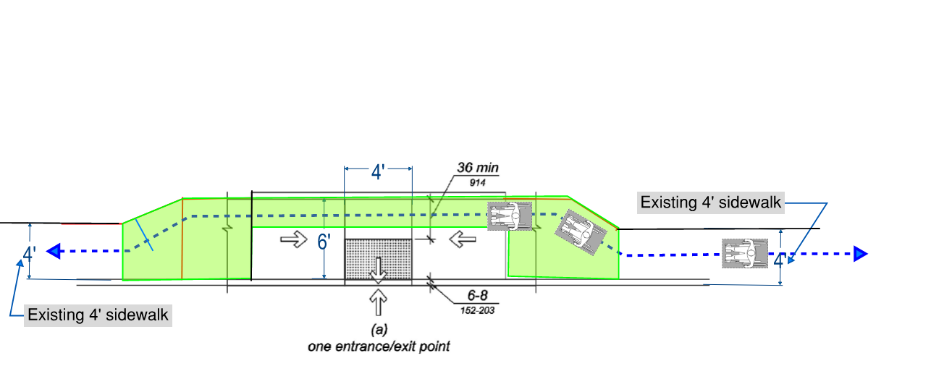
For existing 4’ wide sidewalks:
Will the wheelchair user will zig-zag to avoid rolling over 4’ long truncated domes?
The green highlighted area indicates the additional square footage needed for the extra 2’.

Slide 38
6’ wide parallel curb ramp
Questions
and
Comments

