Slide 1
San Diego Fire-Rescue Department
City of San Diego Fire Hazard Severity Zone Map 2025

Slide 2
San Diego Fire-Rescue
Objectives
Provide a general overview of the FHSZ
Review the Requirements within a FHSZ
Review changes from 2009 to 2025
Highlight SDFD proposed modifications to the map

Slide 3
San Diego Fire-Rescue
History of FHSZ
Oakland Hills Fire 1991
Destroyed almost 3,000 single family homes, 25 people killed
“Bates Bill” (AB 337), Government Code Section 51175
California Legislators declared that:
Wildfires are extremely costly to property owners, residents and local agencies
Wildfires pose a serious threat to the preservation of the public peace, health, or safety
The prevention of Wildland Fires is a statewide concern
Places responsibility on CAL FIRE to evaluate fire hazard severity in local responsibility area and to make a recommendation to the local jurisdiction where very high FHSZs exist.
The Government Code then provides direction for the local jurisdiction to take appropriate action.

Slide 4
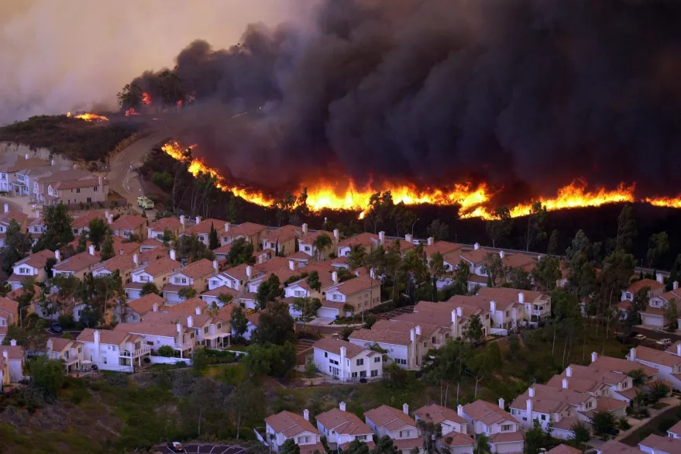
San Diego Fire-Rescue
What is a FHSZ?
A geographic area identified by the state as moderate, high, and very high fire hazard severity zones based on consistent statewide criteria and based on the severity of fire hazard that is expected to prevail in those areas
Includes:
Vegetation
Topography
Climate
Fire history
Other relevant factors

Slide 5
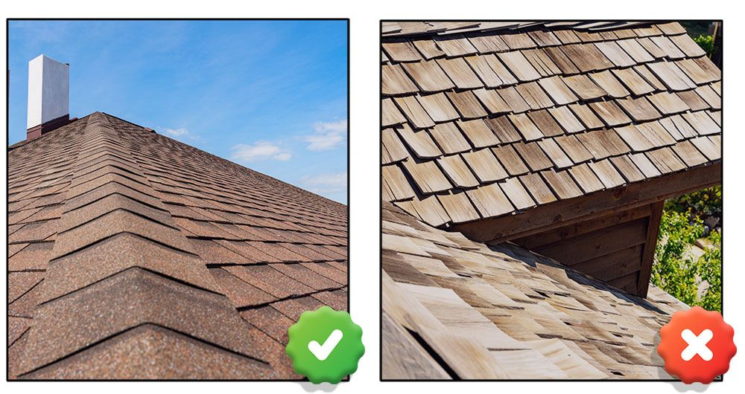
San Diego Fire-Rescue
What Does a FHSZ Determine?
Defensible space requirements
Real estate disclosures
Building construction
Land use and planning

Slide 6
San Diego Fire-Rescue
Local Agency Responsibility
2025 LRA Maps received on March 24, 2025
Within 30 days of receiving the draft map the local agency must make available for review and public comment – GOV 51178.5
Designate by ordinance moderate high and very high FHSZ within 120 days – GOV 51179
Cannot reduce the FHSZ rating – GOV 51179 (b)(3)
May include additional areas based on substantial evidence – GOV 51179 (b)(2)

Slide 7
San Diego Fire-Rescue
Requirements within a FHSZ
Differences between SRA and LRA.
Minimal Requirements for LRA “High”
No Requirements for LRA “Moderate”

Slide 8
San Diego Fire-Rescue
Challenges with Moderate and High Zones
This photo shows an example of a canyon in Tierrasanta where homes that are adjacent to each other would have differing requirements as illustrated in the chart on the previous slide.
Homes shown in red rectangle are in “very high” and must meet all requirements for defensible space, 7A construction and land use and planning.
Homes shown in orange are in “high” and have minimal requirements.
Homes shown in yellow are in “moderate” and do not have any requirements beyond being designated on a map.
Homes in black rectangle are not mapped in a FHSZ.
No Req.
Not Mapped
Min. Req.
All Req.

Slide 9
San Diego Fire-Rescue
Changes in 2025 Maps
 | Moderate | High | Very High
2009 | ----- | ----- | 100,913* 153,903**
2025 | 10,776* | 23,331* | 71,833*
Change | 10,776* | 23,331* | -29,080* -82,070**
*Designated by CalFire
**Designated by CoSD
53 % Reduction in VHFHSZ Acreage from 2009 to 2025
Due to re-classification
Introduction of Moderate and High FHSZ in LRA in 2025
Additional areas designated by City in 2009 (included brush management zones as VHFHSZ)

Slide 10
San Diego Fire-Rescue
Many of the City’s canyon rim areas were not identified in the 2025 LRA maps
Significant History and Risk associated with fires in and around City’s canyons
1985 Normal Heights Fire
2024 Montezuma Fire
Encampment Fires
Almost 2,000 vegetation fires in the last 5 years

Slide 11
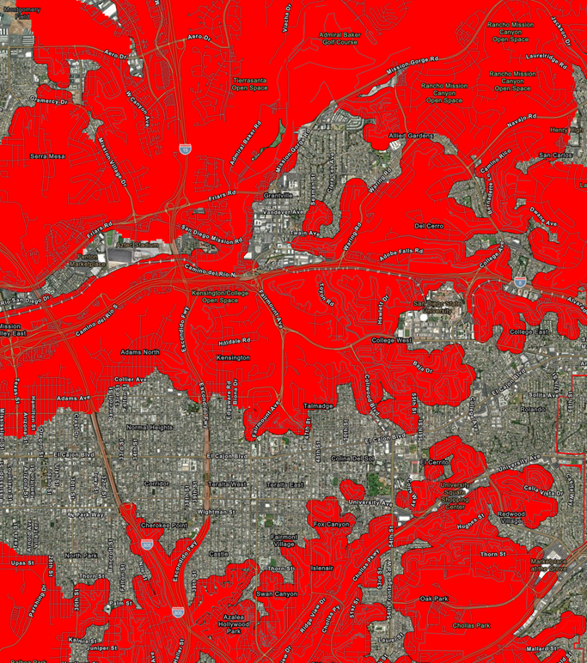
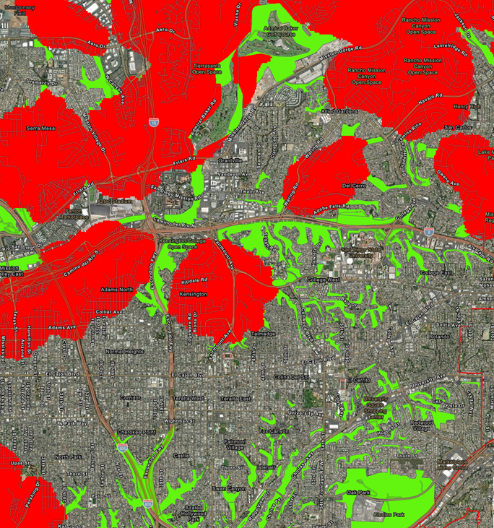
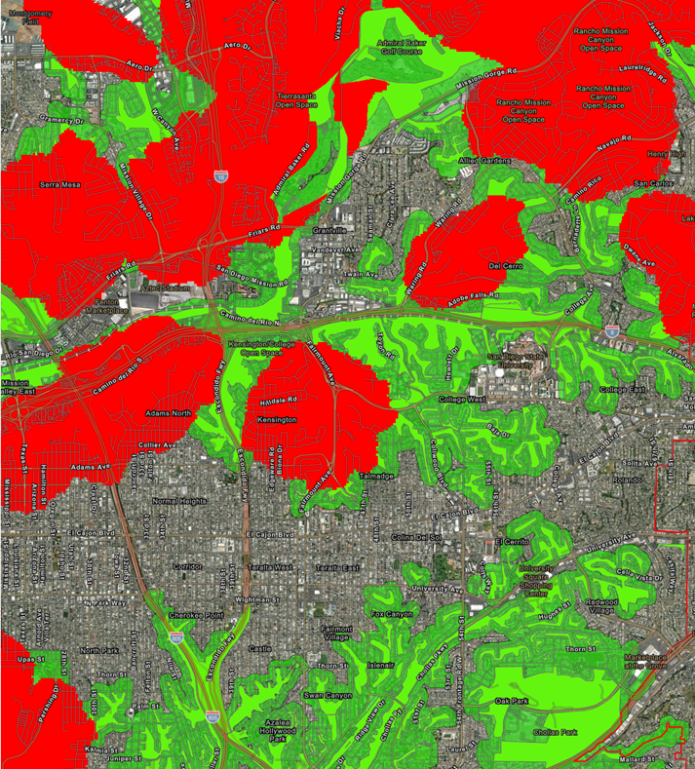
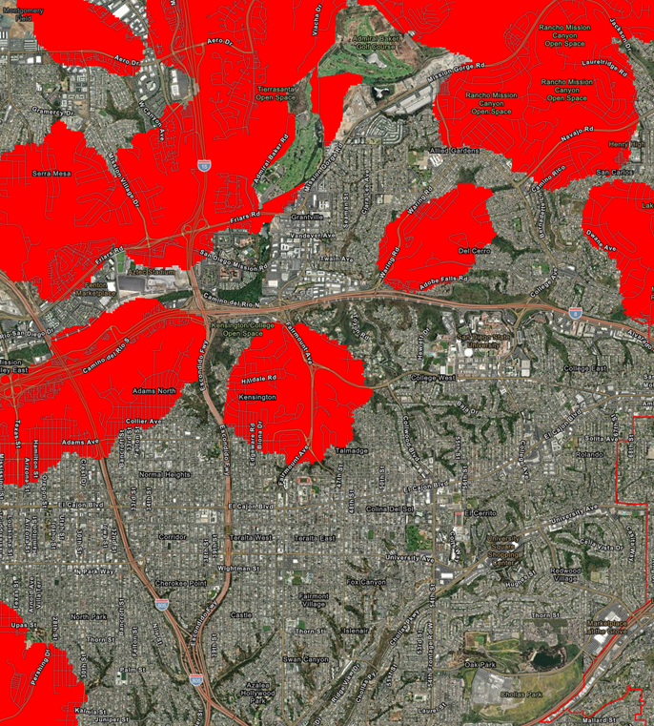
San Diego Fire-Rescue
Proposed Actions by the City
Adopt the FHSZ as designated by the SFM
Re-designate High and Moderate to Very High
Include additional areas identified by SDFD
Designate FHSZ by Ordinance and transmit Ordinance and amended FHSZ maps to CalFire

Slide 12
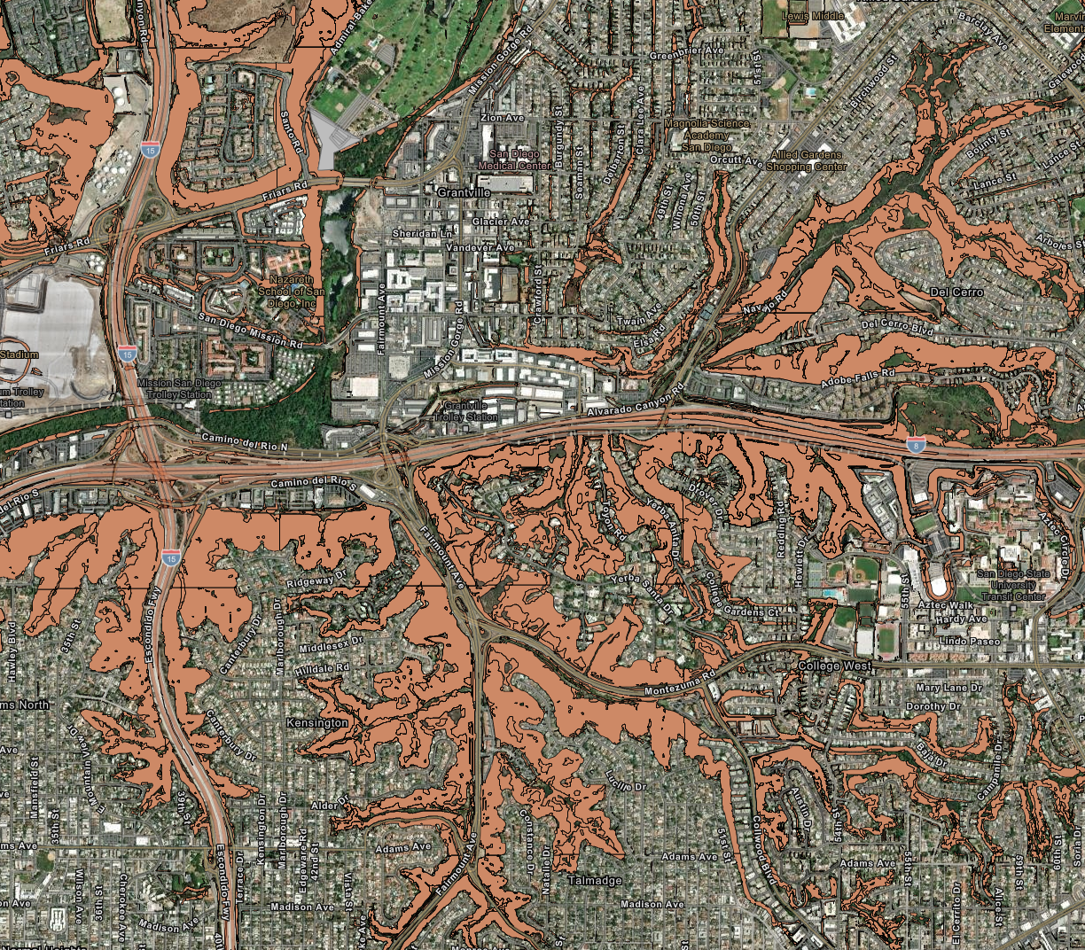
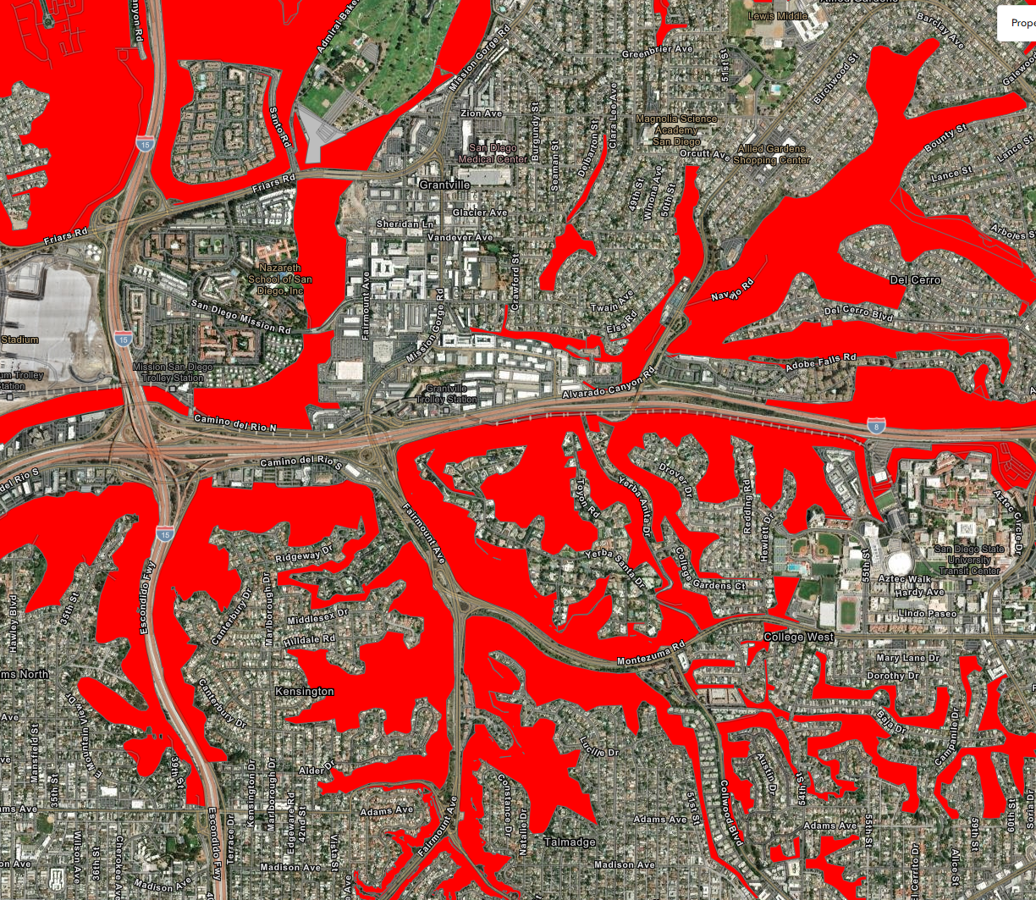
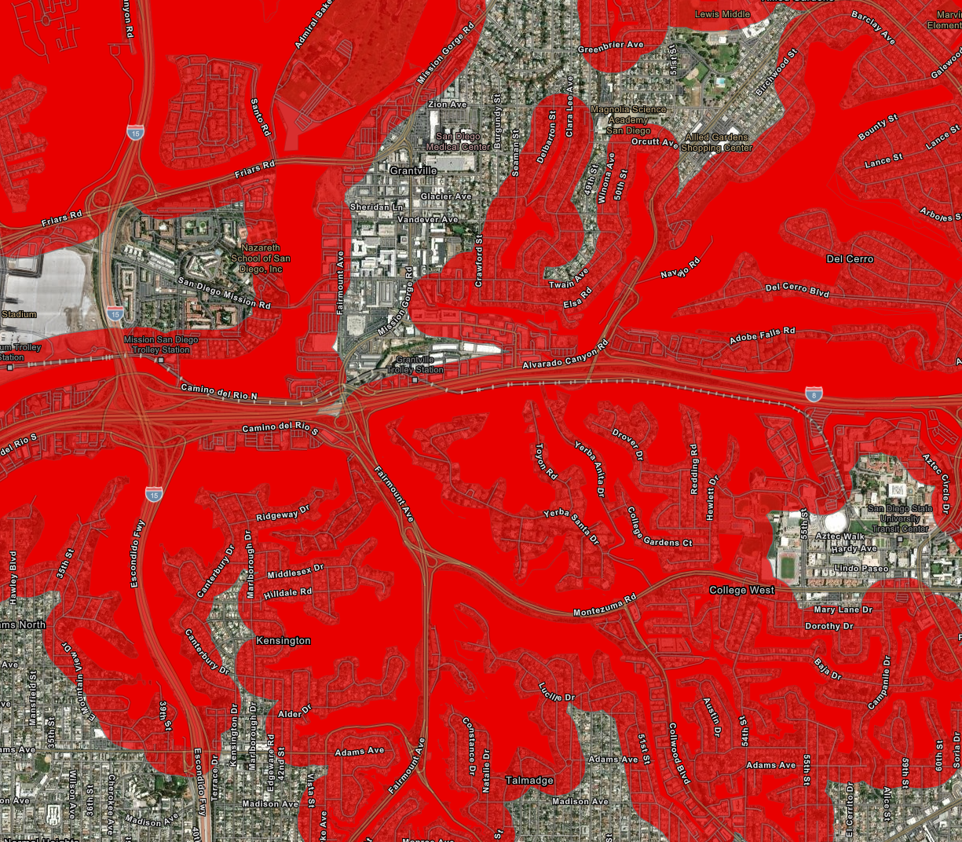
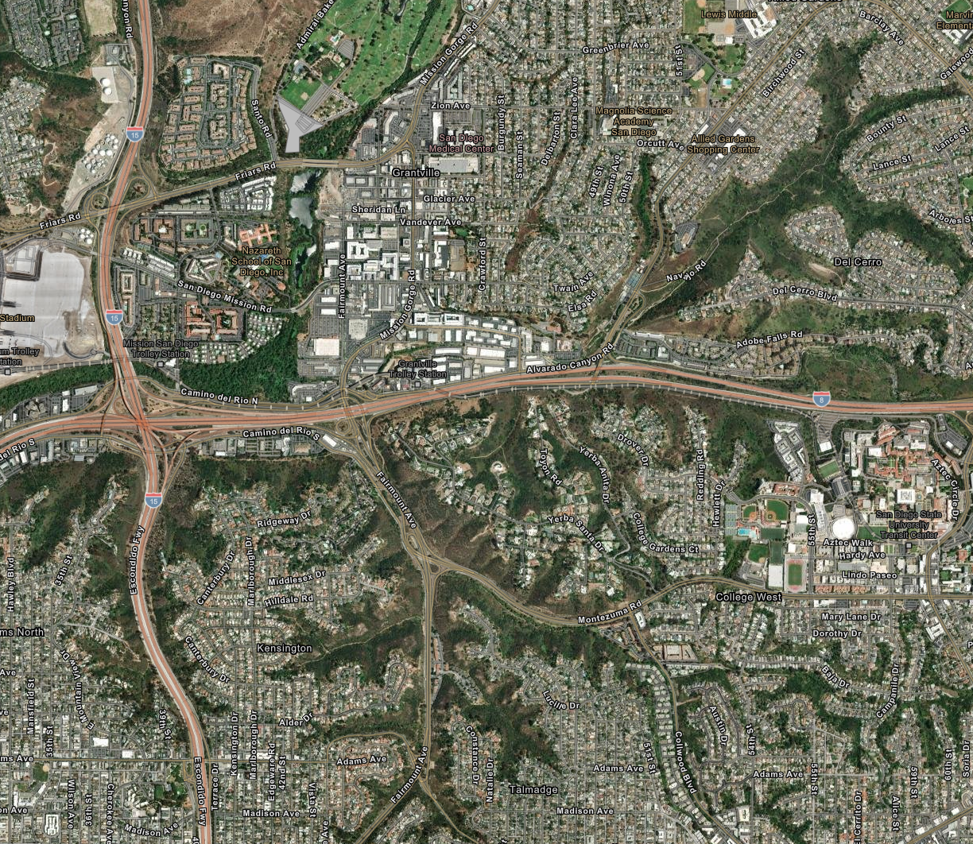
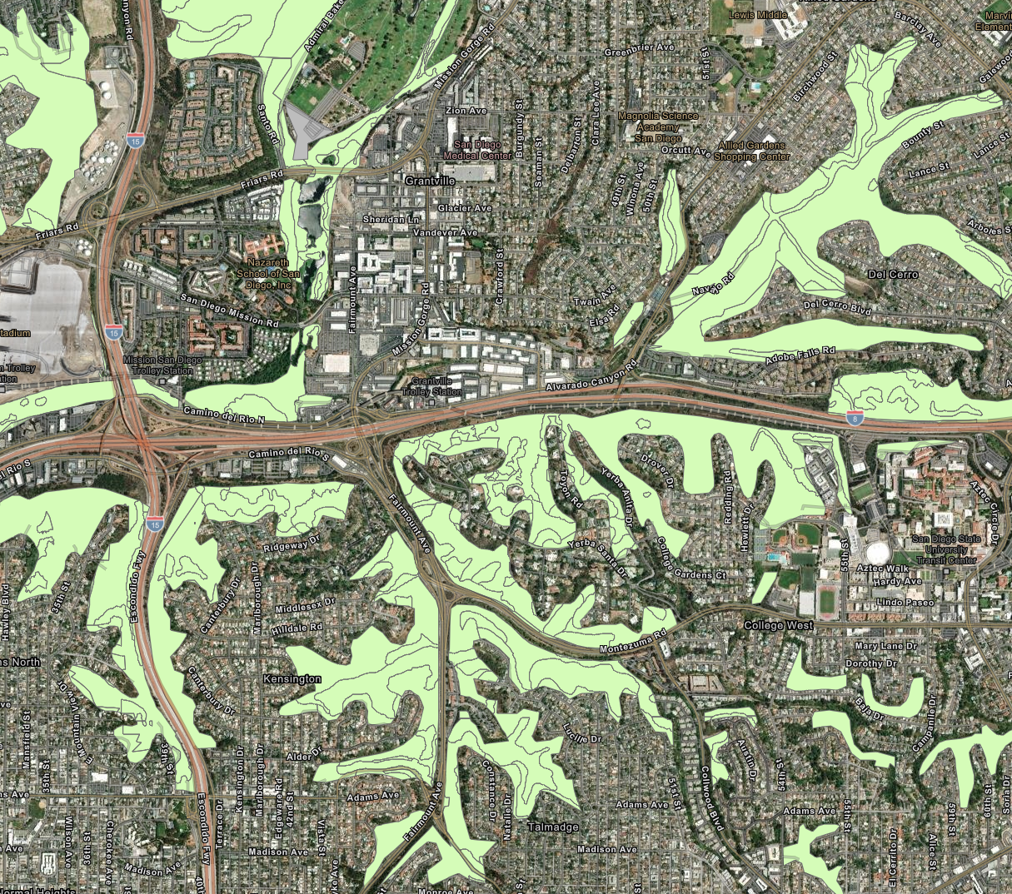
San Diego Fire-Rescue
Inclusion Criteria for City Designated Areas
Primarily located in and around canyons and areas of native and naturalized vegetation.
Considerations:
Vegetation
Slope/terrain
Fire History
Access
Consistent with 2009 methodology

Slide 13
San Diego Fire-Rescue
How will this affect my insurance
FHSZ identify Hazard not Risk
Insurance companies have their own risk models
Hazard + Mitigation = Risk
Long term solutions
Identifying hazardous fire areas enables homeowners and communities to reduce their wildfire risk

Slide 14
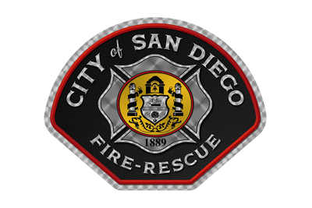
San Diego Fire-Rescue
Questions?

