Slide 1
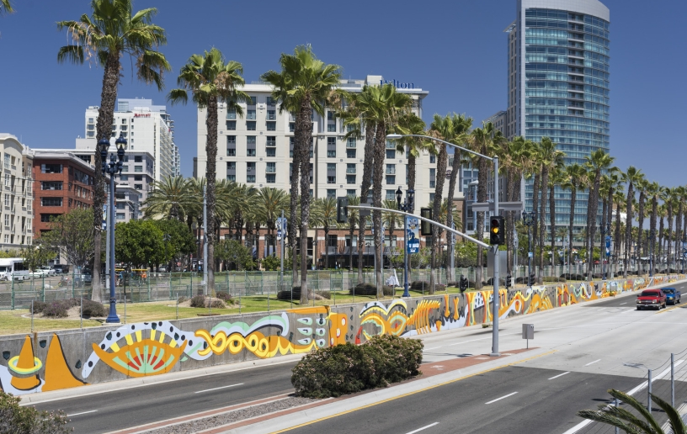
Council Office CPPS Funding Fiscal Year 2026
Council Administration
Abigail Edwards, Grants Manager
Malachi Bielecki, Grants Coordinator
Notes:
Hi everyone! Thank you so much for joining us this evening as we provide an overview of the upcoming grant cycles for the CPPS funding program, which we are excited to announce was funded in the City’s Fiscal Year 2026 budget. My name is Malachi Bielecki and I’m a Grants Coordinator with Council Administration here at the City of San Diego and this is Abby, our Grants Manager. Our team manages the grant process on behalf of the City Council Offices and we’ll be your primary points of contact for anything related to CPPS. We just ask that you hold your questions for the end, when we’ll do a Q&A.

Slide 2
Partnering with the City Council: CPPS Funding
Community Projects, Programs and Services (CPPS) Funding Program
Background
CPPS funding is awarded to nonprofit organizations, public agencies, and City departments for projects, programs, and services that serve a lawful public purpose to benefit the City’s neighborhoods and communities.
CPPS funding is awarded at the discretion of each council office.
CPPS is governed by Council Policy 100-06.
Notes:
CPPS funding is awarded to nonprofit organizations, public agencies, and City departments for projects, programs, and services that serve a lawful public purpose to benefit the City’s neighborhoods and communities. Awards are granted solely at the discretion of each individual Councilmember and their office as this grant gives them the opportunity to connect directly with the needs of their communities and the city as a whole. Our department is not involved in funding decisions, but we do vet applicants for eligibility and compliance and manage the application, contracting, payment, and reporting processes.
The rules governing the CPPS program are articulated in Council Policy 100-06, which is available online. We strongly recommend that applicants familiarize themselves with this document as it articulates the program requirements in full.

Slide 3
Partnering with the City Council: CPPS Funding
FY26 CPPS Budget
Budget Summary
FY26 CPPS Funds: $900,000
$100k per office
Procedures for Funding:
Funding Agreement (contract)
Nonprofits or Public Agencies
Transfer Memorandum
City Departments
City Capital Improvement Projects (CIP)
Notes:
The City’s recently approved Fiscal Year 2026 budget includes a $900,000 allocation for CPPS. This number is divided evenly across the nine Council Offices, with each office maintaining a CPPS discretionary fund of $100,000 and each of them making their own grant funding decisions. Council Offices may use their CPPS funding in two different ways. Most of the time, funds are awarded as grants to nonprofit organizations or public agencies to carry out community projects, programs, and services. This past fiscal year, over 90% of the CPPS budget was used for those purposes. Less frequently, Council Offices transfer CPPS funds to City departments for similar uses or they may allocate funding to an existing City capital improvement project, or CIP.

Slide 4
Partnering with the City Council: CPPS Funding
FY26 CPPS Schedule
Important Dates
Application: July 7 – August 7, 2025
Award Announcement: October 2025
City Processing: October 2025 – March 2026
Payments: March – June 2026
Reporting: June – July 30, 2026
Notes:
The CPPS application opened on Monday, July 7th, and will close just before midnight on Thursday, August 7th. Immediately following the application period, our office will vet applications for eligibility and provide a cure period, allowing applicants to correct any resolvable errors. The Councilmembers and their team will then select their grant allocations and the City Attorney’s Office reviews those selections to confirm legality. With that, we expect to publicly announce this cycle’s tentative grant awards by the end of October. After the announcement, our team works diligently to generate funding agreements, bring the allocations before the full City Council for approval, and complete all City processing, which is slated for completion by the end of March 2026. Once an award has been approved by the full City Council and the funding agreement has been executed, we begin disbursing payments to grantees in good standing. The payment process will take place through the end of the fiscal year. Once a payment is processed, we provide the grantee with reporting documents, which are due no later than July 30, 2026. Please remember that grant allocations are considered tentative until city processing is complete and that these dates are subject to change. We strongly encourage applicants to submit their paperwork as soon as possible due to the typical high volume.

Slide 5
Partnering with the City Council: CPPS Funding
CPPS Council Policy
Funding Eligibility
Hold a legally tax-exempt (IRS) or nonprofit status in good standing or be a public agency functioning within the City.
Tax-exempt with the Internal Revenue Service (IRS).
“ACTIVE” with the California Secretary of State (SOS).
“CURRENT” or “EXEMPT” with the California Attorney General (AG).
Be financially solvent and provide the most current IRS Form 990, similar documentation, or proof of exemption.
Disclose all sources of organizational funding.
Notes:
Now we’ll review funding eligibility. Applicants must hold a legally tax exempt or nonprofit status in good standing or be a public agency functioning within the City. This includes holding a tax-exempt status with the IRS, the most typical designation for which is a 501(c)(3) status, however, we do accept other tax-exempt designations such as 501(c)(6). It also includes being in and remaining in good standing with the California Secretary of State and the California Attorney General or being otherwise exempt. Good standing with the Secretary of State is reflected as an “ACTIVE” status, and a condition for this is good standing with the California Franchise Tax Board. Good standing with the Attorney General is typically reflected as “CURRENT,” “MUTUAL BENEFIT,” or “EXEMPT.” These state agencies require annual filings, and we strongly recommend that nonprofits check to ensure that they are up-to-date on their filings. It’s also important to note that these standards must be upheld both at the time of application submission, and throughout the grant period up to the payment process. Should an applicant or grantee fall out of good standing, we will do our best to assist them in resolving the issue but cannot guarantee qualification. Next, applicants must be able to prove financial solvency by submitting annual return information such as an IRS Form 990 and be able to disclose all sources of organizational funding. Note that new nonprofits that have not yet filed a return with the IRS may provide alternative documentation. Lastly, applicants that do not meet these requirements may be eligible to apply via a fiscal sponsor that can.

Slide 6
Partnering with the City Council: CPPS Funding
CPPS Council Policy
Funding Uses
1. Capital improvements performed on private property.
Capital improvements may not be performed on public property, even with a right-of-entry permit.
Facilities must be open to the public (cannot require membership).
Projects with a total cost over $15,000 that involve alteration, demolition, installation or repair work or new construction work with a total cost over $25,000 will be subject to prevailing wage law.
Notes:
What can funding be used for? Applicants may request funds to perform capital improvements on private property, but not on public property, even with a right-of-entry permit. Capital improvements are only eligible if the space undergoing work will be open to the public and not require an organizational membership for access. It’s important to know that certain projects may trigger prevailing wage law if their costs are above a certain threshold. Generally, for work involving alteration, demolition, installation or repairs, that threshold is $15,000. For new construction, that threshold is $25,000. Please note that these numbers refer to the total cost of the project, not just the amount of CPPS funds that would contribute to the project. Complying with prevailing wage law is often burdensome for small nonprofits as it triggers several additional regulations, including using a contractor that is registered with the Department of Industrial Relations. As such, we encourage applicants to apply for smaller projects. An example of an eligible capital improvement project would be requesting funding to renovate a community room or another part of a facility that is open to the public.

Slide 7
Partnering with the City Council: CPPS Funding
CPPS Council Policy
Funding Uses
2. The purchase, installation, repair, or maintenance of equipment, materials, goods, or supplies, including expenses related to technology or educational services.
Cannot be used for a public works project.
Cannot purchase surveillance technology.
3. The staging of social, environmental, educational, cultural, or recreational community programming or events.
Ticketed events are allowed if they are open to the public and do not require organizational memberships.
Notes:
Applicants may request CPPS funds for the purchase, installation, repair, or maintenance of equipment, materials, goods, or supplies, including expenses related to technology or educational services. Examples may include but are not limited to purchasing staging equipment like tables and chairs, installing software, repairing a computer, or maintaining a vehicle if it is for a clear public purpose. As discussed on the previous slide, these expenses may not be used as part of a capital improvement on public property. It’s also important to note that grantees cannot purchase surveillance technology, such as security cameras, as this could implicate the City’s surveillance ordinance.
Next, applicants may also request funds to stage social, environmental, educational, cultural, or recreational community programming or events. Examples may include, but are not limited to, rental payments for a venue or stipend payments to program participants, such as performing artists. Ticketed events are allowed if they are open to the public and do not require organizational memberships.

Slide 8
Partnering with the City Council: CPPS Funding
CPPS Council Policy
Funding Uses
4. The purchase of food or beverages only if they are provided to individuals or families in need.
Cannot be purchased for other uses.
5. In support of ongoing operational expenses.
Examples may include payroll expenses, rent payments, utility payments, and insurance payments.
Notes:
Applicants may request funding to purchase food or beverages, but only if they are provided to individuals or families in need through a specific program like a food bank. An example of an eligible use of this type would be if a foodbank or homeless shelter used funding to purchase food for its clients. An example of an ineligible use would be purchasing food for an event like a community festival or block party.
Lastly, applicants may request funding to pay for ongoing operational expenses, including but not limited to payroll expenses, rent payments, utility payments, and insurance payments.. An example of an eligible use of this type would be paying rent on an office or facility.

Slide 9
Partnering with the City Council: CPPS Funding
CPPS Council Policy
Important Reminders
CPPS funds cannot be used for any purpose prohibited by laws governing the use of public funds.
No private, political, religious, or fundraising purpose or activity.
Council offices may prioritize funding requests for “one-time” uses.
Council offices may encourage applicants to pursue matching funds.
All expenses must be incurred within Fiscal Year 2026 (July 1, 2025 – June 30, 2026).
Notes:
Here are some other important program reminders:
CPPS funds cannot be used for any purpose prohibited by laws governing the use of public funds, such as private, political, religious, or fundraising purposes or activities. An example of a common situation with which the use of funds would not be allowed is the hosting of a fundraising gala. It’s also worth noting that applicants whose primary focus is in one of these areas, such as a church, may still be eligible for funding if the proposed project itself does not violate these rules. Next, Council Offices may prioritize funding requests for “one-time” uses, meaning that there may be greater scrutiny toward funding requests for ongoing expenses that could require continuous funding to sustain. Council Offices may also encourage applicants to pursue matching funds and may give preference to those who have matching funds available for their project, though they are not explicitly required. Lastly, any expenses must have been incurred within Fiscal Year 2026, which is between July 1, 2025, and June 30, 2026.

Slide 10
Partnering with the City Council: CPPS Funding
CPPS Projects/Programs/Services
Examples from FY25
Mama’s Kitchen: Medically Tailored Meal Service
San Diego Unified School District: Memorial Plaque at Valencia Park Elementary
Persian Cultural Center: Nowruz Persian New Year
Otay Mesa Chamber of Commerce: IT and Software Support / Street Banners
Somali Bantu Association of America: Youth Program Director
Notes:
Here are some examples of organizations and projects that received CPPS funding for a diverse array of programming in Fiscal Year 2025:
Mama’s Kitchen for their Medically Tailored Meal Service program
San Diego Unified School District for the installation of a Memorial Plaque at Valencia Park Elementary
Persian Cultural Center to host their Persian New Year event
Otay Mesa Chamber of Commerce for IT and Software Support as well as the installation of street banners
And lastly, Somali Bantu Association of America to fund their Youth Program Director position
These are just a few of nearly 200 diverse projects that received funding in Fiscal Year 2025.

Slide 11
Partnering with the City Council: CPPS Funding
CPPS Application Process
Pre-Application
Contact the council office(s) to learn more about their funding priorities.
Council Grant Representatives
Verify compliance with all standards required by Council Policy 100-06.
Must be in good standing at the time of application submission.
Recognize that applying for CPPS funding does not guarantee funding.
Notes:
Now we’ll go over some steps to take pre-application. Prior to applying, we strongly recommend that prospective applicants contact the Council Offices that they will be requesting funding from. This will give applicants a better understanding of a Councilmember’s funding priorities since grants are awarded strictly at the discretion of each office. Applicants can locate the CPPS representative for each respective Council Office on our webpage. Next, ensure that your organization can meet all requirements in Council Policy 100-06. Applicants must be able to meet these standards at the time of application submission. Lastly, recognize that applying for CPPS funds does not in any way guarantee that an organization will receive funding, and awards should be considered tentative until they are approved by the full City Council and a funding agreement is finalized by all parties.

Slide 12
Partnering with the City Council: CPPS Funding
CPPS Application Process
Application Overview
Use the CPPS Application Instructions as a guide.
An applicant may submit multiple applications.
Only one project/program/service is allowed per application.
May request funding from multiple council offices within the same application.
A funding request may not be less than $1,500.
Demonstrate that the project/program/service is open to the public, serves a lawful public purpose, and benefits San Diego’s communities.
Notes:
Now we’ll go over the actual application process. We suggest using the detailed application instructions linked on our webpage as a guide to save time. An applicant may submit multiple applications, but only one project, program, or service is allowed per application. However, if a proposed project is part of a series or will be hosted in multiple locations, then those may be consolidated to a single application. Within an application, an applicant may request funding from as few as one Council Office to as many as all nine. Next, funding requests and awards may not be for less than $1,500. In Fiscal Year 2025, grantees received awards as small as $1,500 and as large as $27,000, though the median is a few thousand dollars. Lastly, be able to demonstrate that the proposed project is open to the public, provides a lawful public purpose, and is of value to San Diego’s communities and neighborhoods.

Slide 13
Partnering with the City Council: CPPS Funding
CPPS Application Process
Application Overview
Due at the time of application:
Standard application
Proof of nonprofit status with the IRS
Proof of “ACTIVE” status with the CA SOS
Proof of “CURRENT” (or exempt) status with the CA AG
Certification for a Drug Free Workplace
EOC Workforce Report (pages 1-3)
IRS Form 990, 990EZ, or 990N
IRS Form W-9
Notes:
Malachi Bielecki:
The following is due at the time of application submission:
A completed standard application, which is available on the CPPS webpage and has been provided to our email distribution list.
An IRS determination letter confirming proof of nonprofit status.
Confirmation of good standing or exemption with the California Secretary of State and Attorney General, both of which can be provided by submitting a screenshot of the applicant's page on those respective portals.
A completed Drug Free Workplace report.
A completed EOC Workforce Report.
An IRS Form 990, 990EZ, 990N, or equivalent annual filing.
And lastly, an IRS Form W-9.
The standard application includes a function to upload documents for the proof of good standing with the IRS, Secretary of State, and Attorney General, and to upload the IRS Form 990 or annual filing. The remaining documents, including the Drug Free Workplace Report, EOC Workforce Report, and IRS Form W-9 are fillable within the application itself.
It is very important that your organization fills in all fields on these forms where possible, paying special attention to signatures and dates. Any missing information may result in a delay to your application or loss of eligibility.

Slide 14
Partnering with the City Council: CPPS Funding
CPPS Application Process
Supplemental Documentation
To check nonprofit status:
Use the Tax-Exempt Organization Search tool.
Cannot locate or lost letter:
Contact Customer Account Services by phone, letter, or fax to request an affirmation letter.
The request must include:
Full name
Employer Identification Number
Authorized signature (an officer or trustee)
Notes:
Malachi Bielecki:
Now we’ll go a little bit more in-depth on the supplemental documentation. To check your organization’s nonprofit status, you can use the IRS’s Tax-Exempt Organization Search, which is available online. In the case that you cannot locate your organization’s status; you will need to contact their customer service. It’s important that you have the full IRS determination letter on file for submission, including the signature portion of the letter which we have found is sometimes excluded.

Slide 15
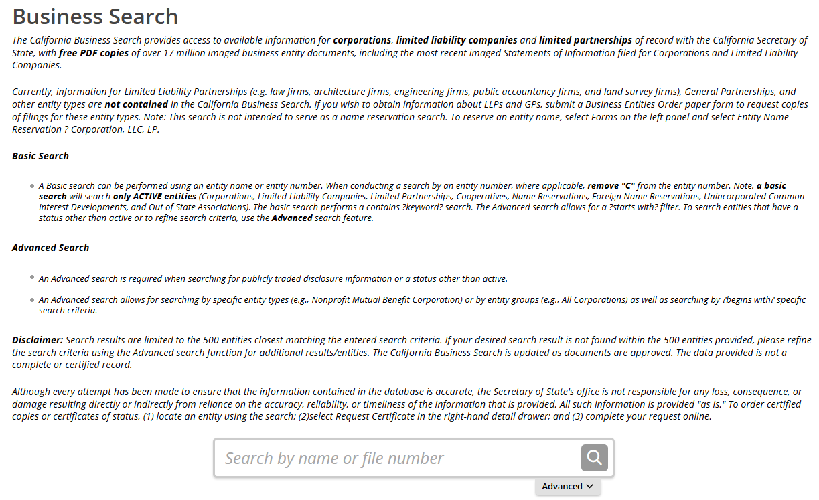
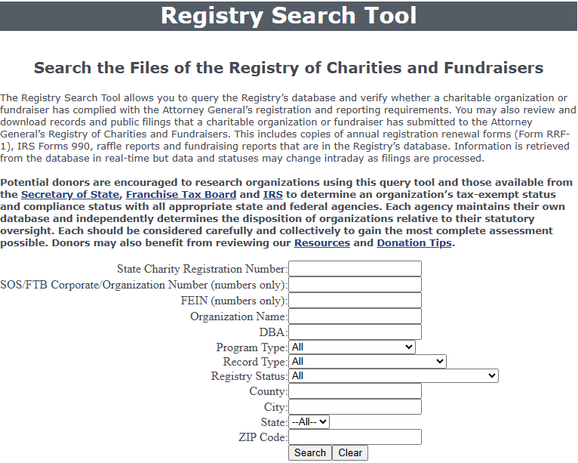
Partnering with the City Council: CPPS Funding
CPPS Application Process
Supplemental Documentation
ACTIVE status with the CA SOS.
CURRENT (or exempt) status with the CA AG.
Statuses must remain in good standing for the duration of Fiscal Year 2026.
Contact your state representatives for assistance with filing processes.
Notes:
Malachi Bielecki:
Both the California Secretary of State and Attorney General have online portals which a nonprofit can easily access to check their status. It is important to note that the statuses must remain in good standing or be otherwise exempt for the duration of the fiscal year. A grantee that falls out of good standing will risk forfeiting their award. Again, we do our best to assist applicants and grantees when they experience issues with these statuses but cannot guarantee funding should issues persist. Please pay careful attention to any outstanding documentation or fees owed to these entities as well as registration and annual renewal dates. These agencies can take up to 90 days to process paperwork, so it is very important to remain aware of impending deadlines. If you continue experiencing issues with one of these agencies and/or if you haven’t received a response from them in over 90 days since submitting a filing, we recommend contacting your state representatives for assistance. Lastly, as noted on the previous slide, when providing us with proof of these statuses, screenshots from their web portals are sufficient.

Slide 16
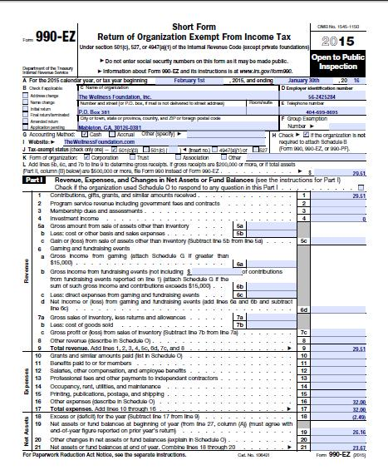
Partnering with the City Council: CPPS Funding
CPPS Application Process
Supplemental Documentation
Certification for a Drug Free Workplace
The City requires that all City grantees comply with the Drug-Free Workplace Policy (Council Policy 100-17).
EOC Workforce Report
Pages 1-3 must be completed in full.
IRS Form 990
Form 990-EZ, Form 990-PF, and Form 990-N (e-Postcard) accepted.
IRS Form W-9
Notes:
Malachi Bielecki:
Next, the Certification for a Drug Free Workplace is a simple form that the City requires for entering contracts. The EOC Workforce report collects gender and ethnic information on a workplace, and applicants must fill out pages 1-3 as completely as possible. There are fields for both paid employees and volunteers, and the applicant can complete whichever is appropriate for them. If a required field is not applicable to the applicant, they may input “0” or “N/A,” for not applicable. Next, the IRS Form 990 is the standard form that we use to verify financial solvency, though this form may be substituted for new organizations that do not yet have a filing, and public agencies are not required to provide this form. Lastly, the IRS Form W-9 is a simple form that requires some basic information about the applicant. On this form, please give particular attention to the address and tax identification number and be sure to sign and date the form. This form is important because should grant funding be awarded, the content of this form is used to accurately disburse grant payments. It is very important that applicants fill in ALL required fields, especially for signatures and dates. Any missing information can cause a delay in the application or the loss of funding eligibility.

Slide 17
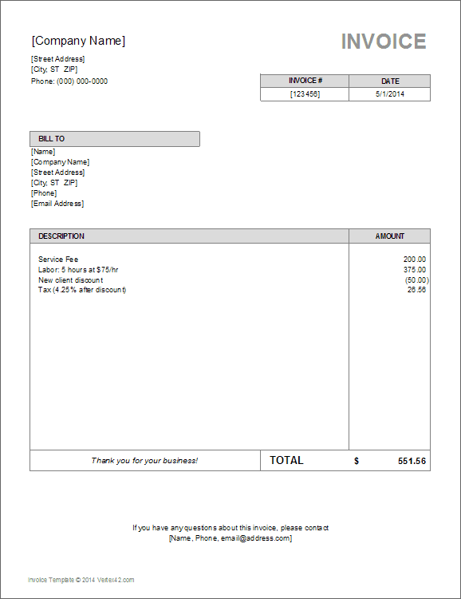
Partnering with the City Council: CPPS Funding
CPPS Payments and Reporting
Payment Procedure
Grant allocations must be approved by the full City Council and funding agreements processed by City staff before payments are disbursed.
This process is normally completed in the springtime.
Once an agreement is approved, a grantee in good standing will receive their payment in-full.
Average processing time of 3 business days; allow up to 30 days to receive payment.
Notes:
Malachi Bielecki:
Now we’ll go over the process for receiving a grant payment should the applicant be awarded. Our office is required to bring all grant allocations before the full City Council for approval and to bring the funding agreements through the City’s contracting process. This is what takes most of the processing time before we can disburse awards and it is usually completed in the springtime. Once Council approves an award and all parties have signed the associated funding agreement, a grantee in good standing is paid their full award amount outright regardless of whether expenses have been incurred. In Fiscal Year 2025, the median date of funding agreement execution was April 25th, and the median payment date was April 29th, representing an average processing time of 3 business days, however, it’s important to note that there are outliers for various reasons and that these timelines are subject to change. Lastly, grantees should allow up to thirty days to receive a payment after it has been processed.

Slide 18
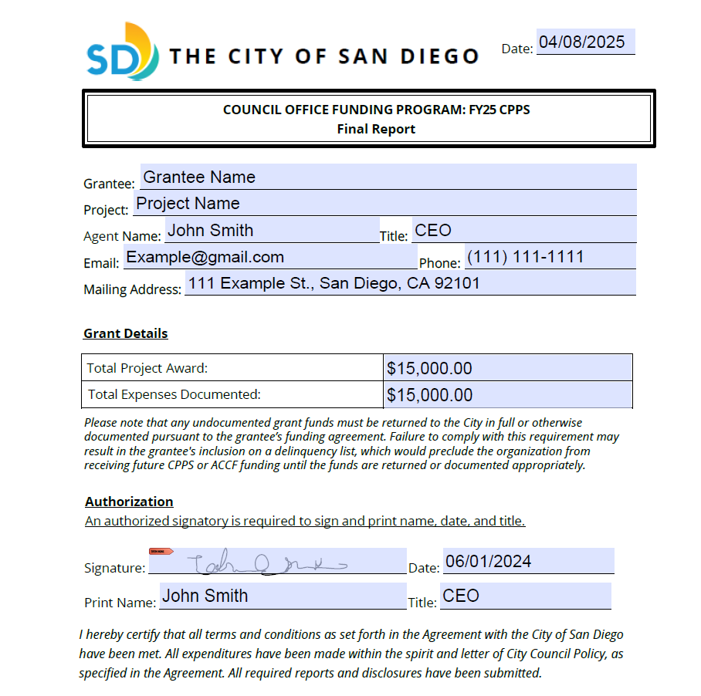
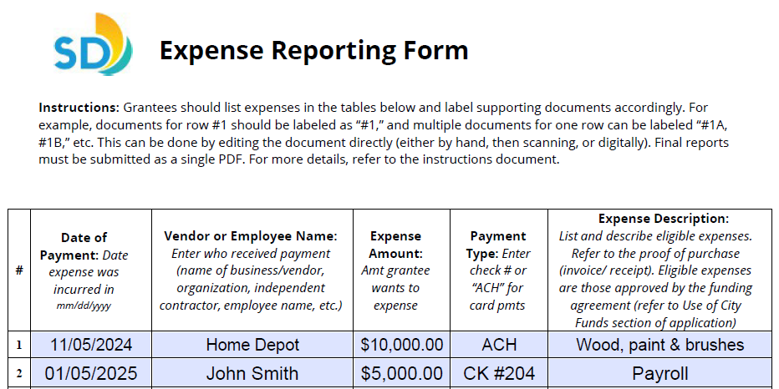
Partnering with the City Council: CPPS Funding
CPPS Payments and Reporting
Reporting Process
Grantee is provided with a reporting template after payment is disbursed.
Please retain:
Proof of Purchase documentation (i.e., receipts, invoices, pay stubs, time sheets, etc.).
Proof of Payment documentation (i.e., bank/credit card statement, cancelled check, etc.).
Reports must be submitted no later than 30 days after the end of Fiscal Year 2026, by July 30, 2026.
Grantees that fail to meet this requirement will be placed on the Delinquency List.
Notes:
Malachi Bielecki:
We’ll now move on to the grant reporting process before going over some general reminders. Our team will contact the grantee with reporting instructions immediately after their payment is disbursed. The final reporting template includes an expense reporting form, which requires the attachment of supplemental supporting documents, a brief performance narrative, and a final checklist. The documents required to support each line item of the expense report include proof of purchase documents and proof of payment documents. Proof of purchase documents may include receipts, invoices, pay stubs, or timesheets, and proof of payment documents may include bank statements, credit card statements, or cancelled checks. Each line-item expense requires these two sets of supporting documents, clearly detailing that an expense was initiated and ultimately incurred and paid for during the grant period. It’s also important to know that grantees receiving awards above $10,000 are subject to additional reporting requirements. Lastly, grant reporting is due no later than 30 days after the end of Fiscal Year 2026, by July 30th, 2026. Grantees that fail to meet this requirement will be placed on a “Delinquency List,” which precludes the grantee from receiving CPPS or ACCF funding until the delinquency is resolved. Our team makes a strong effort to assist grantees in meeting the requirements, and to date, no grantee have been subject to the delinquency classification.

Slide 19
Partnering with the City Council: CPPS Funding
CPPS Payments and Reporting
Important Reminders
CPPS funds cannot be disbursed until awards are approved by the full City Council and funding agreements are signed by all parties.
The full award will be disbursed upon execution of the agreement.
Funds may be applied to any eligible expenses incurred within the City’s Fiscal Year 2026 (July 1, 2025 – June 30, 2026).
Only expenses closely related to the project described in Section 2 of the application as enclosed in the signed agreement are eligible to apply toward the grant.
CPPS applicants should be prepared to finance any proposed projects upfront.
Notes:
Malachi Bielecki:
Here are a few reminders regarding the payment and reporting processes. CPPS funds cannot be disbursed to a grantee, and are considered tentative, until the award is approved by the full City Council and the funding agreement is signed by all parties. Once those steps are complete, the full award is disbursed quickly after the execution of the agreement. The funds may be applied to any eligible expenses incurred by the grantee within Fiscal Year 2026, which runs from July 1, 2025, to June 30, 2026, if the expense is authorized by the funding agreement and does not violate any provision of Council Policy 100-06. Expenses authorized by the funding agreement include those closely related to the project described within the application, specifically Section 2, as enclosed in the signed funding agreement. For example, if a grantees project is to host a public event, the grantee may report expenses that contributed toward that event as long as they comply with the council policy, think staging equipment or salaries, even if those expenses weren’t explicitly listed in the application. Importantly, CPPS applicants should be prepared to finance any proposed projects with their own funds upfront, since funds aren’t disbursed until near the end of the fiscal year.

Slide 20
FY26 CPPS and ACCF
Assistance
To Learn More
Council Offices→ https://www.sandiego.gov/citycouncil
CPPS Homepage → https://www.sandiego.gov/citycouncil/cpps
Office Hours→ By Appointment (Phone)
Contact Us
Submit CPPS questions to CPPS@sandiego.gov
Council Administration Malachi Bielecki Abigail Edwards 619-236-6441 Mbielecki@sandiego.gov EdwardsA@sandiego.gov
Notes:
The last thing I’ll note is that the most common feedback we’ve received is regarding the length of time it takes to receive grant payments. We entirely empathize with these concerns, and we work diligently internally to identify efficiencies and speed up the process. Unfortunately, the City’s contracting requirements are extensive based on transparency, especially since funding is awarded at the discretion of elected officials.
So here is our contact info and links to our website. That concludes our presentation and now we’re happy to take any questions.

