Slide 1

Accessibility Advisory Board
Parallel Curb Ramps
May 14, 2025 - Meeting
Notes:
This presentation was created by Alejandra Warner to illustrate code, and ask AAB if they recommend adhering to current code for naturally sloped pathways where it is required to have back path for wheelchairs, or if naturally sloped pathway make it difficult for person using wheelchair to zig zag around truncated domes and they’ll just go through truncated domes due to slope.

Slide 2
Access Board- Public Right of way accessibility guidelines (PROWAG)
PROWAG PR (2013) R304.3.1 Turning Space
A turning space 1.2 m (4.0 ft) minimum by 1.2 m (4.0 ft) minimum shall be provided at the bottom of the curb ramp and shall be permitted to overlap other turning spaces and clear spaces.
If the turning space is constrained on 2 or more sides, the turning space shall be 1.2 m (4.0 ft) minimum by 1.5 m (5.0 ft). The 1.5 m (5.0 ft) dimension shall be provided in the direction of the pedestrian street crossing.
PROWAG FR (2023) R304.3.4 Landings
Landings shall be provided at the bottom of parallel curb ramps. Landings shall be 48 inches (4.0 ft) wide minimum by 48 inches (4.0 ft) long minimum. The slope of the landing, measured parallel to the direction of travel on the curb ramp run, shall be permitted to be equal to or less than the slope of the roadway or the cross slope of the crosswalk as specified by R302.5..

Slide 3
Parallel curb ramps – California Building Code (CBC)
11B-406.3.2 Turning space. A turning space 48 inches minimum by 48 inches minimum shall be provided at the bottom of the curb ramp. The slope of the turning space in all directions shall be 1:48 maximum.

Slide 4
2019 Intermediate Code Changes
DSA STATEMENT OF REASONS:
This change reformats Section 11B-705.1.2.2 to present detectable warnings requirements separately for perpendicular and parallel curb ramps. Revised detectable warning requirements are also provided for parallel curb ramps with one entrance/exit point (i.e. transition from the turning space to the gutter, street or highway) and those with two entrance/exit points – as may be found in parking lots where a median has accessible parking on both sides of an island.
The amendment language requires the turning space to include a 36” minimum width passage without detectable warnings so pedestrians may travel through the turning space without passing over the detectable warnings. This provision responds to numerous comments from wheelchair users who experience pain when travelling over extended lengths of detectable warnings.

Slide 5
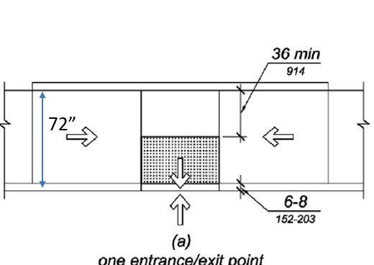
Parallel Curb ramps - CBC
11B-705.1.2.2.2.1 One entrance/exit point. Where the turning space has one entrance/exit point other than the sloped ramp segments, detectable warnings shall be 36 inches deep, as measured perpendicular to the curb, and the turning space shall provide minimum 36 inches wide portion without detectable warnings to allow pedestrian travel in the direction of the sidewalk without travelling over the detectable warnings.
Exceptions:
1. Where it is technically infeasible to provide a minimum 72 inches wide turning space, as measured perpendicular to the curb, the depth of detectable warnings may be reduced to 24 inches minimum.
2.Existing parallel curb ramps with detectable warnings in compliance with the code requirements in effect at the time of installation shall not be required to provide a minimum 36 inches wide portion of the turning space without detectable warnings.

Slide 6
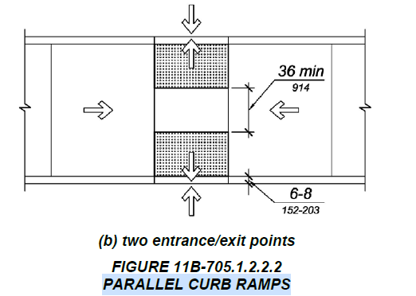
Parallel Curb ramps - CBC
11B-705.1.2.2.2.2 Two entrance/exit points. Where the turning space has two entrance/exit points other than the sloped ramp segments, detectable warnings shall be 36 inches deep at both entrance/exit points, as measured perpendicular to the curb, and the turning space shall provide a minimum 36 inches wide portion without detectable warnings to allow pedestrian travel in the direction of the sidewalk without travelling over the detectable warnings.
Exceptions:
  1. Where it is technically infeasible to provide a minimum 72 inches wide turning space, as measured perpendicular to the curb, the depth of detectable warnings may be reduced to 24 inches minimum.
  2.Existing parallel curb ramps with detectable warnings in compliance with the code requirements in effect at the time of installation shall not be required to provide a minimum 36 inches wide portion of the turning space without detectable warnings.

Slide 7
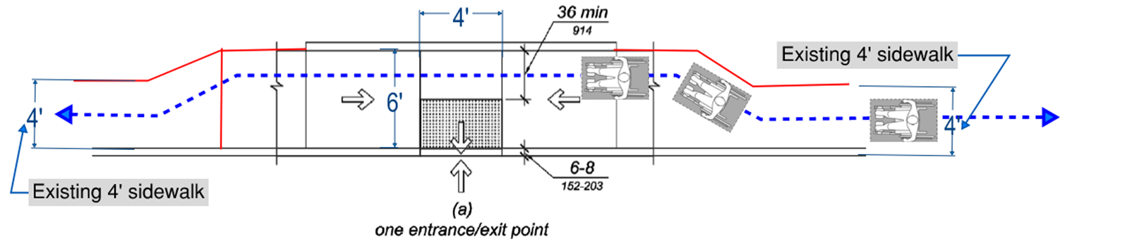
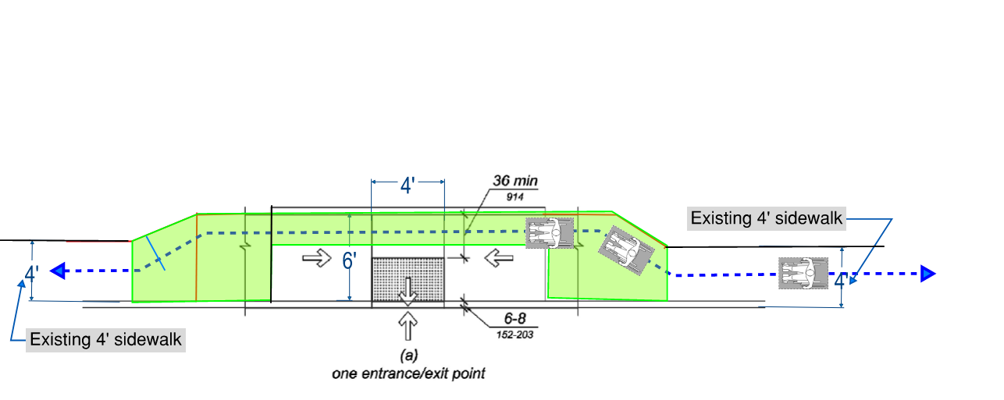
For existing 4’ wide sidewalks:
Will the wheelchair user will zig-zag to avoid rolling over 4’ long truncated domes?
The green highlighted area indicates the additional square footage needed for the extra 2’.

Slide 8

6’ wide parallel curb ramp
Questions
and
Comments

