Slide 1
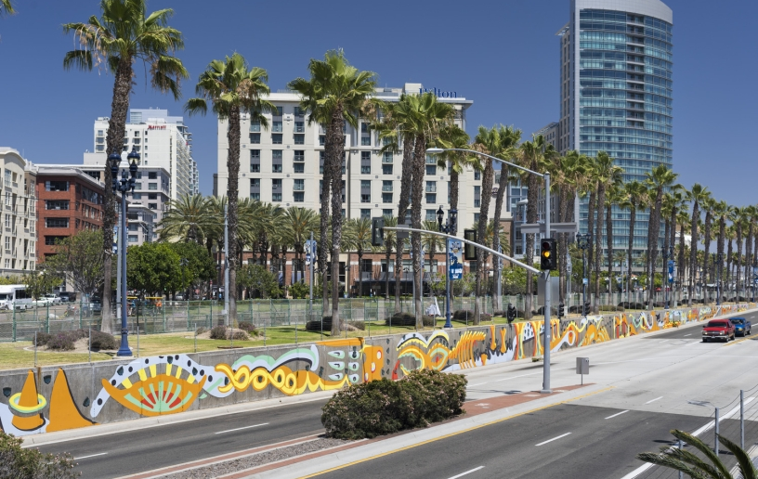
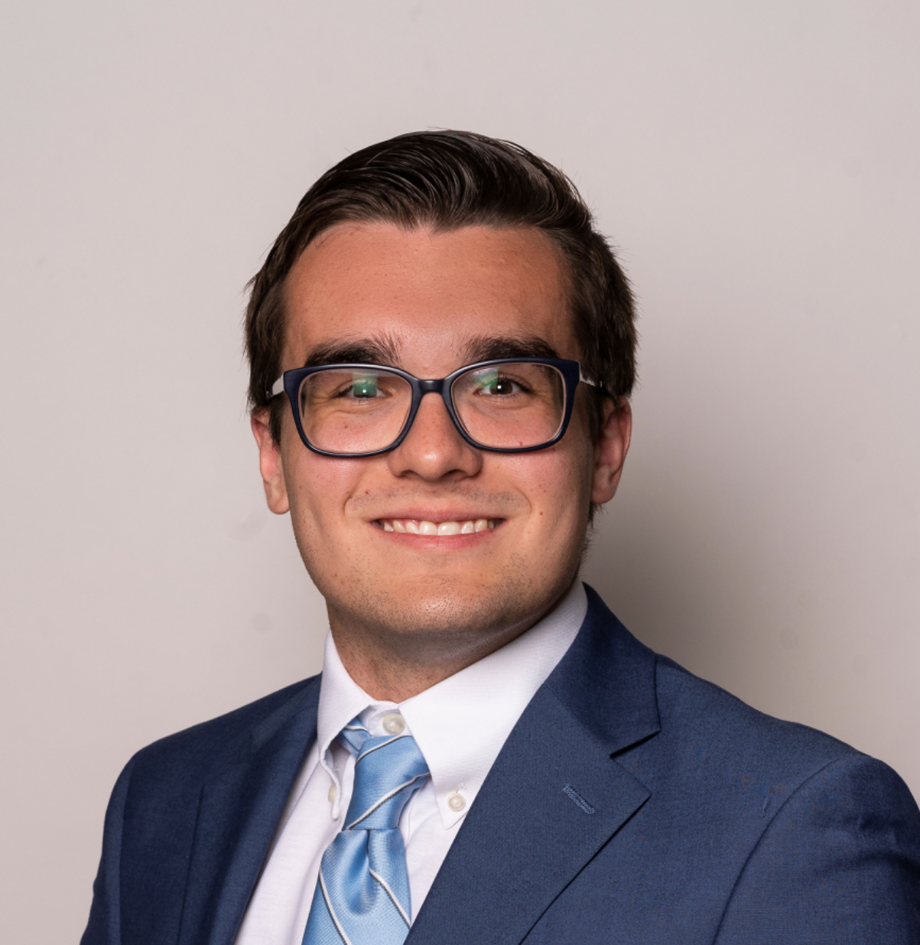


Council Office
CPPS Funding
Fiscal Year 2026
Council Administration
Abigail Edwards, Grants Manager
Malachi Bielecki, Grants Coordinator

Slide 2



Partnering with the City Council: CPPS Funding
Community Projects, Programs and Services (CPPS) Funding Program
Background
CPPS funding is awarded to nonprofit organizations, public agencies, and City departments for projects, programs, and services that serve a lawful public purpose to benefit the City’s neighborhoods and communities.
CPPS funding is awarded at the discretion of each council office.
CPPS is governed by Council Policy 100-06.

Slide 3

Partnering with the City Council: CPPS Funding
FY26 CPPS Budget
Budget Summary
FY26 CPPS Funds: $900,000
$100k per office
Procedures for Funding:
Funding Agreement (contract)
  Nonprofits or Public Agencies
Transfer Memorandum
  City Departments
  City Capital Improvement Projects (CIP)

Slide 4

Partnering with the City Council: CPPS Funding
FY26 CPPS Schedule
Important Dates
Application: July 7 – August 7, 2025
Award Announcement: October 2025
City Processing: October 2025 – March 2026
Payments: March – June 2026
Reporting: June – July 30, 2026

Slide 5
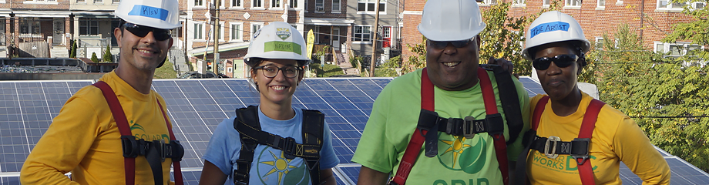
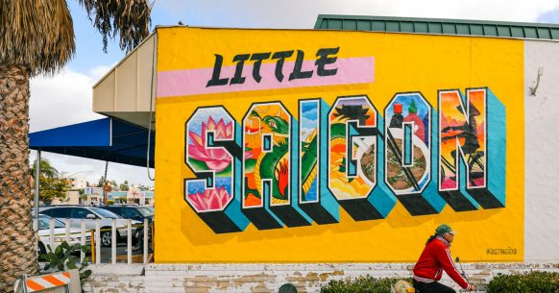
Partnering with the City Council: CPPS Funding
CPPS Council Policy
Funding Eligibility
  Hold a legally tax-exempt (IRS) or nonprofit status in good standing or be a public agency functioning within the City.
    Tax-exempt with the Internal Revenue Service (IRS).
    “ACTIVE” with the California Secretary of State (SOS).
    “CURRENT” or “EXEMPT” with the California Attorney General (AG).
  Be financially solvent and provide the most current IRS Form 990, similar documentation, or proof of exemption.
  Disclose all sources of organizational funding.

Slide 6
Partnering with the City Council: CPPS Funding
CPPS Council Policy
Funding Uses
  1. Capital improvements performed on private property.
    Capital improvements may not be performed on public property, even with a right-of-entry permit.
    Facilities must be open to the public (cannot require membership).
    Projects with a total cost over $15,000 that involve alteration, demolition, installation or repair work or new construction work with a total cost over $25,000 will be subject to prevailing wage law.

Slide 7
Partnering with the City Council: CPPS Funding
CPPS Council Policy
Funding Uses
  2. The purchase, installation, repair, or maintenance of equipment, materials, goods, or supplies, including expenses related to technology or educational services.
    Cannot be used for a public works project.
    Cannot purchase surveillance technology.
  3. The staging of social, environmental, educational, cultural, or recreational community programming or events.
    Ticketed events are allowed if they are open to the public and do not require organizational memberships.

Slide 8
Partnering with the City Council: CPPS Funding
CPPS Council Policy
Funding Uses
  4. The purchase of food or beverages only if they are provided to individuals or families in need.
    Cannot be purchased for other uses.
  5. In support of ongoing operational expenses.
    Examples may include payroll expenses, rent payments, utility payments, and insurance payments.

Slide 9
Partnering with the City Council: CPPS Funding
CPPS Council Policy
Important Reminders
CPPS funds cannot be used for any purpose prohibited by laws governing the use of public funds.
  No private, political, religious, or fundraising purpose or activity.
Council offices may prioritize funding requests for “one-time” uses.
Council offices may encourage applicants to pursue matching funds.
All expenses must be incurred within Fiscal Year 2026 (July 1, 2025 – June 30, 2026).

Slide 10
Partnering with the City Council: CPPS Funding
CPPS Projects/Programs/Services
Examples from FY25
Mama’s Kitchen: Medically Tailored Meal Service
San Diego Unified School District: Memorial Plaque at Valencia Park Elementary
Persian Cultural Center: Nowruz Persian New Year
Otay Mesa Chamber of Commerce: IT and Software Support / Street Banners
Somali Bantu Association of America: Youth Program Director

Slide 11

Partnering with the City Council: CPPS Funding
CPPS Application Process
Pre-Application
  Contact the council office(s) to learn more about their funding priorities.
    Council Grant Representatives
  Verify compliance with all standards required by Council Policy 100-06.
    Must be in good standing at the time of application submission.
  Recognize that applying for CPPS funding does not guarantee funding.

Slide 12
Partnering with the City Council: CPPS Funding
CPPS Application Process
Application Overview
  Use the CPPS Application Instructions as a guide.
  An applicant may submit multiple applications.
    Only one project/program/service is allowed per application.
    May request funding from multiple council offices within the same application.
  A funding request may not be less than $1,500.
  Demonstrate that the project/program/service is open to the public, serves a lawful public purpose, and benefits San Diego’s communities.

Slide 13
Partnering with the City Council: CPPS Funding
CPPS Application Process
Application Overview
  Due at the time of application:
    Standard application
    Proof of nonprofit status with the IRS
    Proof of “ACTIVE” status with the CA SOS
    Proof of “CURRENT” (or exempt) status with the CA AG
    Certification for a Drug Free Workplace
    EOC Workforce Report (pages 1-3)
    IRS Form 990, 990EZ, or 990N
    IRS Form W-9

Slide 14
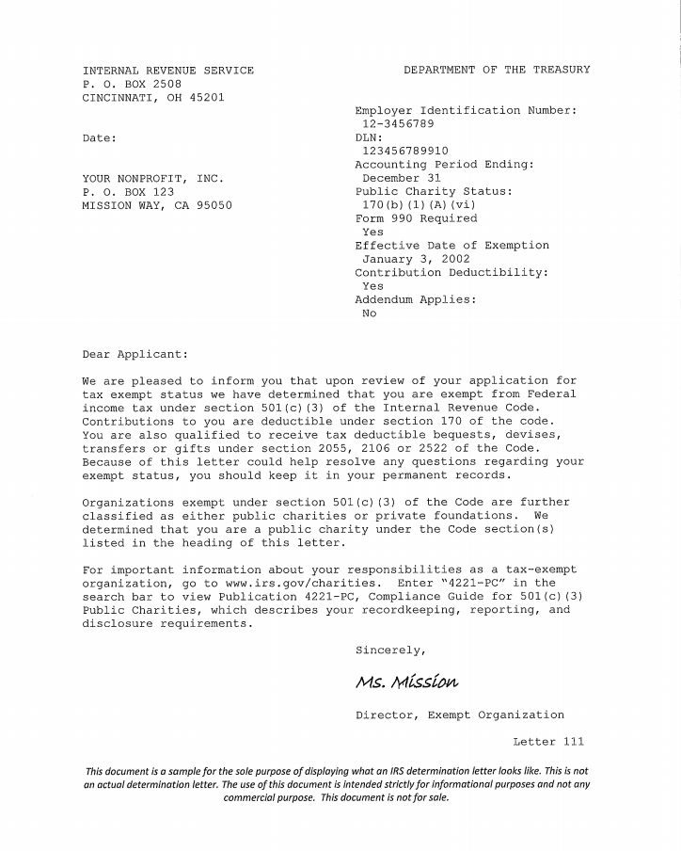
Partnering with the City Council: CPPS Funding
CPPS Application Process
Supplemental Documentation
To check nonprofit status:
Use the Tax-Exempt Organization Search tool.
Cannot locate or lost letter:
Contact Customer Account Services by phone, letter, or fax to request an affirmation letter.
  The request must include:
    Full name
    Employer Identification Number
    Authorized signature (an officer or trustee)

Slide 15
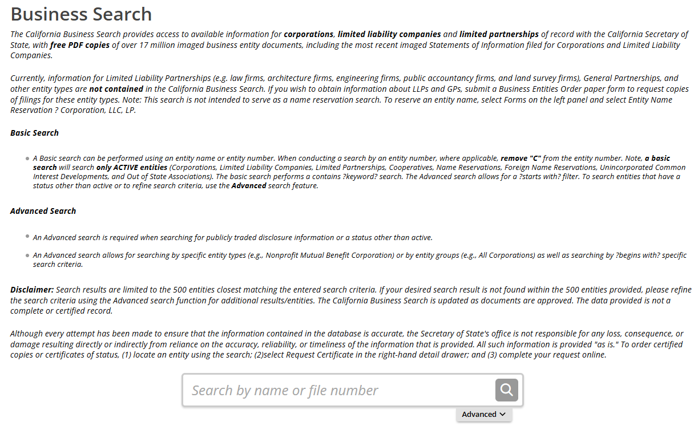
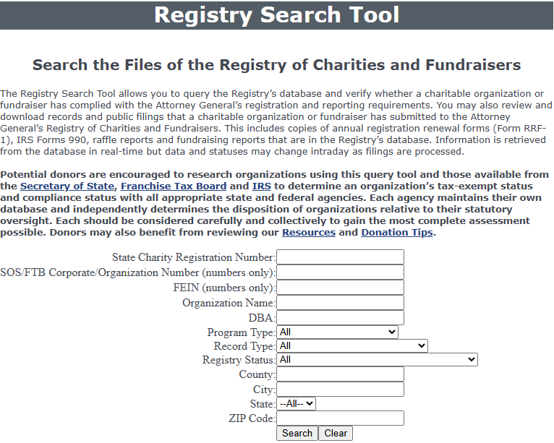
Partnering with the City Council: CPPS Funding
CPPS Application Process
Supplemental Documentation
ACTIVE status with the CA SOS.
CURRENT (or exempt) status with the CA AG.
Statuses must remain in good standing for the duration of Fiscal Year 2026.
Contact your state representatives for assistance with filing processes.

Slide 16
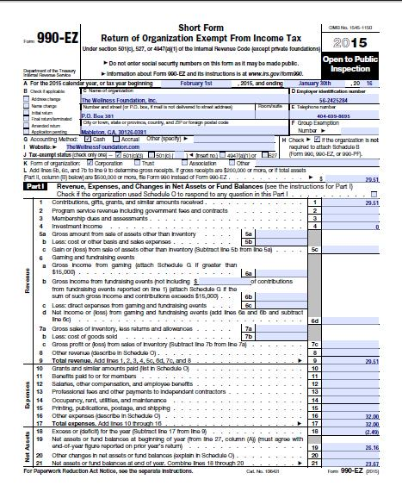
Partnering with the City Council: CPPS Funding
CPPS Application Process
Supplemental Documentation
Certification for a Drug Free Workplace
  The City requires that all City grantees comply with the Drug-Free Workplace Policy (Council Policy 100-17).
EOC Workforce Report
  Pages 1-3 must be completed in full.
IRS Form 990
  Form 990-EZ, Form 990-PF, and Form 990-N (e-Postcard) accepted.
IRS Form W-9

Slide 17
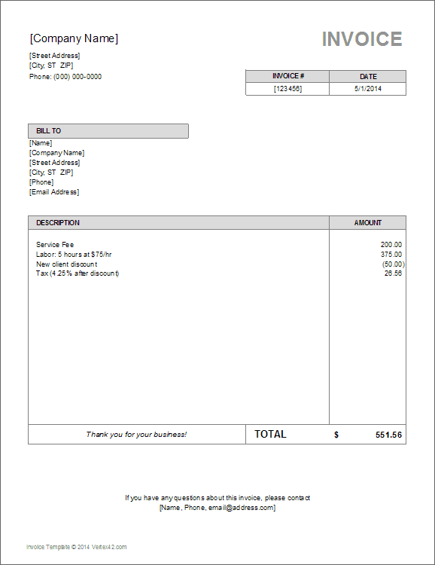
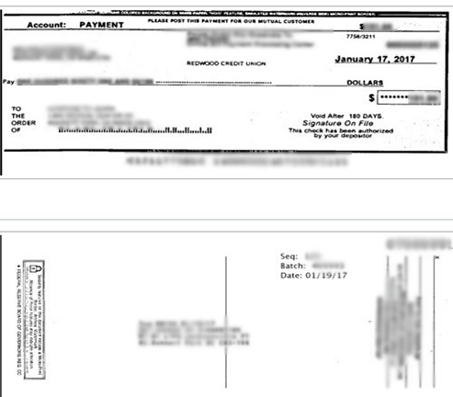
Partnering with the City Council: CPPS Funding
CPPS Payments and Reporting
Payment Procedure
Grant allocations must be approved by the full City Council and funding agreements processed by City staff before payments are disbursed.
  This process is normally completed in the springtime.
  Once an agreement is approved, a grantee in good standing will receive their payment in-full.
    Average processing time of 3 business days; allow up to 30 days to receive payment.

Slide 18
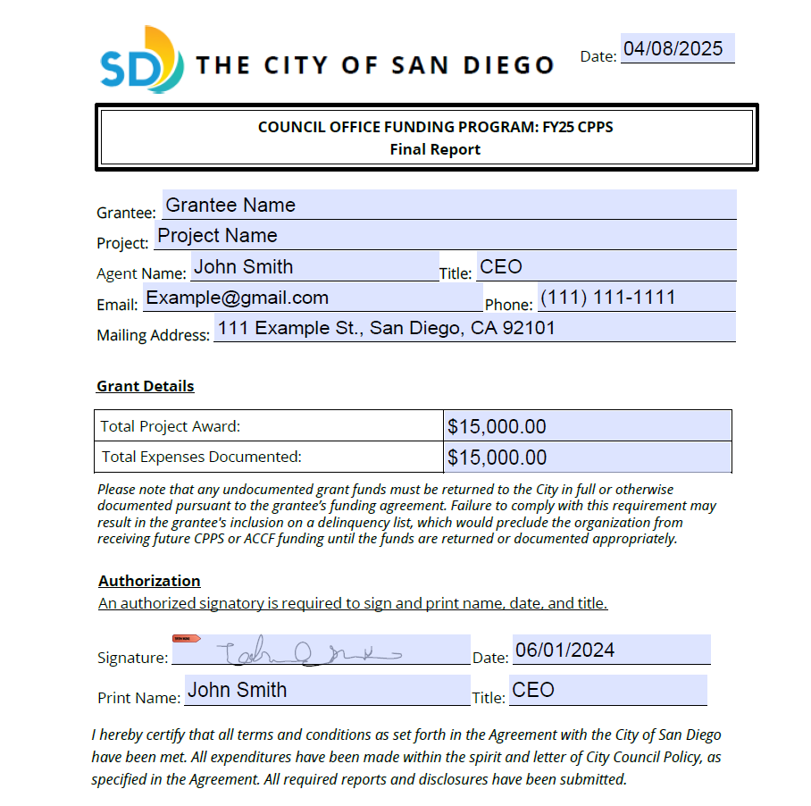
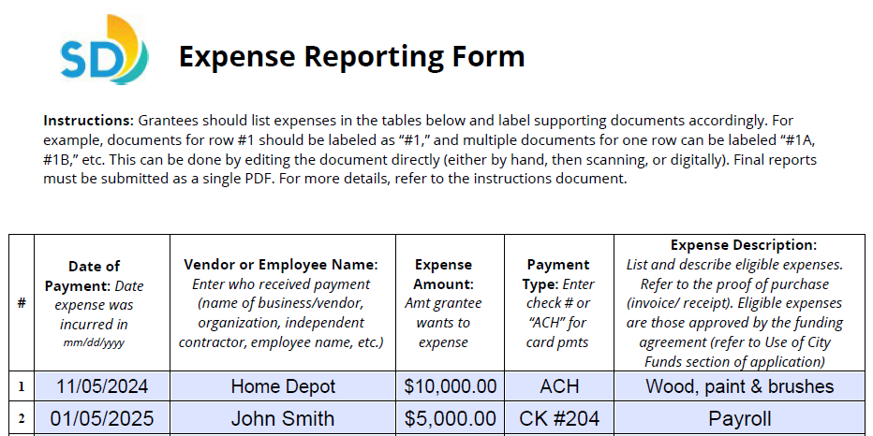
Partnering with the City Council: CPPS Funding
CPPS Payments and Reporting
Reporting Process
Grantee is provided with a reporting template after payment is disbursed.
Please retain:
  Proof of Purchase documentation (i.e., receipts, invoices, pay stubs, time sheets, etc.).
  Proof of Payment documentation (i.e., bank/credit card statement, cancelled check, etc.).
Reports must be submitted no later than 30 days after the end of Fiscal Year 2026, by July 30, 2026.
  Grantees that fail to meet this requirement will be placed on the Delinquency List.

Slide 19
Partnering with the City Council: CPPS Funding
CPPS Payments and Reporting
Important Reminders
CPPS funds cannot be disbursed until awards are approved by the full City Council and funding agreements are signed by all parties.
  The full award will be disbursed upon execution of the agreement.
Funds may be applied to any eligible expenses incurred within the City’s Fiscal Year 2026 (July 1, 2025 – June 30, 2026).
Only expenses closely related to the project described in Section 2 of the application as enclosed in the signed agreement are eligible to apply toward the grant.
CPPS applicants should be prepared to finance any proposed projects upfront.

Slide 20

FY26 CPPS and ACCF
Assistance
To Learn More
Council Offices→ https://www.sandiego.gov/citycouncil
CPPS Homepage → https://www.sandiego.gov/citycouncil/cpps
Office Hours→ By Appointment (Phone)
Contact Us
Submit CPPS questions to CPPS@sandiego.gov
  Council Administration Malachi Bielecki Abigail Edwards
  619-236-6441 Mbielecki@sandiego.gov EdwardsA@sandiego.gov

