Slide 1



San Diego Planning Commission Meeting
PHONE-IN TESTIMONY PERIOD NOW OPEN FOR
Item 1: Mission Valley Community Plan and General Plan Amendment Initiation
To call in and make public comment on this item:
Telephone - Dial 1-669-254-5252 or (Toll Free) 1-833-568-8864.
When prompted, input Webinar ID: 160 944 0367
How to Speak to a Particular Item or During Non-Agenda Public Comment:
TO "RAISE YOUR HAND“: click the button on your computer, tablet, or Smartphone, or by dialing *9 on your phone. You will be taken in the order in which you raise your hand. You may only speak once on a particular item.
TO UNMUTE: When it is your turn to speak, click the unmute prompt that will appear on your computer, tablet or Smartphone, or dial *6 on your phone.

Slide 2
City Planning Department
Mission Valley Community Plan
and General Plan Amendment Initiation
Item #1
September 25, 2025

Slide 3
Mission Valley Community Plan and General Plan Amendment Initiation:
Initiation Request
1.32 Acre Site
Redesignate the subject site:
From: Community Plan Land Use from Right-of-Way
To: Office and Visitor Commercial (Residential Prohibited)
Removal from the Community Plan Implementation Overlay Zone (CPIOZ) Specific Plan Subdistrict
Removal from the Atlas Specific Plan
3

Slide 4
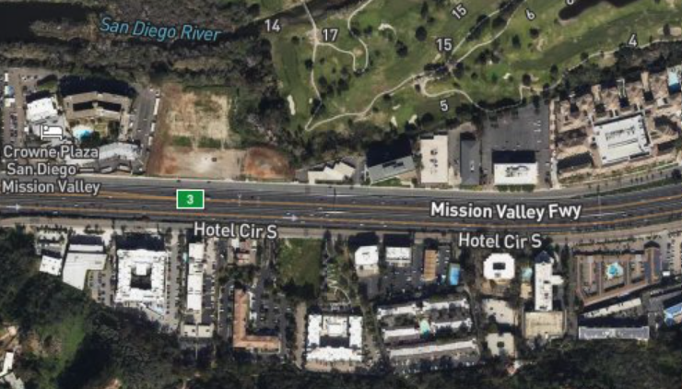
Site Location
Subject Site:
Along Hotel Circle
Applicant:
Kalthia Construction Management, LLC
Mission Valley
Subject Site
Uptown
4

Slide 5
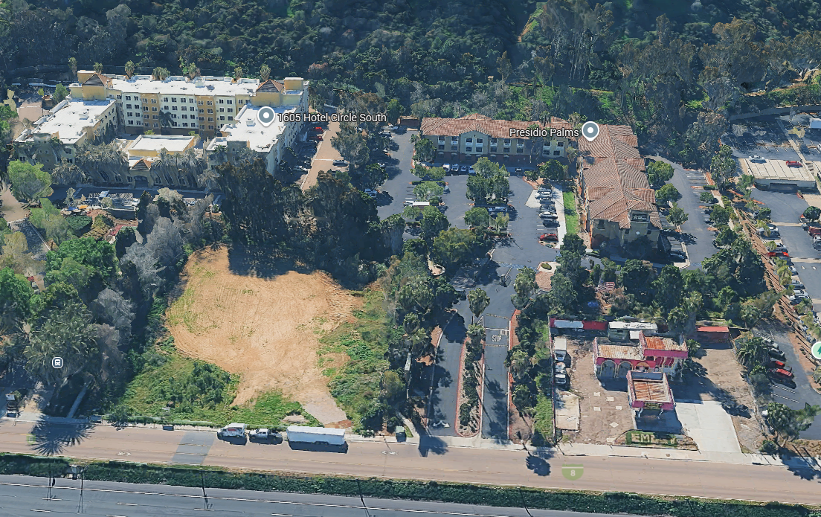
Subject Site
Subject Site
Hotel Circle South
5

Slide 6
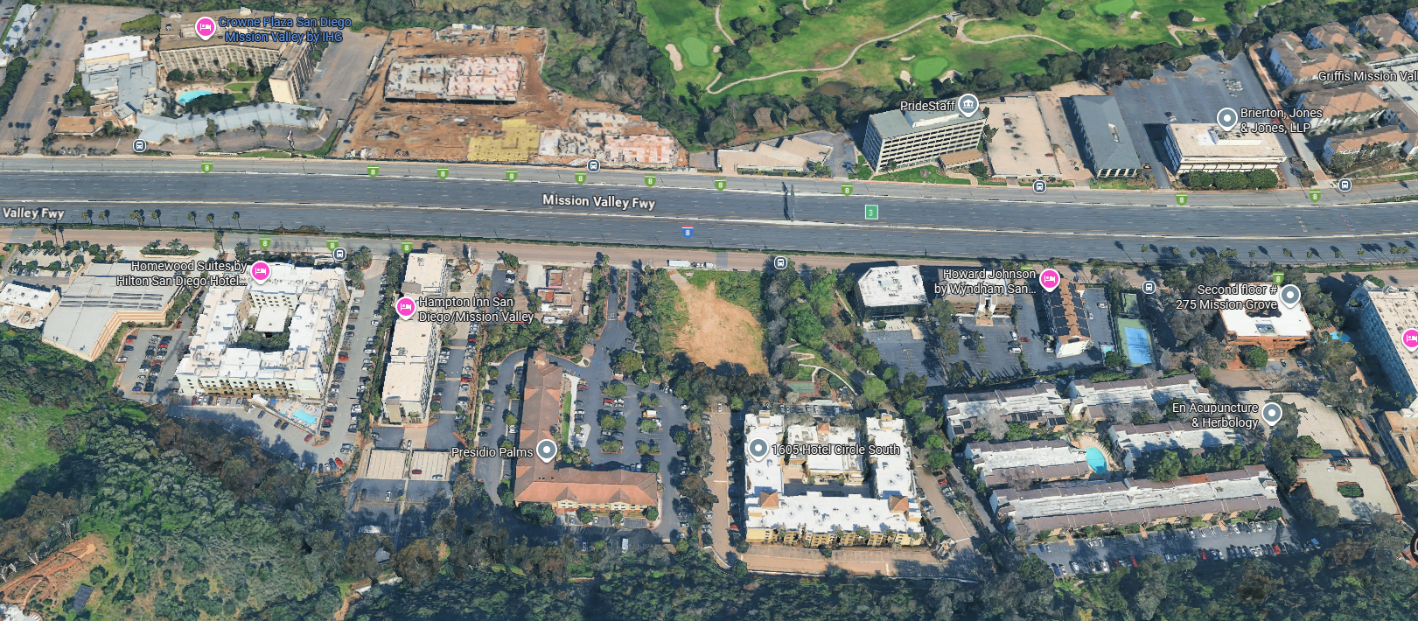
Adjacent Uses
Golf Course
Hotel
Office
Multi-family Residential
Office
Subject Site
Vacant
Office
Hotel
Hotel
Vacant
Office
Hotel
Multi-family Residential
Multi-family Residential
Multi-family Residential
6

Slide 7
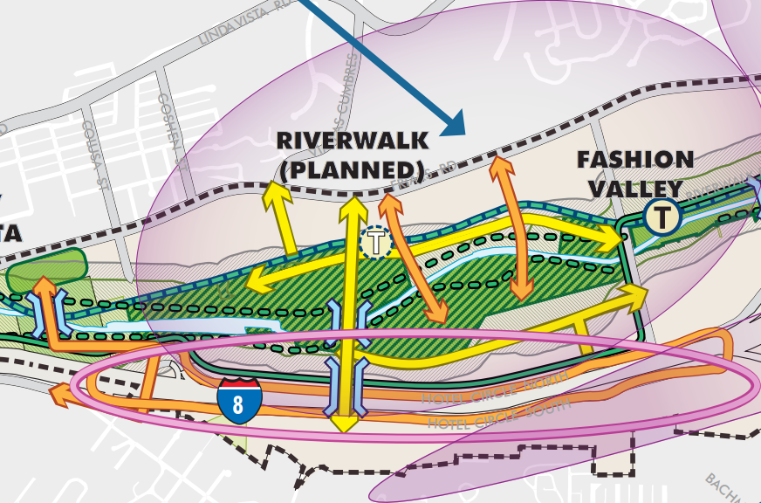
Community Plan
South of I-8
Continued emphasis on:
Office,
Automobile,
Hotel uses
Hillsides
Sense of place
7

Slide 8
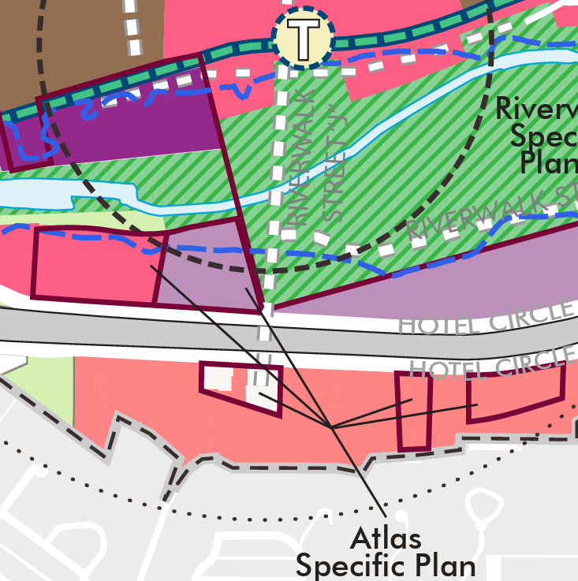
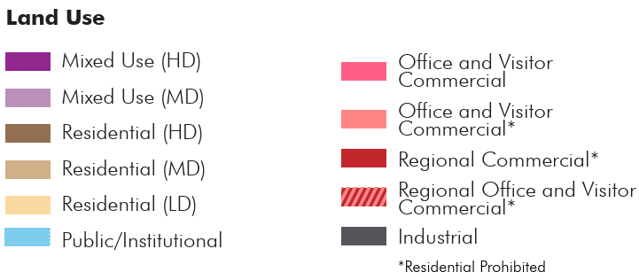
Planned Land Use
Subject Site
8

Slide 9
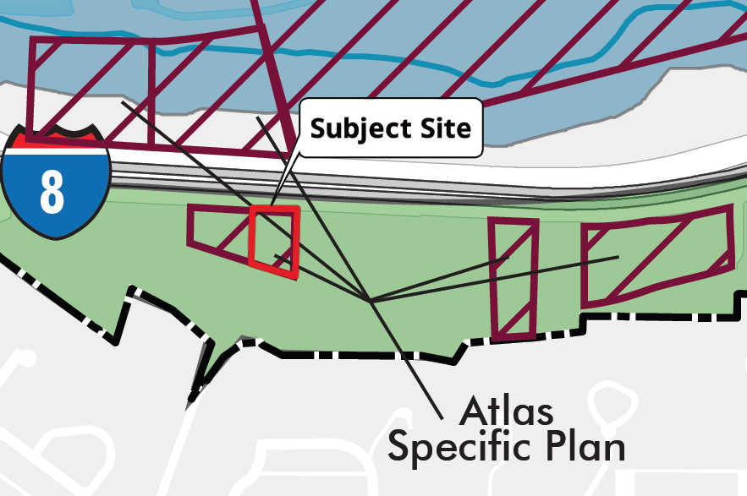
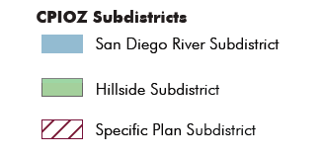
CPIOZ Subdistricts
Community Plan Implementation Overlay Zone - Subdistricts
9

Slide 10
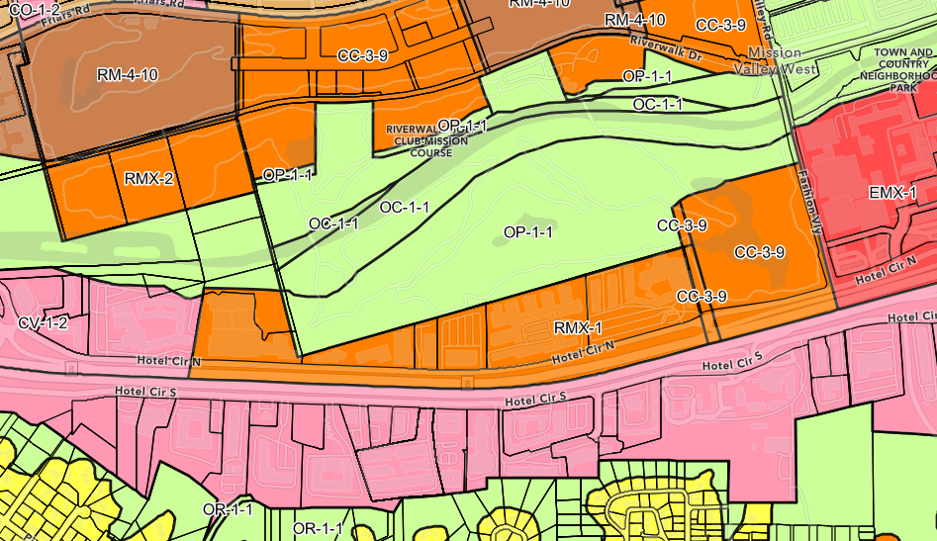
Current Zone
Subject Site:
CO-2-2 (Commercial--Office)
CO-2-2
Subject Site
10

Slide 11
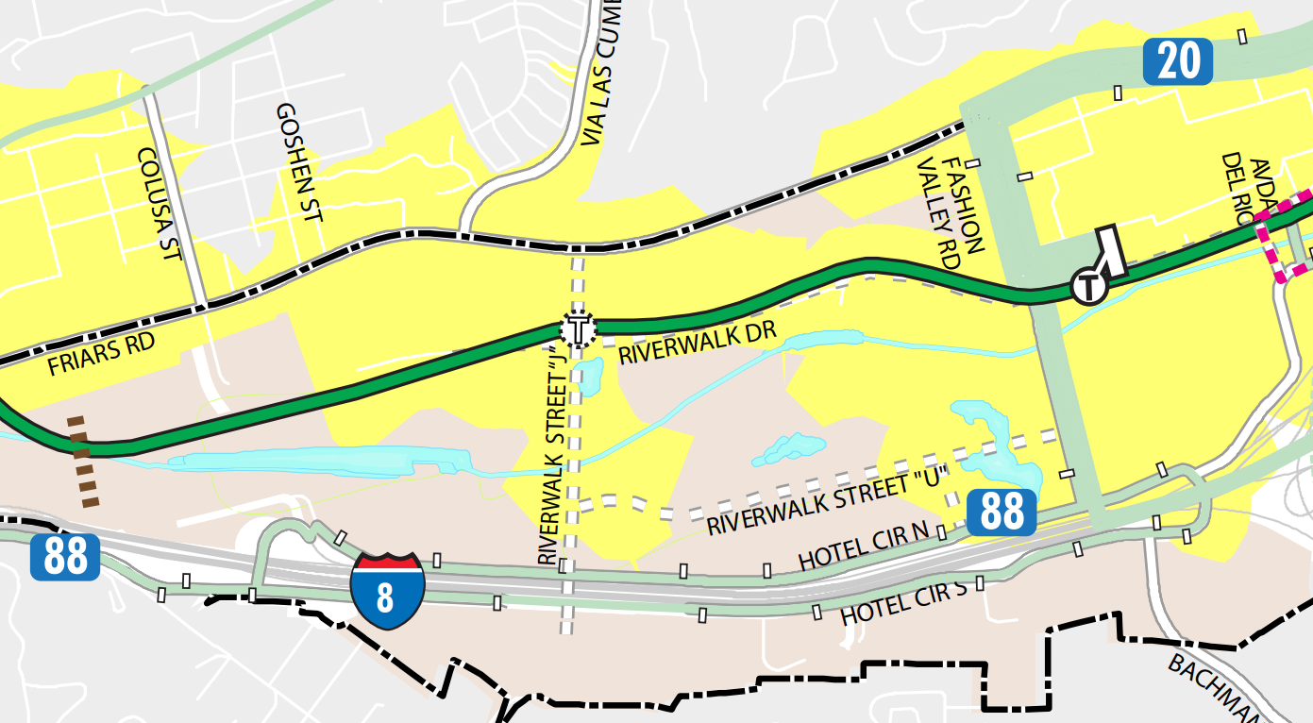
Transit Access
Subject Site
11

Slide 12
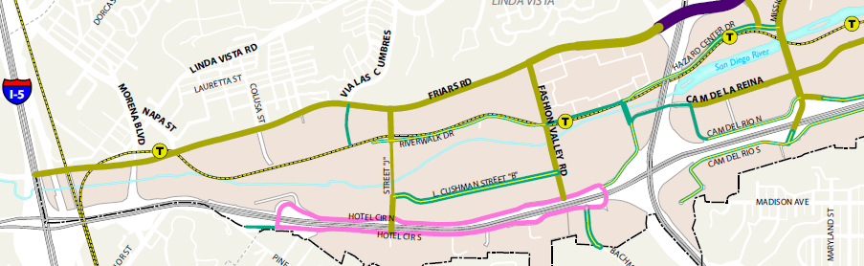
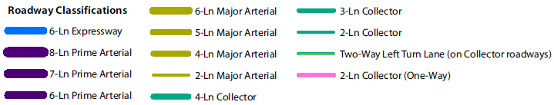
Roadway Classifications
Subject Site
12

Slide 13
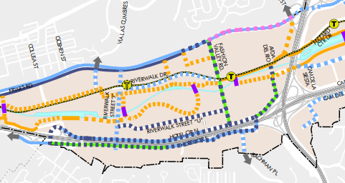
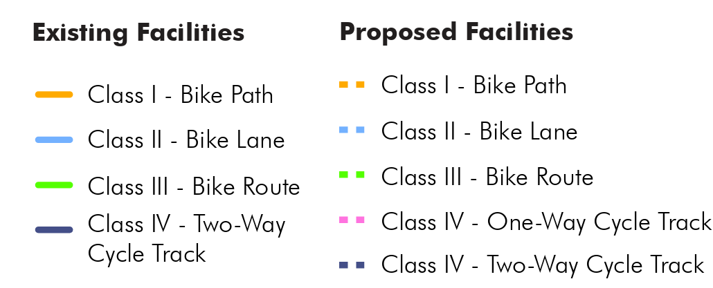
Bicycle Facilities
Subject Site
13

Slide 14
Public Facilities
Public facility location and distance from subject site
Public Facility​ | Location​ | Distance from Subject Site​
Schools​ | Mission Valley, Peninsula​ & Uptown | 2.8 to 4.0 miles​
Park​ | Mission Valley | 0.8 miles
Library | Mission Valley | 1.9 miles​
Fire​ | Uptown | 2.0 miles​
Police​ | Linda Vista​ | 1.8 miles​
14

Slide 15
Housing & Demographics
Mission Valley Community Plan Area
Year | Homes | Population
2010 | 11,233 | 19,357
2023 | 15,612 | 28,129
Change between 2010-2023 (%) | 4,379 (39%) | 8,772 (45%)
SANDAG Data
15

Slide 16
Affordable Homes
Deed Restricted Affordable Homes
731 Deed Restricted Homes
5 percent of Total Homes in Mission Valley
Compared to 5 percent Citywide
Source: San Diego Housing Commission, Sept. 2025
16

Slide 17
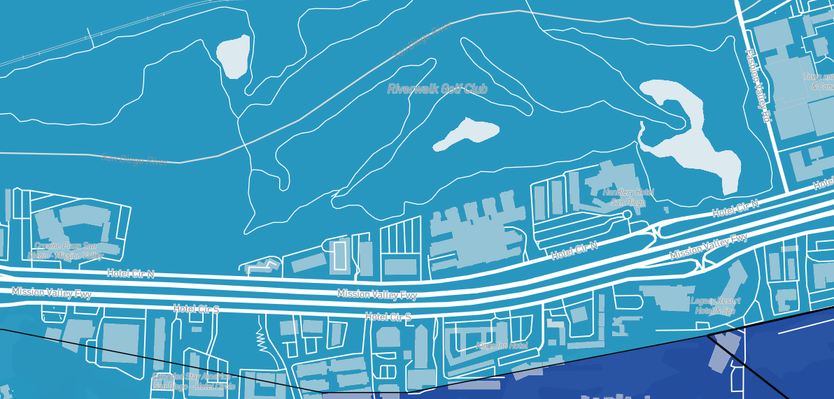
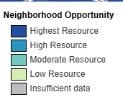
Opportunity Area
Subject Site
17

Slide 18
Employment
Mission Valley Community Plan Area
Year | Jobs
2012 | 43,505
2022 | 54,115
Change between 2012-2022 (%) | 10,610 (24 %)
SANDAG Data
18

Slide 19
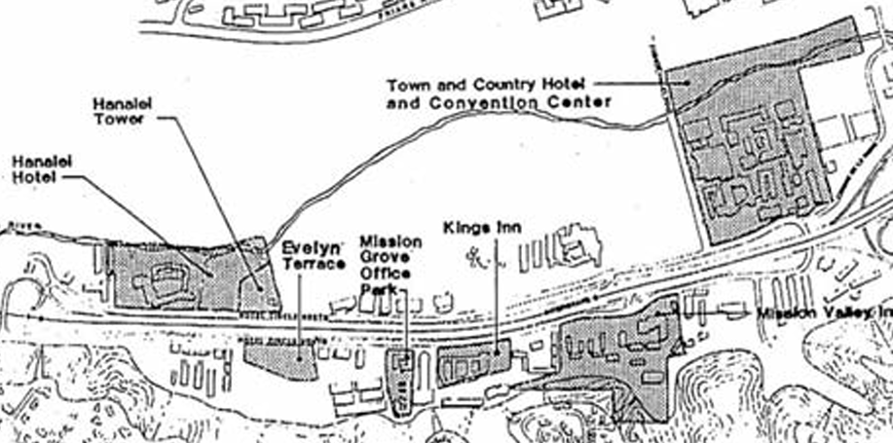
Atlas Specific Plan
Evelyn Terrace Area
No Development
Future I-8/Via Las Cumbres interchange
Riverwalk Street “J” in the Community Plan
Subject Site
19

Slide 20
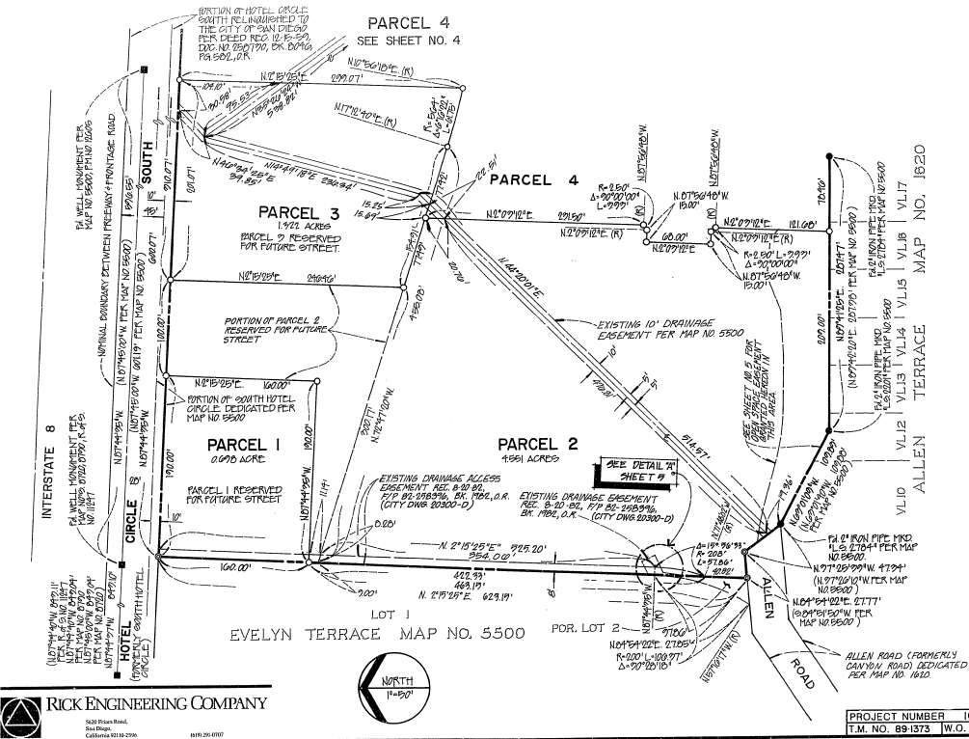
Irrevocable Offer of Dedication
1988 Resolution
Irrevocable Offer of Dedication
Future I-8 interchange
1991 Resolution
Rejected Parcels 1, 2, 3 & 4
Reserved for future streets
25 Years to Accept
20

Slide 21
Mobility Improvements
Riverwalk Street “J”
Future 4 lane major
Friars Road to Hotel Circle South
Bridge over San Diego River
Bridge over I-8
New I-8 Interchange
At Hotel Circle South/Riverwalk Street “J”
Hotel Circle North & South
Cycle Tracks
One-way Couplets
Work with property owners
21

Slide 22
Initiation Criteria
Consistency with goals and policies of the General Plan and Community Plan
Encourages further intensification of employment uses
Supports business development and employment opportunities
22

Slide 23
Initiation Criteria
2. Additional public benefit
Allow for the City to work with the property owner to identify the improvements to implement the Community Plan’s mobility network
Implementation of IA-21 and IA-23 which identify the need to work with property owners as part of a planned street network extension
Implementation of the Riverwalk Street “J” and interchange with I-8 improvements identified in the Community Plan
23

Slide 24
Initiation Criteria
3. Availability of public facilities
All necessary public services appear available
Further analysis would be conducted as part of the Community Plan Amendment Process, including but not limited to the planned street over I-8 and the interchange that are identified in the Community Plan and Specific Plan
24

Slide 25
Mission Valley Planning Group
CPG Recommendation
On August 6, 2025, voted:
10-0-1 to recommend approval of the initiation.
25

Slide 26
Initiation Issues
Mobility
Evaluation of whether the plan amendment could incorporate the mobility improvements identified in the Community Plan:
Extension of Riverwalk Street “J”
I-8 Interchange
Bicycle facilities along Hotel Circle South
Evaluation of how the plan amendment would affect the mobility network
Evaluation of any additional environmental analysis
26

Slide 27
Initiation Issues
Urban Design
Provision of amenities, public spaces, and pedestrian-scale elements
Incorporation of urban and site design considerations
Incorporation of sustainable development features
Ensuring Climate Action Plan consistency
Land Use
Evaluation of the proposed land use designation and zoning
27

Slide 28
Staff Recommendation
INITIATE the plan amendment process to the Mission Valley Community Plan and the Atlas Specific Plan
28

Slide 29
Planning Department
Public Comment
Item #1

