Slide 1

Responses to the 2025 Report on Homes Planning Commission
October 30, 2025

Slide 2
Observations
Above Moderate income housing production continues to lead RHNA targets, while lower income housing production lags RHNA targets
2024 numbers were reduced as a result of Affordable Housing Now program pulling permits for 100% affordable projects into 2023
Allowance of Moderate-Income deed-restrictions is reducing production of Low and Very Low income housing
ADUs are a significant and growing contributor to San Diego’s housing stock

Slide 3
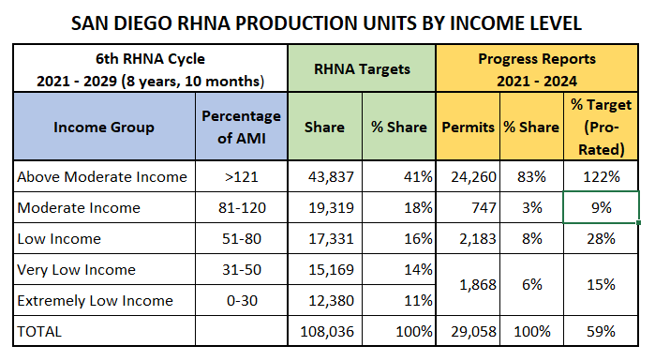
6th Cycle (2021-2029) Regional Housing Needs Assessment (RHNA) Progress (2021–2024)
WE ARE:
Overproducing Above Moderate
Undercounting Moderate Income
Underproducing
Lower Income housing

Slide 4
Reporting Blind Spots
What isn’t in the Annual Housing Report | Questions that would be answered
Demolition of naturally occurring affordable housing (NOAH) | How much net new housing are we getting from density bonus programs?
Rent surveys, including distribution by income | Is supply driving down rents? Is the market meeting the need for moderate-income housing? Or should we be diverting bonus programs from lower incomes into deed-restricted moderate-income housing? How Is demolition of NOAH units affecting rents and availability at lower incomes? Does filtering really work?
Vacancy rates | Does the market confirm projected state housing needs (RHNA)? Can we build ourselves to affordability?

Slide 5
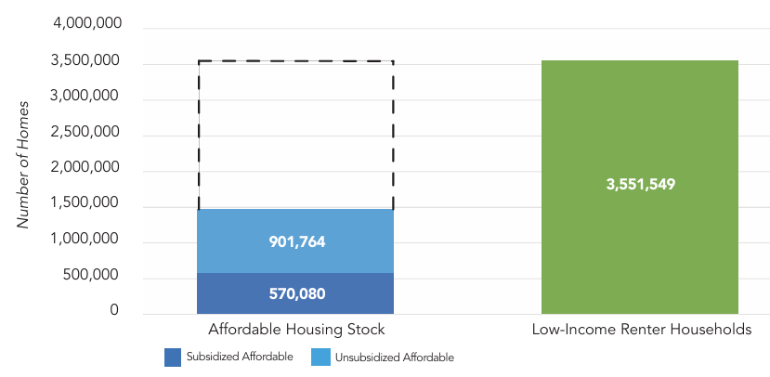
61% of California’s affordable units come from the unsubsidized market
Sources: California Housing Partnership Analysis of CoStar Multifamily Property Database, 2024; California Housing Partnership Preservation Database, April 2025; Analysis of 1-year ACS PUMS data (2023) with HUD income levels.

Slide 6
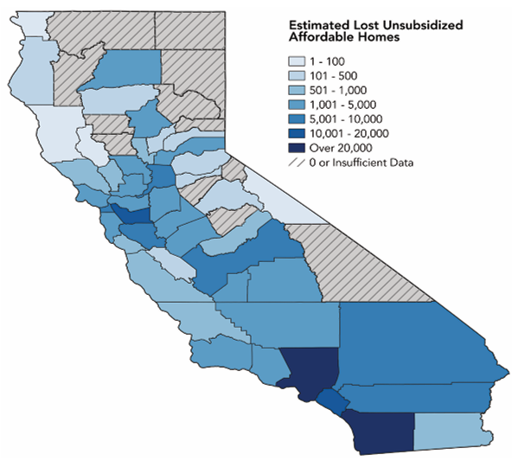
Preserving market affordable housing (NOAH) is particularly important in San Diego
Source: California Housing Partnership Analysis of CoStar Multifamily Property Database, 2024.

Slide 7
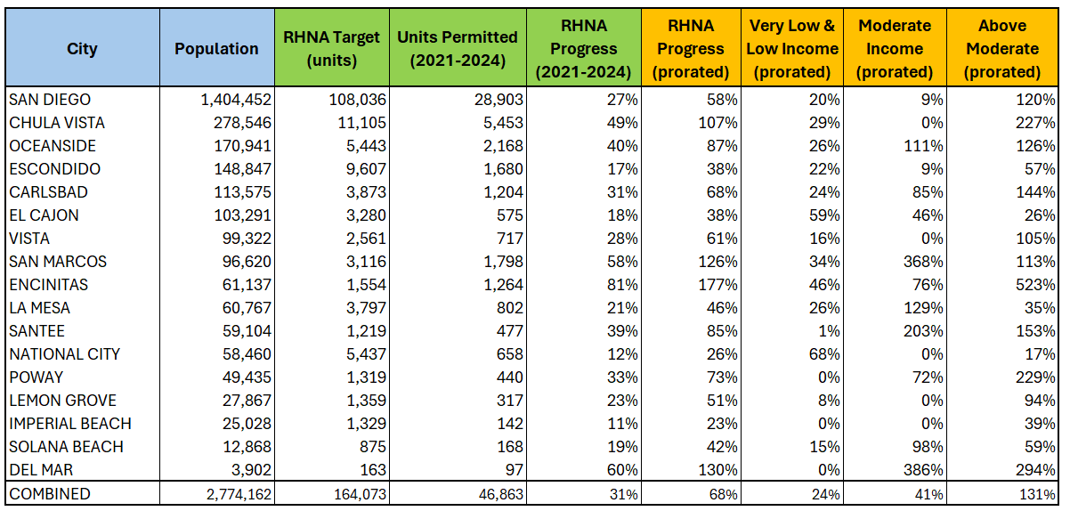
Comparing the San Diego Region (46% of 6th Cycle)
Source: HCD Housing Element Implementation and APR Dashboard, 2025.

Slide 8
Policy Recommendations
Emphasize preservation of existing housing (NOAH)
Update replacement unit policies to match shift to deeded moderate income housing
Include moderate NOAH in CCHS replacement unit requirements
Fix CCHS density threshold
Increase from 20 to 45 dwelling units per acre
Stop making land (=> housing) more expensive through unneeded upzoning
ADUs are working – leave them be!
Need more policy focus on other aspects of housing production and affordability

Slide 9
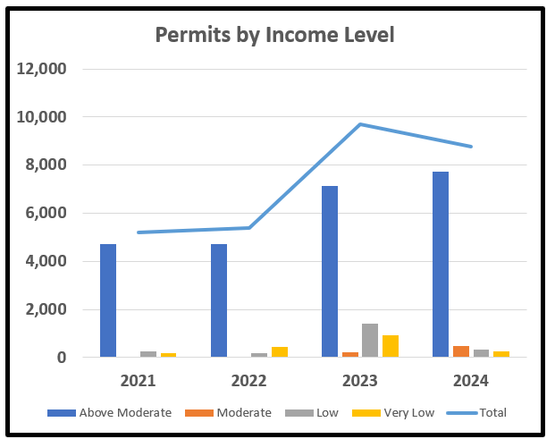
Yearly Permits by Income Level Is shift in affordability levels the result of adding deed-restricted moderate-income options to bonus density programs?
Permits shifted to higher incomes

Slide 10
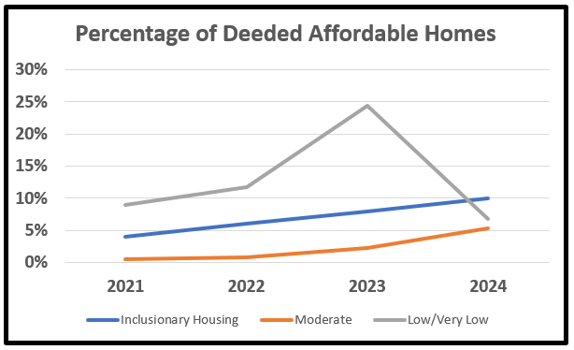
The surge of permits from the 2023 Affordable Homes Now initiative did not persist into 2024

Slide 11
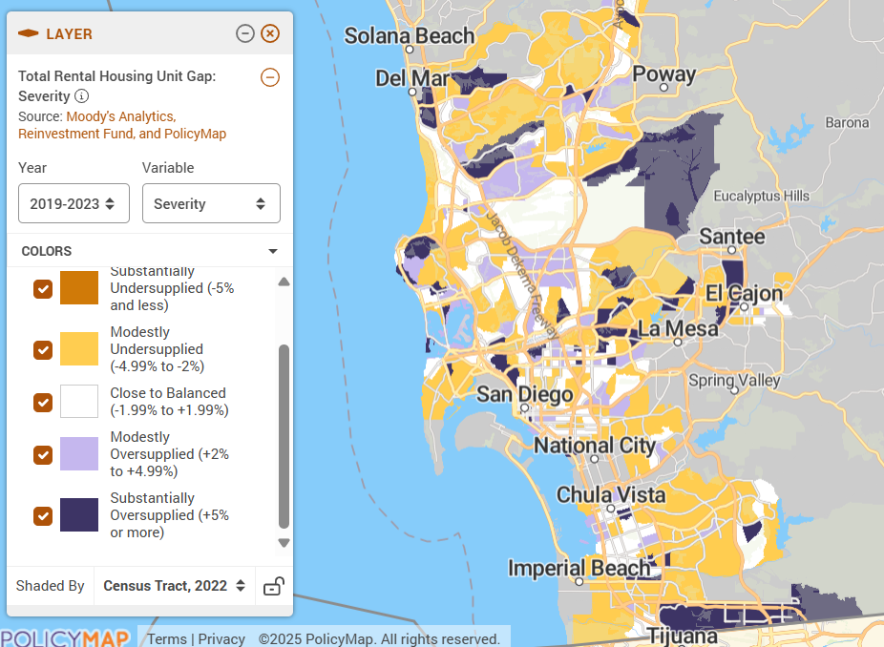
Vacancy Rates reflect market saturation
Source: Moody’s Analytics

Slide 12
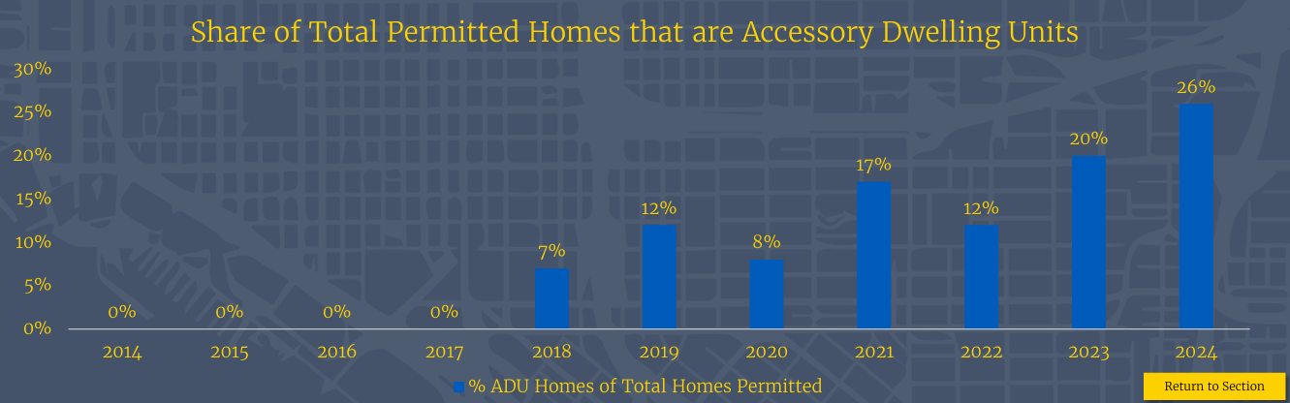
ADUs continue to grow as a significant contributor to San Diego’s housing stock
Need to assess effects of the recently adopted Bonus ADU amendments before pushing further policies that adversely impact single-family neighborhoods

Slide 13
Thank you! Geoffrey Hueter Chair, Neighbors For A Better San Diego NFABSD.org

