Slide 1


Historical Resources Board Meeting
ITEM 2: ALWYN AND EMILY PATERSON HOUSE
Alvin Lin, Associate Planner
City Planning Department

Slide 2
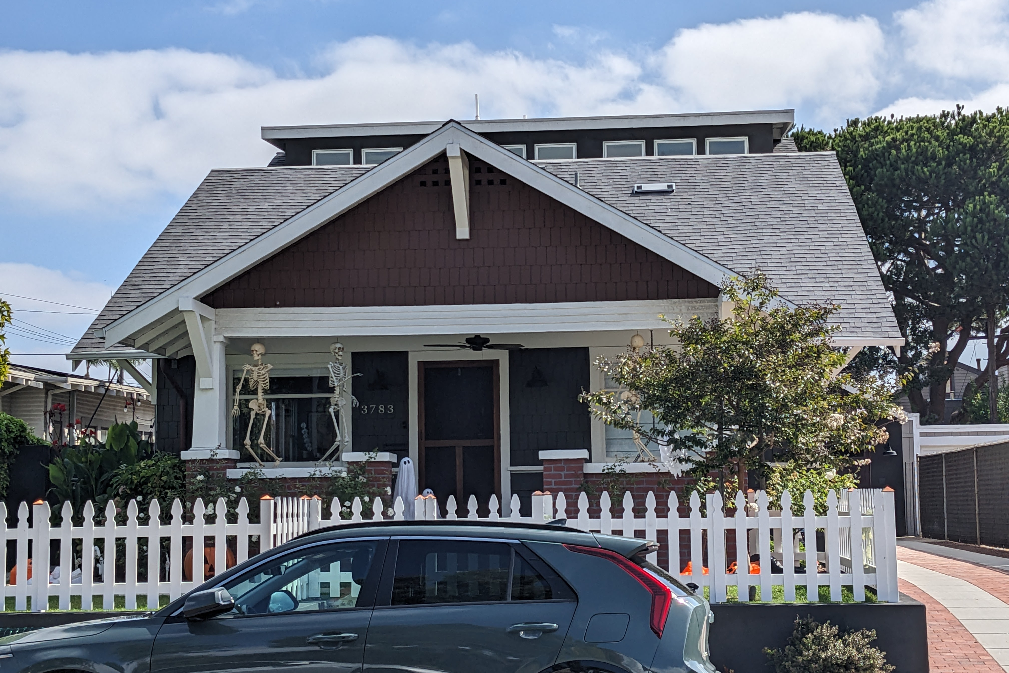
Overview
ALWYN AND EMILY PATERSON HOUSE
3783 Pioneer Place
Designation Nomination
Landmark Historic Preservation; Scott A. Moomjian; Report Findings
  Designate under HRB Criterion C: Exemplifies the Craftsman Style
Staff Recommendation
  Designate under HRB Criterion C: Exemplifies the Craftsman Style
Notes:
The property located at 3783 Pioneer Place is being brought before the Historical Resources Board in conjunction with the owner's desire to have the site designated as a historical resource. A Historical Resource Research Report was prepared, which concludes that the resource is significant under HRB Criterion C, and staff agrees. An architectural analysis by IS Architecture for a 2020-2021 building project was also included as part of this nomination.

Slide 3
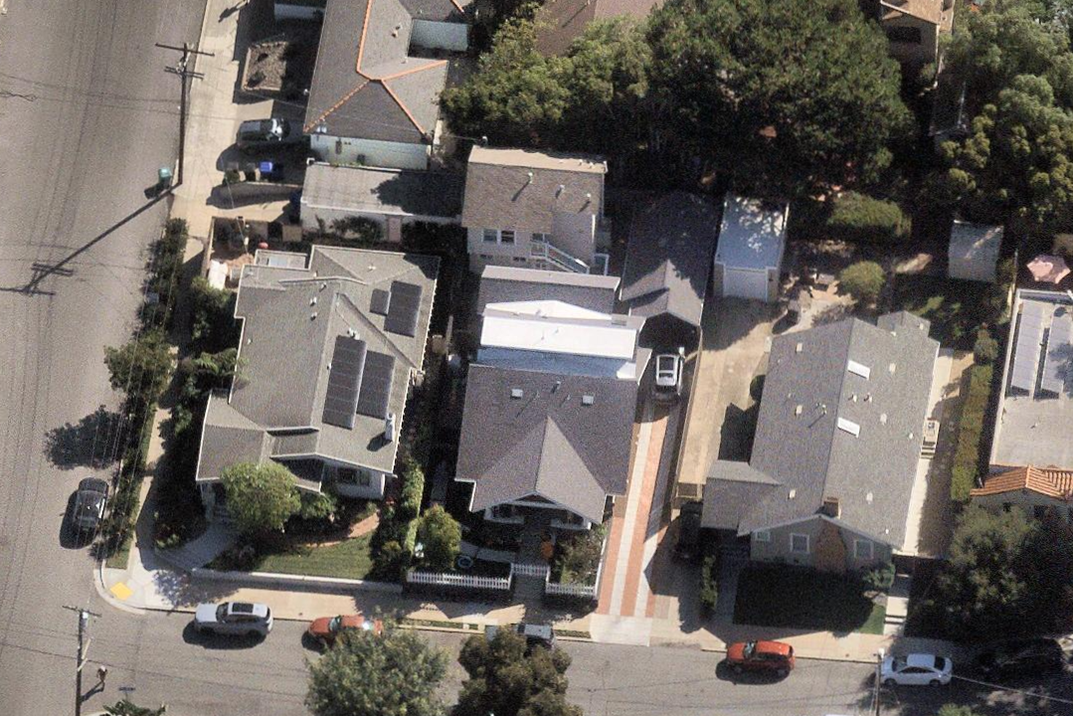
Physical Setting
Address:
3783 Pioneer Place
APN:
451-042-11-00
Community Planning Area:
Uptown
Neighborhood:
Mission Hills
Setting:
Residential
Notes:
The property is located on Pioneer Place Street, which terminates in a cul-de-sac, in a residential neighborhood of the Uptown Community Planning Area. Structures on this parcel include the subject property, a detached 1928 apartment building, and a detached 2021 garage.

Slide 4
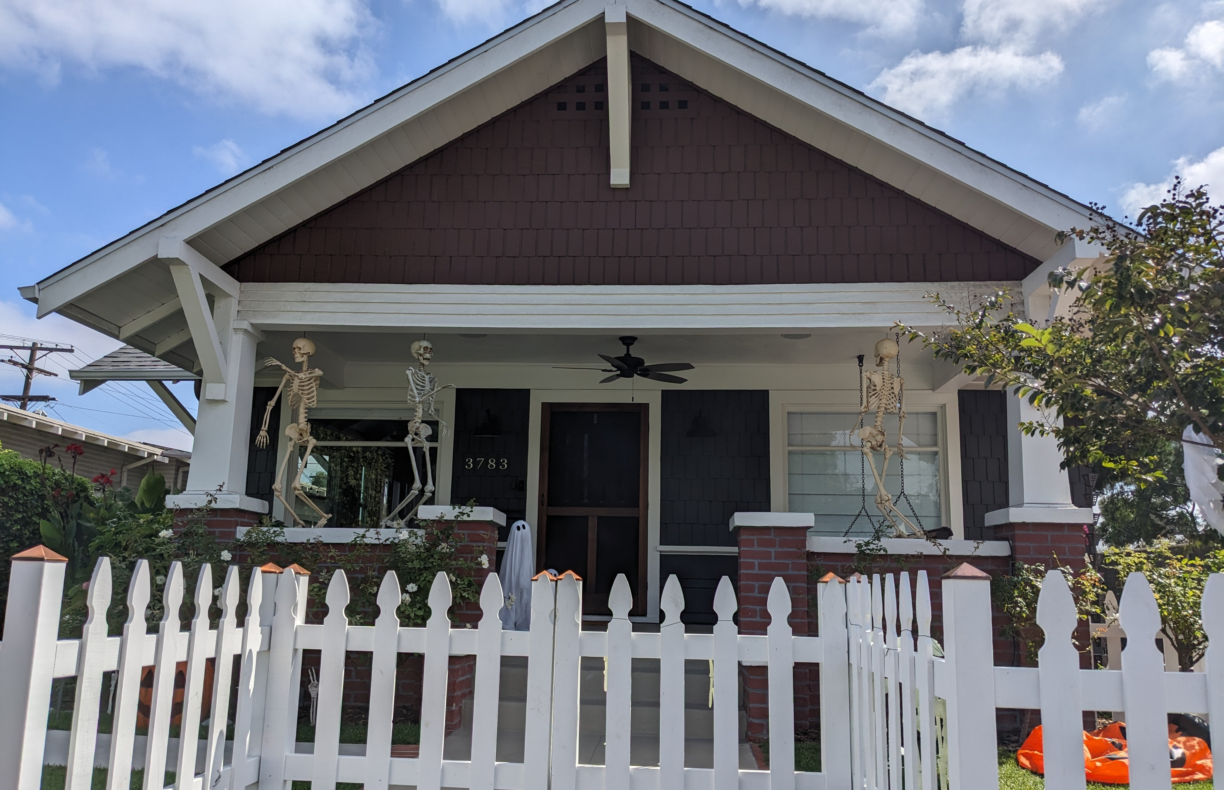
Building Information
Style:
Craftsman
Year Built:
1915
Architect:
Unknown
Builder:
Unknown
Primary Elevation (W)
Notes:
The subject property was built in 1915. The property is cross-gabled with open eaves.

Slide 5
Building Information
Style:
Craftsman
Year Built:
1915
Architect:
Unknown
Builder:
Unknown
Side Elevation (N) (applicant photo)
Notes:
Multiple gables are expressed on the side elevation. The building is clad in horizontal wood siding and wood shingle siding.

Slide 6
Building Information
Style:
Craftsman
Year Built:
1915
Architect:
Unknown
Builder:
Unknown
Side Elevation (S) (applicant photo)
Notes:
A partial-width, gabled front porch is located at the front elevation. The balustrade is constructed of brick.

Slide 7
Building Information
Style:
Craftsman
Year Built:
1915
Architect:
Unknown
Builder:
Unknown
Rear Elevation (E) (applicant photo)
Notes:
A two-story addition is located at the rear elevation, projecting from the rear of the roof. This addition is clad in stucco.

Slide 8
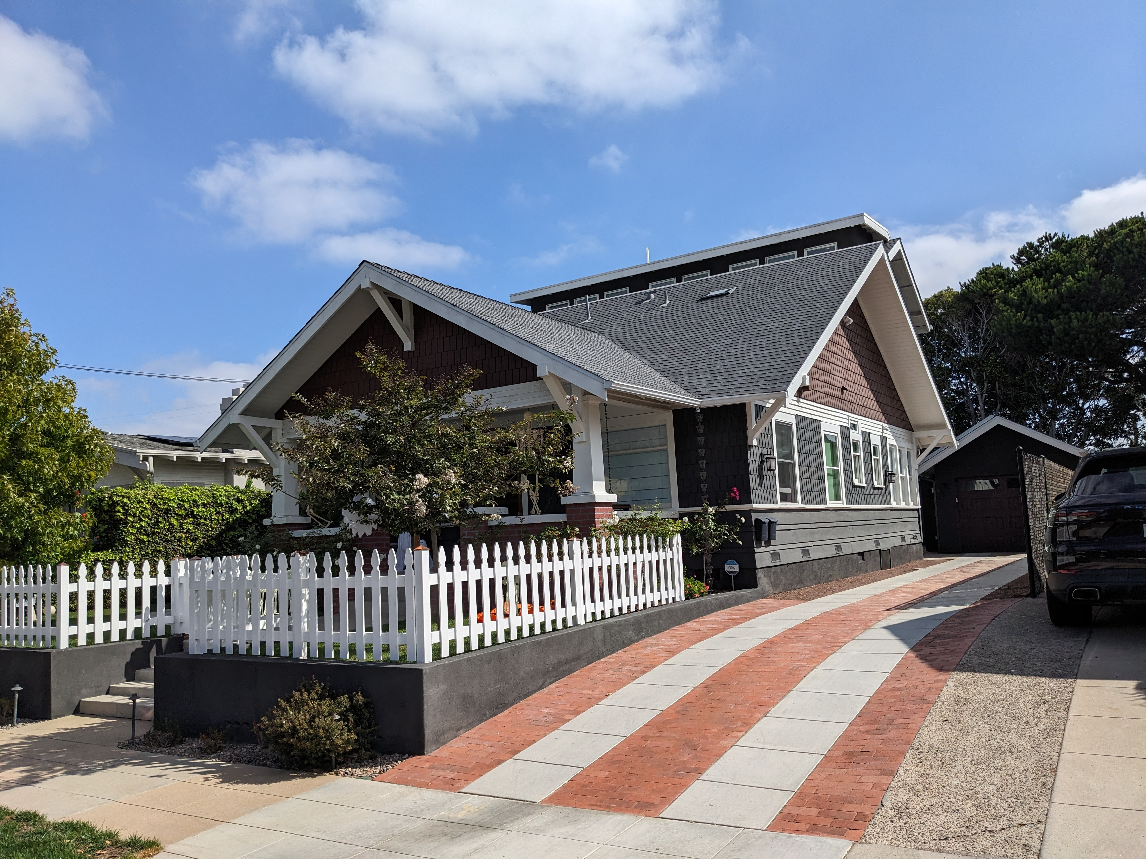
Character Defining Features
Overhanging eaves with exposed rafters
Triangular knee brackets
Partial-width front porch
Battered posts and brick piers
Wood siding and windows, doors
Notes:
The Craftsman character-defining features on this property include overhanging eaves with exposed rafters, triangular knee brackets, a partial-width front porch, porch supports consisting of battered posts over brick piers, and various types of wood siding, wood construction windows, and wood doors.

Slide 9
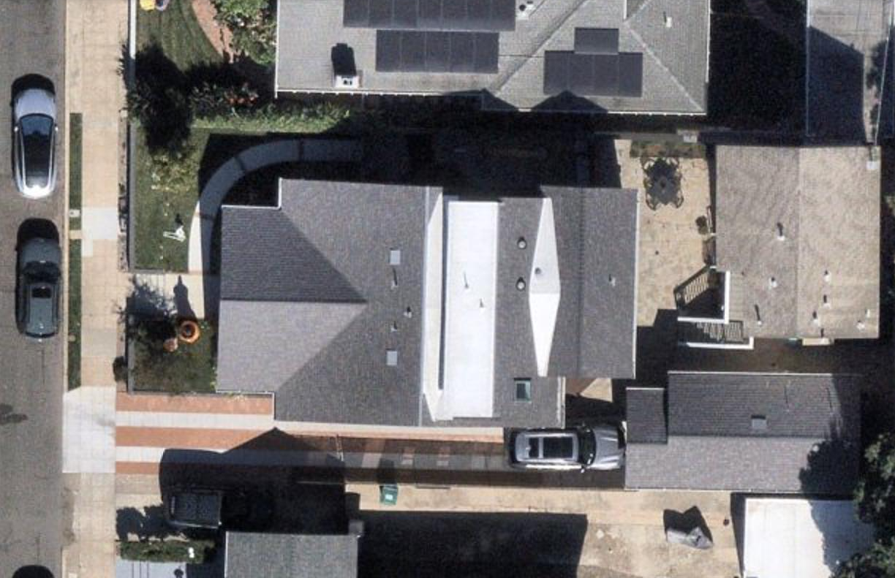
Alterations
  Paint over brick, n.d.
  Rear addition, 2020-2021
  Awning Window, 2023
  Picket Fence, 2025
Aerial (Yellow is footprint; red is addition)
Notes:
Since the subject property was constructed in 1915, it was modified with the painting of the brick porch piers at an unknown date, a two-story addition constructed in 2020-2021 as part of a remodel and addition project, shown on screen boxed in red, an awning window added in 2023, and a picket fence added in 2025.

Slide 10
Alterations
  Paint over brick, n.d.
  Rear addition, 2020-2021
  Awning Window, 2023
  Picket Fence, 2025
Notes:
On screen is a photo collage showing the location and extent of the aforementioned modifications. The top right photo shows the extent of the 2021 two-story addition, and the bottom left photo shows the added awning window in 2023. Other photos show the painted brick and the added white picket fence.

Slide 11

Nominated Designation Criteria
Designation Criterion
The property at 3783 Pioneer Place is nominated as a resource that embodies the distinctive characteristics of the Craftsman Style
cross-gabled roof
overhanging eaves with exposed rafters
decorative attic vents
triangular knee brackets
wood siding
a partial-width front porch
battered posts and brick piers
original wooden glazed front door
wood sash double-hung and fixed windows
Notes:
The subject property is being nominated for designation under HRB Criterion C for the Craftsman style. The property embodies the distinctive characteristics of the Craftsman style, as discussed in the previous slides.

Slide 12
Integrity Analysis
Designation Criterion
The property at 3783 Pioneer Place does retain integrity under HRB Criterion C
Integrity of design, workmanship, and materials
Property retains integrity
2021 two-story addition is consistent with SOI Standards
Painting over brick and awning window addition are minor
Notes:
For a Criterion C nomination, integrity of design, workmanship, and materials are most important.
Heritage Preservation staff reviewed and approved the 2020-2021 remodel and addition permit, which allowed for the construction of a two-story addition. This addition is located at the rear façade with reduced visibility and differentiated in design – therefore, it is consistent with the SOI Standards. Heritage Preservation Staff also approved the addition of a south elevation awning window in an enlarged opening. This alteration is minor in nature and limited to a secondary façade. Similarly, the addition of the picket fence and painting over the existing brick are minor in nature.
Therefore, the property retains integrity under HRB Criterion C to its 1915 period of significance.

Slide 13
Staff Recommendation
Staff recommends that the HRB designates the property at 3783 Pioneer Place under:
HRB Criterion C as a resource that embodies the distinctive characteristics through the retention of character defining features of the Craftsman style with a 1915 period of significance.
Excludes the detached two-story 1928 apartment building, the detached 2021 garage, and the 2021 two-story addition.
Notes:
In conclusion, staff recommends the designation of the subject property at 3783 Pioneer Place under HRB Criterion C as a resource that embodies the distinctive characteristics of the Craftsman style with a 1915 period of significance. The recommendation excludes the detached two-story 1928 apartment building, the detached 2021 garage, and the 2021 two-story addition. This concludes staff’s presentation. Thank you very much.

