Slide 1


Historical Resources Board
January 22, 2026
ITEM 4: 7320 FAY AVENUE
Alvin Lin, Associate Planner
City Planning Department
Notes:
DIRECTION: Update Month and Year. UNHIDE THIS SLIDE FOR HRB PRESENTATION

Slide 2
Overview
Location
7320 Fay Avenue
Designation Nomination
Vonn Marie May; Nicole Purvis
Report Findings
Designate under HRB Criterion C: Exemplifies the Colonial Revival Style
Staff Recommendation
Do not designate under HRB Criterion C for the Colonial Revival Style.
Notes:
The property located at 7320 Fay Avenue is being brought before the Historical Resources Board in conjunction with the owner's desire to have the site designated as a historical resource. A Historical Resource Research Report was prepared, which concludes that the resource is significant under HRB Criterion C. Staff disagrees, finding that the property is not eligible for designation under HRB Criterion C.

Slide 3
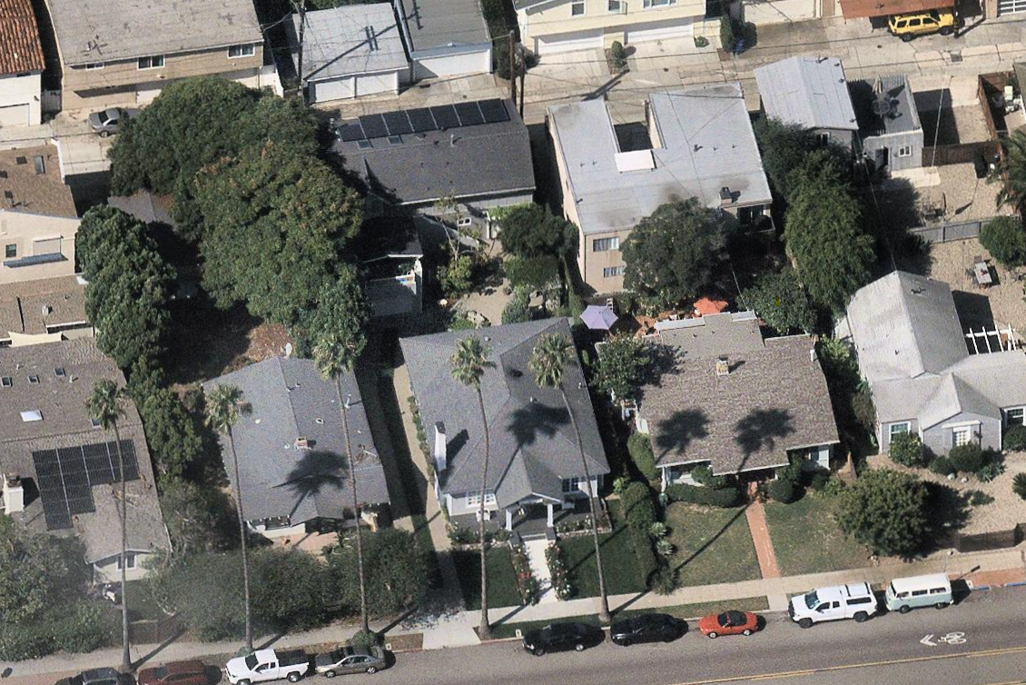
Physical Setting
Address:
7320 Fay Avenue
APN:
351-061-18-00
Community Planning Area:
La Jolla
Neighborhood:
La Jolla
Setting:
Residential
Notes:
The property is located on Fay Avenue in a residential setting within the La Jolla Community Planning Area. Structures on this parcel include the subject property and a detached apartment over garage.

Slide 4
Building Information
Style:
N/A
Year Built:
1928
Architect:
Unknown
Builder:
Judson A. Ferguson
Primary Elevation (E) (applicant photo)
Notes:
The subject property was constructed in 1928. The primary elevation features a portico. The hipped roof is medium-pitched, and the closed eaves are overhanging.

Slide 5
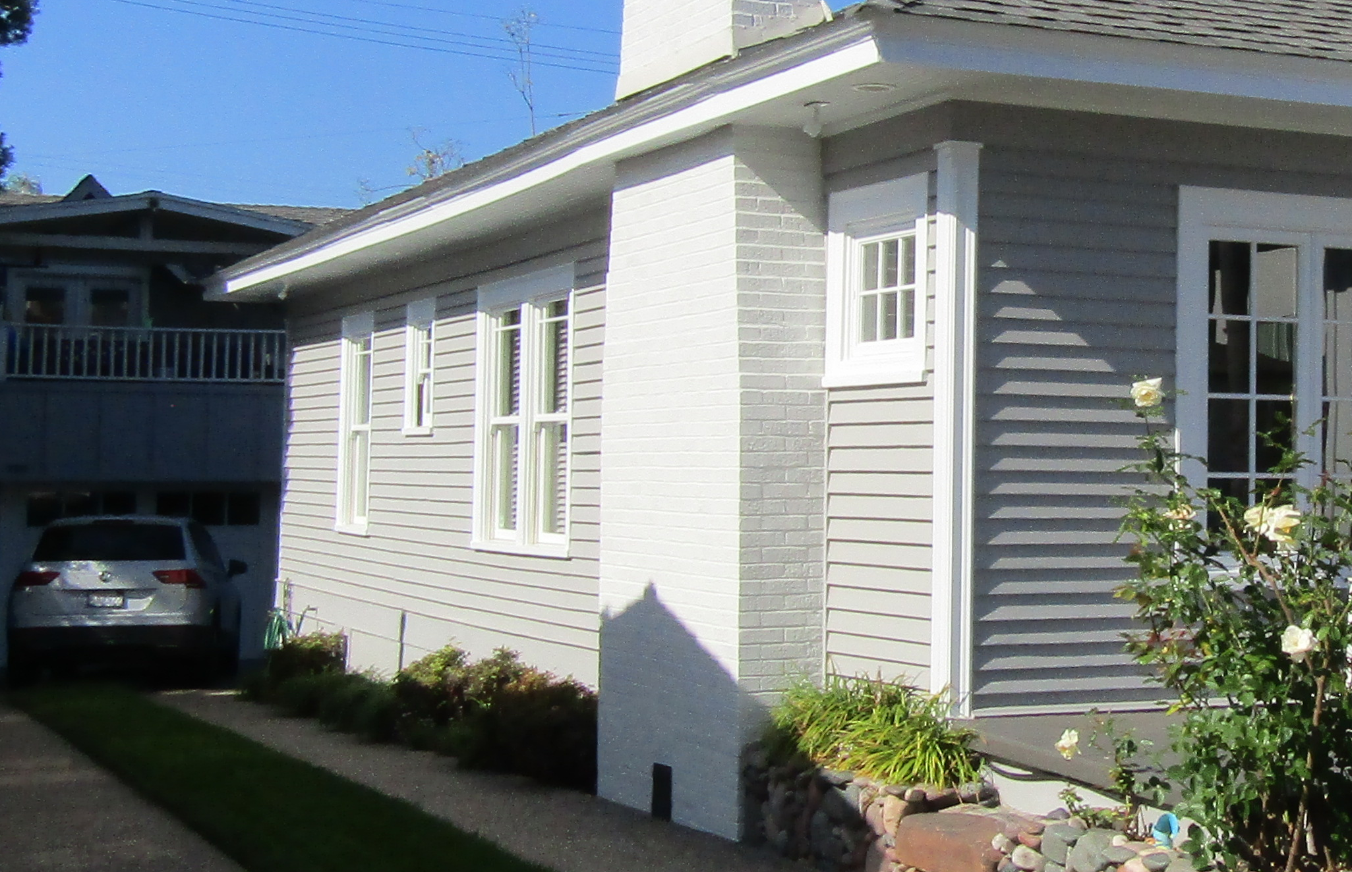
Building Information
Style:
N/A
Year Built:
1928
Architect:
Unknown
Builder:
Judson A. Ferguson
Side Elevation (S)
Notes:
The building is clad in horizonal wood siding. A brick chimney is present on the side elevation.

Slide 6
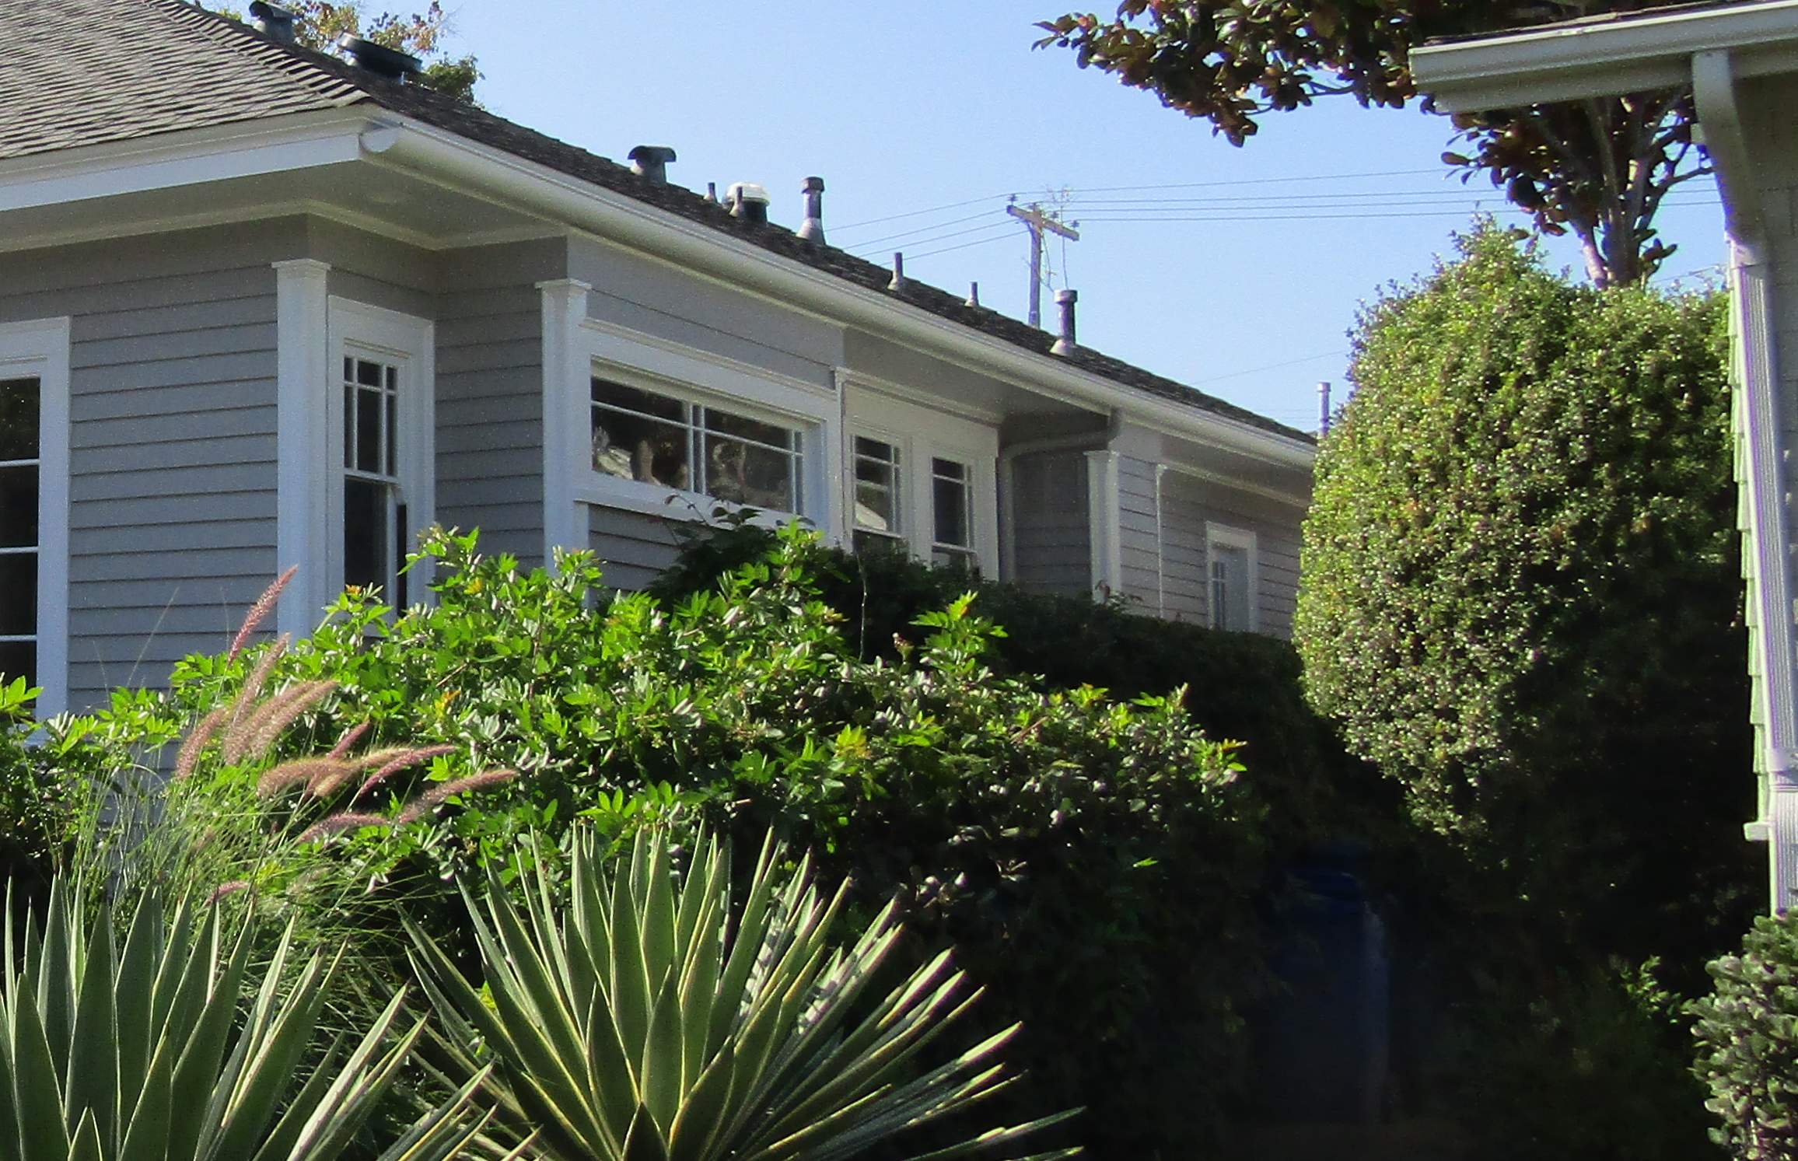
Building Information
Style:
N/A
Year Built:
1928
Architect:
Unknown
Builder:
Judson A. Ferguson
Side Elevation (N)
Notes:
Divided lite wood windows of various types are present on all elevations. A window bay is present on the north side elevation.

Slide 7
Building Information
Style:
N/A
Year Built:
1928
Architect:
Unknown
Builder:
Judson A. Ferguson
Rear Elevation (W) (applicant photo)
Notes:
Architectural elaborations are generally absent on the rear elevation, with wood double hung windows present.

Slide 8
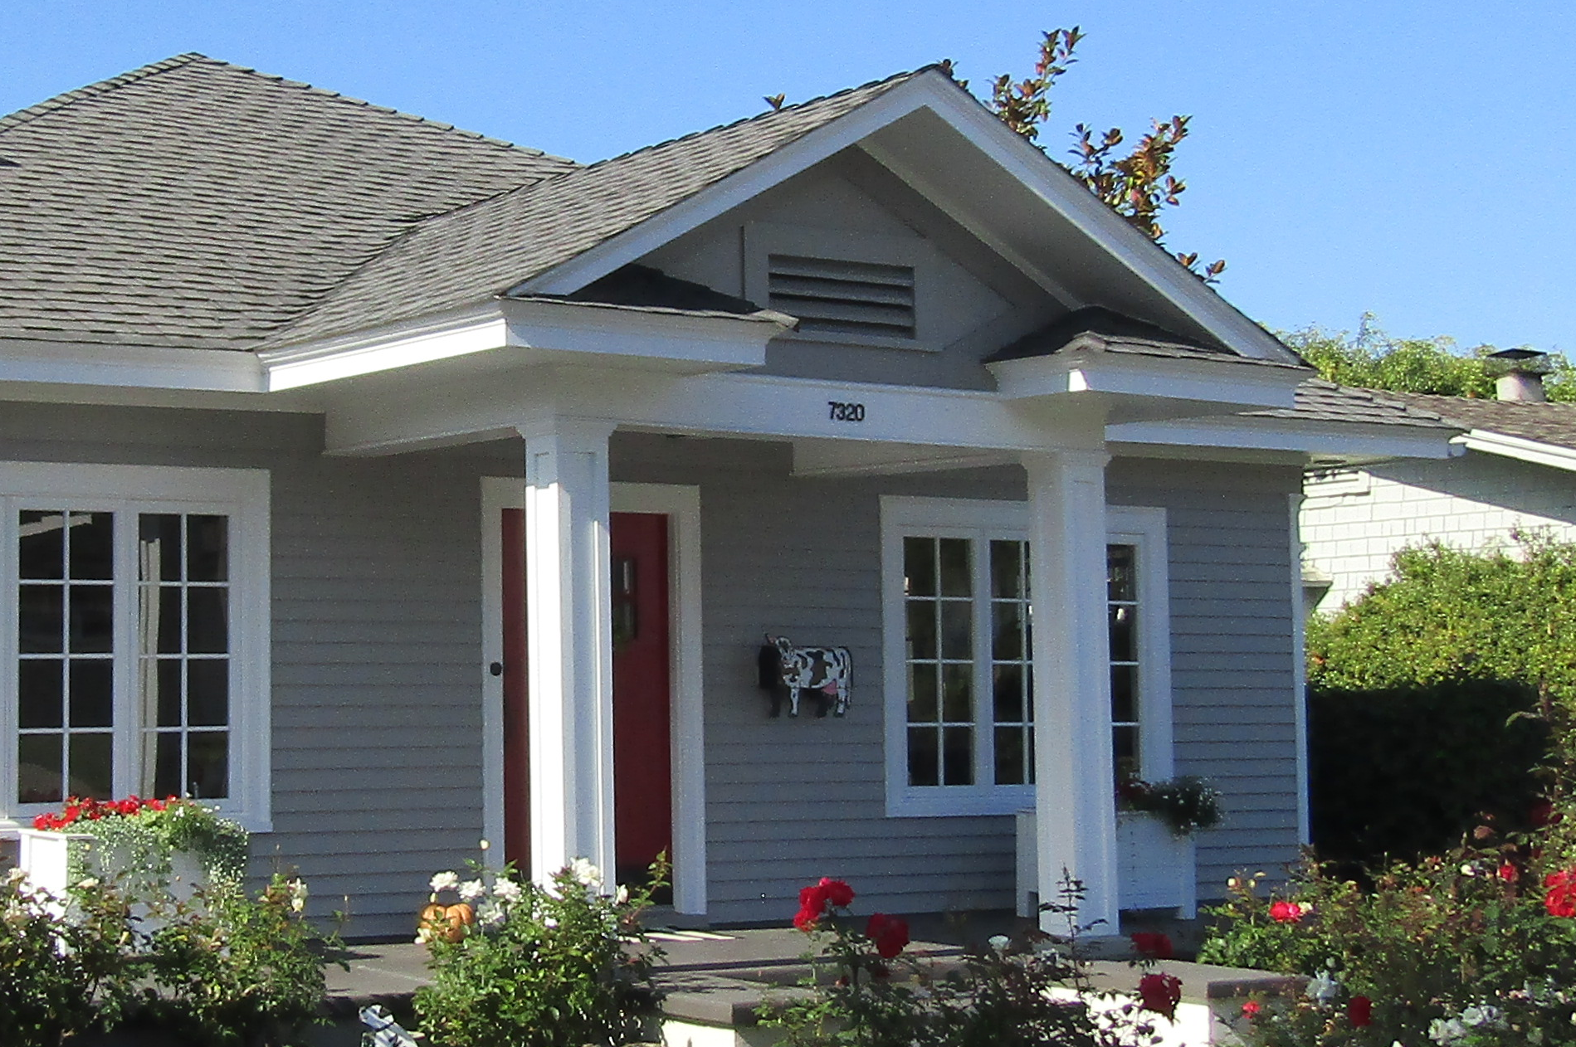
Character Defining Features
Portico with decorative crown and columns
symmetrically balanced windows and doors
Notes:
Architectural features on this property include a portico with a decorative crown supported by square columns, and symmetrically balanced windows and doors. These features are associated with the Colonial Revival Style.

Slide 9
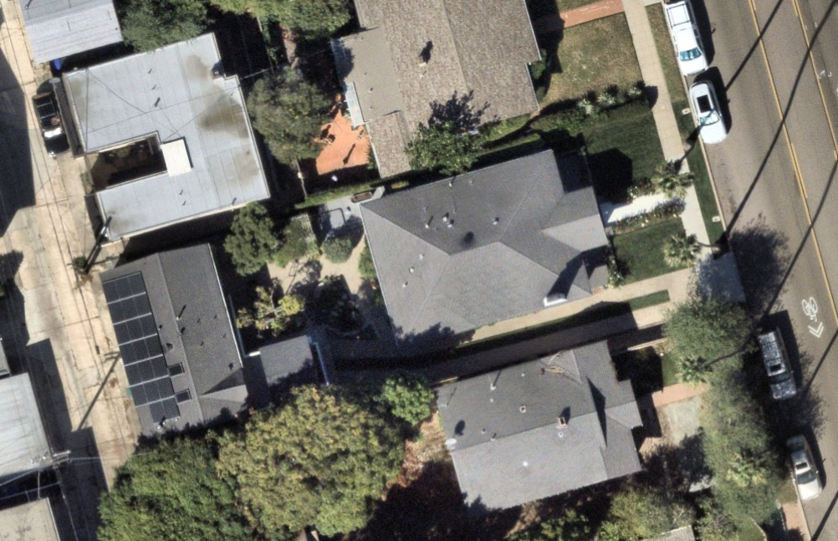
Alterations
Cobble planter, 1992
WH enclosure, 1992
Window-to-door opening conversion, 1992
Aerial (Yellow is footprint; red is addition)
Notes:
Since the subject property was constructed in 1928, it was modified with a new cobblestone planter at the front porch, a water heater enclosure addition at the north elevation, and a window-to-door opening conversion, all of which occurred in 1992. Also in 1992, in-kind replacements of existing windows and the removal of non-original brick veneer occurred. On-screen, the red box indicates the location of the added water-heater enclosure.

Slide 10
Alterations
Cobble planter, 1992
WH enclosure, 1992
Window-to-door opening conversion, 1992
Notes:
The photos on-screen demonstrate the aforementioned added cobblestone planter, a non-original water-heater enclosure, and an enlarged window opening at the north elevation that now fits a door.

Slide 11

Nominated Designation Criteria
Designation Criterion
The property at 7320 Fay Avenue is nominated as a resource that embodies the distinctive characteristics of Colonial Revival Style
"Simple rectangular volume with medium pitched hipped roof”
“Symmetrical facade with balanced fenestration, including pilasters”
“Accentuated front entry with wood door and sidelights”
“Portico with cornice returns, and paneled columns as supports”
“A dominant exterior chimney”
Notes:
The subject property is being nominated for designation under HRB Criterion C for the Colonial Revival style. The historical report identified a number of character-defining features, reproduced on screen here. They include a simple rectangular volume with a medium-pitched roof, a symmetrical façade, an accentuated front entry, a portico, and a dominant chimney.

Slide 12
Integrity Analysis
Designation Criterion
The property at 7320 Fay Avenue does retain integrity under HRB Criterion C
Integrity of design, workmanship, and materials are more important under HRB Criterion C.
Property retains integrity, as alterations were limited to minimally visible secondary elevations, and replacement of existing components were in-kind in design and materials.
Notes:
For a Criterion C nomination, integrity of design, workmanship, and materials are most important.
For the purposes of HRB Criterion C evaluation, the property retains integrity. The alterations include in-kind replacements of original windows, removal of non original features, and alterations limited to secondary facades where visibility is reduced.

Slide 13
Staff Recommendation
Designation Criterion
Staff does not recommend designation of the property at 7320 Fay Avenue under HRB Criterion C.
Only two features represented: portico with decorative crown supported by columns, and symmetrically balanced windows and doors.
Subject property minimally expresses the distinctive characteristics of the Colonial Revival style.
Notes:
However, contrary to the historical report's findings, Heritage Preservation finds that the subject property exhibits only two character-defining features of the Colonial Revival Style: an accentuated entry porch with a decorative crown supported by columns, and symmetrically balanced windows and doors. Together, these features minimally expresses the Colonial Revival Style. Therefore, in considering the overall design of the property, staff finds that the property does not embody the distinctive characteristics of the Colonial Revival style to be eligible for designation under HRB Criterion C.

Slide 14
Staff Recommendation
Staff recommends that the HRB do not designate the property located at 7320 Fay Avenue under any HRB Criteria.
The subject property is not eligible for designation under HRB Criterion C because it does not embody the distinctive characteristics of the Colonial Revival style.
Notes:
In conclusion, staff recommends that the property NOT be designated under HRB Criterion C for the Colonial Revival Style. This concludes staff’s presentation. Thank you very much.

