Slide 1
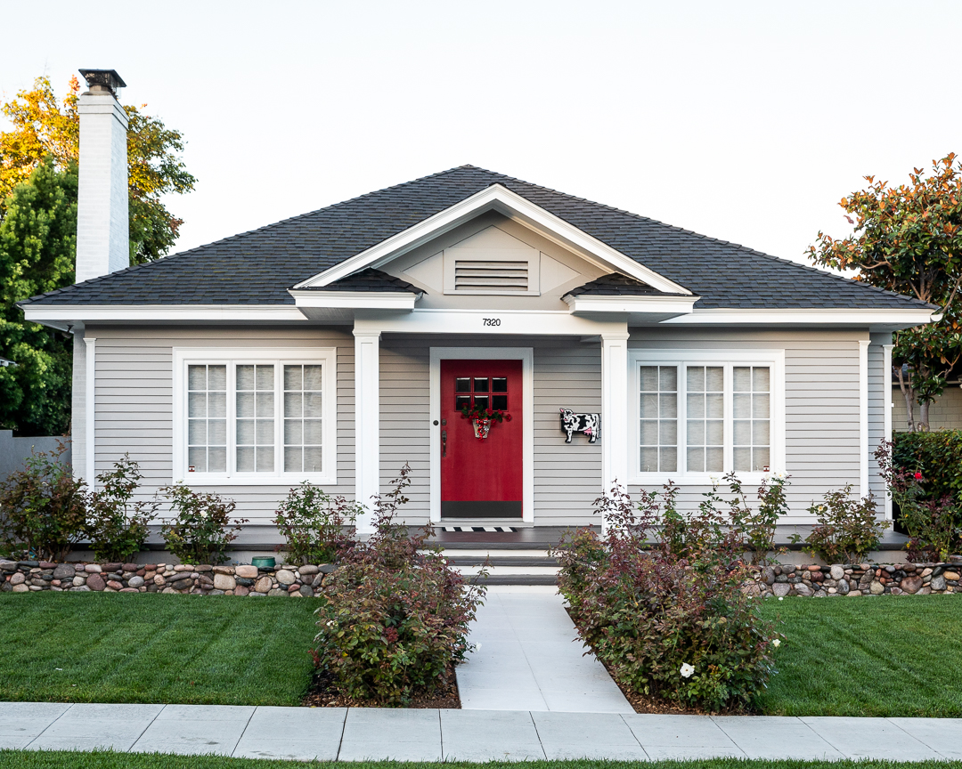
1928 Judson A. & Mary C. Ferguson House

Slide 2
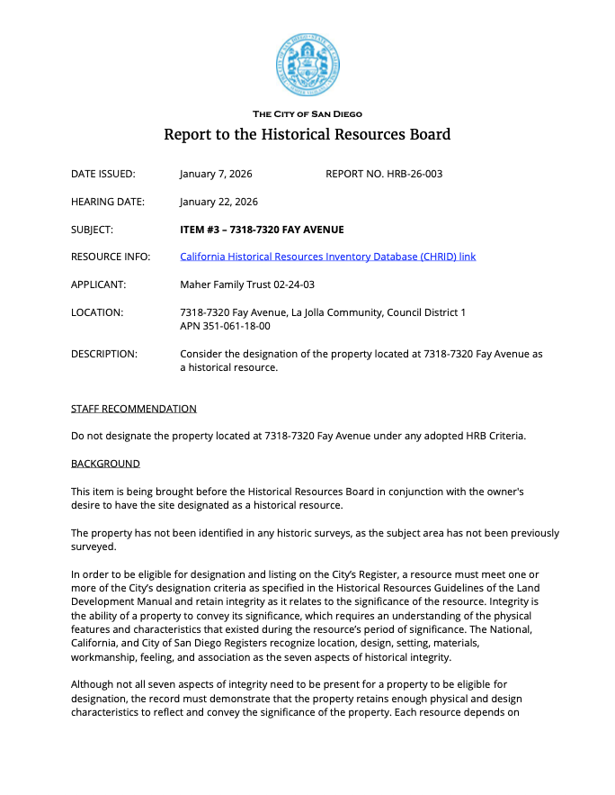
Staff Report to the Historical Resources Board:
"While the property retains integrity, it is the staff’s position that the property does not exhibit sufficient distinctive characteristics of Colonial Revival architecture."

Slide 3
The City’s HRB-authored survey and style guide defines Colonial Revival by simple forms, symmetrical façades, accentuated entries, and restrained classical detailing.

Slide 4
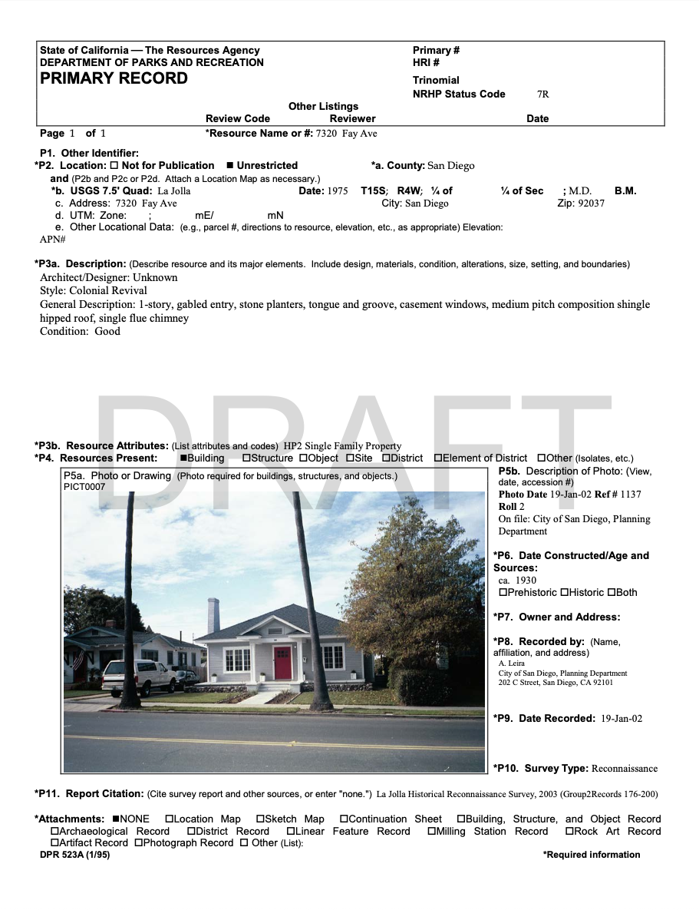
The City of San Diego 2002 reconnaissance survey, on file with the Planning Department, identifies 7320 Fay Avenue as a Colonial Revival residence. This professional classification has stood for more than twenty years.

Slide 5
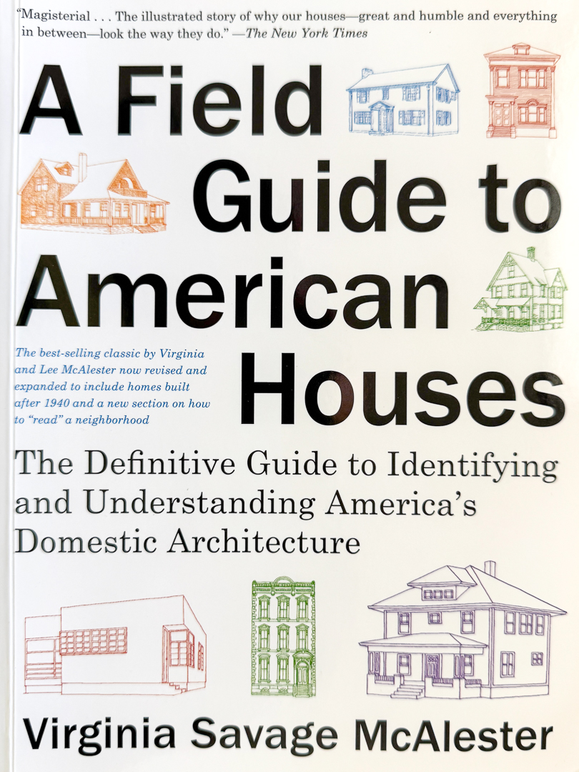
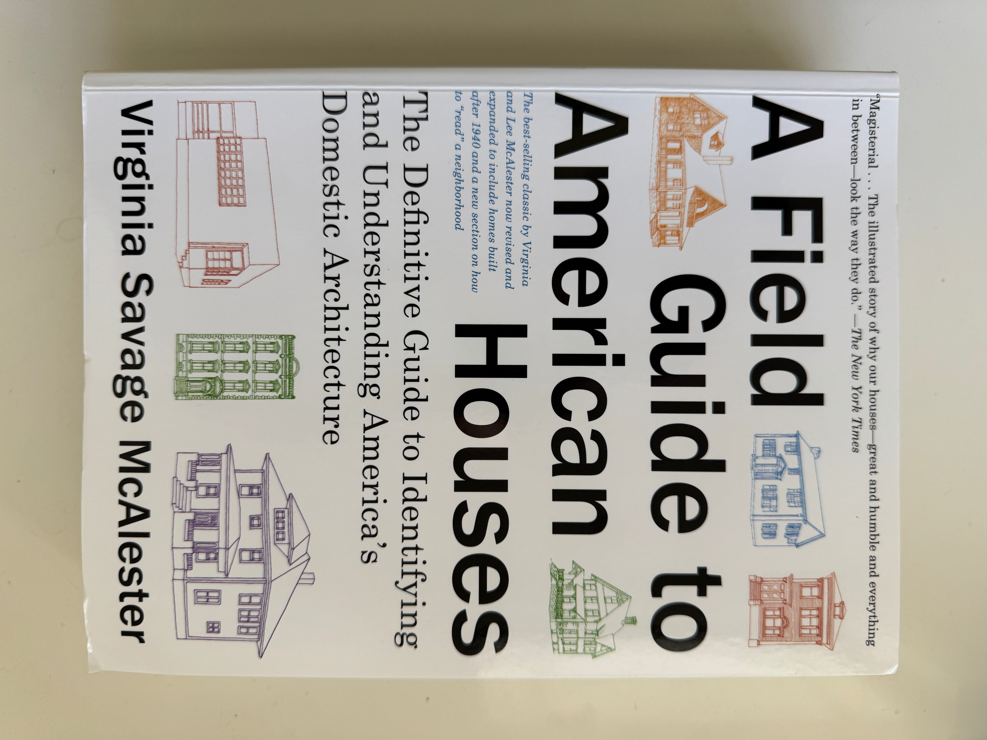
A Field Guide to American Houses McAlester, Virginia Savage & Lee McAlester Revised Edition. New York: Alfred A. Knopf, 2013
A Guide to Architecture in Los Angeles and Southern California Gebhard, David & Robert Winter Santa Barbara: Peregrine Smith, 1977
American Architecture, Volume 2: 1860–1976 Whiffen, Marcus & Frederick Koeper Cambridge, MA: MIT Press, 1981
Architects’ Small House Service Bureau American Institute of Architects Washington, DC, 1923

Slide 6
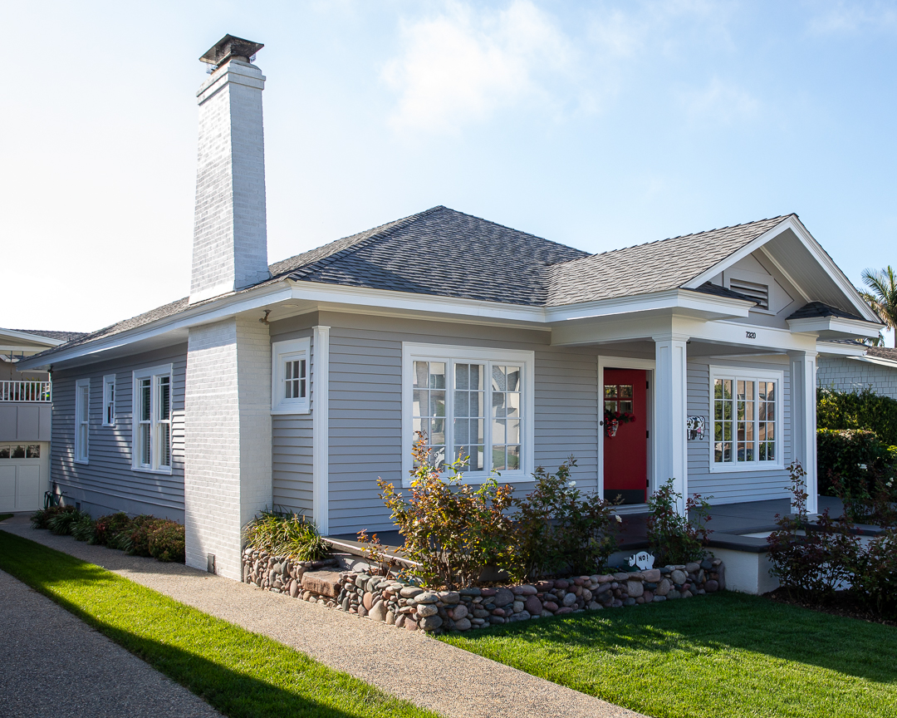
Colonial Revival Cottage Characteristics (AIA)
• One-story 1915-1950 • Compact, rectangular form • Balanced façade, centered • Accentuated entryway • Substantial Chimney • Hipped Roof • Moderate Pitch • Pediment • Portico • Double-hung Windows (13) • Multi-light windows • Front door with lights • Simplified trim • Pilasters (10)

Slide 7
The cumulative effect is 7320 Fay Avenue embodies the historical character of the Colonial Revival movement. It is a modest, Colonial Revival cottage that reflects the style’s characteristic emphasis on symmetry, classical detailing, and simplified traditional forms reflecting the early 20th-century La Jolla streetscape.

Slide 8
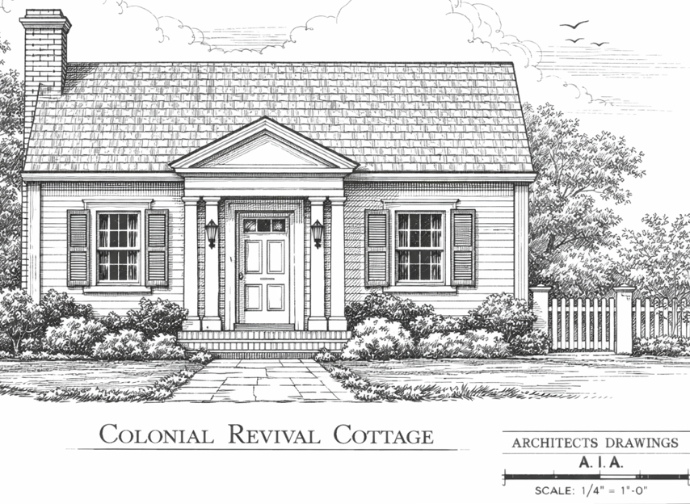
During the 1920s, AIA house plan services were available in Southern California, including the Architects’ Small House Service Bureau, which published plans for Colonial Revival cottages.
Source: Architects’ Small House Service Bureau, Your Future Home (American Institute of Architects, 1923)

Slide 9
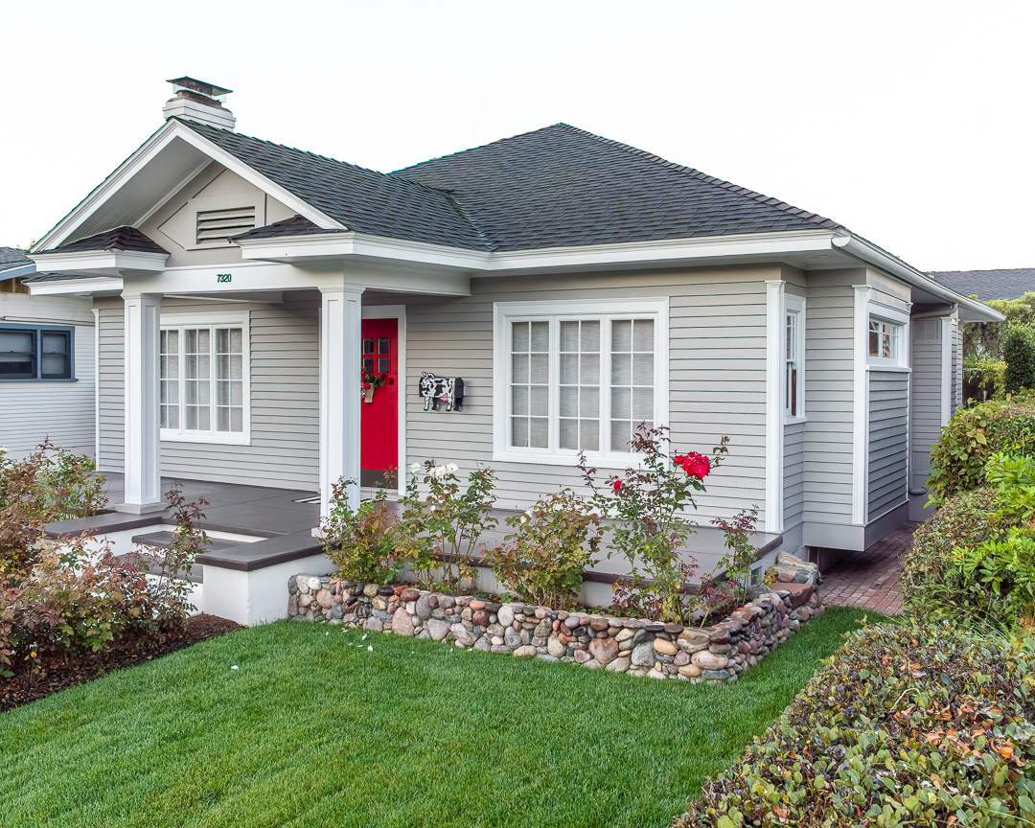
The City staff agrees that this 98-year-old house retains a high level of integrity. It also embodies the Colonial Revival cottage in form, materials, and design. It is one of the last examples of La Jolla’s early permanent residential core, developed primarily in the 1910s and 1920s.

Slide 10
Based on period-appropriate professional standards, 7320 Fay Avenue clearly embodies the defining characteristics of a Colonial Revival cottage and fits its historic context, meeting the intent of HRB Criterion C. I respectfully request the Board’s approval.

Slide 11
1928 Judson A. & Mary C. Ferguson House

