Slide 1
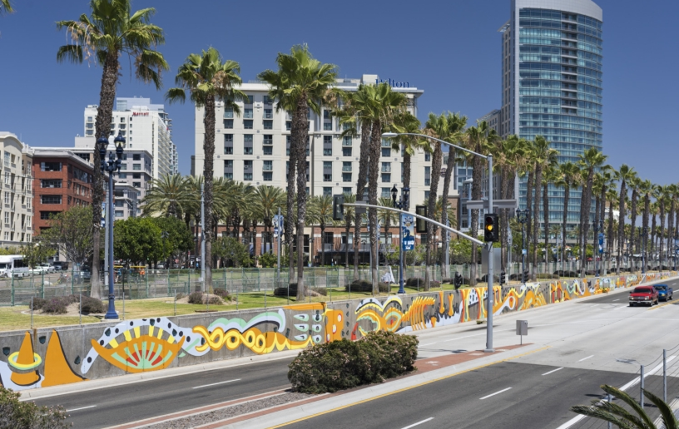


CPPS Grant Reporting
Fiscal Year 2026
Council Administration
Abigail Edwards, Grants Manager
Malachi Bielecki, Grants Coordinator

Slide 2

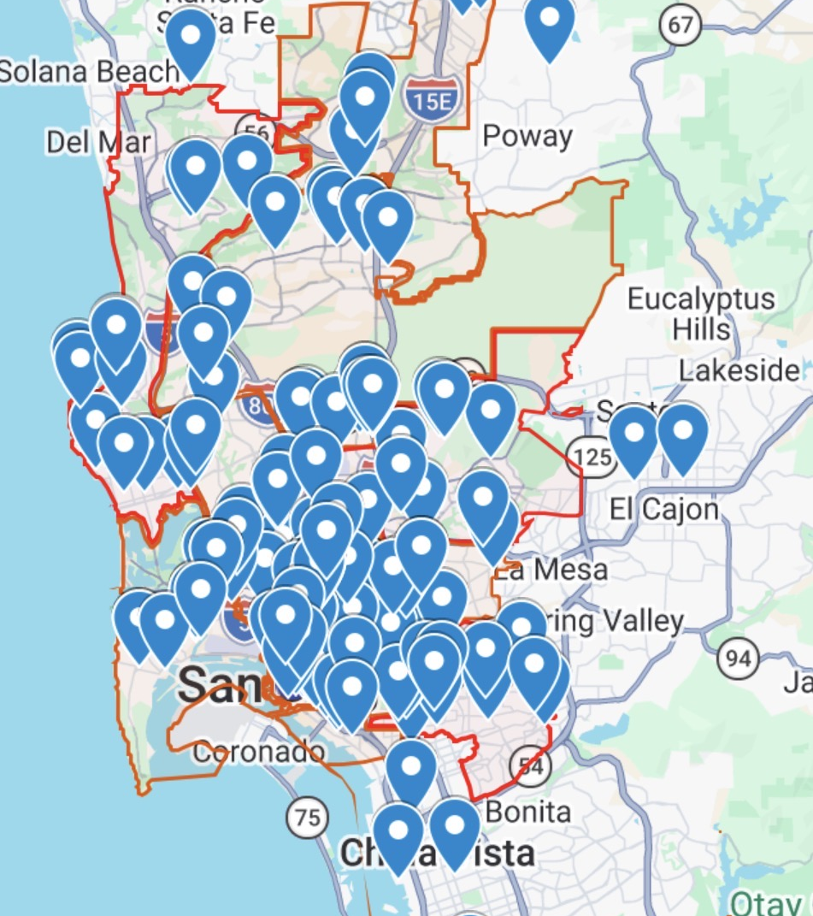
FY26 CPPS Summary
Projects: 216
Funding: $799,787.94

Slide 3
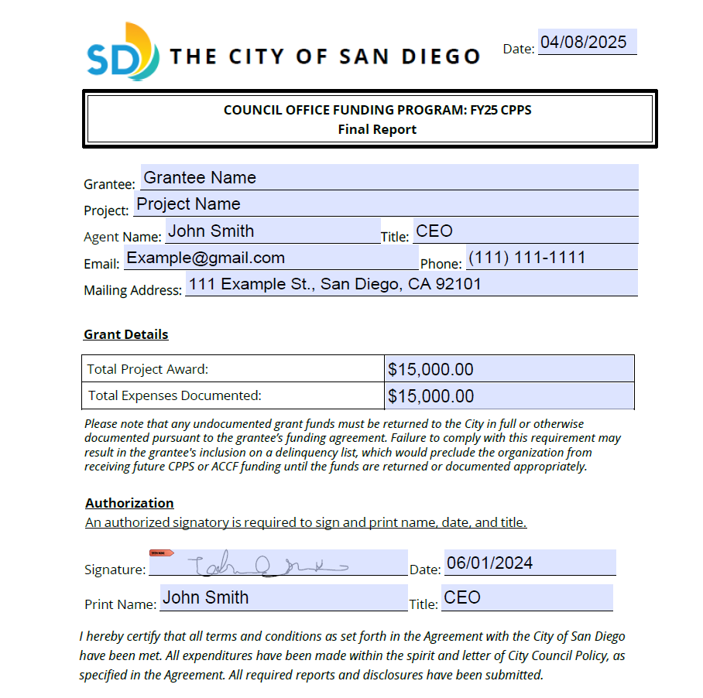
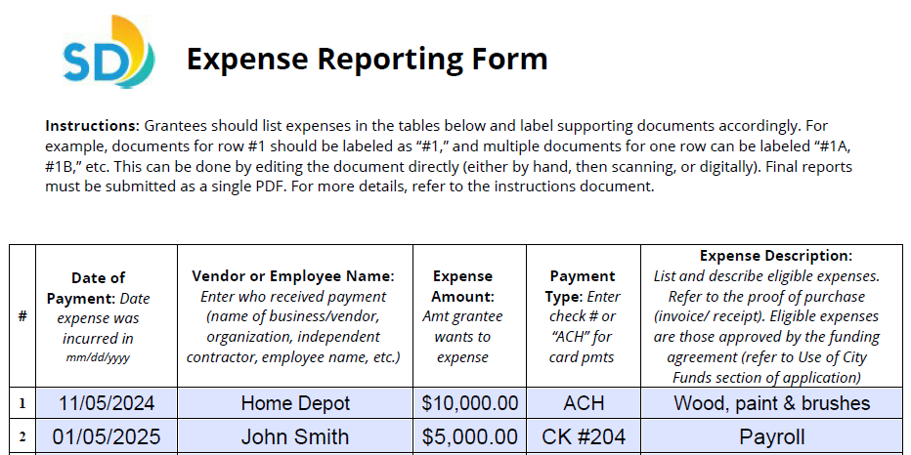
FY26 CPPS Reporting Process
Structure & Process
  CPPS grants are upfront — all grantees should have received a payment via check or direct deposit.
  Final reports are due no later than 5:00 p.m. July 31, 2026.
  Structure as one combined PDF file, including all supplemental documentation.
  Reports are to be submitted to cpps@sandiego.gov and titled “ORG_FY26 CPPS Final Report.”

Slide 4
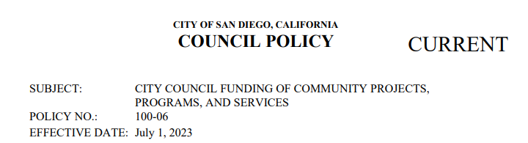
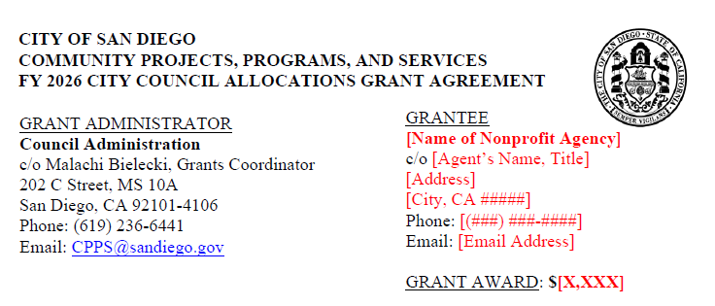
FY26 CPPS Reporting Process
Eligible Expenses
  Permitted by Council Policy 100-06
    Food or beverage is only permitted where they are provided to individuals or families in need.
  Closely related to program activities described in Section 2 of the application as attached in the funding agreement.
  Incurred during City’s Fiscal Year 2026 (July 1, 2025 — June 30, 2026).
  Approved by your grant administrator.

Slide 5

FY26 CPPS Reporting Process
Supporting Documentation
  Two supporting documents:
      Proof of Purchase, such as an invoice, receipt, agreement, or timecard proves an expense was initiated.
      Proof of Payment, such as a canceled check, bank statement, or credit card statement proves an expense was incurred.
  Label documents in sequential order matching the expense table.
  Highlight or circle relevant information such as vendors, dates, and amounts.

Slide 6

FY26 CPPS Reporting Process
Miscellaneous
  Grantees must return the remaining balance of funds if the documented amount accounts for less than the full Grant Award.
    Failure to return funds may result in inclusion on a delinquency list, precluding the grantee from receiving future funding unless cured.
  Grant Awards equal to or greater than $10,000 require additional documents.
    Statement of Activities (Total Revenues and Expenses)
    Statement of Financial Position (Total Assets, Liabilities, and Equity)

Slide 7


FY26 CPPS Reporting Process
Resources
  FY26 CPPS Reporting Instructions
  FY26 CPPS Reporting Example
  Guided Reporting Video Tutorial
  Zoom Recording & PPT
  Contact Council Administration | (619) 236-6441
    Abigail Edwards: edwardsa@sandiego.gov
    Malachi Bielecki: mbielecki@sandiego.gov

