Slide 1

How to Successfully Open Your New Food Business
County of San Diego
Department of Environmental Health and Quality
Food and Housing Division

Slide 2
Overview
Summary of the Department of Environmental Health and Quality
Overview of the Food and Housing Division
How to obtain a health permit
Review of Plan Check process
What to expect after a health permit is obtained

Slide 3
Food, Water and Housing Division (FWHD)
Any person operating a retail food facility (including vending vehicles or a catering business) is required by law to apply for and obtain a valid public health permit from FWHD.
FHD regulates more than 13,800 retail food facilities in San Diego County, including over 8,100 restaurants.
Our Environmental Health Specialists (EHS) conduct more than 33,000 inspections at food facilities each year.
FWHD also inspects over 7,300 public swimming pools, 2,500 housing sites, 30 jail facilities, and body art facilities.

Slide 4
How to Obtain a Food Facility Permit
Two ways to obtain a permit for a permanent food facility:
  1. Plan Check Process:
  - Plan Submittal
  - Consultation
  2. Change of Ownership for an Existing Permitted Food Facility

Slide 5
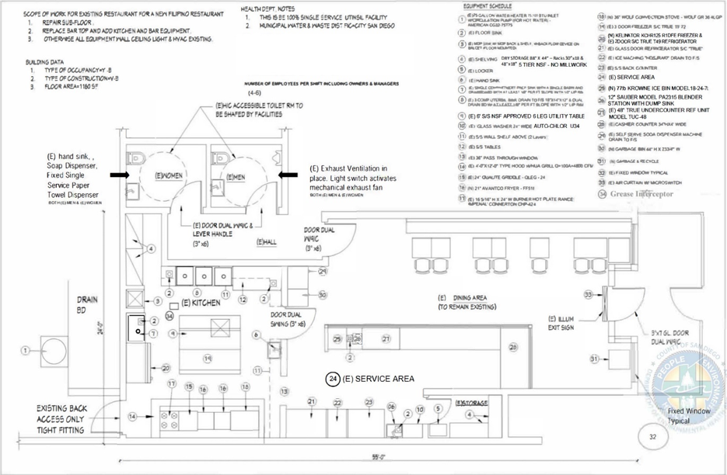
Plan Check Process:
Plan Submittal
Plans are a graphic representation of the proposed facility which include utility connections and equipment.

Slide 6
Plan Check Process:
Plan Submittal
All locations/facilities that are proposing:
  New builds
  Remodels
  Tenant Improvement (aka remodels)
  Change equipment
  Change menu
  Change owner
Plan shall be approved before construction

Slide 7
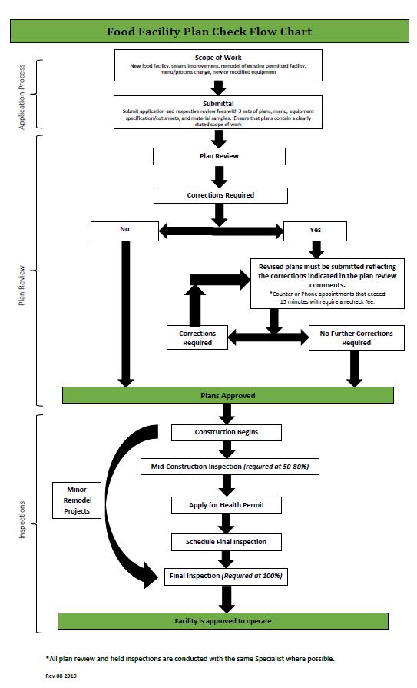
Plan Submission
Plan Submission
  For every newly or remodeled food facility
  Plan approval is required prior to construction
  1 digital file if submitted online
Plan Review Process
  Plan Submittal
  Plan Review
  Plan Approval
  Facility Inspections
  Approval for Operation (pending health permit application)
    Building Approval Needed (if major work completed)

Slide 8
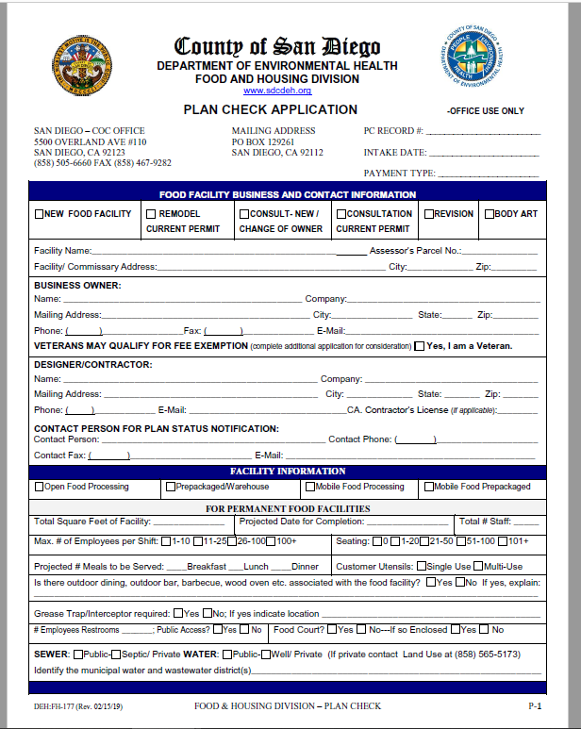
Plan Submission – What is needed?
Plan Packet:
  Plans - 3 sets if paper or 1 set if digital
  Application (not needed if digital)
  Menu
  Exemption forms (mechanical ventilation)
  Fees
  Specification sheets
  Samples of finishes
  Standard Operating Procedures/HACCP
  Any other supporting documentation

Slide 9
Plan Submission – What is on the plan?
Plan Components
  3 sets or 1 if digital
  Done in ink & in a professional manner or digital
  Size of plans- Minimum 11”X17”
  Scale- e.g., ¼” per foot
  Name and address of facility
  Size of facility (ft²)
  Name and address of owner
  Water and waste (septic) district
  Type of facility
  # employees per shift
Plan Components
  Environmental health notes
  Site map
  Floor plan
  Equipment plan and schedule
  Finish schedule
  Plumbing plan and schedule
    Grease trap
  Mechanical plan
    Ventilation hood
  Electrical and lighting plan
  Window and door schedule

Slide 10
Plan Check Construction Inspections
After the approval of plans, inspections need to be conducted at different phases of construction to ensure the facility is being built as per plans, or revision may be need it.
Typically, there are 3 allotted inspections (major construction) and could be a combination of the following:
  Preliminary Inspection (Optional)
  Mid Inspection (50-80% Complete & Required) May apply and pay for health permit
  Prefinal Inspection (Optional) May apply and pay for health permit
  Final Inspection (100% Complete & Required) Building department final or TCO, fire department, air balance report etc.
  Any additional inspection after the 3 inspections would be charged an inspection fee
After Final Inspection, facility will be given approval to operate.

Slide 11
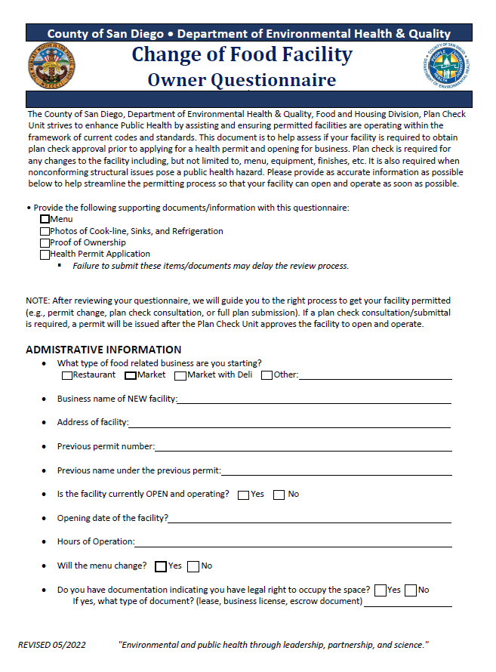
Taking Over an Existing Food Facility -
Change of Ownership
Change of Ownership Requirements:
  Health permit application
  Change of ownership questionnaire
  Menu
  Proof of ownership
Documents will be reviewed and result in:
  Apply and Pay for Health Permit
  Field Consultation
  Plan Submittal

Slide 12
Change of Ownership - Field Consultation
Field consultations are completed when:
  The facility has existing non-conforming conditions.
  The facility has replaced or added minor counter-top equipment.
  The facility has been closed for more than 6 months but all equipment remains on-site.
  When there is a change in menu, but the facility’s old equipment supports the new menu.
Result: Facility may be approved to operate pending health permit application submittal
  Depends on the conditions on-site and if there are any items that need to be corrected.
Field consultations are paid and scheduled (Current fee: $401). Additional inspections will require an additional fee.

Slide 13
Following Approval to Operate
Once a food facility has been granted approval to operate by a Plan Check EHS, the owner must apply for a health permit
Conditions of a health permit:
  Facility will comply with relevant requirements of the California Retail Food Code (CalCode)
  Allow access to FWHD Environmental Health Specialists for unannounced routine inspections
  Rectify any conditions found to be out of compliance with CalCode

Slide 14
Food Facility Routine Inspections
FWHD conducts routine risk-based inspections, focused on conditions that strongly affect food safety and foodborne illness (“major risk factors”), including:
  Employee hygiene
  Food from approved sources
  Cooking and holding temperatures
  Protection from contamination
  Vermin exclusion
Routine inspections occur 1-2 times annually* and include:
  Walkthrough of entire facility
  Review of facilities procedures/processes
  Opportunities for operator/staff education
  Inspection report detailing observed violations and corrective actions
  *Additional inspections may occur in response to public complaints or foodborne illness investigations

Slide 15
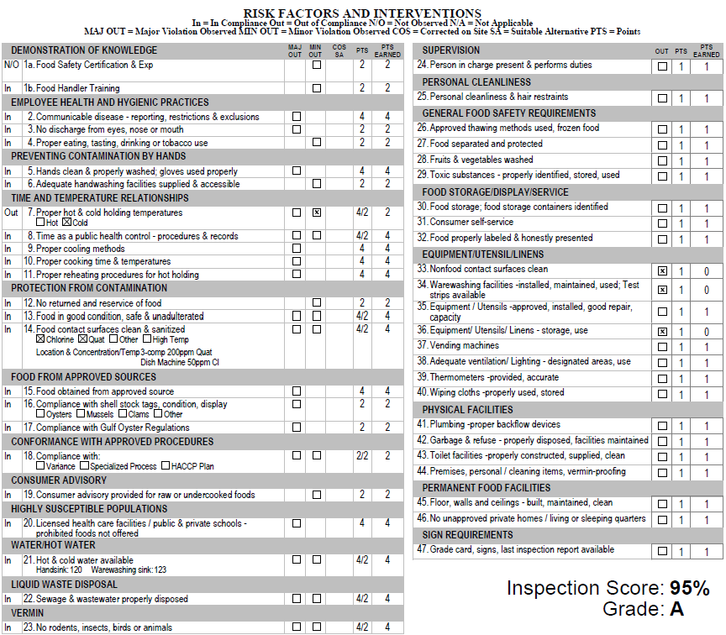
Food Facility Inspection Reports
Reports information on:
  Violations given
  Observation that caused violation to be marked
  Corrective action(s) that need to be made to rectify violation
Inspection scores:
  Facilities start an inspection with a score of 100
  Each observed violation deducts a point value, assigned based on public health risk associated with observation
    “Good Retail Practices” = 1-point deduction
    Minor violations = 2-point deduction
    Major violations = 4-point deduction

Slide 16
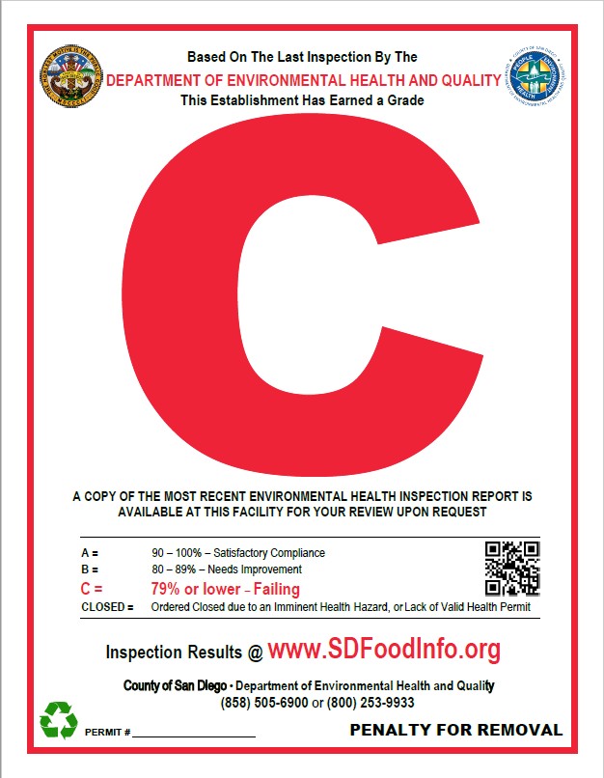
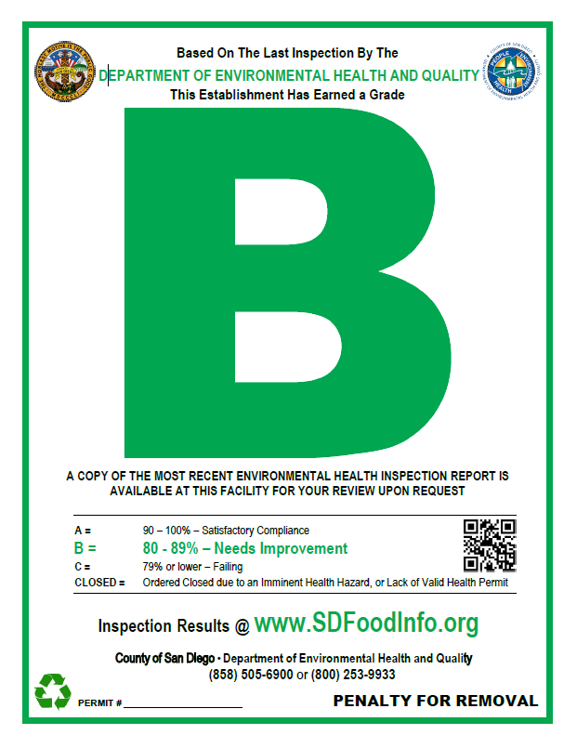
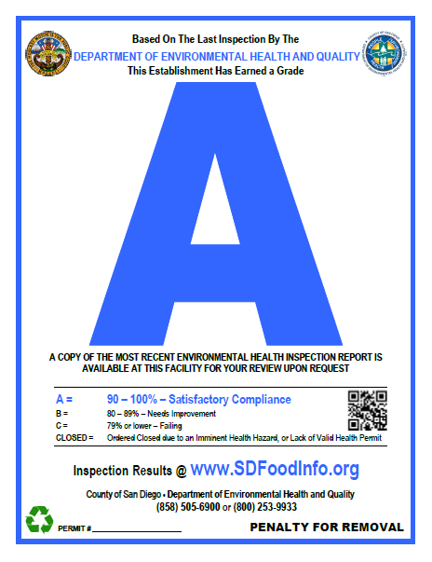
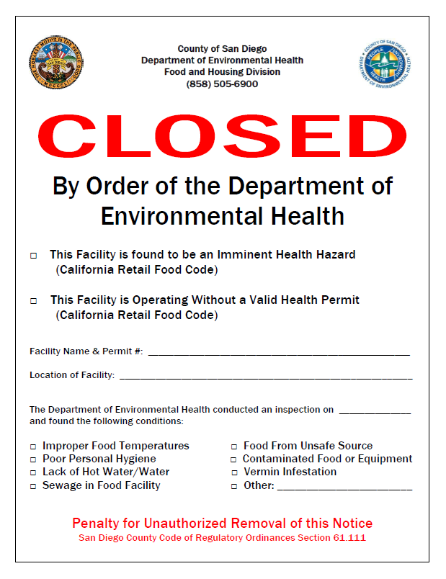
Food Facility Inspection Results
Open food facilities like restaurants receive a grade during their routine inspection
    100-90 - A Grade
    80-89 - B Grade
    70-79 - C Grade
    <69 – Closure
    Potential reasons for downgrade: Multiple major violations based on the major risk factors
Potential reasons for closure:
  Presence of vermin (rodents, flies, and cockroaches)
  No hot water, no water
  Failing sewer system
  No valid health permit

Slide 17
Summary
There are multiple paths to obtain a health permit
  All new food facility builds require Plan Check review and approval
  If taking over an existing food facility, a Plan Check specialist will assess your facility and confirm next steps
Once a health permit is obtained:
  A facility is subject to unannounced routine inspections
  Noncompliant conditions in facility must be rectified, once identified

Slide 18
Contacts
For Health Permit Inquiries:
  FHDPermits@sdcounty.ca.gov
  (858) 505-6666
For Plan Check General Inquiries:
  www.sdcountyplancheck.org – submit an online inquiry
  (858) 505-6660
For General Inquiries:
  fhdutyeh@sdcounty.ca.gov
  (858) 505-6900

Slide 19
Questions?

