Slide 1
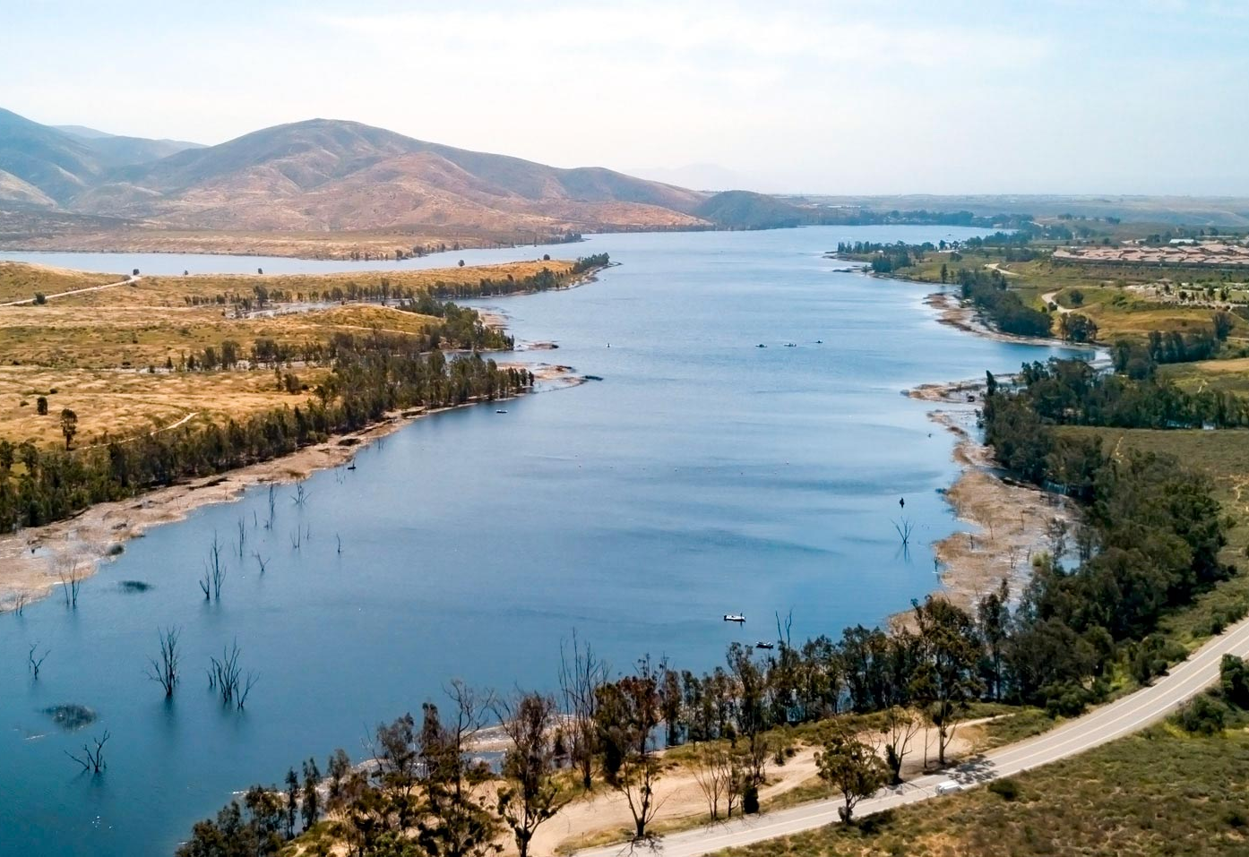

Fiscal Year Ended June 30, 2021
Otay Mesa Enhanced Infrastructure Financing District
Annual Basic
Financial Statement Report
Otay Mesa Enhanced Infrastructure Financing District Public Financing Authority Meeting
June 13, 2022
PRESENTED BY
Peter S. George, CPA
Partner

Slide 2
Agenda
Introductions
Our Audit Responsibilities and Deliverables
Financial Statements
Required Communications to the Public Financing Authority
Upcoming GASB Pronouncements and Audit Standards
Questions?
Notes:
Make hard copy handout of this slide
Slide animations – begin with headlines – fly in bullets
Change all of the template – action slides to
Commitments
Partner Commitments
Firm Commitments

Slide 3
Our Responsibilities & Deliverables
Perform an audit of the District’s governmental activities and each major fund as of and for the year ended June 30, 2021.
The objective of an audit of financial statements is to express opinions that the financial statements are fairly presented, in all material respects, in accordance with Accounting Principles Generally Accepted in the United States of America (GAAP).
The audit is performed in accordance with auditing standards generally accepted in the United States of America and Government Auditing Standards.
Those standards require that we plan and perform the audit to obtain reasonable, rather than absolute, assurance about whether the District’s financial statements are free of material misstatement whether caused by fraud or error.
Unmodified opinion on the District’s basic financial statements.
Unmodified opinion on internal control over financial reporting and on compliance and other matters.
1
Notes:
Make hard copy handout of this slide
Slide animations – begin with headlines – fly in bullets
Change all of the template – action slides to
Commitments
Partner Commitments
Firm Commitments

Slide 4
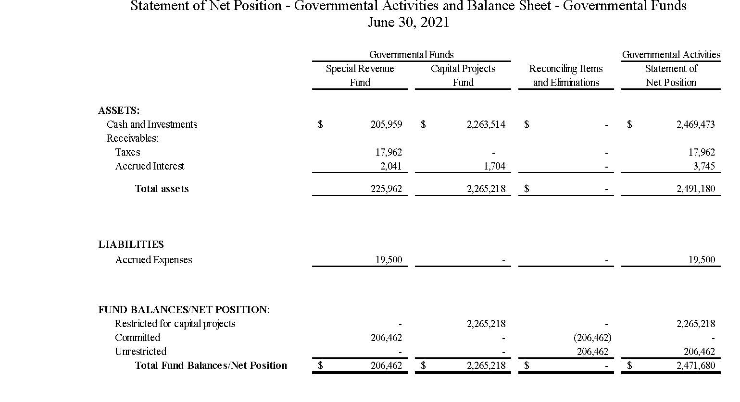
Financial Statements
2
Notes:
Make hard copy handout of this slide
Slide animations – begin with headlines – fly in bullets
Change all of the template – action slides to
Commitments
Partner Commitments
Firm Commitments

Slide 5
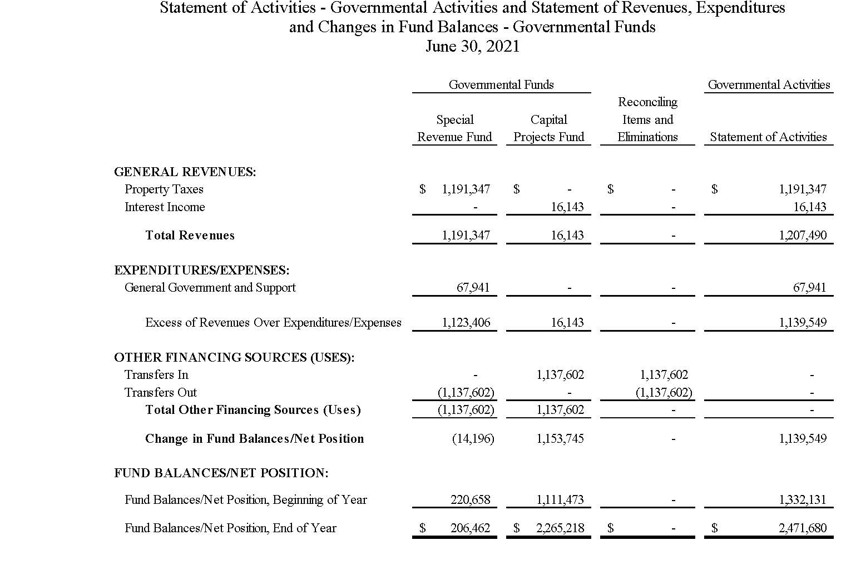
Financial Statements
3
Notes:
Make hard copy handout of this slide
Slide animations – begin with headlines – fly in bullets
Change all of the template – action slides to
Commitments
Partner Commitments
Firm Commitments

Slide 6
Auditor’s Communications
The Auditor’s Communication with Those Charged with Governance
Our responsibilities in relation to the financial statement audit
Planned scope and timing of the audit
Compliance with all ethical requirements regarding independence
Qualitative aspects of the District’s accounting practices
  Significant accounting policies
  Significant accounting estimates
  Financial statement disclosures
No difficulties encountered in performing the audit
No corrected and uncorrected misstatements
No disagreements with management
Representations requested and received from management
No management consultations with other independent accountants
No other matters, audit findings or issues noted
4
Notes:
Make hard copy handout of this slide
Slide animations – begin with headlines – fly in bullets
Change all of the template – action slides to
Commitments
Partner Commitments
Firm Commitments

Slide 7
Looking Forward – FY 2021/22
Implementation of New Accounting & Auditing Standards
  There were no new pronouncements required to be implemented in fiscal year 2020/21.
  GASB Statement No. 87, Leases (FY 21/22)
5
Notes:
Make hard copy handout of this slide
Slide animations – begin with headlines – fly in bullets
Change all of the template – action slides to
Commitments
Partner Commitments
Firm Commitments

Slide 8
Questions?
Notes:
Make hard copy handout of this slide
Slide animations – begin with headlines – fly in bullets
Change all of the template – action slides to
Commitments
Partner Commitments
Firm Commitments

