Slide 1


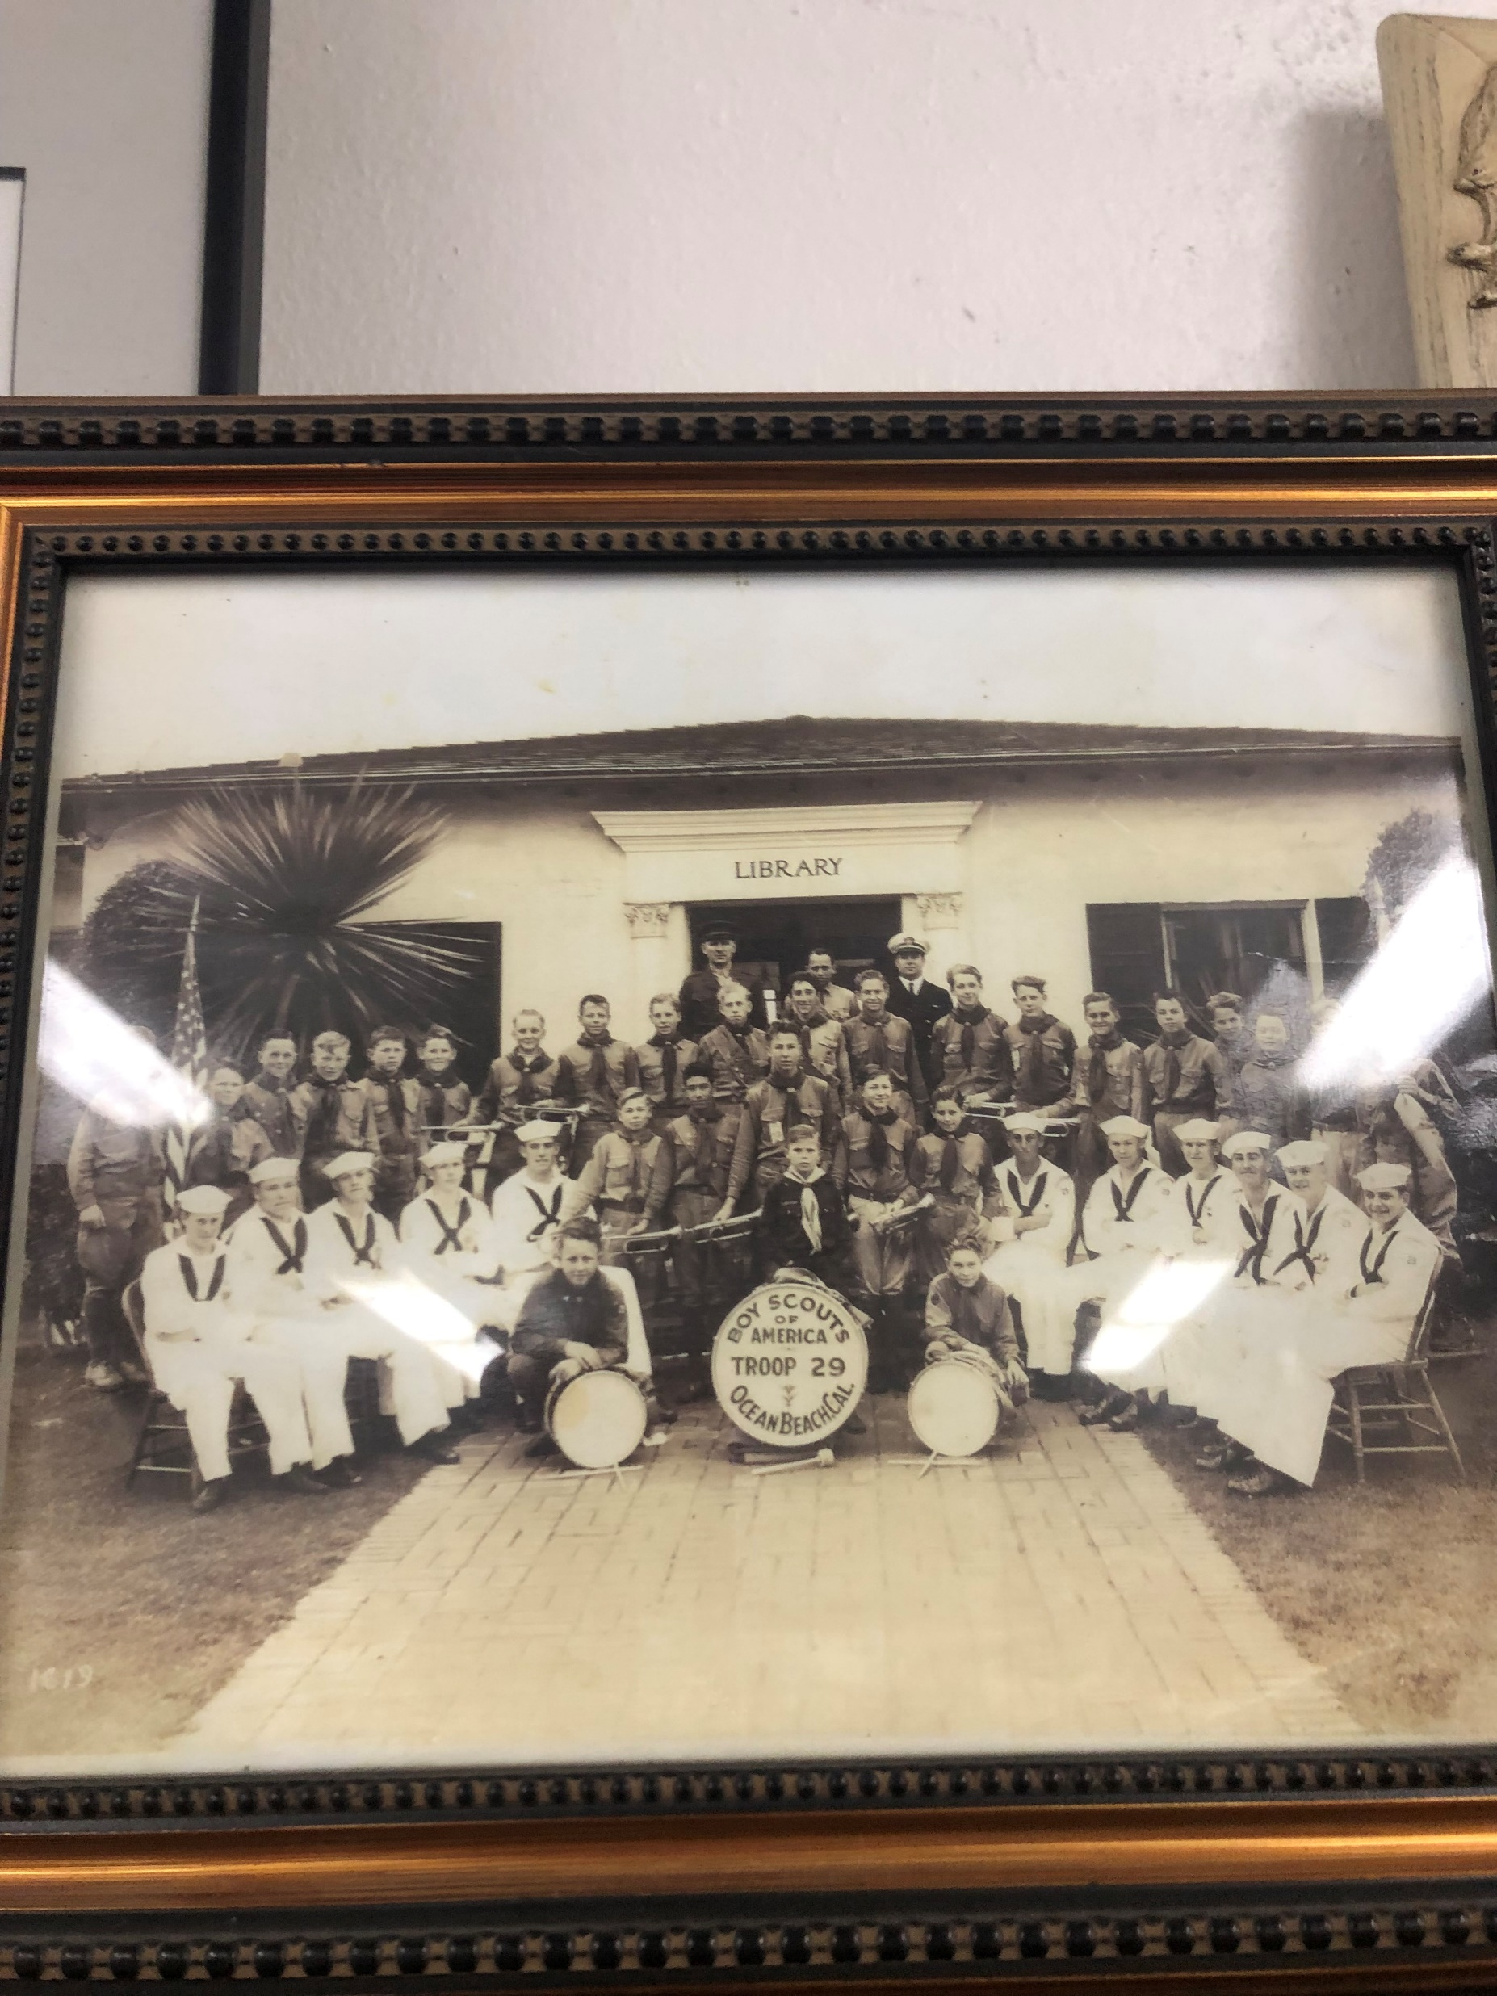
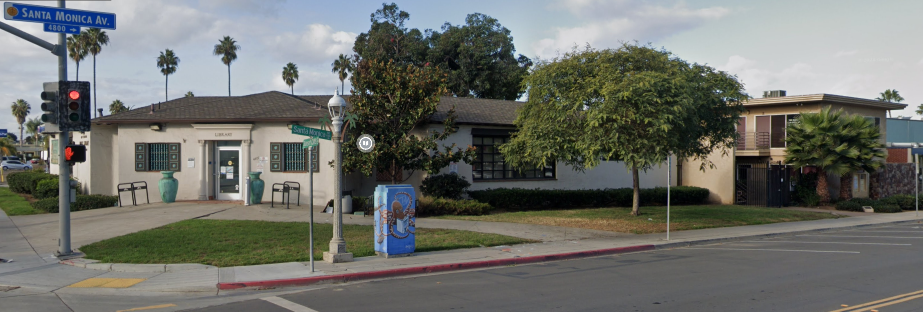
Ocean Beach Library Addition
Ocean Beach Library Historic Designation:
The Historically Designated Building (HRB #565) is located within the Ocean Beach Cottage Emerging District, which is a designated historical district.
This Ocean Beach branch of the San Diego Library was open on October 25, 1928 and is the oldest Library in San Diego. In 1962 the branch expanded to its current size.
The Ocean Beach Library was designated “Historic” in 2002 by the San Diego City Council for its architecture and contribution to the Ocean Beach cultural landscape.
The two large urns, installed in 1993, replaced earlier urns that were damaged. These contain time capsules with assorted local items and are schedule to be opened in 2043.
Proposed Library’s New Addition Design Concept:
The Ocean Beach Library expansion is inspired by the nearby Pacific Ocean as well as the community itself. This Historic Library is an example of the Spanish –Monterey Revival architecture. We are working closely with Historic Planners to ensure that any option chosen will be in conjunction with the Department of the Interiors Standards and harmonious with this style.
This presentation features 3 Concepts: a modern design approach on a Spanish Revival style, a Flexible option, and an option that marries the classic elements of the Spanish Monterey stylings with the metaphoric Waves of the Ocean.
1
1
1

Slide 2
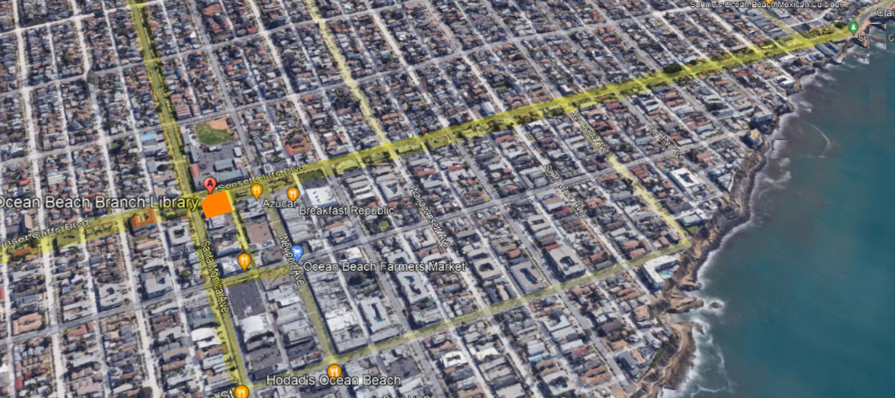
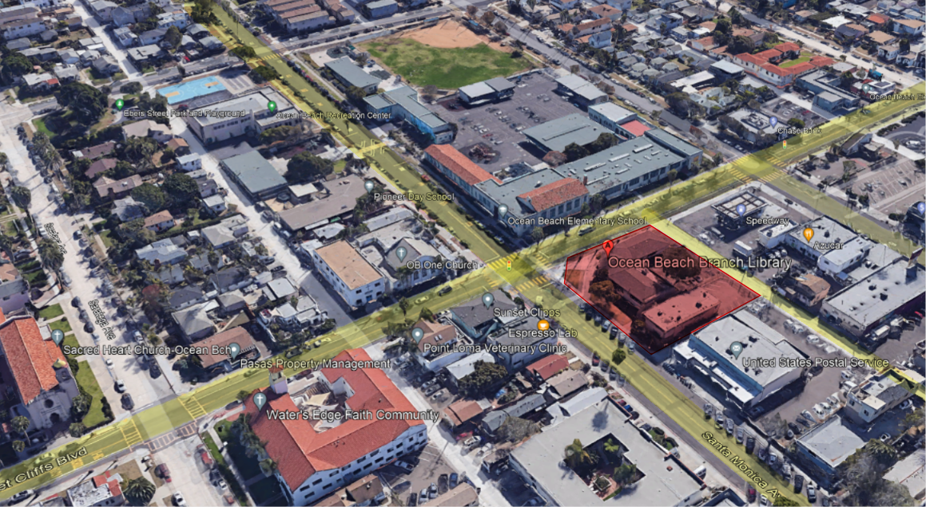
Location
Design Concept
Location:
Located in the heart of Ocean Beach, located at the corner of the intersection of Santa Monica Ave. & Sunset Cliffs Blvd.
The library building and it was expanded in 1962 to its current size of 5,085 square feet. Another renovation in early 2012 provided new carpeting and a new roof.
Sunset Cliffs Blvd.
Ocean Beach Branch Library
Adjacent Site Information:
The surrounding buildings are 1-3 stories high
The roofs in that area are mixed of flat roofs and pitched roofs.
Alley
Santa Monica Ave.
Cable St.
IMPORTANT Information:
The Ocean Beach Library Expansion will include demolition of the 2-story adjacent building (the Annex), remodel the existing 5,085 sf library and construct a new 4,300 sf extension to the library. The new extension will designate space for expanded book collection area, a community meeting room with kitchenette, study rooms, office space, a Teen area, storage rooms, outdoor gathering area and new restrooms.
The operational functioning of the Library has been designed in alignment with the defined “Program” from the Library management. The vast majority of the existing Library will remain as an area to house reference materials and the addition contains office area for the staff as well as the new Community Room meant to support gatherings of up to 100 attendees.
Sunset Cliffs Blvd.
Santa Monica Ave.

Slide 3
Project Constraints
Historical Designation
Funding
Any new addition should be compatible, but differentiated enough so that it is not confused as “Historic” or original to the building.
We are working closely with Historic Planners to ensure that any option chosen will be in conjunction with the Department of the Interiors Standards and harmonious with this style.
The Library Department is part of the City of San Diego’s General Fund.
It is dependent upon funding from the annual City budget, Grants and from Donors.
Accessibility Requirements
Site Slope
Limited Parking
Security Concerns
Summer Moratorium
Many elements will need to be brought up to current accessibility standards including front entry, parking and interior accessible pathways. In addition, site conditions will require coordination to connect the new expansion with the existing.
The building that will be demolished is approximately 3’ lower than the existing library entrance.
This will mean that we will need to add fill or to create a level site
We will gain some parking spaces, but it is anticipated that most Library patrons will walk, bike, skate, or use public transportation. We understand the desire to maximize parking and will work towards that goal.
Security is a top priority. The design will take into consideration any places people may try to hide or climb. We are working with the SDPD to ensure we create a safe space for all users and citizens.
The summer moratorium period extends from Memorial Day to Labor Day.
The restriction affects streets and parking lanes as well as pedestrian walkways in this area. The moratorium is intended to reduce adverse construction activities impacts on local merchants.
Coastal Development Permit
Bring existing Library up to current Energy Codes
Construction Activities Adjacent to Post Office
(Federal Agency)
The Site is in an Archaeological Sensitive Area
CEQA Compliance-
Mitigated Negative Declaration
What does coastal Commission do?
The California Coastal Commission works in partnership with local governments to protect shoreline public access and recreation, terrestrial and marine habitats, views of the coast and scenic coastal areas, agricultural lands, and more, by regulating proposed development along the coast and in nearby areas.
California's energy code is designed to reduce wasteful and unnecessary energy consumption in newly constructed and existing buildings.
We will have to bring the existing Library up to current standards while still maintaining it’s Historic designation
The term “Federal agency” means any department, agency, corporation, or other entity or instrumentality of the executive branch of the Federal Government, including the United States Postal Service.
Native American monitors observe archaeological excavations or construction activity in areas that have been mutually agreed upon to be sensitive. ... The monitors were to represent the Native American heritage area applicable to the specific project, and for the purposes of Public Resources Code 5097
What is the purpose of CEQA?
CEQA is intended to inform government decisionmakers and the public about the potential environmental effects of proposed activities and to prevent significant, avoidable environmental impacts
3
3
3

Slide 4
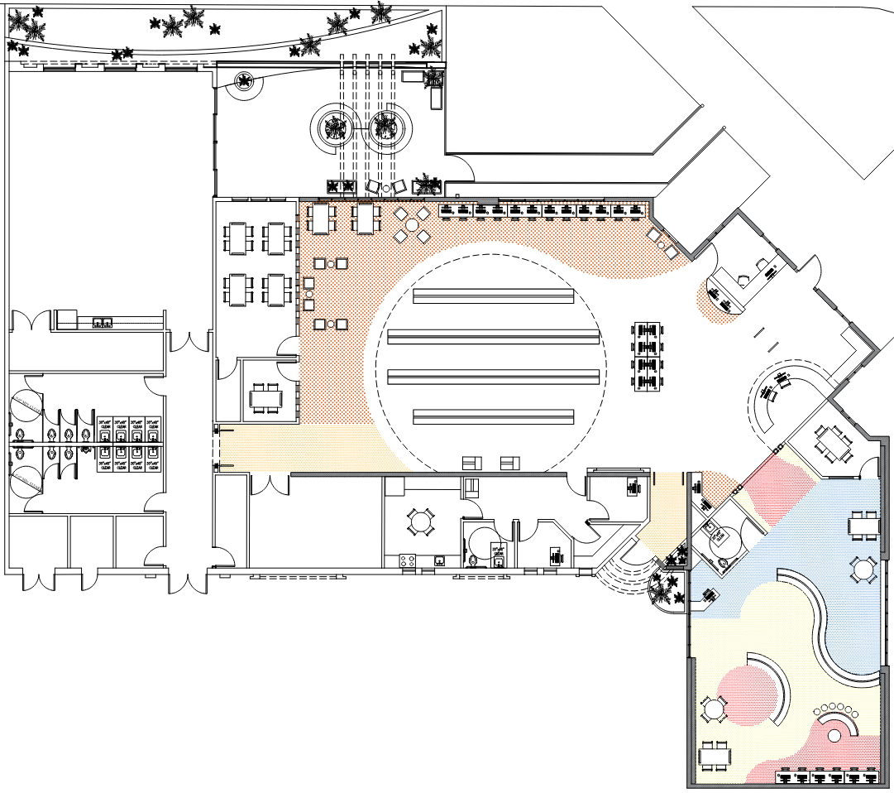


Floor Plan
NORTH ELEVATION - FROM SANTA MONICA AVE.
Proposed Floor Plan
The OB Library is located next to the ocean and the design is inspired by ocean waves- the curved lines in the flooring, ceiling, lighting and furniture. The Kid’s space within the Library is meant to reflect the dynamic of the ocean while giving a playful aspect of the kids, with a low-profile colored furniture that doesn't abstract view and allow for supervision.
The kid’s area includes a study room, staff desk and family restroom which are all located close to the main entrance while the computer terminals are located toward the backwall. Supervision/ monitoring is possible by library staff members working at the Front Desk or the office inside the kid’s zone.
The common area is designed with curved lines to connect with the kid's area, as shown in the reflected ceiling and lighting. Bookshelves will be in the center of the common area with varying lengths to complement the ceiling/lighting design and to allow separation for quiet space the computer, study and reading areas.
The staff area is separated from public access. It includes a breakroom, offices, book drop and restroom.
*The patio shown here is part of one of the options you will see on the other boards. All options for the Courtyard area consider shade and seating options.
COMMUNITY ROOM
OUTDOOR PATIO
ADA RAMP
EAST ELEVATION - FROM SUNSET CLIFFS BLVD
3
6
FRIENDS OF THE LIBRARY
4
4
MAIN
ENTRANCE
2
1
STORAGE ROOM
TEEN ROOM
BOOKSHELVES AREA
COMMON AREA
SEED
LIBRARY
STUDY ROOM
WOMEN ROOM
LOCKABLE
STORAGE
6
RECEPTION DESK
1
5
2
STAFF
OFFICE
1
STUDY ROOM
MEN ROOM
BREAK ROOM
WORK AREA
BUILDING
SUPPORT
FIRE RISER
JANITOR
CLOSET
IT
ROOM
STORAGE ROOM
STAFF
RESTROOM
BOOK DROP
ENTRANCE
FAMILY RESTROOM
KIDS
AREA
ENTRANCE
STAFF
OFFICE
7
STAFF
OFFICE
8
LEGEND:
1
Book Detectors
7
Children’s Studying Tables
2
8
Low-Profile Children’s Bookshelves
Self- Checkout Stations - 2 Stations are ADA Accessible
8
3
Studying Tables
9
Children’s Seating Area
4
Lounge Chairs
10
Children’s Computer Stations
5
Printers
Existing Historical Walls
7
9
6
Computer Stations
New Extension Walls
Colored Flooring
10
4
4
4

Slide 5
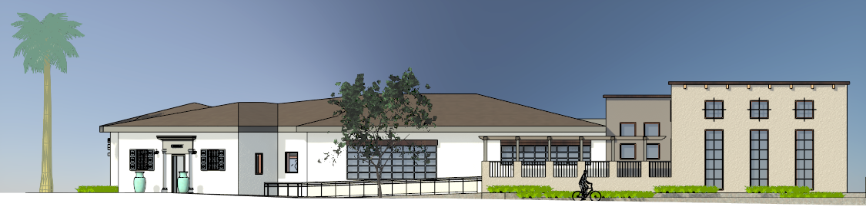
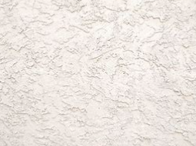


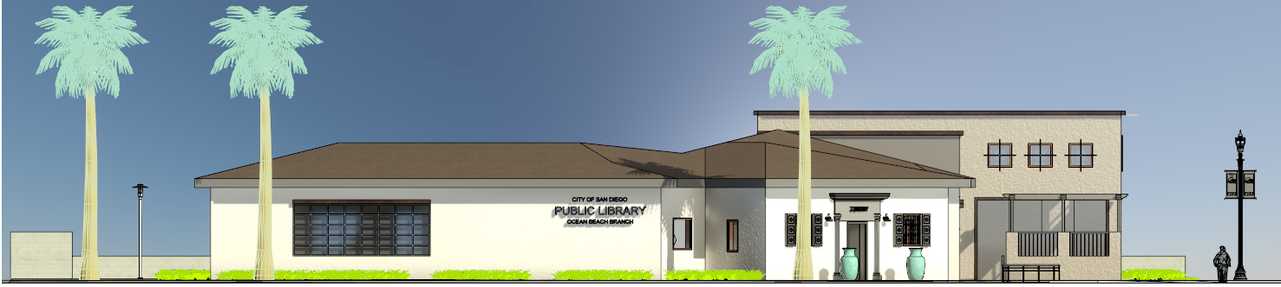
Concept 1 - Modern Spanish Monterey
21’-0”
NORTH ELEVATION - FROM SANTA MONICA AVE.
Proposed Addition Design Concept: The concept behind this elevation is a modern interpretation of the Spanish Monterey stylings. The iron fencing, linear windows, and clean design are all common characteristics of this Style. We’ve added a pergola to provide shading to the courtyard and opted for a flat roof to accentuate the modern theme.
Existing Building Stucco
Pergola
Iron Fencing
Taupe
Stucco Wall
Warm White Stucco
Textured Wall
EAST ELEVATION - FROM SUNSET CLIFFS BLVD
5
5
5

Slide 6
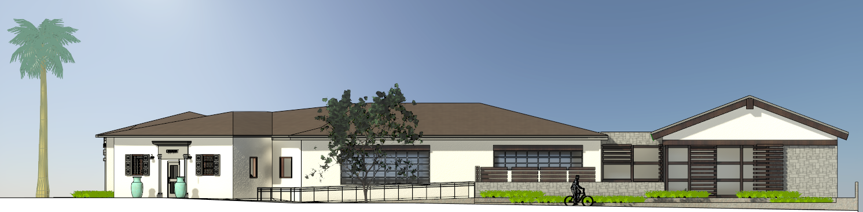
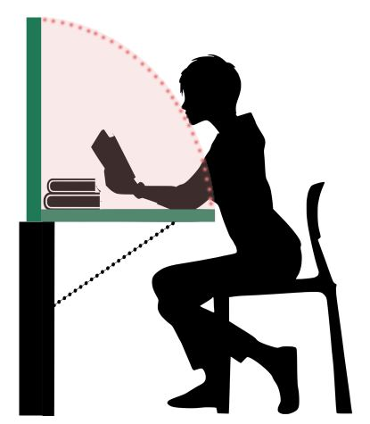
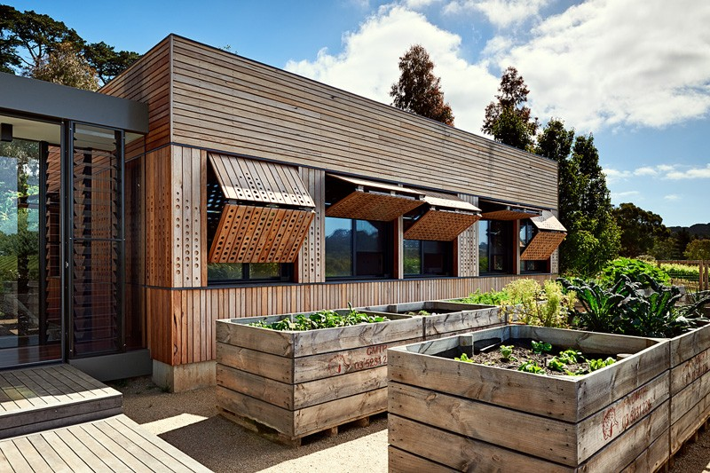
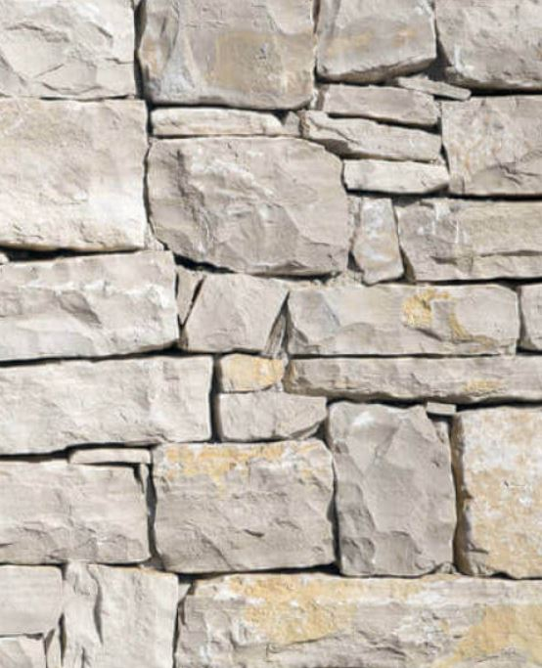
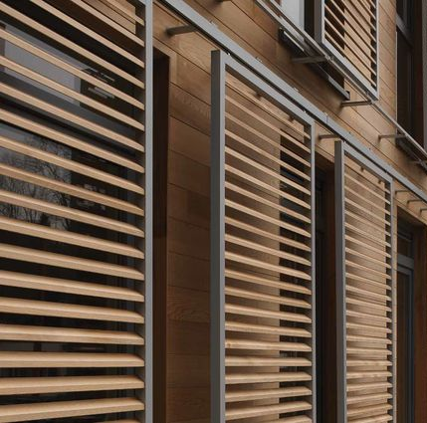
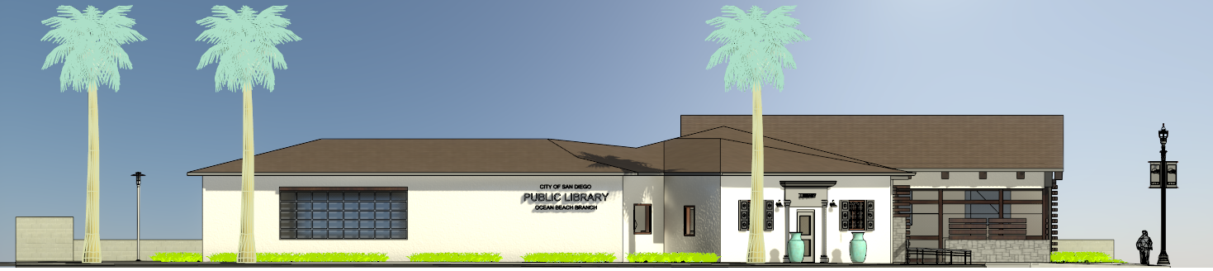
Concept 2 – Modular Flexibility
19’-6”
NORTH ELEVATION - FROM SANTA MONICA AVE.
Proposed Addition Design Concept: The concept behind this elevation is to provide adaptability with contemporary style. The use of stone and wood were chosen for their warmth and in conjunction with the Community Plan to enhance the established nature of the neighborhood.
Existing Building Stucco
Folding fence that can be turned into a study table
Folding
Wooden Shutters at Teen’s room
Rough Stone Veneer
Sliding Window Shutters
EAST ELEVATION - FROM SUNSET CLIFFS BLVD
6
6
6

Slide 7
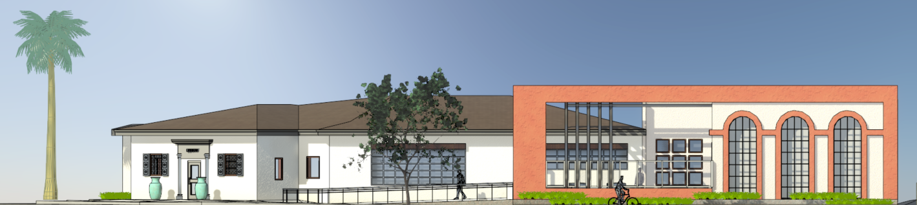

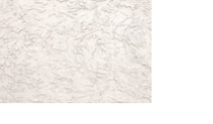

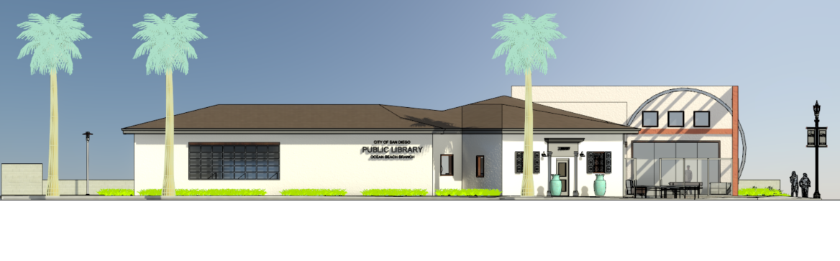
Concept 3 - Modern / Movement
20’-6”
NORTH ELEVATION - FROM SANTA MONICA AVE.
Proposed Addition Design Concept: The concept behind the elevation is to connect the past with the present. This is accomplished by balancing the proportion of the existing building with the newly added elements. The arched windows and the color shown here was widely used in Monterey - Spanish Revival style.
Existing Building Stucco
Tempered Glass Panel “Fencing”
Stainless Steel Post/Fin
Off-White Stucco
Textured Wall
Reddish / Brown Stucco
Rough Textured Wall
EAST ELEVATION - FROM SUNSET CLIFFS BLVD
7
7
7

Slide 8
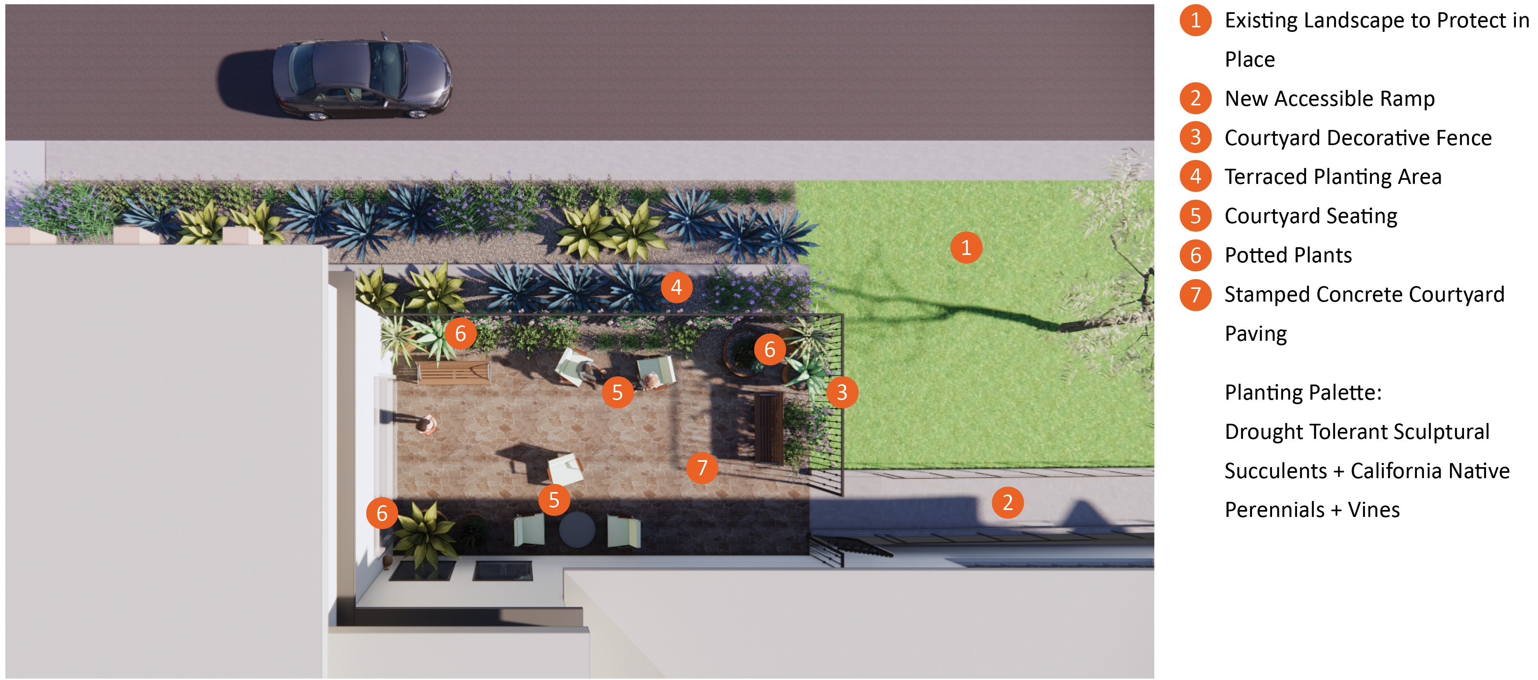
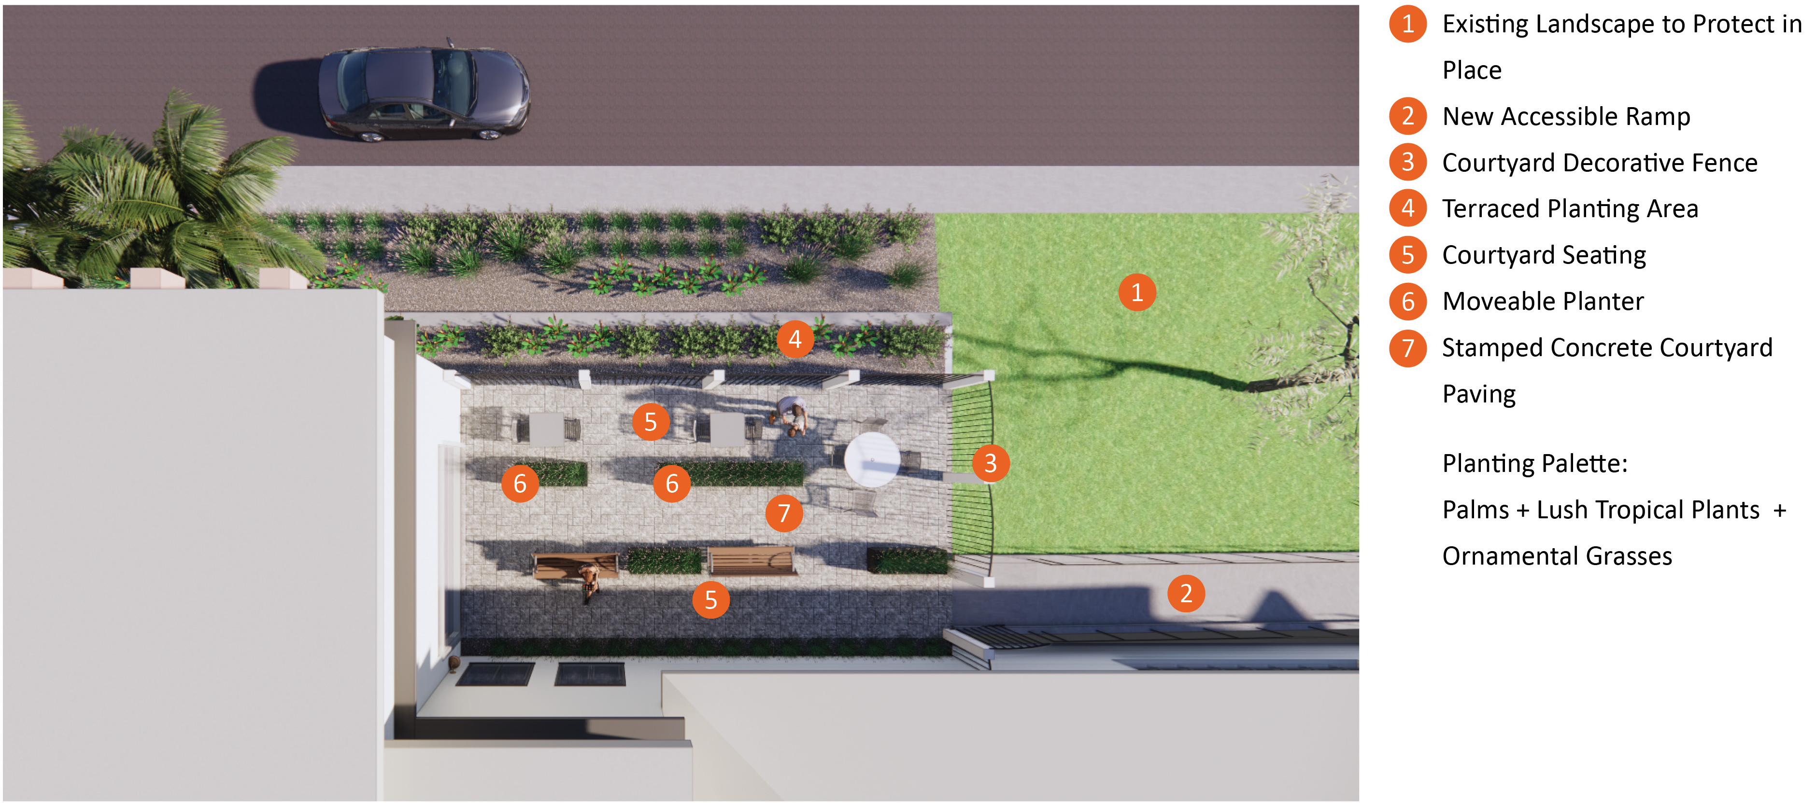
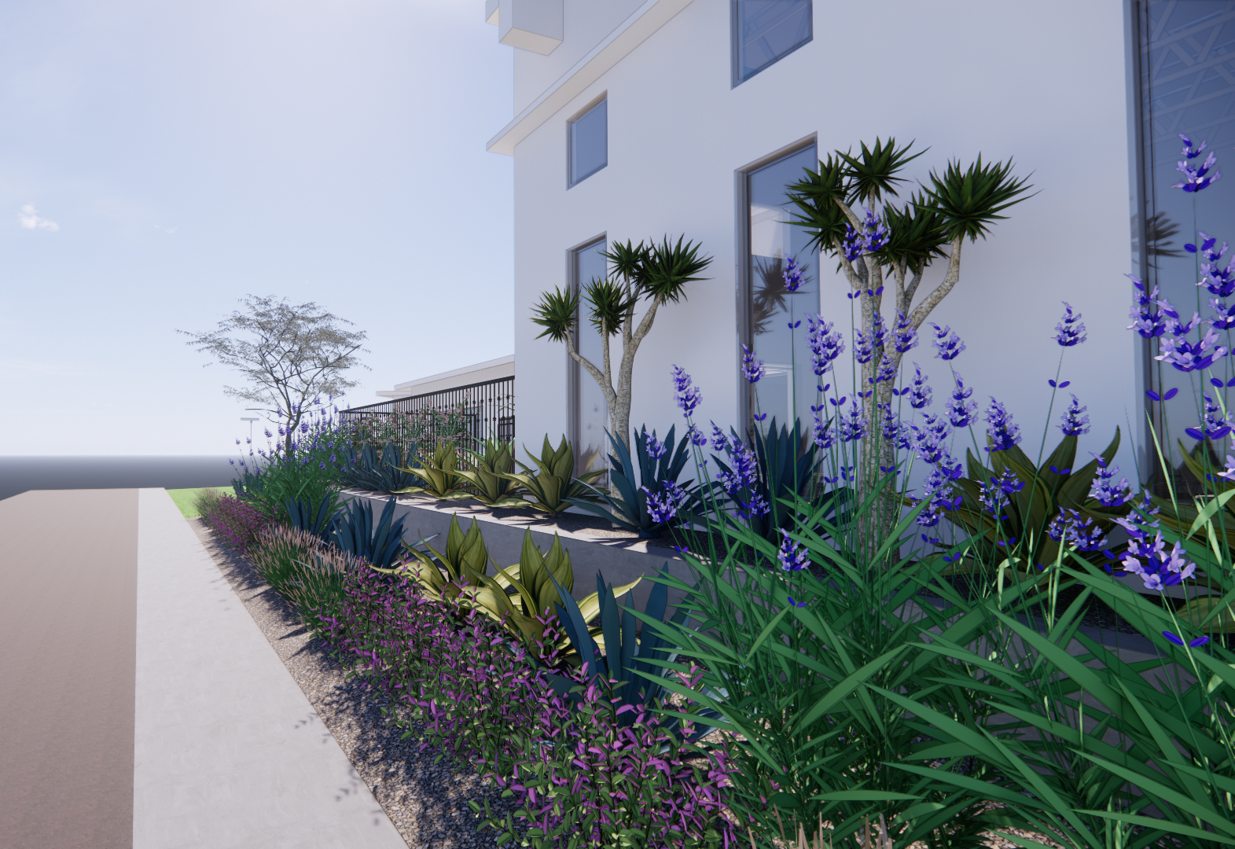
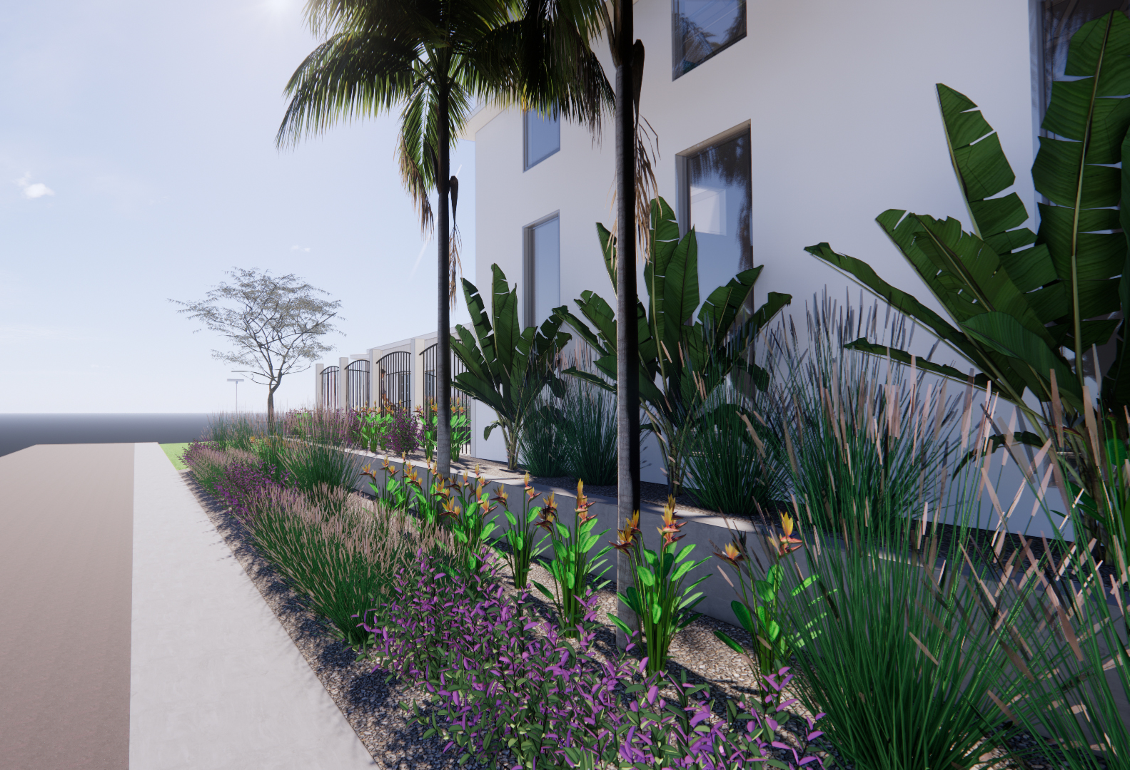


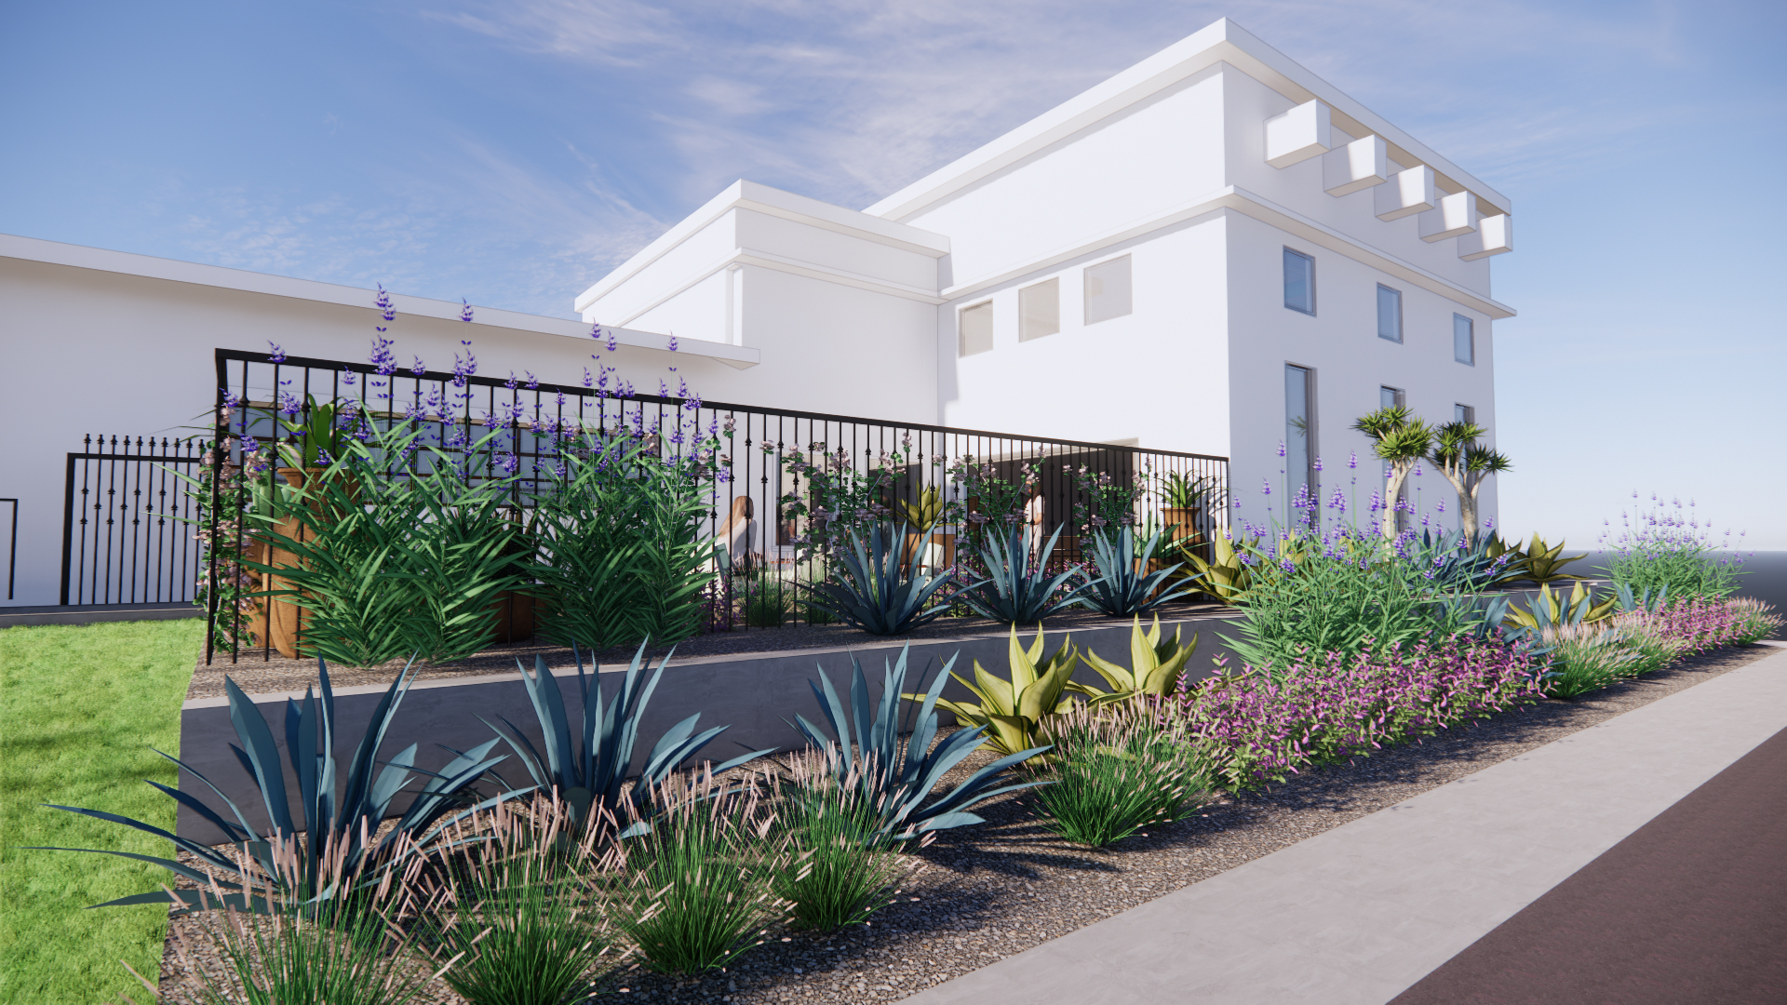
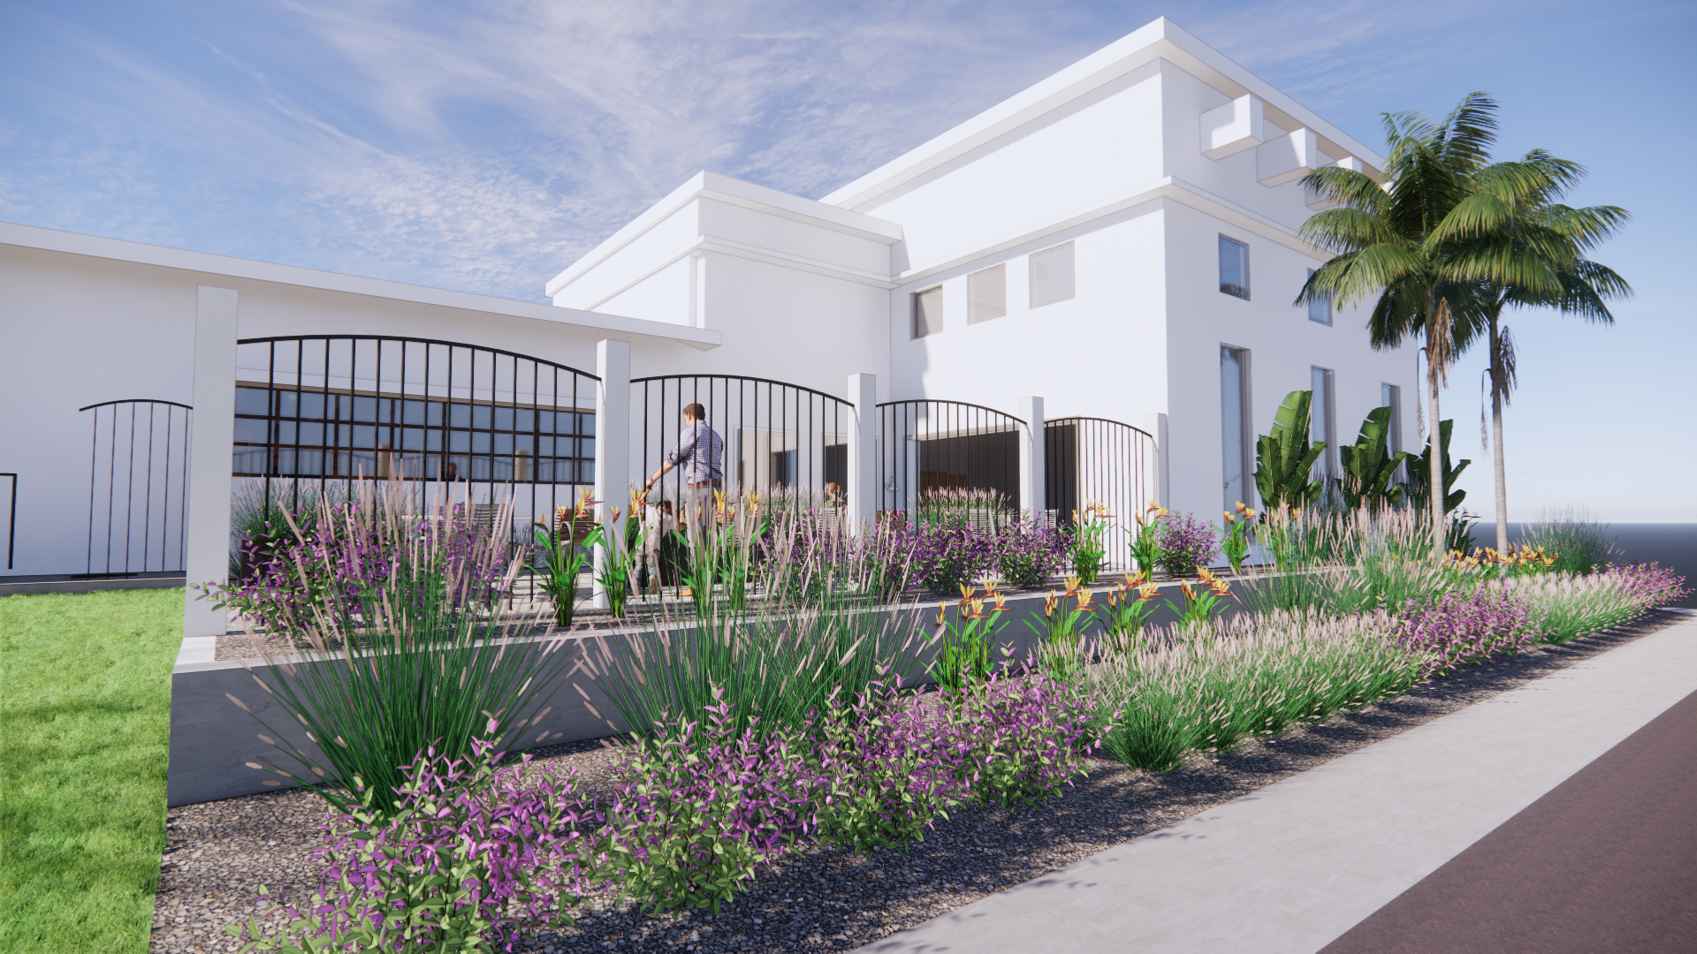
Landscape Options
Drought
Tolerant
Low Water Mediterranean
Please note:
Building Elevations are subject to change.
8
8
8

Slide 9
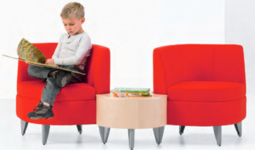
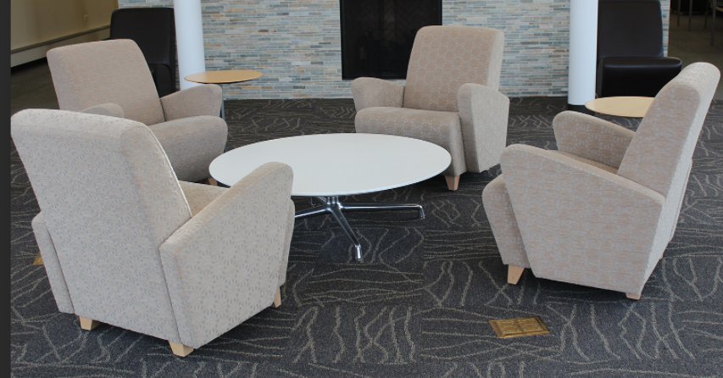
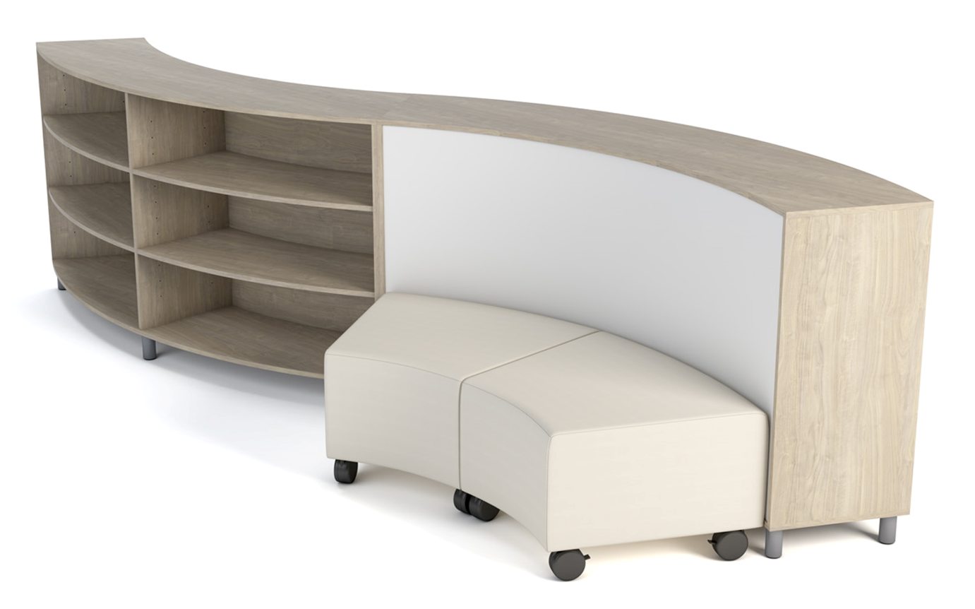
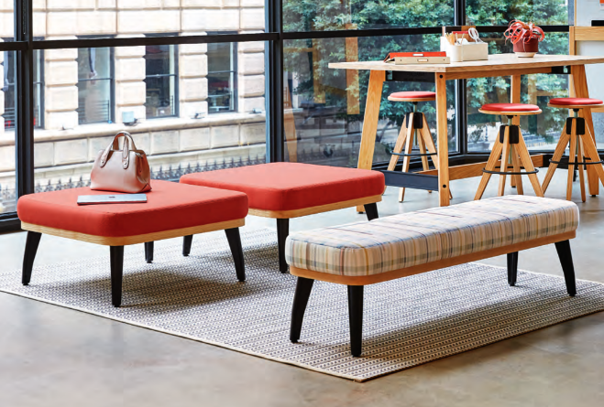
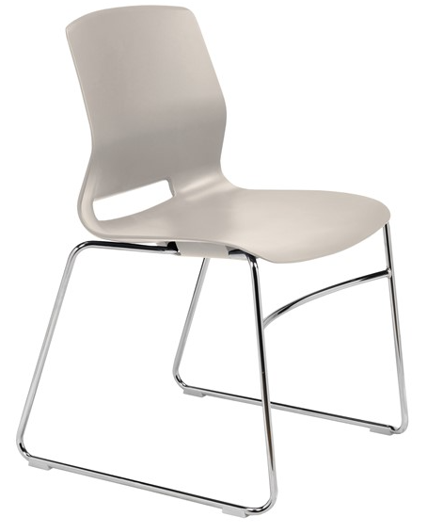
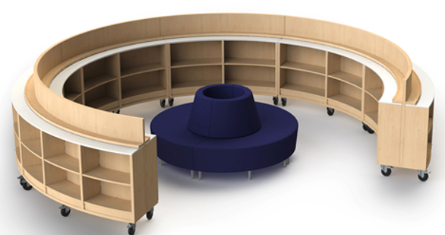
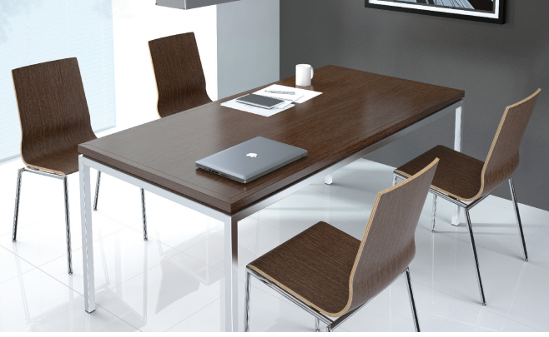
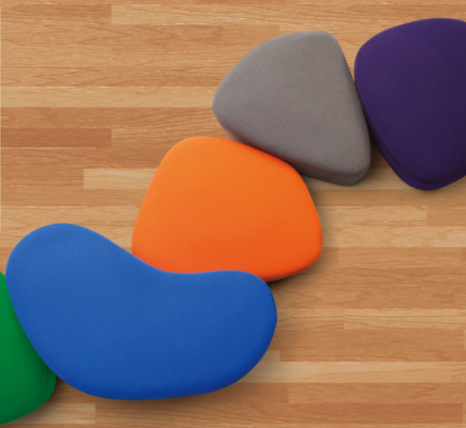
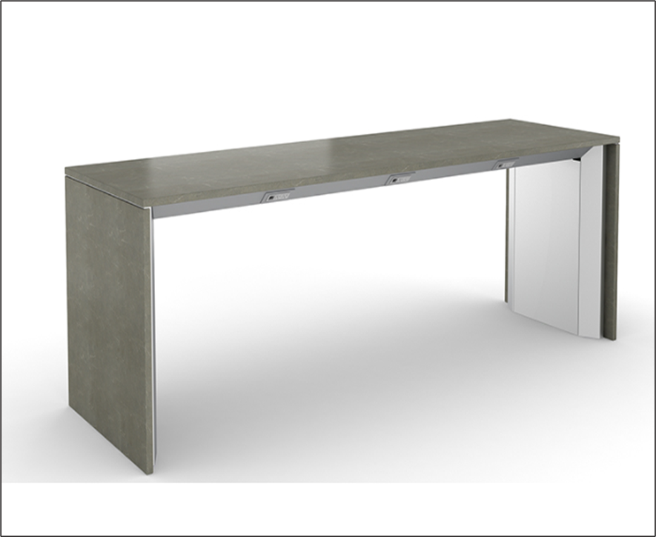
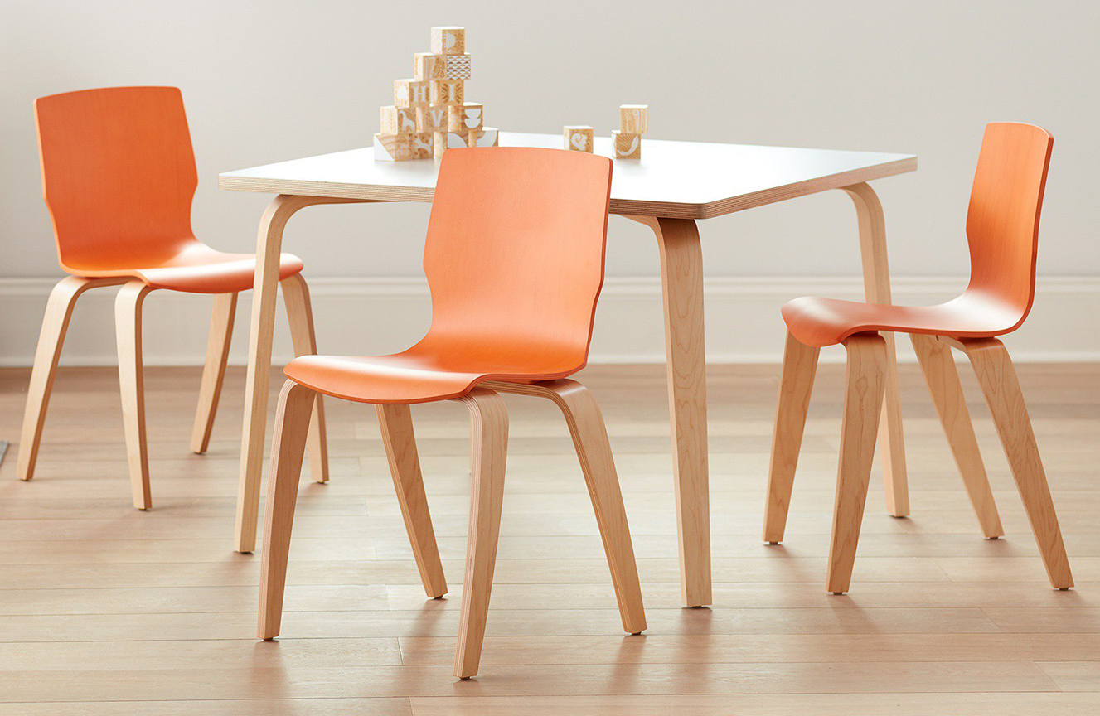
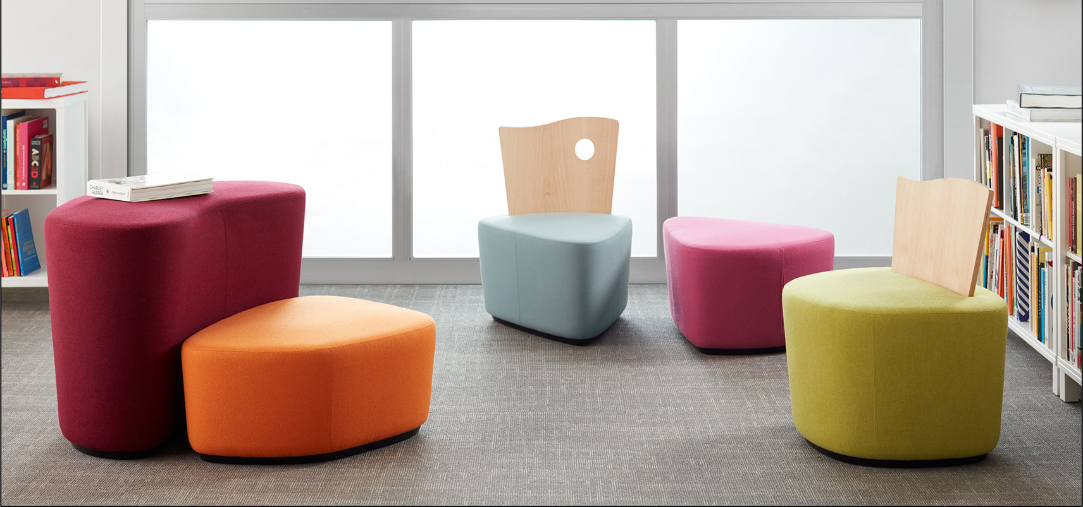
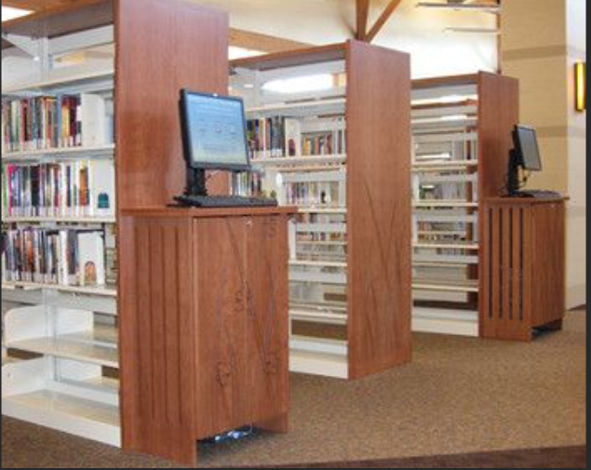
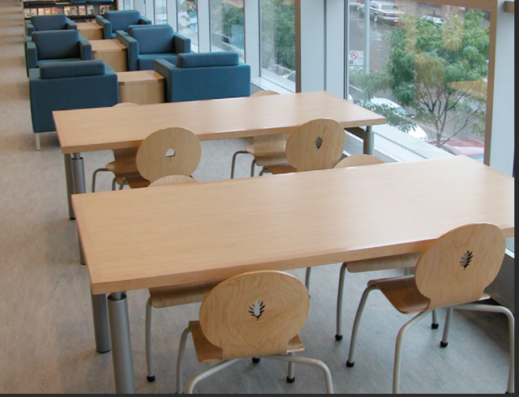
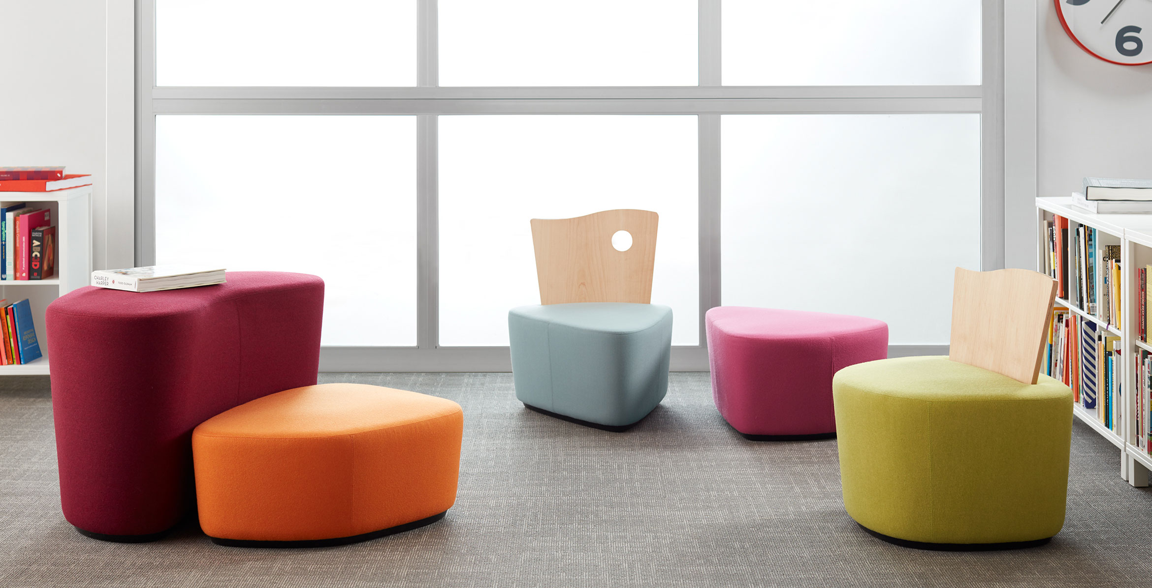
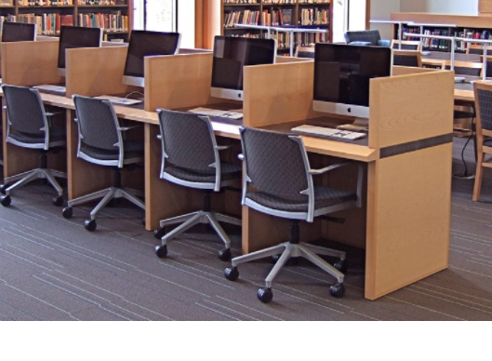
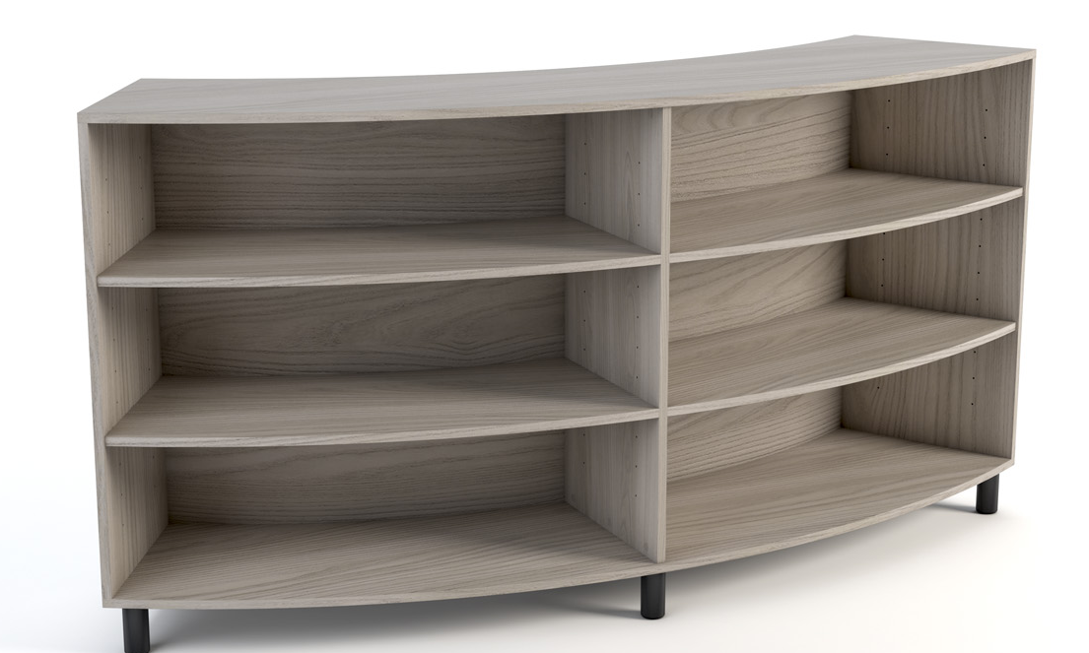
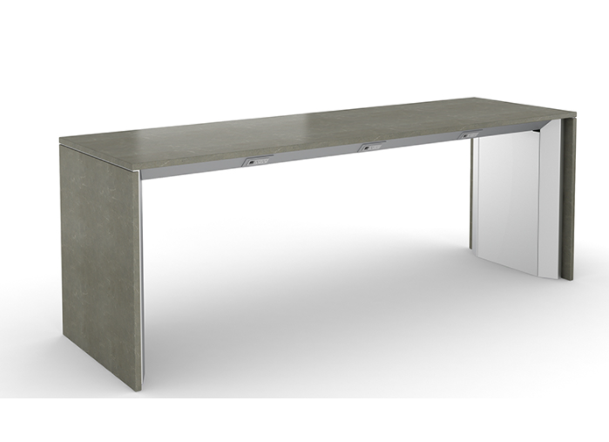
Furnishing Options
KID’S SECTION
COMMON AREA & TEEN SECTION
To provide a fun, flexible & creative environment for a wide variety of kid’s ages, the organic shapes and vivid colors will allow them to immerse themselves into many adventures of their imagination. Additionally, these types of furniture create an environment that enhances a child’s natural curiosity & creativity, making every trip to the library memorable.
The variety of selection between the furniture that will be provided in the common area carters to several different working styles. Whether they would like to sit down for long hours, stand at higher tables, work alone at smaller tables or in amongst others at larger ones, or sit in the lounge area, all types will be provided. Additionally, the cool tones provide a calm and enriching environment for all to work, read, or just relax in.
Power Bar Table
9
9
9

Slide 10
END OF SLIDES

