Slide 1
Redistricting Principles: “Compact” and “Contiguous” Maps Deputy City Attorneys Jennifer Berry and Kathy Steinman Legal Intern Kenneth Armstrong June 17, 2021
Redistricting Commission

Slide 2
Redistricting Review
Redistricting Plan must comply with:
U.S. Constitution
Equal Protection: “One Person, One Vote”
Federal Voting Rights Act of 1965 and subsequent amendments
San Diego City Charter §§ 5 and 5.1
Related statutes and case law interpreting redistricting plans and criteria

Slide 3
Traditional Redistricting Principles: Review
Districts are to have equal population, but also:
Be composed of contiguous territory
Be geographically compact
Preserve “identifiable communities of interest”
Have reasonable access between population centers
Be bounded by natural boundaries, street lines and/or City boundary lines

Slide 4
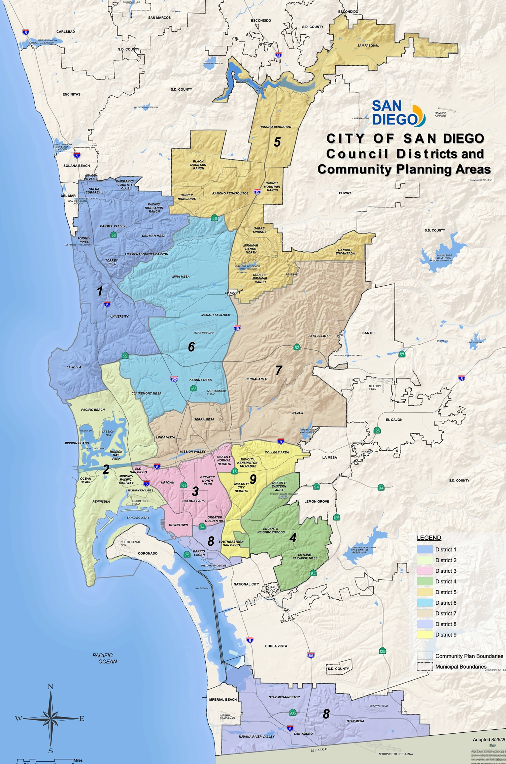
Current Deviation Prior to Redistricting: Review
Council District | Estimated Percent Deviation
1 | 8%
2 | 3%
3 | 24%
4 | -16%
5 | 1%
6 | -5%
7 | 4%
8 | -12%
9 | -7%

Slide 5
Charter Section 5 & 5.1 Requirements
To the extent it is practical to do so, districts shall be:
“…as geographically compact as possible…”
“…composed of contiguous territory with reasonable access between population centers in the district.”
“populous contiguous territory shall not be bypassed to reach distant populous areas”

Slide 6
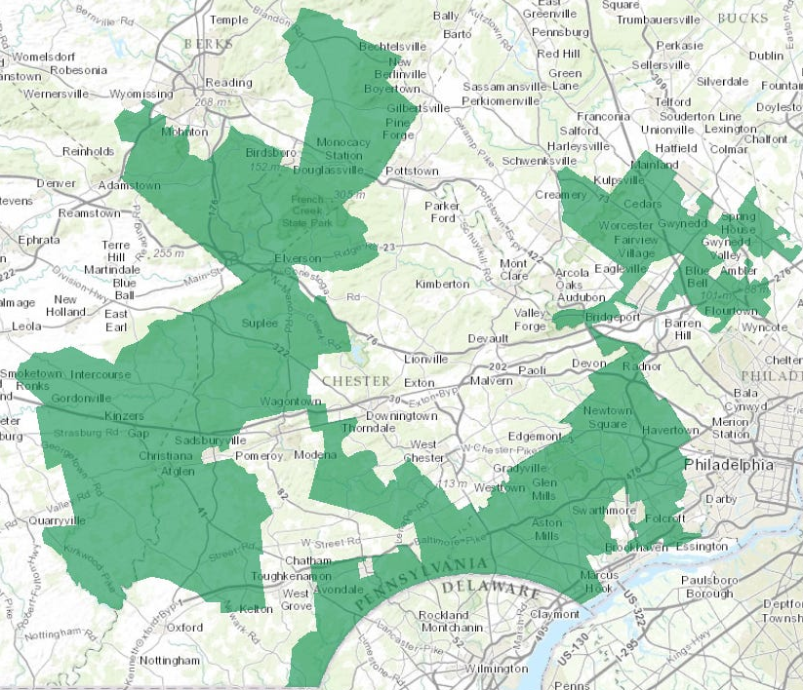
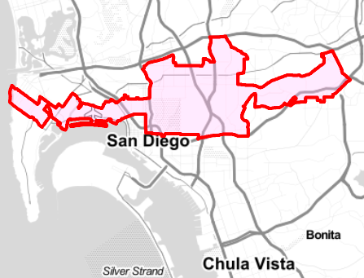
Compactness
Former PA 7th Congressional District
Hypothetical San Diego District
Source: Business Insider
Drawn with We Draw the Lines CA’s tool
Note: The former seventh Congressional district of Pennsylvania was struck down as a partisan gerrymander in 2018. The compactness requirement is, in part, intended to avoid irregular districts like the two above.

Slide 7
Why “Compactness?”
Theory: Officials can better serve constituents in a more limited geographical area, rather than over great distances.
Geographical communities will share common interests, not be grouped with those with different needs.
Reminder: Compactness is just one of several considerations to keep in mind as you draw the districts.

Slide 8
What is “Compactness?”
Charter definition
Guidance from federal law
Practical considerations
The Commission’s tools
Lesson from 2010

Slide 9
1. Charter definition
Charter §5 and §5.1 require “geographical compactness”
General Considerations:
Is the district a regular or bizarre shape?
Are boundary lines jagged or smooth?
Is land arranged neatly into a small space?
Does the geography make sense (dividing natural boundaries)?
Is the population greatly dispersed (from the central core of the district)?
Does the shape follow housing patterns? [This overlaps with communities of interest]
In general, there is no one rule that governs compactness for City Council boundaries.

Slide 10
2. Guidance from federal law
How compact must districts be?
“A §2 district that is reasonably compact and regular, taking into account traditional districting principles such as maintaining communities of interest and traditional boundaries, may pass strict scrutiny without having to defeat rival compact districts designed by plaintiffs’ experts . . .” Bush v. Vera, 517 U.S. 952, 977(1996).
How can one identify compactness?
“Reapportionment is one area in which appearances do matter.” Shaw v. Reno, 509 U.S. 630, 647 (1993).
Overall: How the shape “looks” is a measure of compactness and irregular shapes are vulnerable to scrutiny.

Slide 11
3. Practical considerations
“Physical” versus “functional” compactness:
Physical: How the district looks on a map.
Functional: The degree to which residents can effectively relate to each other and their City Council representative.
For example, a district that looks compact according to its borders might not be functionally compact due to a mountain range that splits the district.
City’s geography: San Diego has canyons, preserves, mountains, rivers, bays, etc. that limit the ability to draw districts of “perfect compactness.”
City’s population shift: the requirement of equally populated districts and the preference for preserving communities of interest complicate compactness.
Make a good faith effort, given the Census data.

Slide 12
4. The Commission’s tools
The mapping consultant will help with criteria and measurements.
Measurement examples:
Dispersion = how spread out is the district?
Perimeter = length of a district’s border, compared to other districts or proposed plans.
Population = compares how district distributes population in and outside of its borders.
But: No specific mathematical formula is required by the Charter.

Slide 13
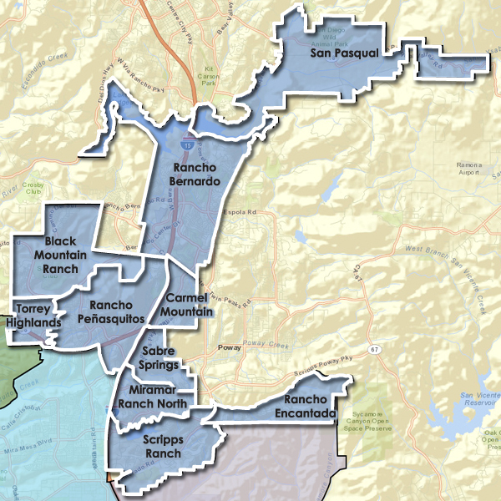
5. Lesson from 2010
The 2010 Commission’s report provides a roadmap.
Example: District 5
“The district is geographically compact to the extent possible, recognizing that the City’s North and East boundaries have jagged lines and while balancing the other criteria and community of interest boundaries. The district does not bypass population unless required to unite communities of interest or otherwise achieve other criteria.” – 2010 Final Redistricting Plan

Slide 14
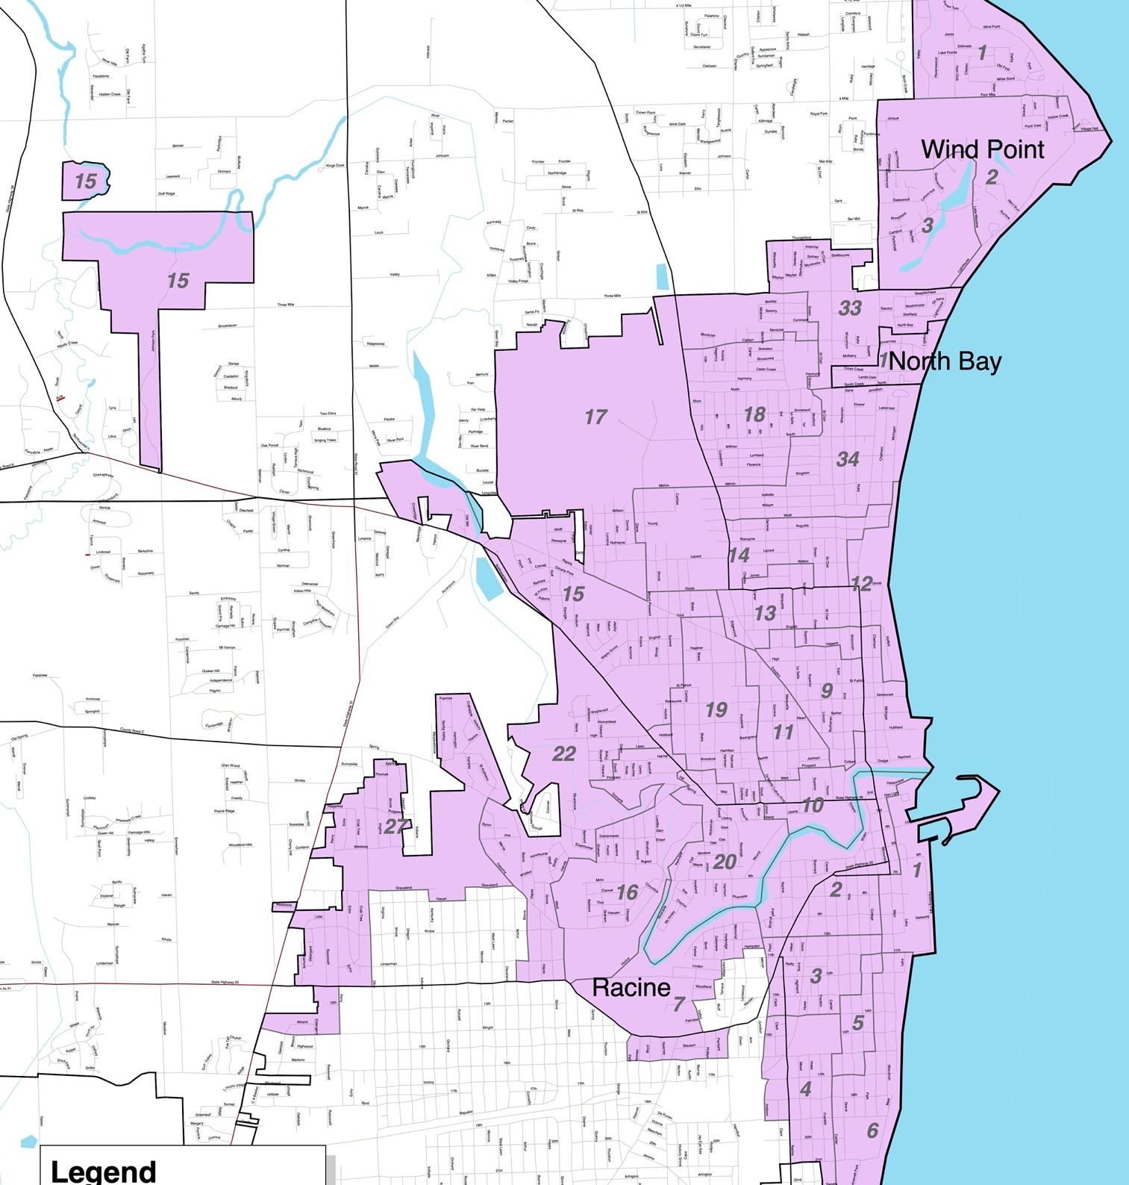
Contiguity
Former WI 61st state assembly District
Hypothetical San Diego District
Source: Professor Justin Levitt
Drawn with We Draw the Lines CA’s tool
Note: Some states, like Wisconsin, allow for non-contiguous districts to address anomalous annexation issues.

Slide 15
Why “Contiguous?”
Without contiguity, districts could be a scattered group of “islands,” which is inconsistent with the basic principles of district-representation.
Connected populations are more likely to have similar interests.
Contiguous districts make it easier for elected representatives to access their constituents and constituents to organize to voice their concerns and interests.
Continuity requirements are a safeguard against gerrymandering.

Slide 16
What is “Contiguity?”
Charter definition
Practical considerations
Lessons from 2010

Slide 17
1. Charter definition
Charter §5.1 requires “contiguous territory”
General Considerations:
A district should be a single, unbroken shape.
All parts of the district should be attached and connected to each other.
Can you travel from any part of the district to any other part without crossing its boundaries (not divided into discrete parts)?
Two areas touching at corners typically do not satisfy contiguity.
Avoid connecting communities or areas only by beach, highway, or waterway corridors whenever possible.

Slide 18
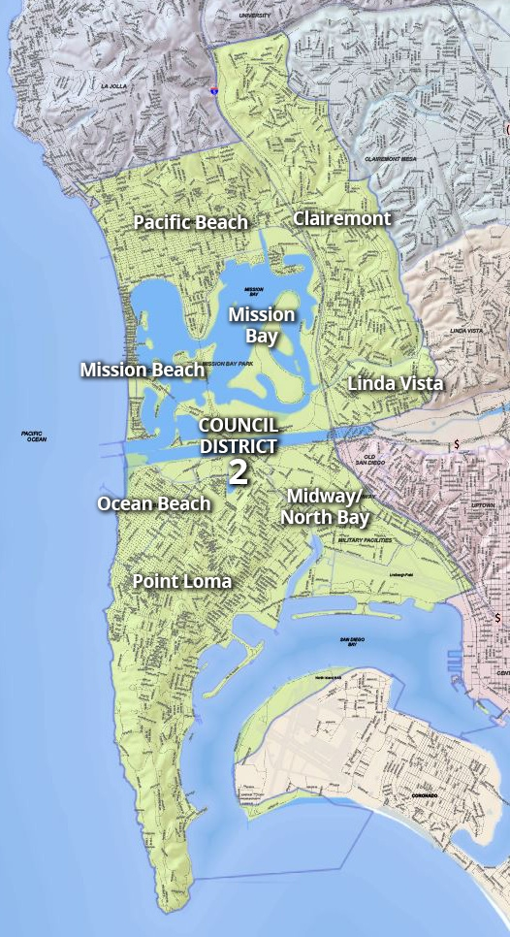
2. Practical considerations
Again, the City’s boundaries and population distribution limit the ability to draw perfectly contiguous districts.
Transportation avenues play a role in creating contiguity.
Example: District 2
“The district is geographically contiguous. There is reasonable access between population centers in the district. Pacific Beach, Mission Beach, Ocean Beach, Point Loma, and San Diego International Airport are accessible by Interstate 5.” – 2010 Final Redistricting Plan

Slide 19
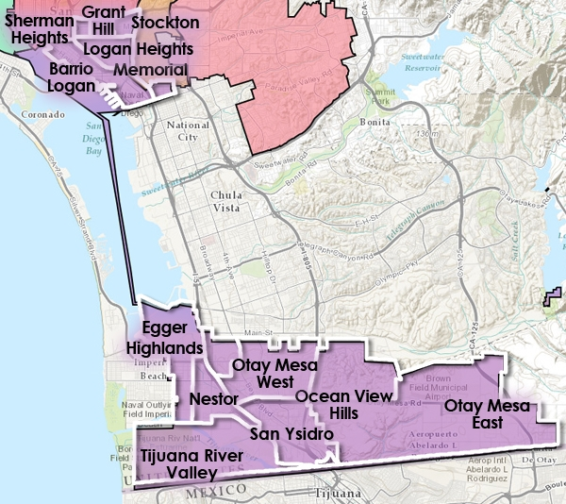
3. Lessons from 2010
Example: District 8
“The district is geographically contiguous to the extent possible because of the need to equalize the population and to connect population in the South Bay to population in the north. There is reasonable access between population centers in the district.” – 2010 Final Redistricting Plan

Slide 20
Summary
Strict population equality is most important.
All traditional redistricting principles must be balanced against each other.
As discussed today, districts should be as compact and contiguous as is practical and possible, to comply with the City’s Charter.
The City’s boundaries and geography present challenges to redistricting principles, including compactness and contiguity.

Slide 21
Questions?

