Slide 1

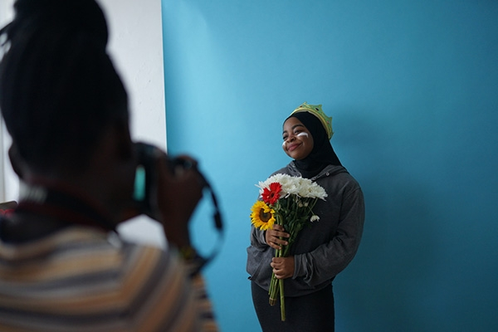
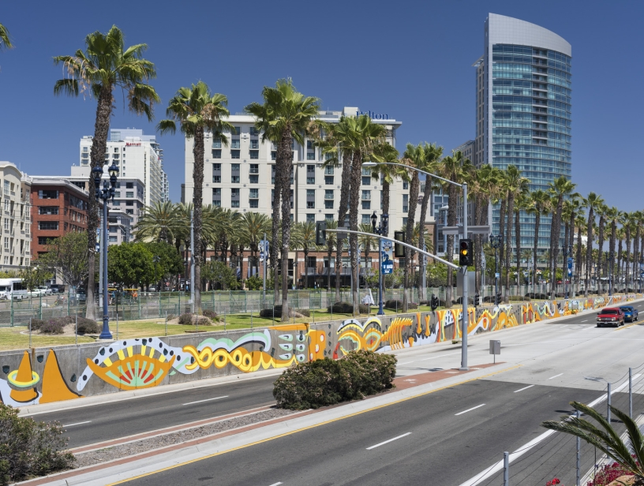
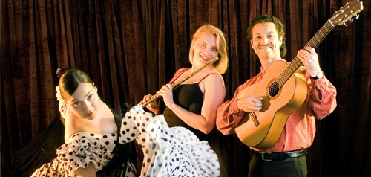

Fiscal Year 2023
Arts, Culture, and Community Festivals (ACCF)
City Council Allocations

Slide 2

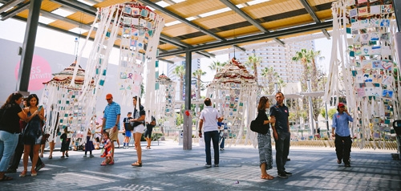
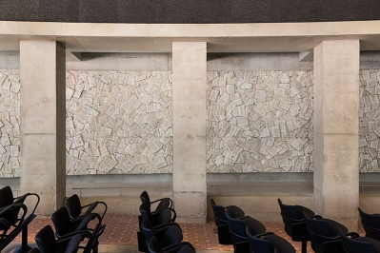
Partnering with the City Council Offices: ACCF Funding
Arts, Culture and Community Festivals (ACCF) City Council Allocations
Background
ACCF City Council allocations are to non-profit organizations and public agencies for the purpose of promoting local arts and culture.
Organizations may produce programs, projects or events that:
  Provide access to excellence in culture and the arts for residents of, and visitors to San Diego.
  Enrich the lives of the people of San Diego and build healthy, vital neighborhoods.

Slide 3
Partnering with the City Council Offices: ACCF Funding
Arts, Culture and Community Festivals (ACCF)
City Council Allocations
Background
The allocations are administered jointly by City Council Administration and Commission staff.
Annual funding levels are subject to the amount of Transient Occupancy Tax (TOT) allocated to each Councilmember in a given fiscal year.
The ACCF Funding Program is governed by Council Policy 100-23.

Slide 4

Contracting with the City of San Diego
Application Process
ACCF City Council Allocation Application
  If your organization has received a CCSD or OSP award:
    An expedited application will be made available on 8/1/22, and your and your FY23 OSP or CCSD agreement will be amended, if approved for ACCF allocation.
    Creative Communities San Diego (CCSD) ACCF applicants can only apply for ACCF funds to support the project they are producing with CCSD funds if the project is open to the public.
    Operational Support Program (OSP) ACCF applicants can apply for ACCF funds for general operating support in alignment with OSP.

Slide 5
Contracting with the City of San Diego
Application Process
ACCF City Council Allocation Application
  If your organization has not received a CCSD or OSP award:
    A full application will be made available on 8/1/22, and you will need to provide supplemental documentation.
    Documentation Required:
      Proof of Nonprofit Status
      Proof of Good Standing with the Secretary of State
      Proof of Good Standing with the Attorney General
      Certification for a Drug Free Workplace
      EOC Workforce Report (pages 1-3)
      IRS Form 990 or 990EZ
      Form W-9

Slide 6
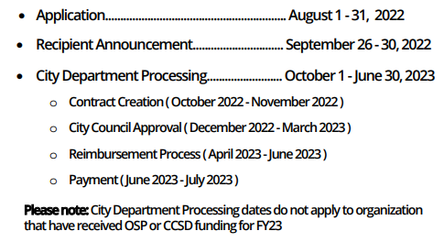

Contracting with the City of San Diego
ACCF Funding Program
Fiscal Year 2023 Schedule
*Dates are subject to change

Slide 7
Partnering with the City Council Offices: ACCF Funding
ACCF Projects/Programs/Events
Examples from FY19
La Jolla Art and Wine Festival: Advertising Campaign
Cabrillo Festival, Inc: 55th Annual Cabrillo Festival
Allied Gardens Community Events: First Fridays Community Concerts
Fern Street Circus: Organizational Support*

Slide 8
Contracting with the City of San Diego
FY23 ACCF City Council Allocations
Funding Summary
FY23 ACCF Total Funds: $500,000
Mayor’s Office- Mayor Todd Gloria: $50,000
District 1- Councilmember Joe LaCava: $50,000
District 2- Councilmember Jennifer Campbell: $50,000
District 3- Councilmember Stephen Whitburn: $50,000
District 4- Council President Pro Tem Monica Montgomery Steppe: $50,000
District 5- Councilmember Marni von Wilpert: $50,000
District 6- Councilmember Chris Cate: $50,000
District 7- Councilmember Raul Campillo: $50,000
District 8- Councilmember Vivian Moreno: $50,000
District 9- Council President Sean Elo-Rivera: $50,000

Slide 9


Contracting with the City of San Diego
ACCF City Council Allocations
Program Reminders & Council Policy Review
ACCF funds cannot be used for food, beverages, travel, private purposes, political, religious, or fundraising activities.
The minimum funding allocation is $1,500 and matching is NOT required.
Funding awards are allocated at the discretion of the City Council Members.

Slide 10
Contracting with the City of San Diego
ACCF City Council Allocations
Program Reminders & Council Policy Review
Funds may be granted to provide organizational support or specific project/event support so long as certain criteria is met.
If a recipient organization chooses to give recognition for their funding award, it shall recognize the City of San Diego, not individual Council Members nor individual Council Districts.
Applications are due August 31st, 2022.

Slide 11
Contracting with the City of San Diego
Request for Reimbursement Process
Note: Request for Reimbursement is only required for ACCF awardees without a current OSP or CCSD award
Funds awarded are paid on a reimbursement basis only.
  After successful completion of application, City Council approval, contracting requirements, and reimbursement documentation, organizations will then receive payment.
  The Reimbursement Form, supplemental documents, and Final Performance Report are due July 31, 2023.
    Proof of purchase (receipts, invoices, pay stubs, time sheets, etc.)
    Proof of payment (cleared checks, bank/credit card statements, etc.).
  ACCF allocation payment can up to two months after reimbursement documentation has been submitted.

Slide 12

Contracting with the City of San Diego
Assistance
To Learn More
Council Offices→ https://www.sandiego.gov/citycouncil
Mayor’s Office → https://www.sandiego.gov/mayor
ACCF Funding Program→ https://www.sandiego.gov/citycouncil/ACCF
Office Hours→ By Appointment (Zoom or Phone)
Contact Us
Submit ACCF questions to ACCF@sandiego.gov
  Council Administration Malachi Bielecki Abigail Edwards
  202 C Street, MS 10A Grants Coordinator Grants Coordinator
  San Diego, CA 92101 202 C Street, MS 10A 202 C Street, MS 10A
  619-236-5918 San Diego, CA 92101 San Diego, CA 92101
  MBielecki@sandiego.gov EdwardsA@sandiego.gov

