Slide 1
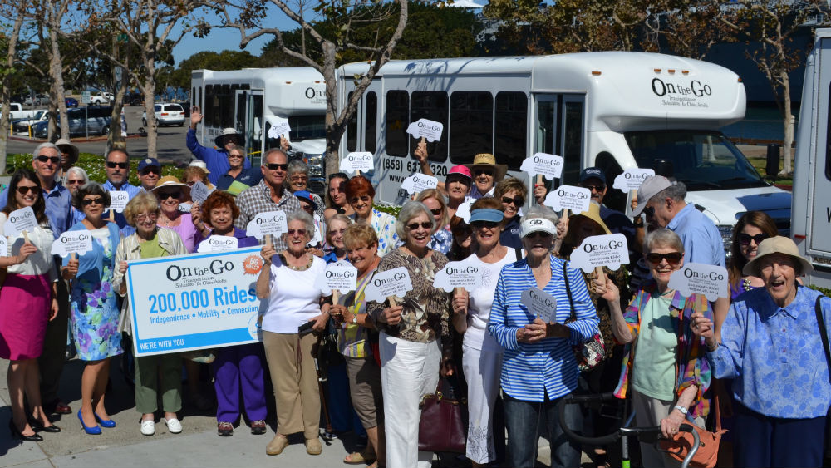
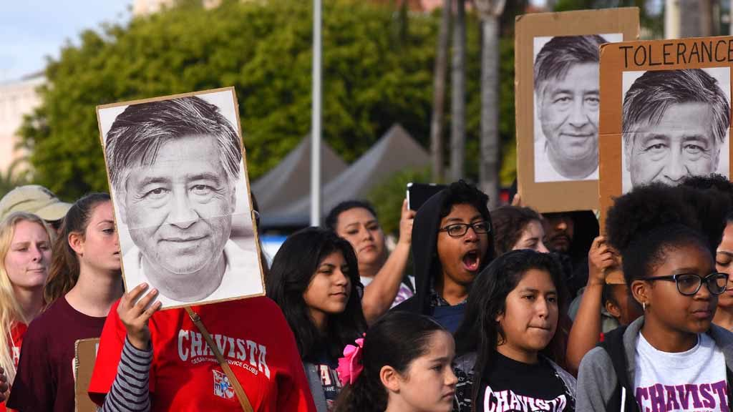
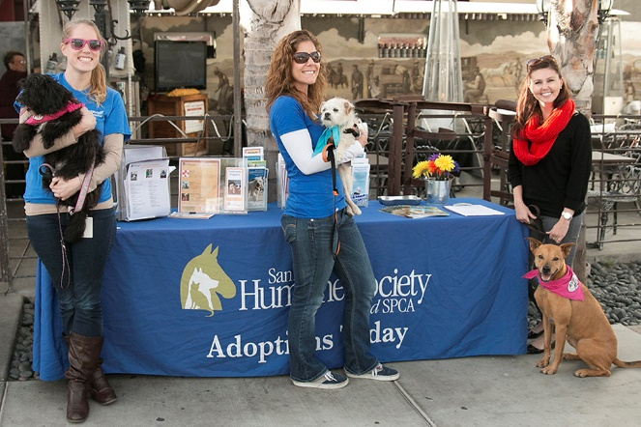
Fiscal Year 2023
Community Projects, Programs, and Services (CPPS) Funding
Notes:
Malachi Bielecki:
Good evening, my name is Malachi Bielecki and I’m a Grants Coordinator for Council Administration here at the City of San Diego. My colleague Abigail Edwards and I are here to tell you a little bit about the CPPS program for Fiscal Year 2023 and we are also here to answer any of your questions.

Slide 2
Partnering with the City Council Offices: CPPS Funding
Community Projects, Programs and Services (CPPS) Funding Program
Background
CPPS funding is awarded to non-profit organizations and public agencies for projects, programs, and services that provide for one-time community, social, environmental, cultural, and recreational community needs that serve a lawful public purpose.
CPPS Funding Program is governed by Council Policy 100-06.
Notes:
Malachi Bielecki:
To provide some background on the program, the CPPS program was first started in 2012 and has provided community organizations with funding every year except for Fiscal Year 2021 due to the pandemic. CPPS funding is awarded to non-profit organizations and public agencies for projects, programs, and services that provide one-time social, environmental, cultural, or recreational community needs that serve a lawful public purpose.
The rules governing the program are laid out in Council Policy 100-06, which is accessible on the city website. We also have a few copies printed out here for anyone who wants one. It’s important to familiarize yourself with this document so that you can fully understand your organizations eligibility and what requirements you must meet.
Courtney Thompson:
-Enter into Contract → Non-profit organizations and agencies with existing Arts & Culture contract are permitted to apply

Slide 3
Contracting with the City of San Diego
FY23 Council Office Funding Available
Funding Summary
FY23 CPPS Total Funds: $1,683,767
*87% increase over FY22
CPPS Funds:
Contracts
Transfer Memorandum:
City Departments
Capital Improvement Projects (CIP)
Notes:
Malachi Bielecki:
Above you can see the total funds which have been allocated for fiscal year 2023.
There is a total of just over $1.6 million, which is an 83% increase in funds over fiscal year 2022.
Council Offices may spend their funding allocation on contracts with prospective nonprofit applicants and public agencies, or they may transfer funds within city departments or to capital improvement projects.

Slide 4
Contracting with the City of San Diego
FY23 Council Office Funding Available
Funding Summary
FY23 CPPS Total Funds: $1,683,767
District 1- Councilmember Joe LaCava: $150,000
District 2- Councilmember Jennifer Campbell: $150,000
District 3- Councilmember Stephen Whitburn: $150,000
District 4- Council President Pro Tem Monica Montgomery Steppe: $150,000
District 5- Councilmember Marni von Wilpert: $150,000
District 6- Councilmember Chris Cate: $326,972
District 7- Councilmember Raul Campillo: $150,000
District 8- Councilmember Vivian Moreno: $306,795
District 9- Council President Sean Elo-Rivera: $150,000
Notes:
Malachi Bielecki:
Above you can see the total funding allocation for each council office, with all Council Offices having a baseline allocation of $150,000, though a handful have additional leftover funds.

Slide 5
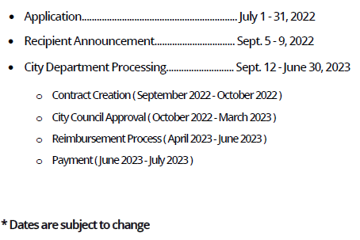
Contracting with the City of San Diego
CPPS Funding Program
Fiscal Year 2023 Schedule
Notes:
Malachi Bielecki:
Above you can see the fiscal year schedule. The application period is between July 1st and July 31st and your application will be reviewed in the first two weeks of August. There will be a cure period between August 8th and August 12th to give organizations a chance to resolve any issues with their original application if required. Recipients will be announced between September 5th and September 9th, and City Department Processing occurs from September 12th until June 30^{th.}
In order to ensure timely responses, please submit paperwork as soon as possible.

Slide 6
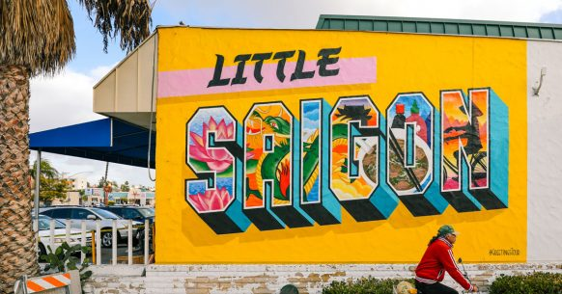
Contracting with the City of San Diego
CPPS Funding Program
Program Reminders & Council Policy Review
Project/program/service must serve a lawful public purpose and be open and cost-free to the public.
CPPS funds cannot be used for food, beverages, travel, private purposes, political, religious, or fundraising activities.
Project/program/service must occur AND be spent within the fiscal year (July 1, 2022 – June 30, 2023).
CPPS funds should be considered a one-time resource.
Notes:
Malachi Bielecki:
Here are some program reminders:
Any project, program, or service must serve a lawful public purpose and be open and cost-free to the public.
Funds may not be used for food, beverages, travel, private purposes, political, religious, or fundraising activities.
All associated services and activities must both occur AND be spent within the fiscal year.
Lastly, CPPS funds should be considered a one-time resource. It is not recommended that your project involve additional costs beyond the initial project.

Slide 7
Contracting with the City of San Diego
CPPS Funding Program
Program Reminders & Council Policy Review
CPPS funds are paid on a reimbursement basis only.
Organizations are only eligible to receive reimbursement for expenses originally identified in their applications.
Expect payment up to two months after reimbursement documentation has been submitted.
Funding awards are at the discretion of Council Offices.
If funding recipient chooses to give recognition for funds received, it shall recognize the City of San Diego, not individual Councilmembers or Council Districts.
Applications are due July 31, 2022.
Notes:
Malachi Bielecki:
CPPS funds are paid on a reimbursement basis only, meaning that your organization must pay the cost of your program upfront and submit for reimbursement after the fact. To guarantee reimbursement, it is very important that you ensure your spending meets the requirements laid out by the program on the website and in Council Policy 100-06. In addition, you will only be eligible to receive reimbursement for the types of expenses originally identified in your application. For example, if you want reimbursement for salary expenses related to your project, you must identify that in the application. You cannot claim it later if it was not originally described in your application.
Funding is awarded at the discretion of the Council Offices, but if a recipient chooses to give recognition for the funds, they must recognize the City of San Diego, rather than the individual Councilmember or Council District.
Lastly, organizations must submit an application by July 31st, 2022, in order to be considered for CPPS funding in fiscal year 2023.

Slide 8
Partnering with the City Council Offices: CPPS Funding
CPPS Projects/Programs/Services
Examples from FY22
Meals-on-Wheels Greater San Diego, Inc.: Web Redesign
Urban Corps of San Diego: Council District 4 Weed Abatement
The San Diego River Park Foundation: Monarch Butterfly Engagement Program
Mira Mesa Town Council, Inc.: Banner Redesign
MANA de San Diego: Tias Program for Latina Success
CTC Foundation, Inc.: Clairemont Holiday Party
Notes:
Malachi Bielecki:
The above are some examples of organizations who received CPPS funding in fiscal year 2022.
More examples of previous projects and services are available on the CPPS website.
Courtney Thompson:
-Enter into Contract → Non-profit organizations and agencies with existing Arts & Culture contract are permitted to apply

Slide 9
Contracting with the City of San Diego
Application Process
CPPS Funding Application
Reminders:
Use CPPS Application Instructions as a guide.
Multiple applications pertaining to different projects are permitted.
Only one project/program/service allowed per application.
May apply for funding from multiple offices.
Demonstrate that the project/program/service is open to the public and provides a public purpose.
Notes:
Malachi Bielecki:
Here are some application reminders:
Using the CPPS Application Instructions as a guide, make sure that your organization meets all eligibility requirements.
Organizations can complete multiple applications for multiple projects, but only one project is allowed per application. And organizations may apply for funding from multiple offices in one application.
Lastly, ensure that your application demonstrates that the project is open to the public and provides a public purpose.

Slide 10
Contracting with the City of San Diego
Application Process
CPPS Funding Application
Reminders:
Provide a detailed Use of City Funds report.
Organizations can only be reimbursed for expenses described in this section.
Include signature and date as needed throughout application.
Please note that all application requirements are attached to the online CPPS application using the SeamlessDocs platform.
Notes:
Malachi Bielecki:
To continue, ensure that your organization provides a detailed Use of City Funds section. This is the section that will determine what types of expenses are reimbursable. Be sure to identify any types of expenses that you will be seeking reimbursement for.
Ensure that you include your signature and the date as needed throughout the application.
And please confirm that all application requirements are attached to your online CPPS application via the SeamlessDocs platform.

Slide 11
Contracting with the City of San Diego
Application Process
Proof of Nonprofit Status /Exemption Determination Letter from IRS
To check an organization’s Nonprofit Status:
Use the Tax Exempt Organization Search tool to find information on an organizations’ status.
Organization not on website / Lost Letter:
Contact Customer Account Services by phone letter, or fax to request an affirmation letter.
A letter or fax requesting an affirmation letter must include your organization’s:
Full name
Employer Identification Number and
Authorized signature (an officer or trustee)
Notes:
Malachi Bielecki:
The following slides are a few examples of forms that will need to be completed and provided in your application submission:
You will need to provide the city with proof of your nonprofit status.
To check an organization’s nonprofit status, you can use the tax-exempt organization search tool and in the case that your organization is not listed, you must contact IRS customer service.

Slide 12
Contracting with the City of San Diego
Application Process
Proof of Good Standing
Active status from Secretary of State
https://bizfileonline.sos.ca.gov/search/business
*Status must remain active for the duration of the contract
Current status from Attorney General
http://rct.doj.ca.gov/Verification/Web/Search.aspx?facility=Y
*Status must remain current for the duration of the contract
Notes:
Malachi Bielecki:
You must provide documentation verifying your organization’s Proof of Good Standing with the State of California.
Your organization must have an active status from the California Secretary of State and a current status with the Attorney General. This can be checked via the online portals listed above.

Slide 13
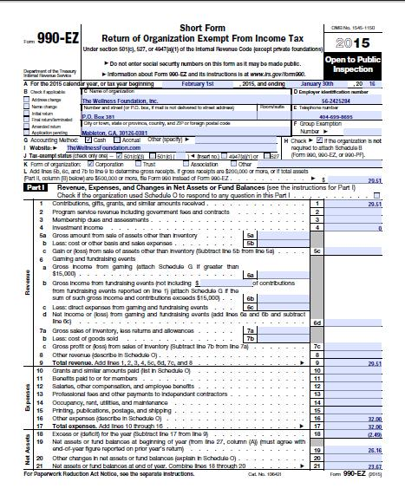
Contracting with the City of San Diego
Application Process
Additional Forms
Certification for a Drug Free Workplace
The City requires that all City grantees and providers of non-professional services to agree to comply with the Drug-Free Workplace Policy (Council Policy 100-17).
EOC Workforce Report
Documents the gender and ethnic make-up of an organization's employees.
Pages 1-3 must be completed.
IRS Form 990
Form 990-EZ, Form 990-PF, and Form 990-N (e-Postcard) accepted.
IRS Form W-9
Notes:
Malachi Bielecki:
Here are some of the additional required forms, including the Certification for a Drug Free Workplace, the EOC Workforce Report, the IRS Form 990, and the IRS Form W-9.

Slide 14
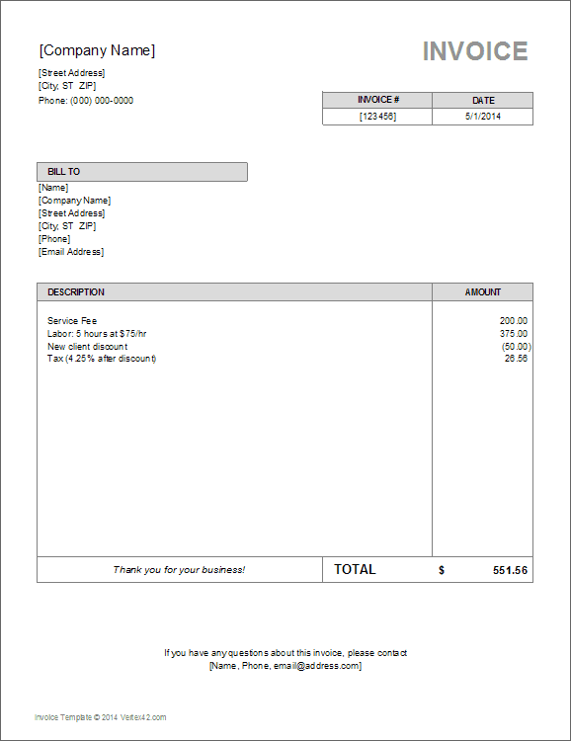
Contracting with the City of San Diego
Request for Reimbursement Process
Additional Information
Funds awarded are paid on a reimbursement basis only.
Project/program/service is funded by the organization.
After successful completion of application, City Council approval, contracting requirements, and reimbursement documentation, organizations will then receive payment.
Expect payment up to two months after reimbursement documentation has been submitted.
Notes:
Malachi Bielecki:
To reiterate, funds awarded are paid strictly on a reimbursement basis- the project, program, or service must be initially funded by your organization.
Upon successful completion of the application, City Council approval, the completion of contracting requirements, and the provision of reimbursement documentation, organizations will then receive payment up to two months after the reimbursement documentation is submitted.

Slide 15
Contracting with the City of San Diego
Request for Reimbursement Process
Additional Information
To receive reimbursement:
Your CPPS representative will inform you when it is time to submit for reimbursement.
Request for Reimbursement Form, supplemental documents, and Final Performance Report must be submitted by July 31, 2023.
Supplemental documents include both proof of purchase (receipts, invoices, pay stubs, time sheets, etc.) and proof of payment (cleared checks, bank/credit card statements, etc.).
Only expenditures made within the Fiscal Year July 1, 2022 – June 30, 2023, are eligible for reimbursement.
Notes:
Malachi Bielecki:
Your assigned CPPS representative, which will be Abigail or myself, will inform you when it is time to submit for reimbursement.
To receive reimbursement, your request for reimbursement form, supplementation documentation, and final performance report must be submitted by July 31, 2023.
Supplemental documents include both Proof of Purchase, which could be receipts, invoices, pay stubs, time sheets, etc., AND proof of payment, which could be a cleared check or a bank/credit card statements, etc..
Only expenditures made within the Fiscal Year, which is July 1, 2022, to June 30, 2023, are eligible for reimbursement.

Slide 16
Contracting with the City of San Diego
Assistance
To Learn More
Council Offices→ https://www.sandiego.gov/citycouncil
CPPS Funding Program→ https://www.sandiego.gov/citycouncil/cpps
Office Hours→ By Appointment (Virtual or Phone)
Contact Us
Submit CPPS questions to CPPS@sandiego.gov
Council Administration Malachi Bielecki Abigail Edwards 202 C Street, MS 10A Grants Coordinator Grants Coordinator San Diego, CA 92101 202 C Street, MS 10A 202 C Street, MS 10A 619-236-5918 San Diego, CA 92101 San Diego, CA 92101
MBielecki@sandiego.gov EdwardsA@sandiego.gov
Notes:
Malachi Bielecki:
Here are some resources, all of which are available on the city’s website.
You may submit CPPS questions to our email at CPPS@sandiego.gov and we will respond promptly.
You may also reach out to Abby or myself.
This PowerPoint and all the links within will be emailed to you and will also be available on the website.
Now we’d be happy to answer any questions you may have.

