Slide 1

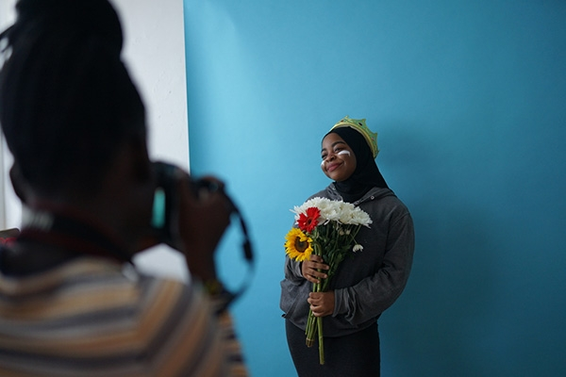
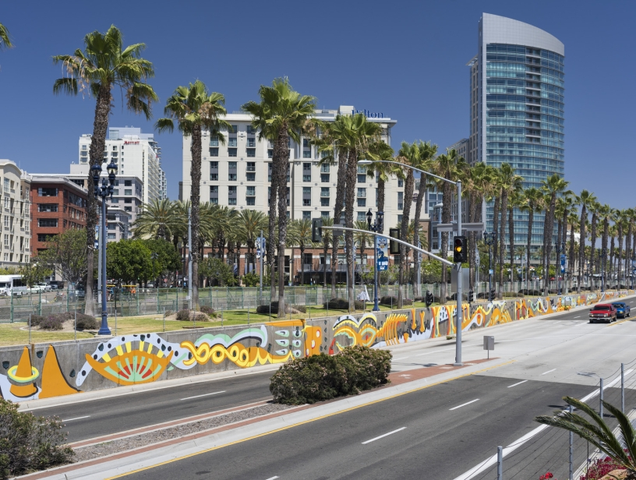
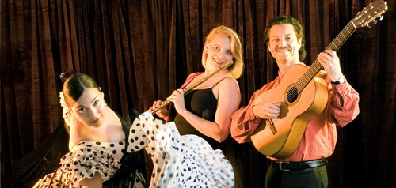

Fiscal Year 2024
Arts, Culture, and Community Festivals (ACCF)
City Council Allocations
Notes:
Good evening, my name is Malachi Bielecki and I’m a Grants Coordinator for Council Administration here at the City of San Diego. My colleague Abigail Edwards and I are here to tell you a little bit about the ACCF program for Fiscal Year 2023 and we are also here to answer any of your questions at the end of the presentation.

Slide 2

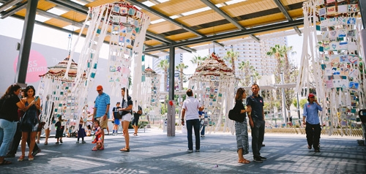
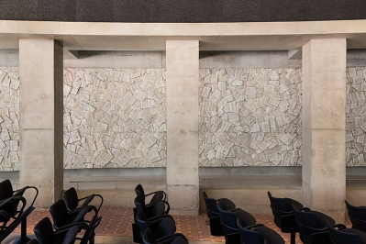
Arts, Culture and Community Festivals (ACCF)
City Council Allocations
Background
ACCF City Council allocations are awarded to nonprofit organizations and public agencies for the purpose of promoting local arts and culture.
Organizations may produce programs, projects or events that:
  Provide access to excellence in culture and the arts for residents of, and visitors to San Diego.
  Enrich the lives of the people of San Diego and build healthy, vital neighborhoods.
Notes:
First, we’ll go over some background on the allocations. City Council ACCF allocations are awarded to nonprofit organizations and public agencies for the purpose of promoting local arts and culture. Generally, organizations receive ACCF allocations for programs, projects, or events that add to the cultural and artistic experience of both residents and visitors to the City of San Diego.

Slide 3
Arts, Culture and Community Festivals (ACCF)
City Council Allocations
Background
The allocations are administered jointly by City Council Administration and Commission for Arts and Culture staff.
Funding is allocated at the discretion of City Councilmembers.
All recipients of ACCF allocations:
  Submit an application.
  Enter into an agreement with the City.
Notes:
The allocations are administered jointly by City Council Administration and Commission for Arts and Culture staff. Funding is awarded strictly at the discretion of City Councilmembers. And all recipients of ACCF City Council allocations will submit an application for review and enter into an agreement with the City.

Slide 4
Arts, Culture and Community Festivals (ACCF) City Council Allocations
Background
Annual funding levels are subject to the amount of Transient Occupancy Tax (TOT) allocated to each Councilmember in a given fiscal year.
ACCF funding is a line item within the City’s Special Promotional Programs section of the budget.
The ACCF City Council allocations are governed by Council Policy 100-23.
Notes:
The annual funding levels of ACCF City Council allocations are subject to the amount of Transient Occupancy Tax (or TOT) allocated to each Councilmember in the budget for a given fiscal year. Within the budget, ACCF funding is a line item within the City’s Special Promotional Programs section. And finally, ACCF City Council allocations are governed by Council Policy 100-23.

Slide 5

Application Process
ACCF Application
  If your organization has received a CCSD or OSP award:
    An abbreviated ACCF application will be made available on 6/1/23, and your FY23 OSP or CCSD agreement will be amended, if approved for ACCF allocation.
    Creative Communities San Diego (CCSD): ACCF applicants can only apply for ACCF funds to support the project they are producing with CCSD funds, and the project must be open to the public.
    Operational Support Program (OSP): ACCF applicants can apply for ACCF funds for general operating support in alignment with OSP.
Notes:
Now we’ll look at the application process. There are two different ways for organizations to apply for ACCF. If the organization has received a CCSD or OSP award for this fiscal year, then an abbreviated application will be made available on June1st. Should the applicant be selected by a Council Office, their OSP or CCSD agreement will be amended to account for the additional funds. Please note that this means that organizations can only use this allocation for the original purposes identified in their OSP or CCSD agreement.

Slide 6
Application Process
ACCF Application
  If your organization has not received a CCSD or OSP award:
    A full application will be made available on 6/1/23, and you will need to provide supplemental documentation.
    Documentation Required:
      Proof of Nonprofit Status
      Proof of "ACTIVE" status with the CA SOS
      Proof of "CURRENT" status with the CA AG
      Certification for a Drug Free Workplace
      EOC Workforce Report (pages 1-3)
      IRS Form 990, 990EZ, or 990N
      Form W-9
Notes:
Alternatively, if your organization does not have a CCSD or OSP agreement for the fiscal year, a full application will be made available on June1st and you will need to provide full documentation. For those organizations that applied for CPPS, this will be a very similar process.

Slide 7
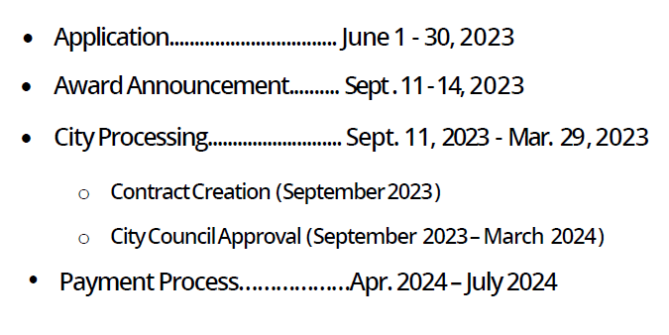

ACCF City Council Allocations
Fiscal Year 2023 Schedule
*Dates are subject to change
*This schedule is only relevant to those completing a full application, it is not relevant to those with existing CCSD/OSP Agreements.
Notes:
Above you can see the schedule for those completing a full application for ACCF City Council allocations. What you see here is not relevant to those with CCSD or OSP awards
The application period is from June1st to june 30th and we anticipate recipients will be announced in September. After awards have been announce organizations who recievd additionally funding for their CCSD or OSP awards will then follow the Commission for arts and cultures schedule. Please remember that ACCF City Council allocations are on a reimbursement basis only. your organization will have to pay expenses up front and you will receive reimbursement towards the end of the fiscal year.

Slide 8
ACCF Projects/Programs/Events
Examples from FY23
San Diego Diverse Business Association: Meet the Designers
House of China: Chinese New Year Fair
San Ysidro Improvement Corporation: 2022 San Ysidro Mural Festival
TransFamily Support Services: TFSS Family Programming Outreach
Via International: Chicano Park Day
Notes:
The above are some examples of organizations who received ACCF City Council allocations in fiscal year 2019. More examples of previous projects and services are available to view on the ACCF website.

Slide 9
FY24 City Council Allocations
Funding Summary
FY24 ACCF Total City Council Funds: TBD
Based on the proposed FY24 Budget: $500,000
District 1- Councilmember Joe LaCava: TBD ($50,000)
District 2- Councilmember Jennifer Campbell: TBD ($50,000)
District 3- Councilmember Stephen Whitburn: TBD ($50,000)
District 4- Council President Pro Tem Monica Montgomery Steppe: TBD ($50,000)
District 5- Councilmember Marni von Wilpert: TBD ($50,000)
District 6- Councilmember Kent Lee: TBD ($50,000)
District 7- Councilmember Raul Campillo: TBD ($50,000)
District 8- Councilmember Vivian Moreno: TBD ($50,000)
District 9- Council President Sean Elo-Rivera: TBD ($50,000)
Mayor’s Office- TBD ($50,000)
Notes:
The FY24 budget will be approved at Council in late June, however above are the proposed funds we are anticipating for this year. Each office is expecting to receive $50,000 according to the Mayor’s proposed budget. However, this could change.

Slide 10


ACCF City Council Allocations
Reminders & Council Policy Review
ACCF funds cannot be used for food, beverages, travel, private purposes, political, religious, or fundraising activities.
The minimum funding allocation is $1,500 and no match is required for the funds.
  While not required, the availability of matching funds is considered when reviewing applications.
ACCF funds should be considered a one-time resource.
Notes:
Now for some reminders and policy review. ACCF funds cannot be used for food, beverages, travel, private purposes, political, religious, or fundraising activities. The minimum funding allocation is $1,500 and no matching is required with the funds, however, the availability of matching funds may be considered by the Council Office reviewing the application. Additionally, ACCF funds should be considered a one-time resource.

Slide 11
ACCF City Council Allocations
Reminders & Council Policy Review
Funds may be granted to provide organizational support or for a specific project/event support so long as certain criteria is met.
If a recipient organization chooses to give written recognition for their funding award, it shall recognize the City of San Diego, not individual Councilmembers nor individual Council Districts.
Applications are due June 30, 2023.
Notes:
Funds may be granted to provide organizational support or specific project/event support, If a recipient chooses to give recognition for their funding award, it shall recognize the City of San Diego, not individual Councilmembers nor individual Council Districts. And finally, applications are due on June 30th, 2023.

Slide 12
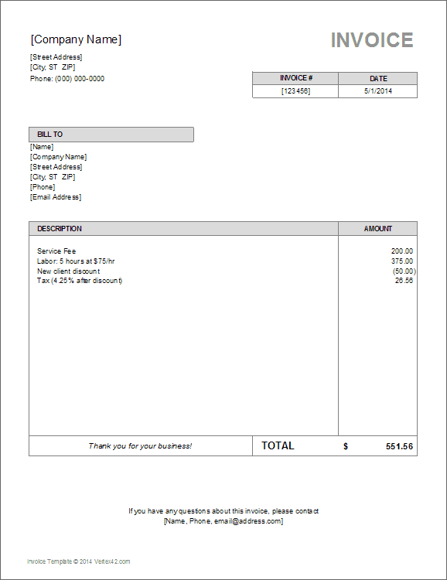
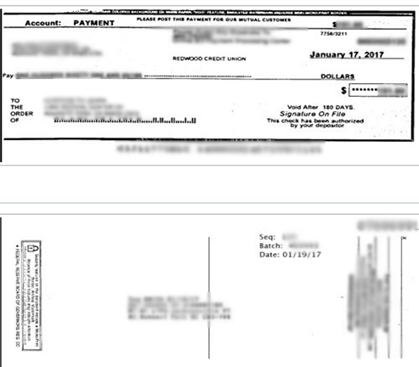
ACCF Payments
Reimbursement Process
To receive reimbursement:
  Request for reimbursement form, supplemental documentation, and Final Performance Report must be submitted by July 31, 2024.
  Supplemental documentation include both proof of purchase (receipts, invoices, pay stubs, time sheets, etc.) and proof of payment (cancelled checks, bank/credit card statements, etc.).
  Your assigned contract administrator will inform you when it is time to request reimbursement.
  Only eligible expenditures incurred within the Fiscal Year (July 1, 2023 – June 30, 2024), are eligible for reimbursement.
Notes:
As you can see here, the same reimbursement documentation is required, similar to the CPPS process. A completed reimbursement form and supplemental documentation will be required in order to receive your reimbursement. Again, all expenses must have been purchased within the fiscal year and documentation are due non later than July 31st, 2024. After reimbursement documentation has been submitted and reviewed, then the City will issue the checks. Mailed checks can take 30-90 days to process.

Slide 13

Assistance
To Learn More
Council Offices→ https://www.sandiego.gov/citycouncil
Mayor’s Office → https://www.sandiego.gov/mayor
CPPS Homepage → https://www.sandiego.gov/citycouncil/cpps
ACCF Homepage→ https://www.sandiego.gov/citycouncil/ACCF
Office Hours→ By Appointment (Zoom or Phone)
Contact Us
Submit ACCF questions to ACCF@sandiego.gov
Submit CPPS questions to CPPS@sandiego.gov
  Council Administration Malachi Bielecki Abigail Edwards
  202 C Street, MS 10A Grants Coordinator Grants Coordinator
  San Diego, CA 92101 Mbielecki@sandiego.gov EdwardsA@sandiego.gov
  619-236-6441
Notes:
Malachi Bielecki:

