Slide 1


Get It Done
App and Online Services

Slide 2

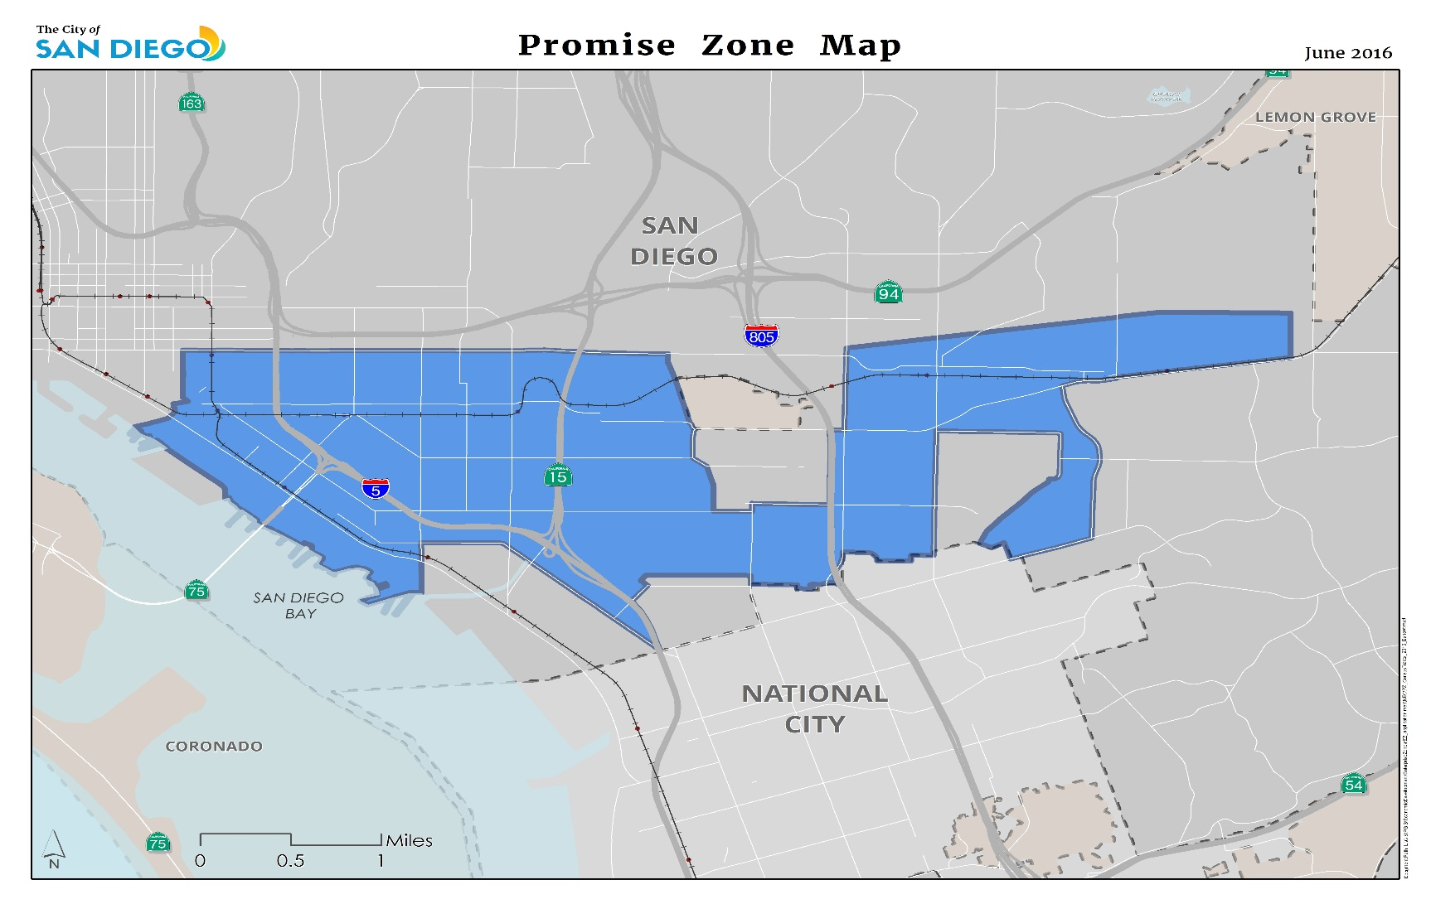
San Diego Promise Zone
Notes:
President Obama unveiled the Promise Zone (PZ) Initiative as part of his State of the Union Address in 2013 to designate a number of urban, rural, and tribal communities nationwide. The initiative seeks to revitalize high-poverty communities by infusing federal, sate, local, community development, and private sector resources into targeted neighborhoods. The Promise Zone initiative is rooted in collective impact and collaboration between community stakeholders, local organizations, and agencies to streamline resources and deliver comprehensive support to our underserved communities. The San Diego Promise Zone is comprised of the areas shaded in blue.

Slide 3







San Diego Promise Zone Goals
1. Create Jobs
2. Increase Economic Opportunity
3. Improve Educational Opportunities
4. Reduce Serious or Violent Crime (Create a Priority of Safety)
5. Increase Access to Quality, Affordable Housing
6. Increase Access to Healthcare and Healthy Foods
Notes:
The City of San Diego and its partners have identified the following six goals to improve the quality of life and accelerate revitalization. Recent rezoning, vacant land along high traffic corridors, and a central location that is well-served by public transit are assets that the SDPZ will build upon to bring economic vitality to these historically underserved communities.
Today, we’re going to address the goal of creating a priority of safety by showcasing the City’s “Get It Done” service.

Slide 4
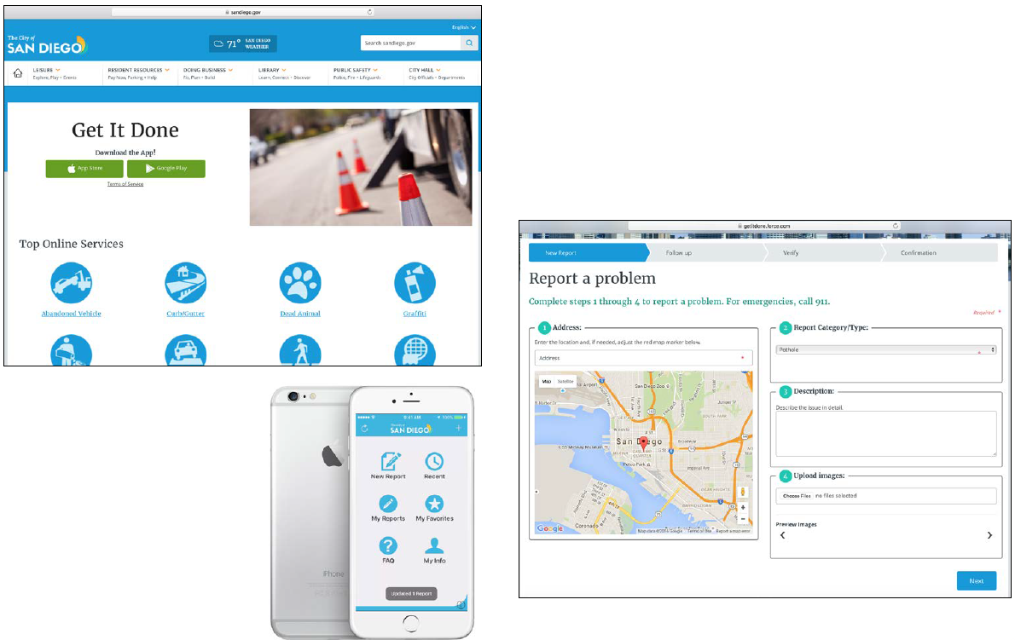
Get It Done app and web portal
Notes:
The City launched the Get It Done app and web portal in 2016 with the help, support, and dedication of the Transportation & Storm Water Department, Department of IT, and “referral partners” which included the Police, Environmental Services, and Parks & Recreation departments. Since the initial launch, the program has been expanded to include reporting incidents of illegal dumping, certain parking violations, potholes, and graffiti. The service provides you with the opportunity to report on problems in your neighborhood to address infrastructure issues and improve community amenities.

Slide 5
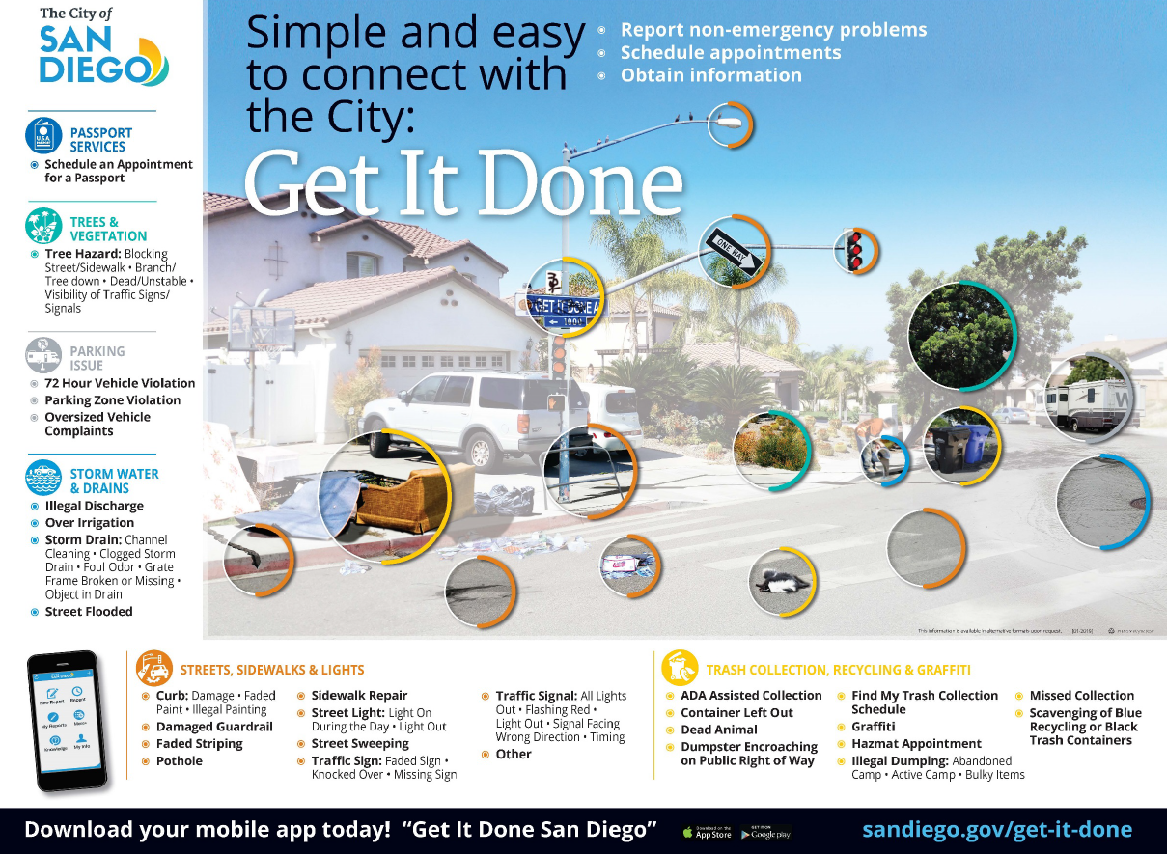
Notes:
Get It Done is the easiest way to connect with the City to report non-emergency problems. With an average of 20,000 reports filed each month, the City works hard to prioritize the most urgent public safety reports.
With every report received, the City staff is directing calls to the appropriate departments and also working with dozens of outside agencies.
In addition to reporting problems, residents can also use Get It Done to schedule passport appointments, household hazardous waste pick up, and other appointments.

Slide 6
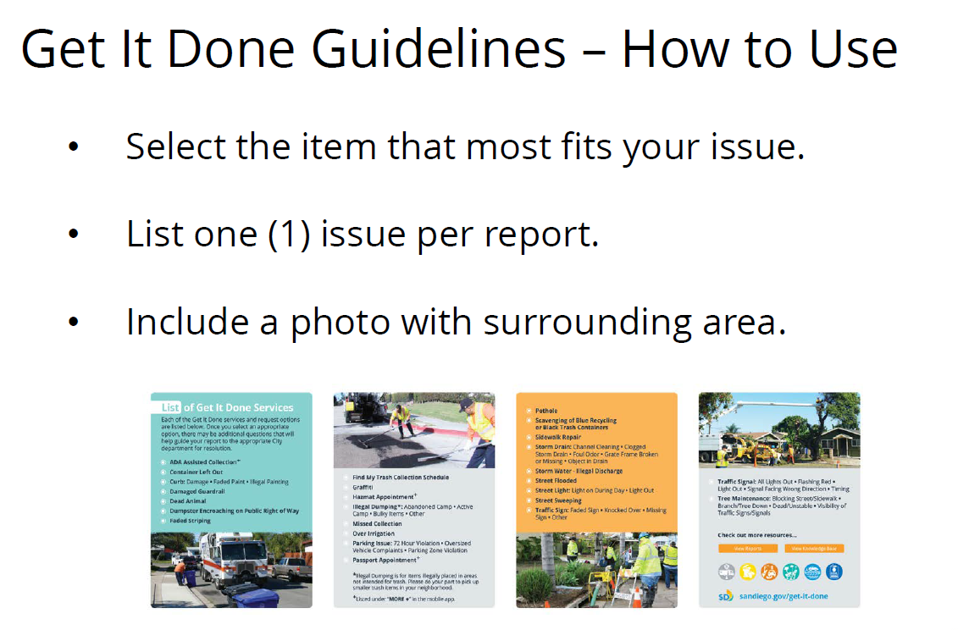
Notes:
Selecting the appropriate item from the Get It Done menu of options assist with routing reports to the correct department for resolution.
List only one issue per report. Issues may go to different departments within the City to get resolved.
It is best to submit reports separately. Include a photo if possible that makes it easier for City workers to locate the issue.

Slide 7
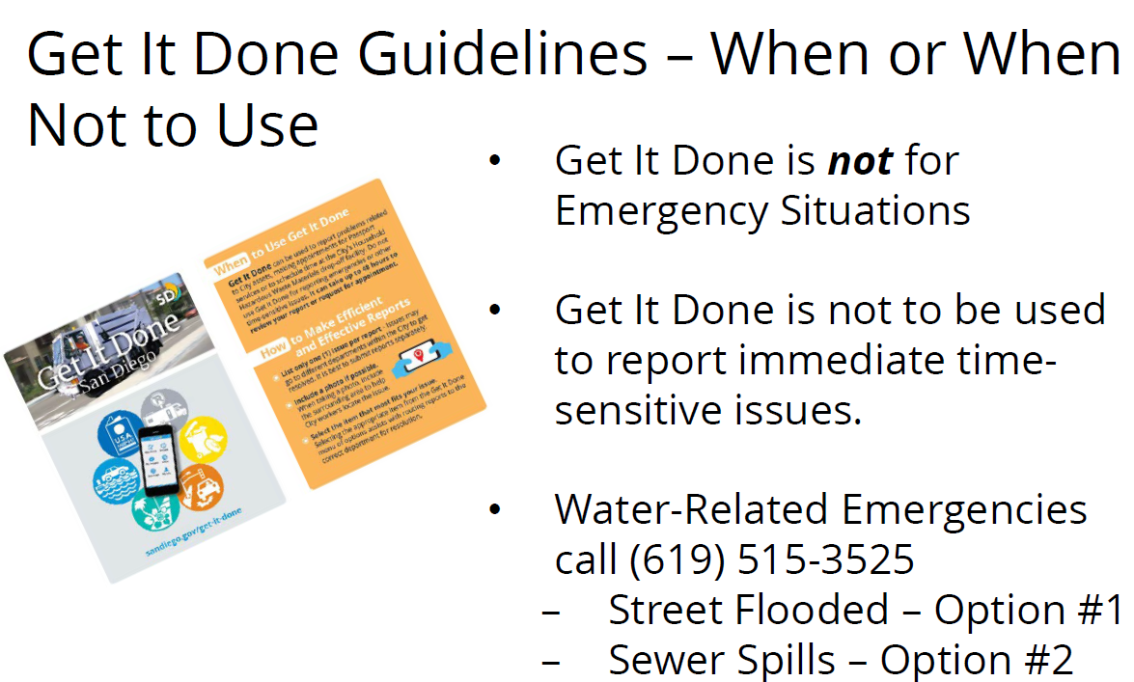
Notes:
Get It Done is a great tool for reporting non-emergency problems, like a sidewalk repair, graffiti, or trash collection concerns.
Please note that this program is not appropriate for reporting police emergencies or other time sensitive matters. It can take up to 48 hours to review your report or request for an appointment.
Timeframes for project completion vary by project. Dead animals may be removed within 48 hours, while curb repainting can take up to 10 business days. Missed trash or recycling collections may take 24-48 hours after being report.

Slide 8

Questions?
For more information on services and for a list of commonly asked questions, visit www.sandiego.gov/get-it-done
Notes:
Any questions about Get It Done?

