Slide 1
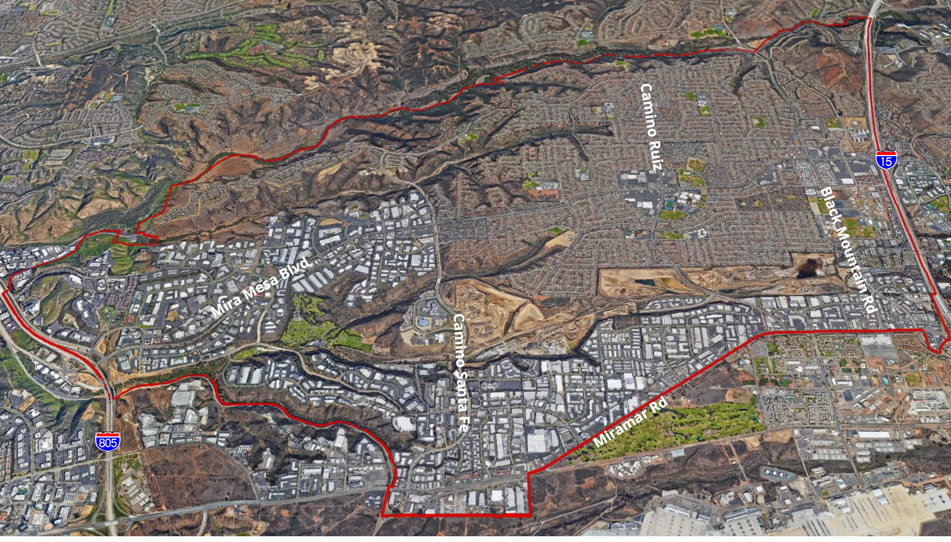

MIRA MESA COMMUNITY PLAN UPDATE

Slide 2
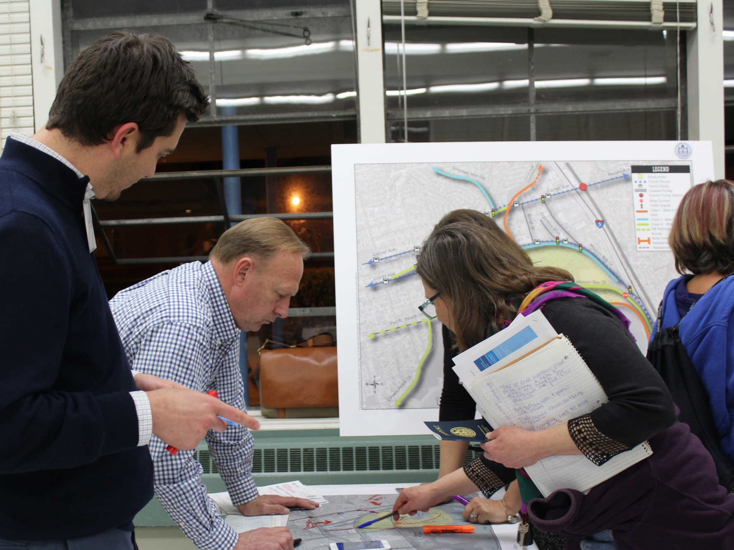
MIRA MESA COMMUNITY PLAN UPDATE
The City is updating the Community Plan in order to help shape the future of Mira Mesa for the next 20+ years.

Slide 3
WHY IS A COMMUNITY PLAN UPDATE NEEDED?
1
Address Regional Growth
2
Understand Community Needs &
Enhance Quality of Life
3
Determine Infrastructure Demand
4
Take Action for the Environment

Slide 4
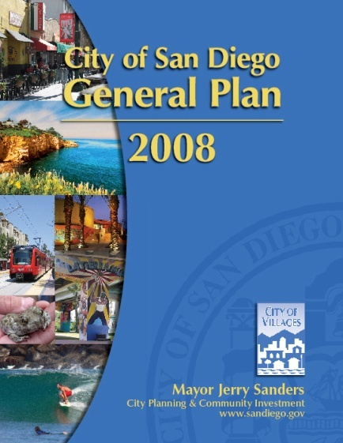
WHAT IS THE PURPOSE OF A COMMUNITY PLAN UPDATE?
Sets vision for growth & development
Identifies infrastructure and facilities needs
Sets design guidelines that enhance community character
Provides framework for improved bike/pedestrian/transit network
Provides a forum for public participation in the planning process

Slide 5
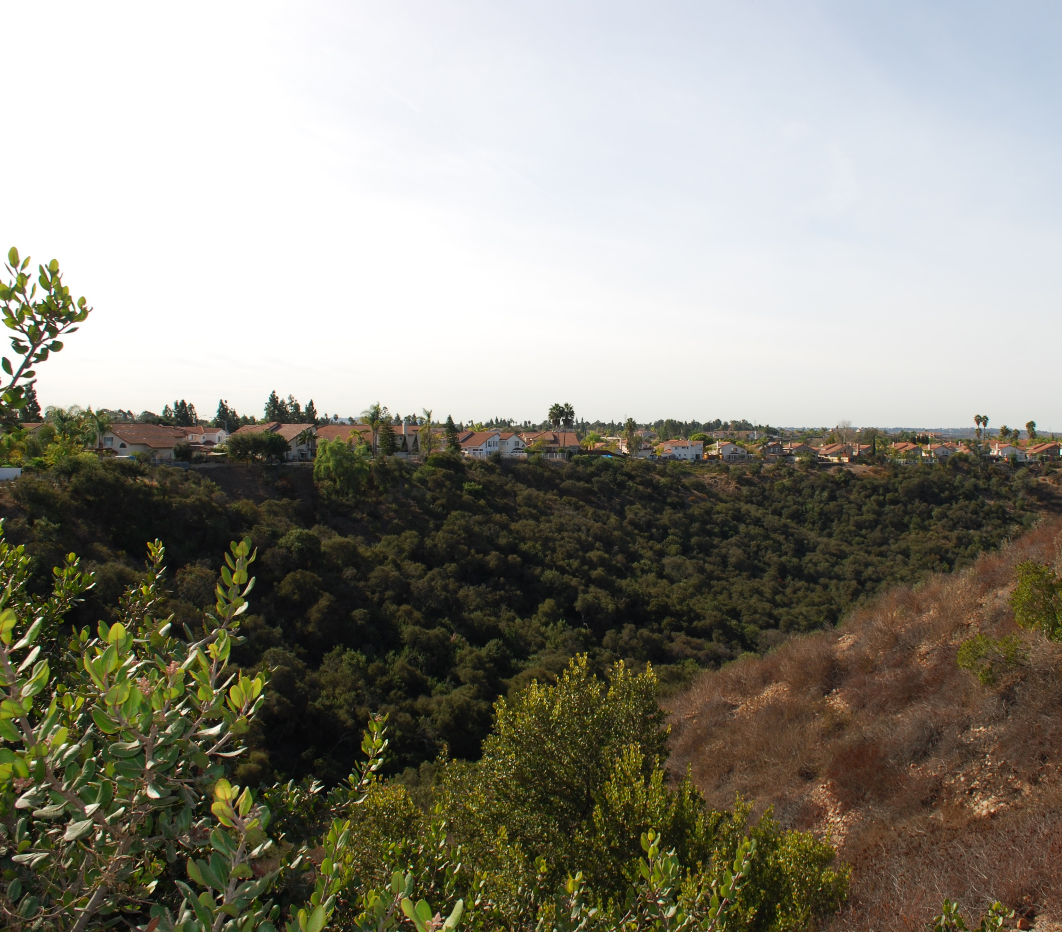
WHAT ARE POSSIBLE COMMUNITY BENEFITS?
Updated population and growth projections
Updated traffic projections and possible improvements
Identification of park and recreation improvements
A sustainable pattern of growth

Slide 6
WHAT IS THE SCHEDULE?
Plan Components and Alternatives
Plan Update Launch
Draft Community Plan
CEQA and Environmental Review
Plan Approval
2018 Jul-Dec
2019
Jan-Jun
2019
Jul-Dec
2020
Jan-Dec
2021
Jan-Jun
Opportunities to Get Involved

Slide 7
How Can I Get Involved?
Visit Us on the Web
https://www.sandiego.gov/planning/community/cpu/miramesa
Contact Us
Alex Frost, Senior Planner
Email: AFrost@sandiego.gov
Phone: 619-236-6006
Bernie Turgeon, Senior Planner
Email: BTurgeon@sandiego.gov
Phone: 619-533-6575

Slide 8
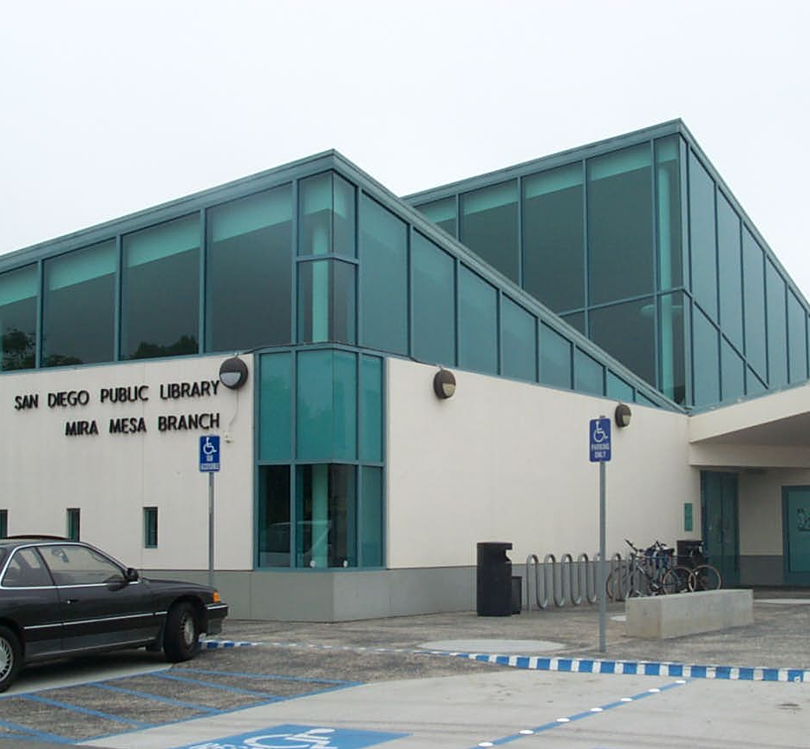
WHAT ARE THE NEXT STEPS?
Form an advisory process
(Mira Mesa Community Planning Group)
Conduct stakeholder interviews
Present draft existing conditions
report
Host community open house

