Slide 1
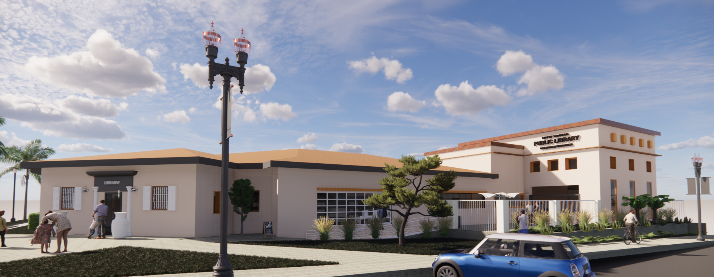
OCEAN BEACH BRANCH LIBRARY 4801 Santa Monica Ave. San Diego 92107
Public Works
Engineering & Capital Projects
sandiego.gov

Slide 2
Team Members
In House Design Team
Nikki Lewis- Senior Civil Engineer
Shannon Stoks- Project Manager/Architectural Design
Christian Ruvalcaba – Architectural Design
In Conjunction with:
sandiego.gov

Slide 3
What is Design Development???
Conceptual Plans
Design Development
This phase aims to lay out the major design elements of the project and establish cost and timeline.
3
sandiego.gov

Slide 4
Before we get started…
4
sandiego.gov

Slide 5
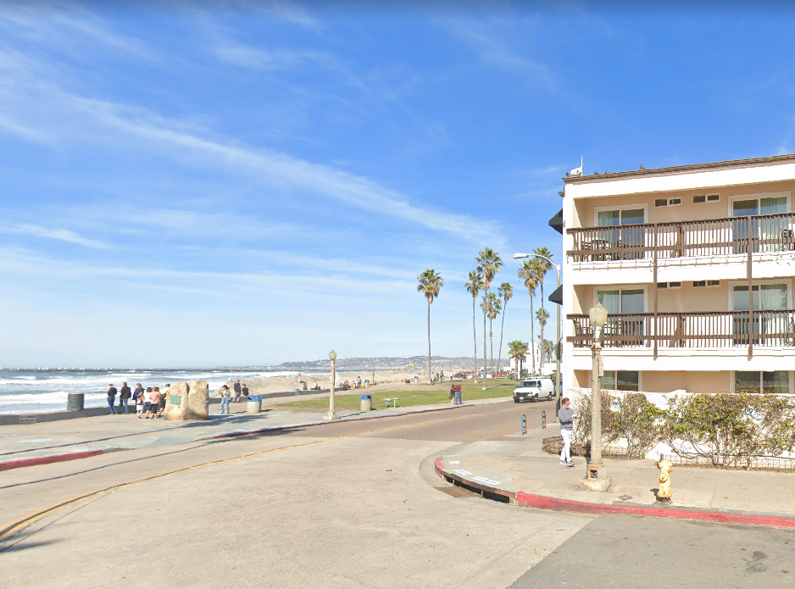
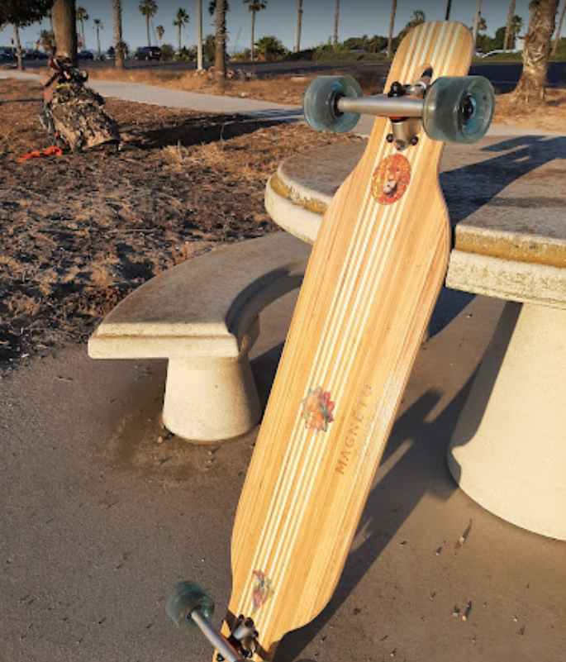
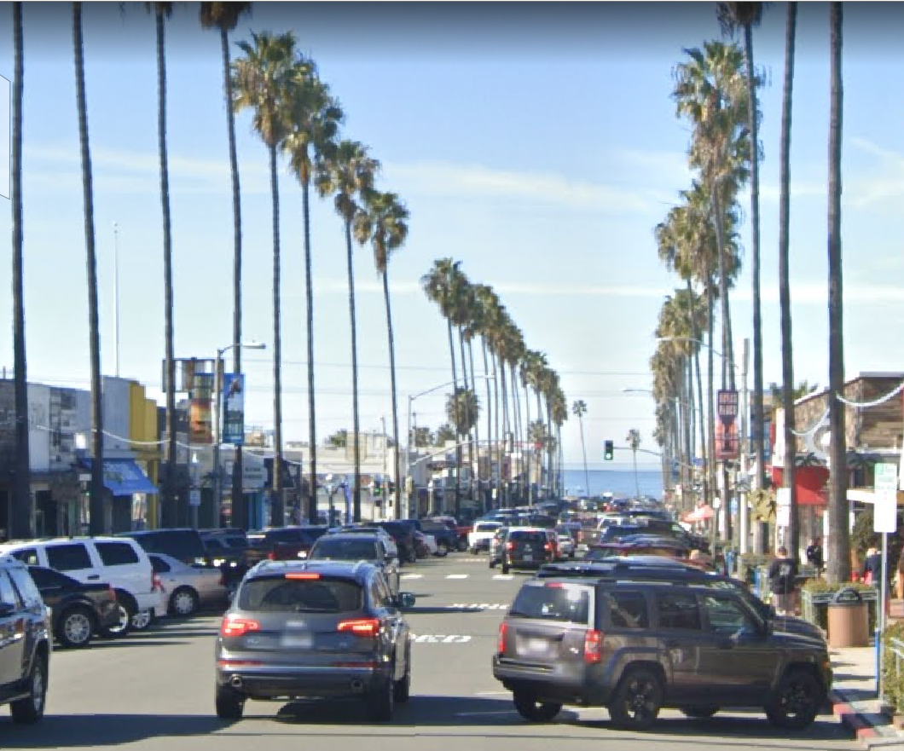
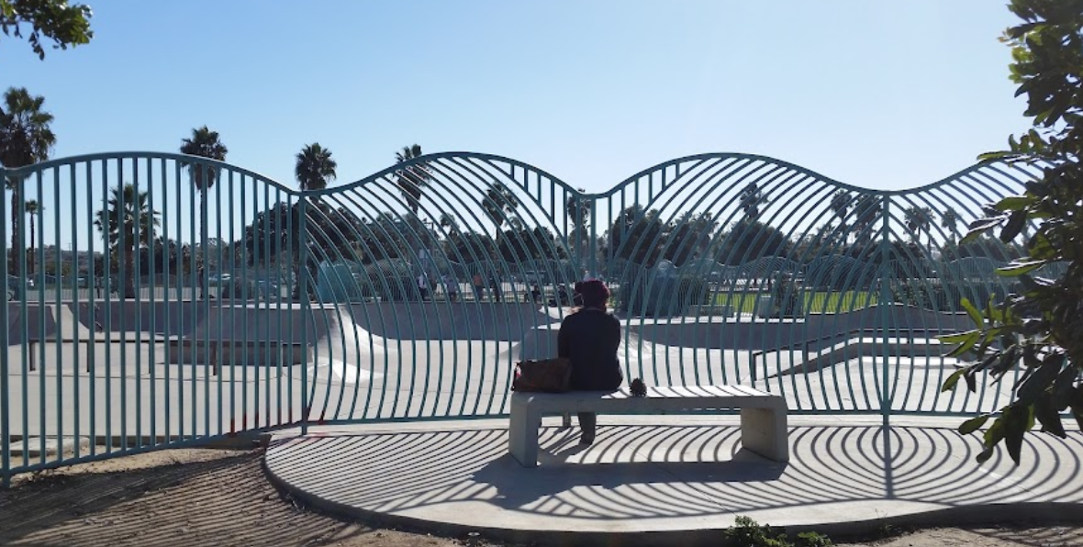
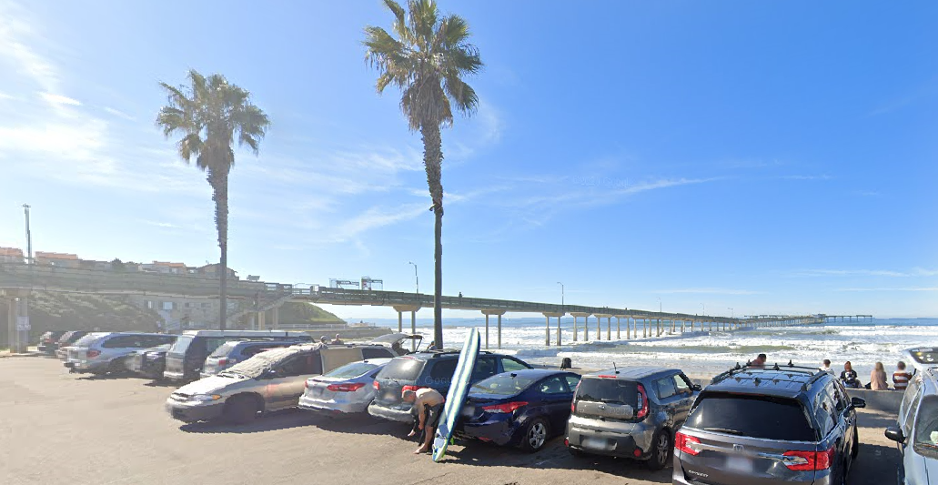
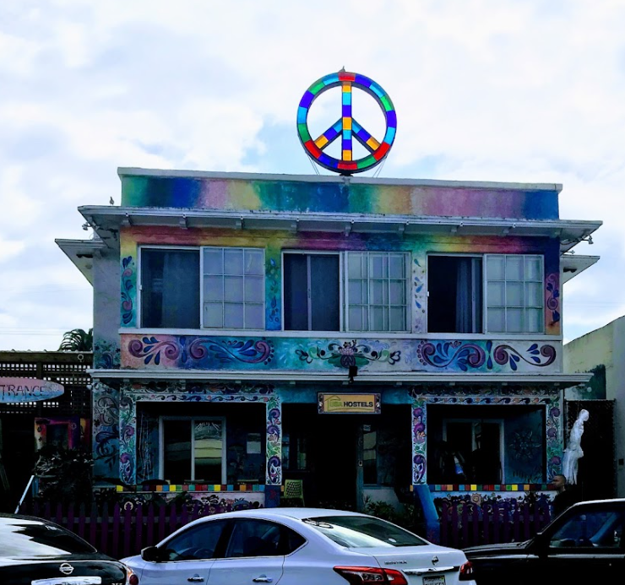
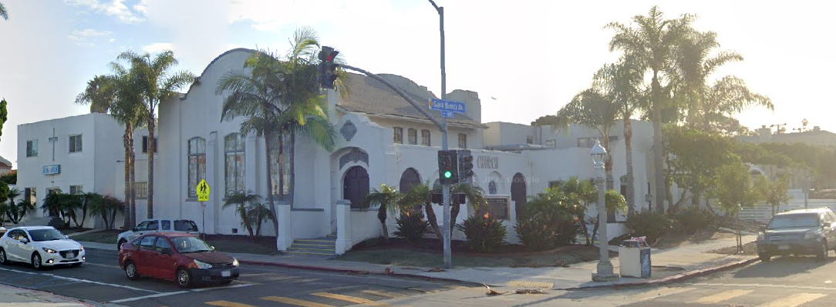
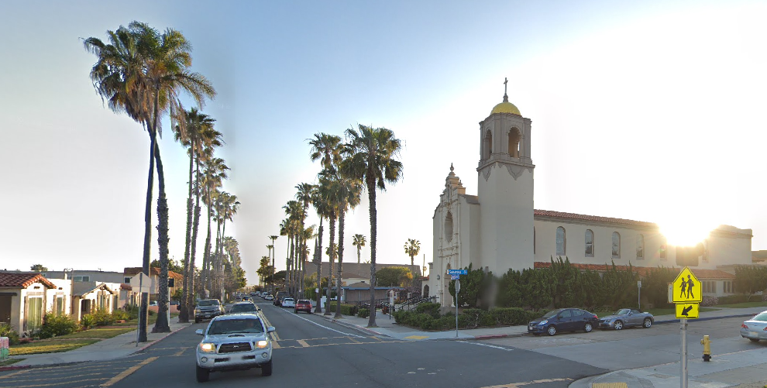
Ocean Beach is a unique and vibrant Community with a diverse population and a variety of exceptional features not found anywhere else in San Diego. We value your input and would like to hear your thoughts so that we can create a Library with a community room that can host a variety of events for all OBceans.
Community Involvement
Community Involvement
5
5
sandiego.gov

Slide 6
Project Information
Ocean Beach Library Expansion
Location: Sunset Cliffs Blvd and Santa Monica Ave
Estimated Cost:
Area: 5,095 existing sf -> 9,300 sf with addition
Current Phase: Design Development- 30% Design
Estimated Cost: $8.5 Million (initial cost estimate)
SCOPE:
Demolition of the 2-story adjacent building
Remodel library and construct a new extension to include:
Community meeting room with kitchenette
Study Rooms
Expanded Office Space
Teen Area
Storage
Courtyard/Outdoor gathering area
New Restrooms, both Multi-user as well as a Family Restroom
6
sandiego.gov

Slide 7
Zoning Info
Zone: CC-4-2
Max. Height: 30’ per Coastal Zone
Original Library 3,670 sf
1962 addition : 1,425 sf
2021 addition: 4,205 sf
New Library : 9,300 sf
Setbacks
Front: 0’
Side: 0-10’ per optional setback 131.0543(b)
Street setback: 0’
Rear: 10’
7
7
sandiego.gov

Slide 8
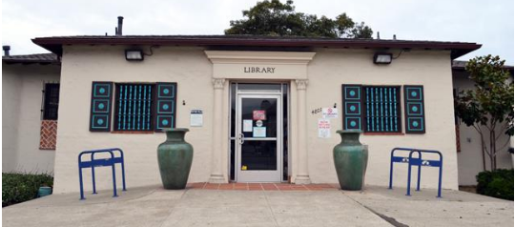
Historic Resource
The Historically Designated Building (HRB #565) Ocean Beach Branch Library
Located within the Ocean Beach Cottage Emerging District, which is a designated historical district.
The Ocean Beach branch of the San Diego Library was originally located on Abbott Street in 1916. It was later moved to this current location when this building was constructed on October 25, 1928. In 1962 the branch expanded to its current size and currently boasts a circulation of about 136,000 books a year.
The Ocean Beach Library was designated “Historic” in 2002 by the San Diego City Council for its architecture and contribution to the Ocean Beach cultural landscape.
The two large urns, installed in 1993, replaced earlier urns that were damaged. These contain time capsules with assorted local items and are schedule to be opened in 2043.
8
sandiego.gov

Slide 9
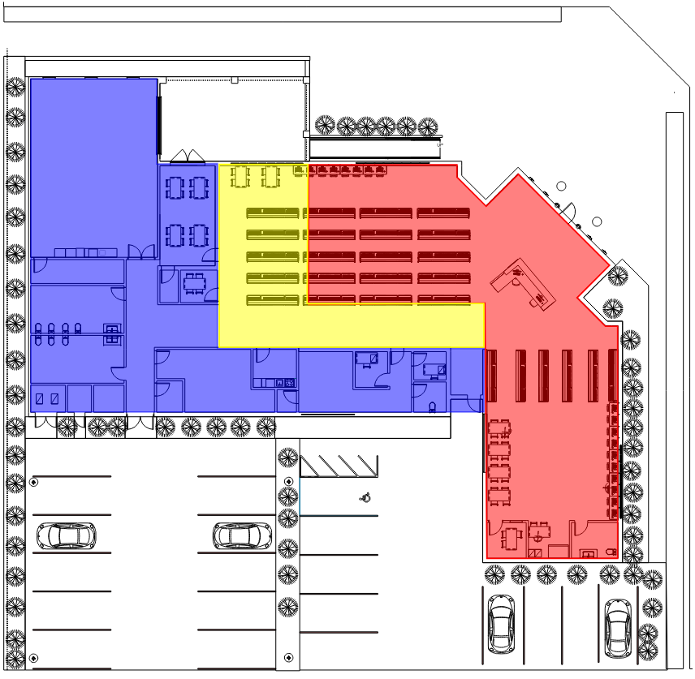
Building Phases
Historic Library
1962 Addition
Proposed Addition
9
9
9
9
9
sandiego.gov

Slide 10
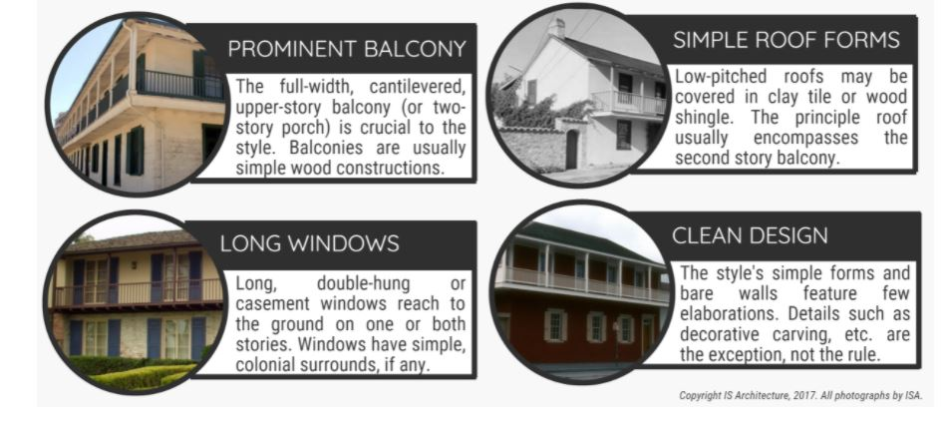
Project Constraints
As an Historical Resource…
We needed to maintain the original Style : Spanish-Monterey (BUT the addition must be distinct)
The Monterey Revival style named for Monterey California. In the early 18th century, Californians blended Spanish colonial and New England colonial styles into something new.
This style is Characterized by :
10
10
sandiego.gov

Slide 11
Project Constraints
Costal Development Permit
CEQA Compliance-
Mitigated Negative Declaration
Archaeological sensitive area = Native American Monitoring
Summer Moratorium
Entry not ADA Compliant
Site Slope
Limited Parking
Adjacent to Post Office (Federal Regs)
Security Concerns
Asbestos on Exterior Stucco
Bring existing Library up to current Energy Codes
11
11
11
sandiego.gov

Slide 12
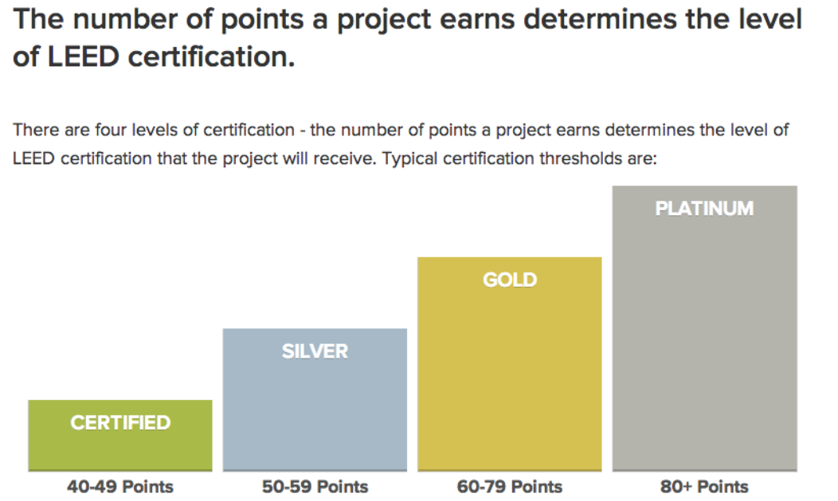
LEED - Leadership in Energy & Environmental Design
Council Policy 900-14 May 20, 2003
On April 16, 2002, the Mayor and City Council adopted CMR 02-060
Which requires City projects to achieve the U.S. Green Building Council’s LEED Silver standard
for all new buildings and major renovations over 5,000 sf.
What is LEED Certification?
LEED certification is available at several levels, each indicating a different amount of energy efficiency or renewable product usage. The certification is designated by the US Green Building Council and is the most commonly used green building grating system in the world. Certification is available for any building project type, including brand new construction, interior updates or outfits, and maintenance or operations. The certification is universally recognized as a high standard of achievement as it relates to sustainability.
12
12
sandiego.gov

Slide 13
Annex Building to be Demolished
Current Site Conditions
13
13
13
13
sandiego.gov

Slide 14
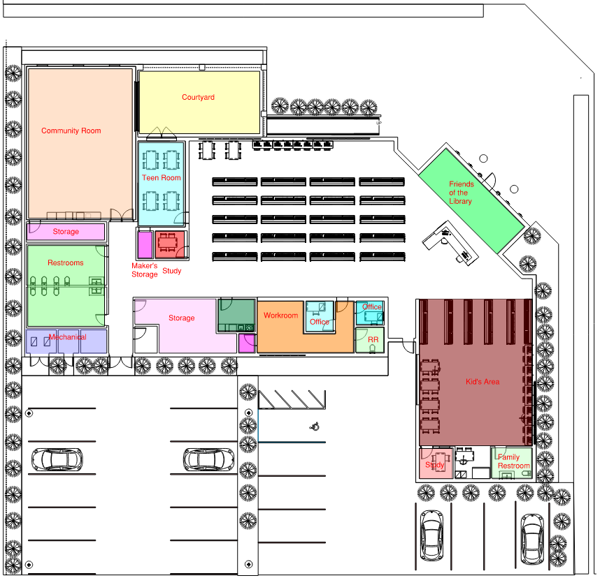
Proposed Floor Plan
14
14
14
14
14
sandiego.gov

Slide 15
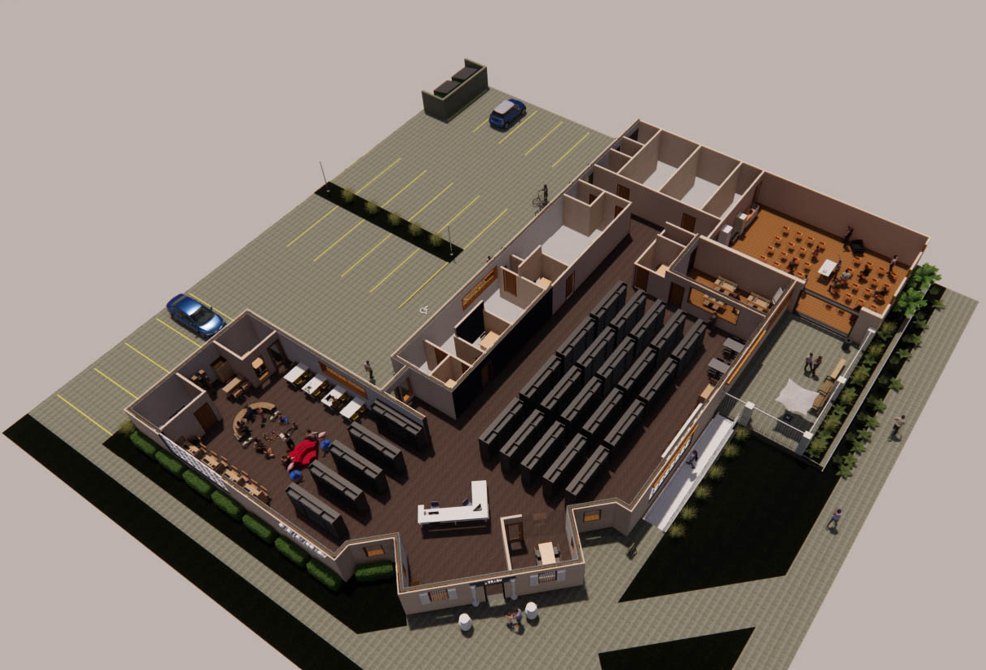
3-D Floor Plan
15
15
15
15
15
sandiego.gov

Slide 16
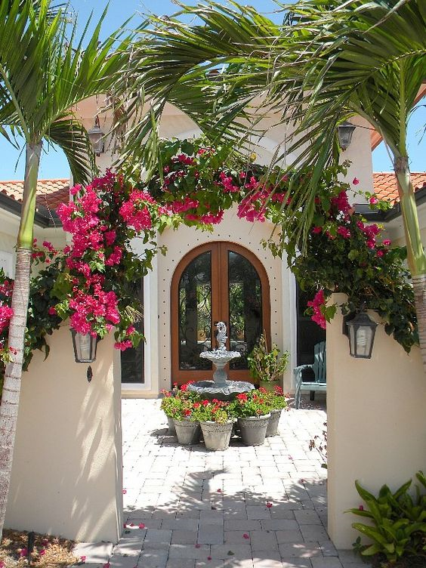
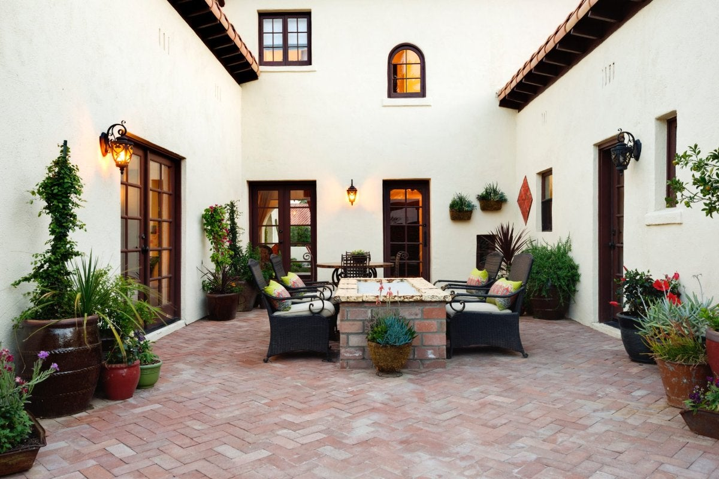
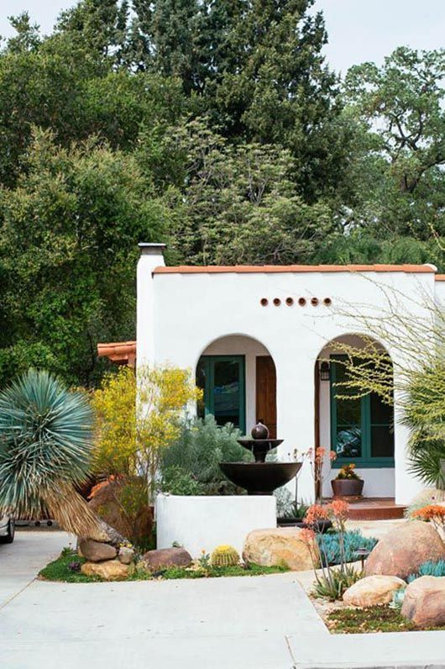
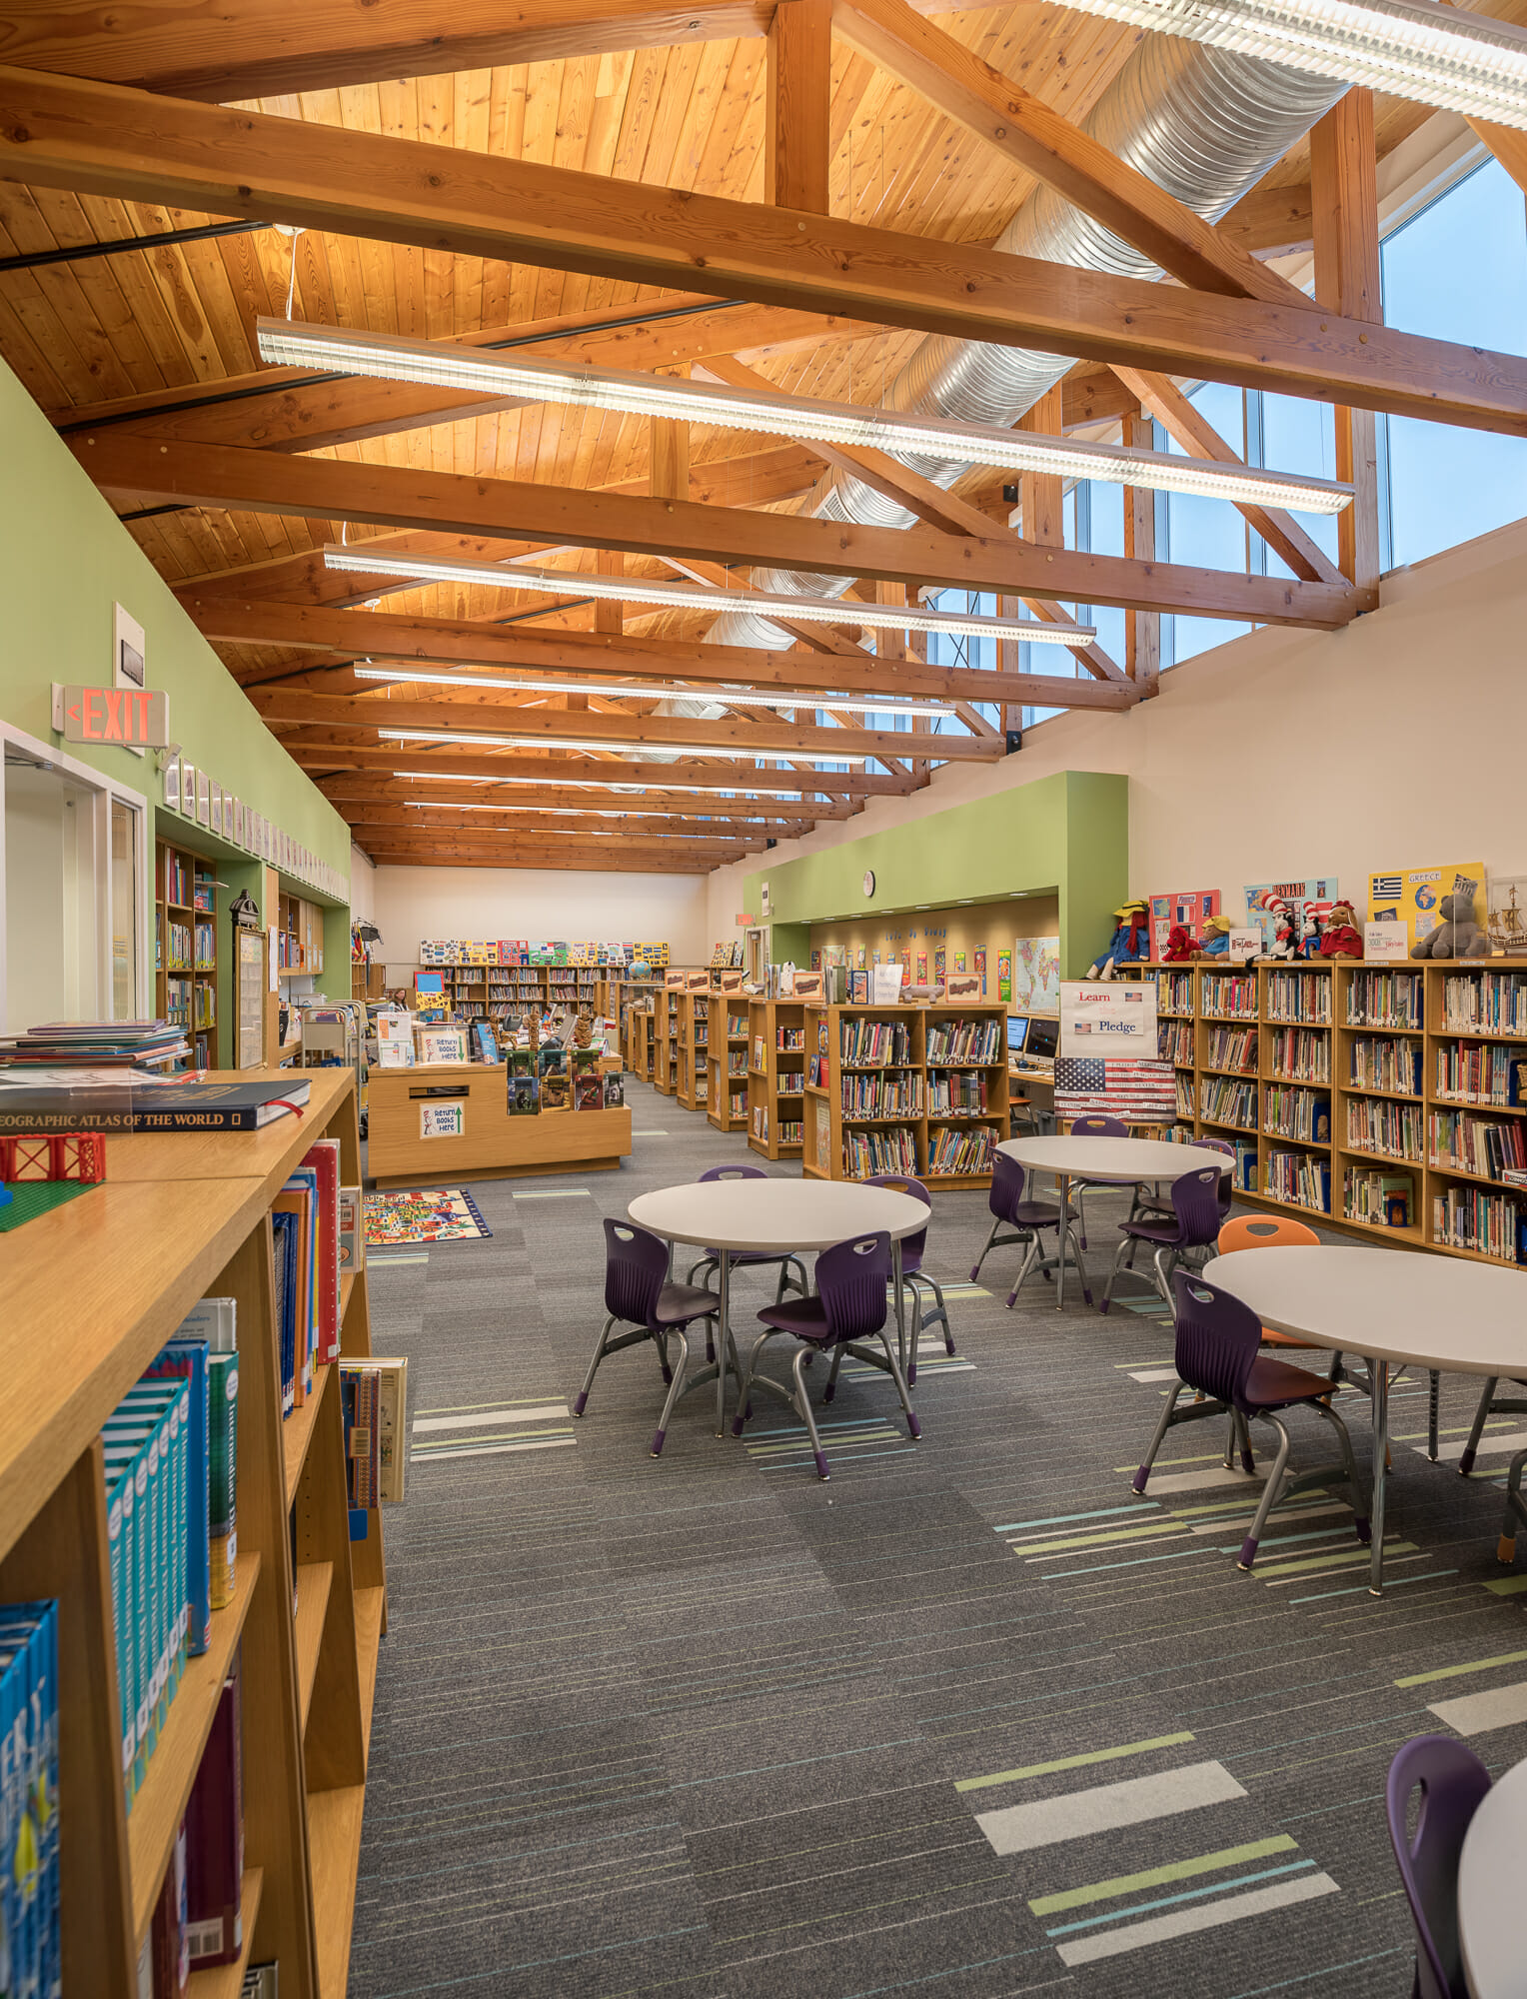
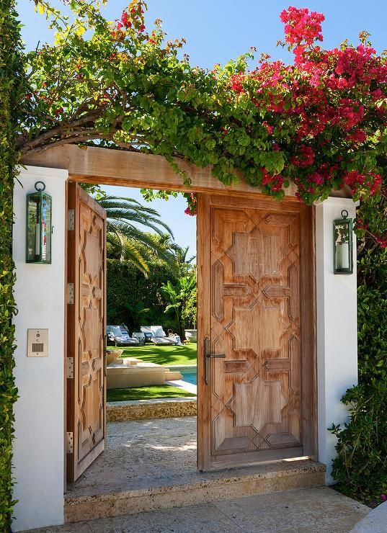
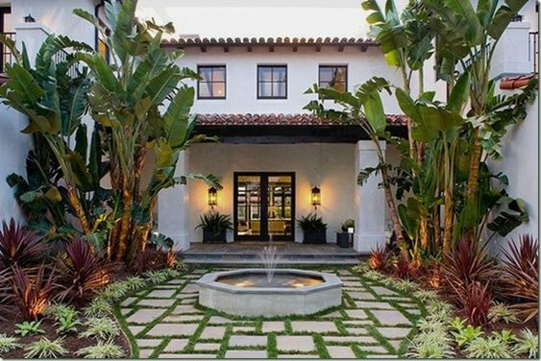
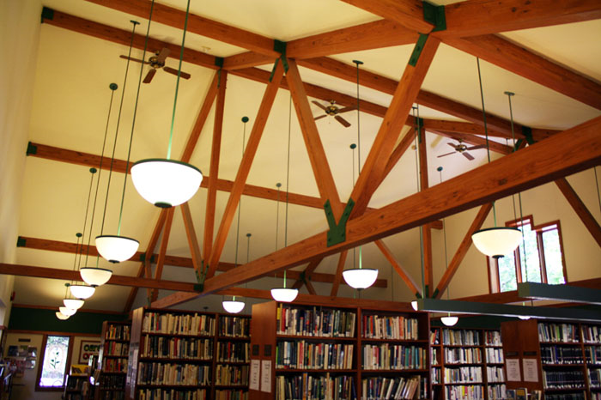
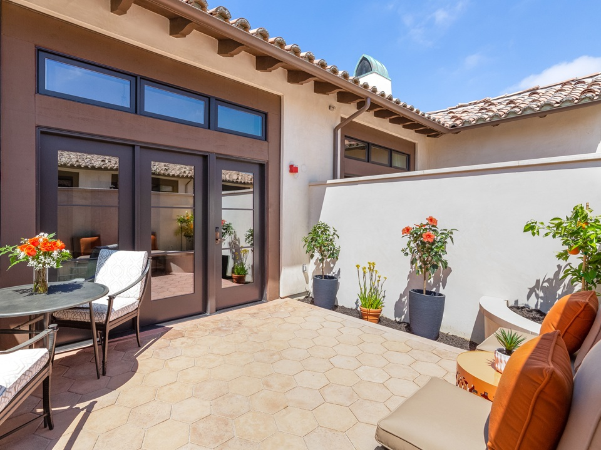
Concept Elements- Spanish Monterrey Style
16
16
16
sandiego.gov

Slide 17
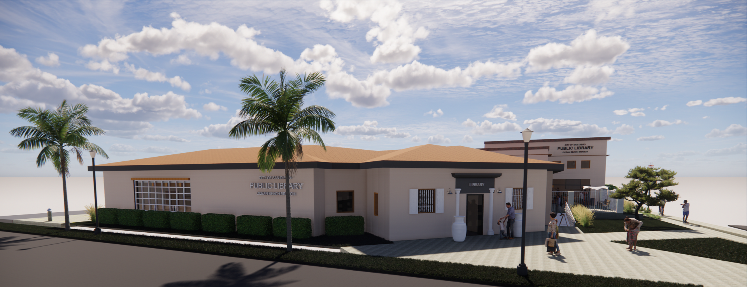
Sunset Cliffs Blvd View
Sunset Cliffs Blvd View
17
17
17
17
17
17
sandiego.gov

Slide 18
View from Sunset Cliffs Blvd and Santa Monica Ave
18
18
18
18
18
sandiego.gov

Slide 19
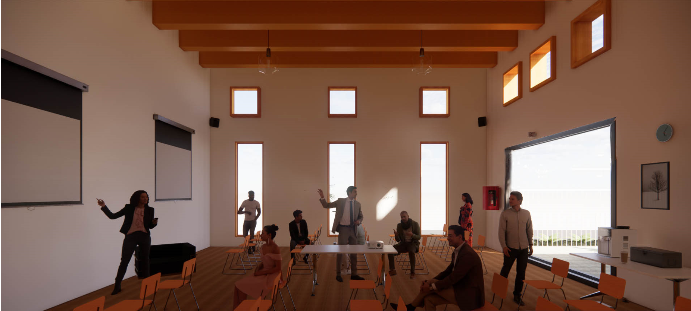
Community Room
19
19
19
19
19
sandiego.gov

Slide 20
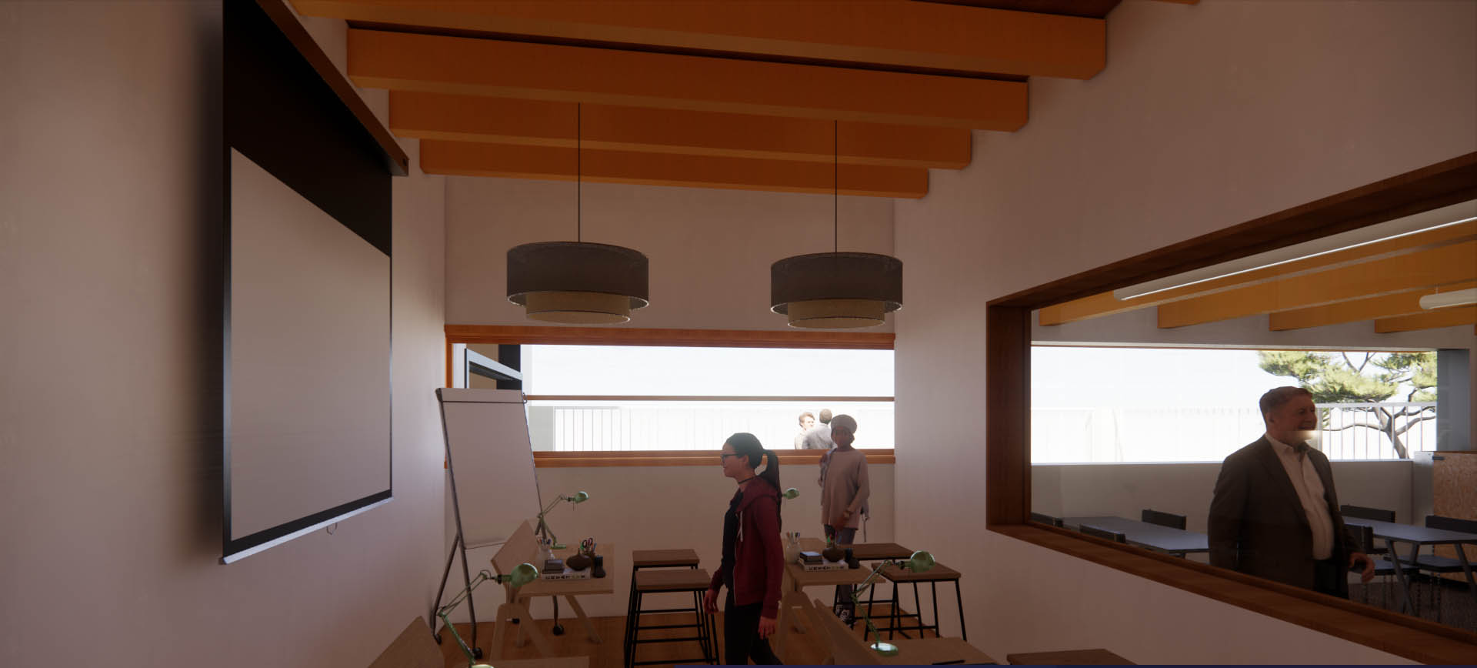
Teen Room
20
20
20
20
20
sandiego.gov

Slide 21
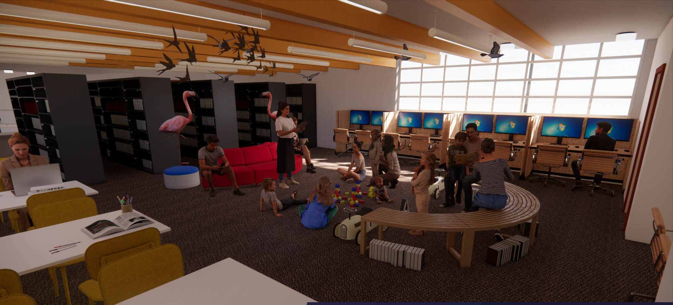
Children’s Area
21
21
21
21
21
sandiego.gov

Slide 22
Alley Elevation
22
22
22
22
22
22
sandiego.gov

Slide 23
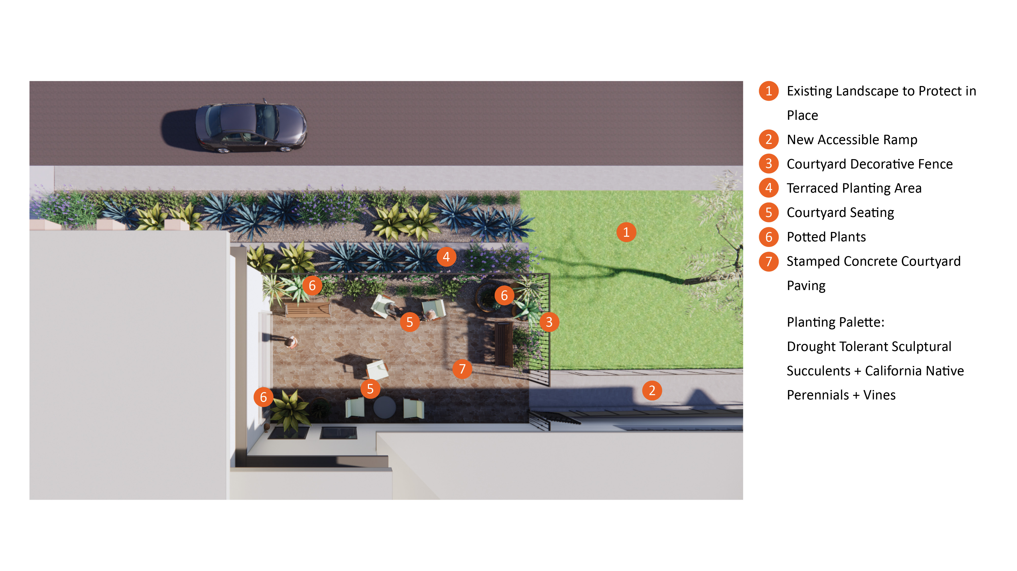
Landscape Design – Option A
23
sandiego.gov

Slide 24
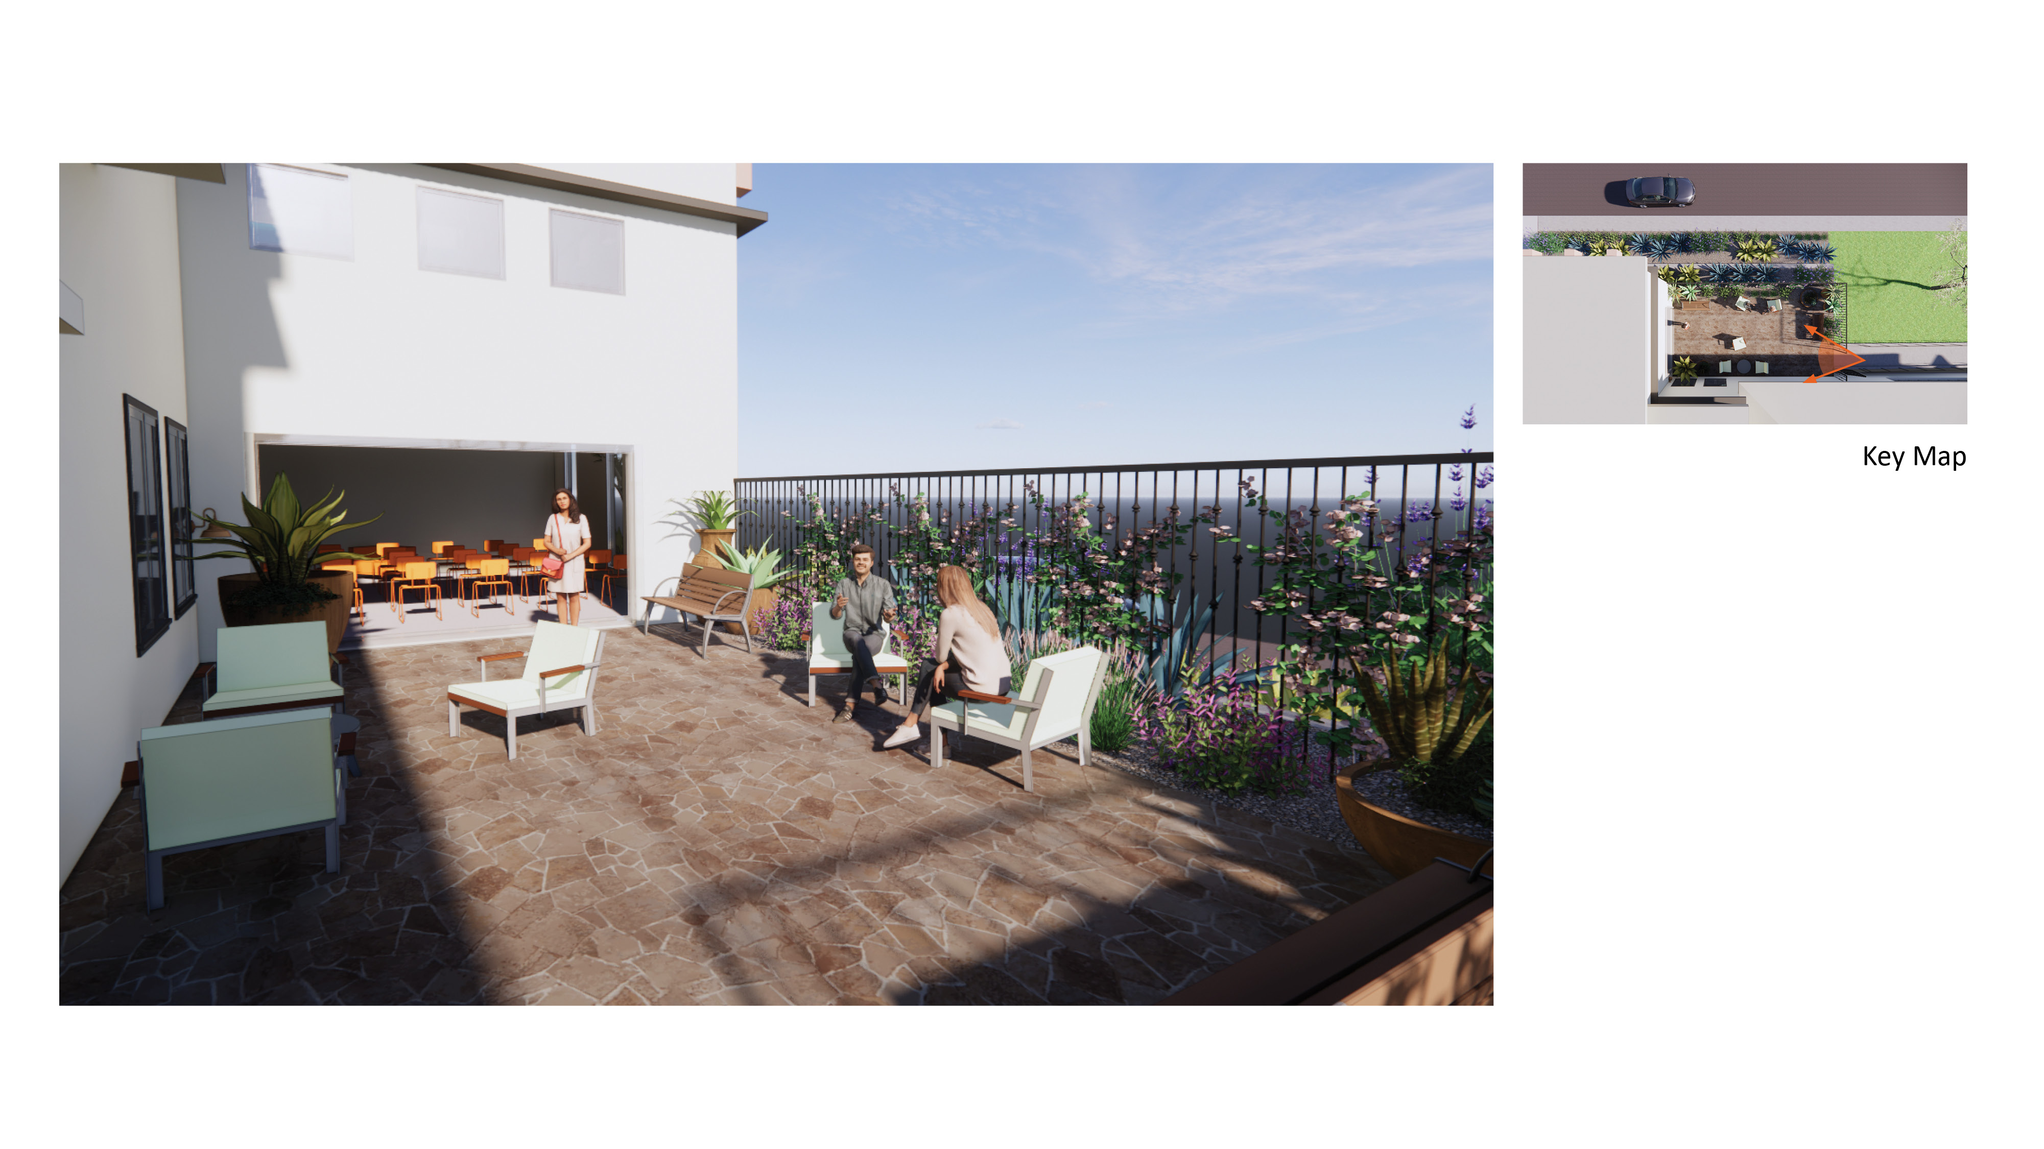
Landscape Design – Option A
24
sandiego.gov

Slide 25
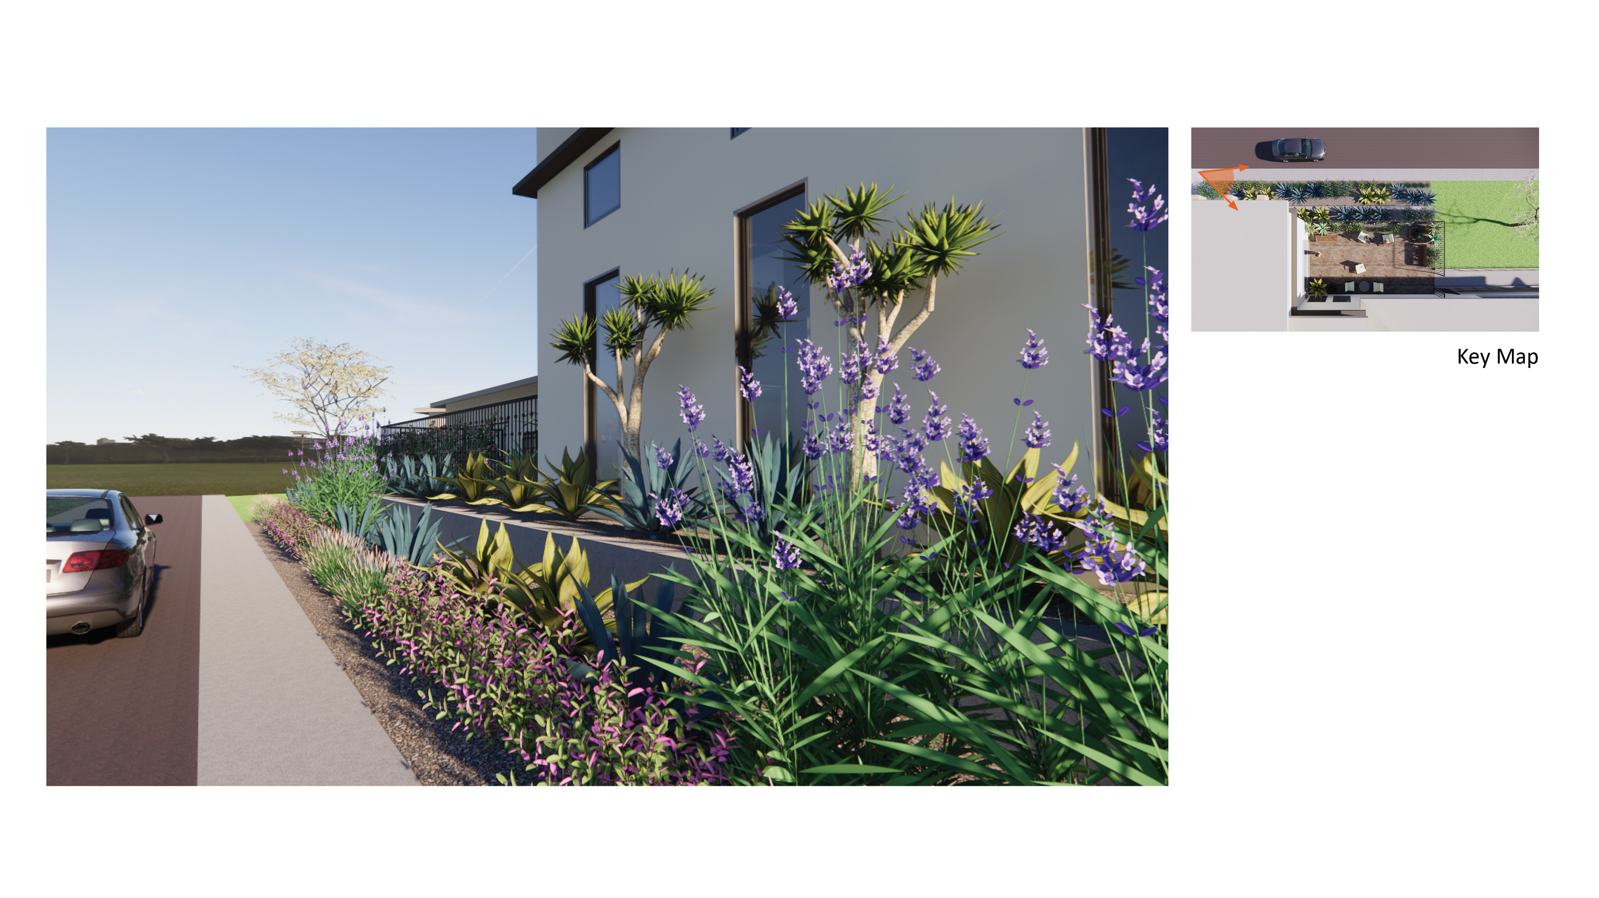
Landscape Design – Option A
Landscape Design – Option A
25
sandiego.gov

Slide 26
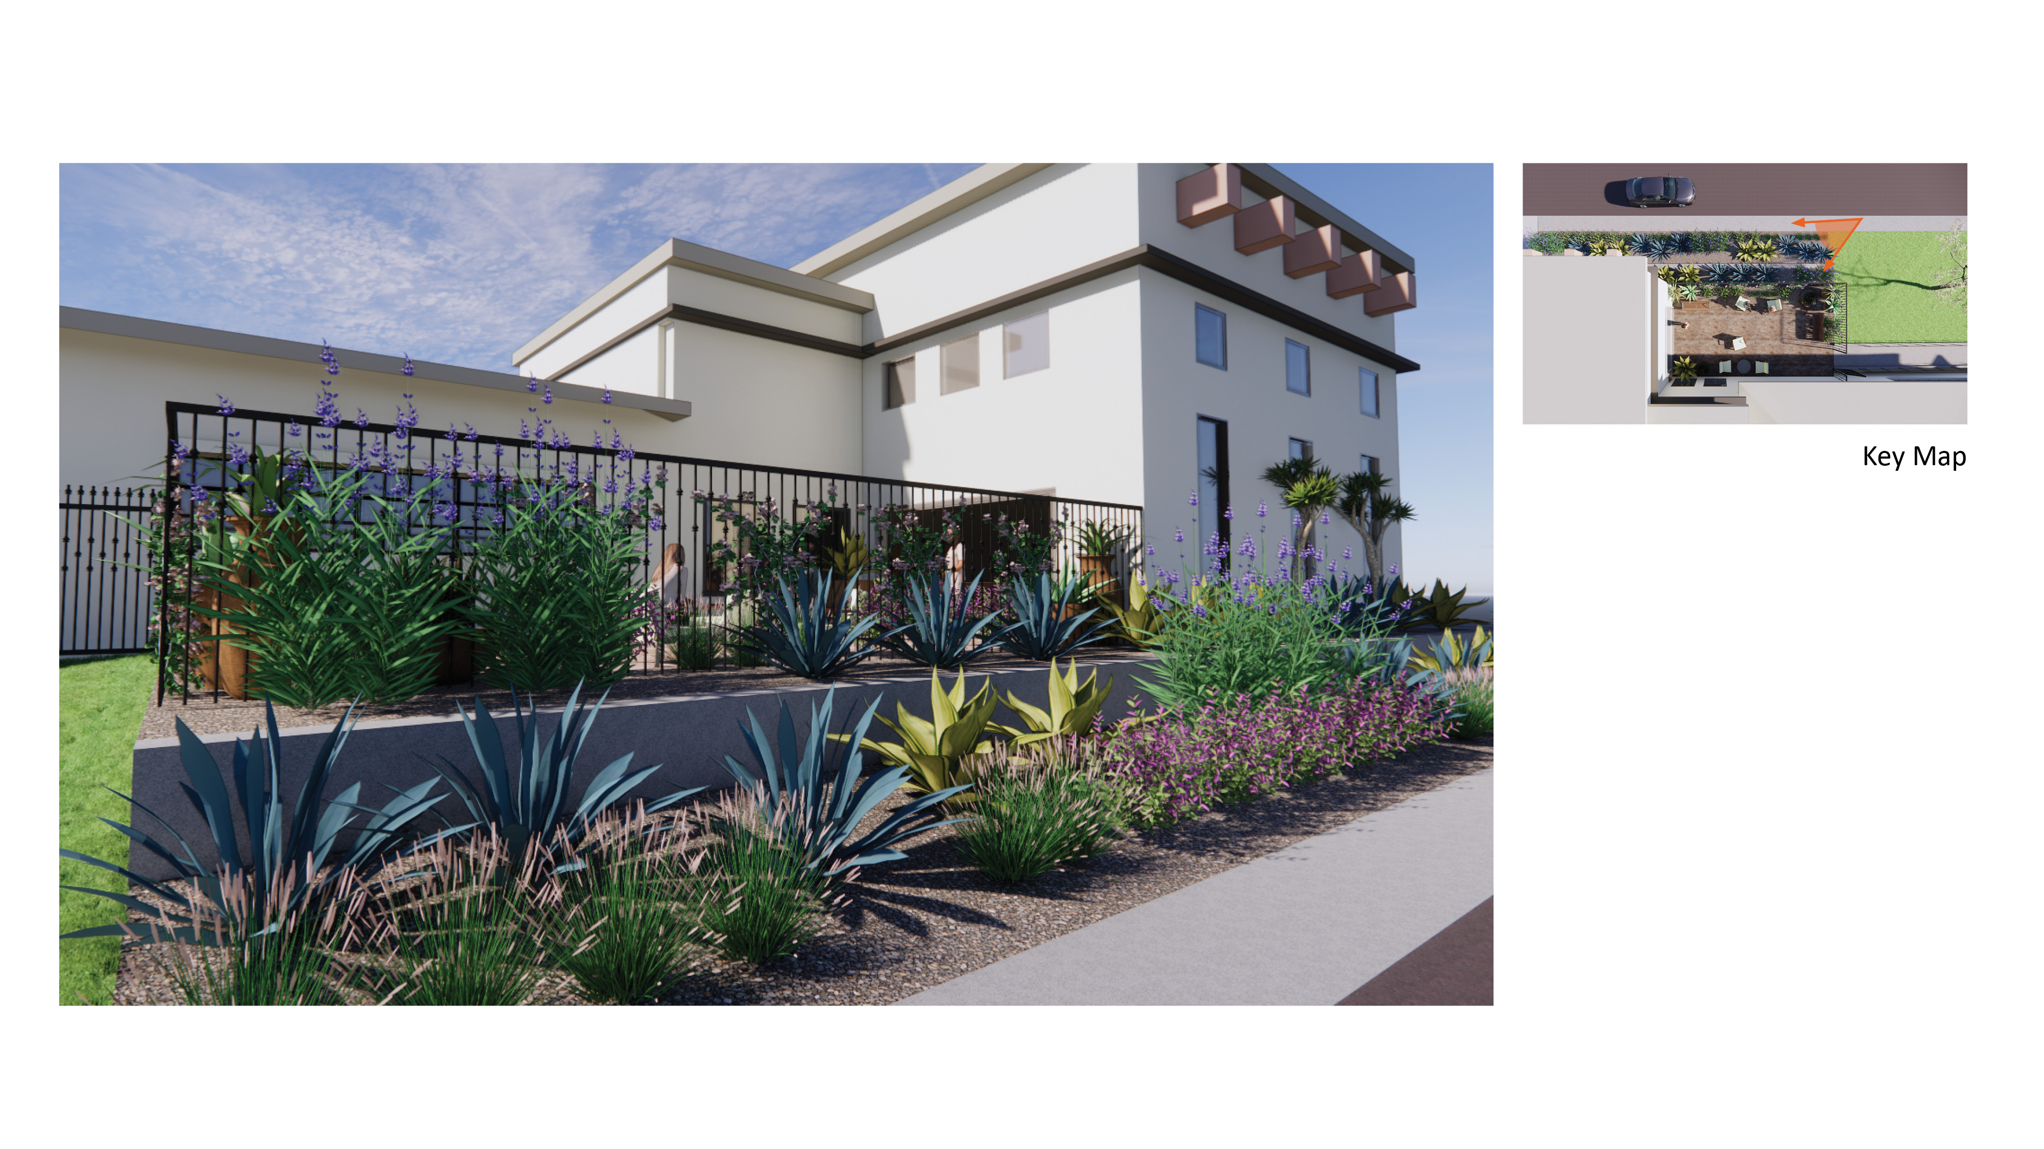
Landscape Design – Option A
26
sandiego.gov

Slide 27
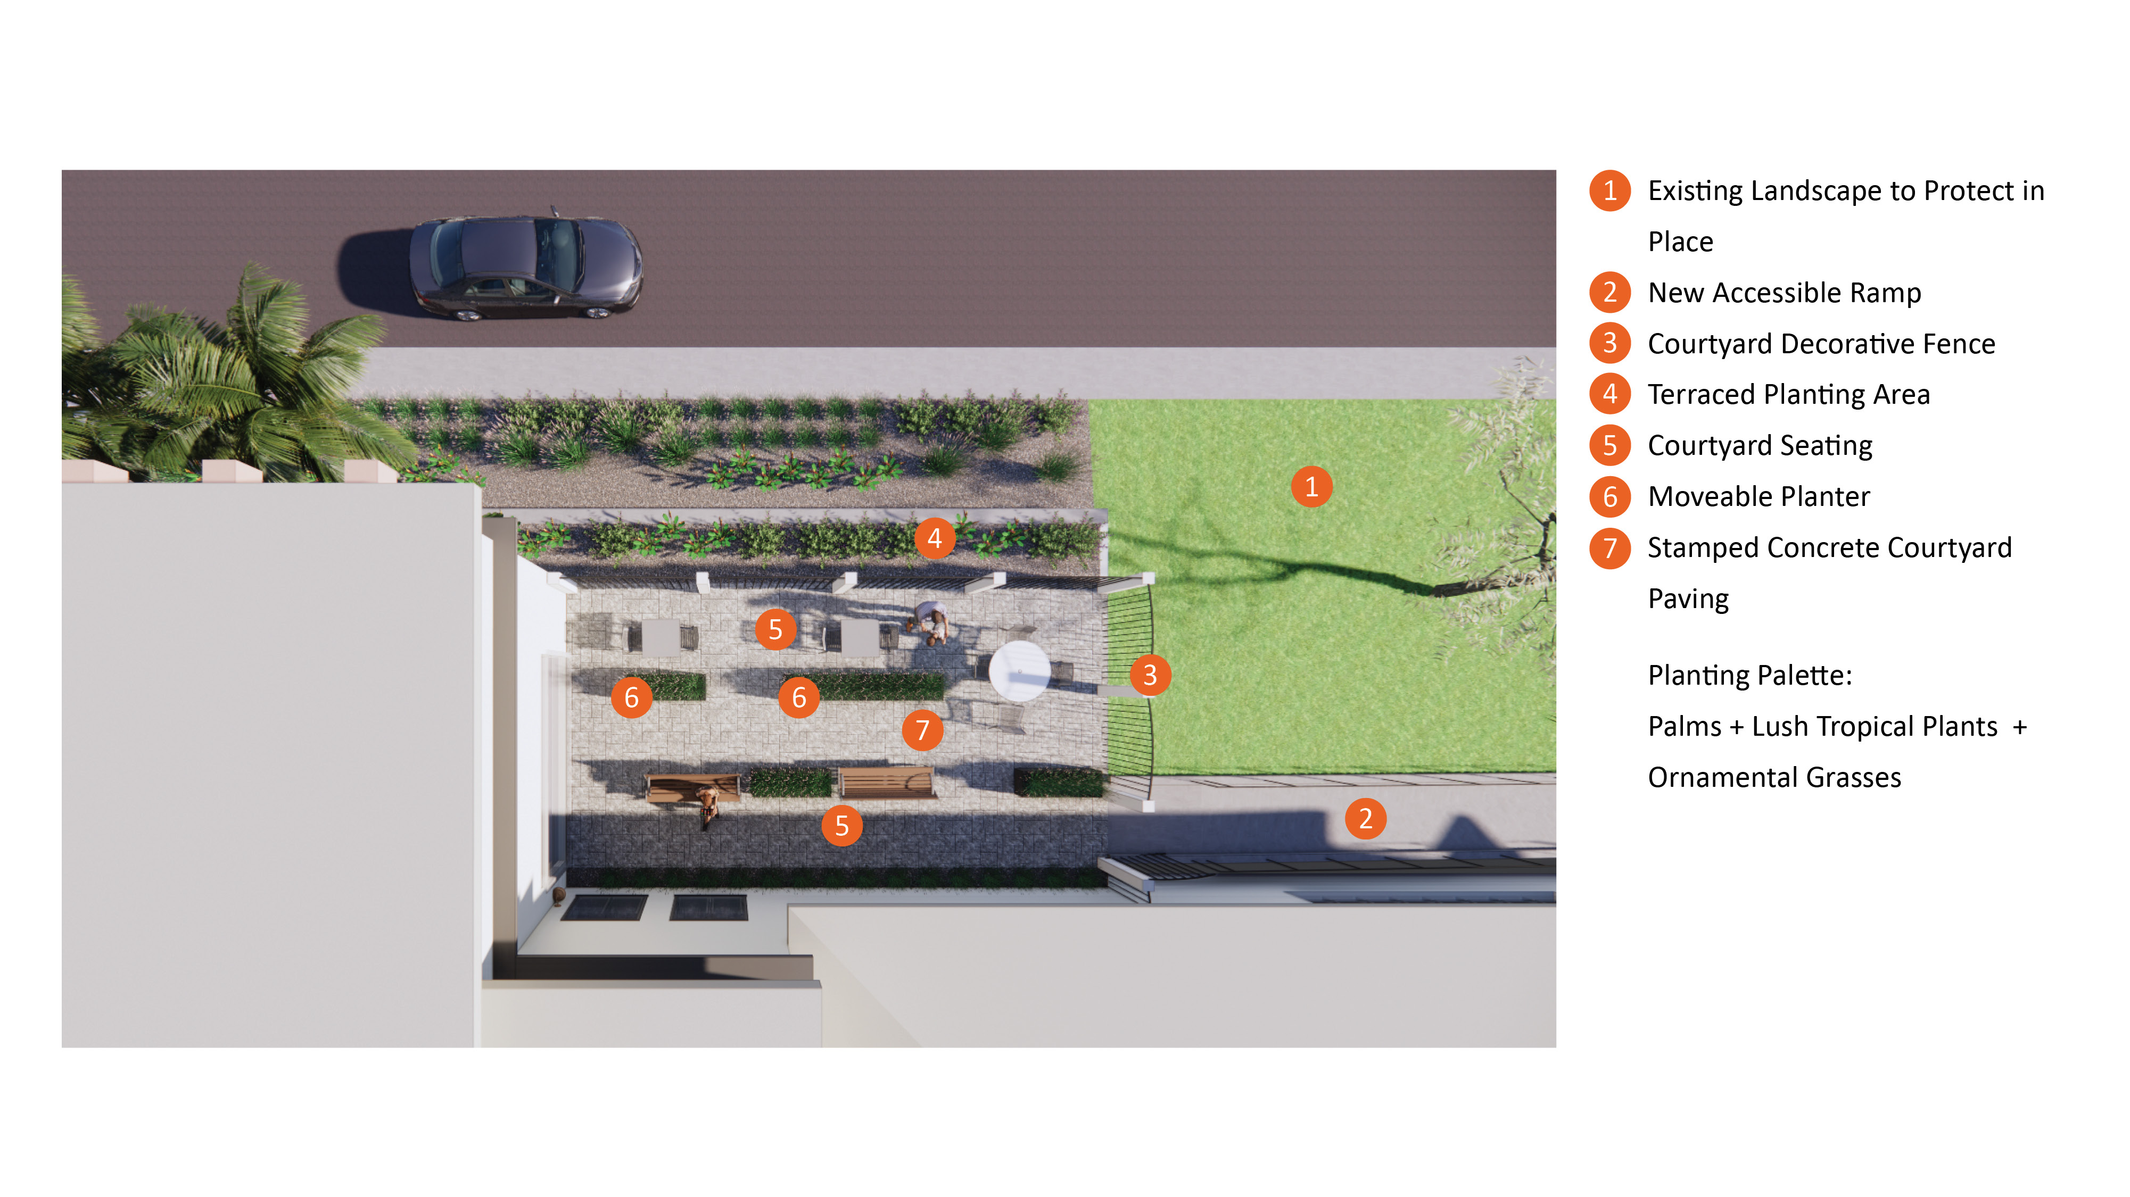
Landscape Design – Option B
27
sandiego.gov

Slide 28
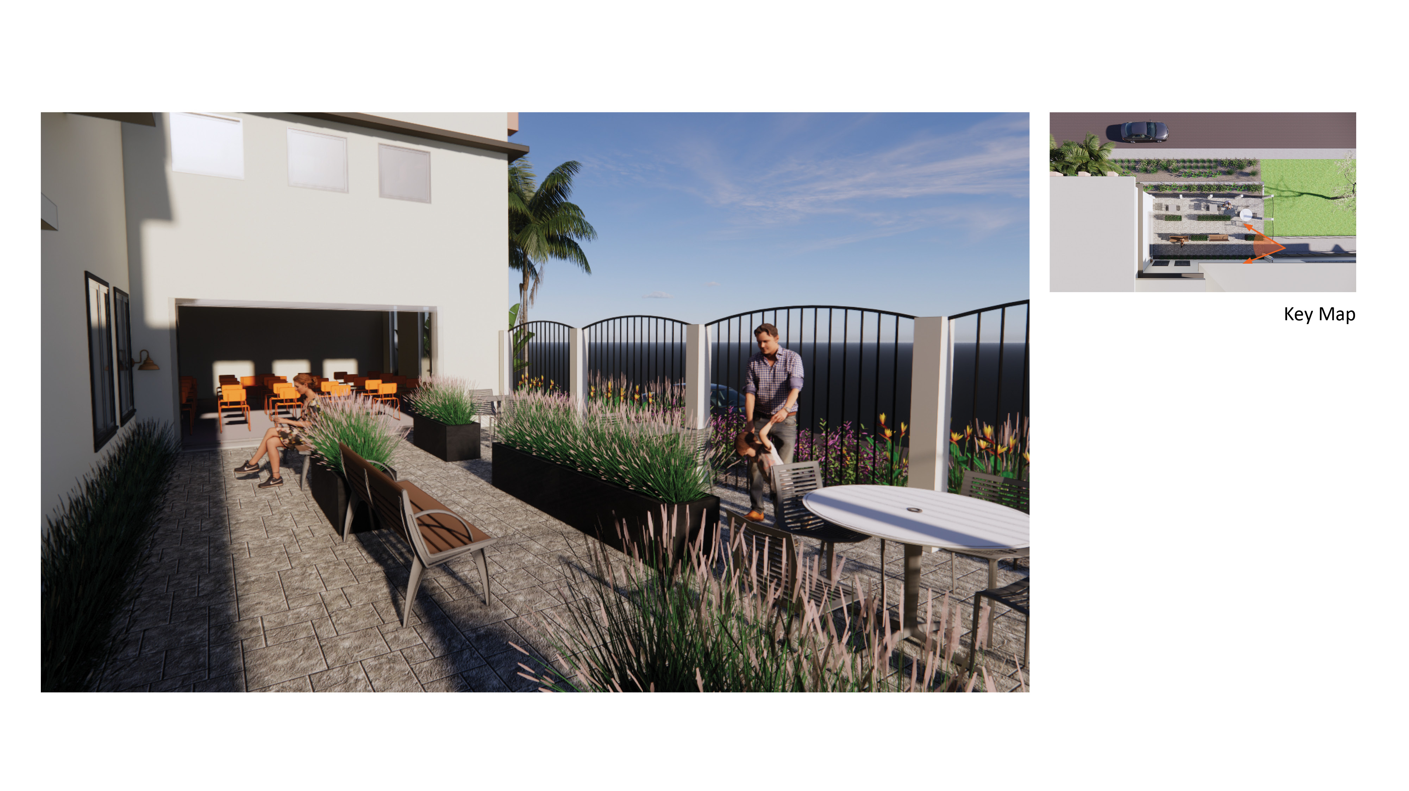
Landscape Design – Option B
28
sandiego.gov

Slide 29
Landscape Design – Option B
29
sandiego.gov

Slide 30
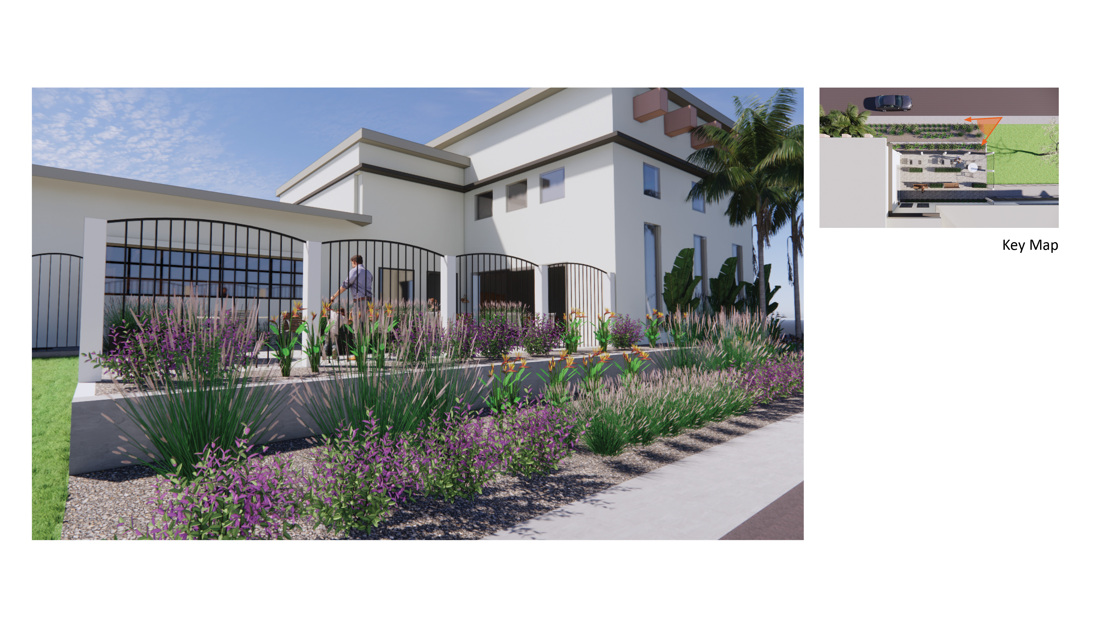
Landscape Design – Option B
30
sandiego.gov

Slide 31
Questions? Comments? THANK YOU!
Community Feedback
31
sandiego.gov

