Slide 1


Ocean Beach Library Expansion
Survey Results
September 7, 2022

Slide 2

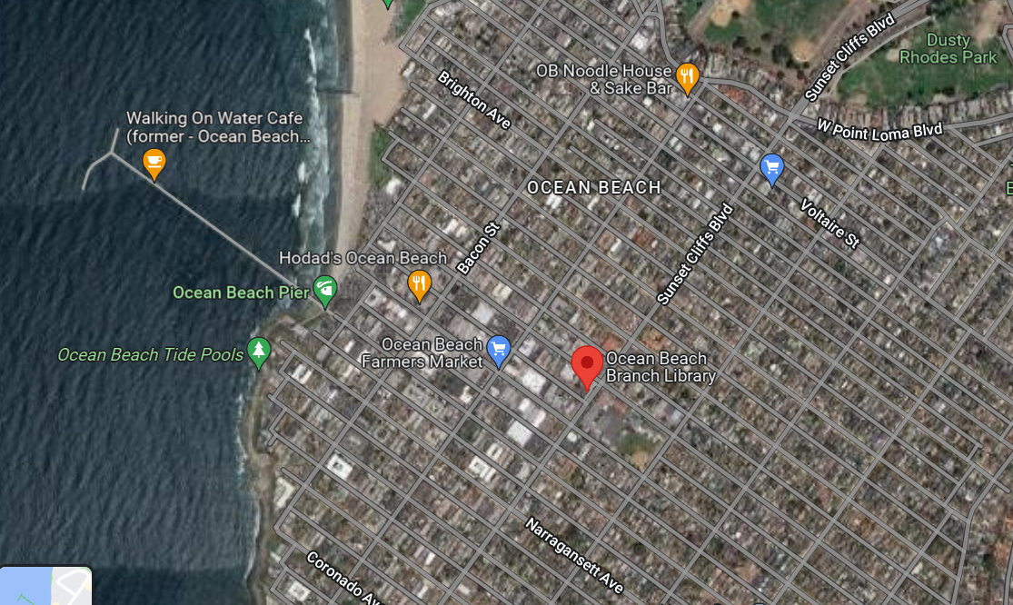
Project Location
4801 Santa Monica Ave
San Diego, CA 92107

Slide 3
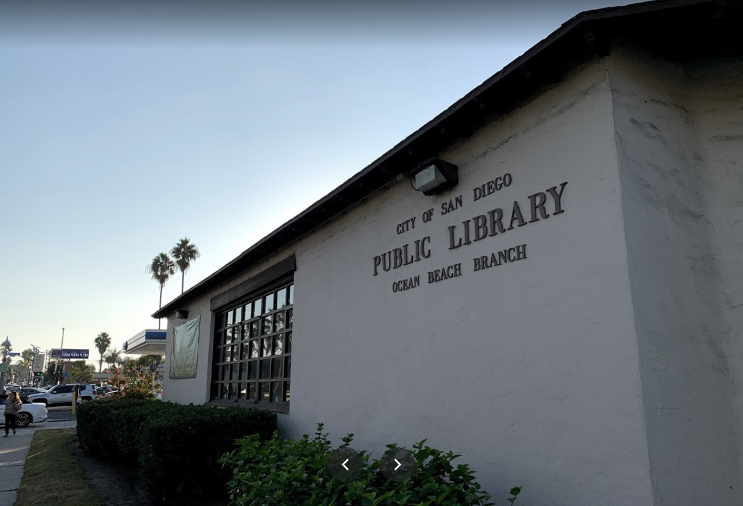

Project History and Status
Nov 2021 OB Planning Board initial concept proposed
  Upon requests from the Community, 3 Architectural styling Concepts were developed to
May 2022 Presented concepts to the Community at the OB Town Council Meeting.
  Surveys collected May 31-July 8
  Friends of the Library and local volunteers participated in community engagement activities (OB Farmer's Market, Chili Cook-off) to get feedback from interested parties.
Sept 2022 Present the findings from the Surveys at the OB Planning Board
  seek approval from the OB Planning Board to move forward with Community's preferred concept

Slide 4

Tonight’s Objective and Next Steps
Seek approval from the OB Planning Board to move forward with Community's preferred concept
Develop package for Coastal Development Submittal
After Coastal Development Permit is obtained begin process to hire Design/Build team

Slide 5
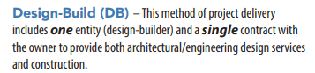

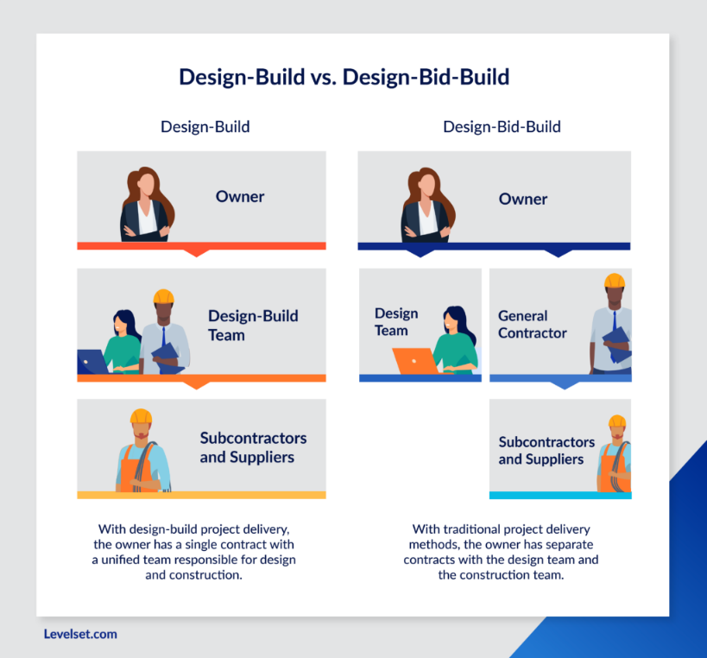
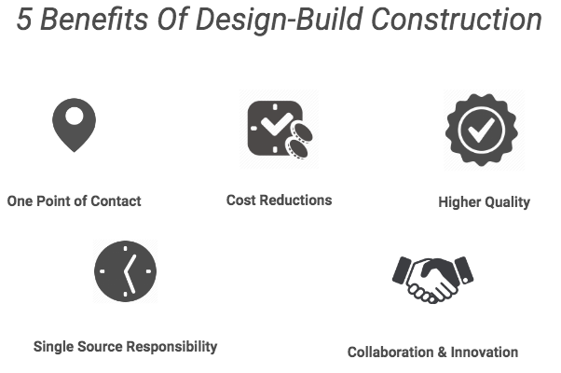
What is Design Build?
Design-Build v Design-Bid-Build Benefits of DB
*Design Build Graphics from Raywest DesignBuild

Slide 6




Surveys Received
Total of 164 surveys received
  44 online surveys- administered by OB Town Council
  120 handheld Surveys- Friends of the Library
Special Thanks to:

Slide 7
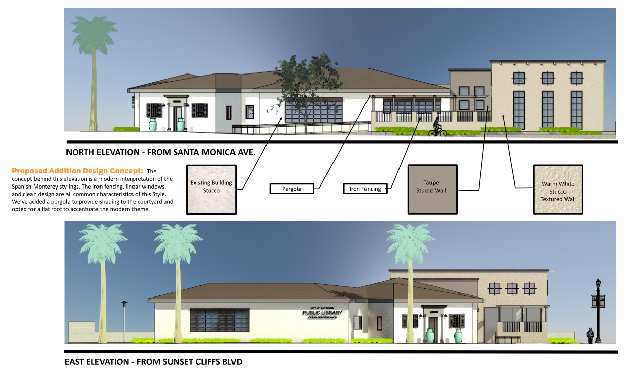
Concept 1

Slide 8
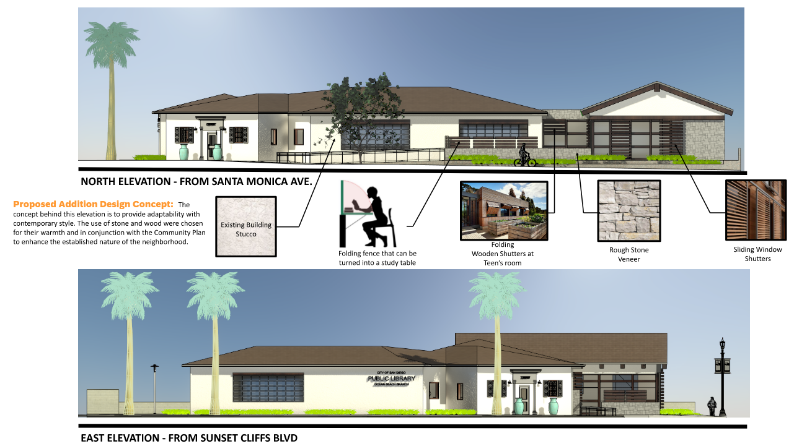
Concept 2

Slide 9
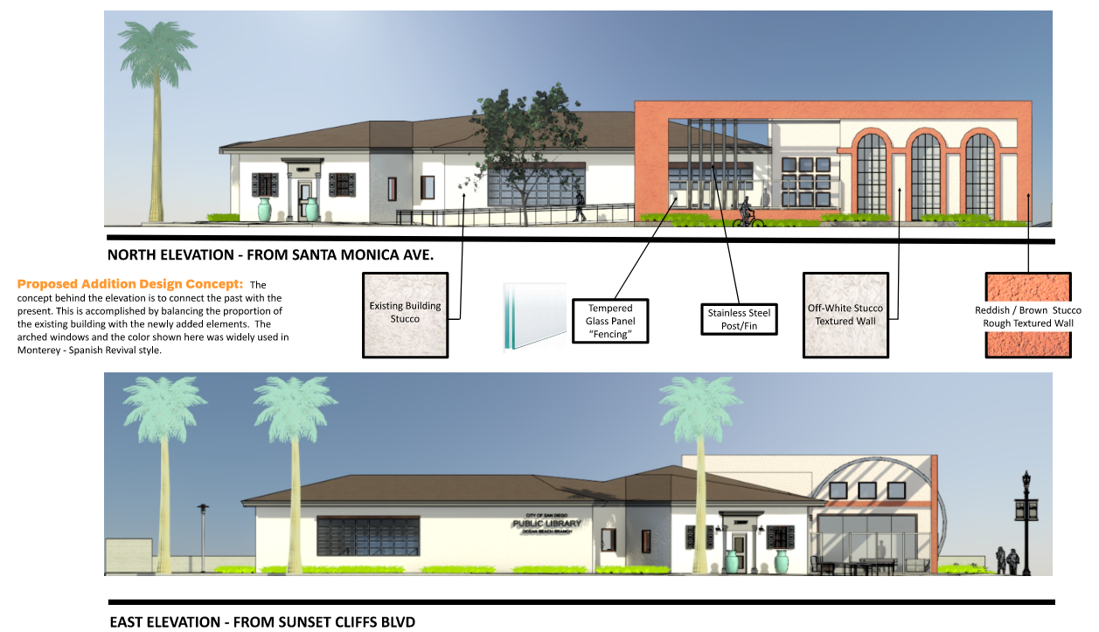
Concept 3

Slide 10
Survey Results
  Please share with us your overall preference from the 3 elevations
Concept 1- 54 votes
Concept 2- 84 votes
Concept 3- 26 votes
“Concept 2 is classy and modern.
There’s just enough features to stand out yet subtle enough to look natural”
“Option 2 complements the OB Community plan vision and the OB Craft and Materials”
“I like the roof in this version (Concept 2)”
“Like Concept 2 but the stone looks to dark/grey…
Possibly use another material or an interesting mosaic artistic design incorporating ocean waves and sun.”
“I like Concept 2, but not the wood” “The wood is a maintenance problem” “Too many moving parts”

Slide 11
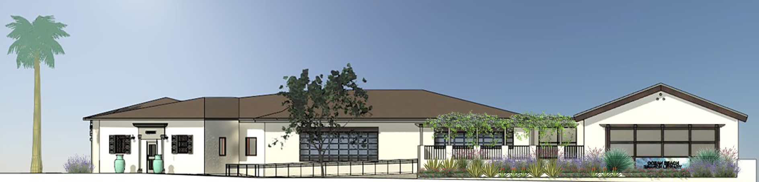
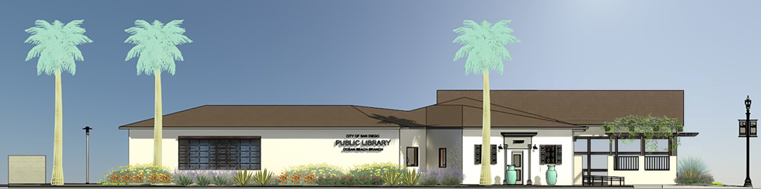
Concept 2 (with modifications based on feedback)
Addition Height 19’-5”

Slide 12
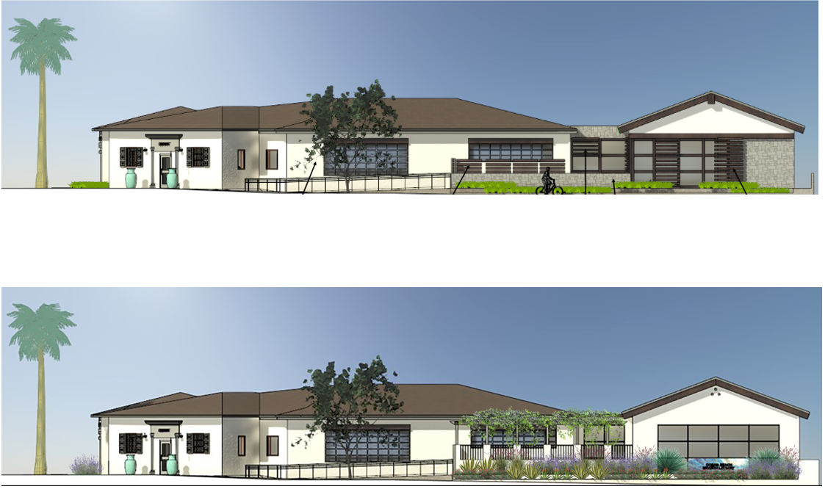
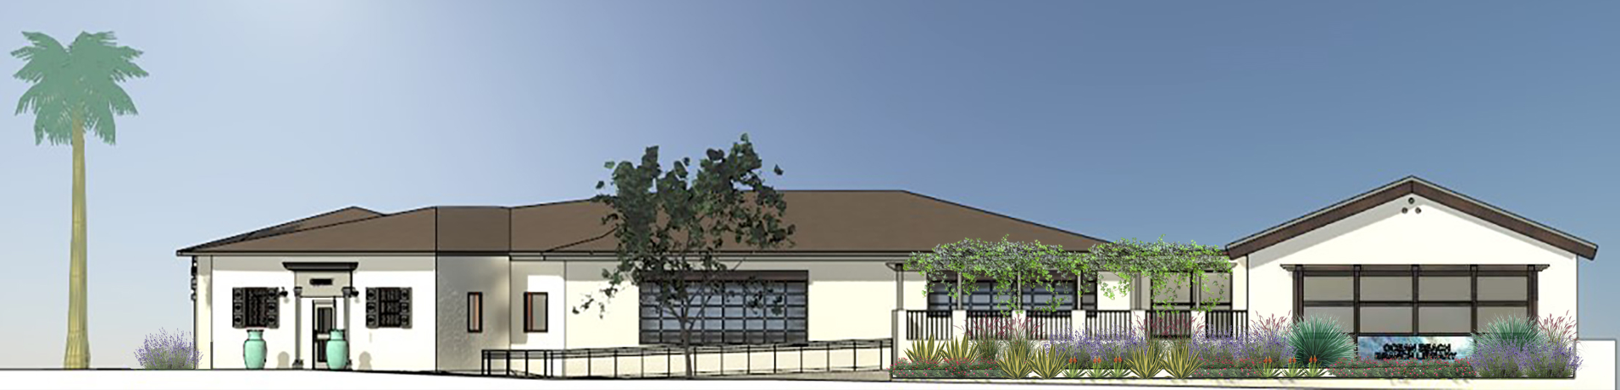
North Elevation Original and Modified based on Comments
Historically designated library from 1926.
Stone façade removed
Wood sliders and fencing removed

Slide 13
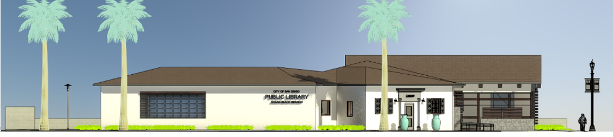
East Elevation Original and Modified based on Comments
Historically designated library from 1926.
Stone façade removed
Wood sliders and fencing removed

Slide 14
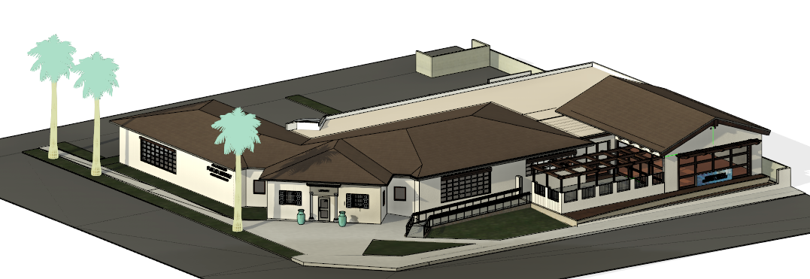
Basis of Design
  *The Actual Final Plan may vary slightly based upon the selection of the Design/Build team, the availability of materials, as well as input from the Historic Planning Board.
  However, WE WILL COME BACK UPON COMPLETION OF DESIGN BUILDERS DESIGN

Slide 15
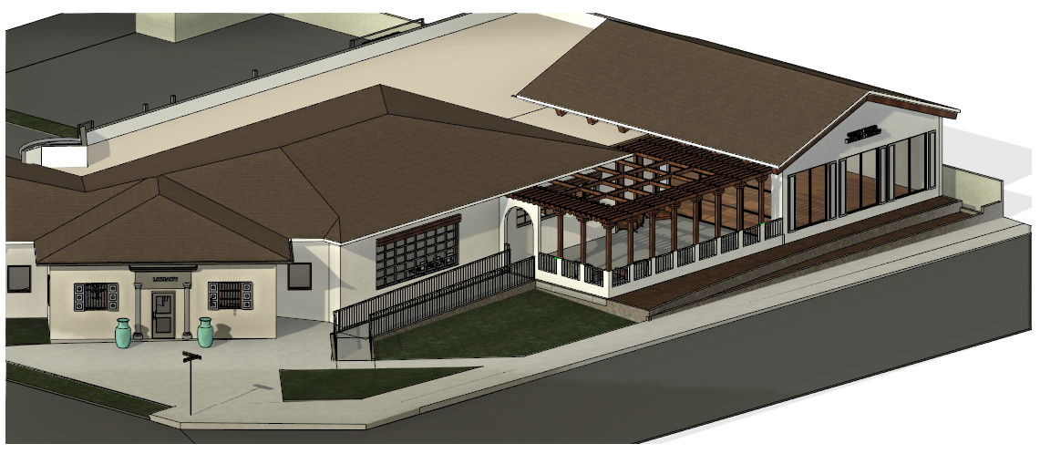
Example
  Possible Interpretation of the Basis of Design

Slide 16
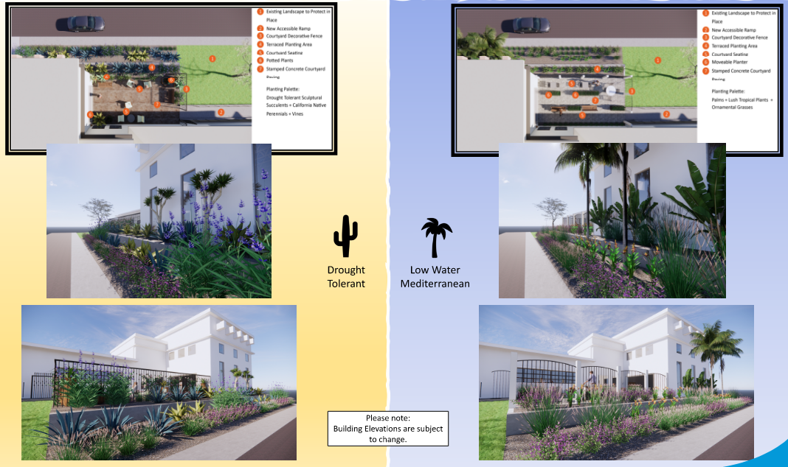
Landscape Options

Slide 17
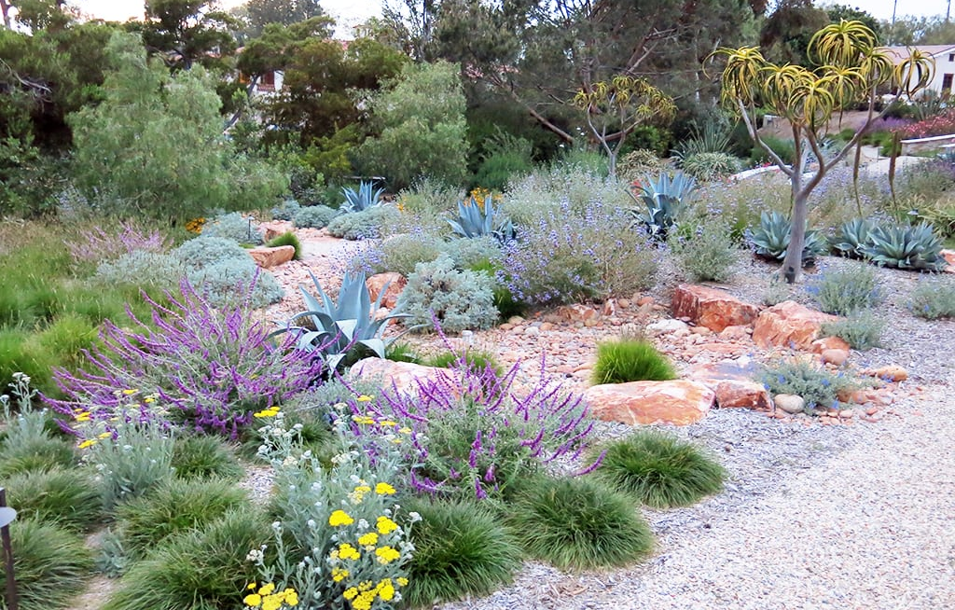
Landscape Results
  Landscape Options:
Drought Tolerant- 58 votes
Mediterranean - 28 votes
“OB is known for being socially responsible and progressive.
Planting native plants aligns with this identity”
“OB has a lot of environmentalists who support water-wise efforts and
the drought tolerant is better than low water/Mediterranean option”
“We have the opportunity here to bring back our native plants, to showcase them,
and to proudly exhibit what was here before we were.”
“Natives only. It is better for birds, animals and the environment.”

Slide 18

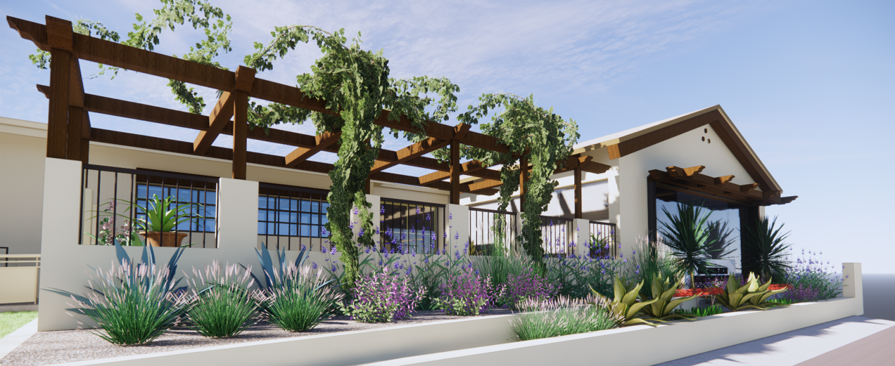
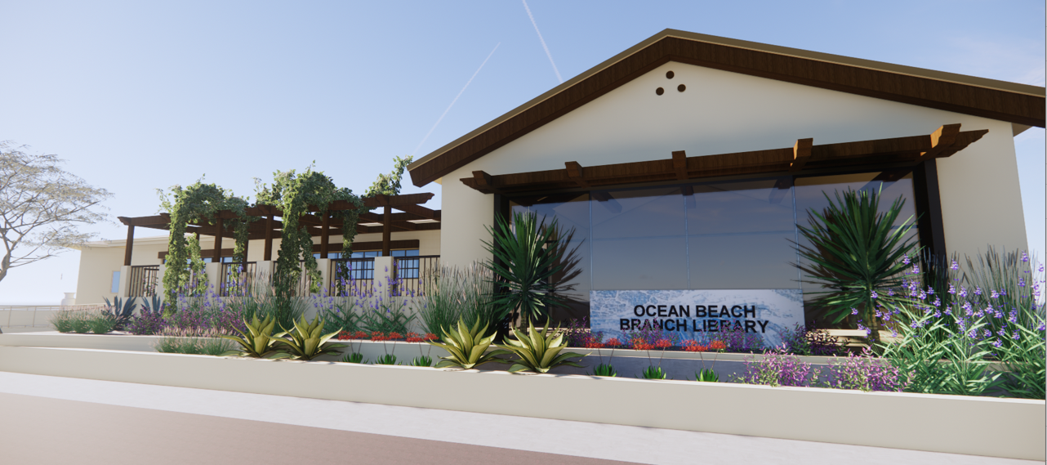
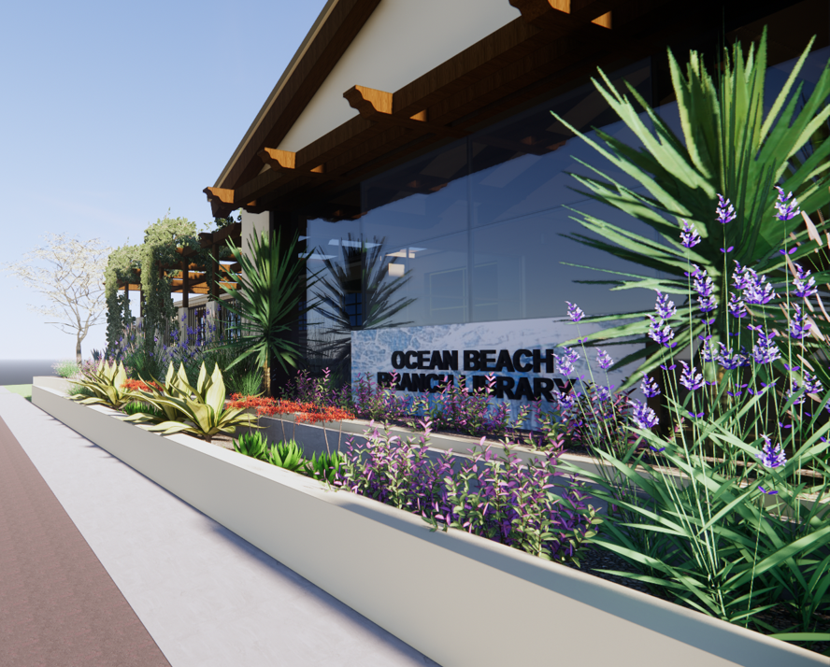
Native Landscape

Slide 19
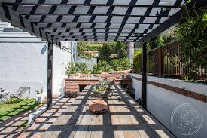
Courtyard Comments
  How would you like to see the courtyard utilized?
“I visualize it as a place to hang out- to read, socialize and engage the community.”
“Tables and chairs for reading and other quiet activities such as chess.”
“Area to study, gather, or host events”
“I want to see people reading on the grass, enjoying each other’s company or just the beautiful weather. I want to see groups of children listening to a story being read or playing and enjoying childhood”
“Social seating area and more events. Mommy and Me yoga? Movie Nights?”

Slide 20
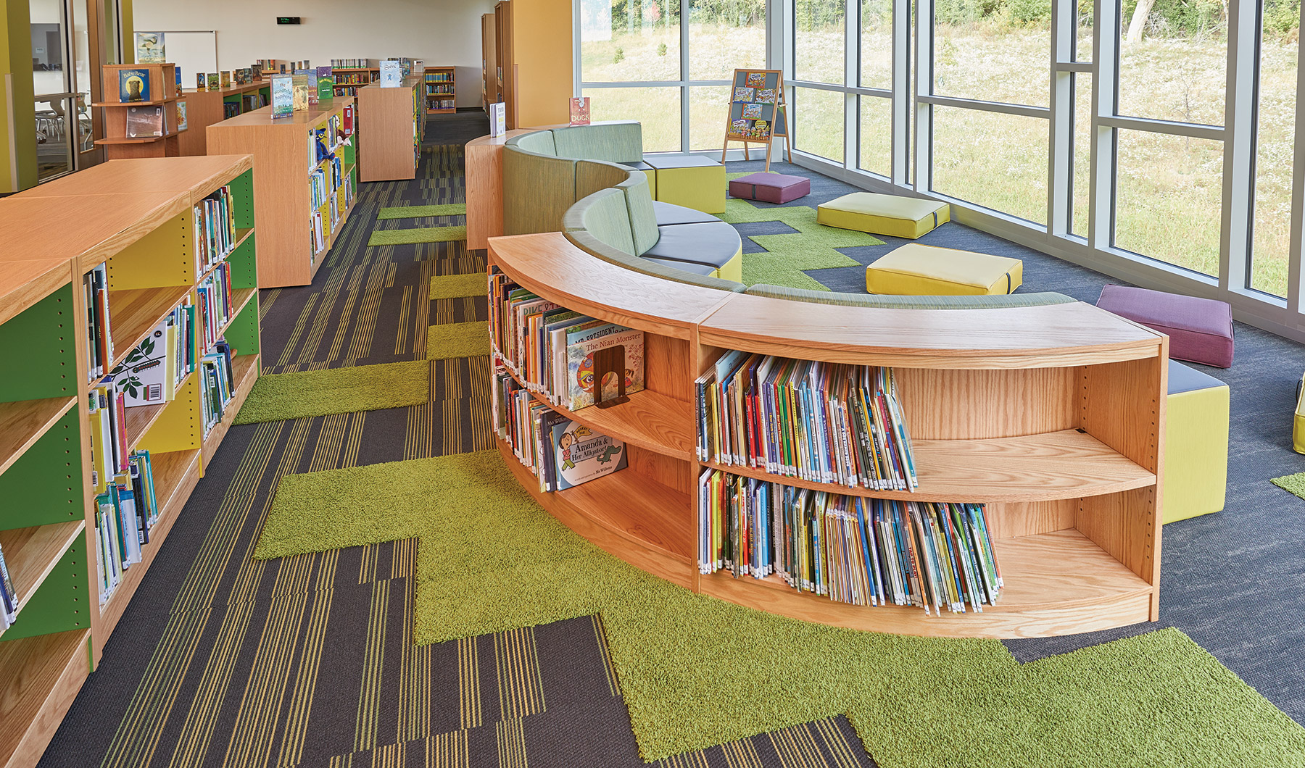
Furnishing Comments
  Thoughts or ideas on types of furnishings
“Please have adult sized chairs in the kid’s area too.”
“We need items that are easy to clean and maintain.”
“Adults want chairs with backs, so benches aren’t a good choice.”
“Please be mindful to include spaces that are functional for folks with differing abilities (visual, hearing, neurological, physical, etc.)”
“No benches, No hard seats, No high stools…”
“Add some comfortable reading chairs for kids and their parents.”

Slide 21
Clarification Comments
  Highlighted comments from in the surveys…
“Please match existing windows…roofline…colors”
Matching Old and New is in violation of the Historic Standards.
The Addition should distinct but cohesive and should not be “the star of the show”
“Patio should be secured to prevent illegal activity”
This is a top priority with our design. We are working with the SDPD to ensure we are taking security measures to provide safety for all.
“Please remove the grass- we are in a drought!”
Doing so is in violation of the Historic Standards. The grass will remain in front of the existing Historic portion of the Library. This said, we will not be adding any grass and will keep with drought resistant Native plants.
Community Garden was requested
Due to water restrictions and maintenance the Courtyard option was more desirable.
However, the Seed Library will be featured inside.

Slide 22

Ideas
  There were many great contributions!
“The inside of the Library isn’t the only place for learning; interpretive signage can accompany the native plants, identifying them, giving some natural history, and explaining how the indigenous peoples used them.”
“I suggest working with the CA Native Plant Society…Good for the birds, the insects and the landscape as our climate changes.”
“Be mindful of floor material to reduce the noise of book carts.”
“Would love to see Ocean or Ocean Beach themed décor. Mural on children’s wall?”

Slide 23

Thank you for your participation!

