Slide 1
Housing Action Package 2.0
Notes:
Good morning, Planning Commissioners. I am Seth Litchney, Program Manager for Housing Policy with the Planning Department. Joining me today are Planning Director Heidi Vonblum, Deputy Director Tait Galloway, and Development Project Manager Jeff Ryan.
Today we holding a Planning Commission workshop on the City’s second Housing Action Package, known as HAP 2.0. This workshop is meant to serve as an opportunity for Planning Commission and the public to provide input on the proposed programs and initiatives in HAP 2.0.

Slide 2


What is the Housing Action Package 2.0?
Amendments to the
Land Development Code
Build upon the first Housing Action Package
Allow / incentivize diverse range of home products & affordable homes
Affirmatively further fair housing
Notes:
Housing Action Package 2.0 is a series of policy actions that amend the city’s Land Development Code.
HAP 2.0 builds upon the first Housing Action Package, passed in 2022, and incentivizes a greater variety of new and affordable homes while also addressing the City’s climate and equity goals.
The package affirmatively furthers fair housing by allowing for more home opportunities for all residents in all areas of the city.
.

Slide 3
Why are Land Development Code amendments needed?
Adequate supply of homes to meet present and future demands
Makes it easier to build more homes at all income levels and for all people
Does not displace residents
Implements goals and policies in:
  General Plan – Housing Element
  Community Plans
  Climate Action Plan
Notes:
We’re amending the Land Development Code in order to provide enough homes to meet future demand.
This requires making it easier to build more homes at all income levels, while also not displacing current residents
We’re also amending the land development code in order to implement goals and policies found in the General Plan’s Housing Element, Community Plans, and our Climate Action Plan.

Slide 4

Housing Element Consistency
Housing Element Goals:
Goal 1: Facilitate the Construction of Quality Housing
Goal 2: Improve the existing Housing Stock
Goal 3: Provide New Affordable Housing
Goal 5: Exemplify Sustainable Development and Growth
Notes:
The Housing Element is the City of San Diego’s comprehensive housing plan. The Housing Element is required to adequately plan for housing to meet the needs of the community and include goals, objectives, policies and programs to assist in seeing the homes get developed.
The second housing action package implements four of the 6 goals stated in the 2021-2029 Housing Element.
Specifically, these actions facilitate the construction of quality housing, improve the existing housing stock, provide new affordable housing, and exemplify sustainable development and growth.

Slide 5
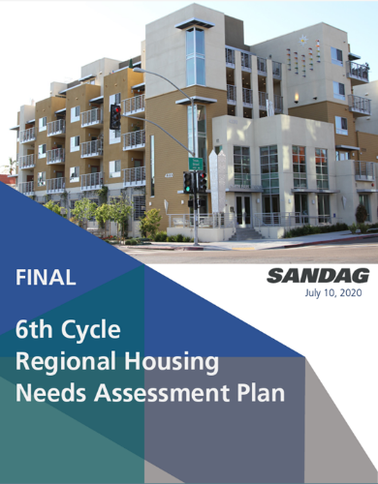
2021-2029 City Regional Housing Needs Allocation
Income Type (% of AMI*) | 6th Cycle RHNA Allocation
Very Low (<40%) | 27,549
Low (40% to 80%) | 17,331
Moderate (80% to 120%) | 19,319
Above Moderate (>120%) | 43,837
Total | 108,036
*2022 San Diego Area Median Income: $106,900
https://www.sdhc.org/wp-content/uploads/2022/AMIIncomeRentChart-2022.pdf
Notes:
Per state law, San Diego is responsible for permitting a certain number of new homes by 2029, as specified in SANDAG’s 6th Cycle Regional Housing Needs Assessment.
In total, the City is expected to permit over 108,000 new homes building permits by 2029. Of these, over 44,000 must be affordable for very low- and low-income residents, and another 19,00 for moderate income community members.
Historically, the City of San Diego has struggled to meet regional housing need allocation goals, especially for lower income households.
The Housing Action Plan includes programs aimed at assisting the City in meeting these targets.

Slide 6

Housing Action Package 2.0 is:
Part 1: Encourage the Development of New Homes
Part 2: Strengthen Fair Housing
Part 3: Missing Middle Housing
Part 4: Thriving Neighborhoods
Notes:
The housing action package is comprised of four parts, Encouraging New Homes, Fair Housing For All, Thriving Neighborhoods, and Missing Middle Housing.

Slide 7
Housing Action Package
Changes from Planning Commission Workshop
Attachment
Memo
Missing Middle Housing - Amended
  On-site affordable housing incentives
  Affordable housing In Lieu Fees
  ADUs do not count toward unit count
  ADUs not required to be affordable
Complete Communities - Amended
  DIF Waiver for homes with more than three bedrooms
  3 and 2 bedroom FAR bonus
  Geographic location of off-site affordable homes
Notes:
Before I begin on the presentation., I would like to note the areas that have been amended or added since the Planning Commission Workshop in April.
Two items related to the Missing Middle Housing SB 10

Slide 8
Housing Action Package
Changes from Planning Commission Workshop
Homes on Publicly Owned Sites - Amended
  Removed FAR Bonus in Mobility Zone 4
Anti-Displacement Measures - Amended
  Removed Priority Preference for Affordable ADUs
  Priority Preference take effect as part of a future action of the Housing Authority/City Council
Previously Conforming Harmful Uses – Amended
  Set 15-year time frame for ending previously conforming uses
Notes:
The development of a program to ensure priority preference is made available to community members in these areas will require collaboration with stakeholders, funding, and other actions to ensure it is effective in addressing displacement. Therefore, the priority preference requirements would not be implemented until a program can be developed and approved as part of a future action of the Housing Authority and/or City Council to ensure successful implementation

Slide 9
Housing Action Package
Changes from Planning Commission Workshop
Accessory Dwelling Units – Amended
  Minor ADUs removed
Off-Campus Student Housing – Amended
  Separated requirements for Student Housing from Fraternities and Sororities
Building Permit Extension – New
Neighborhood Enhancement Fee Resolution – New
Notes:
Before I begin on the presentation., I would like to note the areas that have been amended or added since the Planning Commission Workshop in April.
Two items related to the Missing Middle Housing SB 10

Slide 10
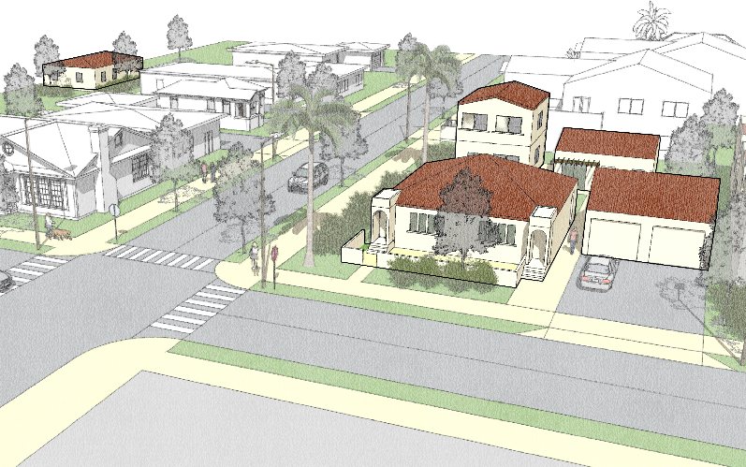
Housing Action Package 2.0
New homes on public land
New homes for students
Limiting Oversupply of parking / Allowing efficient use of land
Encouraging New Homes
Notes:
Encouraging New Homes policies promote the development of new homes by implementing recently adopted state law related to parking requirements, revising existing regulations and affordable housing programs to encourage new homes on publicly owned land and providing new homes for students.

Slide 11
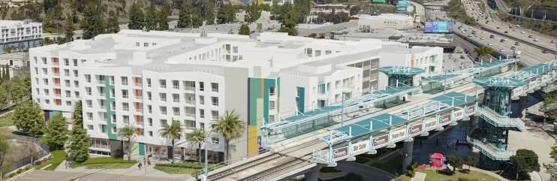
1. Implementation of Assembly Bill 2097
AB 2097 is presently in effect and mandatory
Limits oversupply of parking to allow for most productive uses of lands that bring more jobs, homes, and public spaces.
In Transit Priority Areas, allows development to provide needed parking while also providing other land uses.
Expands parking oversupply protections from current Parking Standards Transit Priority Area to Transit Priority Areas, as required by state law.
Notes:
The first item is AB 2097. This bill was adopted by the State in 2022 and is currently in effect. The Housing Action Package proposes to implement AB 2097 in our local code.
The new law limits oversupply of parking to allow for the most productive uses of lands that bring more jobs, homes, and public spaces.
In Transit Priority Areas, it allows development to provide needed parking while also providing other land uses.
Locally, the implementation of AB 2097 expands parking oversupply protections from the City’s current Parking Standards Transit Priority Area to the Transit Priority Areas, representing an increase in their applicability.

Slide 12
2. Revisions to the Junior Accessory Dwelling Unit Regulations
Better aligns the JADU regulations with guidelines recommended by the state
No longer allow JADUs inside detached garages and other ADUs (State law requirement)
Notes:
The second item relates to the City’s Junior Accessory Dwelling Unit regulations. Junior ADUs are limited to between 150 to 500 square feet and are limited in where they can be built on a property.
The Housing Action Package proposal includes better alignment with state requirements by no longer allowing JADUs in detached garages or other ADUs. Instead, JADUs will only be allowed within the walls of an existing structure, including an attached garage. This aligns the City’s definition of an ADU with the recommendations of the Department of Housing and Community Development.

Slide 13

3. Providing an Incentive to Build ADA Accessible ADU Homes
Expands housing opportunities for people with disabilities, mobility limitations and special needs including veterans
Incentivizes accessible ADU homes
Allows up to one accessible ADU home in development in the ADU Home Density Bonus Program
Minimum two affordable ADU homes
Notes:
To ensure the Housing Action package is providing homes for all of us, the proposal includes a new incentive for accessible ADUs. These ADUs will provide living opportunities for people with disabilities, mobility limitations, and special needs, including veterans.
The incentive would be applied to the City’s existing ADU Home Density Bonus Program, which allows for bonus ADUs when they are deed restricted for affordable households. The proposal would allow the development of one accessible ADU as long as a minimum of two affordable ADU homes are included.

Slide 14
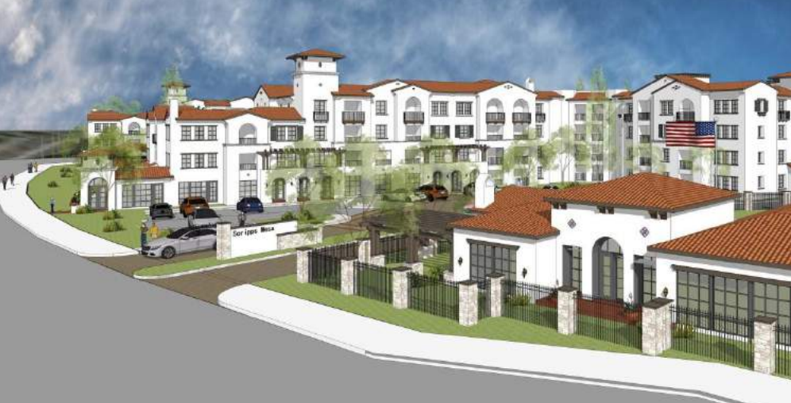
4. Providing Additional Floor Area to Develop Homes on Publicly-Owned Land
Provides greater flexibility for homes on publicly-owned land zoned as commercial or residential
Increases building Floor Area Ratio (FAR) bonuses
FAR bonus based on mobility zone and percent of total units set aside as deed-restricted affordable
Notes:
The fourth item would provide public agencies greater flexibility in developing homes on publicly owned land.
HAP 2.0 would amend the Land Development Code to increase building Floor Area Ratio (FAR) bonuses for qualifying housing developments that increase the base-unit affordable homes to allow for greater flexibility in developing affordable homes on publicly owned land

Slide 15
4. Providing Additional Floor Area to Develop Homes on Publicly-Owned Land
Floor Area Ratios by Mobility Zone, Income Level and Percent of Homes that are Affordable
Mobility Zone | Affordable Income Level | Floor Area Ratio by Percent of Homes that are Affordable
 |  | 25-34% | 35-49% | 50-100%
1 | Very Low, Low and Moderate | - | - | -
2 | Very Low, Low | 6.0 | 7.0 | 8.0
 | Moderate | 5.0 | 6.0 | 7.0
3 | Very Low, Low | 4.0 | 5.0 | 6.0
 | Moderate | 3.0 | 4.0 | 5.0
Notes:
As shown on this chart and in the report to the Planning Commission, the FAR bonus based on mobility zone and percent of total units set aside as deed-restricted affordable. Providing additional opportunities for affordable and middle income homes would help to meet the General Plan Housing Element goals.

Slide 16
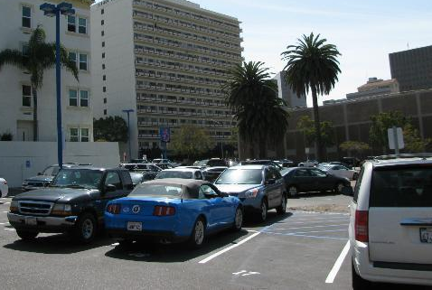
5. Incentivizing Homes on Underutilized Commercial Sites
Incentivizes the production of homes as part of mixed-used developments
Provides a 0.5 FAR bonus for residential or mixed-use development on sites:
  In Sustainable Development Areas
  Have a commercial zone that allows for residential or mixed-use
  Have a current use that is non-residential
May be used in addition to other incentives
Notes:
The fifth item would provide an incentive to encourage the production of mixed-used development with homes on commercial sites to support the implementation of community plan updates.
To qualify, a proposed mixed-use housing development must be:
Located within a Sustainable Development Area; and
Located in an area that is zoned for residential development; and
Have a current land use that is non-residential.
If a property owner redevelops a qualifying site with a mixed-use housing development that meets the criteria listed above, the development may have its maximum FAR bonus increased by .5

Slide 17
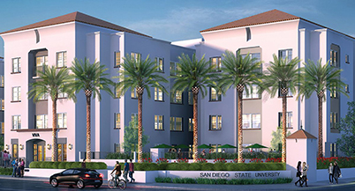
6. Off Campus Student Housing
Provides additional opportunities for additional student homes including affordable
Flexibility for student housing
Any multifamily zone within SDA and 1 mile of a campus
Removes potential for oversupply of parking for cars
Increase bicycle parking for people
Notes:
The City is home to multiple community colleges and major universities, however, the supply of on campus homes has not been able to meet the demand for student housing given the shortage of more affordable off campus rental housing options. The shortage in on campus housing creates a need for more student housing off campus, especially housing affordable to low income students.
The sixth Housing Action Package item eases the City’s existing regulations to allow for more student housing by basing the Student Housing Density Bonus on percentage of the homes deed restricted for low income students. These developments would be allowed in areas zoned for multifamily housing within a SDA and 1 mile of a University or College campus
Increases bicycle parking requirements addresses the potential for an oversupply of parking.
Eliminates the requirement that development must have an operating agreement or master lease with one or more institutions.

Slide 18
7. Building Permit Extension
Provides more flexibility for developments that face delays due to unforeseen circumstances beyond their control.
Allows City Building Official to extend a building permit an additional 180 days for a total of two times

Slide 19
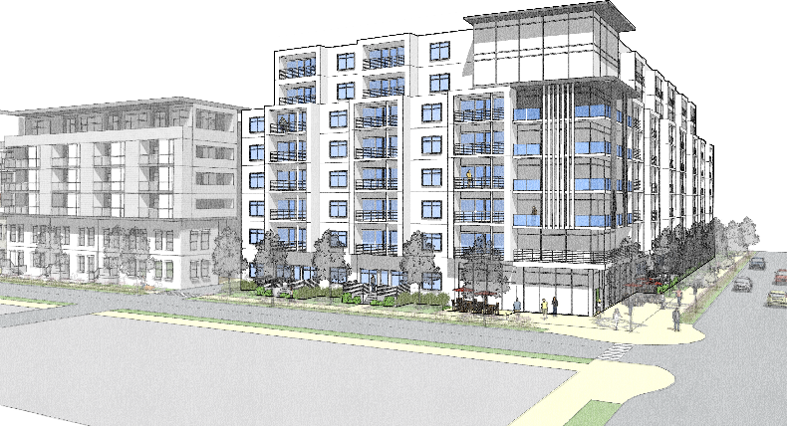
Housing Action Package 2.0
Furthering Fair Housing
Strengthen Fair Housing
New homes for families
New homes for very low income community members
New homes for moderate income community members

Slide 20
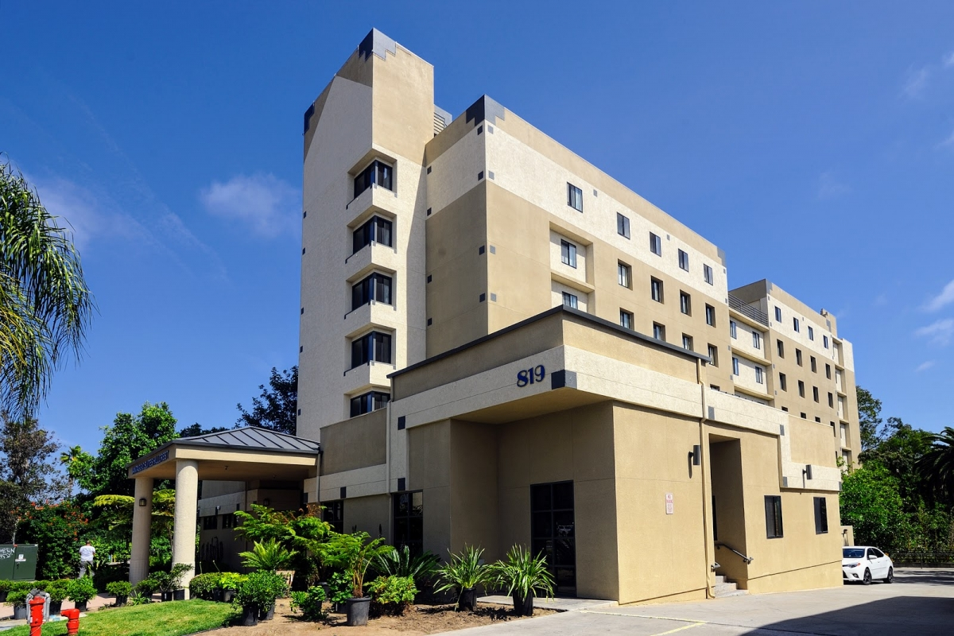
8. Incentivizing Single Room Occupancy (SRO) Homes
Incentivizes the production of new SRO Homes particularly at the very low-income level
Provides low-cost home option for community members, especially seniors and people with disabilities
Allows SRO homes under Affordable Housing in All Communities
Allows for ministerial approval for SRO homes in areas near transit
Notes:
The seventh item is an incentive for single room occupancy homes. These homes are provide a low cost home for very low income community members especially seniors and people with disabilities and this item is intended to encourage the development of new SROs.
Allows SRO homes under Affordable Housing in All Communities
Allows for ministerial approval for SRO homes in areas near transit

Slide 21
9. Complete Communities: Housing Solutions
A. Development Regulations
Certain development requirements can discourage the production of new homes under the CCHS programs
Adjusts development regulations that can disincentivize family homes
Waiver of the private exterior open space requirement for a development
  If at least 10 percent of all homes have 3 or more bedrooms
Notes:
The eight item is amendments to the Complete Communities housing solutions program. This program provides a density bonus for development that includes affordable housing and amenities for community members. However, the program has mainly seen the construction of smaller, one bedroom homes. These amendments adjust the regulations that can disincentives homes with more bedrooms for families.
To address this issue, Housing Action Package provides a waiver of private exterior open space requirement for a development if at least 10% of all dwelling units have three or more bedrooms.

Slide 22
9. Complete Communities: Housing Solutions
B. Development Impact Fees (DIF)
Implements Citywide DIF scaling for all homes, with incentives for larger homes for families
Since CCHS was adopted in 2020, DIF has been scaled based on home size, with smaller homes generally subject to payment of lower fees than larger homes
Need for scaling/incentives as a benefit has become obsolete
Replaces fee waiver for homes under 500 square feet with a fee waiver for homes with more than three bedrooms
Notes:
Additionally the Housing Action Package implements the Citywide DIF scaling for homes under Complete Communities.
Since the DIF is now based on a scaling rate based on home size, smaller homes are subject to lower fees than larger homes and need for a scaling incentive in Complete Communities is no longer needed.
Add to your speaking pnts here that micro units under 500 sf are already more attractive for a developer’s ROI since more homes can be included in a development.

Slide 23
9. Complete Communities: Housing Solutions
C. 100 Percent Moderate Income Option
Provides an alternative pathway to providing deed-restricted affordable homes under CCHS
Creates an alternative to 40% affordable homes requirement
Require that 100% of base units be deed-restricted as affordable for moderate income households
  50% to households at up to 80% AMI
  Remaining at up to 120% AMI
Notes:
Moderate income homes can be challenging to produce, and the Housing Action Package includes amendment to Complete Communities to help the program provide these important homes.
Currently, Complete Communities requires 40% of the base units be deed restricted for affordable housing at different income levels.
The proposed option would allow for development where 100% of the base units are deed restricted affordable for moderate income households as long as at least of the homes are deed restricted at the 80% area median income. This way, the moderate income homes will be available to more community members at lower side of the moderate area median income.

Slide 24
9. Complete Communities: Housing Solutions
D. Incentivizing Family Housing
Incentivizes the production of family homes by providing a 1.5 Floor Area Ratio (FAR) bonus
10% of total homes must have at least 2 bedrooms and
10% of total homes must have at least 3 bedrooms
Limits one lease agreement per home
Additional 1.5 FAR bonus
Notes:
The Housing Action Package includes an incentive for more family housing by providing and additional FAR bonus if 30 percent of the homes have at least two bedrooms and 10 percent have at least 3 bedroom. These homes would only be allowed to have one lease per home to be available to families.

Slide 25
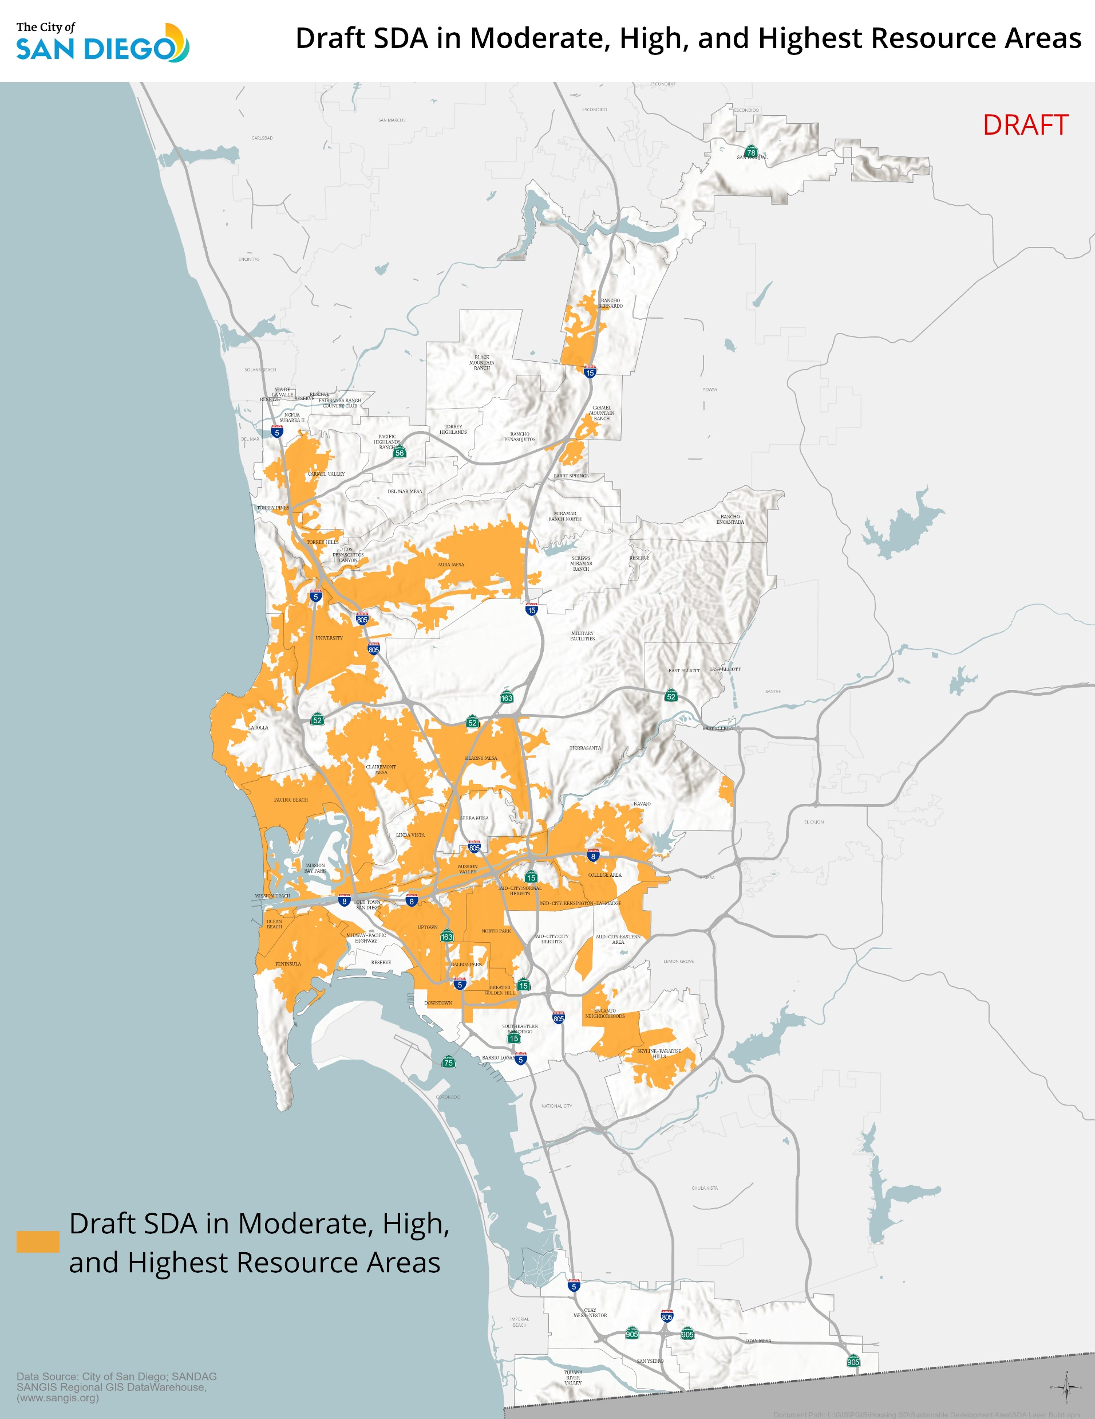
9. Complete Communities: Housing Solutions
E. Off-Site Affordable Option
Provides option to develop CCHS required affordable homes off-site within:
Sustainable Development Area; and
Moderate, High or Highest Resource Area; and
Subject to Neighborhood Enhancement Fee
Notes:
Finally, the Housing Action Package includes an option for off site affordable homes required under complete communities.
These units would only be allowed in a Sustainable Development Area, a moderate, high or highest resource area, within the same community planning area or a community planning area with less than 5% of its homes deed restricted affordable, or within 1 mile of the development.
The off site units would be subject to the Neighborhood Enhancement Fee as well, note that the offsite units are capped at the NEF for the subject premises.

Slide 26
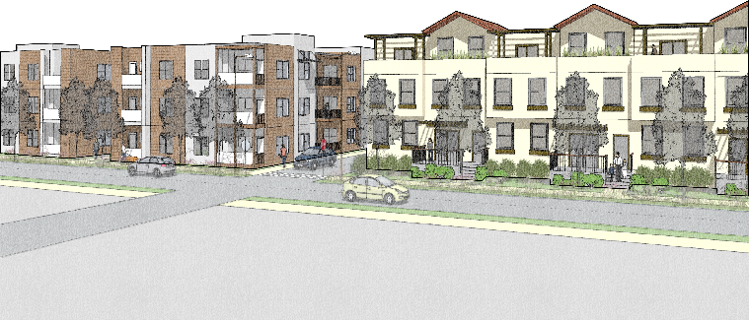
Housing Action Package 2.0
Thriving Communities
Replace harmful uses
Provide rental preference to existing community members
Make home protection regulations permanent
Reduce displacement of residents
Notes:
Thriving Communities consists of two items that look to reduce the displacement of community members and address harmful uses in communities of concern.

Slide 27
10. Introduces Anti-displacement Measures a. Dwelling Unit Protections
Introduces measures to reduce displacement by new market rate development
Removes citywide expiration date of January 1, 2025
Makes dwelling unit protection regulations permanent
Removes exemption from housing unit replacement for commercial and mixed-use developments
Clarifies that dwelling unit protections only apply to previously renter-occupied units
Notes:
Amends Dwelling Unit Protections to make protections permanent and preserve more units
Remove citywide January 1, 2025 expiration date
Remove the exemption from housing unit replacement for commercial and all mixed-use projects

Slide 28
10. Introduces Anti-displacement Measures b. Coastal Overlay Zone Affordable Housing Replacement
Introduces measures to reduce displacement by new market rate development
Replacement of affordable dwelling units to very low-income units
Expands to apply to premises with 2 or more structures containing a total of 5 or more units
Eliminates 3-mile allowance for replacement of affordable units/disallows replacement affordable units in low or very low resource areas
Relocates off-site replacement affordable units in high/highest resource communities in areas that is also high/highest resource community
Clarifies affordable housing replacement requirements do not apply to previously owner-occupied units
Notes:
The City has additional requirements that only apply in the Coastal Zone. The housing action package includes amendments these regulations by
Requiring the Replacement of affordable dwelling units to very low-income units
Expanding to apply to premises with 2 or more structures containing a total of 5 or more units
Eliminating the 3-mile allowance for replacement of affordable units/disallows replacement affordable units in low or very low resource areas
Requiring the off-site replacement of affordable units in high/highest resource communities in areas that is also high/highest resource community
And clarifying the affordable housing replacement requirements do not apply to previously owner-occupied units

Slide 29
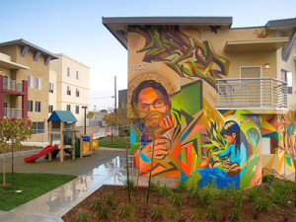
10. Introduces Anti-displacement Measures d. Priority Rental Preference for Affordable Units
Reduce displacement by new market rate development
Provides existing residents
  In Low or Lowest Resource Areas
  Priority preference to rent new deed-restricted affordable units.
Notes:
The Housing Action Package includes
Provides existing residents
In Low or Lowest Resource Areas
Priority preference to rent new deed-restricted affordable units.

Slide 30
10. Introduces Anti-displacement Measures e. Condo Conversion Regulations
Reduce displacement by new market rate development
Allows tenants of rental units proposed for conversion into a condominium to have first opportunity to buy before seller accepts other offers
Notes:
Reduce displacement by new market rate development
Allows tenants of rental units proposed for conversion into a condominium to have first opportunity to buy before seller accepts other offers

Slide 31
11. Discontinuing Previously Conforming Harmful Uses
Advances environmental justice and allows for more homes in Promise Zone
Applies to harmful uses not consistent with existing zoning
Applies in the Promise Zone only
Provides FAR bonus for new homes which would need to be used within a defined period
No longer allows the continuation if the use is ended for any reason other than building maintenance and repair or safety
No longer allows the harmful use after a defined period
Notes:
Certain existing previously conforming uses, such as wrecking and dismantling of motor vehicles, storage and material scrap yards, are in areas that have been rezoned to allow for homes and mixed-use development as part of a community plan update. These uses can cause a negative affect to community members and reduce the quality of life in these neighborhoods. Many of these previously conforming uses are in the Promise Zone which has been recognized by the federal government as the most disadvantaged and underserved communities in the City which include portions of: Downtown, Barrio Logan, Southeastern San Diego, and the Encanto Neighborhoods. The proposed amendments provide legacy business owners a set period of time to transition their premises to another use out of recognition that business operators may not be prepared and will require sufficient time to change uses.
Properties subject to Discontinuing Harmful Uses must meet the following criteria:
Are assigned a land use designation of auto-dismantling or junkyards; and
Are located within a Promise Zone; and
Are currently zoned to allow residential development
To replace these harmful uses, the following incentives and amendments would apply to these previously conforming uses.
Providing FAR bonus for new homes that are consistent with the current zone and which would need to be used within a defined period
No longer allows the continuation if the use is ended for any reason other than building maintenance and repair or safety
No longer allows the harmful use after a defined period
The defined periods of when the use would no longer be allowed and how long the incentive would be available are still under discussion, but will be determined when the Housing Action Package is brought for a recommendation.

Slide 32
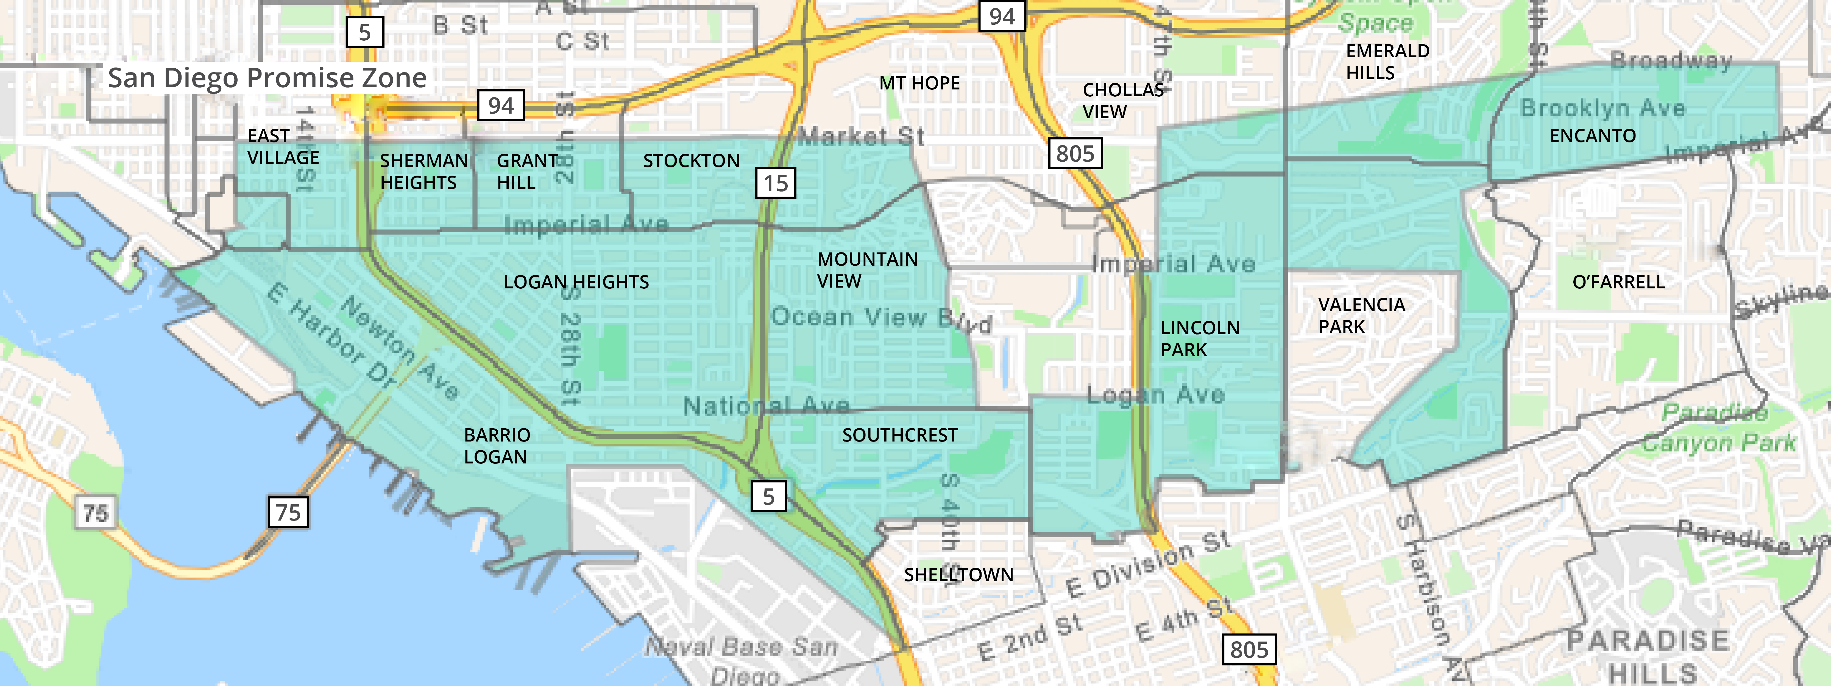
11. Discontinuing Previously Conforming Harmful Uses
Notes:
This map shows the boundaries of the San Diego Promise Zone. The Promise Zone was designated by the Federal Government in 2016 and covers a 6.4-square-mile area that spans East Village and Barrio Logan east to Encanto and is home to the City’s most culturally rich and ethnically diverse neighborhoods, but also some of the most disadvantaged and underserved communities.
Through the Promise Zone Initiative, federal government partners work with local government agencies, community-based organizations, direct service providers, residents, and business owners to streamline resources and deliver comprehensive support. Leading the effort, the City has partnered with numerous local organizations and agencies to develop programs and initiatives in six Working Group goal areas to improve quality of life among Promise Zone residents by Increasing Economic Activity, Increasing Access to Quality Affordable Housing, and Promoting Access to Healthcare and Healthy Communities.
The Promise Zone also includes some of the areas with the highest scores on the State of California’s Enviroscreen mapping tool. These areas have some of the most impacted
IF NEEDED
There are a total of 28 identified sites that qualify as a discontinued harmful use near residential uses.
All sites are currently used as Junkyards and recycling facilities, which have a negative effect on community health.
11 qualifying parcels are located within Barrio Logan. Of these sites, 9 are in a zone designated as Commercial Neighborhood and two are located within a strictly residential zone.
9 out of 11 sites have a cal-enviroscreen score greater than 90.
In the Southeastern Community area, there are 17 qualifying parcels all of which are in a zone designated as Commercial Neighborhood.
9 of 17 qualifying parcels in Southeastern have a cal-enviroscreen score greater than 90.

Slide 33
12. Amendments to Neighborhood Enhancement In Lieu Fee (R-313282)
Amends NEF Resolution to implement policies introduced in Land Development Code Updates Housing Action Packages
Amends NEF resolution to replace Transit Priority Area with Sustainable Development Area
Provides clarifications regarding distribution of funds
Includes provisions regarding Missing Middle Housing Regulations

Slide 34
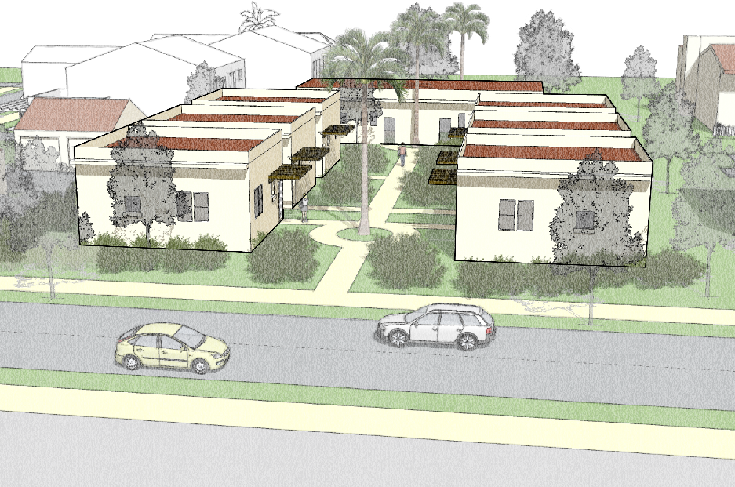
Housing Action Package 2.0
Missing Middle Homes
Implement Senate Bill 10
Provide homes near transit
Allow for missing middle homes in all communities
Notes:
HAP 2.0 would create new opportunities to build “missing middle” homes near jobs, schools, transit, and other amenities. As part of the City Missing Middle Housing regulations, the implementation of SB 10 would provide an opportunity for missing middle homes like duplexes, townhomes, rowhomes, and small-scale multifamily development. The Missing Middle Housing regulations would also provide an opportunity to provide affordable homes, family homes, opportunities for home ownership, and furthering fair housing. The amendments would make it easier to build more homes on a single parcel of land to create more affordable, entry-level homes aimed at providing homeownership opportunities for middle-income individuals and families.

Slide 35
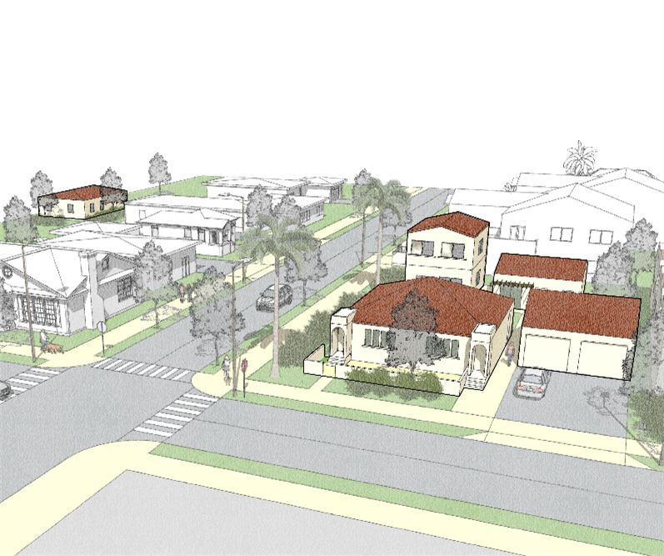
13. Missing Middle Homes (SB 10)
Creates new opportunities to build Missing Middle homes near jobs, schools, transit, and other amenities
Allows option to adopt an ordinance to allow up to 10 homes per parcel
Must be within 0.5 miles of a major transit stop or on urban infill sites
Allows for implementing regulations to be tailored
Notes:
Creates new opportunities to build Missing Middle homes near jobs, schools, transit, and other amenities
Allows option to adopt an ordinance to allow up to 10 homes per parcel
Must be within 0.5 miles of a major transit stop or on urban infill sites
Allows for implementing regulations to be tailored

Slide 36
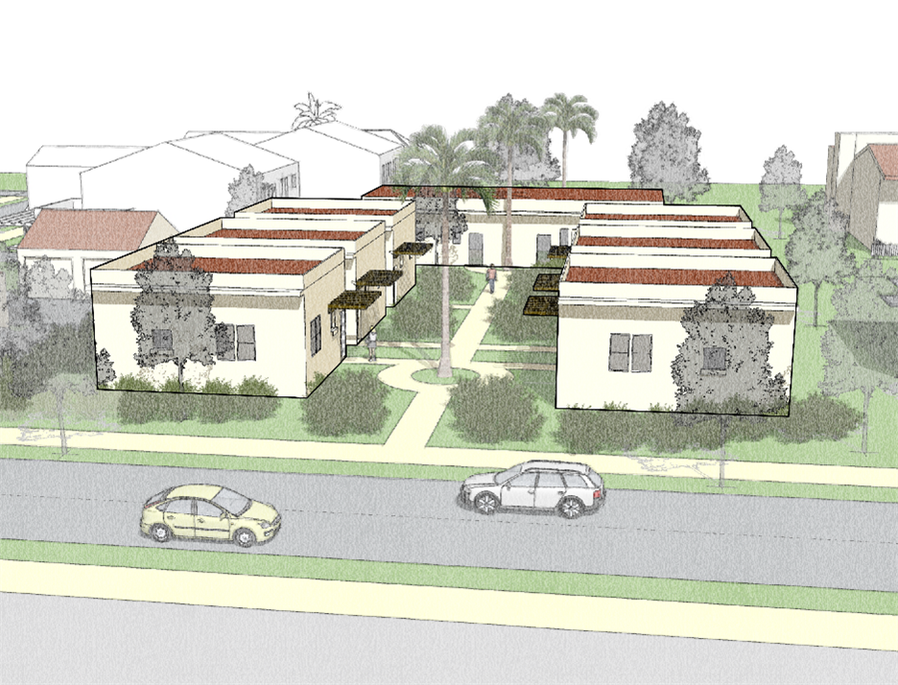
13. Missing Middle Homes (SB 10)
Applicability
Would apply to parcels within: Sustainable Development Areas
Would not apply to parcels that are:
More than 0.5 miles from a major transit stop and are not 75 percent surrounded by urban uses
With existing deed-restricted affordable homes or SROs
That front streets that do not meet certain City standards such as without sidewalks
Notes:
SB 10 Would apply to qualifying parcels within the Sustainable Development Areas
Would not apply to parcels that are:
More than 0.5 miles from a major transit stop and are not 75 percent surrounded by urban uses
With existing deed-restricted affordable homes or SROs
And on streets that do not meet certain City standards such as without sidewalks

Slide 37
13. Missing Middle Homes (SB 10)
Applicability
Would not apply to parcels that are in:
Very High Fire Severity Zones, on hazardous waste sites, on earthquake fault zones, and floodways, unless mitigation measures are included to address the impact of these hazards
Multi-Habitat Planning Areas and Environmentally sensitive lands
Historic districts and designated historic resources designated before January 2023
Designated or dedicated open space areas and parks
Notes:
SB 10 would not apply in Very High Fire Severity Zones, on hazardous waste sites, on earthquake fault zones, and floodways, unless mitigation measures are included.
But SB 10 would not apply to parcels in the MHPA, on Environmentally sensitive lands, in Historic districts and designated historic resources, and on Designated or dedicated open space areas and parks

Slide 38
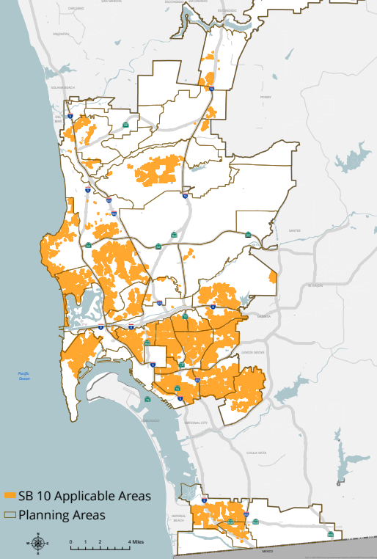
13. Missing Middle Homes (SB 10)
DRAFT
DRAFT

Slide 39
13. Missing Middle Homes (SB 10)
Residential Maximums
Would apply to parcels that are:
Zoned for multifamily:
  Up to a maximum of 10 homes
Zoned for single family:
  1 home for every 1,000 square feet of lot area
  Maximum of 10 homes
Notes:
SB 10 Allows a maximum of 10 Units.
Parcels that are zoned for multifamily zone are allowed up to 10 units.
SB10 projects are limited to 1 unit per 1,000 sq ft of lot area in single family zones.

Slide 40
13. Missing Middle Homes (SB 10)
Affordable Homes
Would apply to developments with more than 4 homes:
1 home affordable to very low, low, or moderate income households
Additional home affordable to very low- or low income residents if located within High/Highest Resource Area
Notes:
Projects proposing more than four homes must include at least one deed-restricted affordable unit. Projects in a High or Highest resource area must provide an additional low or very low deed restricted home.

Slide 41
13. Missing Middle Homes (SB10)
Alternative Compliance to Affordable Housing Requirement
California Tax Credit Allocation Committee Opportunity Area | Percent of Inclusionary In Lieu Fee
High Segregation and Poverty or Low Resource Area | 100%
Moderate Resource Area | 125%
High or Highest Resource Area | 150%

Slide 42
13. Missing Middle Homes (SB10)
On Site Affordable Housing Incentives
Development that provide on-site affordable homes may use one of the following incentives:
  Neighborhood Enhancement Fee Waiver
  Replacement of one required three-bedroom home with one additional two-bedroom home
  A deviation from development regulations

Slide 43
13. Missing Middle Homes (SB 10)
Development Regulations:
Applies RM-1-1 Base Zone requirements except for:
  Setbacks: 4 ft side/rear, 5-15 ft front
  Max Height: 35 ft or base zone (whichever is greater)
  Minimum lot size: 1,000 sq ft
  Floor area ratio: 3.0 or base zone (whichever is greater)
Requires access from street frontage
Sets limits on driveway and parking coverage
Notes:
Generally, SB 10 will apply the RM-1-1 base zone requirements, except four foot setbacks would be allowed on the side and rear, the maximum hight would be 35 feet or the base zone, whichever is greater, minimum lot size would be 1000 square feet and the floor area ratio would be 3.0 or the base zone.

Slide 44
13. Missing Middle Homes (SB 10)
Bedrooms
For developments with more than four homes:
At least 2 homes have 3+ bedrooms; and
At least 1 home has 2+ bedrooms
Notes:
Additionally, developments with more than four homes would be required to have at least 2 homes have 3+ bedrooms; and
At least 1 home has 2+ bedrooms
Note that this can be waived if affordable housing provided onsite.

Slide 45
13. Missing Middle Homes (SB 10)
Parking
Inside Transit Priority Area (TPA)
  State parking allowances apply (AB 2097)
  Development provides parking along with other uses
Outside TPA
  No additional parking required for first 2 homes
  One parking space for each additional home after the first 2
Notes:
Inside of the Transit Priority Area, the AB 2097 parking requirements would apply, but outside of the TPA, the first two homes would not be required to provide parking and all other homes would be required to provide one parking space.
Please note that this is consistent with requirements for ADUs and SB 9.

Slide 46
13. Missing Middle Homes (SB 10)
Homeownership
Require that parcel could be subdivided into individual ownership without the need for additional physical improvements
Fees
Development Impact Fee at the multifamily rate
Neighborhood Enhancement Fund Fees
Notes:
Finally, SB 10 would promote homeownership by requiring a parcel could be subdivided without additional physical improvements.
And DIF and Neighborhood Enhancement fees would apply to SB 10 development at the multifamily rate to ensure public amenities can be funded.

Slide 47
13. Missing Middle Homes (SB 10)
ADUs
Single Family Zones
  One ADU
  One JADU
Multi Family Zones
  Two ADUs
  Two JADUs
Notes:
Finally, SB 10 would promote homeownership by requiring a parcel could be subdivided without additional physical improvements.
And DIF and Neighborhood Enhancement fees would apply to SB 10 development at the multifamily rate to ensure public amenities can be funded.

Slide 48
Missing Middle Development Scenario
Scenario
Lot Size: 5,000 Sq Ft
Base Zone: RS-1-7
TCAC Area: High Resource
Homes Requirements Breakdown
ADU
3 Bedroom Home Required
3 Bedroom Home Required
How many allowed homes?
Five allowed homes
Two 3-bedroom homes and one 2-bedroom home
Two deed-restricted affordable units
One ADU/One JADU
JADU
2 Bedroom Home Required
1 Home - No Bedroom Specifications
1 Home - No Bedroom Specifications
Notes:
In the first scenario, someone would like to develop on a 5,000 square foot lot.
The base zone for this scenario is single-family, specifically RS 1-7.
This development is also located in a TCAC High Resource area.
Because the premises is in a single-family base zone, our program will allow the development of 1 home per 1,000 sq ft lot. So in this case, a 5,000 square foot lot would allow for up to five homes.
If someone would like to build the full 5 homes, they would be required to build at least two homes with three or more bedrooms, and one home with two or more bedrooms.
Building five homes would also require that one home be deed restricted as affordable for very low, low, and moderate resource households.
Because this project is also located in a High Resource Area, it would be required to set aside an additional home as deed-restricted for very low- or low-income households.
Under the City of San Diego’s proposed regulations, applicants have the option to pay an inclusionary in-lieu fee as an alternative to providing the on-site affordable units. The fee rate would depend on site’s location within a California Tax Credit Allocation Committee (CTCAC) Opportunity Area.
To encourage keeping affordable units onsite, applicants that choose to develop the affordable units onsite may receive one of the following waivers.
First, they could receive a waiver from the Neighborhood Enhancement Fund Fee,
Alternatively, they could replace a required three-bedroom unit with an additional two-bedroom unit, Receive a development regulation waiver
In total, for someone to build five homes in a single family zone on a 5,000 sq ft lot, they would be required to build at least three homes suitable for families and two homes set aside as affordable units. (show the types of proposed homes)
In this scenario, the removal of a single-family building would result in the creation of five homes, two of which are affordable. A total net gain of 4 homes.

Slide 49
Next Steps
City Council Committee
Summer
2023
City Council Adoption
Summer
2023
Notes:
The next steps in

Slide 50
Community Planner’s Committee
Recommend that SB 10 not be implemented in San Diego at the current time.
Recommend to:
  Increase SB 10 affordability requirement to 30 percent, with 15 percent being set aside for very low and low income households and 15 percent for moderate income households.
  Amend SB 10 to direct Development Impact Fees generated under SB 10 to areas where projects are built.
Notes:
April 28, 2022

Slide 51
Staff Recommendation
Recommend to the City Council approval of the proposed Housing Action Package 2.0.

Slide 52
Housing Action Package 2.0
Planning Commission Workshop
April 6, 2023

