Slide 1

Otay Mesa Enhanced Infrastructure Financing District
Otay Mesa CIP Status
October 12, 2020
Public Financing Authority Meeting

Slide 2

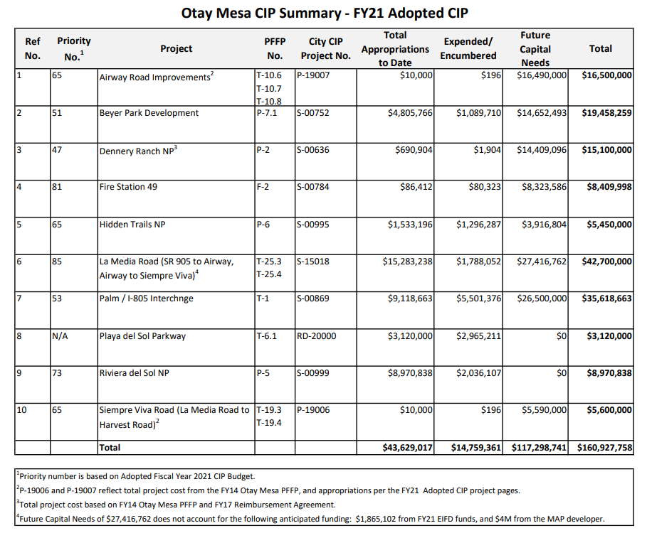
Otay Mesa Enhanced Infrastructure Financing District
Otay Mesa CIP Status

Slide 3
Otay Mesa Enhanced Infrastructure Financing District
Questions?
Otay Mesa CIP Status

Slide 4
Otay Mesa Enhanced Infrastructure Financing District
Otay Mesa CIP Status
October 12, 2020
Public Financing Authority Meeting

