Slide 1
Presentation to the
Sustainable Energy Advisory Board
August 8, 2019
Project Summary
Phase 1 Solar Installations at City Facilities
City of San Diego
Sustainability Department
Doran Aivati and James Chen
Presentation to the
Mission Valley Design Advisory Board
February 5, 2018

Slide 2
Description & Goals
Brief description of the work:
17 sites, including Police Stations, Recreation Centers, Libraries, etc.
A total of 3.5 MW solar panels are installed
Goals:
The City’s proposed Climate Action Plan goal of 100% Renewable Energy citywide by 2035
Installation of renewable energy supports the City’s Climate Action Plan and sustainability goals and GHG reduction
Partners or vendors and brief description of their roles:
Onyx Renewable Partners LP – Developer/Owner
Helix Electric, Inc. / Helix Renewables – General Contractor
MBarC Construction (Carport installation)
Horizon Underground, Inc. (Civil Work)
Subsurface Imaging (Coring and GRC)

Slide 3
Budget & Timeline
Budget and/or description of funding:
The City signed a “Power Purchase Agreement” (PPA) with Onyx Renewable Partners LP for 20 years at a fixed rate for each site
Timeline and/or contract term:
The City signed a “Power Purchase Agreement” (PPA) with Onyx Renewable Partners LP for 20 years at a fixed rate for each site
The whole portfolio was initiated in July 2015 and the last site was energized on 4/16/2019
The City first signed a Cooperative Procurement Contract with SunEdison through SPURR’s (School Project for Utility Rate Reduction) REAP (Renewable Energy Aggregated Procurement) Program
SunEdison went bankruptcy; Onyx Renewable Partners LP took over the portfolio from SunEdison through an Amendment, which was signed in January 2017. The first site was energized on 11/3/2017

Slide 4
Tasks & Deliverables
 |  |  | Phase 1 (Onyx) Solar PV System at City of San Diego Facilities (17)
Department | Council District | PPA Rate | Name | Address | SPSA Size DC (kW) | actual size (kW) | Total power generation in 20 years (kwh) | Energization Date | 20-year Savings
Library | 4 | $0.1400 | Malcolm X Library Parking Lot | 5148 Market St | 192.96 | 138.60 | 4,498,055 | Energized on 11/3/2017. | $523,390.89
Library | 7 | $0.1500 | Serra Mesa / Kearny Mesa Library Parking Lot | 9005 Aero Dr | 132.66 | 138.60 | 3,897,432 | Energized on 11/7/2017. | $453,502.82
P & R | 1 | $0.1350 | Carmel Valley Rec. Center Rooftop & Parking Lot | 3777 Townsgate Dr | 289.44 | 259.29 | 7,553,856 | Energized on 12/1/2017. | $878,962.06
Fire | 6 | $0.1650 | Fire Repair Facility Rooftop | 3870 Kearny Villa Rd | 138.69 | 138.69 | 4,093,230 | Energized on 12/18/2017. | $476,285.71
P & R | 5 | $0.1425 | Rancho Bernardo Senior Center Parking Lot | 18402 W. Bernardo Dr | 186.94 | 180.90 | 5,445,982 | Energized on 12/28/2017. | $633,691.17
Police | 7 | $0.1350 | Eastern Division Police Station Parking Lot | 9225 Aero Dr | 156.78 | 144.72 | 4,345,742 | Energized on 12/26/2017. | $505,667.89
Police | 8 | $0.1500 | Southern Division Police Station Rooftop | 1120 27th St | 126.63 | 144.72 | 4,516,921 | Energized on 4/16/2018. | $525,595.36
Library | 2 | $0.2300 | Point Loma Library Rooftop | 3701 Voltaire St | 48.22 | 84.42 | 2,417,446 | Energized on 4/27/2018. | $281,292.49
P & R | 9 | $0.1550 | Mountain View Community Center Rooftop | 641 S. Boundary St | 102.51 | 90.45 | 2,745,424 | Energized on 4/27/2018. | $319,455.85
Police | 1 | $0.1350 | Northern Division Police Station Rooftop & Parking Lot | 4275 Eastgate Mall | 217.08 | 217.08 | 6,415,077 | Energized on 5/3/2018. | $746,454.47
P & R | 7 | $0.1350 | Tierrasanta Community Pool Parking Lot | 11238 Clairemont Mesa Bl | 259.29 | 144.72 | 4,583,184 | Energized on 5/9/2018. | $533,296.50
Police | 6 | $0.1350 | Western Division Police Station Parking Lot | 5215 Gaines St | 156.78 | 144.72 | 4,514,160 | Energized on 8/6/2018. | $525,264.93
Library | 7 | $0.1550 | Mission Valley Library Parking Lot | 2123 Fenton Py | 174.87 | 168.84 | 4,976,620 | Energized on 8/7/2018. | $579,076.47
Police | 8 | $0.1350 | Central Division Police Station Parking Garage Parking lot | 2501 Imperial Av | 295.47 | 229.14 | 6,902,616 | Energized on 8/31/2018. | $803,184.15
P & R | 7 | $0.2100 | Mission Trails Regional Nature & Visitor Center Parking Lot | Father Junipero Serra Trail | 217.08 | 235.17 | 7,357,943 | Energized on 12/29/2018. | $856,165.77
P & R | 3 | $0.1150 | Inspiration Point Parking Lot (Balboa Park) | Park Blvd. | 844 | 982.89 | 30,939,944 | Energized on 1/8/2019. | $3,600,152.80
P & R | 9 | $0.1500 | Park de la Cruz Recreation Center Rooftop & Parking Lot | 3901 Landis St. | 72.36 | 72.36 | 2,203,241 | Energized on 4/16/2019. | $256,367.84
 |  |  |  | Subtotal | 3611.76 | 3515.31
 |  |  |  |  |  | 3515.31 | 107,406,873 | Total | $12,497,807.17

Slide 5
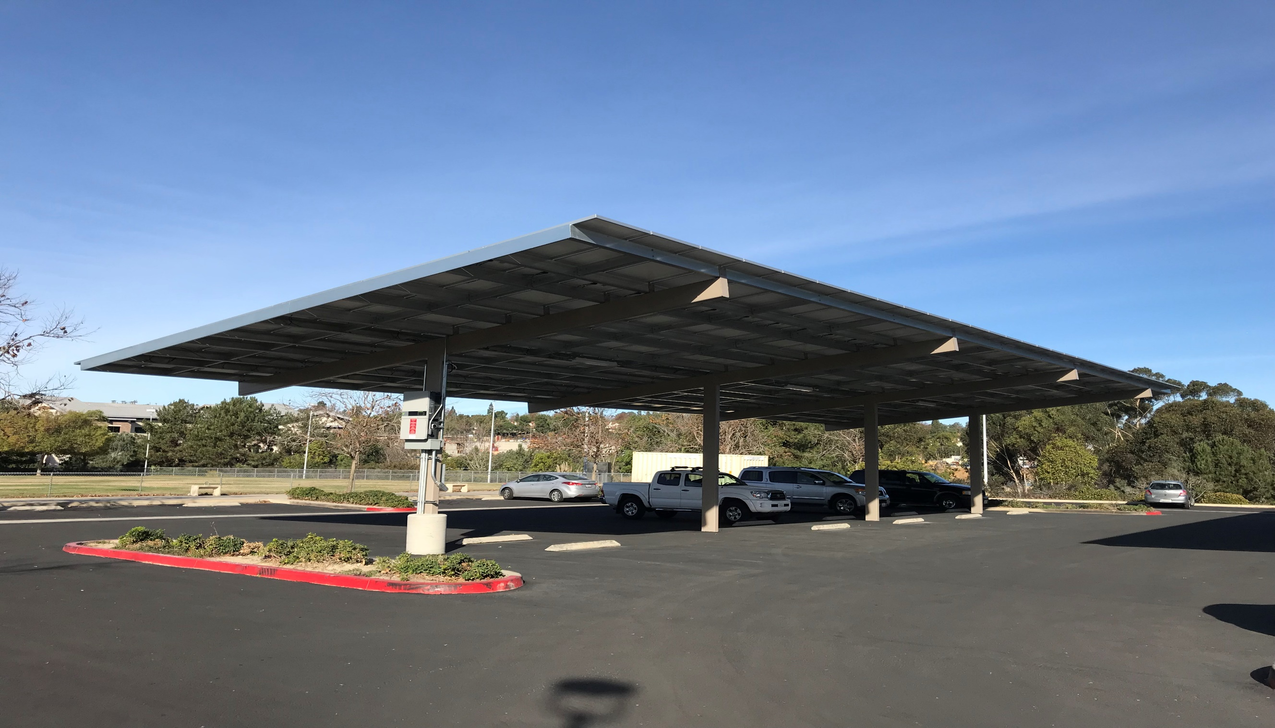
APWA Honor Award 2018

Slide 6
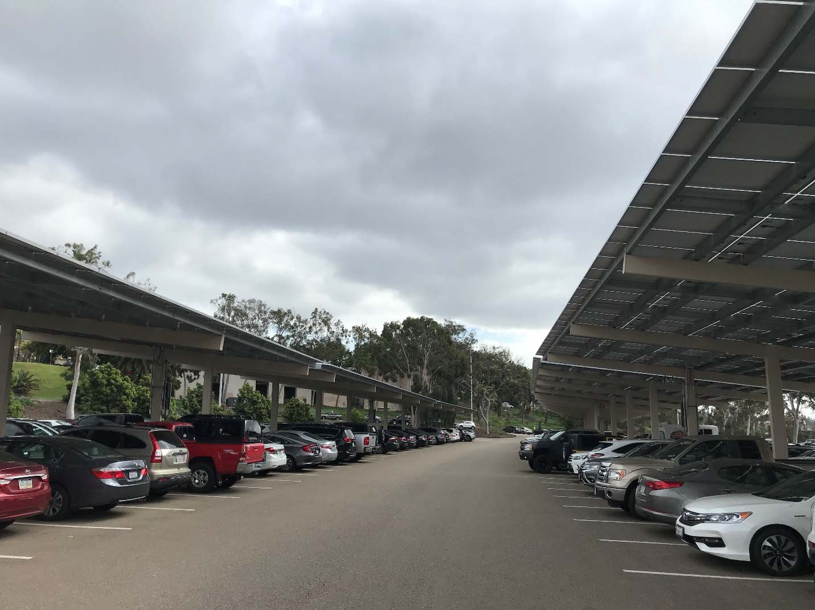
APWA Project of the Year 2019

Slide 7
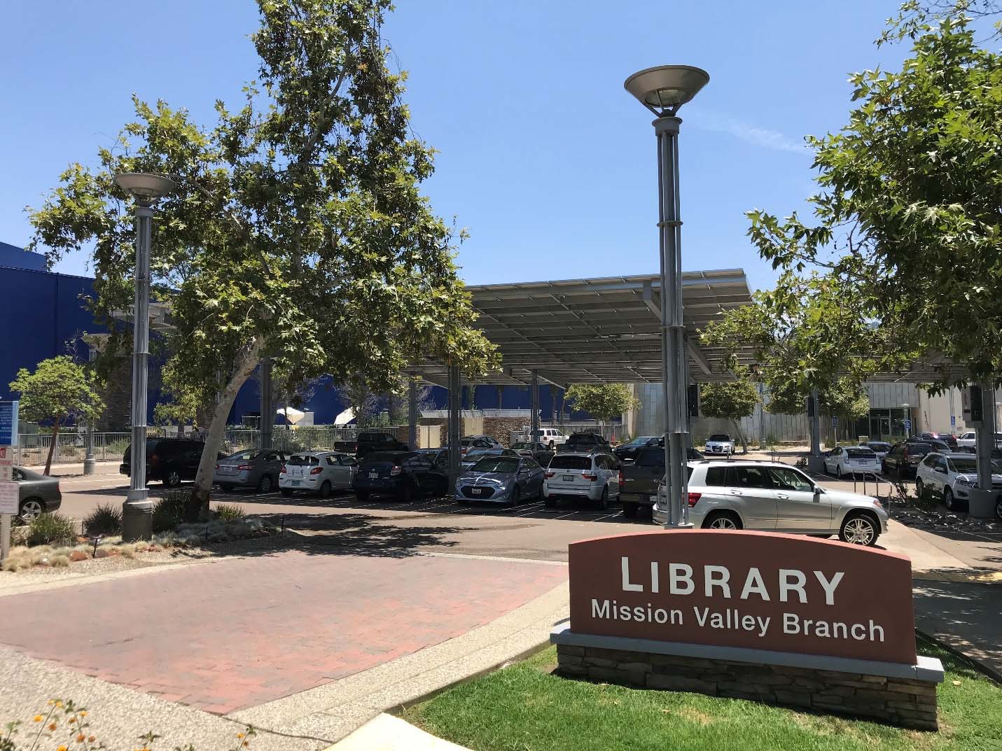
APWA Project of the Year 2019

Slide 8
Issues & Future Risks
Issues During Planning and Construction:
Community support
Received push back from stakeholders based on blocking architectural views and conflicting land uses
Restore parking lot and landscape conditions after the completion of construction
Future Risks:
Roof replacement or repair
4 of 17 projects are on roof tops
Roofs will likely need to be replaced or repaired within PPA 20 year term
Will result in costs to City to remove and replace panels, and costs to cover loss in revenue while panels are not generating (the contract only allows 15 days as Allowed Disruption Time over 20 years

