Slide 1

CPMA Middle and Gage Elementary
General Development Plan
Planning Department
Park and Recreation Board
April 20, 2017
Information Item #201

Slide 2

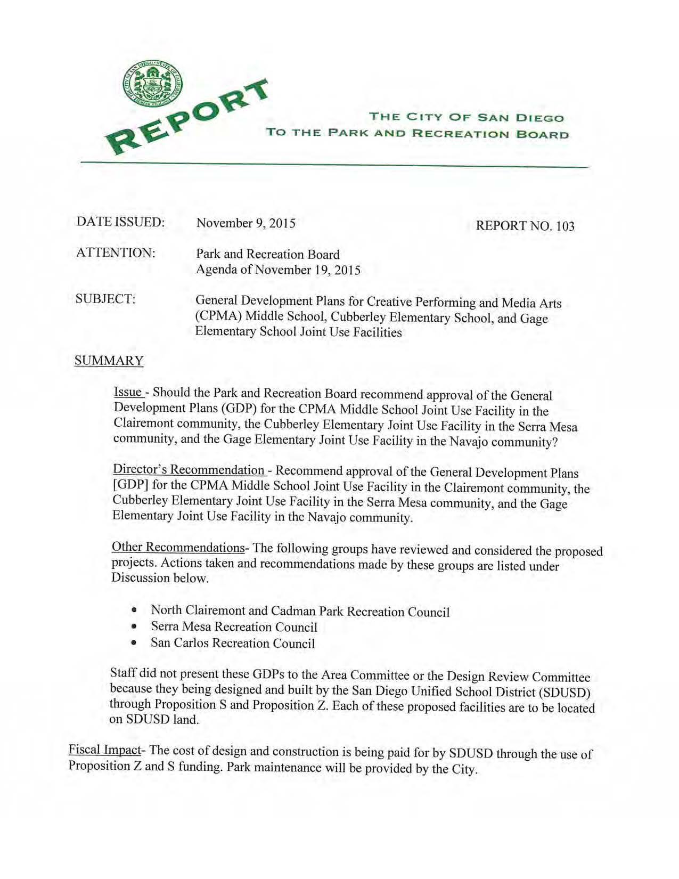
Planning Department
Background
On November 19, 2015, Report No. 103, the Park and Recreation Board took action to recommend approval of the General Development Plans for joint use facilities at:
Creative Performing and Media Arts (CPMA) Middle School located at 5050 Conrad Avenue in the Clairemont Community
Gage Elementary School located at 6811 Bisby Lake Avenue in the Navajo Community
A Notice of Exemption for the projects has been prepared by San Diego Unified and will be taken to the School District Board for approval on April 25, 2017.

Slide 3
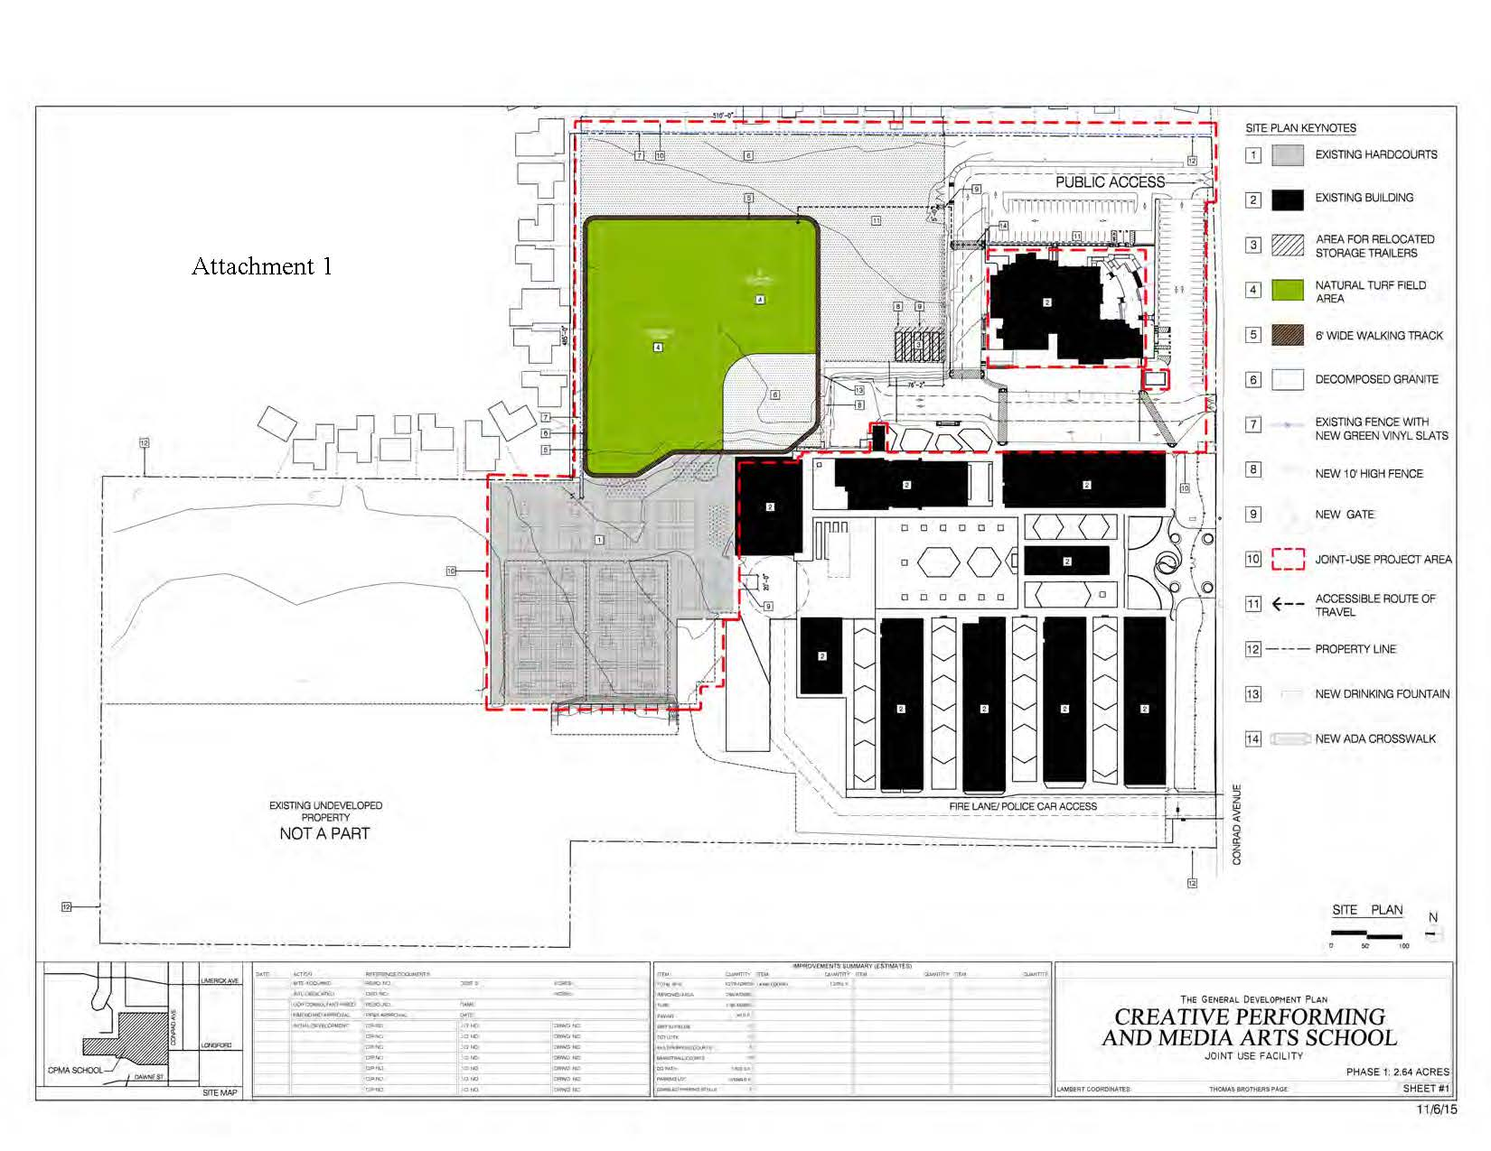
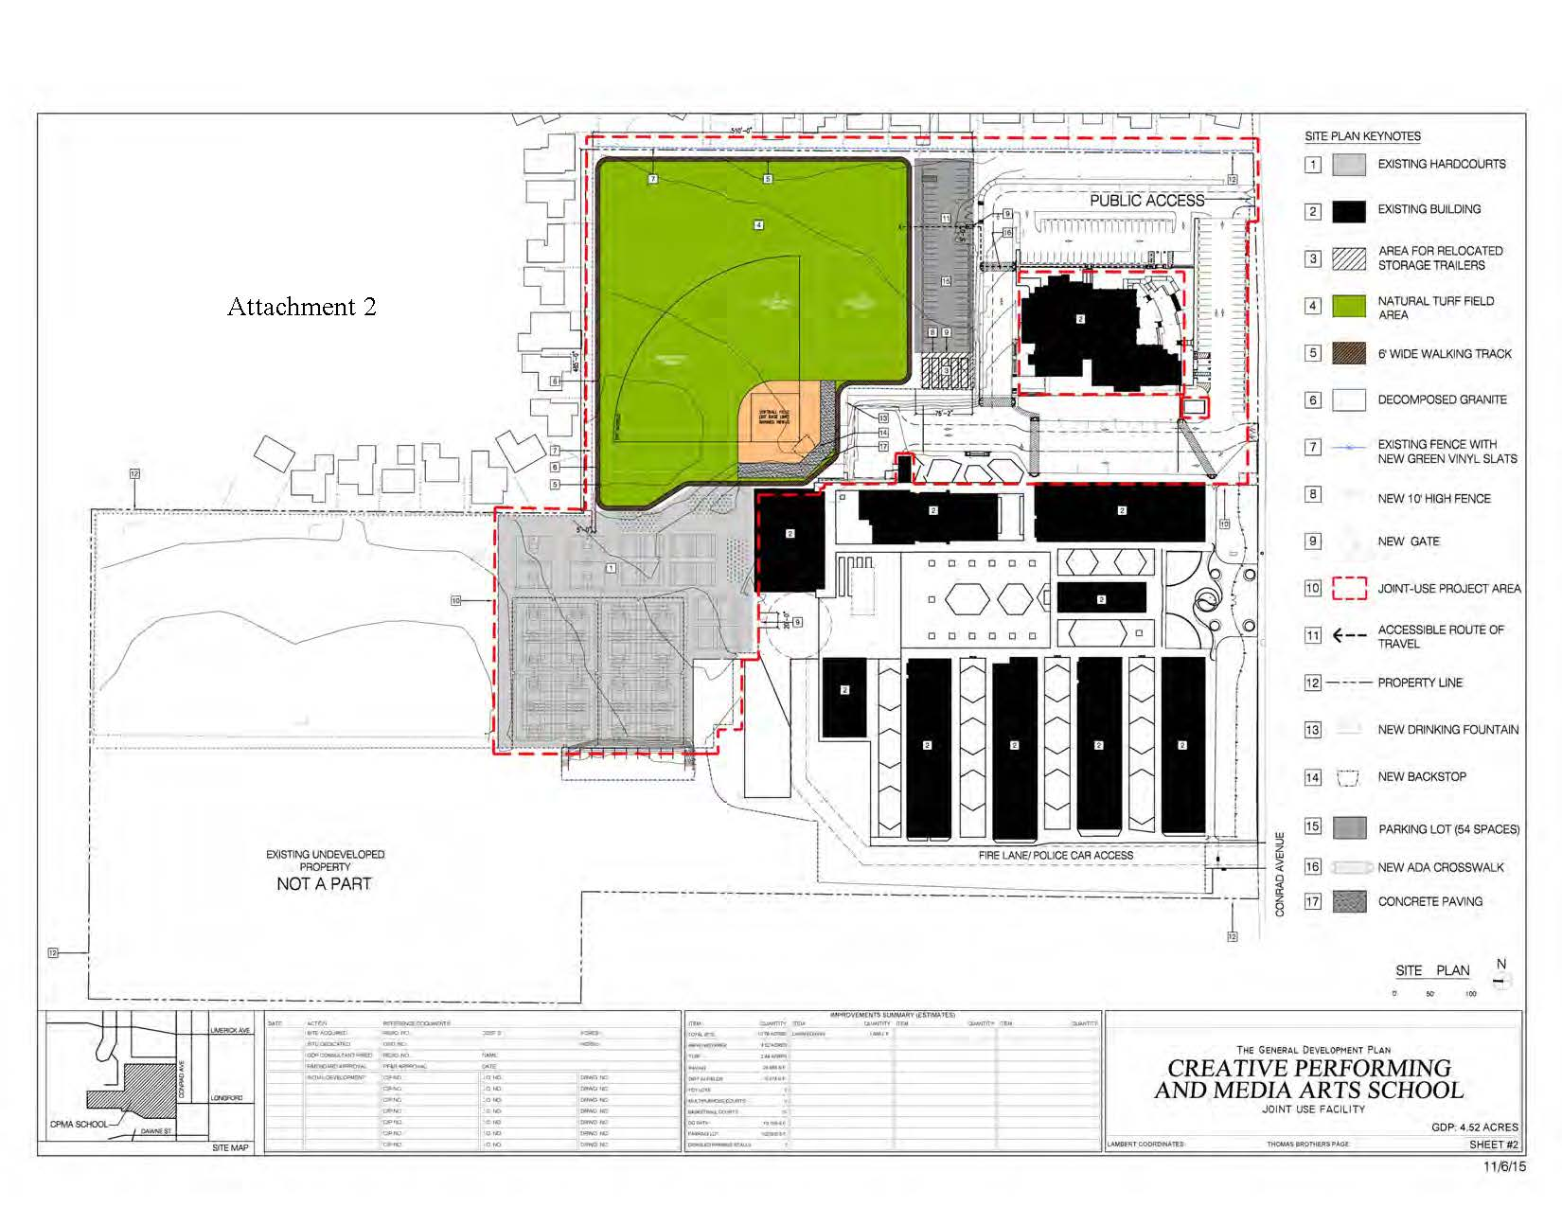
Planning Department
CPMA Middle School
General Development Plan
Phase 1
Design is complete. Construction anticipated to begin summer 2017
Phase 2
Design and construction to occur when funding is identified

Slide 4
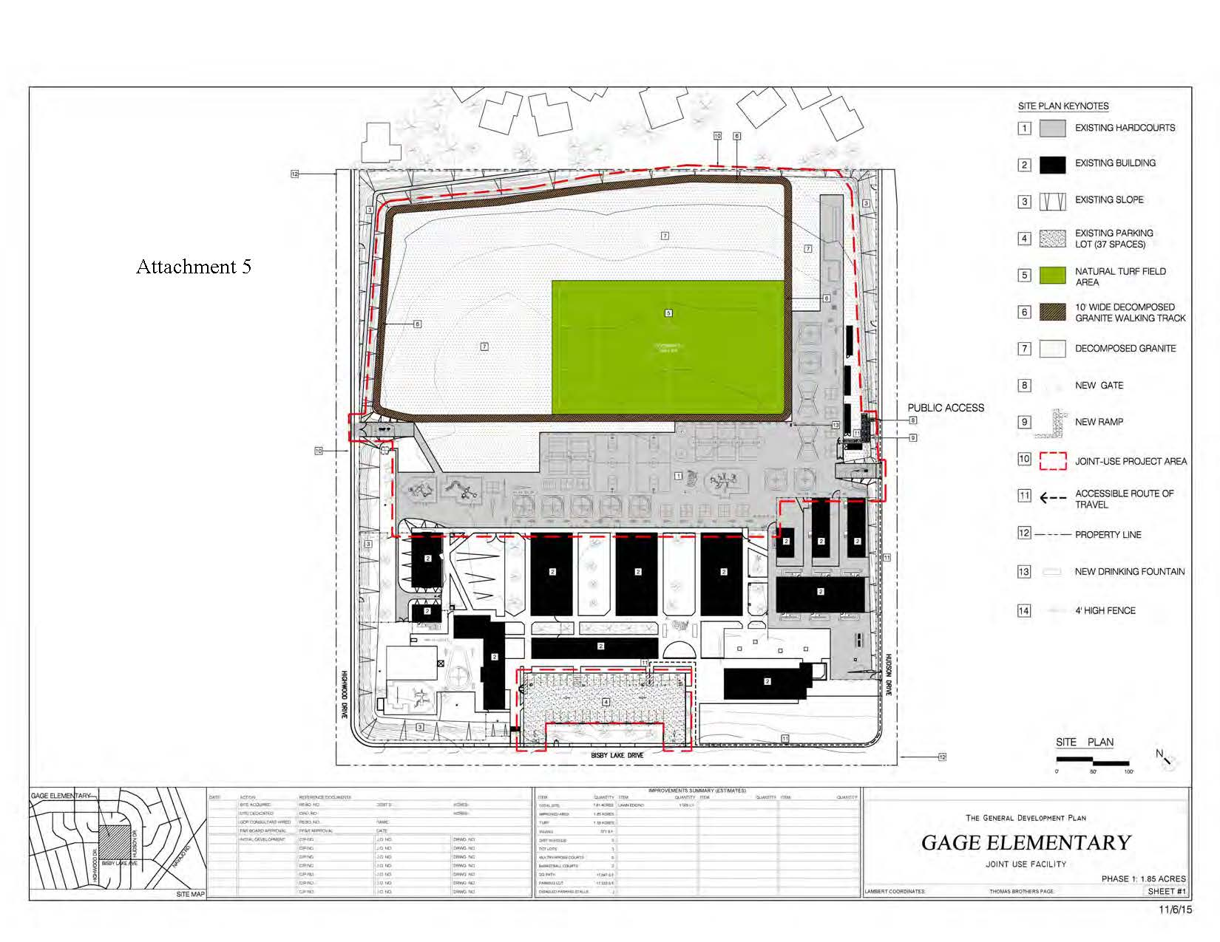
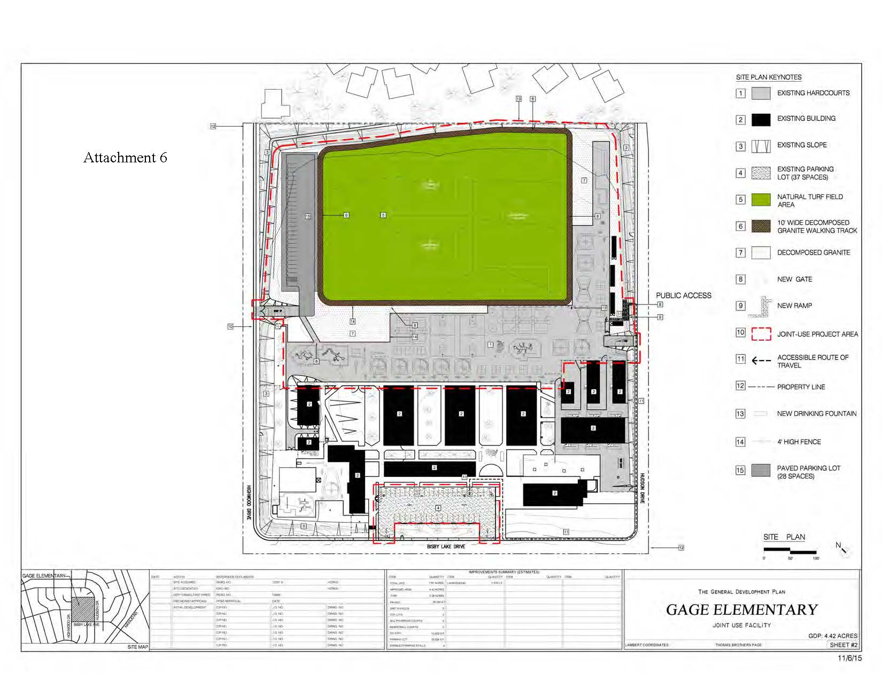
Planning Department
Gage Elementary School
General Development Plan
Phase 1
Design is complete. Construction anticipated to begin summer 2017
Phase 2
Design and construction to occur when funding is identified

