Slide 1
Linda Vista Elementary School Joint Use General Development Plan
Planning Department
Park and Recreation Board
April 20, 2017
Action Item #101

Slide 2
Planning Department
Introduction
Play All Day Parks Program
New initiative put forth by Mayor Kevin Faulconer and Superintendent Cindy Marten in 2016
Over 30 new joint use parks in the next 5-10 years
Joint-use Facility will be open to the public when school is not in session

Slide 3
Planning Department
Background
Linda Vista Elementary School
This project provides for the design and construction of a new joint use facility at Linda Vista Elementary School.
Located at 2772 Ulric Street in the Linda Vista Community, Council District 7.
Will provide 2.27 acres of population based park land in this park deficient community.
Linda Vista Elementary Joint Use

Slide 4
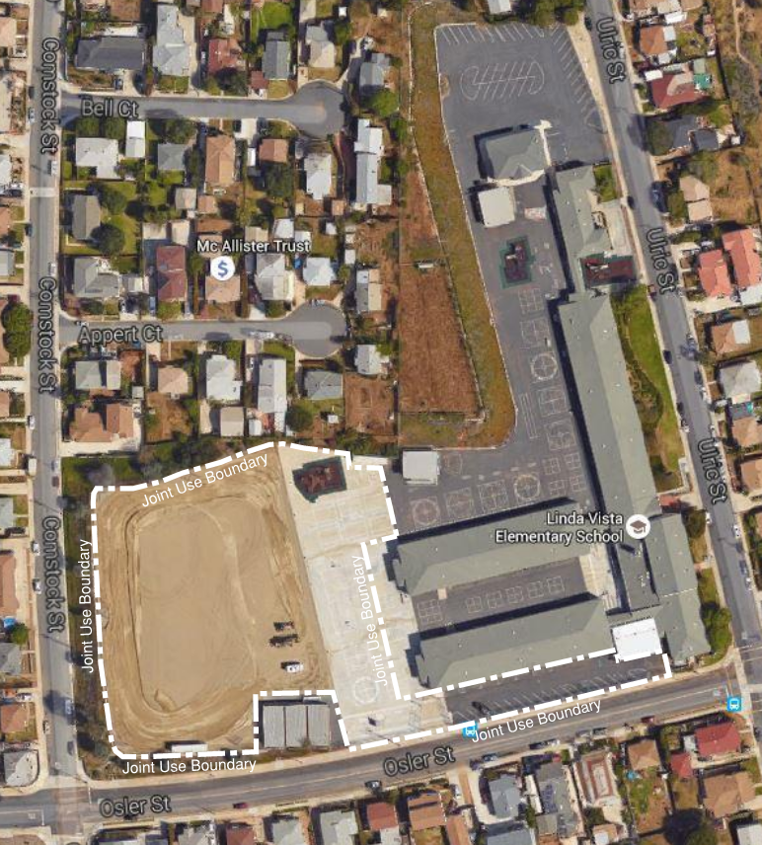
Planning Department
Project Scope
Design and construction of a multi-purpose natural turf field, walking track, drinking fountain, trees and existing hardcourts and play equipment.
Funding for Design and Construction:
San Diego Unified School District Proposition S & Z Capital Improvement Bond Program
Linda Vista Elementary School
Site Location, Aerial Map

Slide 5
Planning Department
Discussion
Community Concerns
Nighttime Security
Gates will be locked at dusk by a security company
Security Lighting
Additional wall pack security lighting will be added to school buildings
Noise
No amplification of noise permitted at this site

Slide 6
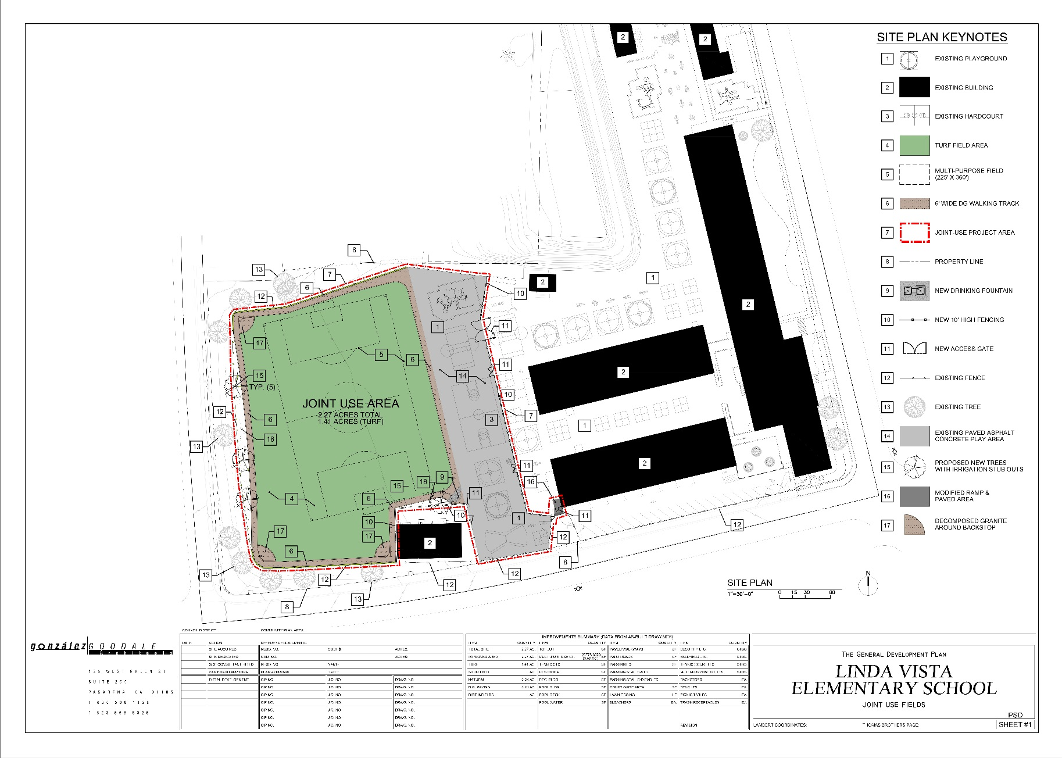
Planning Department
General Development Plan

Slide 7
Planning Department
Public Input Process
Other Recommendations
On April 27, 2016, a public meeting was conducted at the Linda Vista Elementary School to introduce the project and gather community input in preparation of the GDP.
On May 10, 2016, the Linda Vista Recreation Council voted (9-0-0) to approve the proposed GDP.
On December 13, 2016, the Linda Vista Recreation Council voted (9-0-0) to recommend approval of the Revised General Development Plan that eliminated the off-street parking for the Linda Vista Elementary School Joint Use Facility.

Slide 8
Planning Department
Recommendation
Recommend approval of the General Development Plan (GDP) for the Linda Vista Elementary School Joint Use Facility

