Slide 1
Marvin Elementary School Joint Use General Development Plan
Planning Department
Park and Recreation Board
April 20, 2017
Action Item #102

Slide 2
Planning Department
Introduction
Play All Day Parks Program
New initiative put forth by Mayor Kevin Faulconer and Superintendent Cindy Marten in 2016
Over 30 new joint use parks in the next 5-10 years
Joint-use Facility will be open to the public when school is not in session

Slide 3
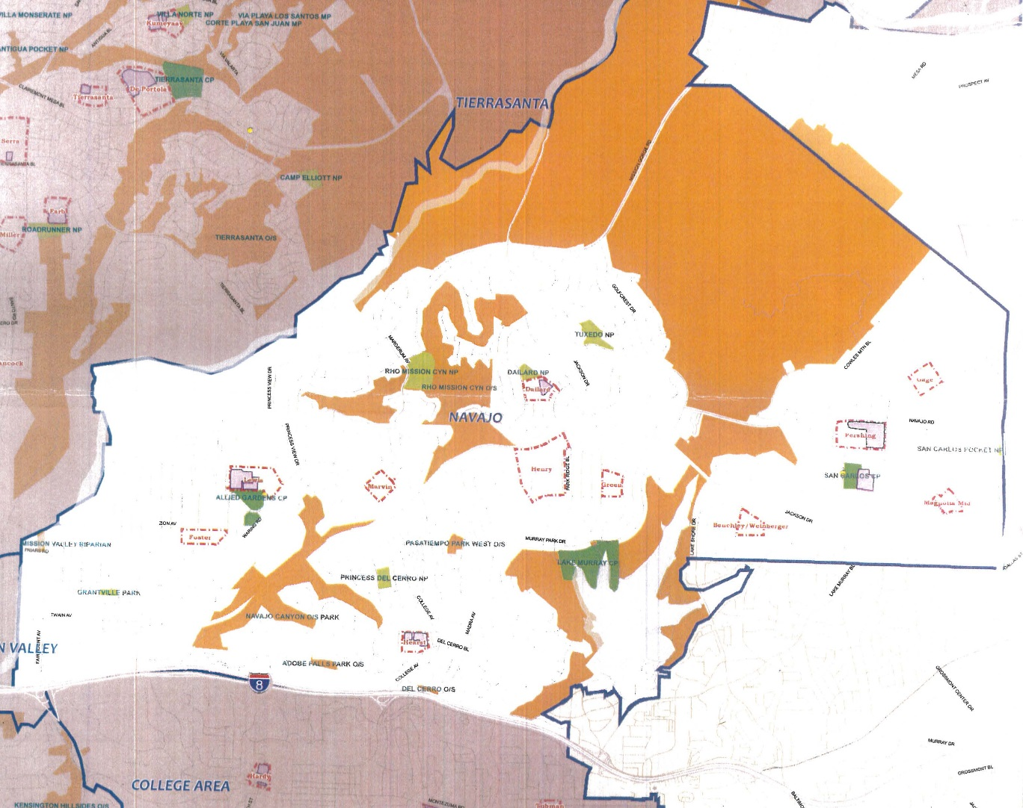
Planning Department
Background
Marvin Elementary School
This project provides for the design and construction of a new joint use facility at Marvin Elementary School.
Located at 5720 Brunswick Avenue within the Navajo Community, Council District 7.
Will provide 3.87 acres of population based park land in this park deficient community.
Linda Vista Elementary Joint Use

Slide 4
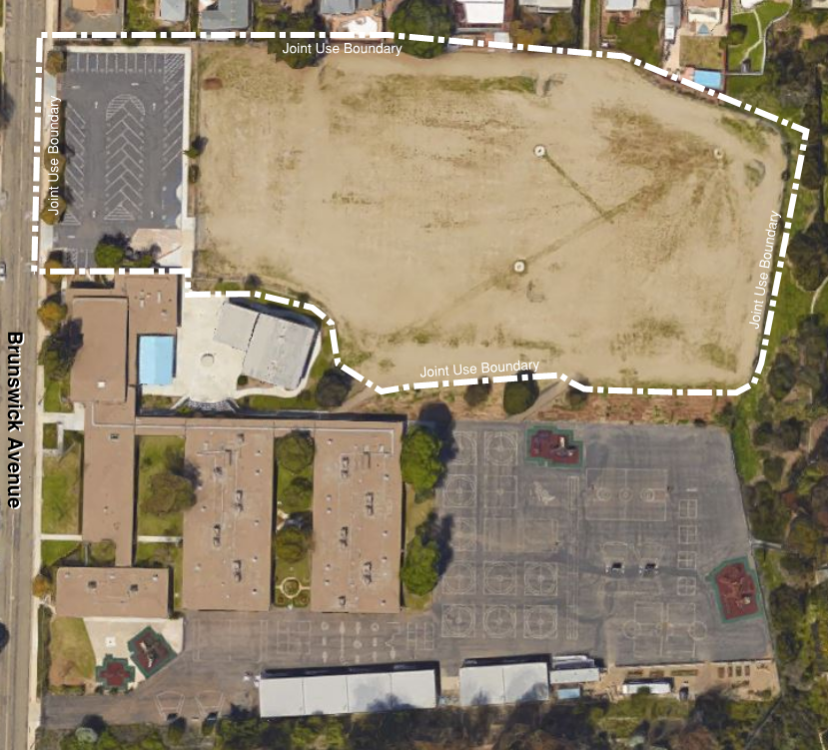
Planning Department
Project Scope
Design and construction of a multi-purpose natural turf field, walking track, drinking fountain, trees, fence screening and off-street parking.
Funding for Design and Construction:
San Diego Unified School District Proposition S & Z Capital Improvement Bond Program
Marvin Elementary School
Site Location, Aerial Map

Slide 5
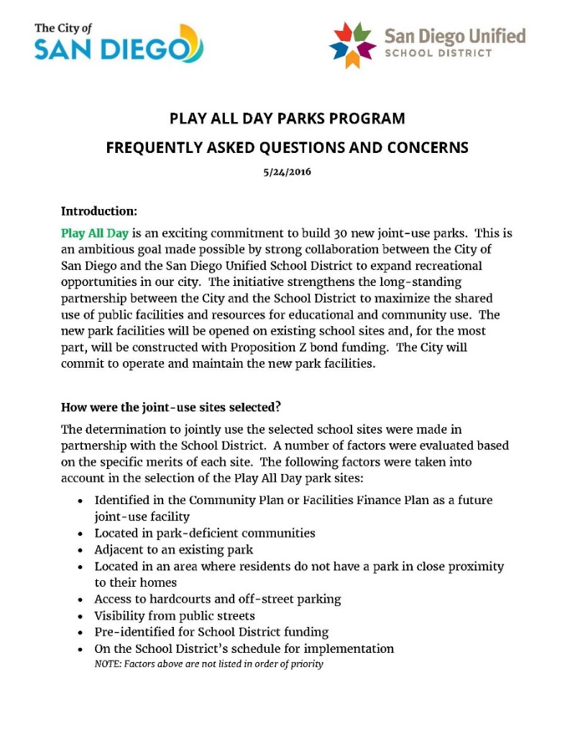
Planning Department
Discussion
Community Concerns
Nighttime Security
Gates will be locked at dusk by a security company
Noise
No amplification of noise permitted at this site
Ballfield Lighting
No field lighting will be permitted at this site
Parking and Traffic
New off-street student drop off provided
Trees and Screening
Fence screening and trees on north side of field
Future trees on south side of field to provide shade

Slide 6
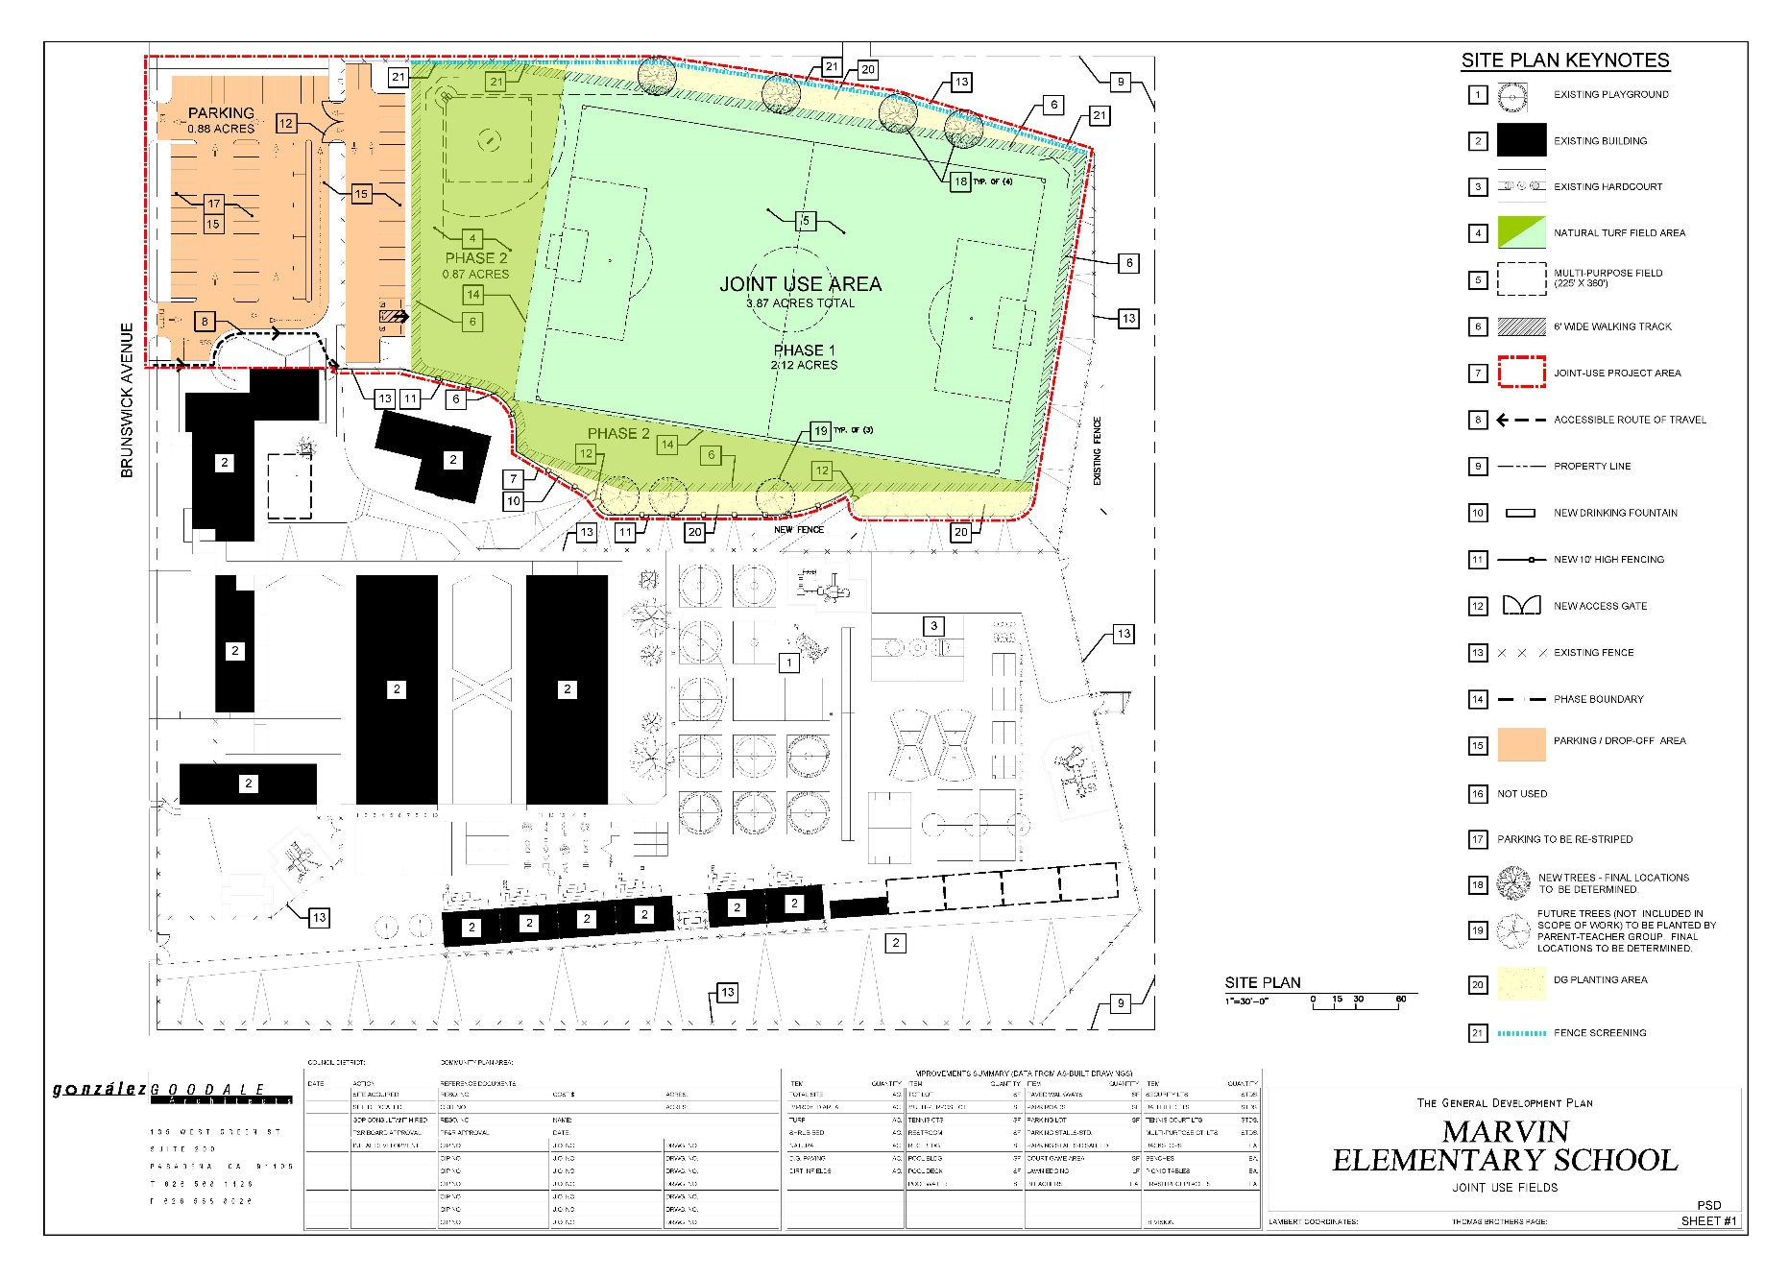
Planning Department
General Development Plan

Slide 7
Planning Department
Public Input Process
Other Recommendations
On April 20, 2016, a public meeting was conducted at the Marvin Elementary School to introduce the project and gather community input in preparation of the GDP.
On May 2, 2016, the Allied Gardens Recreation Council voted to take no action on the proposed GDP.
On September 12, 2016, the Allied Gardens Recreation Council voted (12-0-0) to recommend approval of the General Development Plan for the Marvin Elementary School Joint Use Facility.

Slide 8
Planning Department
Recommendation
Recommend approval of the General Development Plan (GDP) for the Marvin Elementary School Joint Use Facility

