Slide 1

Planning Department
City of San Diego Park & Recreation Board
Meeting April 20, 2017
Item #202
Mission Trails Regional Park Master Plan Update /
Natural Resource Management Plan /
Programmatic Environmental Impact Report

Slide 2


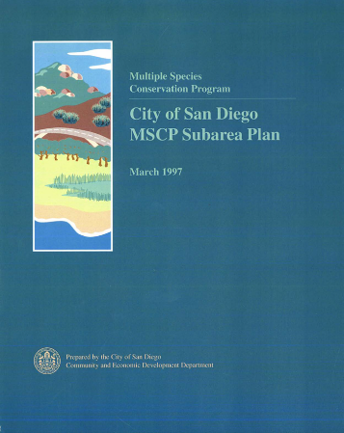
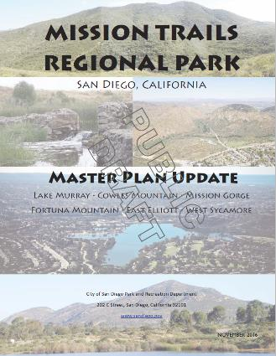
1985 – Adoption of the Mission Trails Regional Park Master Development Plan
1997 – Adoption of the City of San Diego Multiple Species Conservation Program Subarea Plan
2017 – Anticipated Adoption of the Mission Trails Regional Park Master Plan Update

Slide 3
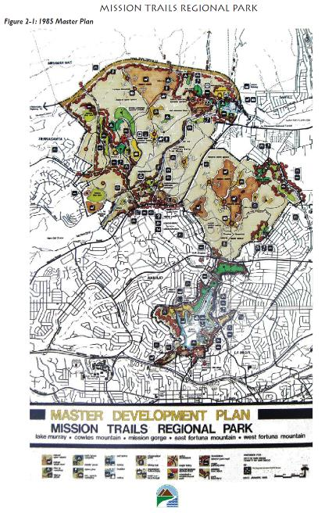
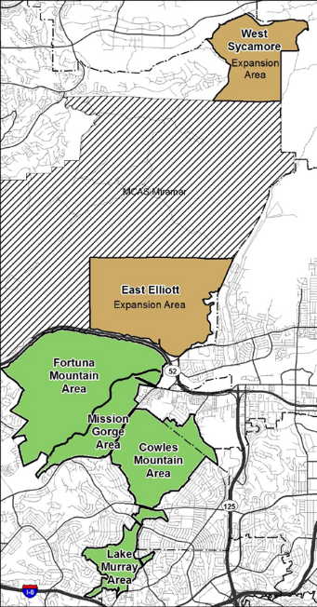
Reasons for Master Plan Update:
1997- Multiple Species Conservation Program Subarea Plan limited development potential of the 1985 MTRP Master Development Plan
Proposed expansion of park boundaries.
2012 West Sycamore – approximately 1,800 acres deeded to the City
East Elliot - approximately 2,600 acres/City currently owns about 730 acres

Slide 4
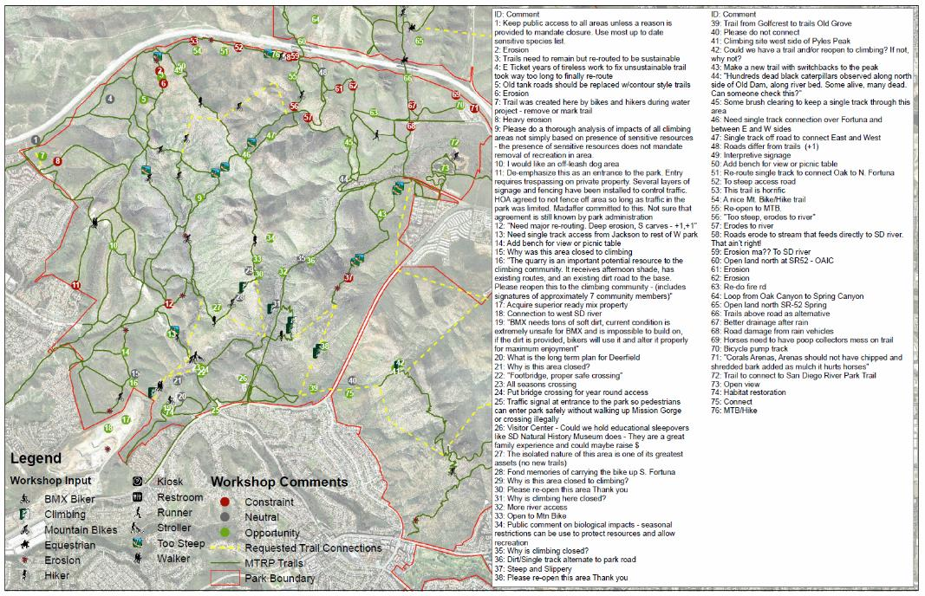
Public Input Process:
Workshop #1 (27JAN2011): Objectives, Issues, Concerns & Priorities
Workshop #2 (31MAR2011): Draft Alternatives
Workshop #3 (09JUN2011): Preferred Alternative

Slide 5
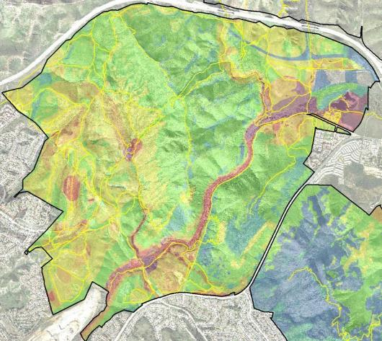
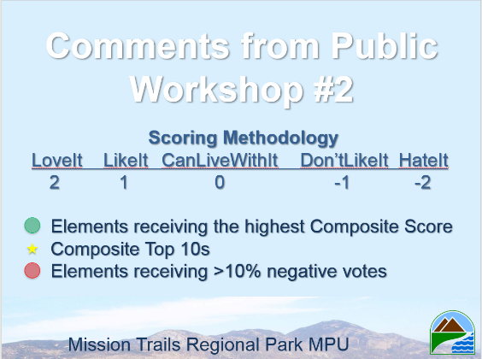
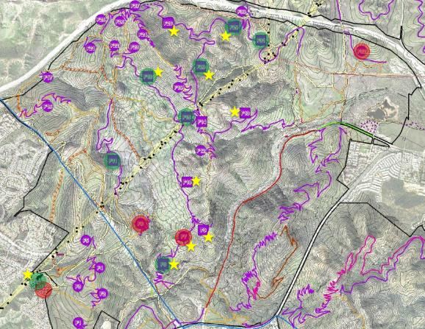
Public Input Process:
Workshop #1 (27JAN2011): Objectives, Issues, Concerns & Priorities
Workshop #2 (31MAR2011): Draft Alternatives
Workshop #3 (09JUN2011): Preferred Alternative

Slide 6
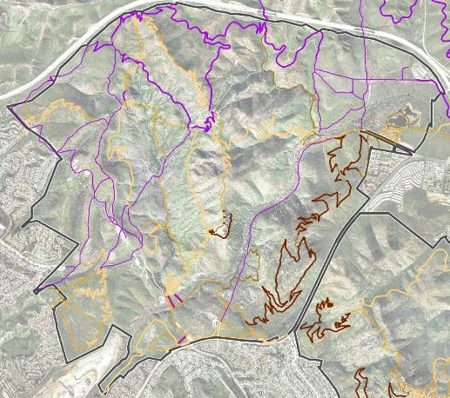
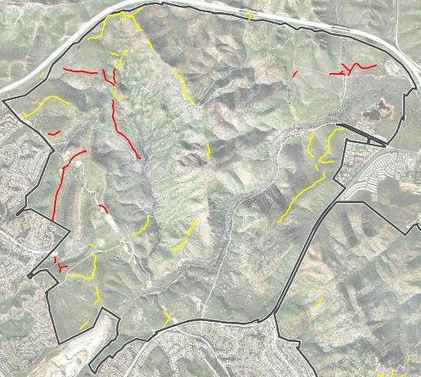
Recommendations:
San Diego River Trail
Deerfield Bike Skills
Oak Grove Parking
San Diego River Crossing
Several New Trail Connections/Loops
South Fortuna Climbing Access
Public Input Process:
Workshop #1 (27JAN2011): Objectives, Issues, Concerns & Priorities
Workshop #2 (31MAR2011): Draft Alternatives
Recommendations:
Close several redundant trails
Reroute and close several fall line trails
Reroute and close a few trails with resource management conflicts
Workshop #3 (09JUN2011): Preferred Alternative

Slide 7
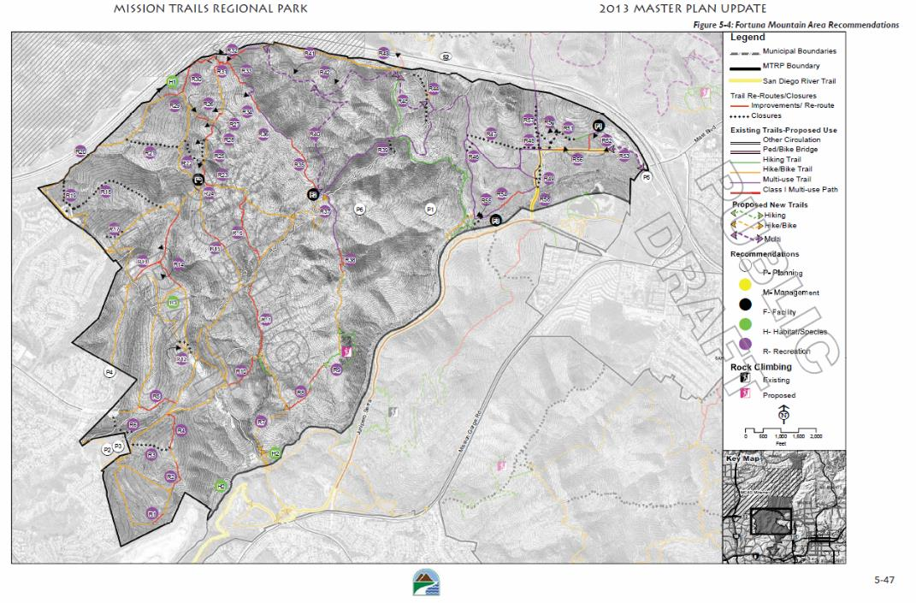
Draft MTRP MPU:
First Public Draft (NOV2013)

Slide 8
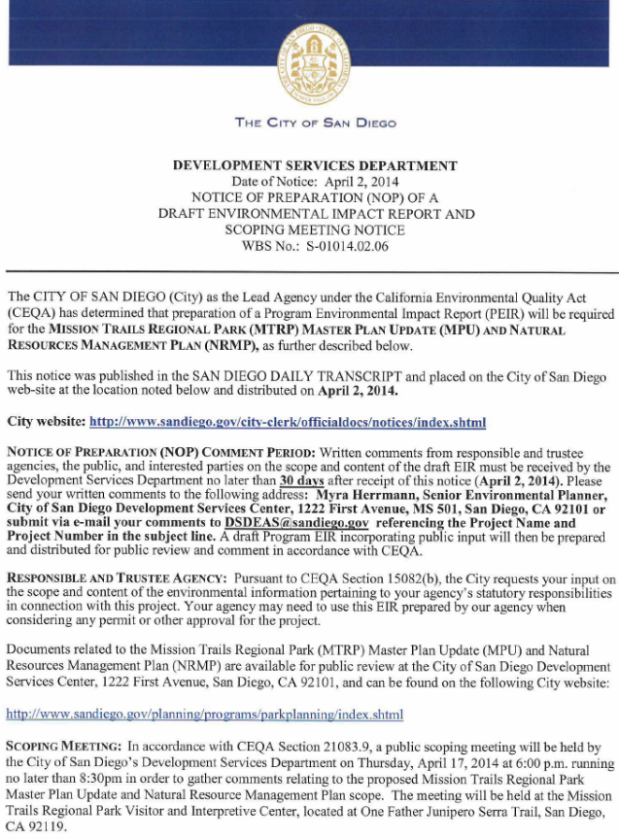
Draft MTRP MPU:
First Public Draft (NOV2013)
NOP (APR2014)

Slide 9
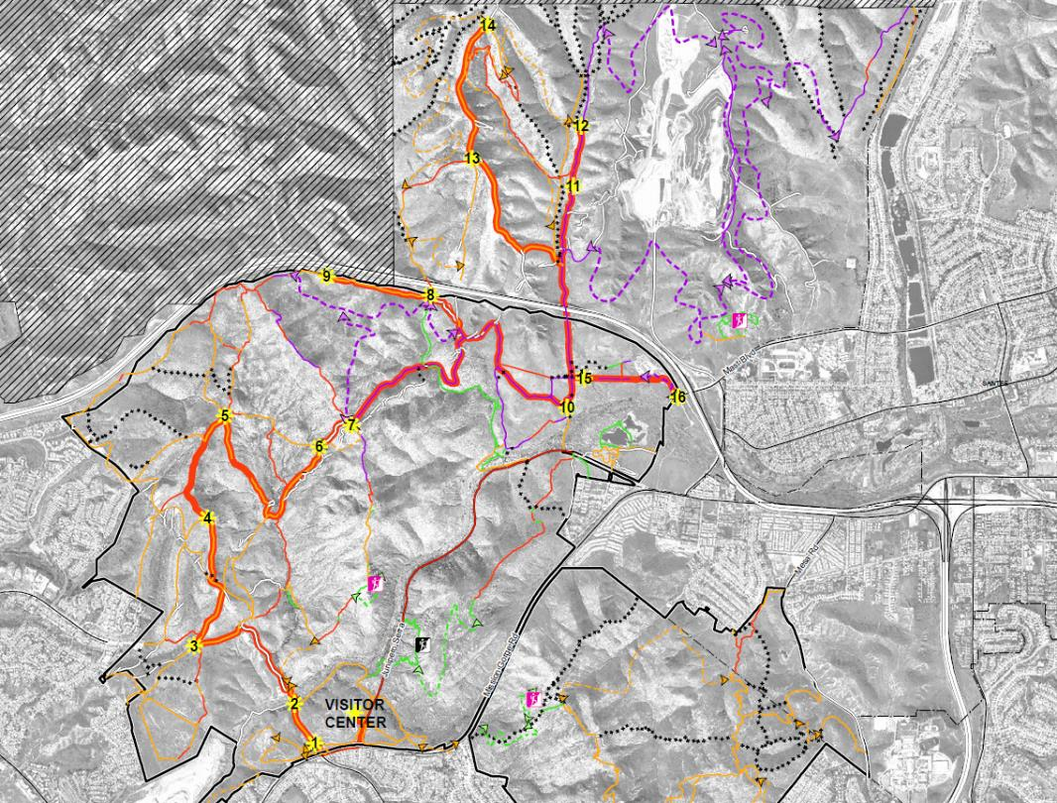
Draft MTRP MPU:
First Public Draft (NOV2013)
NOP (APR2014)
Coordination w/Resource Agencies & Interested User Groups

Slide 10
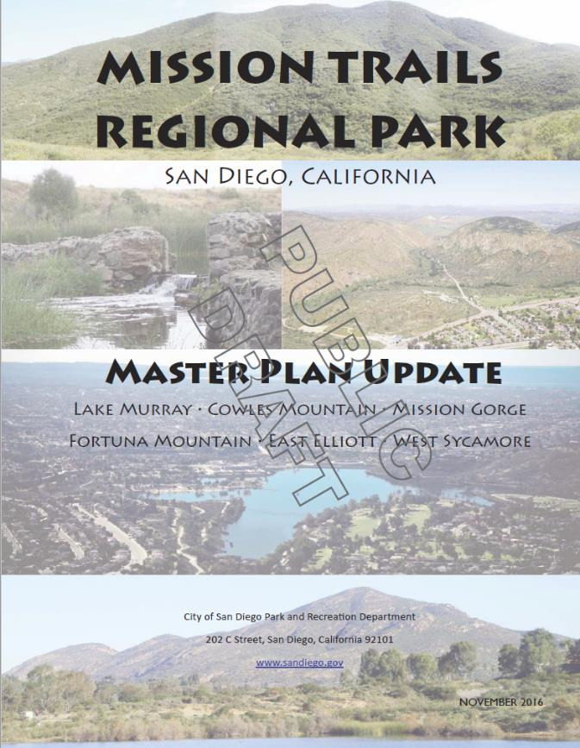
MTRP MPU Organization:
Introduction
History of the Park
Park Overview
Planning and Analysis
Recommendations
Implementation
Appendices

Slide 11
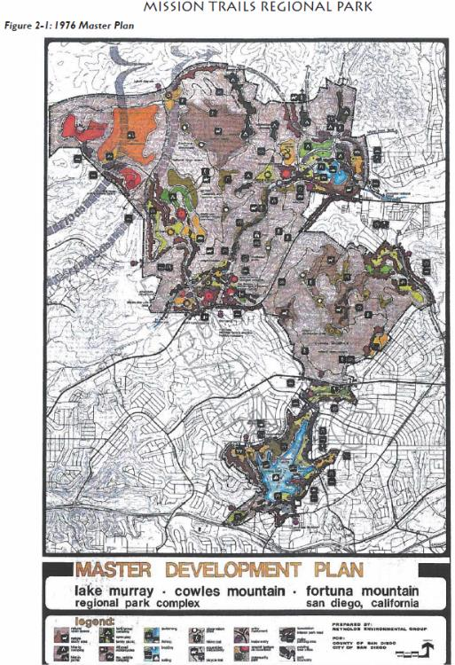
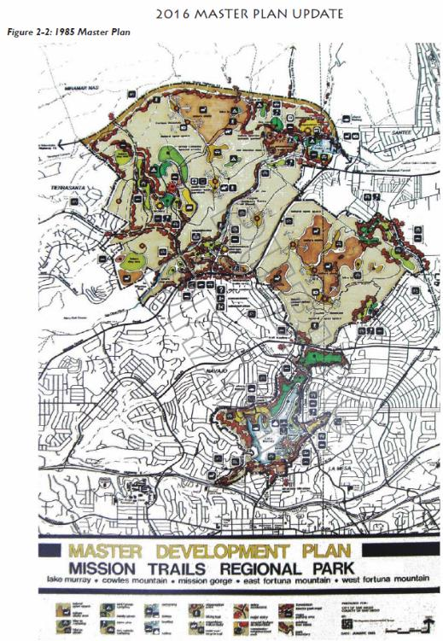
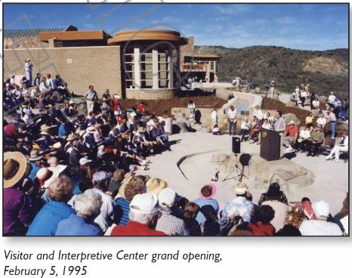
MTRP MPU Organization:
Introduction
History of the Park
Park Overview
Planning and Analysis
Recommendations
Implementation
Appendices

Slide 12
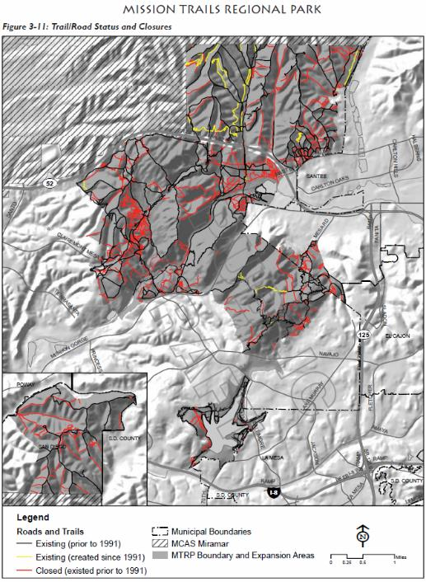
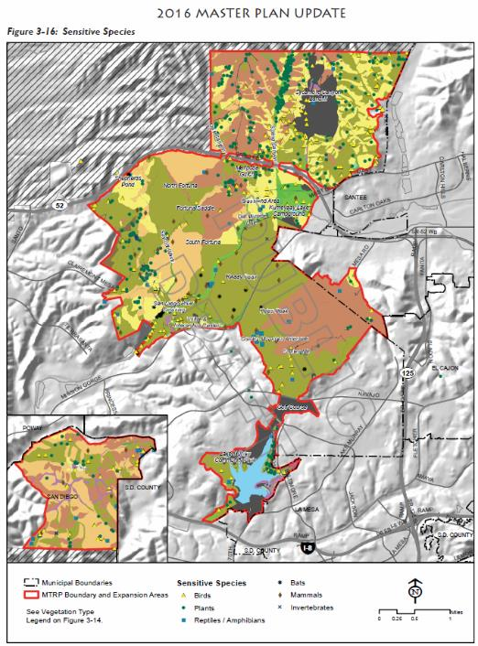
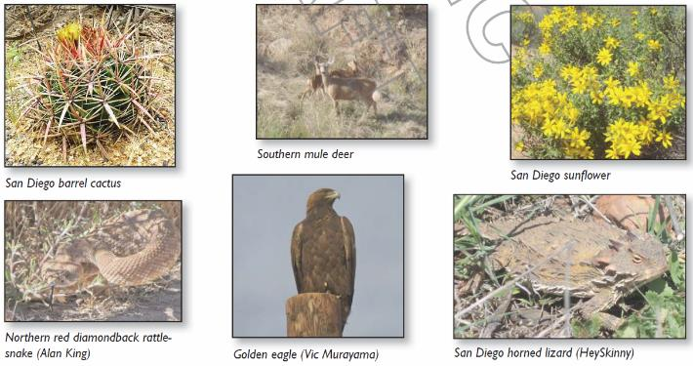
MTRP MPU Organization:
Introduction
History of the Park
Park Overview
Planning and Analysis
Recommendations
Implementation
Appendices

Slide 13
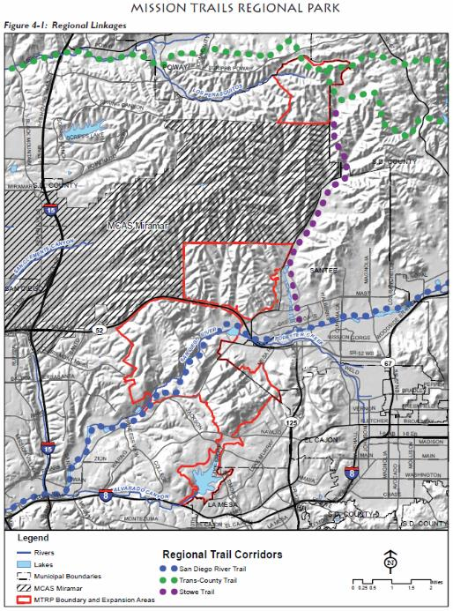
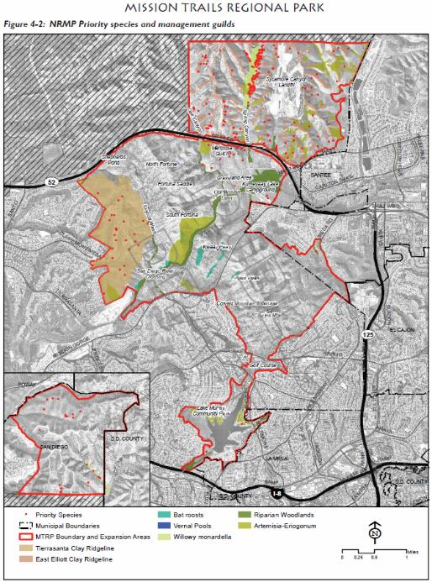
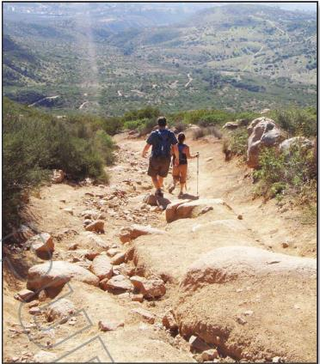
MTRP MPU Organization:
Introduction
History of the Park
Park Overview
Planning and Analysis
Recommendations
Implementation
Appendices

Slide 14
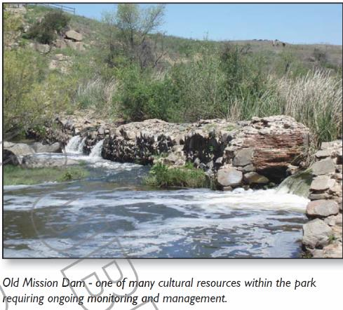
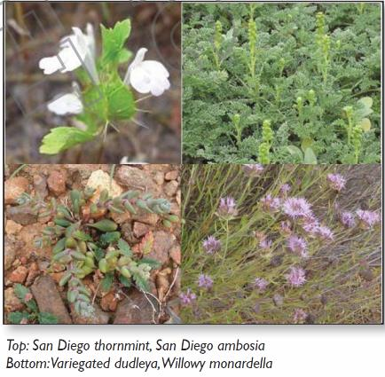
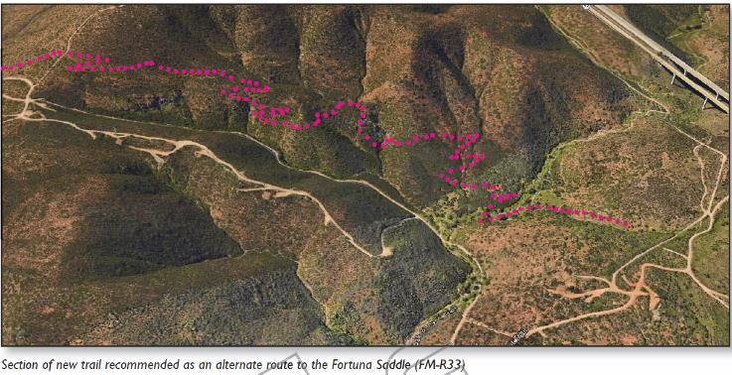
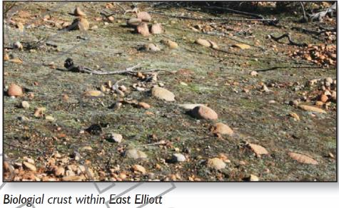
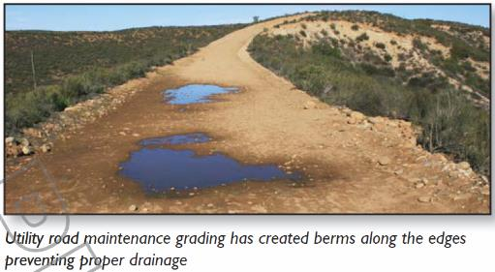
MTRP MPU Organization:
Introduction
History of the Park
Park Overview
Planning and Analysis
Recommendations
Implementation
Appendices

Slide 15
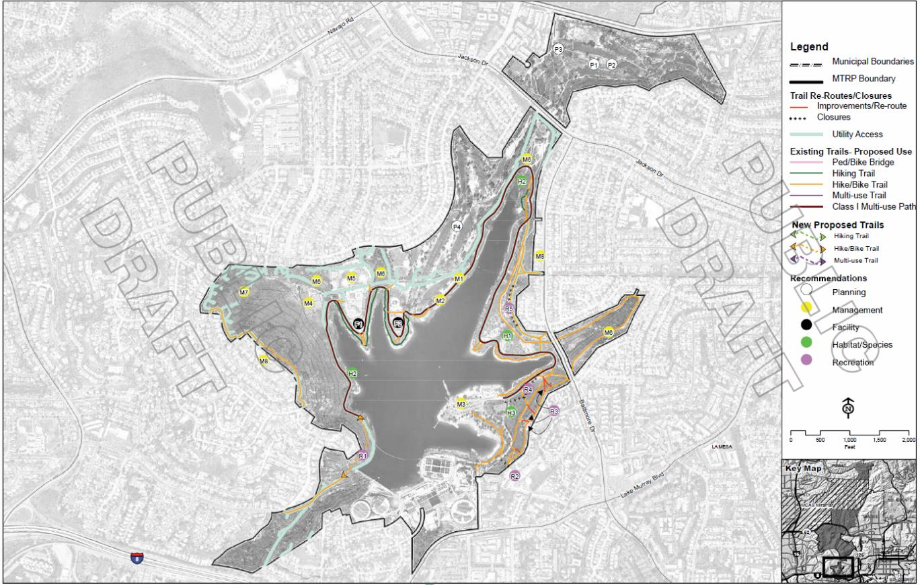
2016 Draft MTRP MPU
(Lake Murray Area)

Slide 16
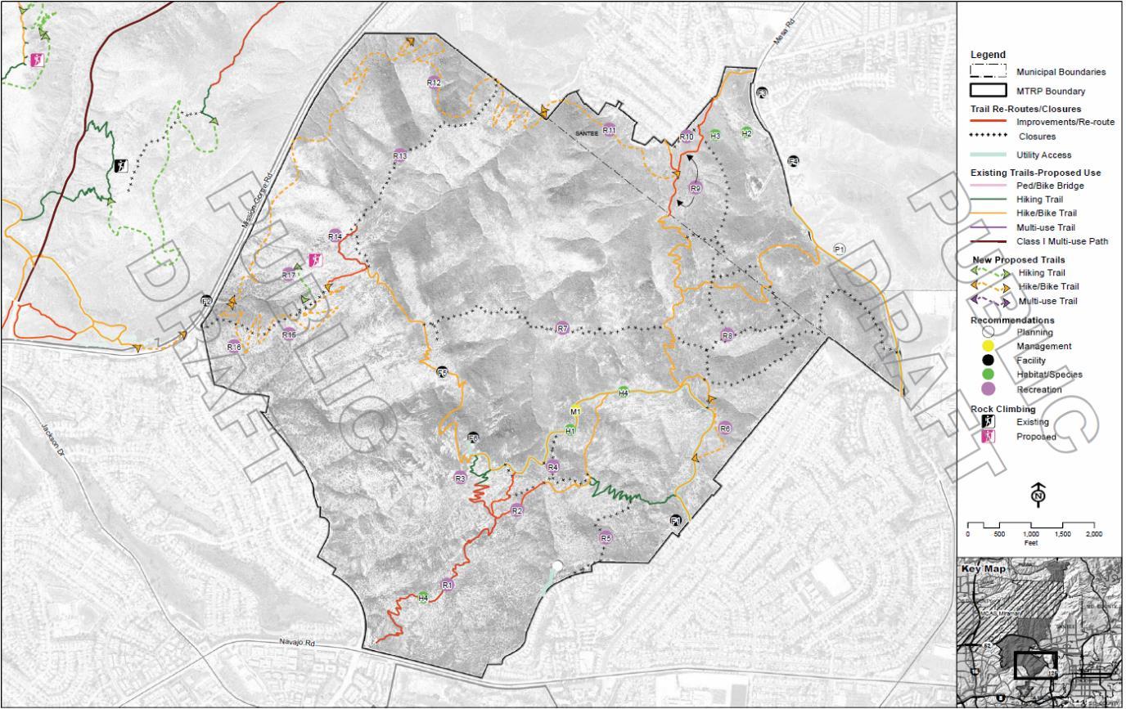
2016 Draft MTRP MPU
(Cowles Mountain Area)

Slide 17
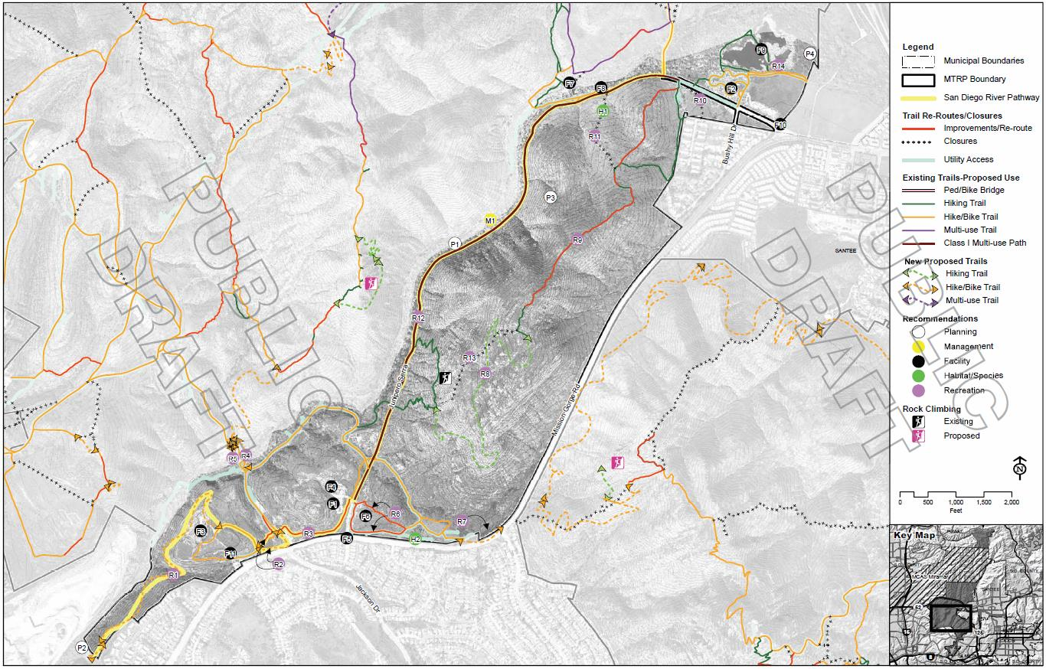
2016 Draft MTRP MPU
(Mission Gorge Area)

Slide 18
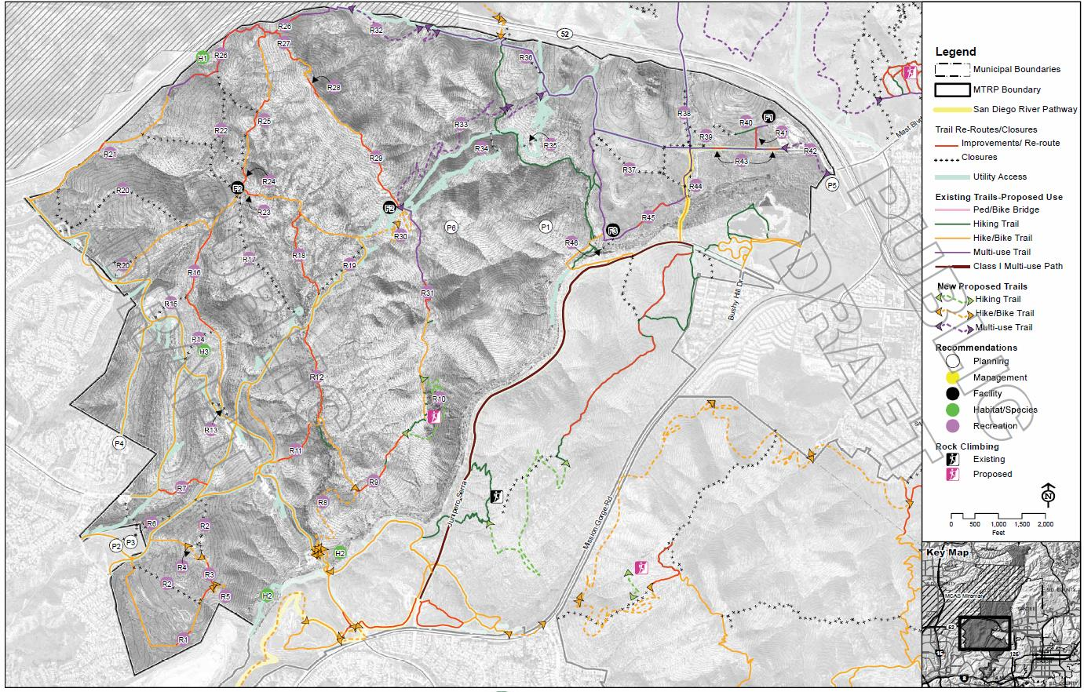
2016 Draft MTRP MPU
(Fortuna Mountain Area)

Slide 19
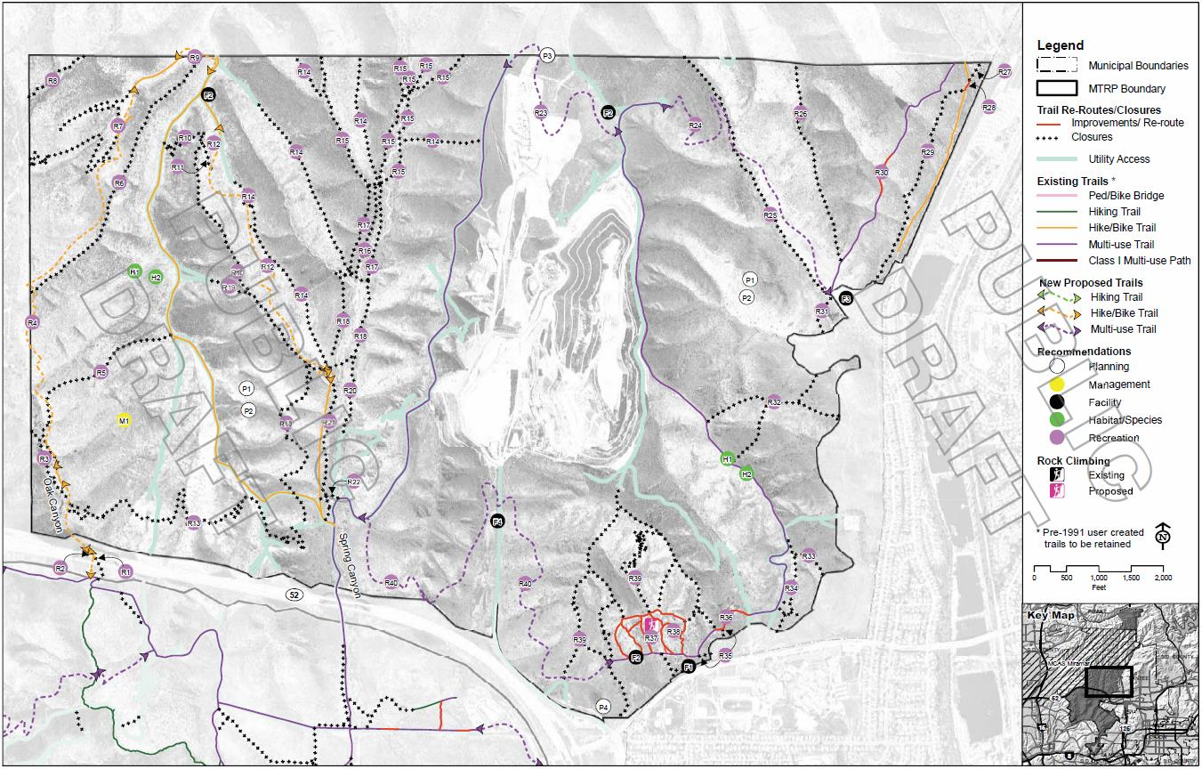
2016 Draft MTRP MPU
(East Elliott Area)

Slide 20
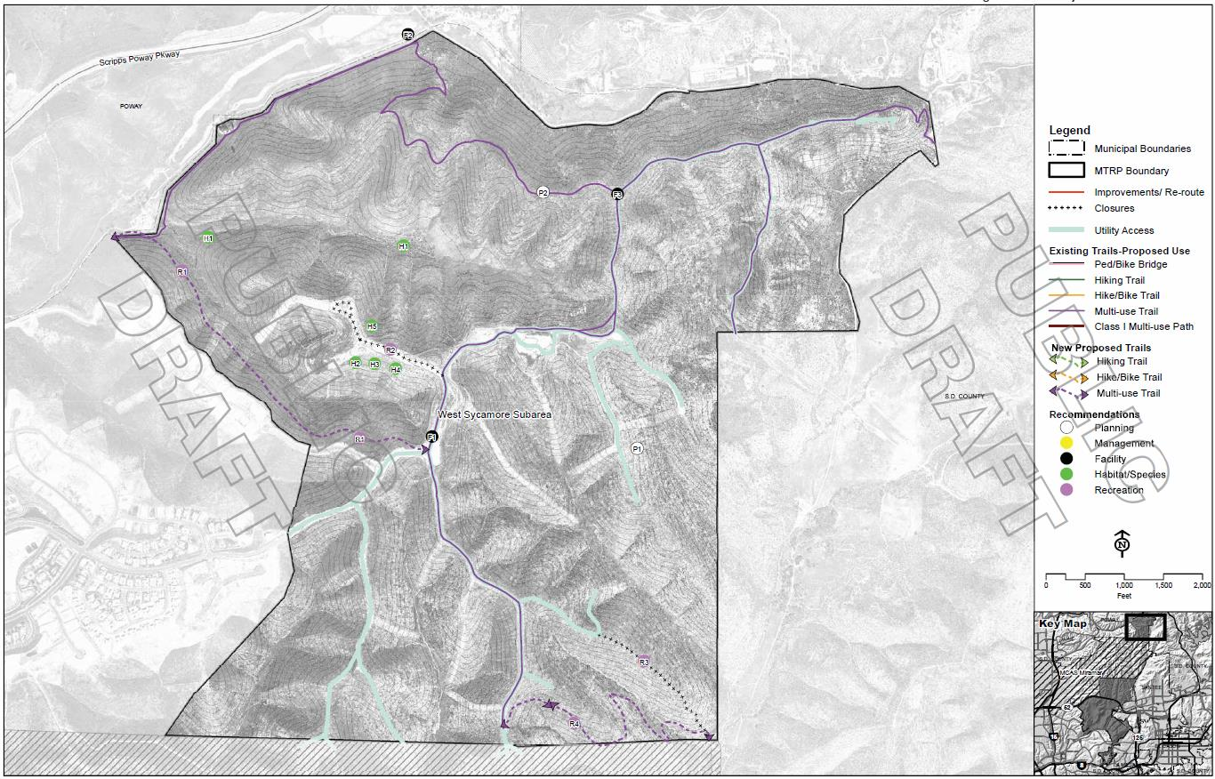
2016 Draft MTRP MPU
(West Sycamore Area)

Slide 21
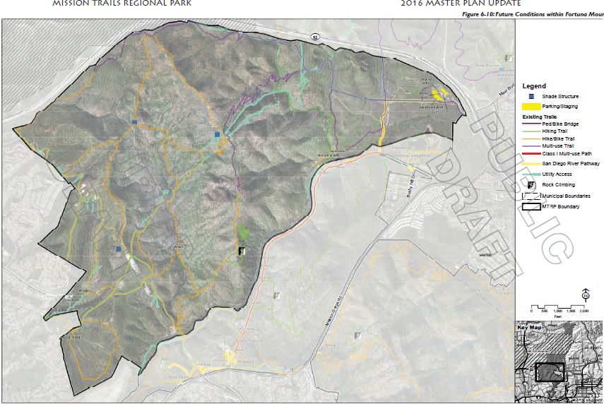
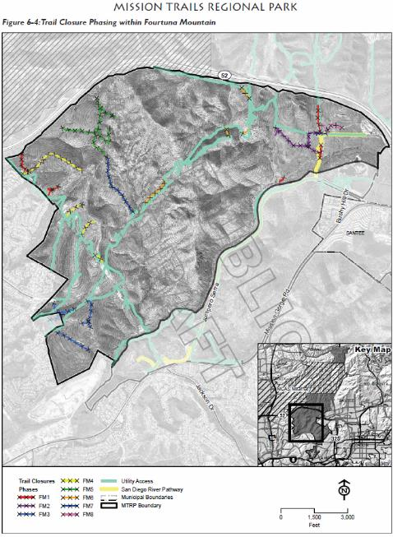
MTRP MPU Organization:
Introduction
History of the Park
Park Overview
Planning and Analysis
Recommendations
Implementation
Appendices

Slide 22
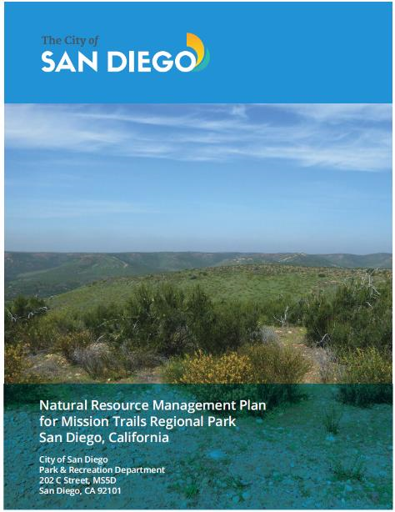
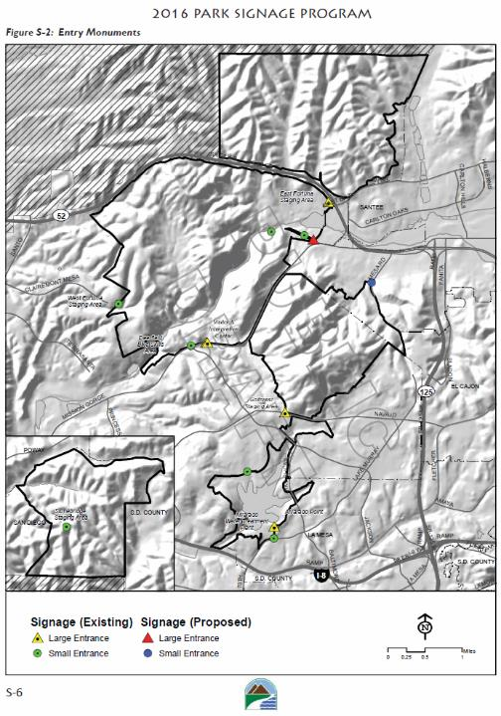
MTRP MPU Organization:
Introduction
History of the Park
Park Overview
Planning and Analysis
Recommendations
Implementation
Appendices

Slide 23
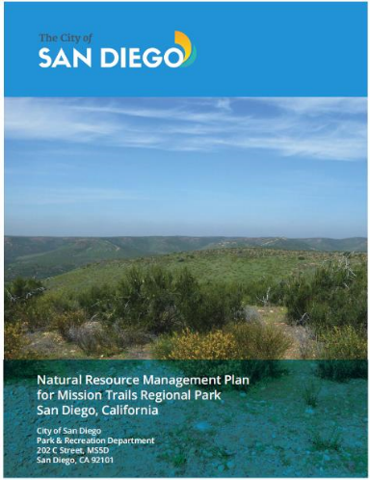
Specific Objectives of the NRMP
Update sensitive species and habitat mapping
Develop management guilds (management units based on habitat groupings with similar life-history requirements and/or threats) for groups of species and/or habitats
Identify and prioritize threats to sensitive species and habitats
Document current understanding of natural systems and species life history requirements using conceptual models
Develop conservation and enhancement goals for individual populations/habitats and/or management guilds based on MSCP conditions of coverage (MSCP Plan Table 3-5
Develop specific management actions (e.g. ASMDs) within an adaptive management framework to address the identified threats and ensure long-term, viable populations of these species within MTRP
Develop protocols (e.g., data collection methods, success criteria) to evaluate adaptive management techniques and projects proposed in this plan

Slide 24
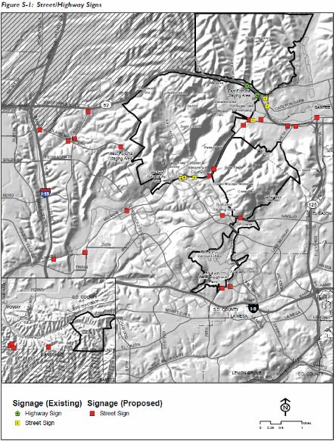
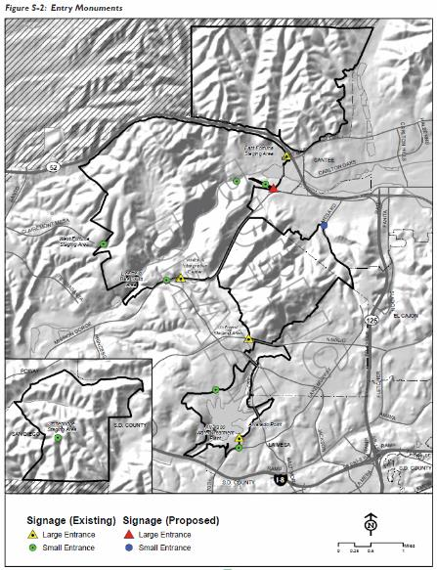
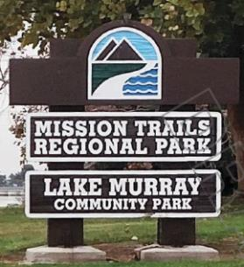
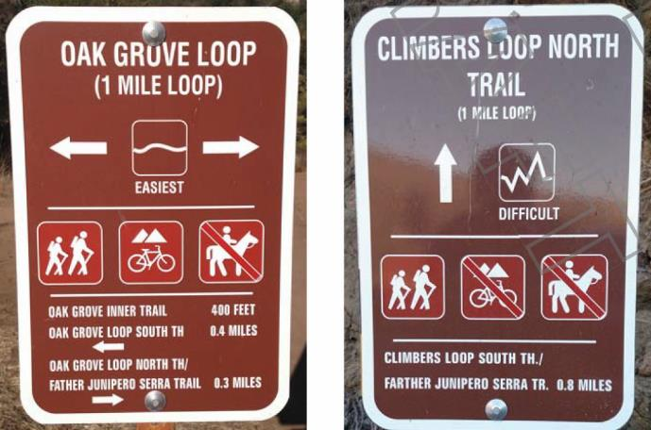
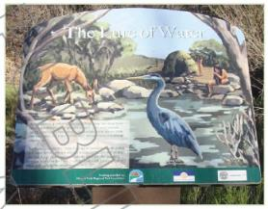
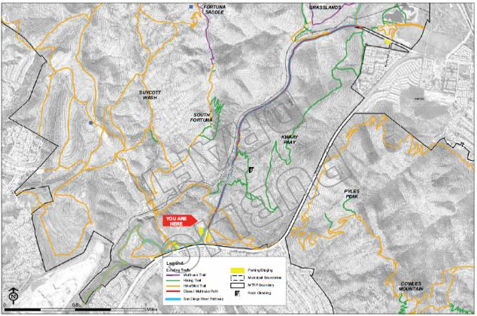
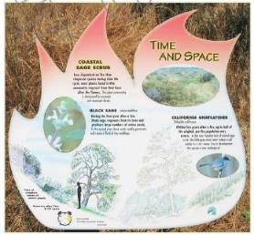
MTRP Signage Program:
Street/Highway
Entry Monuments
Regulatory Signs
Informational Signs
Trail Network Graphics and Maps

Slide 25
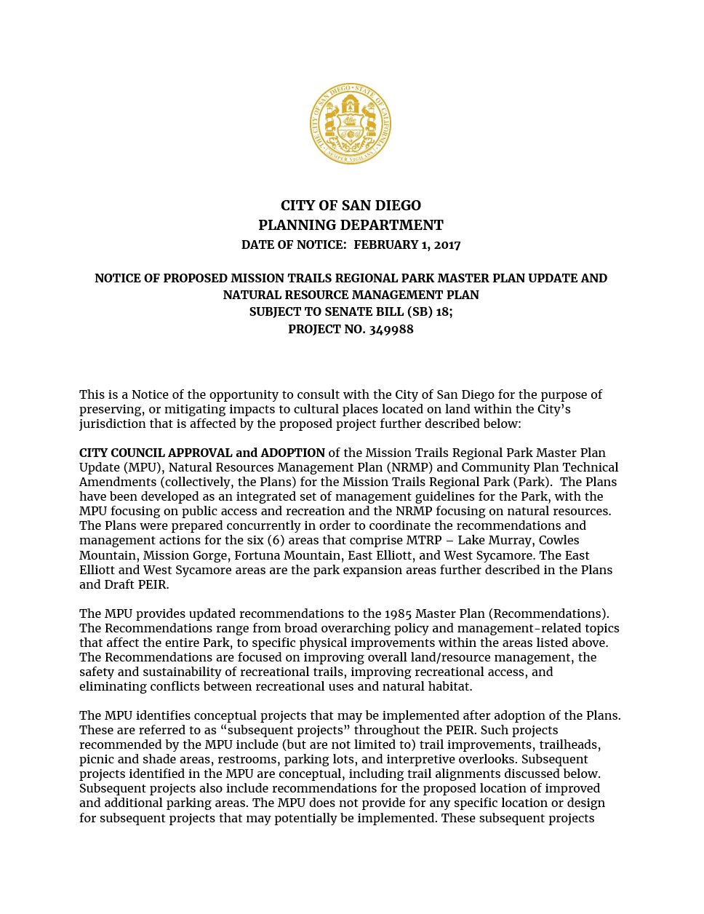
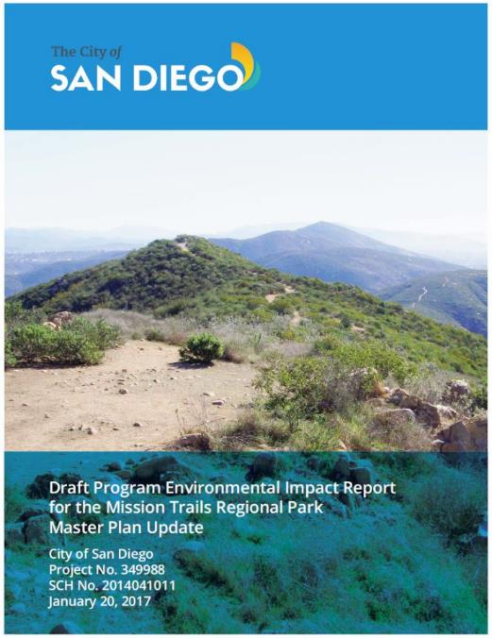
MTRP Programmatic EIR:
45 day public review, comments are due March 8th
Programmatic EIR is available for review and comment at http://www.mtrp.org/master_plan

Slide 26
Master Plan is available at:
http://www.mtrp.org/master_plan

Slide 27
Questions?

