Slide 1


Park Amenity Condition Assessment
Fiscal Year 2016
Park and Recreation Board
Agenda of March 16, 2017
Public Works Department
Park and Recreation Department

Slide 2

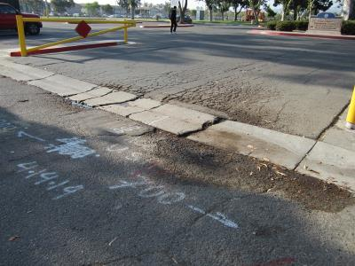
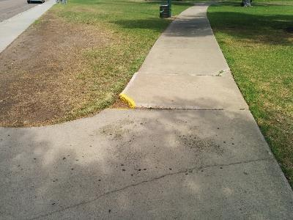
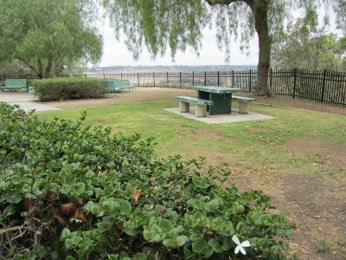
Department
Public Works Department
Park and Recreation Department
Park Amenity Condition Assessment
Introduction
Status Update
Scope of Assessments
Methodology (terms, groupings)
FY16 PCA Results
  75 Community, Neighborhood and Mini Parks
  Balboa Park
Proposed Service Level
Next Steps
San Ysidro Athletic Area
(Larsen Field)
Kennedy Neighborhood Park
Old Trolley Barn Neighborhood Park

Slide 3
Department
Public Works Department
Park and Recreation Department
Park Amenity Condition Assessment
Overview
Developed Parks to Assess
249 parks equaling
  2,675 assessed acres (developed areas)
Consultant: Kitchell CEM
FY 16 Assessments
  76 Parks
    1,252 acres assessed – 47%
    111 playgrounds
    202 courts
    98 acres of parking lots and park roads
  Field data collected along with photo documentation
  As-Built drawings reviewed
Assessed Park Locations

Slide 4
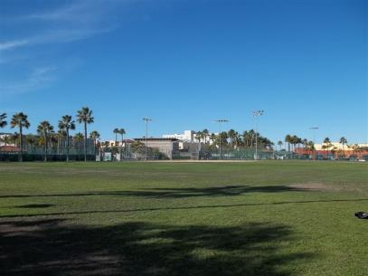
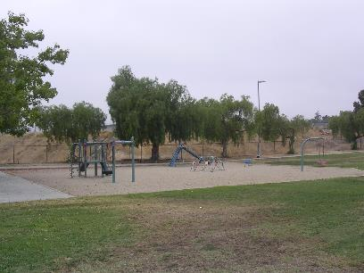
Department
Public Works Department
Park and Recreation Department
Park Amenity Condition Assessment
Scope of Assessments
Assessment of existing developed park assets
  Detailed assessment of all above grade assets.
    Park Roads, Parking Lots, Pedestrian Paving, Playgrounds, Playing Fields and Courts, Park Furnishings, Fences, Walls, Landscaping, Above-Ground Storm Drain
  Cost projections for maintenance and capital renewal
  GIS Mapping of park assets
Assessments do not include:
  Underground Assets and Electrical Systems
  Irrigation
Park Amenity Assessment complementary with:
  Facility Condition Assessments
  Stormwater Assessments
  Future Parks Master Plan
City Heights Community Park
Lomita Neighborhood Park

Slide 5
Department
Public Works Department
Park and Recreation Department
Park Amenity Condition Assessment
Methodology and Terminology
PCI: Park Condition Index
  Condition Range specified by City of San Diego (Consistent with the FCI ranges for the Building Assessments)
  Lower PCI - better condition, Higher PCI – poorer condition
  Current Maintenance Backlog: The accumulation of subsystem deficiencies
  Capital Replacement Backlog: The accumulation of subsystems that have reached the end of their useful life.
  Plant Replacement Value (PRV): cost to replace assessed assets in kind.
  PCI = Cost of Maintenance Backlog + Cost of Capital Backlog Plant Replacement Value (PRV)
PCI Condition Ratings |  | Examples
Good | 0 - 20 | Nobel Athletic Area (9) MLK Community Park (8)
Fair | 21 - 29 | South Clairemont Community Park (26) Dusty Rhodes Neighborhood Park (27)
Poor | 30 or Above | Allied Gardens Community Park (32) Keiller Neighborhood Park (36)

Slide 6
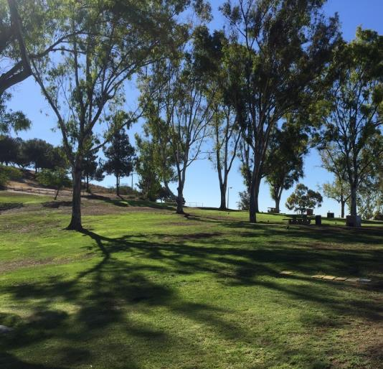
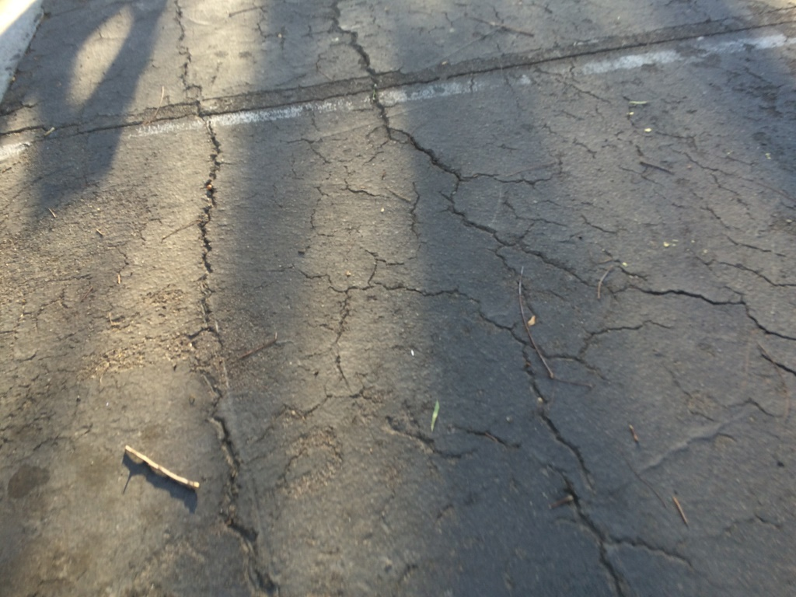
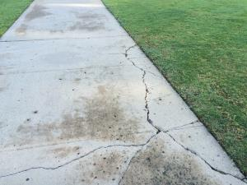
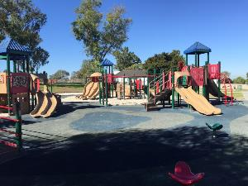
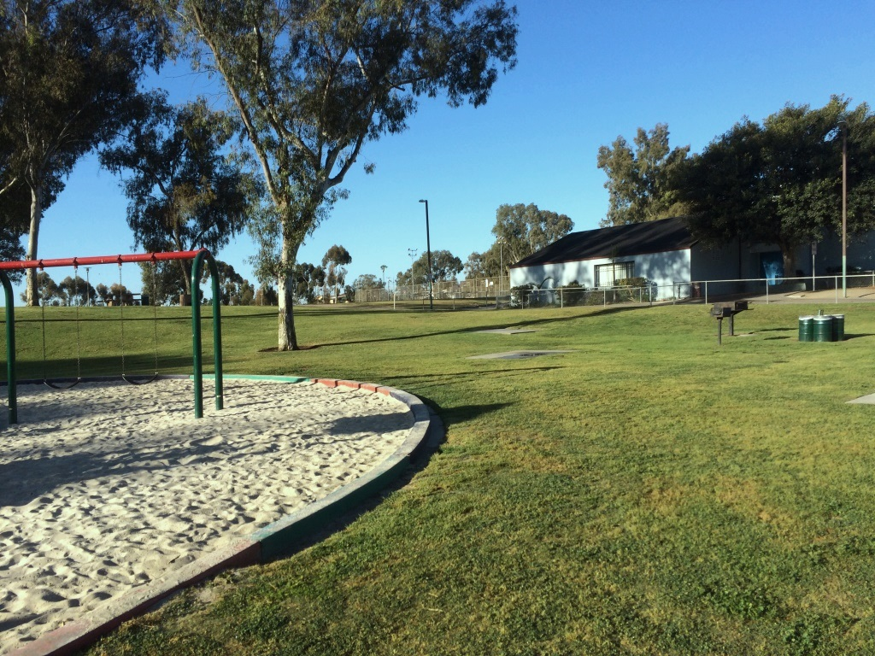
Department
Public Works Department
Park and Recreation Department
Park Amenity Condition Assessment
Example of Good Condition:
Martin Luther King Jr. Community Park
  Council District 4
Good Condition – Minor Improvements Needed
PCI 8
Major Systems affecting PCI:
  Parking lots – need repairs
  Pedestrian Paving – needs repairs
  Playground – good condition
  Landscaping – good condition
Martin Luther King Jr. Community Park
Asphalt needs repairs
Pedestrian Paving needs repairs
Playground in
good condition
Landscaping in good condition

Slide 7
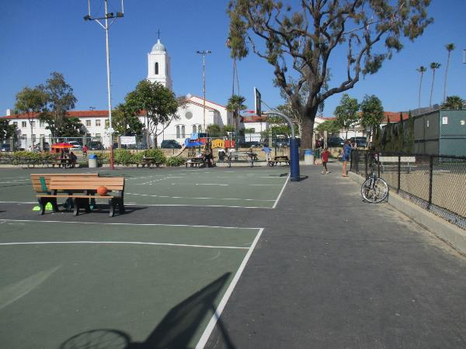
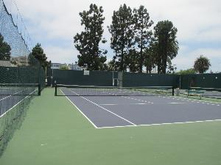
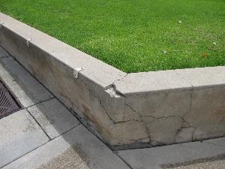
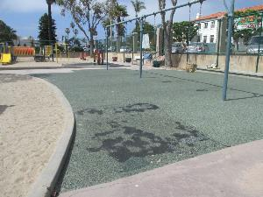
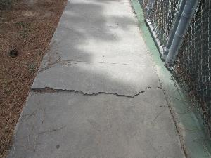
Department
Public Works Department
Park and Recreation Department
Park Amenity Condition Assessment
Example of Fair Condition:
La Jolla Community Park
  Council District 1
Fair Condition – Some Significant Repairs Needed
PCI 29
Major Systems affecting PCI:
  Outdoor courts – good condition
  Retaining Wall – need repairs
  Playground – needs replacement
  Pedestrian paving – needs repair
La Jolla Community Park
Outdoor courts in
good condition
Retaining wall
needs repairs
Playground surfacing
in need of repairs
Pedestrian paving needs repair

Slide 8
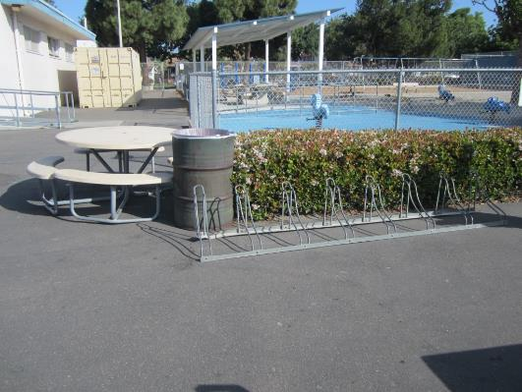
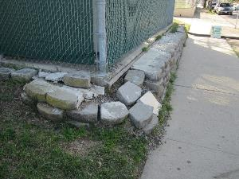
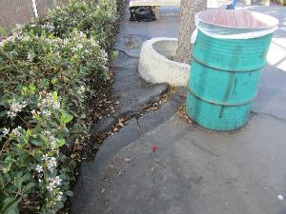
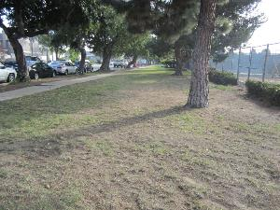
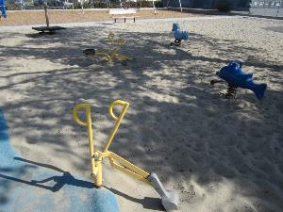
Department
Public Works Department
Park and Recreation Department
Park Amenity Condition Assessment
Example of Poor Condition:
Pacific Beach Community Park
  Council District 2
Poor Condition – Major Repairs Needed
PCI 36
Major Systems affecting PCI:
  Playgrounds – needs replacement
  Pedestrian Paving– needs major repairs/replacement
  Landscaping – needs repairs
  Retaining Wall - needs repairs
Pacific Beach Community Park
Site Retaining Wall
needs repairs
Asphalt needs replacement
Landscaping needs repairs
Playground beyond useful life

Slide 9
Department
Public Works Department
Park and Recreation Department
Park Amenity Condition Assessment
Methodology: Group Parks by Function
Parks Types by Function
Regional Parks | Regional asset, tourist destination, special natural feature | Balboa Park Mission Bay Park Chicano Park
Community Parks | Serve a population of approx. 25,000 residents | Passive and active recreation, rec. centers, aquatic complex
Neighborhood Parks | Serve a population of approx. 5,000 residents | Passive recreation, playgrounds, picnic areas
Mini Parks | Serve residents within ½ mile | Playgrounds, picnic areas
Note: Mission Bay Park & 25 additional community and neighborhood parks are scheduled to be assessed in FY2017.

Slide 10
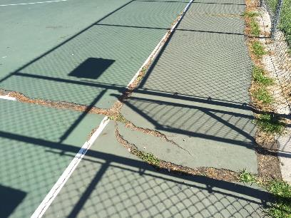
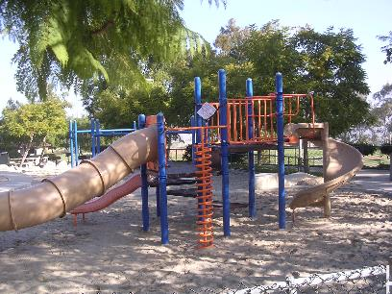
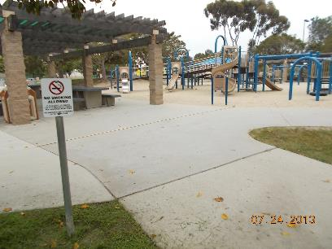

Department
Public Works Department
Park and Recreation Department
Park Amenity Condition Assessment
Methodology: Parks Assessed by Asset Type
Assets within the Parks
Playgrounds | Park Furnishings
Landscaping | Fences and Walls
Above-Ground Storm Water Devices | Pedestrian Paving
Playing Fields | Parking Lots
Outdoor Courts | Park Roads
Clay Neighborhood Park
Cypress Canyon Neighborhood Park
Doyle Community Park

Slide 11
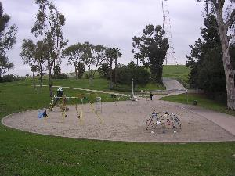
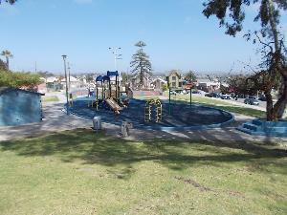
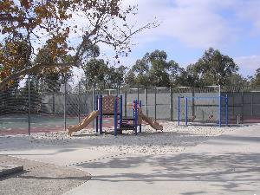
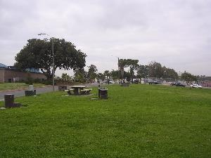
Department
Public Works Department
Park and Recreation Department
Park Amenity Condition Assessment
Methodology: Define Reliability Levels
Reliability Levels by Park Subsystem
Level 1 Operations Impacts | Level 2 Deterioration | Level 3 Appearance
Playgrounds | Parking Lots | Landscaping
Athletic Fields | Park Roads | Park Furnishings
Pedestrian Walkways | Above-Ground Stormwater Devices | Fences and Walls
Outdoor Courts |  | Signage
Emerald Hills Neighborhood Park
Grant Hill Neighborhood Park
Jerabek Neighborhood Park
Mountain View
Neighborhood Park

Slide 12
Department
Public Works Department
Park and Recreation Department
Park Amenity Condition Assessment
Results: Summary of PCI’s
Park Type | No. Parks Assessed | Acres Assessed | Number of Parks in Each Rating Category | AVG. PCI
Regional Parks | 1 | 416 | 1 - Good | 5: Good
Community Parks | 39 | 586 | 28 - Good 8 - Fair 3 – Poor | 15: Good
Neighborhood & Mini Parks | 36 | 250 | 19 - Good 4 - Fair 13 – Poor | 21: Fair
Total Number of Parks Assessed | 76 | 1,252 | 48 - Good 12 - Fair 16 - Poor | 16: Good

Slide 13
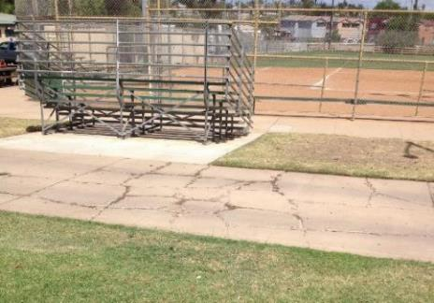
Department
Public Works Department
Park and Recreation Department
Park Amenity Condition Assessment
Results: Backlog by Reliability Level
Asset Function | No. Parks Assessed | Acres Assessed | Reliability Level 1 Operations Impacts* | Level 2 Deterioration* | Level 3 Appearance*
Regional Parks | 1 | 416 | $4.8M | $6.9M | $46K
Community Parks | 39 | 586 | $53.7M | $18.3M | $4.3M
Neighborhood and Mini Parks | 36 | 250 | $27.3M | $4.2M | $2.0M
Total | 76 | 1,252 | $85.8M | $29.4M | $6.3M
* Numbers reflect amounts to reach an overall PCI of 0. Necessary Reinvestment does not include capital renewal, improvements, expansion, or upgrades.
Reliability Level Subsystems | Playgrounds | Parking Lots | Landscaping
 | Athletic Fields | Park Roads | Park Furnishings
 | Pedestrian Walkways | Above-Ground Stormwater Devices | Fences
 | Outdoor Courts |  | Signage
Southcrest Community Park

Slide 14
Department
Public Works Department
Park and Recreation Department
Park Amenity Condition Assessment
Results: Proposed Service Level – PCI 15
PCI of 15 “Good” – All Parks – 76 Parks Assessed
It is not Industry Best Management Practice for agencies to improve existing facilities to a $0 backlog. Adopting an appropriate Service Level defines the acceptable backlog for the portfolio.
Note: All numbers are in 2016 dollars
Asset Function | No. Parks Assessed | Acres Assessed | Avg. PCI | Goal PCI | Necessary Reinvestment to Obtain a PCI of 15 for 76 Parks
Regional Parks | 1 | 416 | 5: Good | 15: Good | $0
Community Parks | 39 | 586 | 15: Good | 15: Good | $13.1M
Neighborhood and Mini Parks | 36 | 250 | 21: Fair | 15: Good | $11.7M
Total for PCI of 15 | 76 | 1,252 | 16: Good | 15: Good | $24.8M¹
1. Necessary Reinvestment does not include capital renewal, improvements, expansion, or upgrades.

Slide 15
Department
Public Works Department
Park and Recreation Department
Park Amenity Condition Assessment
Results: Buildings Located at the FCI 15/20 for 76 Parks
A separate assessment was performed on buildings throughout the City of San Diego
  Building presentation: Previously reported.
Asset Function | No. of Buildings Assessed* | Avg. PCI | Goal PCI | Necessary Investment to Obtain FCI of 15**
Regional Parks | 118 | 19: Good | 15/20: Good | $79.2M
Community Parks | 101 | 10: Good | 15: Good | $45.4M
Neighborhood and Mini Parks | 25 | 10: Good | 15: Good | $1.7M
Total for PCI of 15 | 244 | 24: Fair | 15: Good | $126.3M
1. Necessary Reinvestment does not include capital renewal, improvements, expansion, or upgrades.
* Number of Buildings Assessed refers to only the number of buildings on the same property as the 76 parks assessed.
** Numbers reflect only the buildings located on the same property as the 76 parks.

Slide 16
Department
Public Works Department
Park and Recreation Department
Park Amenity Condition Assessment
Results: Buildings & Parks Combined FCI/PCI 15 for 76 Parks
Combined Park and Building Numbers for the 76 Parks
Note: All numbers are in 2016 dollars
Asset Function | Building: Reinvestment For FCI 15/20 For 76 Parks* | Parks: Reinvestment For PCI 15 For 76 Parks | Goal FCI/PCI | Total Necessary Reinvestment to Obtain a FCI/PCI of 15/20 For 76 Parks
Regional Parks | $79.2M | $0 | 15/20: Good | $79.2M
Community Parks | $45.4M | $13.1M | 15: Good | $58.5M
Neighborhood and Mini Parks | $1.7M | $11.7M | 15: Good | $13.4M
Total for FCI/PCI of 15/20 | $126.3M | $24.8M | 15/20 Good | $151.1M
Necessary Reinvestment does not include capital renewal, improvements, expansion, or upgrades.
Numbers reflect only the buildings located on the same property as the 76 parks
FCI/PCI 15 applies to Public and Semi-Public categories
FCI/PCI 20 applies to City offices and work-yards

Slide 17
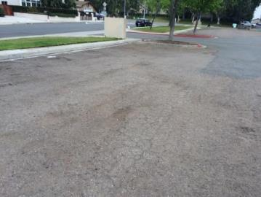
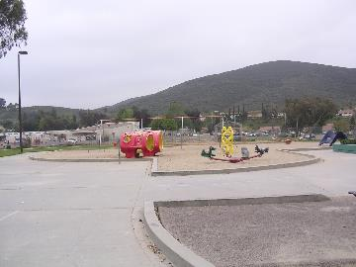
Department
Public Works Department
Park and Recreation Department
Park Amenity Condition Assessment
Key Study Concepts & Findings
Service Level Changes Affect the Results
  Lower PCI = Higher Costs
  Small PCI changes can result in significant cost changes
Some park subsystems can have a significant affect on the overall PCI score.
  A playground replacement in a mini park
  Playground replacement and major parking lot repairs in a community park
Asset Management Plan needed to develop total costs
  Approved Service Level needed to analyze and recommend maintain vs. rehab vs. replace decision
  Maintain/rehab/replace schedule determines total cost
Palm Ridge Neighborhood Park
Rolling Hills Neighborhood Park

Slide 18
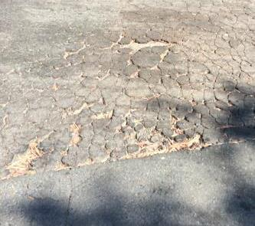
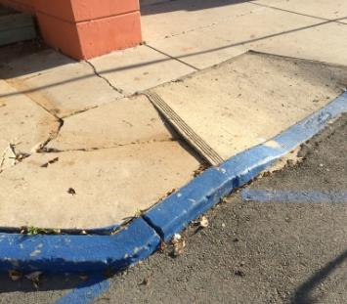
Department
Public Works Department
Park and Recreation Department
Park Amenity Condition Assessment
Next Steps: Future Efforts and Updates
Mission Bay Park as well as 25 Other Parks to be Assessed in FY2017
  Currently being assessed
Continue park assessments through FY2020
Expand assessments to joint use & open space facilities & Irrigation Systems after FY2020
Develop asset management plan to work with IAM San Diego and SAP
San Ysidro Community Park
Memorial Community Park

Slide 19
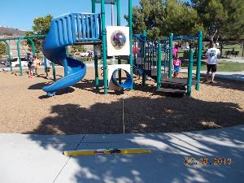
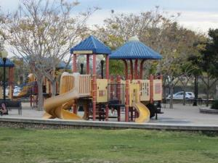
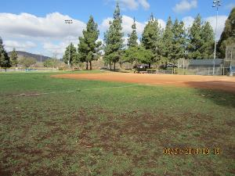
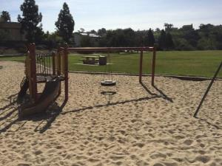
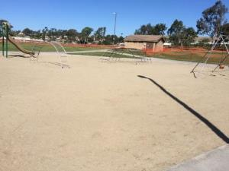
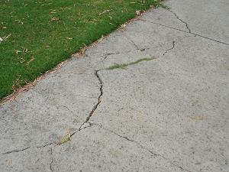
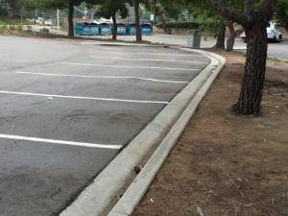
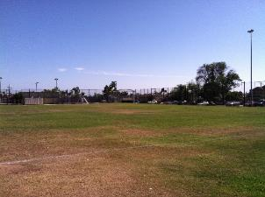
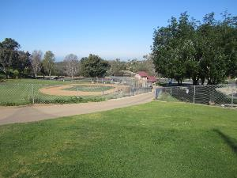
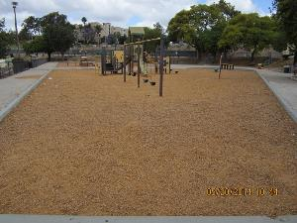
Department
Public Works Department
Park and Recreation Department
Westview Neighborhood Park
Ward Canyon Neighborhood Park
Rancho Bernardo Community Park
Adobe Bluffs Neighborhood Park
Questions?
Bay Terraces Community Park
Canyonside Community Park
Carmel Mountain Community Park
North Park Community Park
Tecolote
Community Park
Colina Del Sol Community Park

