Slide 1
Overview of E3’s
Deep Decarbonization Study
Publicly available at www.ethree.com

Slide 2
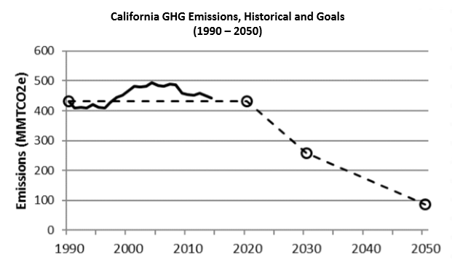



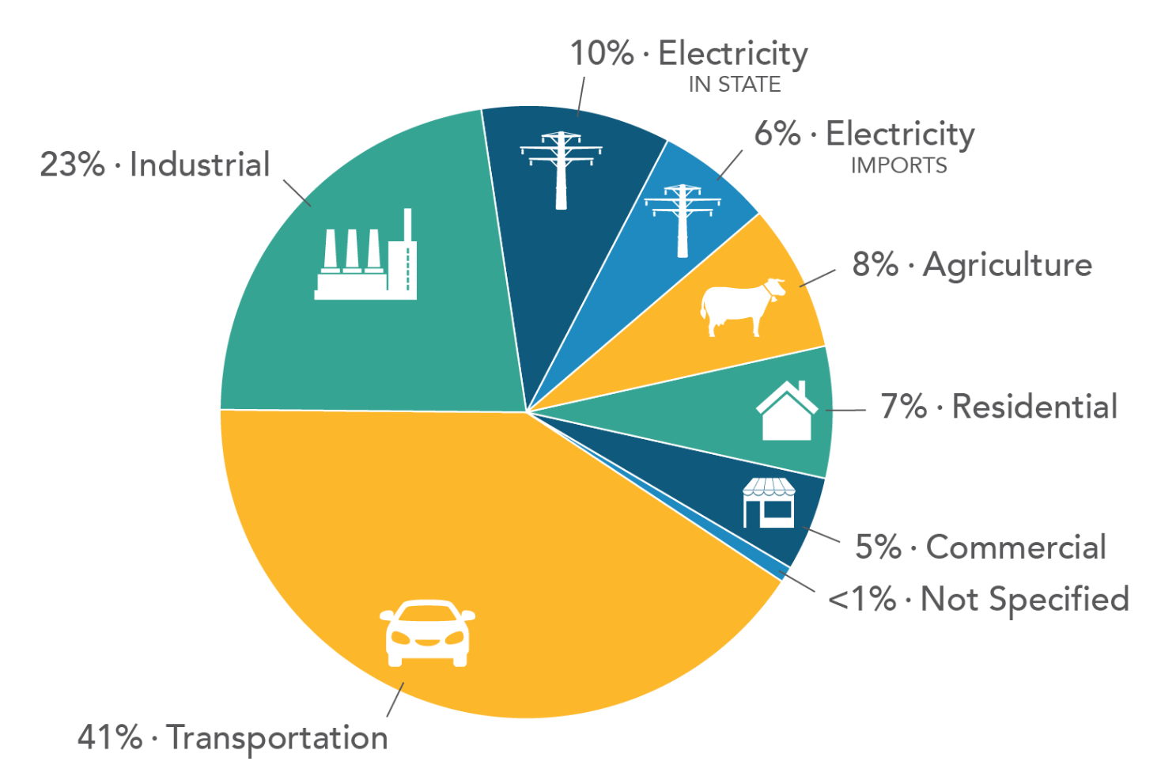
Introduction and Purpose
Mitigation
Business as Usual
SB 350
Mitigation by Means of High Electrification
Statewide Emissions by Sector (CARB, 2016)

Slide 3



Short-Term GHG Reducing Strategies
Scale Up and Deploy
Energy Efficiency in Buildings and Industry
Renewable
Electricity
Smart
Growth
Deployment of LED lighting
Higher Efficiency Plug Load
Improved Shell in Existing Buildings
Continued Improvements and Enforcement of Building Codes
Industrial Energy Efficiency
70% - 80% zero-carbon electricity with renewable integration solutions
Flexible Loads
Market-Based Curtailment
Cost-Effective Grid Storage
Reduced Vehicle Miles Travelled
Increase use of Public Transportation
Walking and Biking
Telecommuting
Denser mixed-use community design
Key Challenges
● Consumer Decisions ● Market Failures ● Implementation of Integration Solutions ●

Slide 4




Medium-Term GHG Reducing Strategies
Market Transformation
Zero-Emission
Light-Duty Vehicles (ZEV)
Advanced Building Efficiency & Electrification
At least 6 million ZEVs
More than 60% of new sales are zero-emission vehicles
Drivers have Access to day-time charging and time-of-use charging
50% of new water heater and HVAC sales are high efficiency heat pumps
F-Gas Replacement
Methane Capture
Replace F-gases (used in refrigeration, AC units, blowing agents for foam and aerosol propellants) with lower global warming potential refrigerants
Methane capture from manure, fugitive and process emissions, landfills and wastewater
Key Challenges
● Consumer Decisions & Costs ● Equity of Cost Impacts ● Cost and Retrofits of Existing Buildings ●

Slide 5



Long-Term GHG Reducing Strategies
Reach Technologies
Advanced
Sustainable Biofuels
Zero-Emissions
Heavy-Duty Trucks
Demonstrated use of sustainable, carbon-neutral biomass feedstocks to produce commercial-scale biofuels
Commercial deployment of battery-electric and/or hydrogen trucks
Industrial Electrification
Electrolysis Hydrogen Production
Cost-competitive electrification of industrial end uses, including boilers, machine drives, and process heating
Improved cost and efficiency at commercial scale.
Business model for flexible hydrogen production
Key Challenges
● Cost ● Sustainability Challenges ●

