Slide 1
The California Grid, Energy Storage, and Microgrids
June 13, 2019
James Strange, J.D., Policy Manger,
Jonathan Hart, M.A., Specialist, Distributed Energy Resources

Slide 3
About CSE
501(c)(3) nonprofit organization
Offering clean energy program administration and technical advisory services.
Headquarters: San Diego, CA
Regional offices: Boston, Brooklyn, Stony Brook, Oakland, Sacramento and Los Angeles
185+ dedicated, mission-driven employees
Managing ~50 projects and programs
National programs | Statewide incentive projects | Region-specific solutions

Slide 4
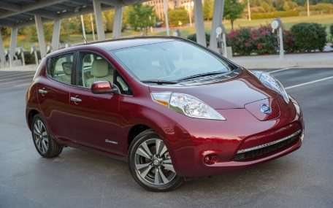
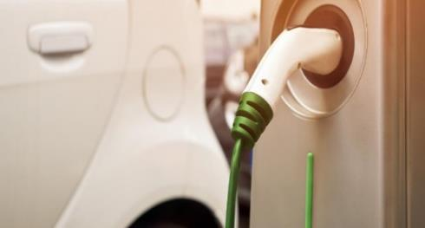
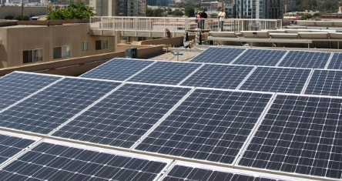
Billion Dollar Program Management Experience
EPIC Grants
  Energy Storage and DR Pilots
  Microgrids
SGIP
  $100 million+
  ~800 MW of installed Capacity since 2001
  Funding extended through 2024
SOMAH
  $1 billion
  300 MW + virtual net energy metering
  Nearly ready to launch

Slide 5
Our Reach
We work with governments, regulators, utilities, CCAs, businesses, property owners and consumers as a trusted and objective implementation partner.
Northern
California
Tackling issues of national importance
Central
Valley
Statewide incentive programs
Southern
California
Region-specific solutions

Slide 6
Benefits of Energy Storage
California Independent System Operator (CAISO)
Manage California’s Transmission System
Operate an energy and ancillary services market
Price maps of CA
http://www.caiso.com/PriceMap/Pages/default.aspx
Electricity demand, supply, emissions
http://www.caiso.com/TodaysOutlook/Pages/default.aspx

Slide 7
Benefits of Energy Storage
Grid Benefits
Flatten load – reduce steep ramping of generators
Help grid-constrained areas
Environmental Benefits
Integrate intermittent renewable generation
Replace fossil-fuel generation
Customer Benefits
Reduce customer bills
Provide additional value streams

Slide 8
Benefits of Energy Storage
Help grid-constrained areas https://www.sce.com/about-us/reliability/meeting-demand/our-preferred-resources-pilot
Replace fossil-fuel generation https://www.greentechmedia.com/articles/read/sce-picks-major-battery-portfolio-in-place-of-puente-gas-plant

Slide 9
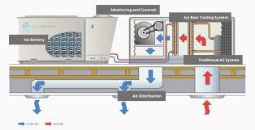
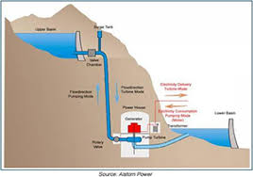
Energy Storage Technologies
Electrochemical
Batteries
Supercapacitors
Thermal
Store heat, ice, cool water, etc.
Mechanical
Pumped hydro
Flywheel
Compressed air

Slide 10
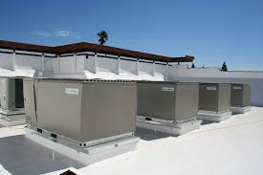
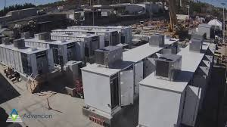
Energy Storage Location
Customer Site
Grid-Connected

Slide 11
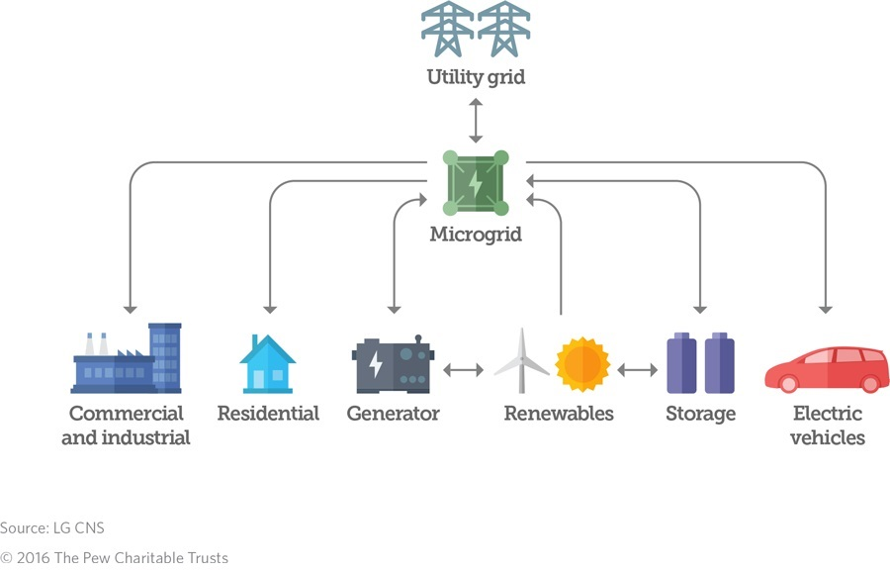
Microgrids
What is a Microgrid?
A microgrid is a group of interconnected loads and distributed energy resources within clearly defined electrical boundaries that acts as a single controllable entity with respect to the grid.
A microgrid can connect and disconnect from the grid to enable it to operate in both grid-connected or island mode.
-U.S. Department of Energy

Slide 12
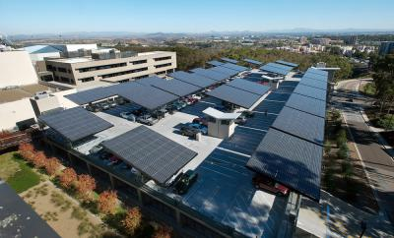
Microgrid Example: (Customer Controlled)
UCSD
Supplies electricity, heating, and cooling for 45,000
13.5 MW gas turbines, one 3 MW steam turbine, and a 1.2 MW solar-cell installation that together supply 85% of campus electricity needs.
DOE just gave USCD a grant to model the effects on the local distribution system from the ramping up and down of the solar PV system’s output.

Slide 13
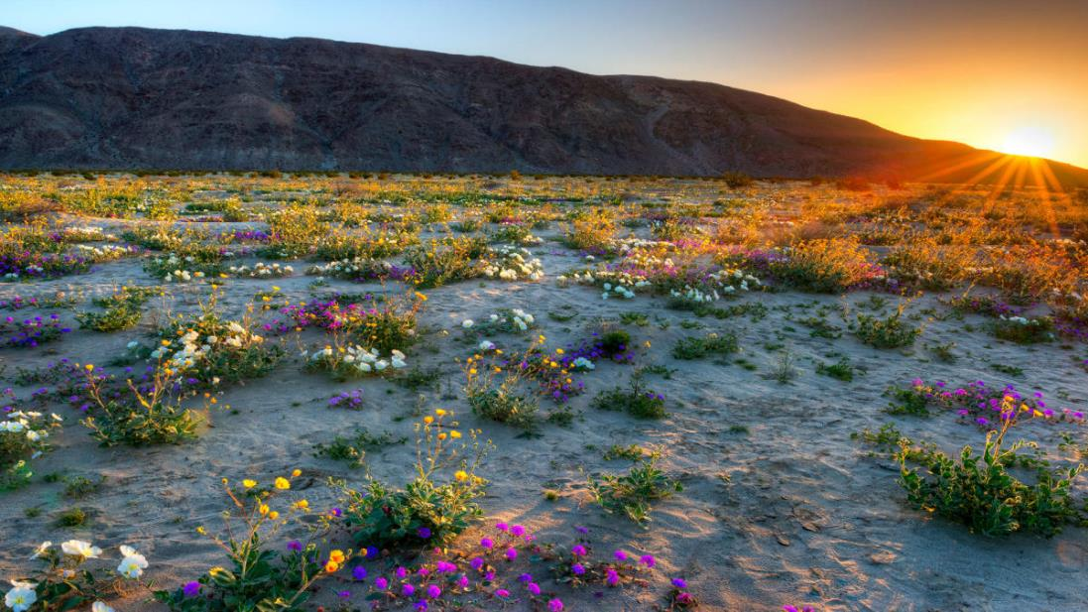
Microgrid Example: (Utility Controlled)
Borrego Springs Microgrid
Borrego Springs Population 3,429 (2010).
4 MW microgrid installed to island in the event power is interrupted.
  2 – 1.8MW diesel generators
  1 – 500kW/1500 kWh battery
  3 – 50 kWh batteries,
  6 – 4kW/8 kWh home energy storage units
  700 kW of rooftop solar

Slide 14
7 Microgrid Projects
SDG&E Proposal: 7 Microgrids
SDG&E Proposal
Kearny Mesa
AB 2868 (2016): Created state’s IOUs to procure 500 megawatts of energy storage, specifically distribution grid-connected or behind-the-meter batteries.
SDG&E proposes 100 megawatts of battery-backed SDG&E ownership and investment in “circuit- and service-level microgrid energy storage projects on the distribution grid.”
Melrose
Boulevard
Clairemont
Paradise
Elliot
Santee
“By using utility-owned land and existing infrastructure, these sites were selected to maximize benefits and minimize costs. –SDG&E

Slide 15
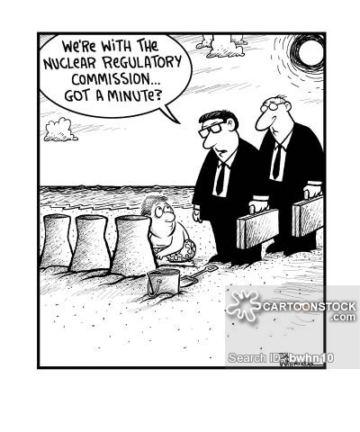
Microgrid: Barriers
CPUC Code
  CPUC Section 216
  CPUC Section 218
Standby Charges
Non-bypassable/departing load charges
SB 1339 (2018) and impending Microgrid proceeding

Slide 16
Questions?

