Slide 1
COMMUNITY PLAN UPDATE OVERVIEW
UNIVERSITY
Notes:
Add Color

Slide 2
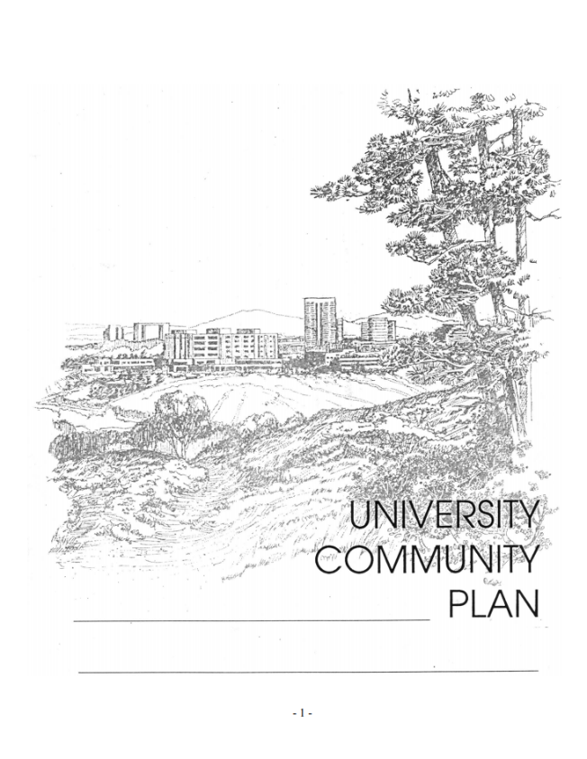
EXISTING COMMUNITY PLAN
Adopted In 1987
Overall Community Goals:
  Cohesive Development with UCSD
  Create a Self Sufficient Balanced Community
  Equitable Allocation of Development Intensity
  Ensuring a Workable Circulation System
Amendments:
  18 Amendments Since Plan Adoption
  3 Amendments Currently Under Review
Notes:
The majority of amendments are meant to increase allowed intensity on project site.
Create physical, social and economic environment complimentary to UCSD.
Develop University as a self sufficient community offering balance of housing, employment, business, cultural, educational, and recreational opportunities.
Create an Urban Node with two high density, mixed-use core areas (UTC & La Jolla Village Square)
Equitable allocation of development intensity
Ensuring a workable correlation system

Slide 3
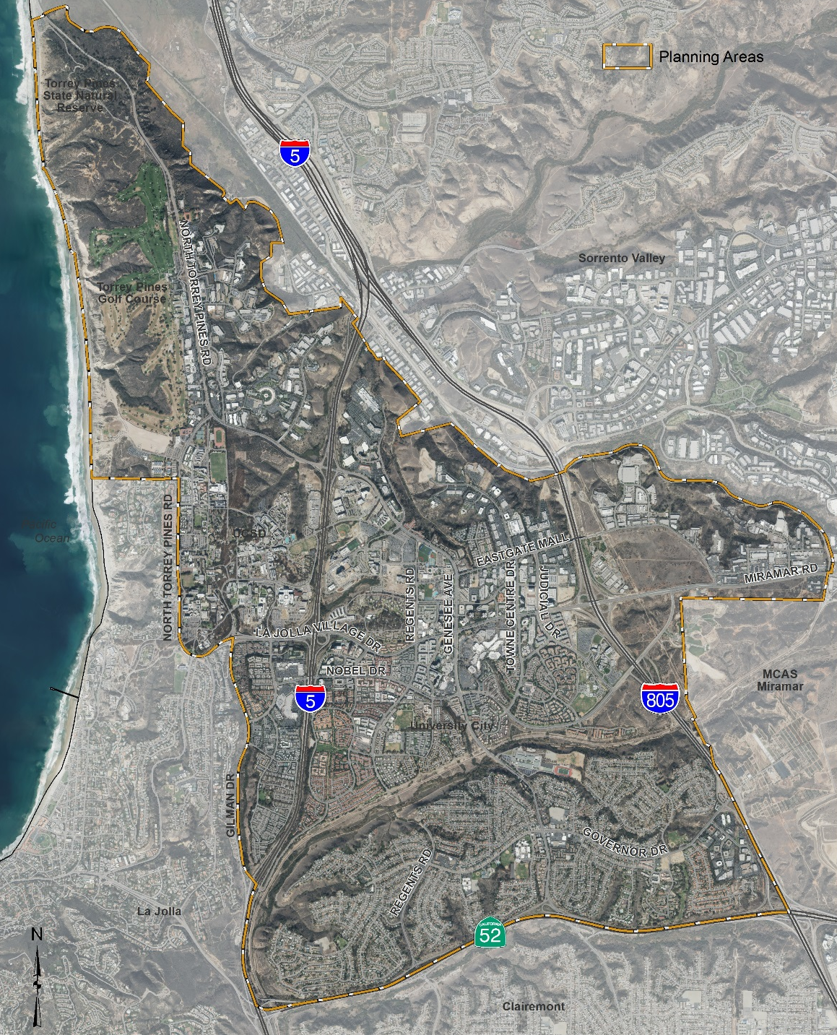



OVERVIEW
8,500
Acres
70,000
Residents
27,000
Housing Units
Notes:
The City of San Diego’s Planning Department is embarking on an update to the University Community Plan. Last updated in 1987, the community plan encompasses roughly 8,500 ac and is bound by Interstate5 on the west, Interstate 805 on the east and State Route 52 to the south.
Known as the Golden Triangle, because of its location within 5, 805 and 52, the community is home to numerous world class businesses as well as UC San Diego. With a population of nearly 70,000 residents and 27,000 housing units, the community has a vast mix of single family homes south of Rose Canyon, to a mix of multi-family homes in the north that range from 15 up to 75 du/ac. As part of the update we will analyze the community’s economic, social, and environmental health as well as study how the community will grow over the next 2-3 decades to a more sustainable community.
As I mentioned earlier, the last comprehensive update to the community plan occurred in 1987. A lot has changed since then. The Community, as well as UC San Diego, has grown tremendously over the last 3 decades; and will continue to grow. We need to balanced that growth, coordinate with UC San Diego’s update to their LRDP, and capitalize on the investment in transit within the community.

Slide 4
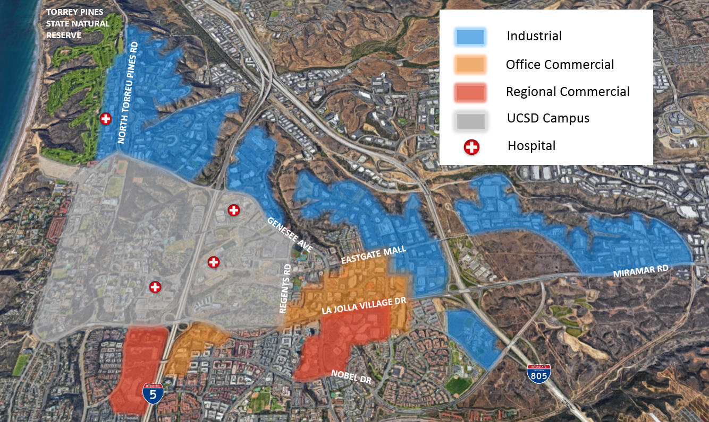
OVERVIEW
DENSE INOVATION CLUSTER
Notes:
As seen here, UC San Diego is located near the center of the community and is surrounded by a very dense area of employment which is key to the city’s economic growth. This collaboration of research and innovation between UC San Diego and San Diego’s life science cluster is what makes this area one of the leading life science centers in the nation.
Replace? Check-in with Claudia

Slide 5
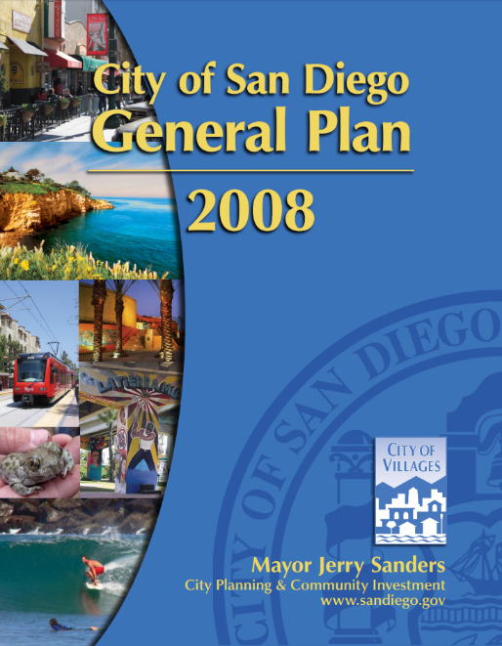
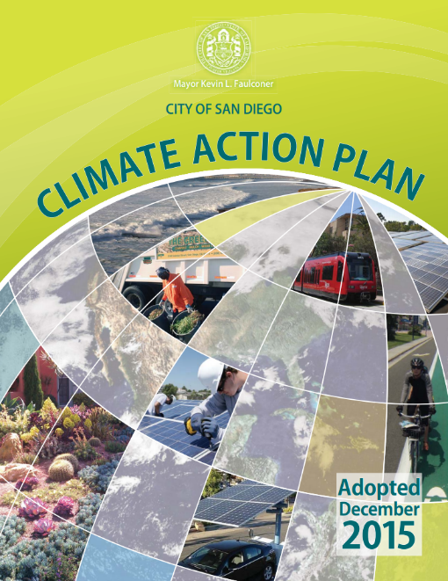
GUIDING PLANNING DOCUMENTS
City of San Diego General Plan
Provides a Comprehensive Slate of Citywide Policies
Furthers The City of Villages Smart Growth Strategy
Climate Action Plan
Provides Citywide Emission Reduction Targets
Highlights 5 Strategies to Cut Emissions
Works in Concert with Other Policy Documents
Notes:
The City's General Plan is its constitution for development. It is comprised of 10 elements that provide a comprehensive slate of citywide policies and further the City of Villages smart growth strategy for growth and development.
The General Plan update did not include land use designation or zoning changes, which is the purview of the City's community plans.
he General Plan was comprehensively updated by unanimous vote of the City Council in 2008.
The City Council also certified the General Plan Community plans work together with the General Plan to provide location-based policies and recommendations in the City's five-plus community planning areas.
Community plans are written to refine the General Plan's citywide policies, designate land uses and housing densities and include additional site-specific recommendations as needed. Read more about how the General Plan and Community Plans work together.

Slide 6



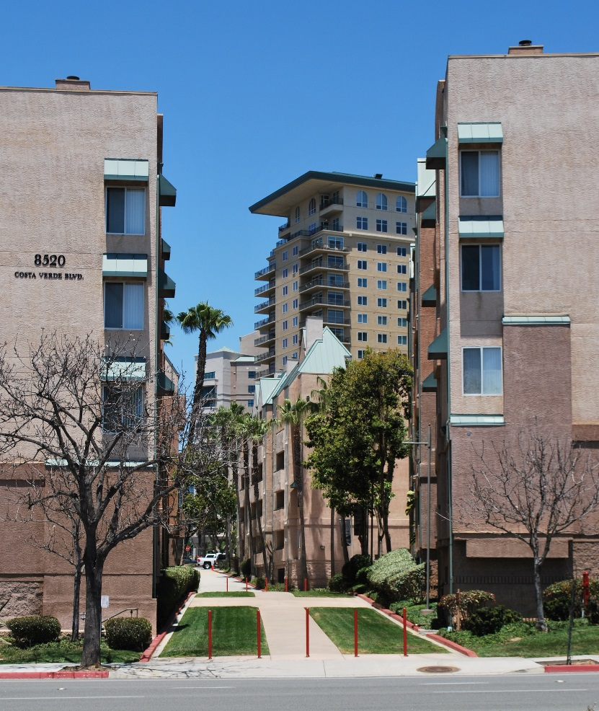






PURPOSE
Strengthen Economy
Address Housing Crisis
Implement Climate Action Plan
Infrastructure Planning
Live / Work Opportunities

Slide 7
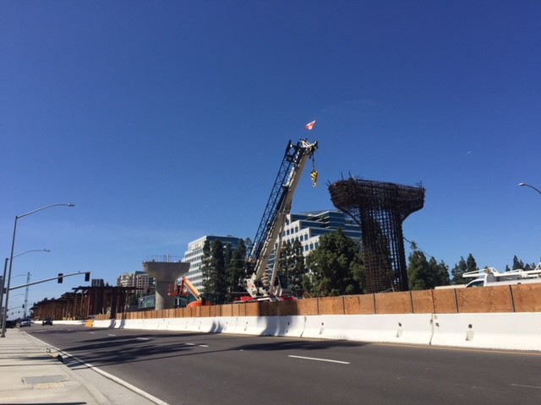
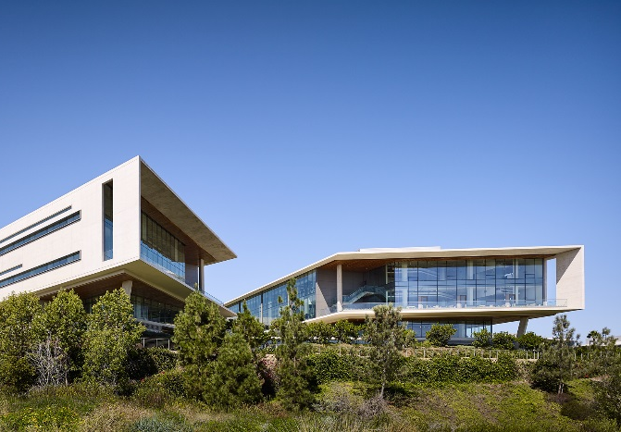
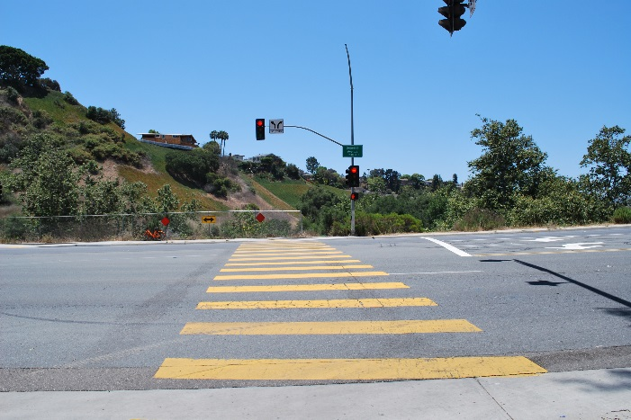
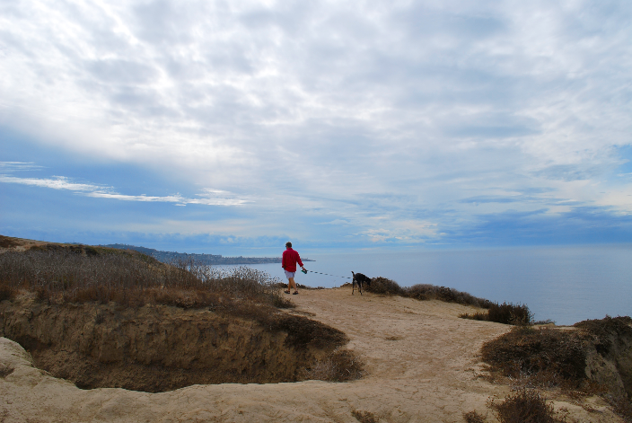
OPPORTUNITIES
Reinforce Community Role as a Major Employment Center
Support a Sustainable Pattern of Growth
Promote a Well Balanced Mobility Network & Maximize Transit Investment
Plan for Digital Infrastructure to Support Smart Cities San Diego
Increase Connectivity of Uses
Foster a Place to Live, Work, and Play

Slide 8
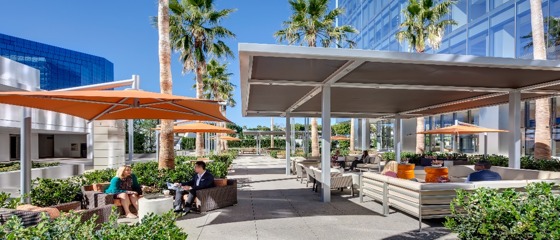
TIMELINE
  2018
2019
PLAN UPDATE LAUNCH
OUTREACH
EXISTING CONDITIONS COMMUNITY ATLAS
  2020
DEVELOPMENT OF PLAN ALTERNATIVES
MONTHLY CPU SUBCOMITTEE MEETINGS
2021
CEQA ENVIRONMENTAL REVIEW
DRAFT COMMUNITY PLAN
PREPARATION OF FINAL COMMUNITY PLAN & EIR
PUBLIC HEARING PROCESS

Slide 9
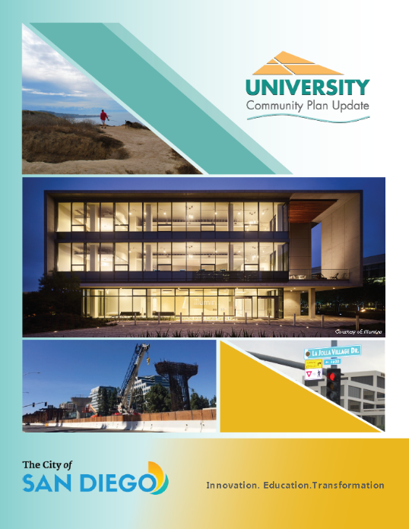

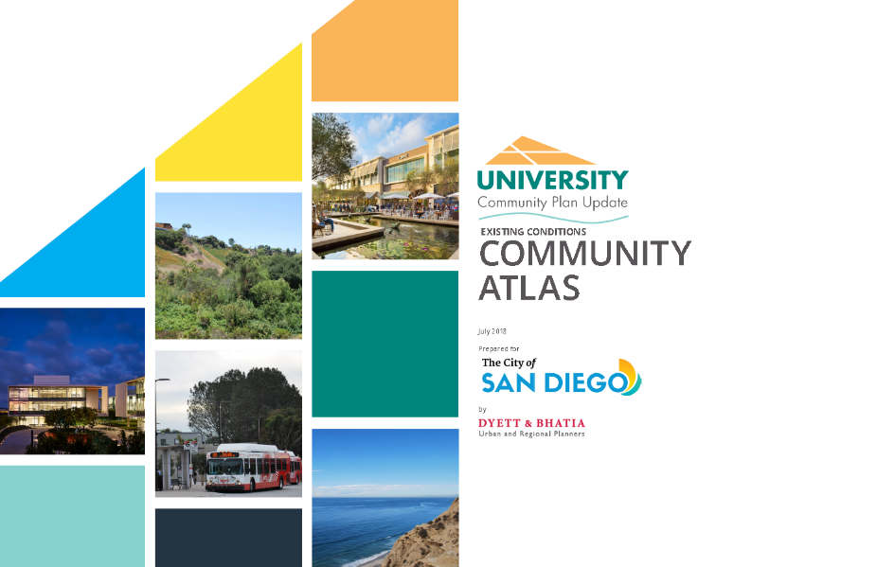


PROGRESS
Existing Conditions Community Atlas
Informational Brochure
Community Plan Update Website
PowerPoint Presentation
Stay Connected
Your Community Plan Team

Slide 10
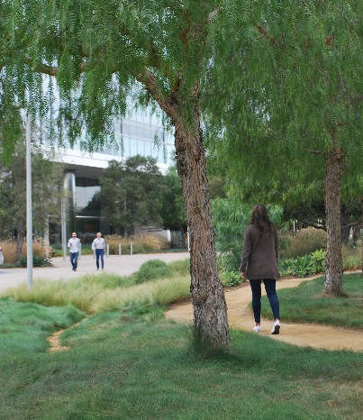
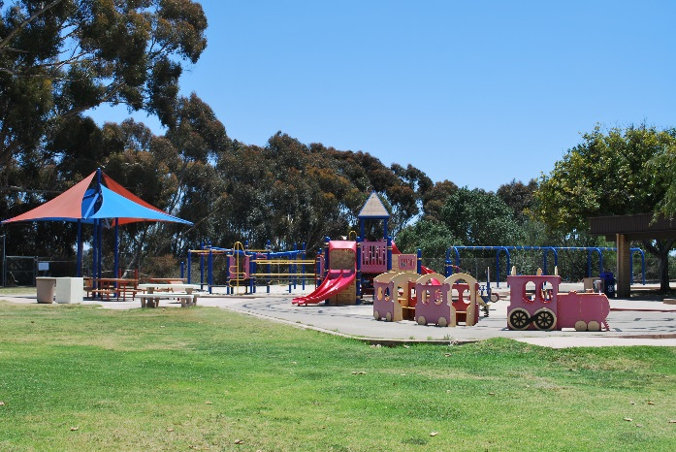
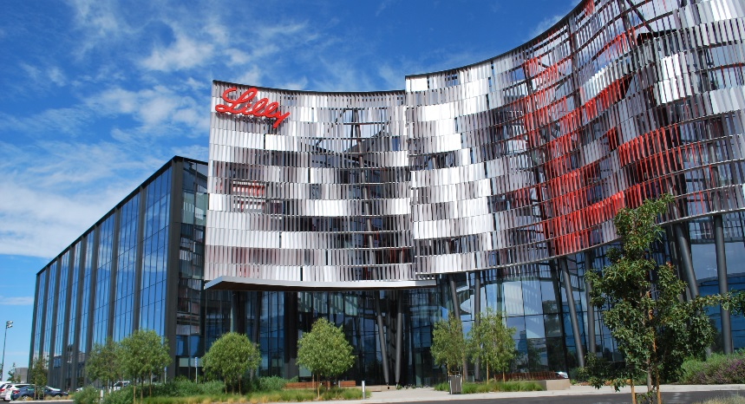
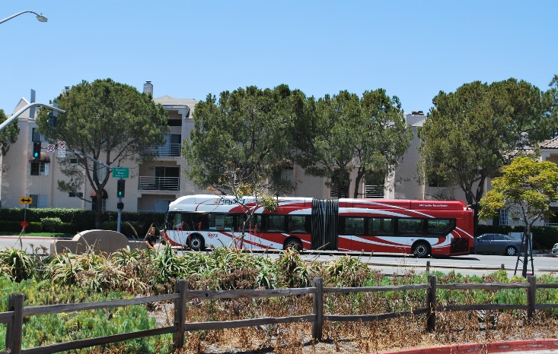
NEXT STEPS – GET INVOLVED!
Present Existing Conditions Community Atlas
Host Community Open House
Form Community Plan Update Subcommittee
Online Engagement

Slide 11

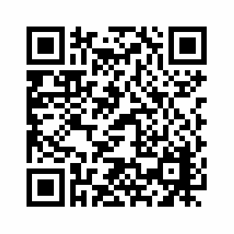
YOUR VOICE COUNTS – STAY UP TO DATE
Visit Us On The Web
  https://www.sandiego.gov/planning/community/cpu/university
Contact Us:
Melissa Garcia
Senior Planner
City of San Diego
Planning Department
T (619) 236-6173
magarcia@sandiego.gov

