Slide 1
COMMUNITY PLAN UPDATE WORKSHOP
UNIVERSITY
Planning Commission
February 28, 2019

Slide 2



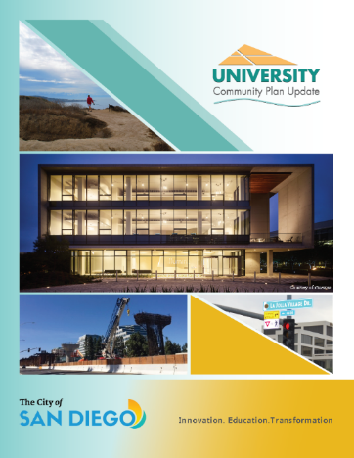
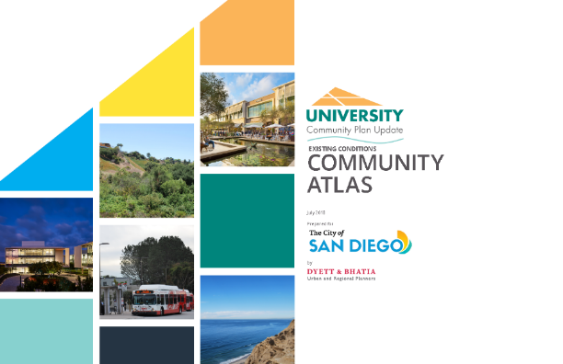
Community Plan Update Status
Stay Connected
Your Community Plan Team
September 2018
Community Plan Update Website
Existing Conditions Community Atlas
Informational Brochure
September 26, 2018
Open House Kick-Off
October 9, 2018
UCPG Subcommittee Formation
2

Slide 3
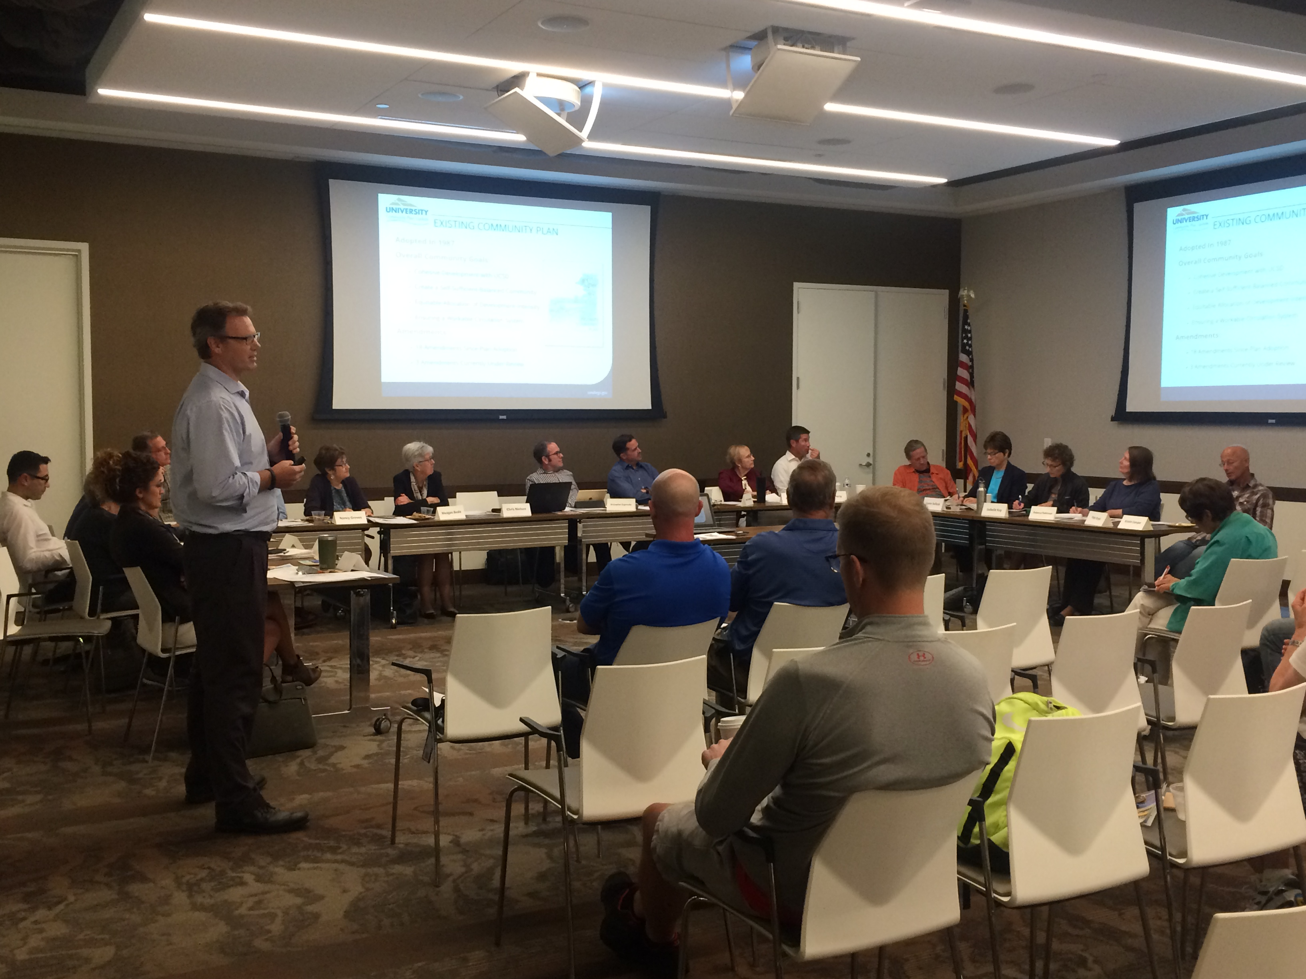
University Community Planning Group CPUS
Community Plan Update Subcommittee (CPUS) Meetings
January 8, 2019
February 12, 2019
March 19, 2019
3

Slide 4
Regional Location
4
Notes:
As we move through some background on the community, I want to note that the maps you see in the presentation today come from the Existing Conditions Community Atlas posted to our website.

Slide 5
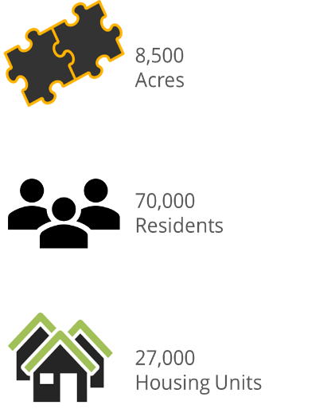
Planning Area
5

Slide 6
Existing Land Use
6

Slide 7
Existing Land Use
7

Slide 8
Residential Density
8

Slide 9
Non-Residential Floor Area Ratio (FAR)
9

Slide 10
Airport Influence Area
10

Slide 11
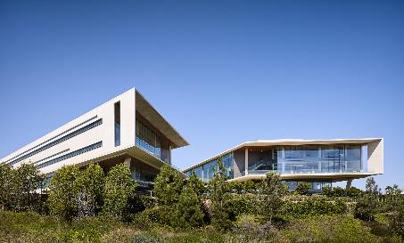
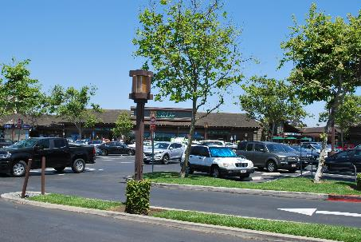
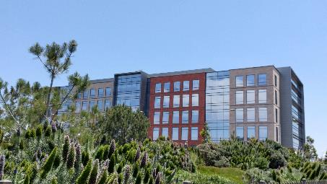
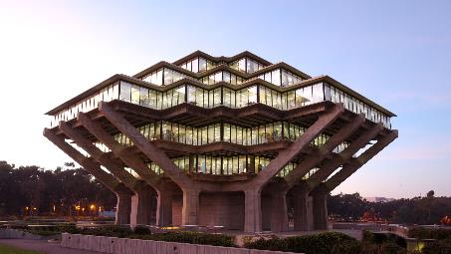
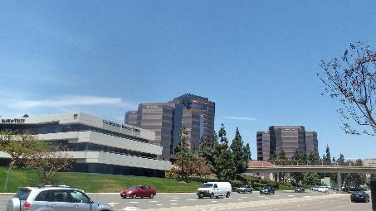
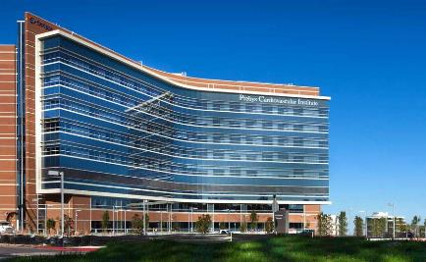
Job Sectors in University
12.3% Jobs
City of San Diego
3,300 Businesses
92,000 Jobs
11
Notes:
University occupies only about 4% of San Diego’s land area, yet companies within the community provide about 12.3% of private jobs within the city. The 3,300 businesses that exist in the community employ about 92,000 people. As seen in this chart, about 70% of jobs are within the Educational Services, Professional, Scientific, and Tech services, healthcare, Finance and Insurance, and Accommodation and Food service sectors.

Slide 12
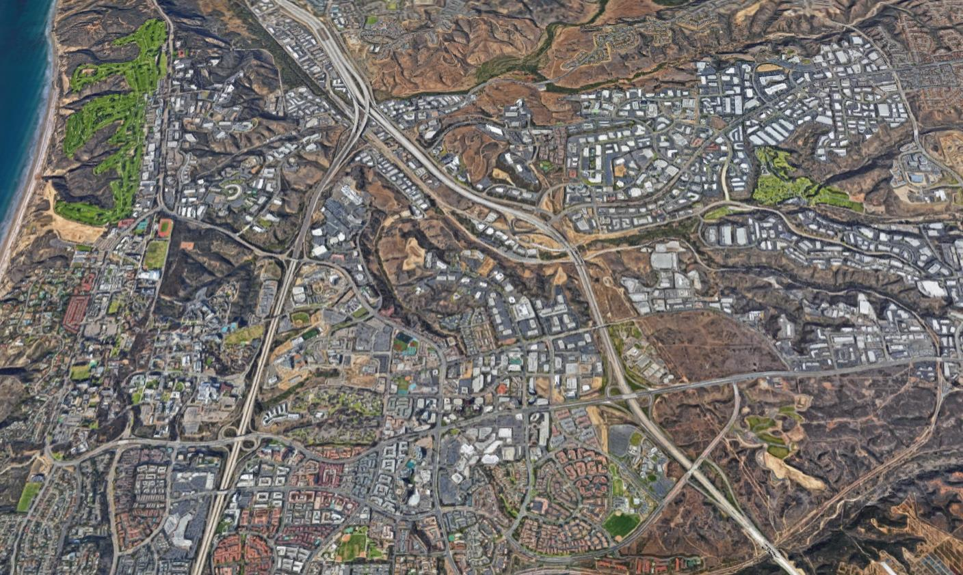




Major Employment Areas
TORREY PINES STATE NATURAL RESERVE
Industrial
Office Commercial
NORTH TORREY PINES RD
Regional Commercial
UCSD Campus
Hospital
GENESEE AVE
EASTGATE MALL
MIRAMAR RD
REGENTS RD
LA JOLLA VILLAGE DR
NOBEL DR
12

Slide 13
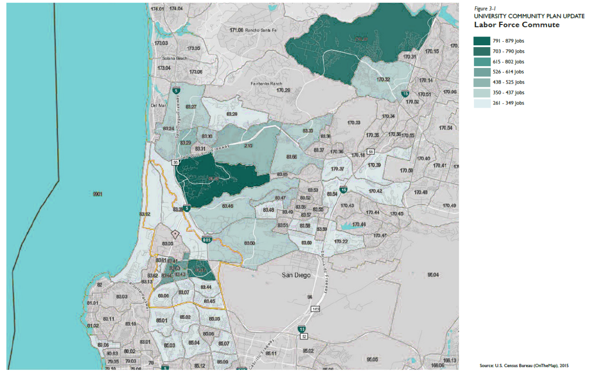
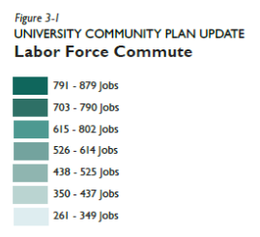
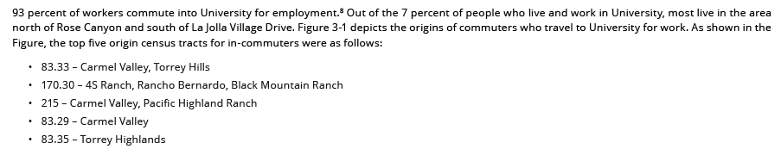
Labor Force Commute
13
Notes:
Of those 92,000 jobs, 93 percent of workers commute into University for employment. Out of the 7 percent of people who live and work in University, most live in the area
north of Rose Canyon and south of La Jolla Village Drive. This map depicts the origins of commuters who travel to University for work. As shown in the
Figure, the top five origin census tracts for in-commuters were as follows:
•Carmel Valley, Torrey Hills
• 4S Ranch, Rancho Bernardo, Black Mountain Ranch
• Carmel Valley, Pacific Highland Ranch
• Carmel Valley
• Torrey Highlands
In addition, UC San Diego draws employees from across the region, about 15,000 in total; however, about one quarter travel less than 5 miles, suggesting that many UC San Diego employees live in University or nearby communities.

Slide 14
Parks, Recreation, and Open Space
14
Notes:
The community has approximately 84 acres of population-based parks, which include 3 community parks, 5 neighborhood parks and 2 mini-parks (located in the Easgate Technology Park area). There are three joint-use parks with San Diego Unified at Doyle Elementary, Spreckels Elementary and Standley Middle School with 18.5 usable acres. And community has approximately 1,700 acres of resource-based parks in Torrey Pines State Park, Torrey Pines City Park and the Torrey Pines Golf Course, in addition to major open space areas, most notably Rose Canyon Open Space Park

Slide 15
Existing Transit Routes and Access
15
Notes:
Regarding transit service – the University Community is currently served by 14 MTS bus routes which cover a good portion of the community. These routes provide connections to transfer stations and Coaster/Amtrak stations which allow users to access other regional transit service. However, there are access limitations due to coverage, such as south of Rose Canyon, or due to high-stress or missing pedestrian and bicycle connections. For example, the existing community plan included a Urban Node pedestrian network to improve the connectivity between land use and transit, this included a system of pedestrian bridges to provide safe crossing over two major arterial roadways - Genesee Avenue and La Jolla Village Drive. There are two pedestrian bridges today, two which were removed, but will be replaced as part of the Mid-Coast Trolley extension and two which have not been constructed yet. Through the plan update we’ll be identifying missing ped and bike connections and determining if features such as pedestrian bridges are key to improving accessibility to transit.

Slide 16

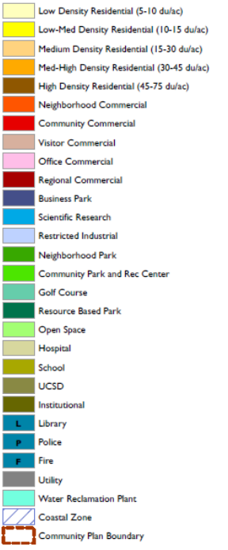
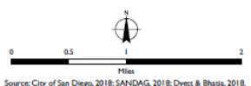
Existing Community Plan
16
Notes:
The current community plan was adopted in 1987. The plan identifies several key issues, goals and implementation actions for the community. This includes improving the transportation system, relating development intensity to the capacity of the transportation system, developing a self-sufficient community with a balance of housing, employment, business, cultural, educational and recreational opportunities, encouraging mixed-use development on large sites to offer environments for living, working, shopping and related activities, guiding the urban form and physical development that protects and is responsive to the physical environment, and encouraging the development of neighborhood facilities and services that meet the daily needs of its residents.

Slide 17
Development Intensity Element
17
Notes:
In order to meet those goals and objectives, the current community plan controls residential density and non-residential intensity through the allocation of building square footage and dwelling units per net acre. Because most of south university is single family residential, this element only applies to areas north of Rose Canyon, with the exception of the Governor Park Office development in the southeast corner of the community. On the left is is the map which identifies the subarea and the to the right is a page from the Development Intensity Table where densities and intensities are identified for each subarea. Since plan adoption in 1987, there have been 18 amendments to the plan, with 3 more in process. Many of these amendments revised this Table to increase the density and/or intensity within a specific subarea, either through a straight increase or through a transfer of intensity between two or more subareas.

Slide 18
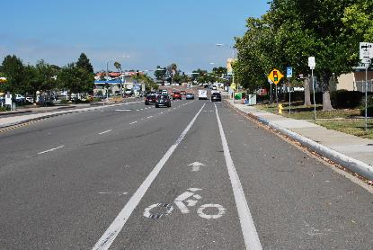
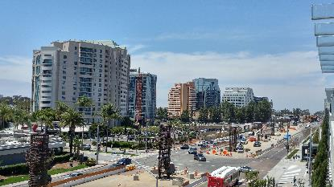
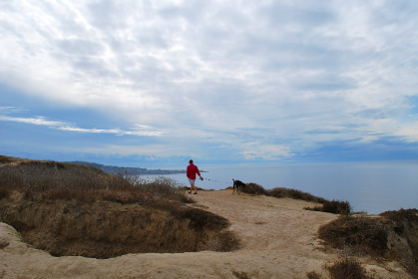
Purpose & Opportunities
Reinforce Role as a Major Employment Center
Support a Sustainable Pattern of Growth
Promote a Well Balanced Mobility Network
Maximize Transit Investment
Increase Connectivity of Uses
Foster a Place to Live, Work, and Play
18

Slide 19
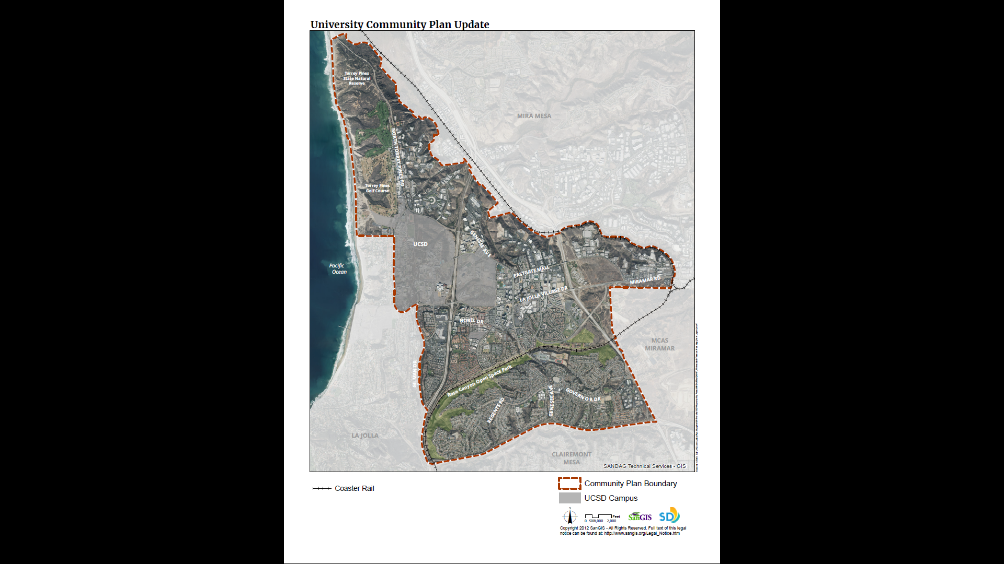
19
Notes:
Keeping in mind the purpose and opportunities; I’ll now go through a series of maps which highlight areas of opportunity due to the extension of the Mid-Coast Trolley and location of Transit Priority Areas; and also some constraints due to noise contours and accident potential zones from MCAS Miramar.

Slide 20
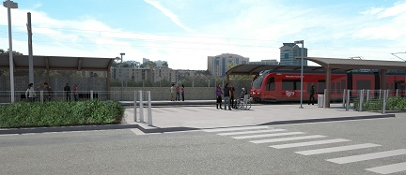
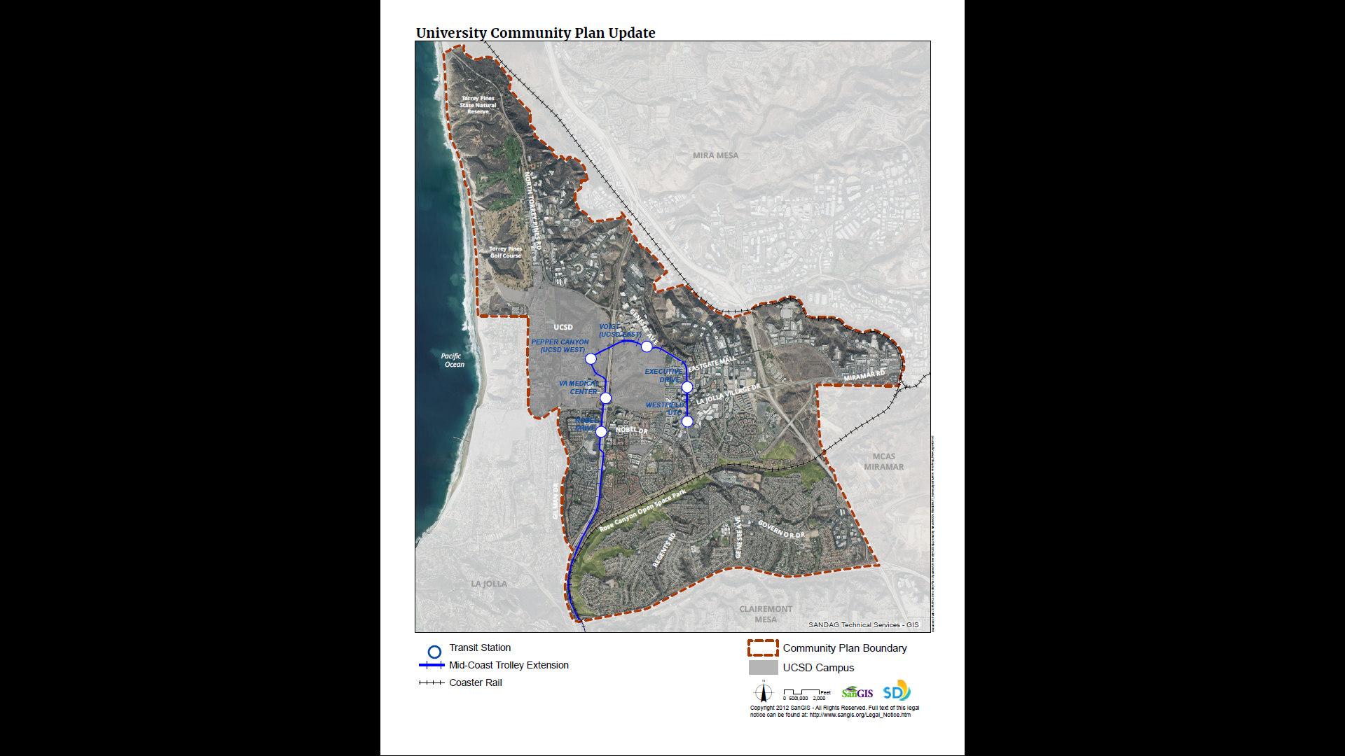
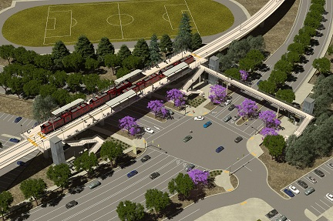
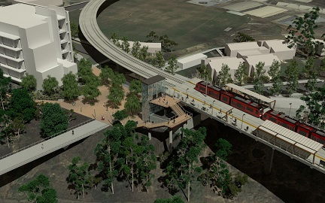
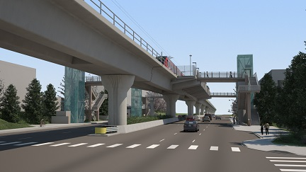
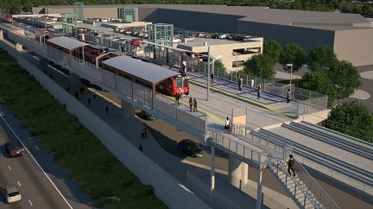
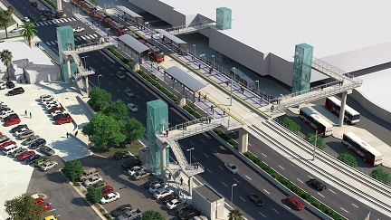
Pepper Canyon
Voigt Drive
Executive Drive
VA Medical Center
Noble Drive
UTC Transit Center
20

Slide 21
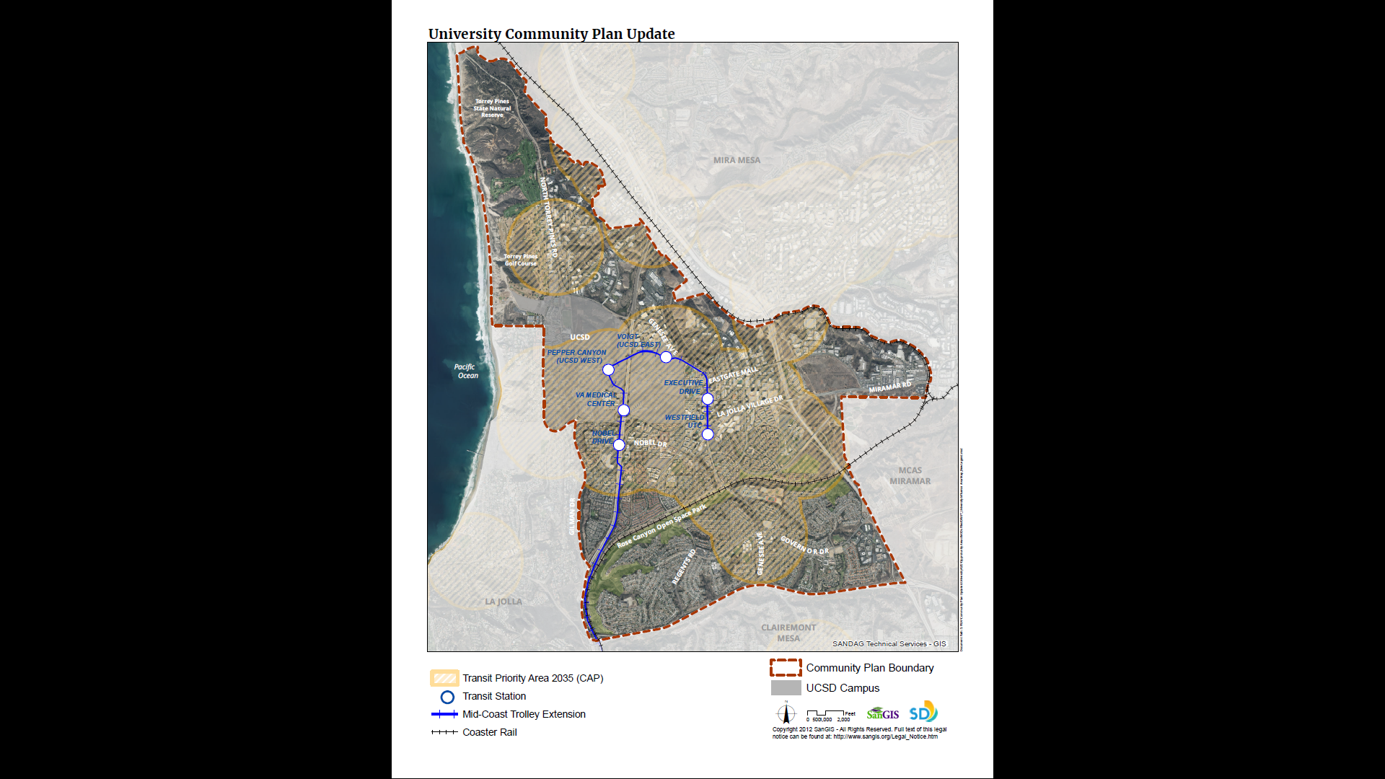
21

Slide 22

22

Slide 23
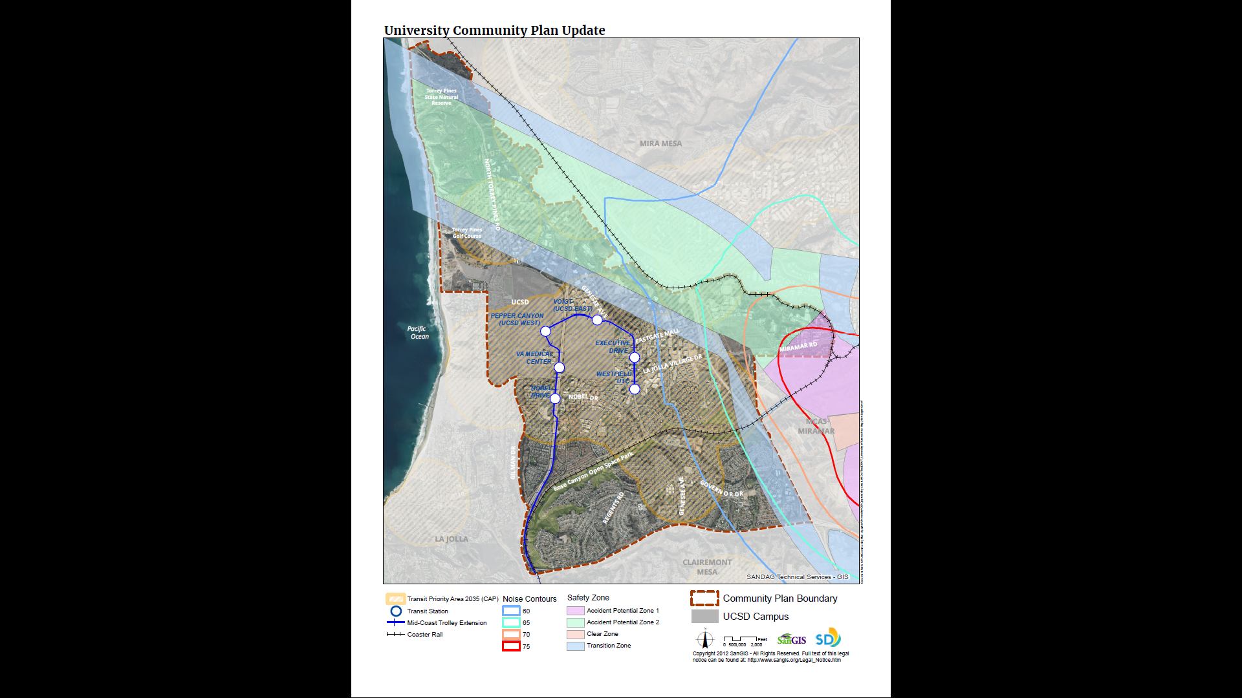
23

Slide 24
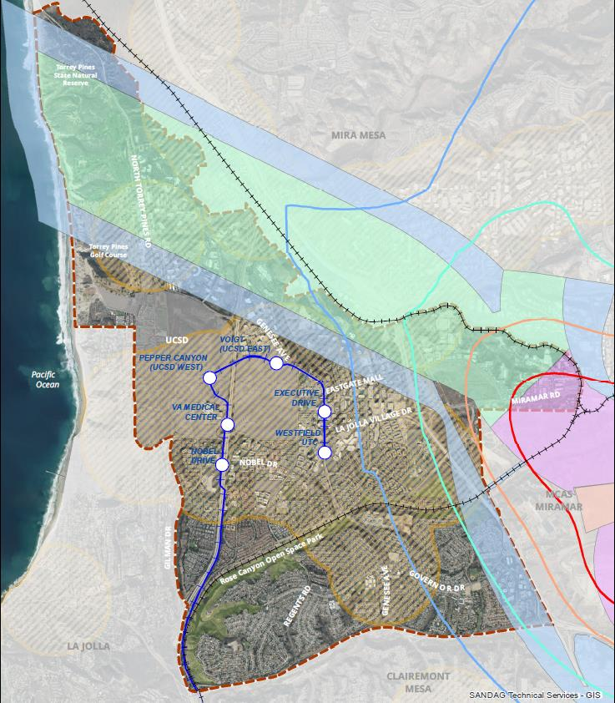
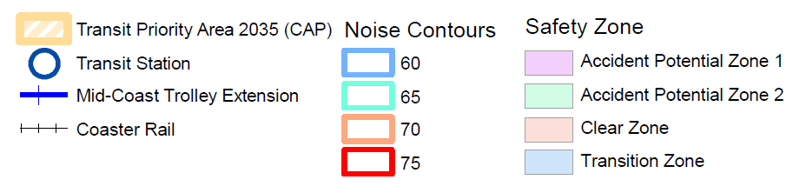
24

Slide 25
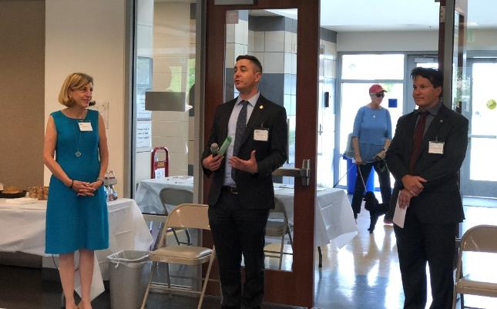
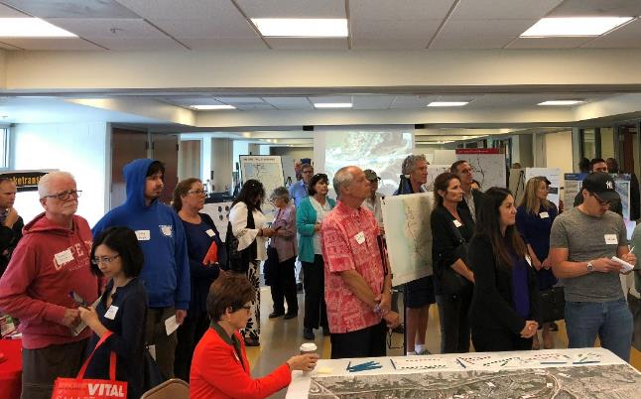
Open House Kickoff
Over 115 attended the event
Planning Director Mike Hansen kicked off the Community Plan Update efforts
Council member Barbara Bry attended in support of the public process
Community members provided their feedback through various activities and comment cards
25

Slide 26
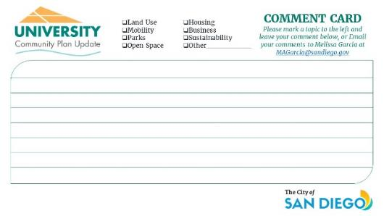
Community Feedback
  Long term balanced development for Economic "Upward" development in North University without sprawling "outward" into parks and open space areas
  Ensuring a workable circulation system with better bicycle, pedestrian and transit connections
  Focus on community beautification
  Preserve and protect community Open Space areas
  Develop canyon overlook park
Comment Cards Summary
Land Use | 8
Mobility | 18
Urban Design | 3
Open Space | 43
Sustainability | 5
Parks | 5
Suggestions to City Staff | 5
Overall Total | 87
26
Notes:
A total of 87 comment cards were received. Here are just some of the themes that came from the

Slide 27
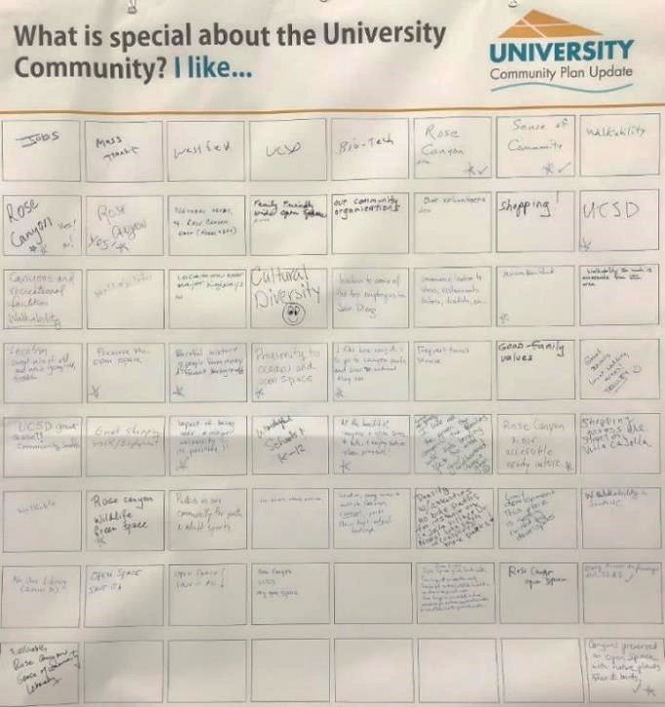
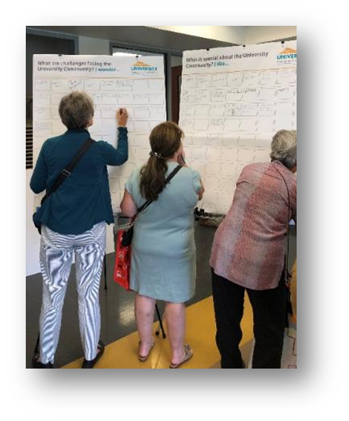
Community Feedback
What is special about the University Community?
I Like…
  Jobs
  Sense of Community
  Mass Transit
  Rose Canyon
  Walkability
  Culture Diversity
  UCSD
27

Slide 28
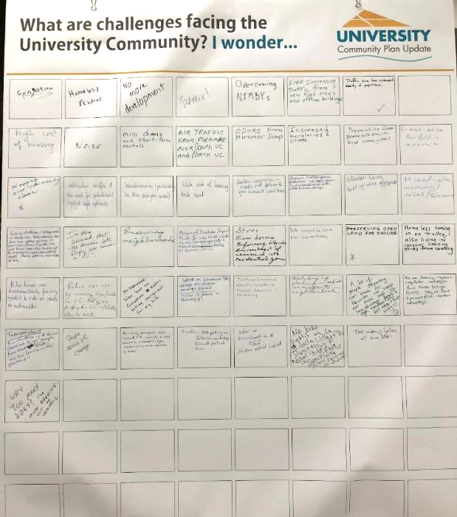
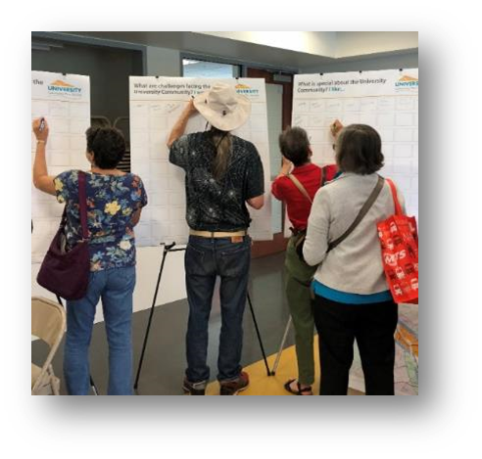
Community Feedback
What are challenges facing the University Community?
I Wonder…
  Traffic and congestion
  No more development
  Preserving Rose Canyon
  High cost of housing and rent
  Preserving neighborhoods
  Noise
  Homeless
28

Slide 29
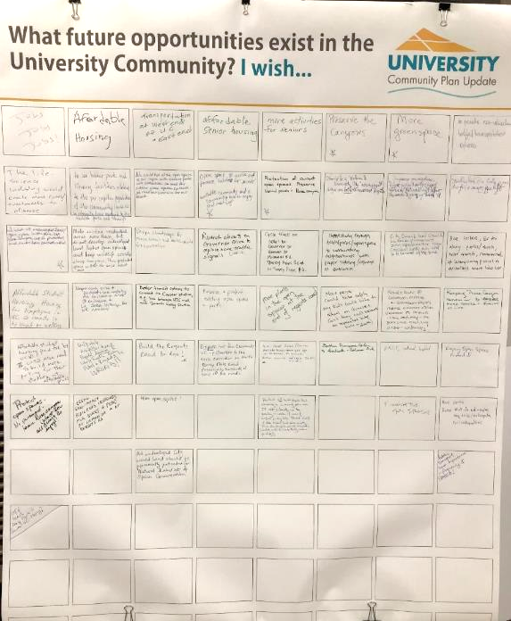
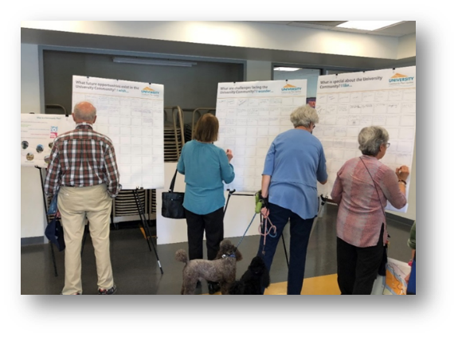
Community Feedback
What future opportunities exist in the University Community?
I Wish…
  Jobs! Jobs! Jobs!
  Affordable housing
  More senior, student and affordable housing
  More dog parks
  Preserve and protect Rose Canyon
29

Slide 30
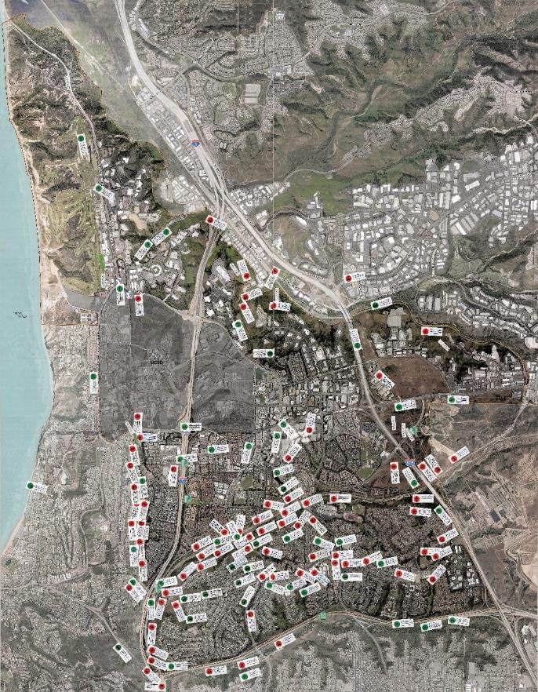
Community Feedback
Mobility Station
  Received 200 comments
  Stickers and written comments provided on a map
  Stickers identified a mode of travel
  Staff available for discussion
30
Notes:
At our mobility station we conducted an exercise where community members were asked to provide written comments on stickers and place on a map noting locations where improvements should be made.
Each sticker had a travel mode indicated so that staff would know from which perspective the comment was made
Participants wrote their comment and then placed the comment at the appropriate location. Staff from our Mobility Planning team was also available for discussion and to fully understand community member’s experiences.
Through this exercise, we received 200 comments scattered all over the community as can be seen on this picture

Slide 31
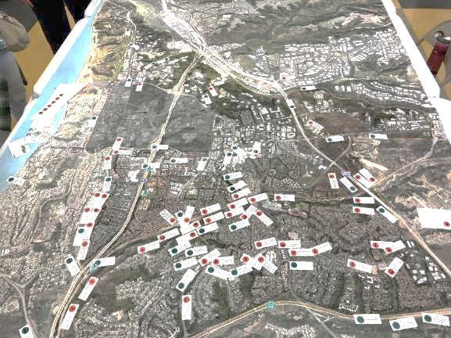
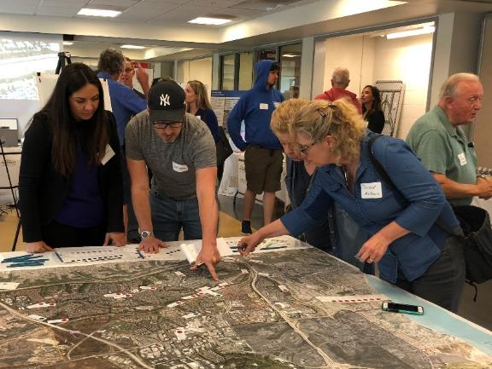
Community Feedback
Mobility Station Community Comments
Comments identified need for:
  Slowing speeds along corridors
  Intersection improvements
  New and improved bicycle facilities and connections
  Protection of canyons
  Bus service/station improvements
  Safer crossings
31
Notes:
The majority of the comments identified specific improvements to slow traffic along certain corridors, improve intersections, install or enhance bicycle facilities, protect canyons in the community, improve bus service and bus stations and provide better crossings. Some of the comments were passed along to other departments for further review (ie. Trails comments were provided to parks planning staff, comments regarding bus service were forwarded to MTS) but our mobility planning team will look into all comments.

Slide 32
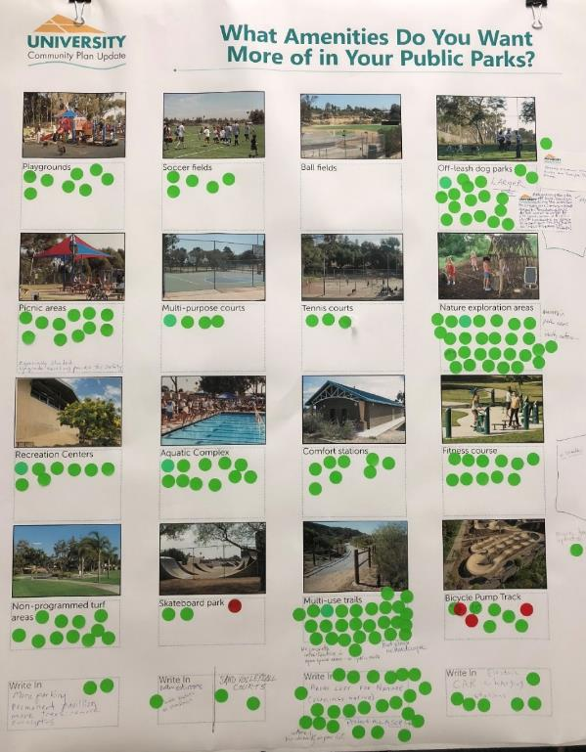
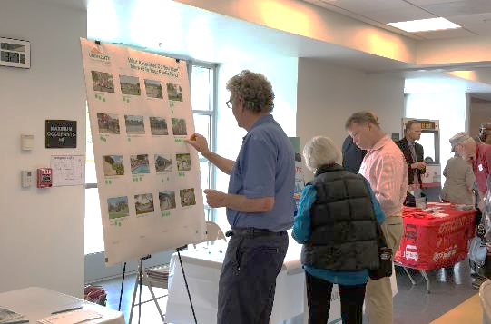
Community Feedback
What amenities do you want more of in your public park?
  Multi-Use Trail
  Nature exploration areas
  Off-leash dog parks
  Non-programmed turf areas, picnic areas, fitness course
32

Slide 33
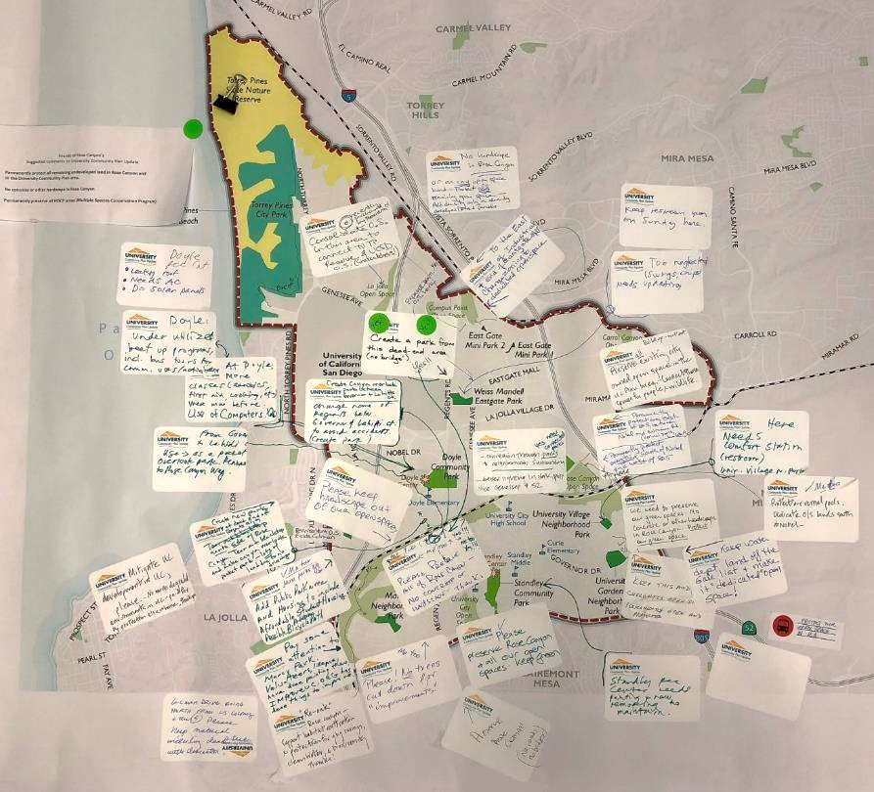
Community Feedback
  Protect Open Space areas
  Create overlook parks at end of Regents Road on both sides of canyon
  Keep hardscape out of Open Space
  Need connected parks and neighborhoods
33

Slide 34
Open House Summary
Open House Summary Document
All Open House comments are posted online
Open House Feedback will be used to inform the process, assist in developing a vision for the community, and identifying priorities
34

Slide 35
Timeline
  2018
2019
PLAN UPDATE LAUNCH
  2020
CPUS MEETINGS
DEVELOPMENT OF PLAN ALTERNATIVES
2021
CEQA ENVIRONMENTAL REVIEW
PREPARATION OF FINAL COMMUNITY PLAN & EIR
35

Slide 36

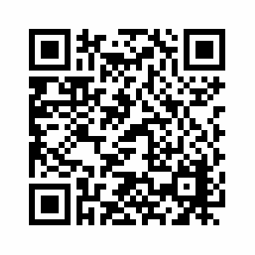
YOUR VOICE COUNTS – STAY UP TO DATE
Visit Us On The Web
  https://www.sandiego.gov/planning/community/cpu/university
Contact Us:
Dan Monroe
Senior Planner
City of San Diego
Planning Department
T (619) 236-5529
DMMonroe@sandiego.gov
36

Slide 37
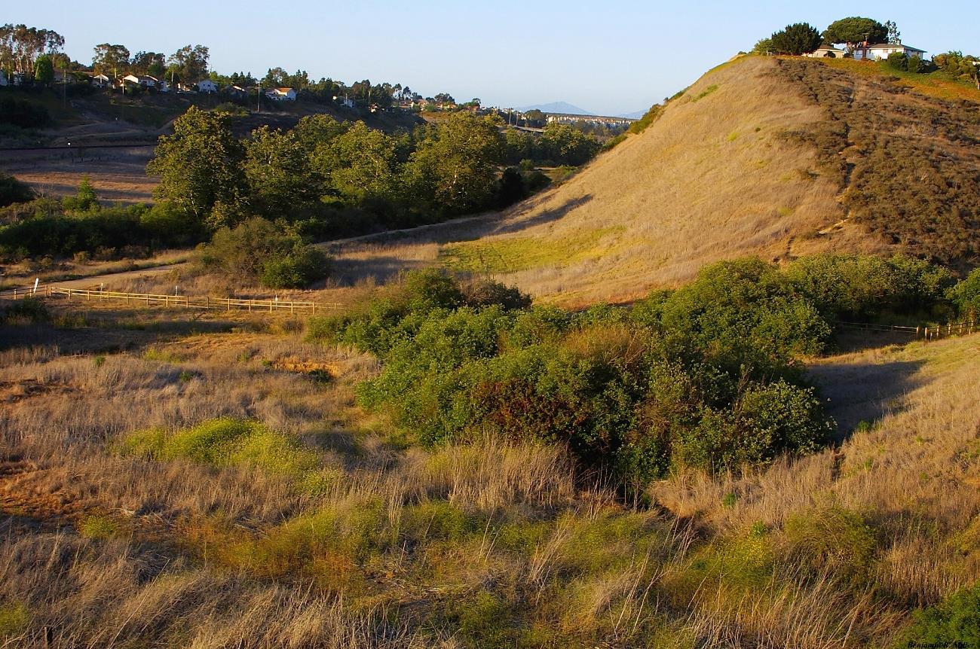
QUESTIONS
&
DISCUSSION

Slide 38
Pedestrian Bridges

